Slide 1
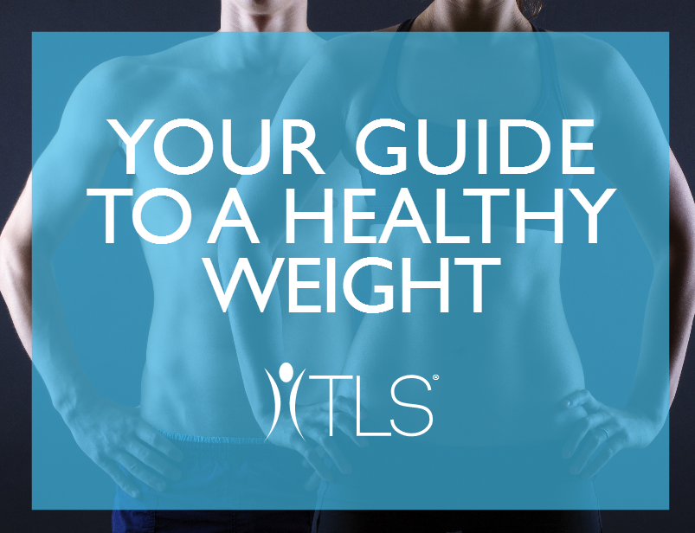

Slide 2
WHAT ARE YOUR GOALS?
Why do you want to manage your weight?
What is your ideal weight?
How will your life be different when you achieve your ideal weight?
Notes:
http://www.chp.gov.hk/files/pdf/ncd_watch_mar2015.pdf

Slide 3
WHAT ARE YOUR STRUGGLES?
Why do you struggle with weight?
Too much to do for everyone else
I don’t have time to exercise
I don’t like to cook
I spend a lot of time at work
I’ve tried to diet, but nothing has worked/I’ve fallen off the wagon
I make poor food choices
I eat too much, too often
Other: _____________________
Notes:
http://www.chp.gov.hk/files/pdf/ncd_watch_mar2015.pdf

Slide 4
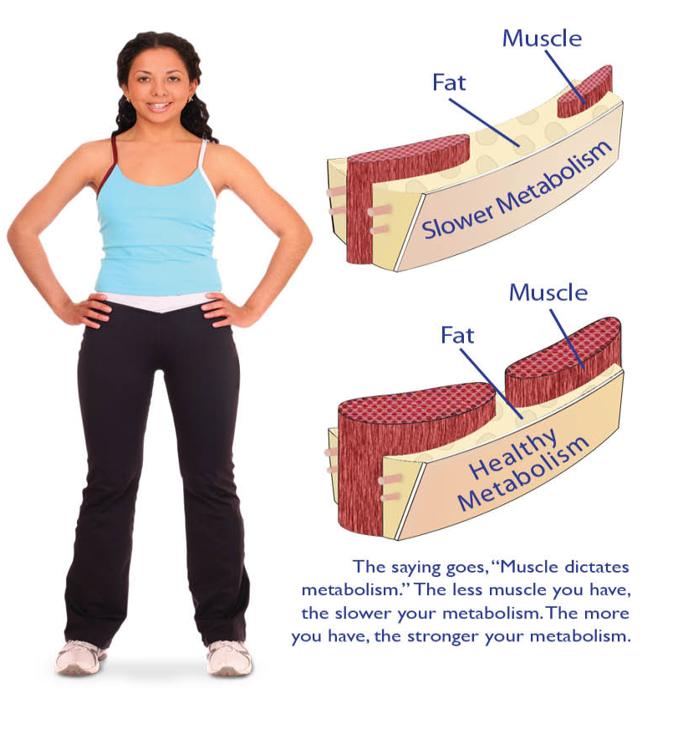
WEIGHT MANAGEMENT ISN’T UNIVERSAL
There is no one-size-fits-all plan for weight loss. What’s right for someone else isn’t always right for you.
Many commercial weight loss programs place an emphasis on what to eat, not how to eat.
Many programs focus on weight loss, rather than actual fat loss. True health and fitness is the result of an optimized ratio of muscle to fat.
Notes:
http://www.chp.gov.hk/files/pdf/ncd_watch_mar2015.pdf

Slide 5
WHAT IS THE TLS® SOLUTION?
Four components?
Low-Glycemic-Impact-Eating
It’s about eating right, not eating less.
Body Composition
Focusing on fat loss instead of weight loss.
Science-Based Supplementation
Working with your body to enhance weight loss efforts.
Education
Being aware and changing unhealthy behaviors for life.
Notes:
http://www.chp.gov.hk/files/pdf/ncd_watch_mar2015.pdf

Slide 6
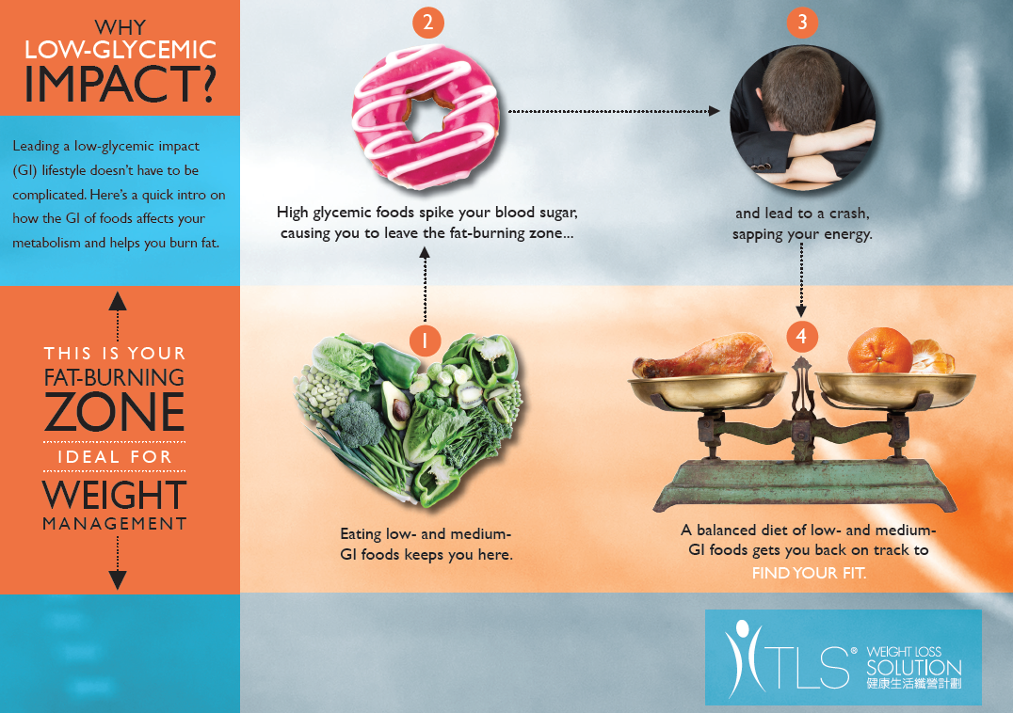
Notes:
Blue zone is Where fat is burned
A person has more
Energy and hormones are at optimal levels

Slide 7
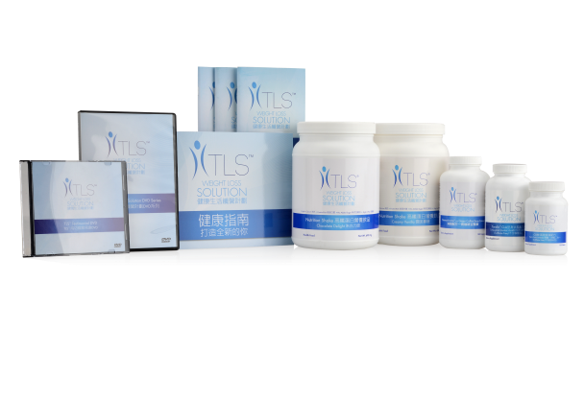
WHAT ARE YOUR OPTIONS?
TLS Weight Loss Solution is the most customizable weight loss program available today.
Finding a solution that fits your lifestyle has never been easier.
Notes:
http://www.chp.gov.hk/files/pdf/ncd_watch_mar2015.pdf

Slide 8
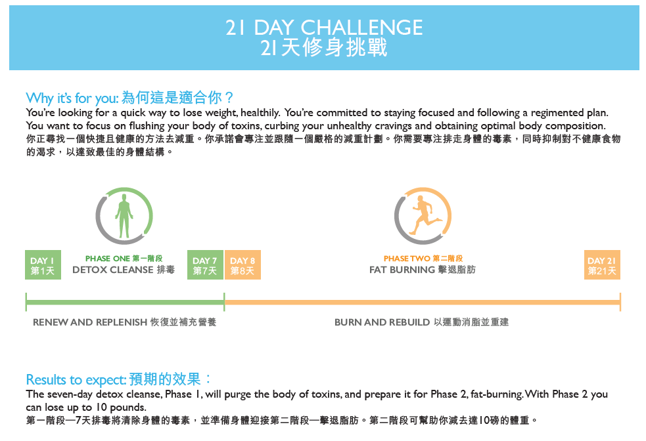

Slide 10
7 DAY DETOX
Why it’s for you:
You’re looking for a kick-start to receive maximum benefits from your TLS program.
What to expect:
Varies for each individual; purges the body of toxins, resulting in decreased energy for a couple of days followed by a surge of energy.
What you’ll do:
Follow a strict Low-Glycemic Plan
8-12 cups of vegetables
3 fruits
Two 3oz servings of protein
Two servings of good fat oils
No Grains, Dairy, Starches, alcohol, junk
8+ Cups water
No Exercise
Notes:
Go through plan and do’s & don’ts. Address detox is optional

Slide 11
FAT SHREDDER
Why it’s for you:
For those who are extremely committed to achieving short-term weight loss goals, the Fat Shredder program is a high-intensity, two-week weight loss regimen. Through a focused food guide, a quick, but intense workout plan and use of TLS supplements, you’ll shred fat, add muscle and feel better, physically and emotionally, knowing you can do anything you set your mind to doing.
What to expect:
Lose up to 10 pounds during this two-week program.
What you’ll do:
Follow a strict meal plan with each day consisting of:
6-8 cups of vegetables
2 TLS Nutrition Shakes
3-4 servings of protein
2 servings of good fats
2 servings of fruit
Take TLS Supplements, as directed.
Notes:
Explain program details

Slide 12
RAPID RESULTS
Why it’s for you:
You’re motivated, dedicated and committed to do what it takes to reach your weight loss goals. You’re ready to break unhealthy habits and start shedding fat and inches.
What to expect:
Lose 2-3 pounds per week.
What you’ll do:
Follow a strict low-glycemic menu plan, with each day consisting of:
5-6 servings of proteins
6-12 servings of vegetables
2 servings of dairy
No grains or starches
2 servings of good fats
2 servings of fruits
Exercise (4-5 days per week)
Take TLS Supplements, as directed.

Slide 13
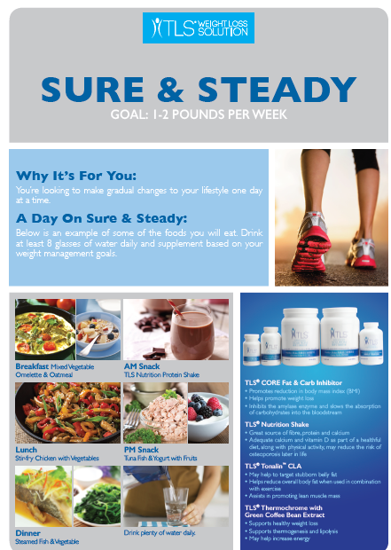
SURE & STEADY
Why it’s for you:
Some people don’t dive right into the water; they ease their way in. The Sure & Steady plan helps those individuals looking to make gradual changes to their lifestyle, one day at a time. Throughout this 12-sddk program, you’ll see that even small changes to your diet, regular exercise, and support from TLS supplements can help achieve a healthier you.
What to expect:
Lose 1-2 pounds per week.
What you’ll do:
5-6 servings of proteins
6-12 servings of vegetables
2 servings of dairy
1 serving of starches
2 servings of good fats
1 serving of whole grains
2 servings of fruit
Exercise (3-5 days per week)
Take TLS Supplements, as directed.

Slide 14
CONTINUED COMMITMENT
Why it’s for you:
You’re at a healthy weight and are looking to maintain a healthy lifestyle. You want to focus on maintaining optimal body composition but are looking for a plan with flexibility, allowing the occasional indulgence.
What to expect:
Healthy, everyday living at your target weight.
What you’ll do:
Follow a balanced and healthy menu plan, with each day consisting of:
5-6 servings of proteins
6-8 servings of vegetables
2 servings of dairy
1 serving of starches
2 servings of good fats
2 servings of whole grains
2 servings of fruit
Exercise (4-5 days per week)
Continue use of TLS Supplements, as needed.

Slide 15
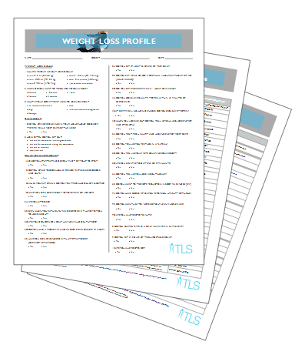
FREE WEIGHT LOSS PROFILE
Find the best custom plan for you based on:
Lifestyle
Diet
Activity levels
Goals
Behavior

Slide 16
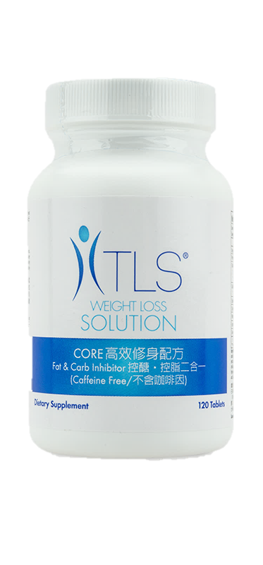
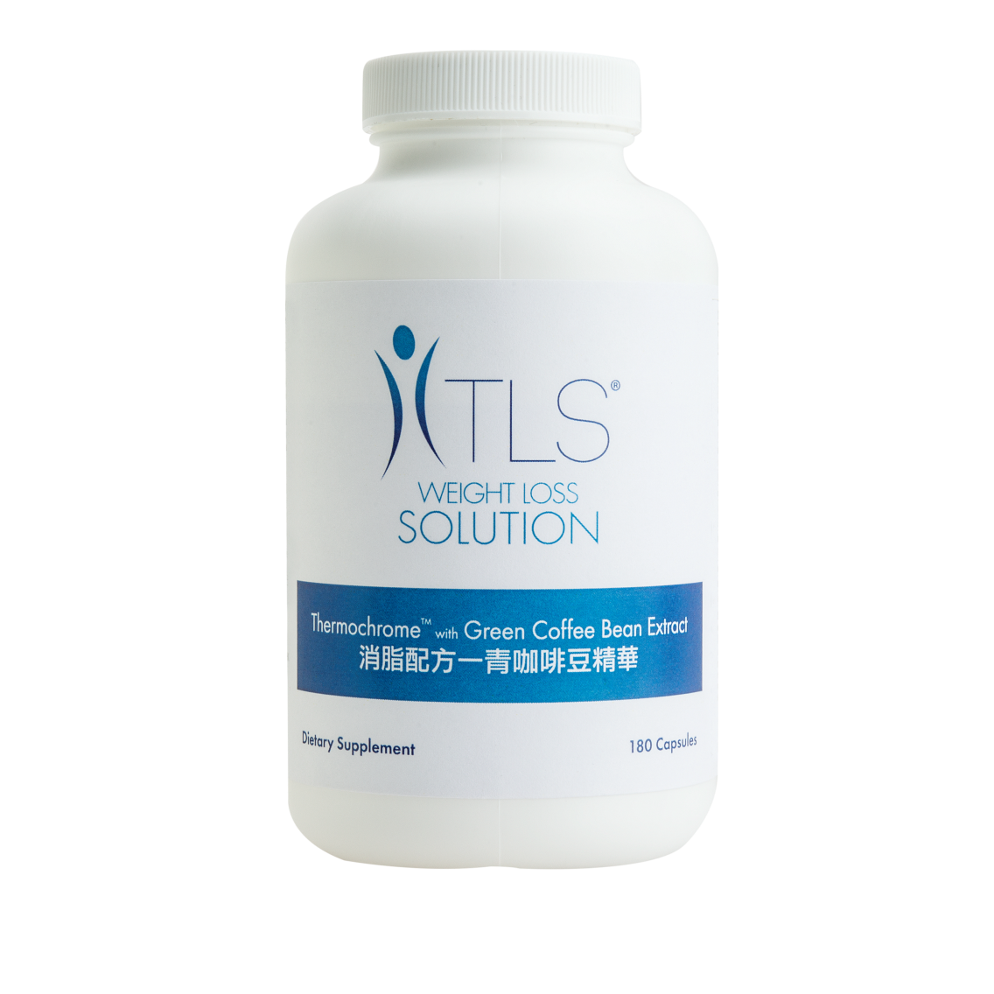
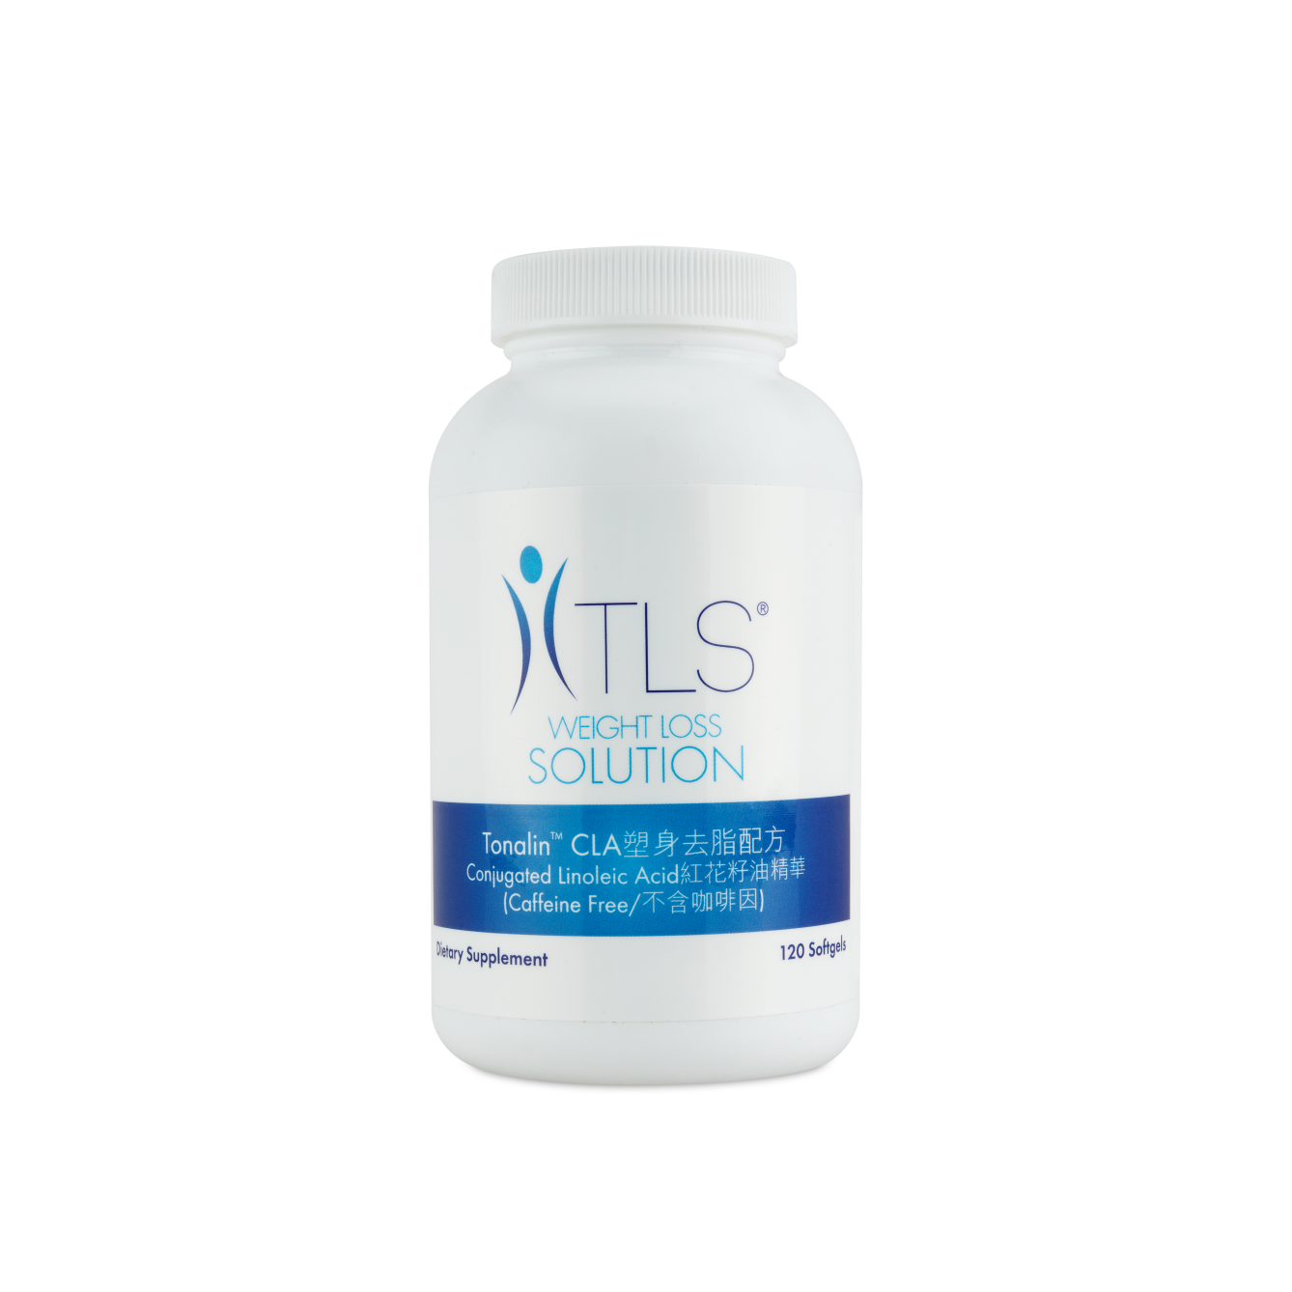
TLS SUPPLEMENTS
OVEREATING?
Tame your hunger with TLS® CORE Fat & Carb Inhibitor.
TLS CORE helps suppress your appetite with the help of Lepticore™, an all-natural ingredient with the demonstrated ability to enhance weight loss.
Promote weight loss, help controls carbohydrates and help your body stop storing fat with TLS CORE
SLOW METABOLISM?
Increase energy and support metabolism with TLS Thermochrome with Green Coffee Bean Extract.
TLS Thermochrome helps facilitate the use of stored fat as a source of energy – promoting thermogenesis.
TLS Thermochrome use Svetol™ Green Coffee Extract, the most clinically researched brand of green coffee bean extract.
STRESSED OUT?
Stabilize your mood with TLS® ACTS Stress Support Formula.
Don’t turn to food to comfort you from stress. Your body’s reaction to stress can be directly impacted by the adrenal and thyroid glands and the hormone cortisol.
TLS ACTS addresses the root of the problem by helping your body adapt to stress and assisting you with your weight loss.
TONING UP?
Slim down with TLS Tonalin™ CLA
TLS Tonalin CLA contains natural ingredients to help redistribute fat to fat-burning muscle tissue, promoting lean muscle mass and decreasing the amount of fat stored in your body.
A great supplement while on an exercise plan, TLS Tonalin CLA will help your body use fat as fuel, helping enhance your lean muscle mass.

Slide 17
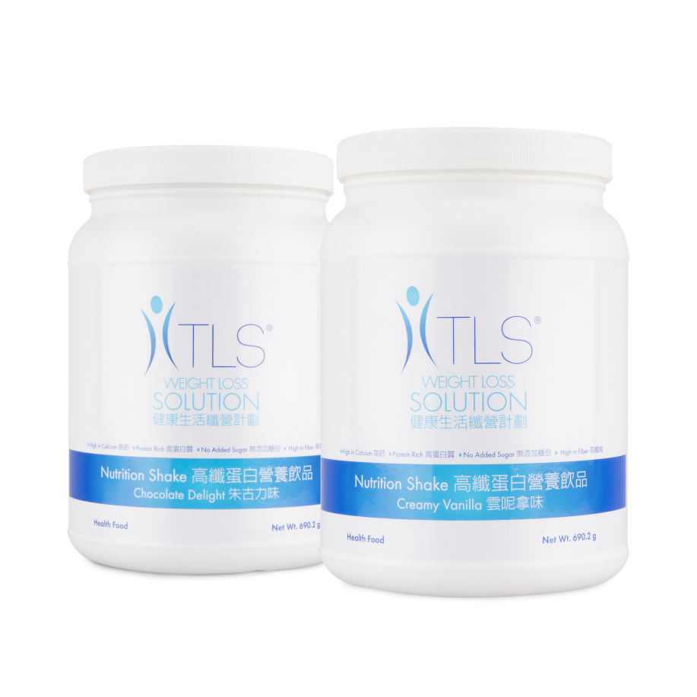
TLS SHAKES
NEED MORE PROTEIN AND FIBER?
TLS Nutrition Shakes – Creamy Vanilla and Chocolate Delight
TLS Nutrition Shakes are formulated to delivery 18 grams of protein, 10 grams of fiber and over one-third of the recommended daily allowance (RDA) of 22 different vitamins and minerals in each serving.

Slide 18
TLS TOOLS
TLS Health Guide & Journal
The first step in securing your commitment to TLS, the Health Guide & Journal is designed to take you day by day through your first 12 weeks of the program, helping instill behaviors and techniques to help you stay healthy, feel great and lose weight.
HK.TLSSLIM.COM
Our cutting edge website offers personalized weight management plans and supplement recommendations, educational videos, BMI and body fat calculators, TLS success stories, printable grocery lists, online parties, TLS downloads and so much more!

