Slide 1




Slide 2

MOTIVES® MISSION STATEMENT
People Empowering People…
“The ability to make people look
and feel better while achieving
the lifestyle they have always
dreamed about.”
-Loren Ridinger

Slide 3
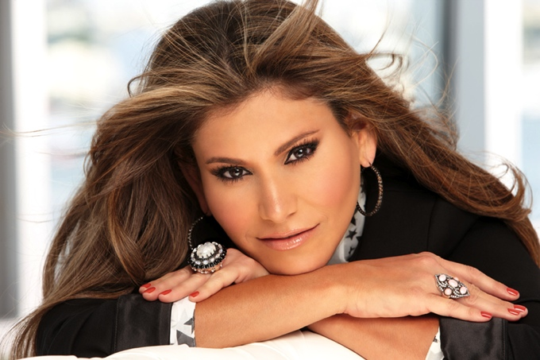
Loren Ridinger
Named as one Vogue’s Top 100 Most Influential Women
Awarded the Woman of Substance and Style Award
Recognized by Fashion Group International for her contribution to the fashion and beauty industry
Named Entrepreneur of the Year by Business Leader Magazine three years in a row
Her personal blog, LorensWorld.com, was named as one of Forbes’ Top 100 Websites for Women
Named one of the Top 50 Most Motivational People of the Web and Twitter by Under30CEO.com
Close to 300,000 followers on Twitter

Slide 4
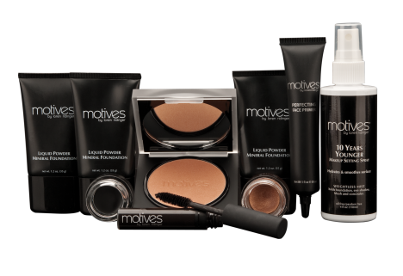
MOTIVES® BY LOREN RIDINGER
We bring the cosmetic counter to your home!
Customizable cosmetics line
Complements every age, skin tone and skin type
Perfect formulas for easy and foolproof application
Powders are micro-pulverized for a smooth, flawless finish
Fully pigmented cosmetics for photo shoots and fashion shows

Slide 5



BEAUTY IN EVERY SHADE

Slide 6
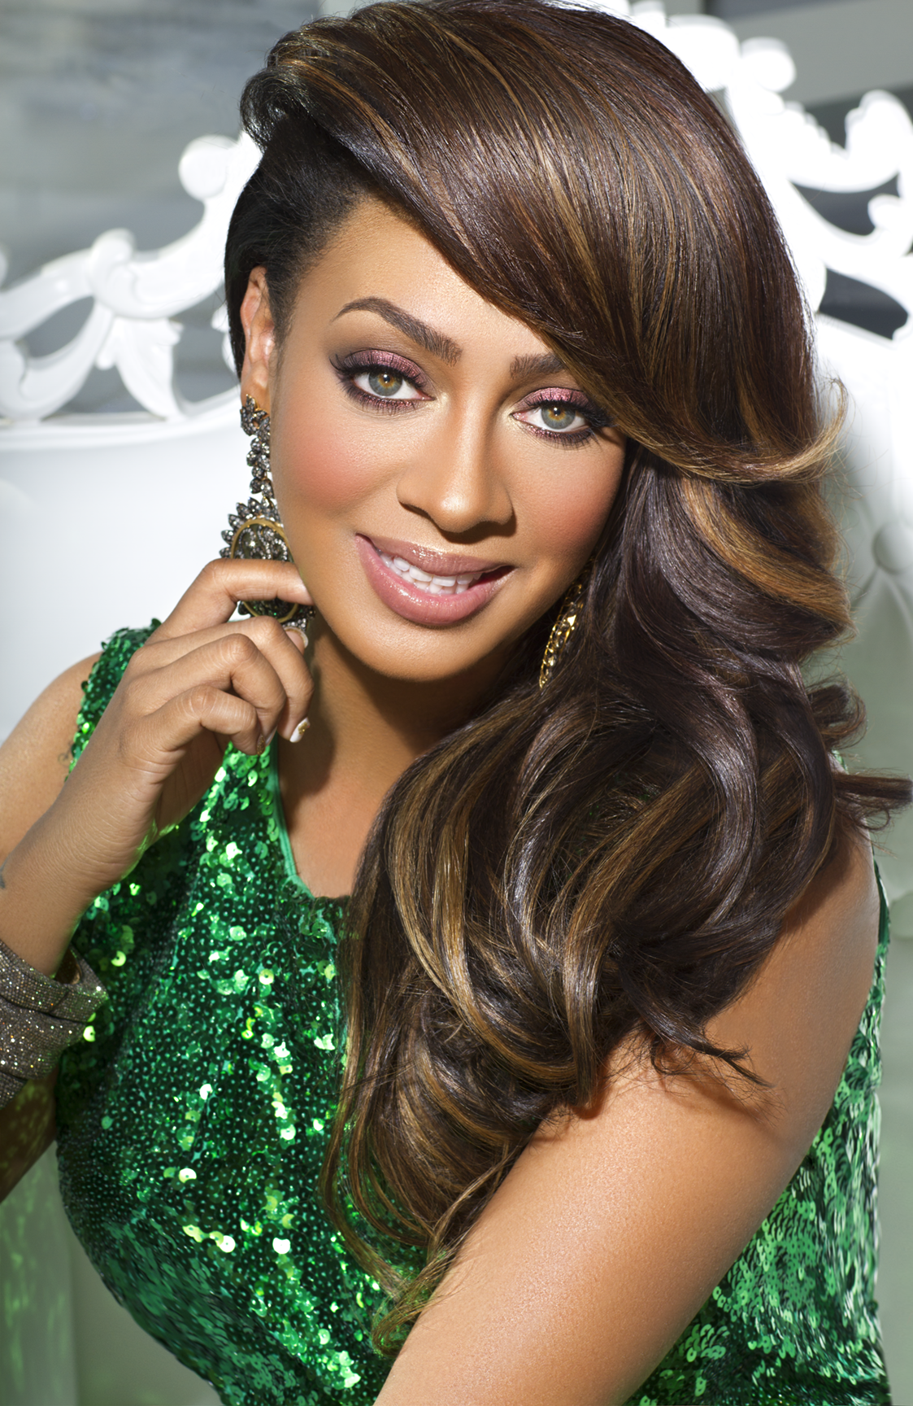
La La Anthony
Radio Celebrity
Internet Mogul
Trend Setting Fashionista
Television Star
  MTV® VJ
  Current hit reality show
  La La’s Full Court Life on VH1®
Silver screen Actress
  Think Like a Man by Tyler Perry, amongst others
Off-Broadway Sensation
  Love, Loss and What I Wore

Slide 7
Visibility

Slide 8
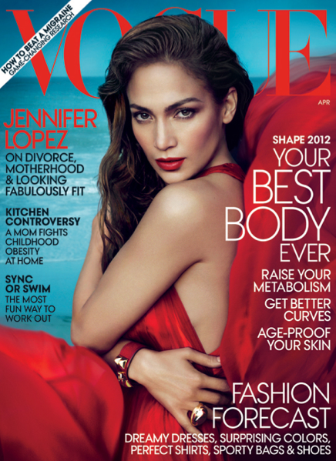
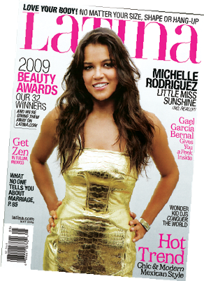
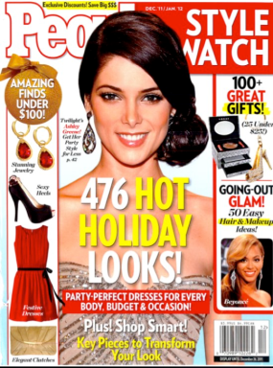
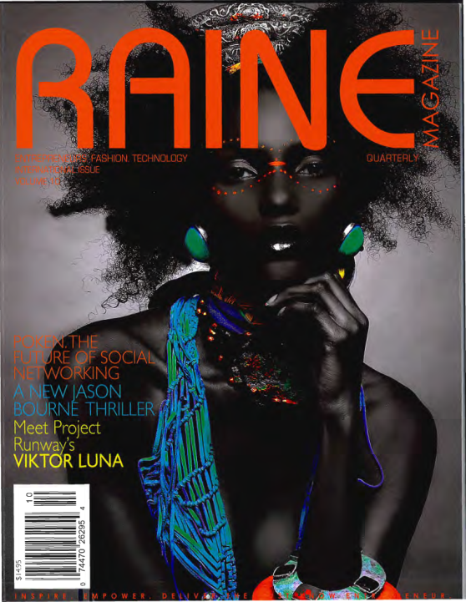
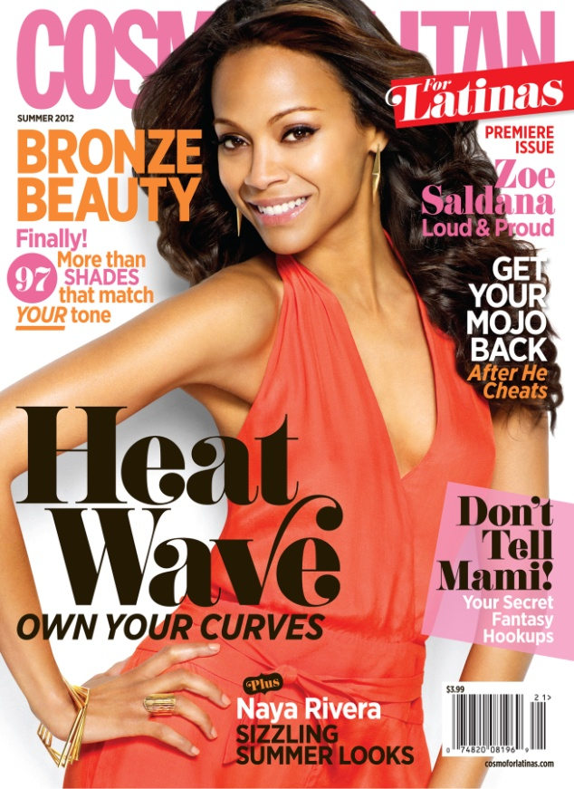
MOTIVES® BY LOREN RIDINGER
HAS BEEN FEATURED IN:
New York Post
In Touch magazine
Every Day with Rachael Ray magazine
Bravo’s “The Fashion Show”
People En Español magazine
Life & Style magazine
Us Weekly magazine
Latina magazine
100 Thousand Club magazine
Prime Woman magazine
Semana magazine
The Makeup Show NYC 2009
BeautySnob.com
Elle.com
AMomInRedHighHeels.com
HelloBeautiful.com
ProductFiend.com
BeautyandtheFeastBlog.com
DaniellesFabFinds.com
PoshGlam.com
AdrianaCastroBlog.com
ABeautyfulSentiment.com
TalkingMakeup.com
News & Record
Careerconfessions.com

Slide 9
MOTIVES® BY LOREN RIDINGER
HAS BEEN FEATURED IN:
VOGUE
LUCKY MAGAZINE
PEOPLE STYLE WATCH
ELLE.COM
NY POST
COCO PEREZ
LATINA MAGAZINE

Slide 10
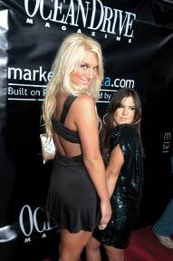
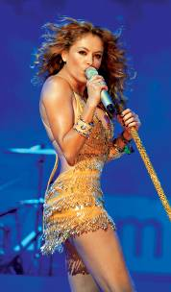
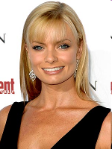
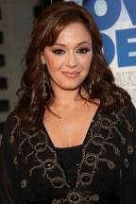
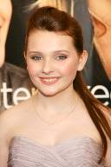
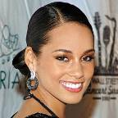
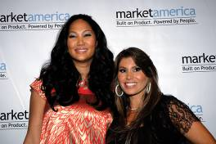


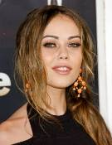

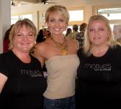
LOYAL CELEBRITY Following:
Paulina Rubio
Brooke Hogan
Jaime Pressly
Marisol Nichols
Kimora Lee Simmons
Alicia Keys
Leah Remini
Kim Kardashian
Stephanie Jacobsen
Alexis Dziena
Abigail Breslin
Miss South Carolina 2009
Stephanie Smith
Cast of “Bold and
the Beautiful”
Alicia Keys and Leah Remini photo courtesy
of Google

Slide 11











Motives® by Loren Ridinger® has been featured in:

Slide 12
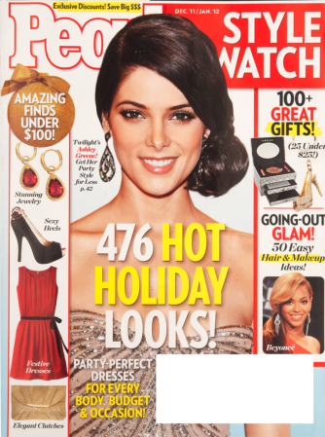
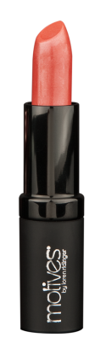
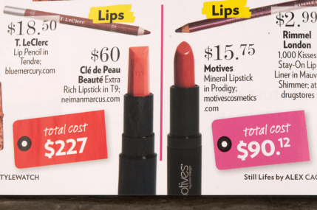
People Style Watch
Circulation: 2,071,388
MOTIVES MINERAL LIPSTICK “…get the look for less…” $60 vs MOTIVES $15.75”

Slide 13
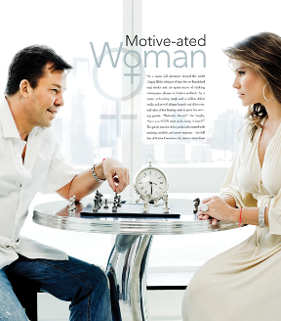
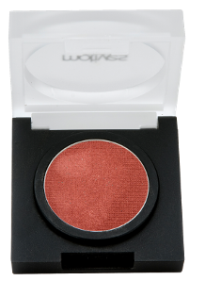
100 Thousand Club
Circulation: 575,000 quarterly
“Revolutionary new products allow Customer Managers to earn income at their own pace”
Latina
Circulation: 400,000 monthly
“Best Eye Shadow”
Winner of Latina Beauty Award

Slide 14
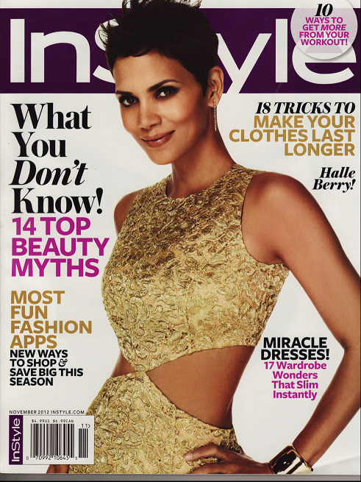

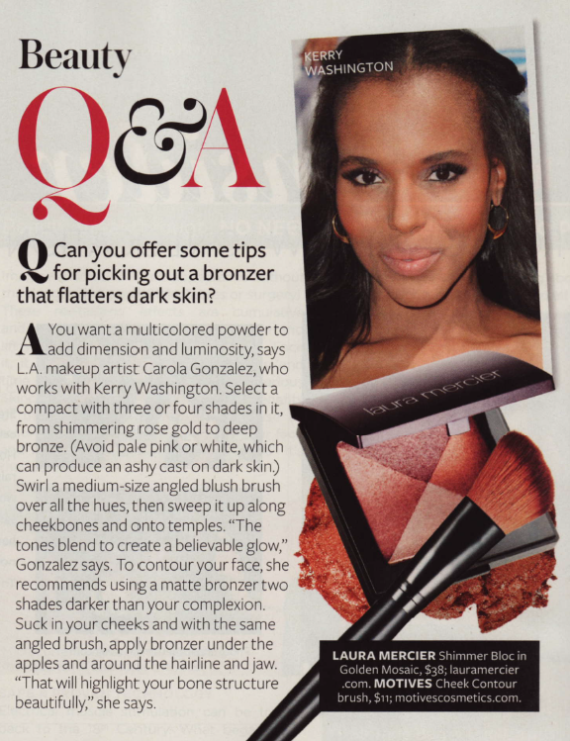
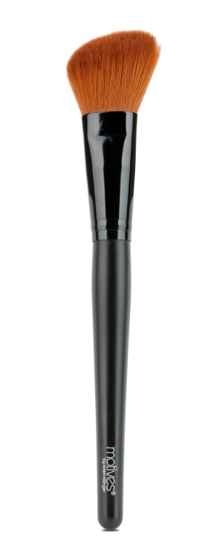
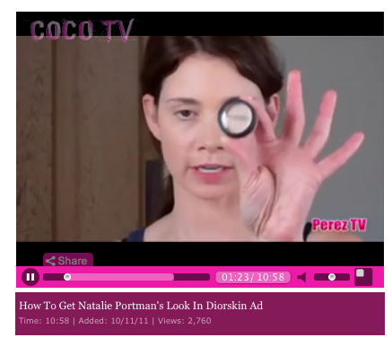
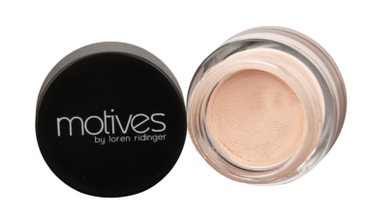
“helps to create a smooth surface that really will hold makeup”
InStyle Magazine
Circulation: 9,780,000 monthly
Featured Motives Cheek Contour Brush

Slide 15

Raine
Circulation: 1,875,000 quarterly
“MOTIVES is exceptional makeup that doesn’t
sacrifice quality for price…”

Slide 16
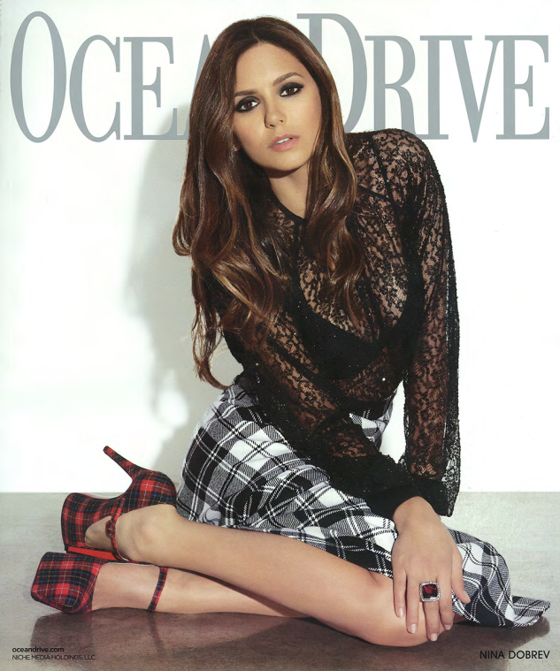
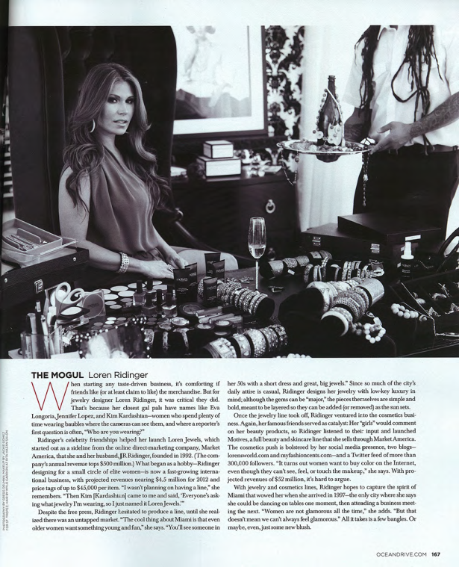
Lucky
Circulation: 2,821,960 monthly
Khloé Kardashian wears Motives® by Loren Ridinger on the cover of Lucky Magazine
Ocean Drive
Circulation: 50,000 monthly
Feature on Motives and Loren Jewels

Slide 17


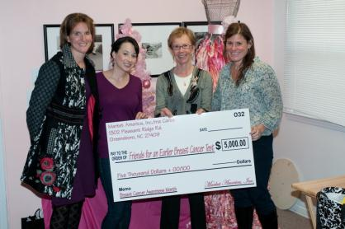
Motives Gives Back
Donated $5,000 to Earlier.org for Breast Cancer Research

Slide 18
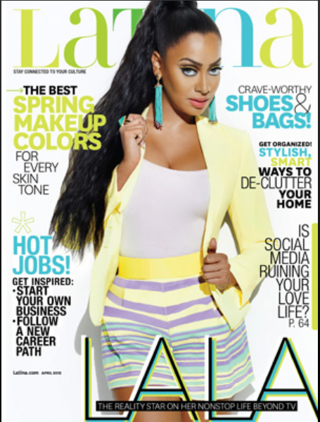
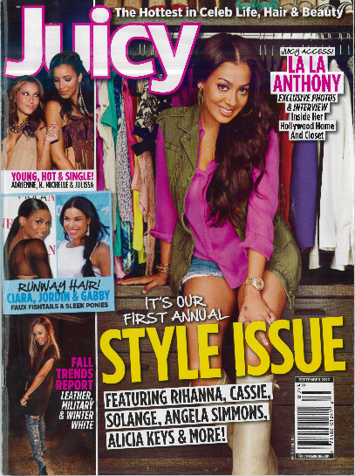

















MOTIVES® FOR LA LA HAS BEEN
FEATURED IN:

Slide 19
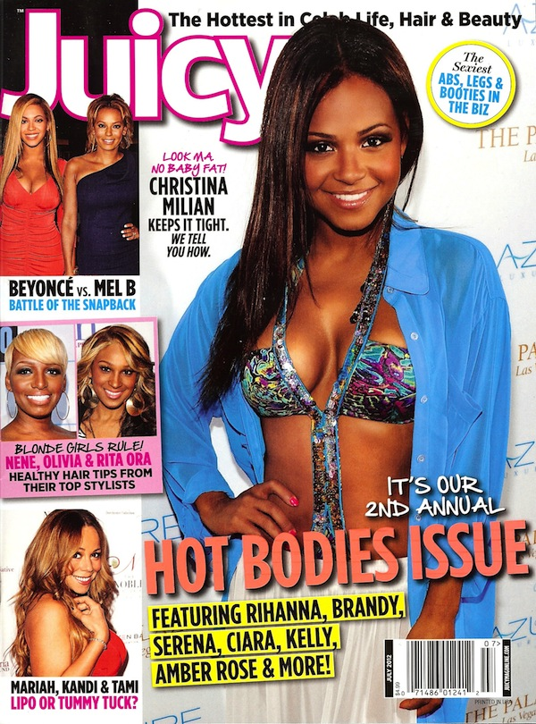
“Since its launch, La La Anthony and
Motives® creator Loren Ridinger
continue to fill a void in the beauty
market that necessarily doesn’t
cater to African American and
Latina women”
-Juicy Magazine, July 2012

Slide 20
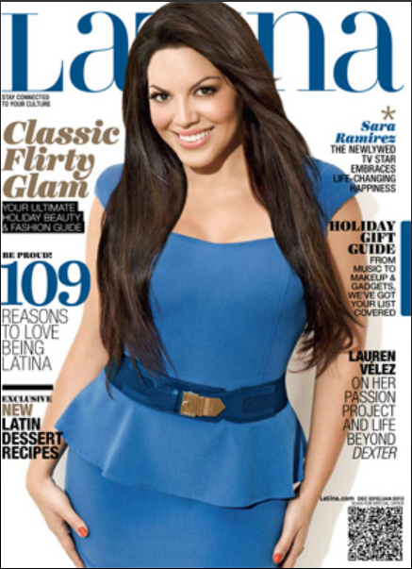
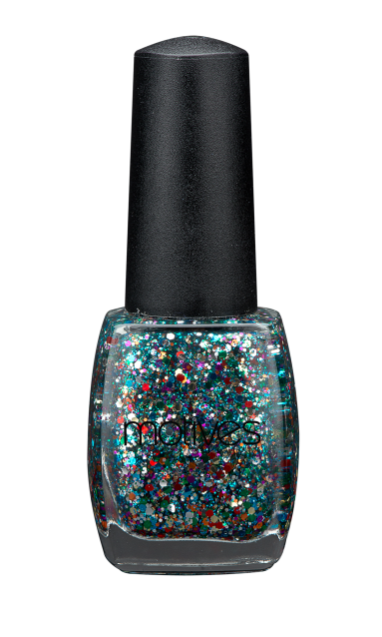
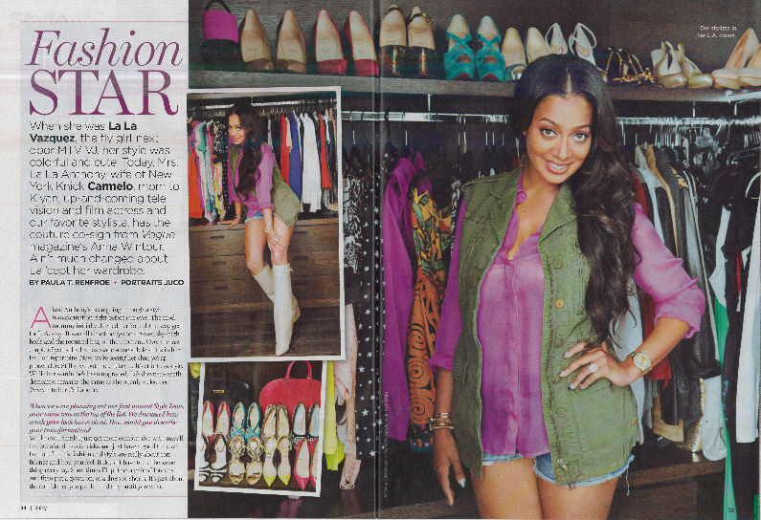
Motives® for La La has been featured in:
Juicy Magazine
Circulation: 150,000 monthly
“Motives cosmetics are infused with antioxidants and vitamins that enhance true beauty and nourish the skin.”
Latina Magazine
Circulation: 400,000 monthly
“Motives for La La Confetti Nail Lacquer – sparkly and festive, this glittery shade is perfect as a stocking stuffer!”

Slide 21
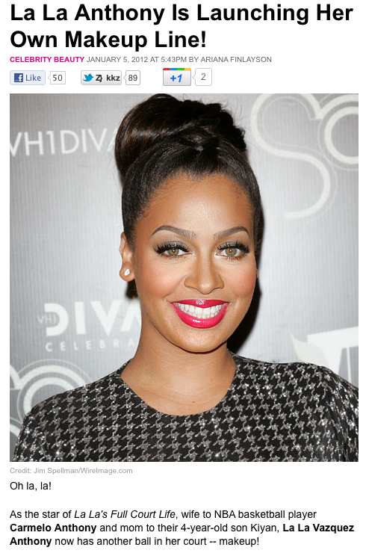
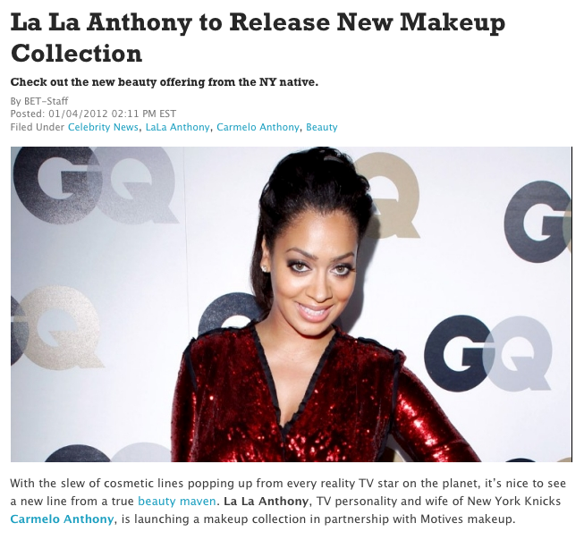
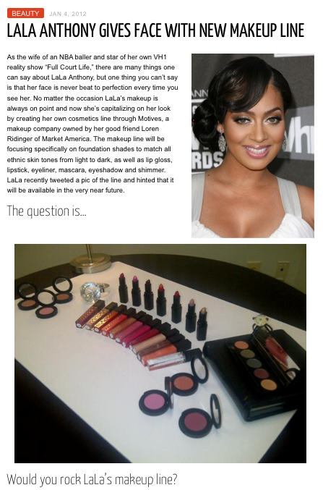
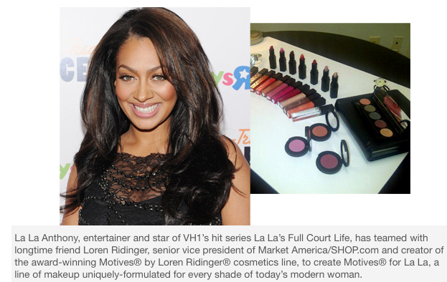

Slide 22
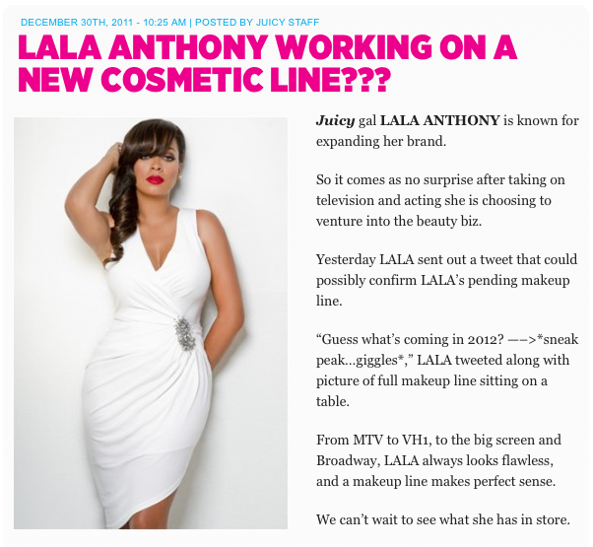

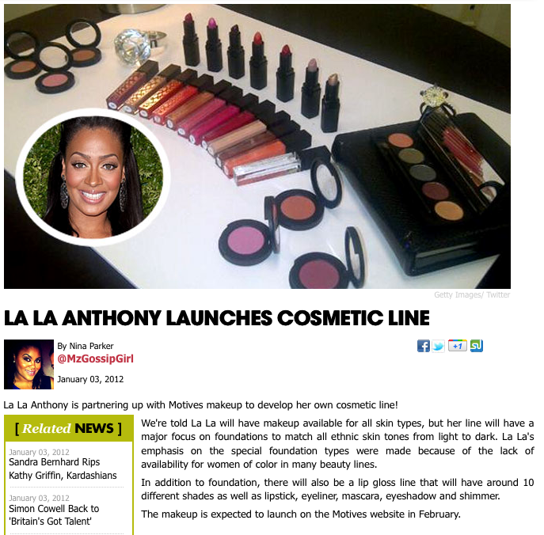
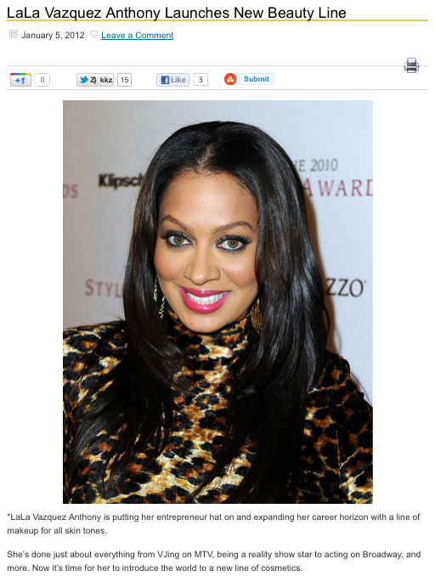

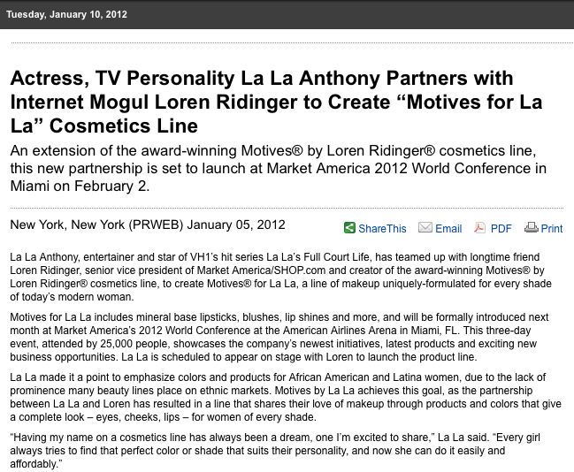

Slide 23
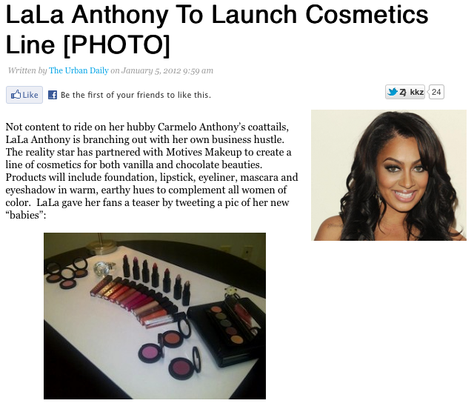
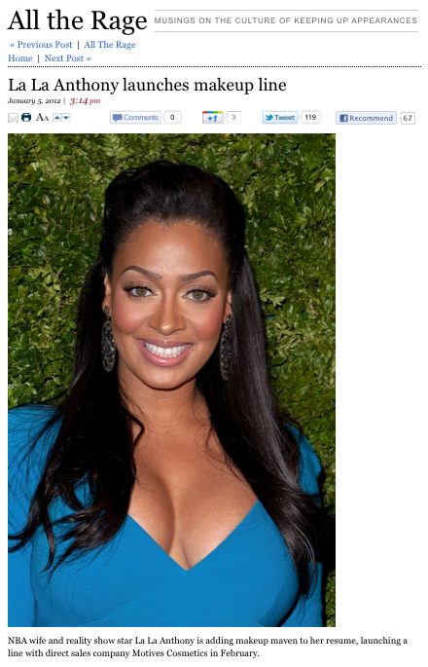
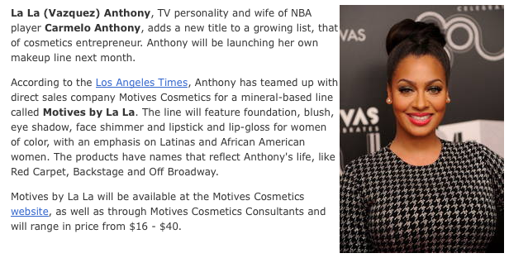

Slide 24
Product Line

Slide 25
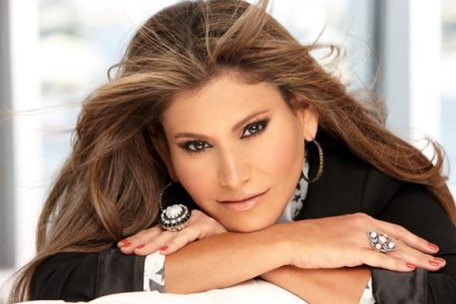
    Award-Winning Cosmetics Line
    Proprietary Formulas
    Highest Quality Ingredients
    Hypoallergenic
    Non-comedogenic
    Desirable and Attractive Packaging
    Affordable Pricing

Slide 26

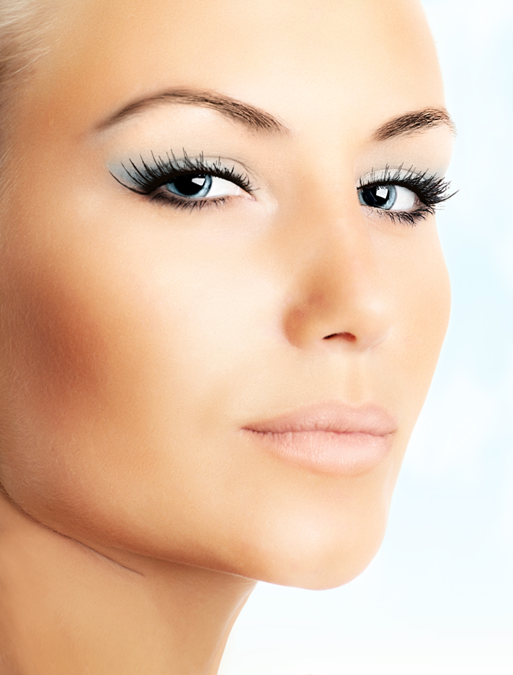
Priming
and
Base

Slide 27
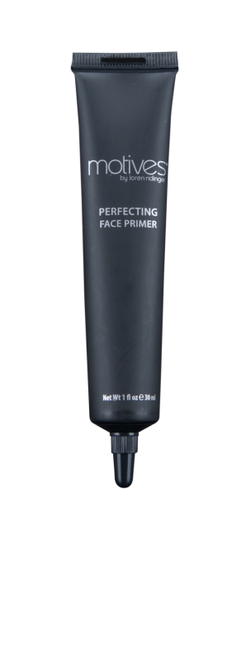
MOTIVES® PERFECTING FACE PRIMER
What it does:
Seals the skin to allow foundation to cover
redness and imperfections
Helps fill in lines and smooth skin
Creates a smooth canvas
Ensures makeup looks fresh and lasts longer
Contains vitamins A, C and E
Moisturizes skin
Why we love it:
This oil-free super hydrator evens skin texture and deflects imperfections, allowing makeup last longer
SR: $207.00

Slide 28

MOTIVES® CRÈME CONCEALER
What it does:
Covers dark under-eye circles
Creates smooth, intense coverage
Works well under foundation, or by itself
Delivers moisture to dry under-eye area
Conditions skin and provides antioxidant
protection with vitamin E
No caking, crease resistant and non-drying
Water-based
Why we love it:
This formula conditions the skin without creasing, to cover problem areas
SR: $173.00 4 shades available

Slide 29








MOTIVES® LIQUID POWDER
MINERAL FOUNDATION
What it does:
Protects skin with exclusive multi-mineral complex that complements most skin tones
Evens out the skin and covers imperfections
Provides easy, one step process with primers, silicone and sunscreen
Goes on smooth and dries to a satin finish
Why we love it:
This formula is an all-in-one, self-setting foundation that protects and conditions the skin for a youthful appearance
SR: $248.00 7 shades available

Slide 30

Eyes

Slide 31

MOTIVES® EYE BASE
What it does:
Neutralizes lid and covers discolorations
Keeps shadow colors true
Provides a creamy texture
Eliminates creasing
Keeps shadow in place all day and night
Why we love it:
Smoothes and neutralizes the eyelids with a light cream-to-powder finish; keeping eye shadows from creasing, helping color last all day
SR: $150.00

Slide 32


MOTIVES® PRESSED EYE SHADOW
What it does:
Deflects light away from lines, skin imperfections and hyper-pigmentation, creating an anti-aging effect
Does not run or crease
Long wear and impeccable hold
Why We Love it:
These shadows provide a long-lasting, high-color look with flawless retention that stay put
SR: $133.00 | 33 shades available

Slide 33

MOTIVES® FOR LA LA
LA LA’S COURT MINERAL EYE SHADOW PALETTE
What it does:
Long-lasting, intense pigment colors
transition from day to night
Features five complementary colors
Mineral formula provides even, smooth,
silky application
Why we love it:
Five mix-and-match silky-smooth
mineral pressed eye shadows in
one convenient palette
SR: $360.00

Slide 34

MOTIVES® KHOL EYELINER
What it does:
Defines eyes with ease
Does not pull on delicate skin
Infused with antioxidants
Amazing staying power
Hypoallergenic
Why We Love it:
Make your eyes your best feature.
These Khol Eyeliners are perfect to create subtle daytime or dramatic nighttime looks
5 shades available

Slide 35

MOTIVES® LUSTRAFY MASCARA
What it does:
Maximizes the look of the length and volume of your lashes
Creates a fan of long, separated lashes
Does not clump or glob on your lashes
Fortified with Panthenol to condition lashes and make them look longer
Smudge-free formula
Why we love it:
Creates luxurious, magnified lashes that resist smudging and flaking
SR: $177.00

Slide 36

MOTIVES® ESSENTIAL BROW KIT
What it does:
Contains soft brow powder for striking color and sleek wax for brow-sculpting control and shine
Applies effortlessly
Creates glamorous, shaped and sexy
brows that stay put all day long
Why we love it:
Our specialty formula contains wax to sculpt the brows and two powder shades to fill in and define the brows
SR: $292.00

Slide 37

Cheeks

Slide 38

MOTIVES® PRESSED BLUSH
What it does:
Blends well and layers exquisitely
Nourishes and conditions the skin without clogging pores
Creates a natural, healthy glow so skin looks renewed and flawless
Minimizes the look of imperfections and visible pores
Paraben, fragrance and oil free
Why we love it:
You have so many options to achieve a perfect, healthy,
natural-looking glow
SR: $145.00 | 8 shades available

Slide 39

MOTIVES® FOR LA LA
MINERAL PRESSED BLUSH
What it does:
Reflects light away from imperfections with shimmer to matte pigments
Applies sheer so you can layer and blend to create the ideal look
Why we love it:
This mineral-based formula nourishes and conditions the skin without clogging pores creating a natural, healthy glow
SR: $170.00 | 2 shades available

Slide 40

Lips

Slide 41

MOTIVES® LIP CRAYON
What it does:
Defines your lips
Creamy, smooth formula
Amazing staying power
Infused with antioxidants
Amazing staying power
Non-comedogenic and hypoallergenic
Why we love it:
Line and define your lips with this creamy, smooth, long-lasting formula
SR: $153.00 | 6 shades available

Slide 42

MOTIVES® RICH FORMULA LIPSTICK
What it does:
Provides luxurious and even coverage for luscious lips
Enriched with minerals and vitamins to increase true color for better wear
Transforms into a fluid veil of radiant color when it touches your lips
Paraben free
Why we love it:
Pampers your lips with moisture-rich
formula for a glamorous, full-color finish
SR: $153.00 | 24 shades

Slide 43





MOTIVES® FOR LA LA
MINERAL LIPSTICK
What it does:
Protect and nourish lips with seven antioxidant-infused lipsticks
La La’s favorite red carpet colors
Why we love it:
Pamper your lips with rich, eye-catching shades that contain vitamin E to protect and condition
SR: $160.00 | 5 shades available

Slide 44









MOTIVES® FOR LA LA
MINERAL LIP SHINE
What it does:
Delivers buildable sheer to medium coverage with ultra-shine
Hydrates and conditions lips with mineral formula
Provides accuracy and even coverage with brush applicator
Why we love it:
In nine fabulous shades, this mineral
based lip shine protects your lips with
ultra shine for full-color lips
SR: $175.00 | 10 shades available

Slide 45



TOUCH UPS, ADD-ONS AND TOOLS

Slide 46

Motives® Nail Lacquer
Free of toluene, formaldehyde and dibutyl phthalate
Free of toluene, formaldehyde and dibutyl phthalate
What it does:
Provides brilliant, chip-resistant finish
Offers long-lasting color
Applies smoothly and easily
Why we love it:
With 27 sexy, trend-setting
colors for every look,
Motives Nail Lacquers
let your nails have some
fun!
SR: $70.00

Slide 47

MOTIVES® 10 YEARS YOUNGER
MAKEUP SETTING SPRAY
What it does:
Helps diminish the appearance of lines
and wrinkles
Alleviates dry or powdery appearance with six moisturizers
Helps reduce makeup slippage into pores, wrinkles or scars
Sets your makeup, helping it last longer
throughout the day
Why we love it:
Unique pigment dispersion system helps
conceal uneven texture and create hold
SR: $277.00

Slide 48
MOTIVES® 7 PIECE BRUSH SET
What it does:
Contains the finest makeup brushes using the most select grade of natural and synthetic bristles
Stylish, convenient and easy-to-carry
black clutch
Keeps your brushes clean and organized
Why we love it:
A versatile yet portable collection
that’s ideal for quick touch-ups
on-the-go
SR: $325.00

Slide 49



Slide 50

Lumiere de Vie™
The next generation of skin care
Designed to promote the natural healing process of any skin type, regardless of age, Lumiere de Vie™ helps to provide revitalized radiance, a healthy glow and improved clarity using the power of the sea and the earth
With the highest-quality natural ingredients
and powerful formulas that help heal,
soothe, moisturize and protect,
Lumiere de Vie™ acts as first aid for
your skin

Slide 51




Slide 52

Cellular Laboratories®
Scientifically engineered with award-winning ingredients to minimize the appearance of lines and wrinkles, protect the skin from UV damage and support the skin on a cellular level
Some products are for all skin types, however Cellular Laboratories is formulated for the Anti-Ageing consumer
who has normal to dry and very dry skin types
concerned with fine lines, and wrinkles
Over time, using this complete regimen will
result in softer, younger and firmer-looking
skin

Slide 53
Business

Slide 54

IT’S TIME TO CREATE YOUR
OWN FINANCIAL FUTURE!
Notes:
NPD data
Internet- think Market Hong Kong, Motives, Cellular Labs, Timeless etc!

Slide 55

MOTIVES® UNIQUE BUSINESS Model
Make money doing what you’ve always wanted to do
Get your own website
We provide training, tools, marketing and support to ensure your success
Be your own boss and make your own schedule
Work from home, online
or in-person
Proven business system
Earn residual income

Slide 56

A CAREER PATH TO SUCCESS
Motives® is for everyone from beginners to professional elite
  Basic to advanced trainings
  Basic and professional kits
  Free downloads to grow your business
  Viral marketing tools
No matter what your expertise, you have a proven career path to success

Slide 57



DOWNLOADS
FREE TOOLS TO GROW YOUR BUSINESS
FLYERS
HANDOUTS
BUSINESS TOOLS

Slide 58


Video Options to send Prospects
Visit Market America’s channel on YouTube.com

Slide 59


MOTIVES.COM.hk
MAXIMIZING SALES
Taps into the fastest growing channel in Beauty Care industry
All the benefits of the website, focused on the Beauty Care customer to increase sales
Personalized site that is consistently updated
Constant selling- 24/7
Free leads for new customers and Beauty Advisors

Slide 60

MOTIVES® ADVANTAGES
FOR THE CUSTOMER
The customer can customize their own collection
Motives Beauty Advisor helps select the best products for the customer’s skin type
Motives Beauty Advisor helps choose the best colors for the customer’s skin tone
Motives Beauty Advisor educates and teaches customers how to use each product
Customers are allowed to try the products before they purchase them
Customers earn CASH back for every qualified purchase

Slide 61


MOTIVES® MARKETING TOOLS

Slide 62
WHAT YOU CAN EARN
As a Motives® Beauty Advisor:
Earn 30% or more in retail profit from your sales
Earn HK$2,280+ per Beauty Event
Hold two events per month and earn HK$4,560+ in retail profits alone
*Average Beauty Event generates sales of HK$7,600 or more per event

Slide 63
WHAT YOU CAN EARN
As a Motives® Team Builder… Leverage Your Efforts
Partner with other Beauty Advisors
They will earn 30% or more in retail profits, you will earn additional revenue
Build two teams of five, each holding two events per month to earn HK$11,500+ in commissions alone
*Average Beauty Event generates sales of HK$7,600 or more per event

Slide 64
WANT TO EARN MORE?
It’s up to you.
Build two more teams and double your commissions.
With Motives®, there is no limit on what you can earn!
The income levels mentioned in this presentation are for illustration purposes only. They are not intended to be representative of the earnings of any specific class of Market Hong Kong Independent Distributors, nor are they intended to represent that any given Independent Distributor will earn income in that amount. The success of any Market Hong Kong Independent Distributor will depend upon the amount of hard work, talent, and dedication which he or she devotes to the building of his or her Market Hong Kong business.

Slide 65

TURN YOUR LOVE
OF MAKEUP INTO MONEY
HK$2,300+
HK$7,600 Weekly or Monthly
HK$4,600+
HK$15,200 Weekly or Monthly
HK$76,000/ Week
HK$11,500/ Week
HK$6,900+
HK$22,800 Weekly or Monthly
HK$76,000/Bi- Weekly
HK$23,000/Month
HK$9,200+
HK$30,400 Weekly or Monthly
HK$76,000/Month
HK$11,500/ Month

