Slide 1
全球網站 Global.SHOP.COM

Slide 2
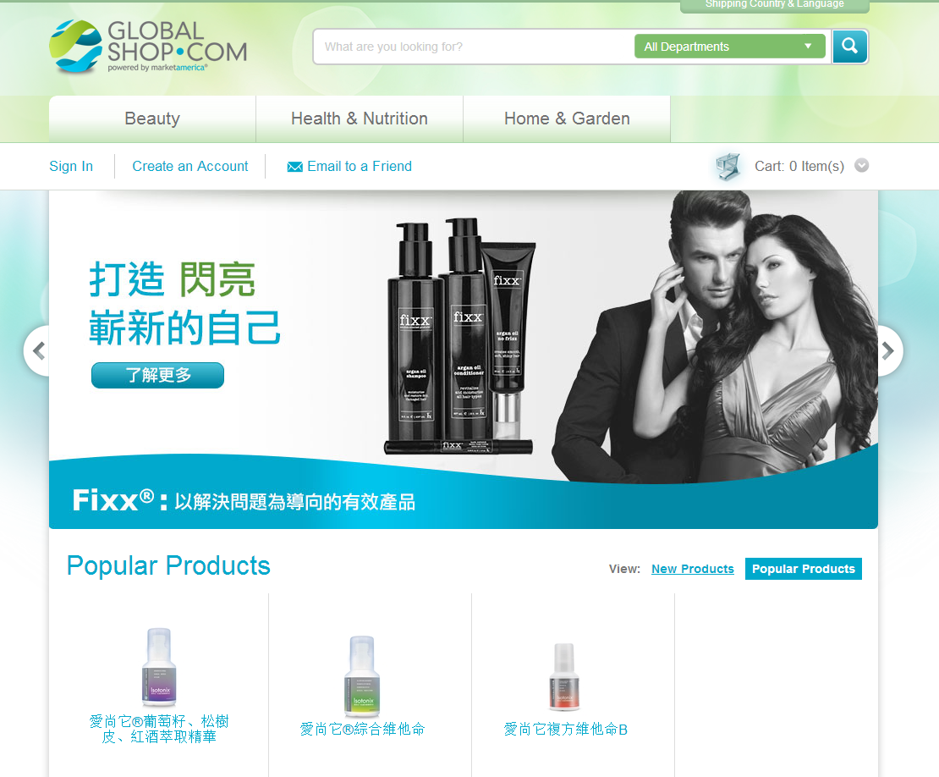

Slide 3
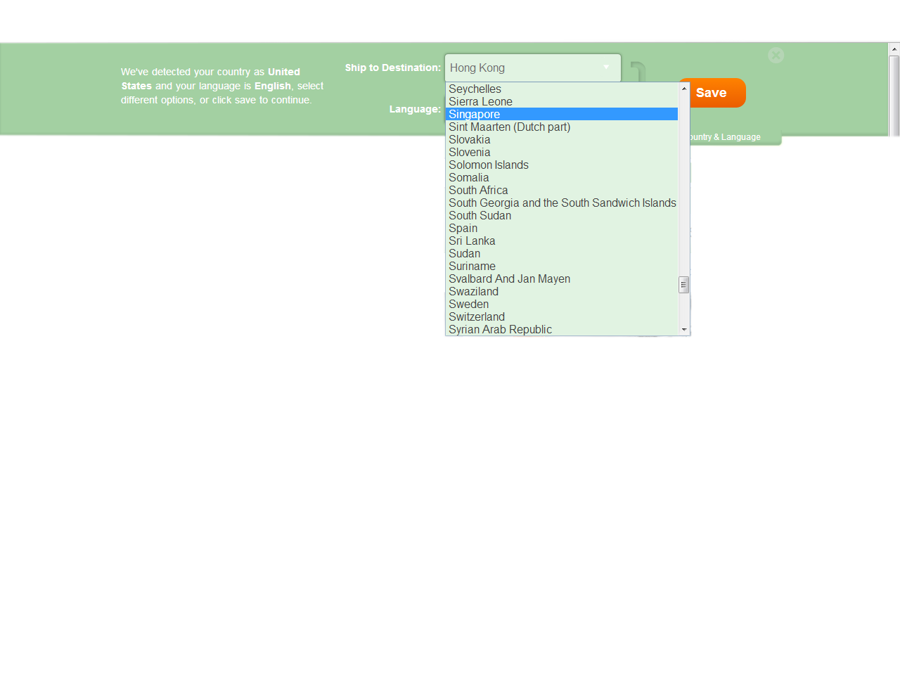
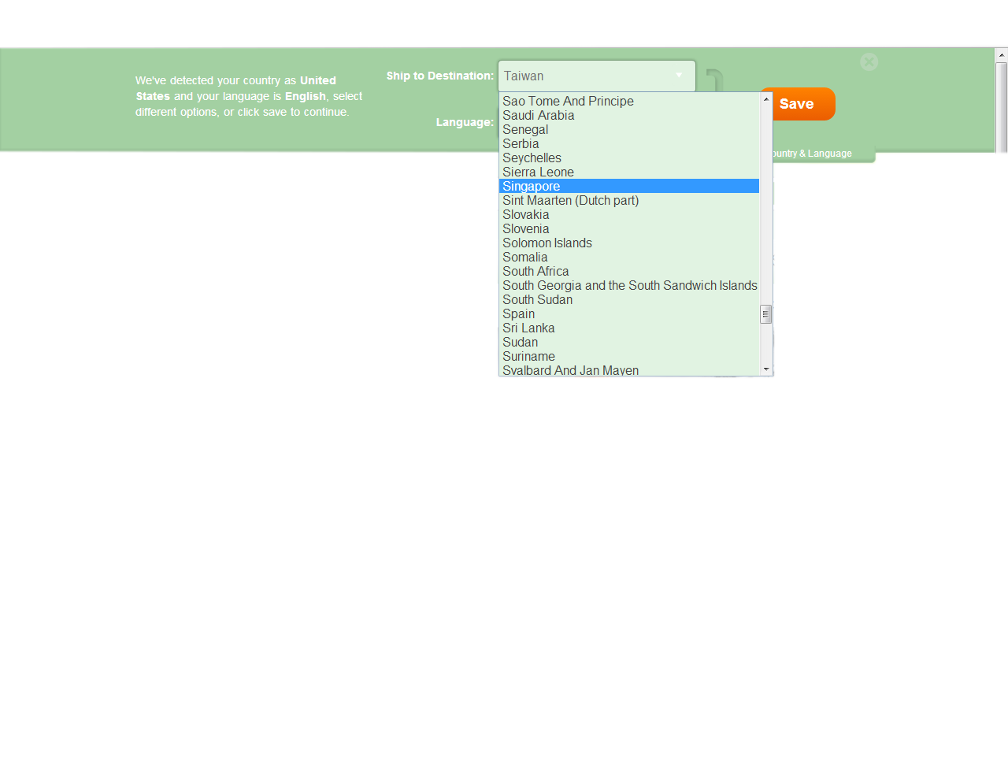
所有美安公司
獨家品牌產品
Access to all MA Branded Product
Notes:
Show drop down of countries – TW slide: HK and Singapore and HK slides: Singapore and TW.

Slide 4
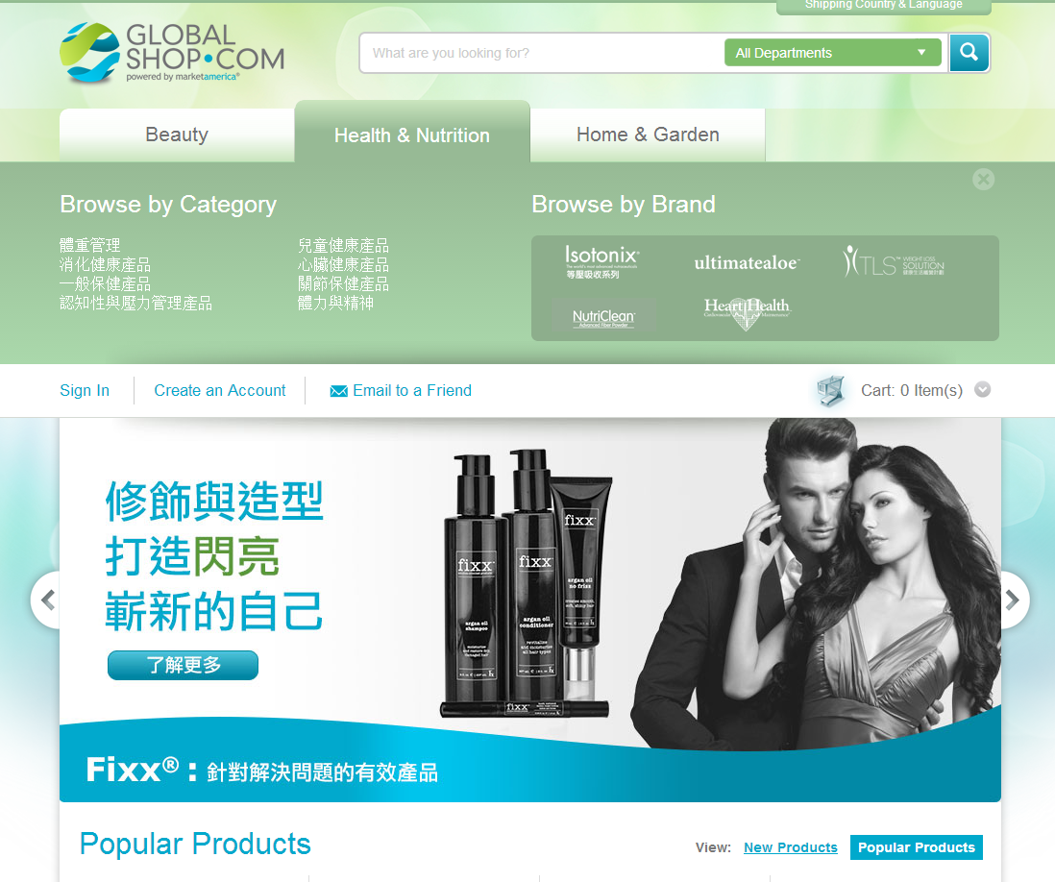
按種類瀏覽
按品牌瀏覽

Slide 5
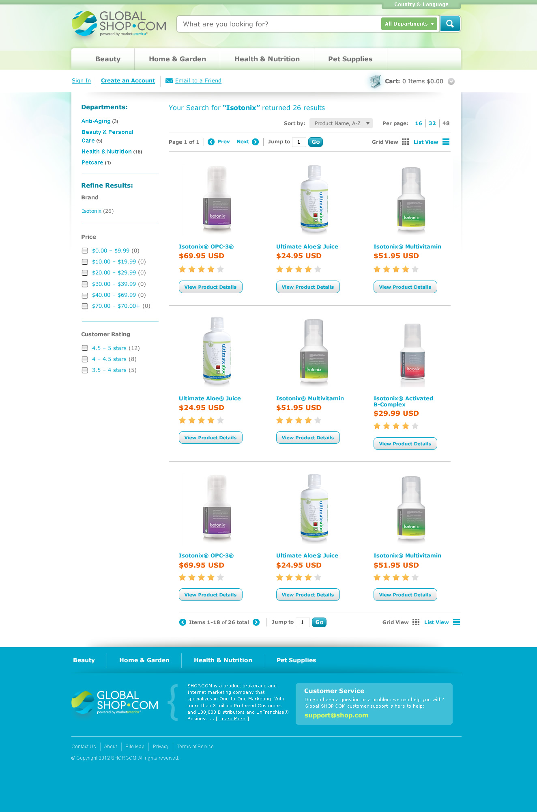

Slide 6
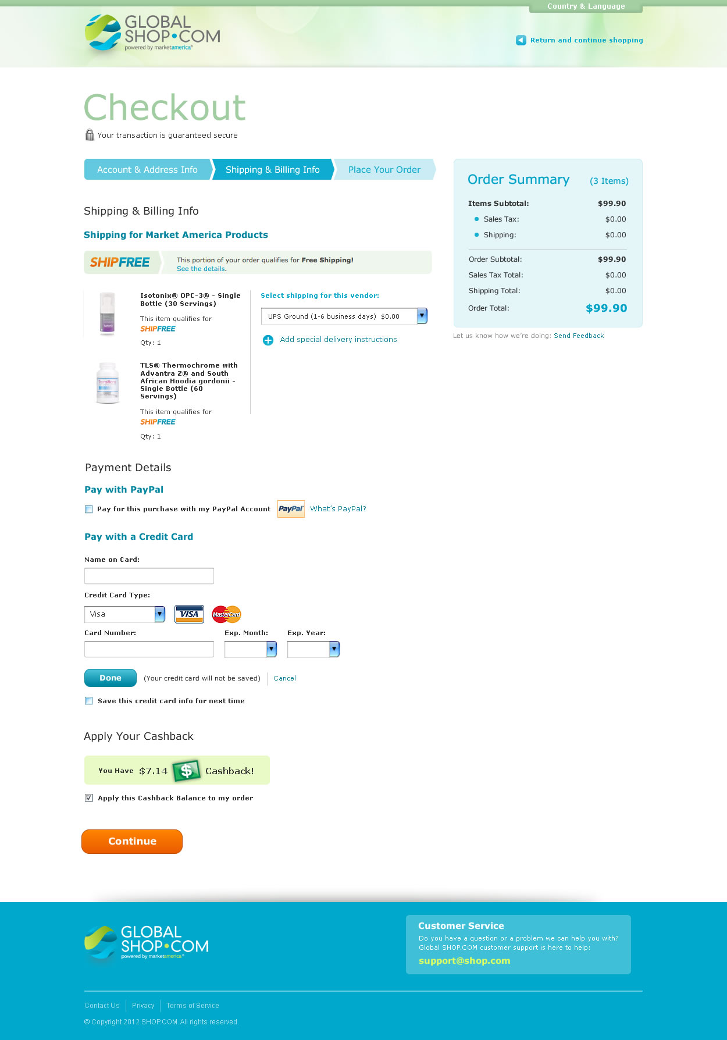
全球的顧客可以體驗快捷及簡易的結帳程序，讓你的國際顧客輕鬆購物。
Global Customers experience quick and easy Checkout. Making it easy for your international customers to shop and go without all the hassle.

Slide 7
送貨呢？ What About Shipping?
訂單超過50美元，即免費送貨！
Orders over US$50, shipping is FREE!

Slide 8
全球網站Global SHOP.COM的好處 Benefits of Global SHOP.COM
國際性擴展顧客基礎
從購物賺取推介紅利
所有BV計算入本國
Expansion of customer base internationally
Earn referral bonuses for purchases
All BV gets credited to your home country

Slide 9
全球網站Global SHOP.COM的其他好處 Other Benefits of Global SHOP.COM
所有經銷商將得到屬於個人的Global.SHOP.COM/xxxxx 網址
All Distributors will get their very own Global.SHOP.COM/xxxxx address
http://global.shop.com/marc

Slide 10
不單止擴展顧客基礎 Not Just for Expansion of Customer Base
全球網站Global.SHOP.COM不單擴展你於其他國家的顧客基礎，還有助公司開拓其他市場
Global.SHOP.COM是通向新興市場計劃的途徑
Global.SHOP.COM not only will grow your customer base in other countries but it will help the company emerge in other markets.
Global.SHOP.COM is the doorway to our new Emerging Markets Program.

Slide 11
新興市場計劃 (EMP) Emerging Markets Program
新興市場計劃為公司提供簡易、優化的程序開拓新市場，而且產品可以很快推出
The EMP provides the company a simple, streamlined process for opening new markets with a very quick time-to-market for those countries
Notes:
Open total 7 new markets – doubled number of countries in 1 yr.

Slide 12
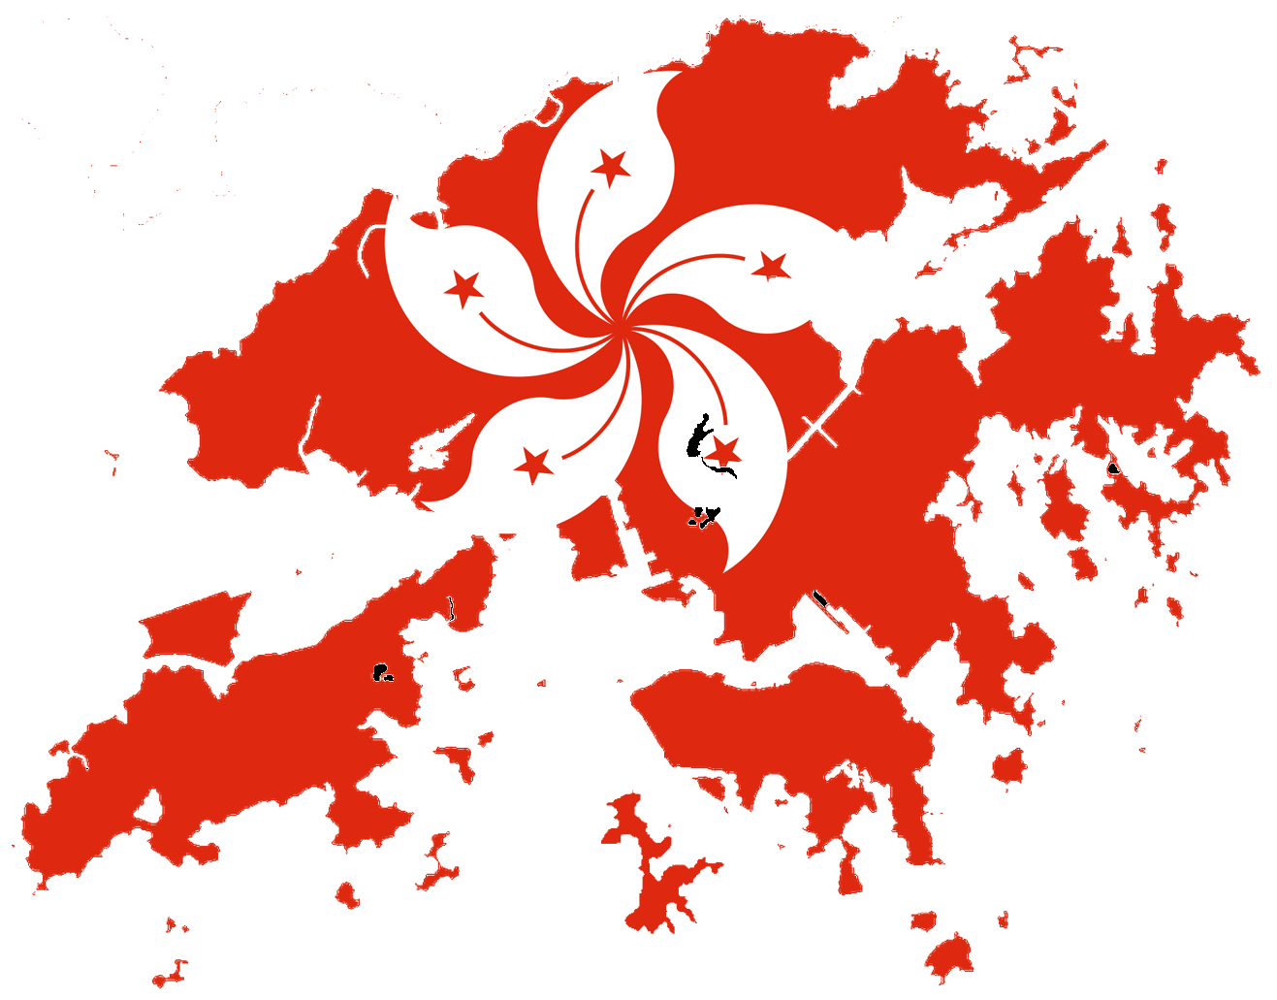
現有市場
Current Market Countries

Slide 13
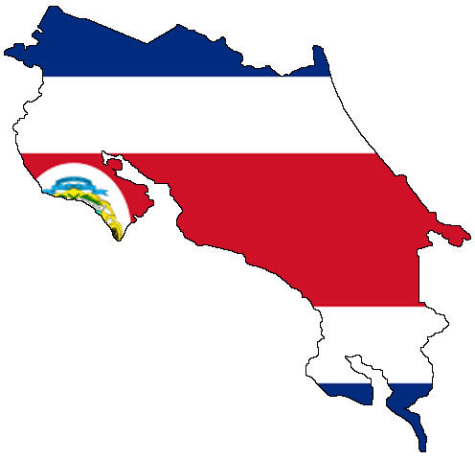
新興市場計劃國家
EMP Markets
西班牙 Spain
多米尼加共和國
Dominican Republic
哥斯達黎加 Costa Rica
哥倫比亞 Columbia
厄瓜多爾 Ecuador

Slide 14
新興市場計劃 (EMP) Emerging Markets Program
首批新興市場計劃國家
哥斯達黎加
哥倫比亞
多米尼加共和國
厄瓜多爾
西班牙
Initial EMP country list
Costa Rica
Columbia
Dominican Republic
Ecuador
Spain
1年內，我們的市場多了一倍We’ve Doubled Countries in less than 1 Year
Notes:
Open total 7 new markets – doubled number of countries in 1 yr.

Slide 15
新興市場計劃(EMP) Emerging Markets Program
現有市場經銷商可於新興市場計劃國家推薦 經銷商
如現有市場的經銷商一樣，新興市場計劃國家的經銷商可推薦新經銷商，並賺取佣金
新興市場計劃國家可銷售BV產品（IBV或夥伴商店不適用）
Distributors in all market countries are able to sponsor distributors in EMP countries
EMP country distributors are able to sponsor new distributors, earn commissions just like market country distributors
EMP countries get access to BV products (no IBV or partner stores)

Slide 16
如現有市場的經銷商一樣，新興市場計劃的經銷商有完整的後台辦公室。
EMP Distributors have a complete back office just like market country distributors.

Slide 17
新興市場計劃(EMP)的好處 Benefits of EMP Program
新興市場計劃的經銷商可賺取BV佣金
新興市場計劃的經銷商可透過銷售產品賺取推介紅利(referral bonus)
讓我們評估市場的銷售額，並根據增長情況全面發展市場
EMP’s will be able to earn BV Commissions
EMP’s will earn a referral bonus on each product sale
Enables us to monitor sales and fully launch in those countries based upon growth.

Slide 18
亞太區一體化 Asia Pacific Unification
不再需要全球BV庫
不再需要重續全球BV庫（助你節省金錢）
可於亞洲市場推薦任何新經銷商
更快賺取佣金支票！
No need for global banks anymore.
No need to renew global banks (saves you money)
Sponsor any new distributor in the Asian Market.
Earn Commission checks faster!
Notes:
Open total 7 new markets – doubled number of countries in 1 yr.

Slide 19
現有BV庫
Current BV Banks

Slide 20
現有3個BV/IBV庫 Current 3 BV/IBV Banks
001
001
001
002
003
002
003
002
003

Slide 21
限制 Restrictions
必須為全球經銷商，方可於這些不同國家賺取佣金
必須於各國家擁有一個全球中心
各個全球中心都須合格
必須重續各個全球中心
Must be global distributor to earn commissions in these different countries.
Must have a global center in each country.
Must qualify each global center.
Must renew each global center you are in.

Slide 22
亞太區一體化 Asia Pacific Unification
亞太區佣金計劃
可於亞太區市場推薦任何新經銷商
更快賺取佣金支票！
One Asia Pacific Commission Plan
Sponsor any new distributor in the Asian Pacific Market.
Earn Commission checks faster!
Notes:
Open total 7 new markets – doubled number of countries in 1 yr.

Slide 23
亞太區一體化
Asia Pacific Unification
已於多個全球BV/IBV庫賺取佣金的經銷商不受新計劃所限
化繁為簡！
對每個人來說都是雙贏！
Distributors who have earned commissions from multiple global banks will have the opportunity to be grandfathered.
Simplification!
It’s a Win, Win for everyone!

Slide 24
由管理多個全球中心 Go From Managing Multiple Global Centers
au1
001
tw1
au2
au3
hk1
hk2
tw2
tw3
au1
hk3
tw1
au2
au3
hk4
hk5
tw2
tw3

Slide 25
變成管理一個組織 To Managing One Organization
無論是哪個亞太區市場，所有BV/IBV都向上流
All BV/ IBV flows up no matter what Asia Pacific country
一個更大的BV/IBV庫
ONE
LARGER
BV/IBV BANK
001
hk1
hk2
hk3
tw1
hk4
hk5
tw2
tw3
au1
tw1
au2
au3
tw2
tw3
au1
hk6
au2
au3
hk7
hk8

Slide 26
等等！你不想要更多嗎！？

Slide 27
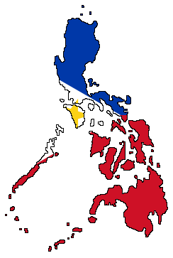
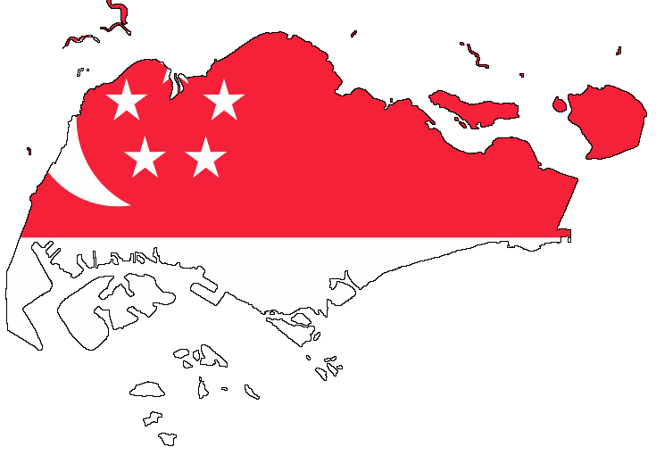
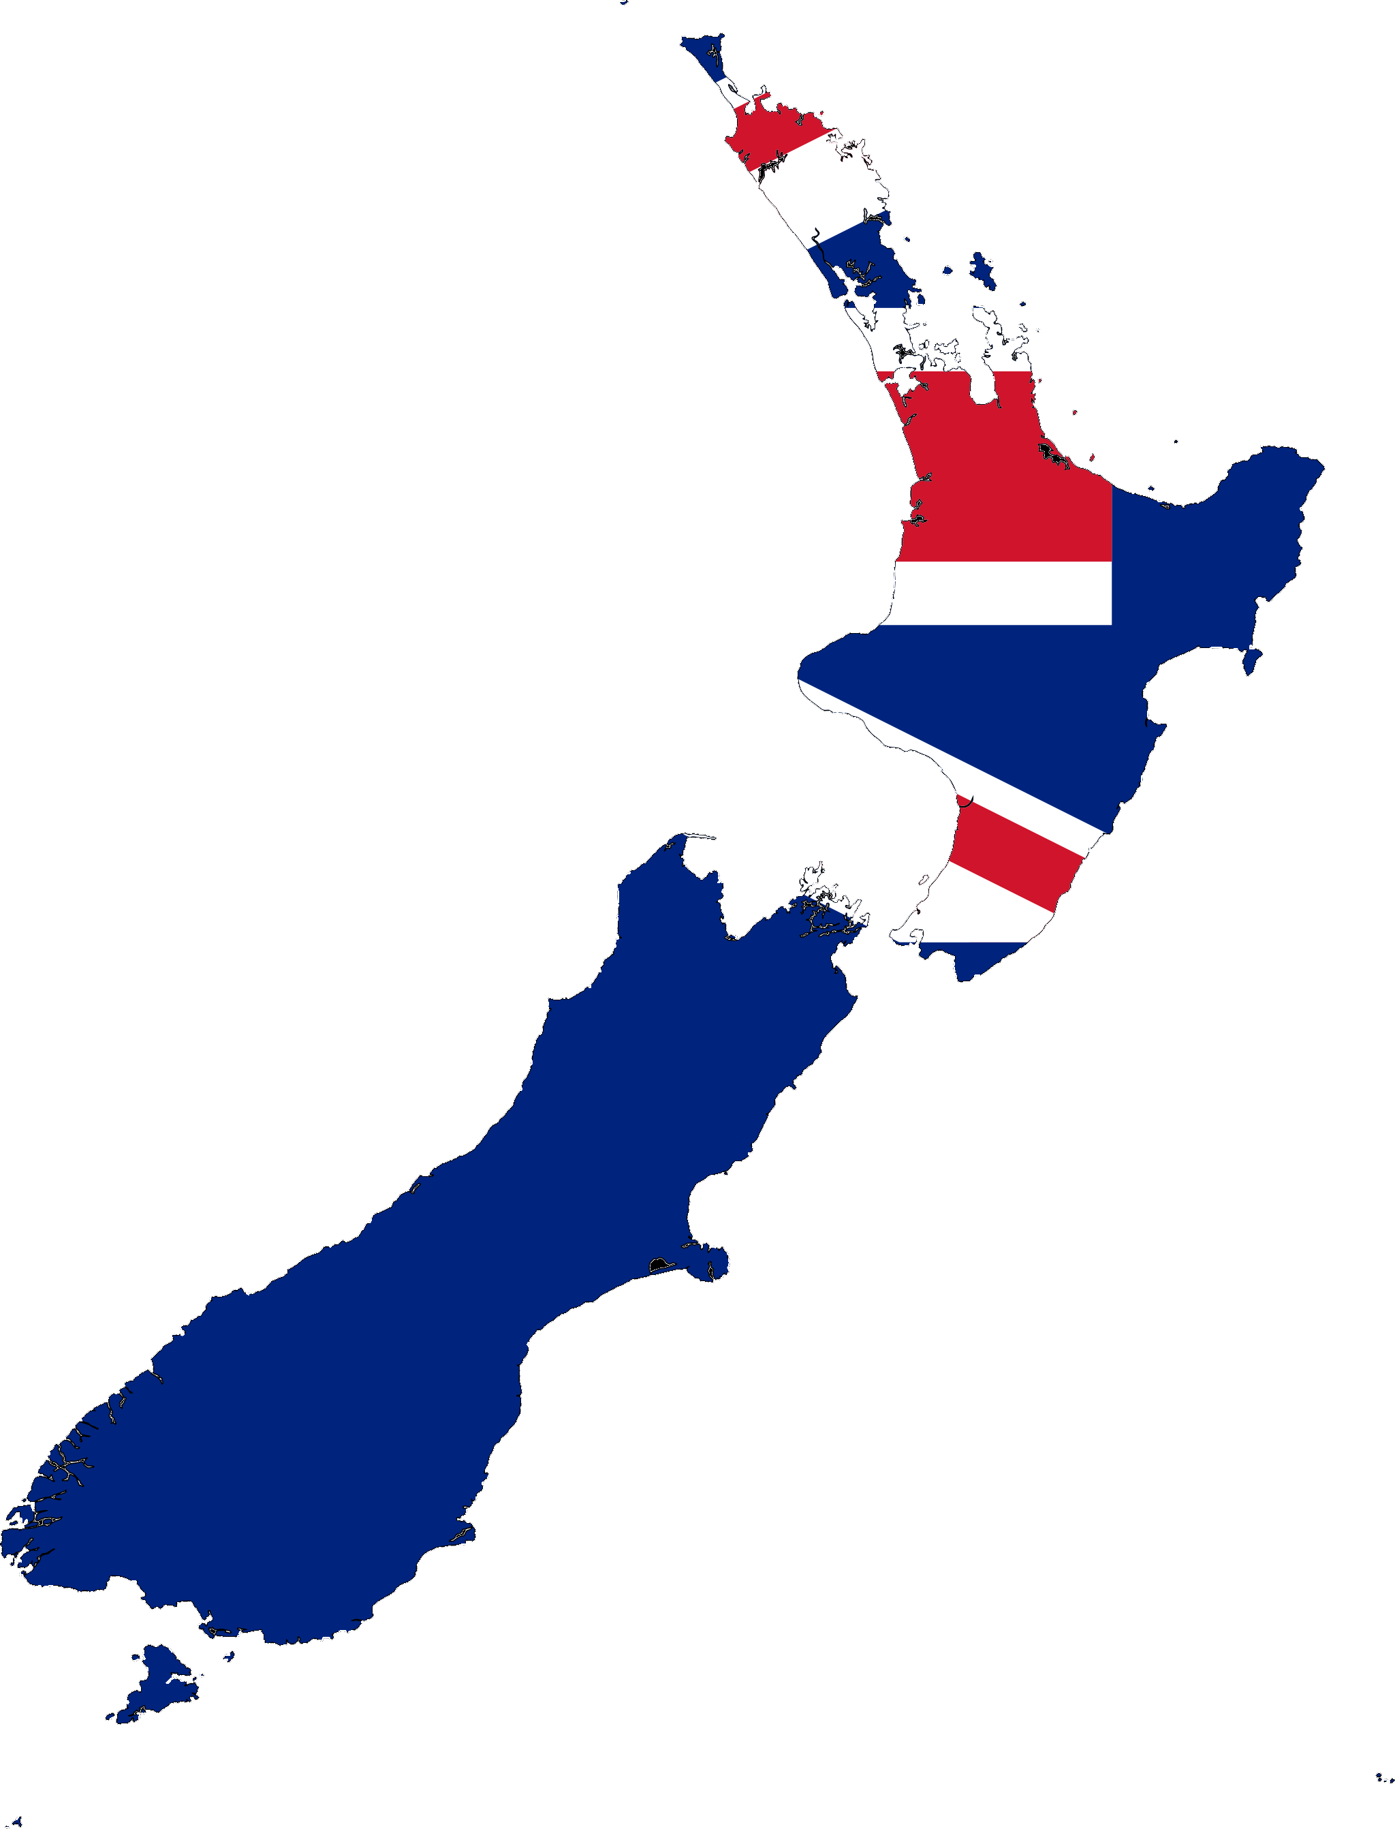
即將開拓的市場！Coming Soon!
菲律賓 Philippines
巴拿馬 Panama
新加坡 Singapore
新西蘭 New Zealand

Slide 28
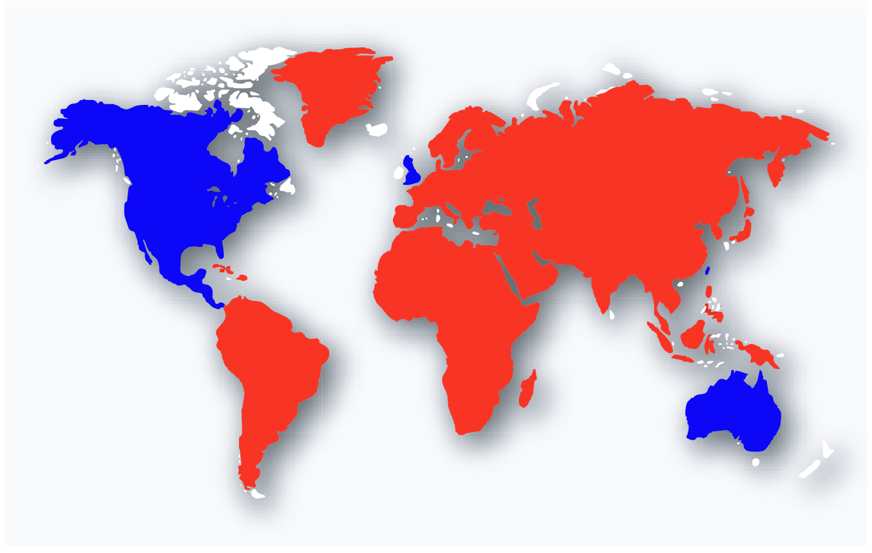
全世界
The World

Slide 29
.
Notes:
29

