Slide 1
HK.SHOP.COM
美安香港的使命
是徹底改革顧客網上選購
產品及服務的新方式
Market Hong Kong’s mission is to revolutionize the way consumers shop for products and services online.

Slide 2
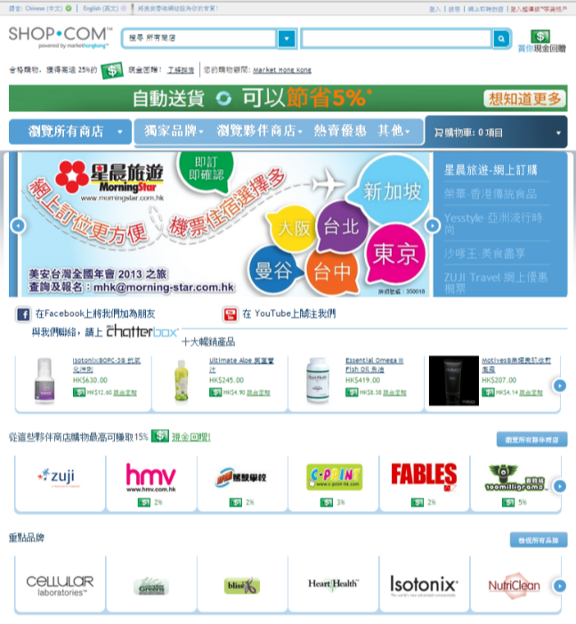
你入門網站的優勢 Benefits of Your Portal
用簡易方式讓你及你的顧客購買美安香港獨家品牌產品
為你及你的顧客提供數百間夥伴商店
快捷、準確的產品及內容搜尋
熱賣優惠
加上為你及你顧客的合格消費提供現金回贈/IBV計劃
Easy way for your consumers to purchase mhk Brand products
Offers hundreds of partner stores for you and your customers.
Quick, Accurate Product & Content Search
Hot Deals
Plus offers you & your customers a cashback / IBV program for qualified purchases.

Slide 3
為甚麼你需要入門網站？ Why do you need a portal?

Slide 4
網上購物 Online Shopping
財經消息
MasterCard 調查：
超過一半香港受訪者
透過互聯網購物

Slide 5
MasterCard 調查 MasterCard Survey
超過一半香港受訪者透過互聯網購物
58%本港受訪者透過互聯網購物
Over Half of Hong Kong Respondents Now Shopping Online.
58% of people use the Internet to make purchases.

Slide 6
MasterCard 調查 MasterCard Survey
在過去三個月內曾經上網購物的香港受訪者當中，他們平均購買產品的數量亦上升，由2010年的4.3次增至2011年的4.8次。網上購物繼續以女性消費者為主（62%為女性對比54%男性）。整體來說，18至24歲（57%）及25至34歲（62%）的消費者較多利用互聯網購物。
The average number of purchases made by those who have shopped online in Hong Kong in the past three months has also increased, rising from 4.3 in 2010 to 4.8 in 2011. Women continue to lead the way in online shopping (62% of women vs. 54% of men), while more broadly those aged 18-24 (57%) and 25-34 (62%) are more likely to access the Internet to buy online.

Slide 7
MasterCard 調查 MasterCard Survey
另外，18%港人計劃於未來六個月以手機上網購物，主要由於手機應用程式的普及與便捷，令手機購物變得更為容易。電影戲票（24%）、優惠券（22%）及玩具／禮物（19%）為三項最常購買的商品類別。
A further 18% of Hongkongers plan on making a purchase in the next six months. This has been driven primarily by the added convenience and the proliferation of apps which makes it easier to shop using mobile phones, with cinema tickets (24%), coupon deals (22%) and toys/gifts (19%) making up the top three purchase categories.

Slide 8
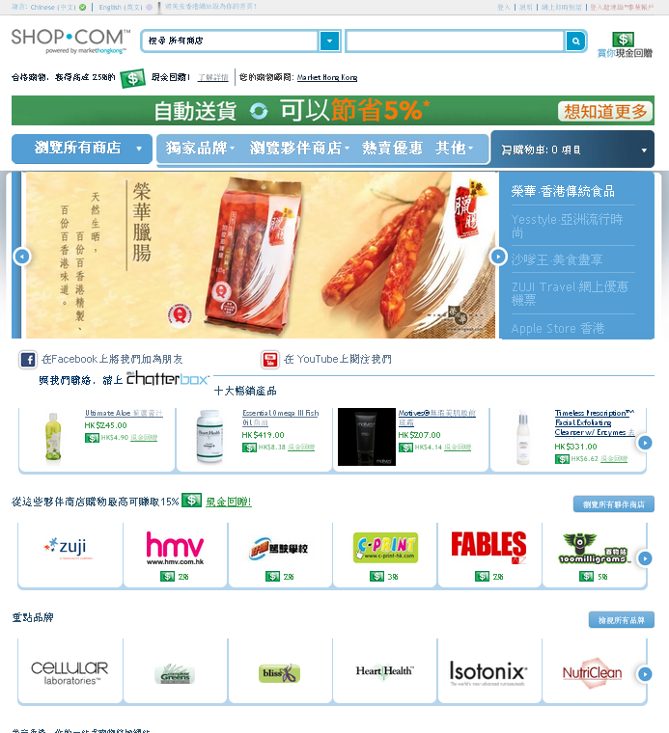
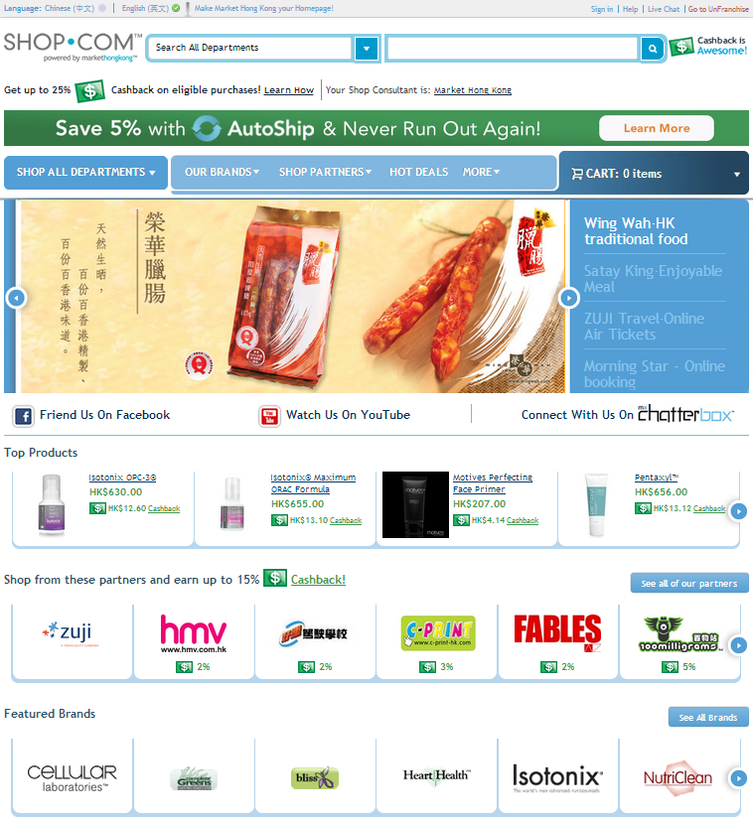

Slide 9
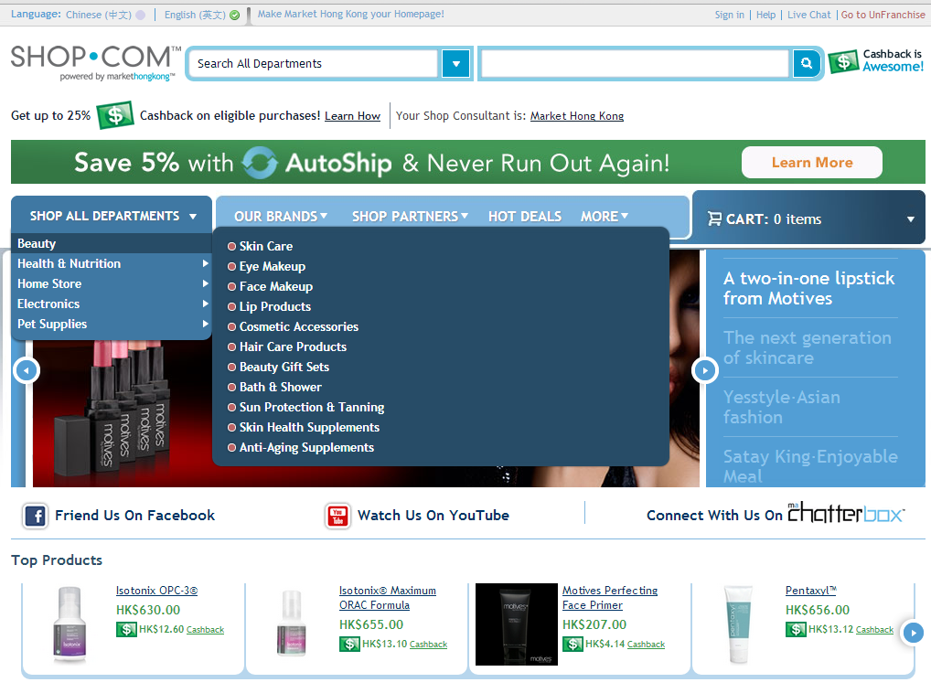

Slide 10
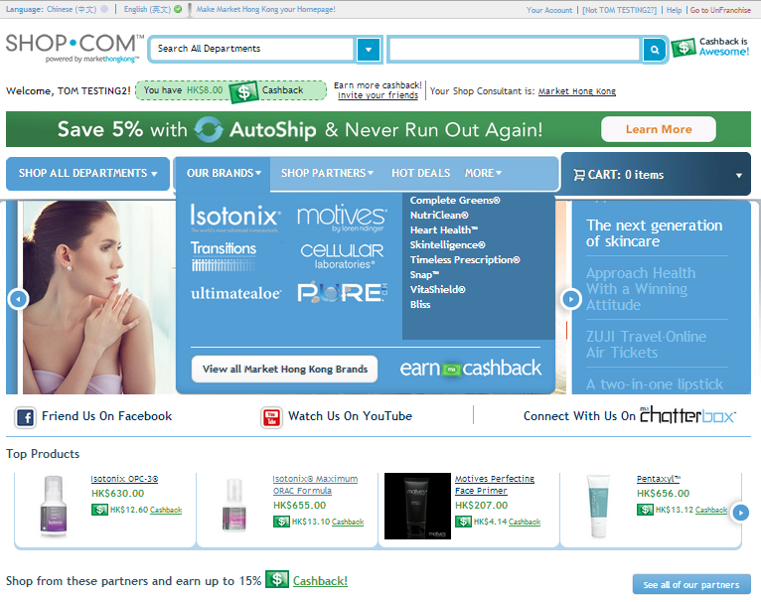

Slide 11
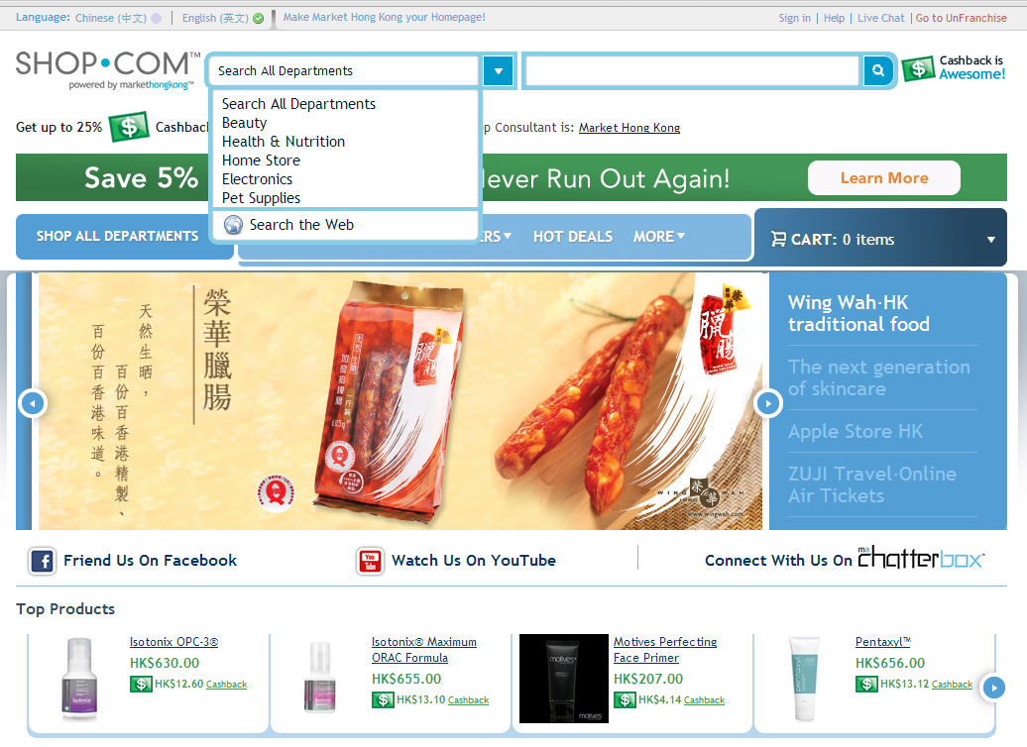
isotonix

Slide 12
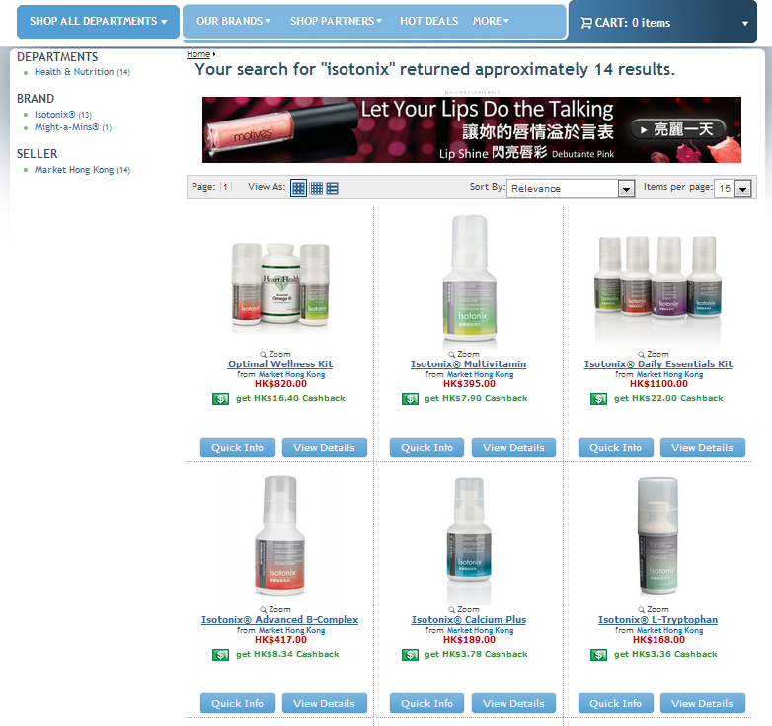

Slide 13
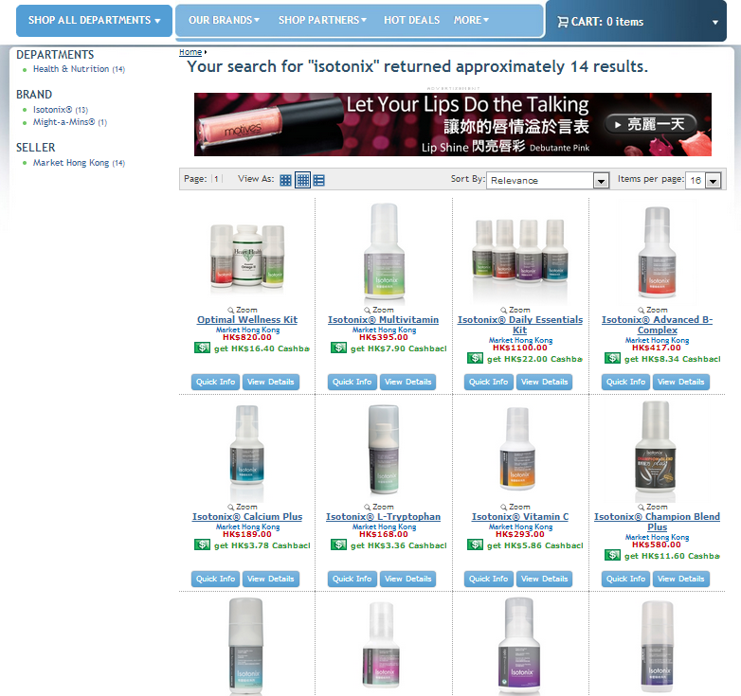
您搜尋 "isotonix" 大概有 14 結果.

Slide 14
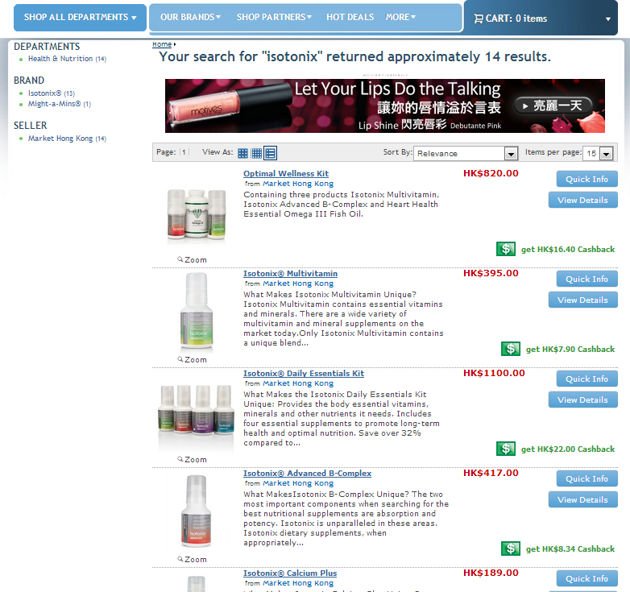
您搜尋 "isotonix" 大概有 14 結果.

Slide 15
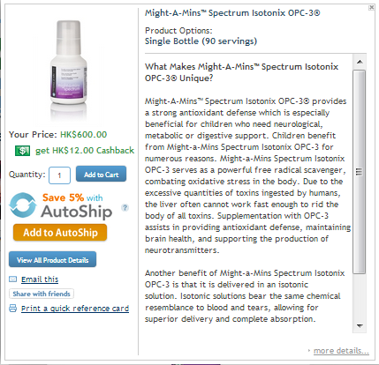

Slide 16
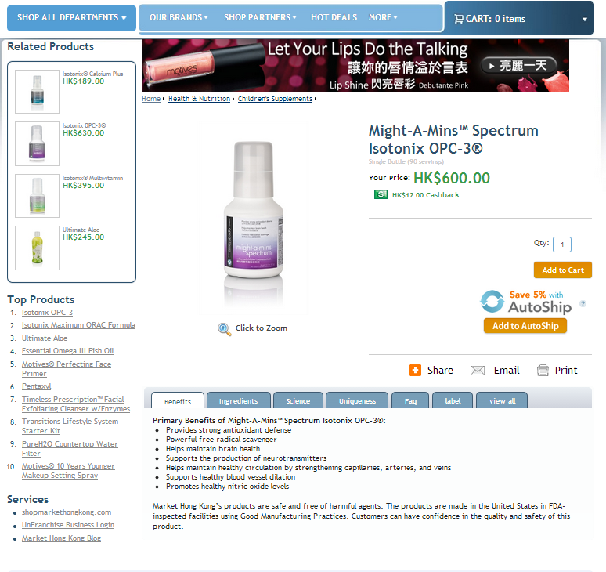

Slide 17
可於超過300個
社交媒體網站分享，如:
Share on over 300+ Social Media sites like:

Slide 18
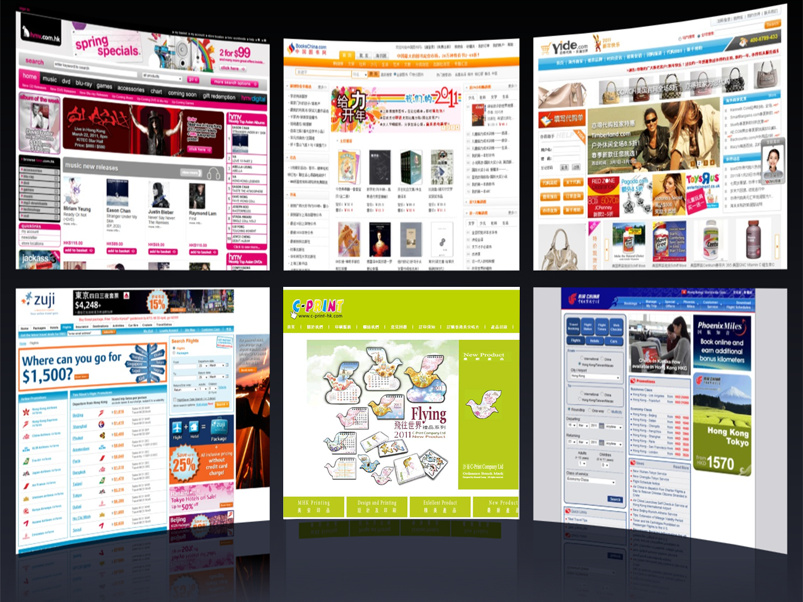
夥伴商店 Partner Stores

Slide 19
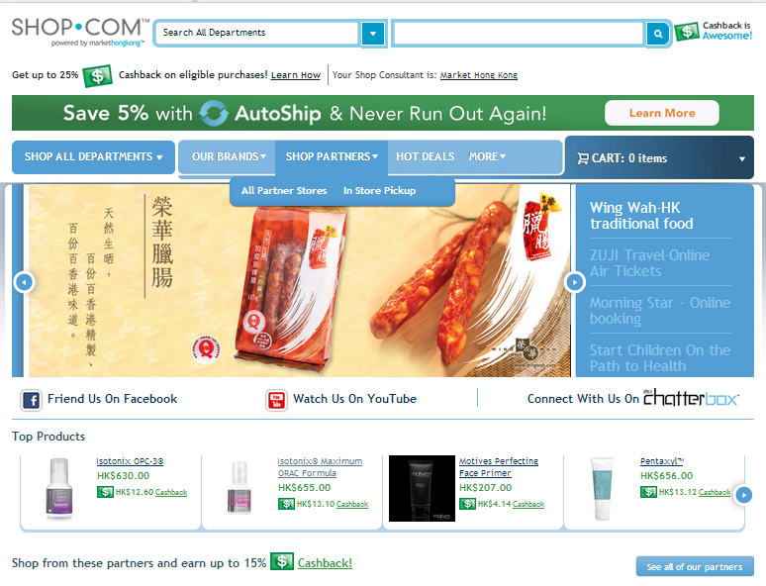
選擇網上商店或
店內提貨
Choose from either
the Online Stores or even the In Store Pickup

Slide 20
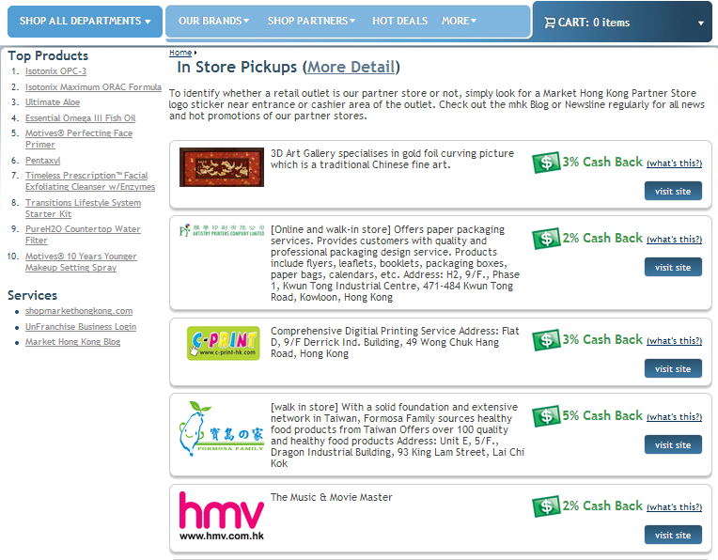

Slide 21
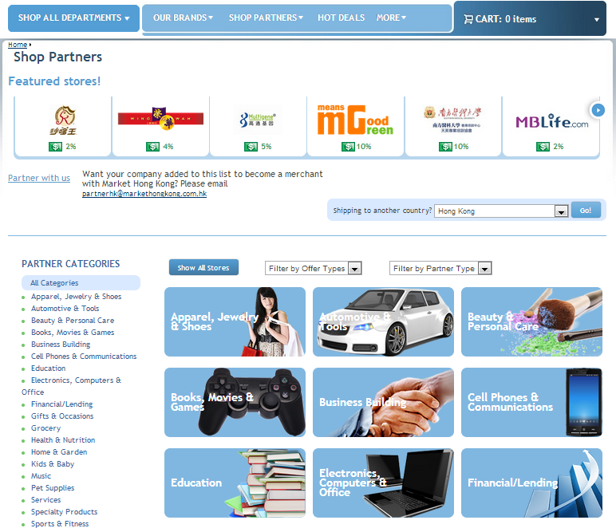

Slide 23
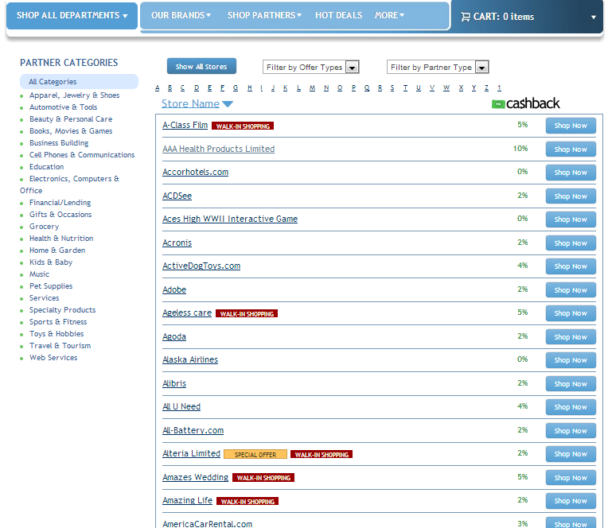

Slide 24
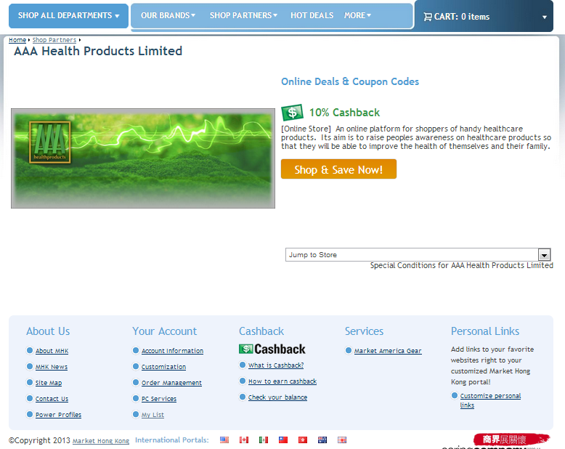
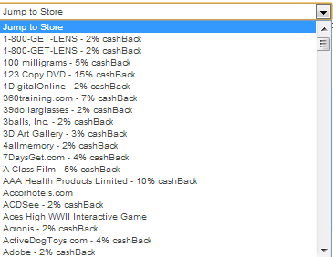

Slide 25
夥伴商店 Partner Stores
超過1,000間夥伴商店供你購物
超過400間夥伴商店提供2%以上現金回贈
超過120間親臨夥伴商店讓你賺取現金回贈及IBV
Over 1,000+ partners to shop from
Over 400 partners greater than 2% Cashback
Over 120+ Walk-In Stores that you can earn Cashback and IBV from.

Slide 26
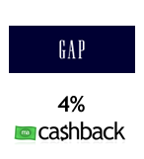
夥伴商店 Partner Stores
3%
3%
3%
2%
3%
2%
10%
10%
7%

Slide 28
瑪姬美容集團
Beauty Maggie
專業美容服務
一站式美容護理中心
IBV/現金回贈：
8% IBV 7% 現金回贈
Privilege Beauty Experience
One Stop Skin care & Beauty centre
IBV/Cashback:
8% IBV 7% Cashback
親臨夥伴商店
Walk-In Partner
Shop Alert!

Slide 29
沙嗲王 Satay King
著名東南亞菜式
全線分店可享現金回贈
IBV/ 現金回贈：
5% IBV 2% 現金回贈
Popular South-east Asian cuisine; Cashback available at All Branches!
IBV/Cashback:
5% IBV 2% Cashback
親臨夥伴商店
Walk-In Partner
Shop Alert!

Slide 30
於HMV的全球音樂庫中購買CD，DVD和更多產品!
IBV/現金回贈：
5% IBV 2% 現金回贈
Purchase CD’s, DVD’s and more at HMV plus HMV’s worldwide music pool!
IBV/Cashback:
5% IBV 2% Cashback
店內提貨
IN-STORE
PICKUP
Shop Alert!

Slide 31
網上首飾和按個人喜好配搭的鑽石飾物
IBV/現金回贈：
12% IBV 2% 現金回贈
Online jewelry & diamonds with DIY your own accessories.
IBV/Cashback:
12% IBV 2% Cashback
網上夥伴商店 Online
Partner
Shop Alert!

Slide 32
網上旅遊預訂引擎，可訂購所有機票及酒店套票
每月特別優惠套票！
IBV/現金回贈：
3% IBV
Online Travel Booking engine. Book all your airline tickets and hotel packages through Zuji
Monthly special discounted packages available!
IBV/Cashback:
3% IBV
網上夥伴商店 Online
Partner
每月都會推出特別優惠套票！
Monthly special discounted packages available!
Shop Alert!

Slide 33
好運駕駛學校
Good Luck Motoring School
專業駕駛學校 提供24小時網上申請服務，網上申請還包括中國駕照
IBV/現金回贈：
5% IBV 2% 現金回贈
Professional Driving School. 24 hour online applications; online application for Mainland China driving license.
IBV/Cashback:
5% IBV 2% Cashback
親臨夥伴商店
Walk-In
Partner
Shop Alert!

Slide 34
榮華
Wing Wah
傳統餅店，已有60年歷史
著名食品有臘腸、蛋卷、粽
IBV/現金回贈：
4% IBV 4% 現金回贈
Traditional cake shop of 60 years. Preserved meat sausage, egg roll, rice dumplings.
IBV/Cashback:
4% IBV 4% CASHBACK!
即時現金回贈優惠和IBV
Instant Savings & IBV
Shop Alert!

Slide 35
2% IBV
Travel

Slide 36
Hong Kong Privilege Card
Register on HK.SHOP.COM
Earn cashback and IBV at
local stores

Slide 37
熱賣優惠

Slide 38
熱賣優惠和推廣 Hot Deals & Promotions
美安香港和夥伴商店的熱賣優惠已成為搜尋折扣和優惠的最佳熱點
Hot Deals has become the best place to find any special promotion or offer for any Market Hong Kong Product and a Partner Store

Slide 39
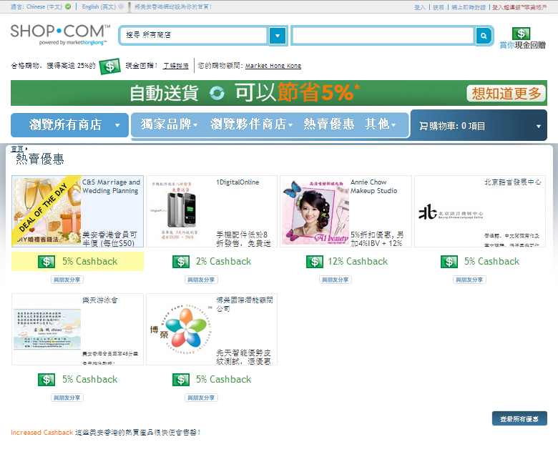

Slide 40
邀請朋友工具 Invite Friends Tool

Slide 41
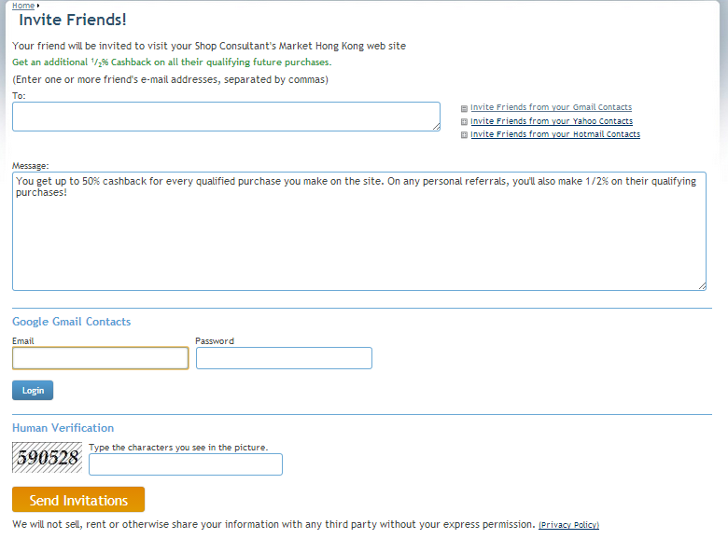
於不同平台邀請朋友
Invite Friends From:

Slide 42
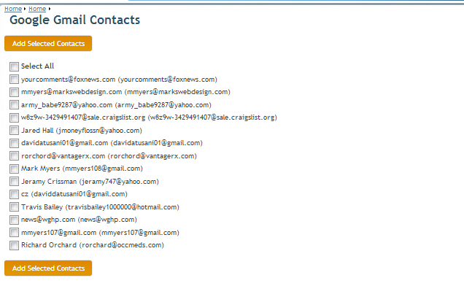
加入選定聯絡人

Slide 44
當你的朋友點擊「立即註冊」，就會自動連結至你入門網站的簡易註冊程序。
Now when your friend clicks “Sign Up Now”, they will be automatically EZ-Registered on your Portal.
Notes:
Replace with Taiwan Email

Slide 45
更快賺取IBV Faster IBV
當夥伴商店向我們提供你或你客戶的訂單後​​，我們就會進行跟進並處理，向你分派IBV
你無需再等待至我們收取交易款項後才收到IBV
Once the partner store sends us your order or your customers order, we will go ahead and post your IBV at the time we process it
You no longer have to wait until we get paid to receive your IBV

Slide 46
更快賺取IBV Faster IBV
你接獲新訂單時會收到通知
你將有24小時決定放置訂單位置，又或者你可不用理會，令它放於IBV自動放置位置
當你選擇另外的放置位置，你的IBV會顯示於選定位置
You will be notified of new orders
You will have 24 hrs to change the placement of the order or you can leave it and it will go to your IBV auto-placement
Once you choose to override, your IBV is now posted right then and there

Slide 47
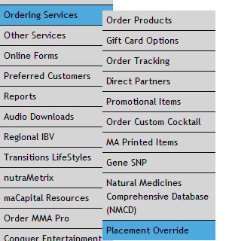
有兩種查閱訂單的方法 一是登入超連鎖事業帳戶， 然後在主頁選項中選擇 Two Ways to See Your Orders One is login to UF.com and you can choose from the menu option

Slide 48
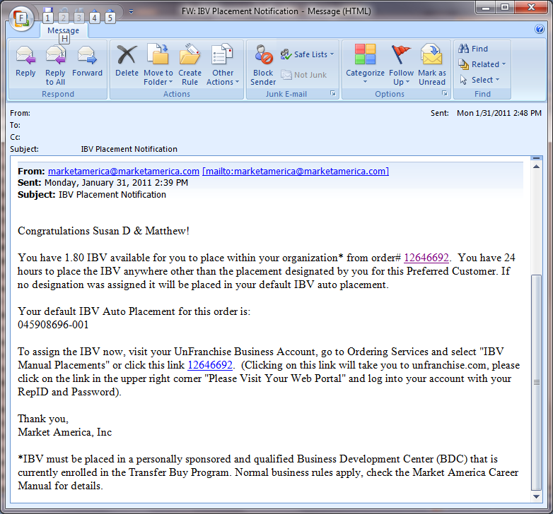
有兩種查閱訂單的方法
二是在點擊通知電郵的連結
Two Ways to See Your Orders Two, click through
the email notification

Slide 49
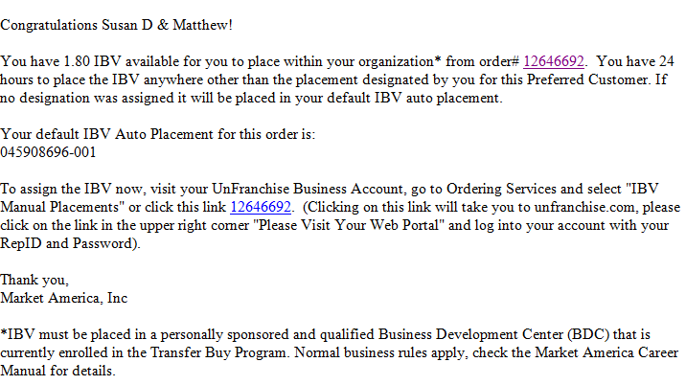
新IBV放置選項 New IBV Placement Override

Slide 50
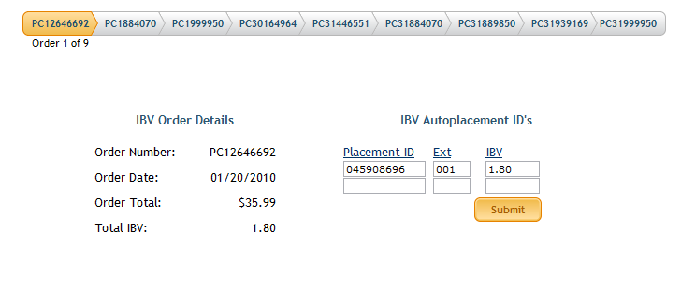
新IBV放置選項 New IBV Placement Override

Slide 51
新IBV放置選項 New IBV Placement Override

Slide 52
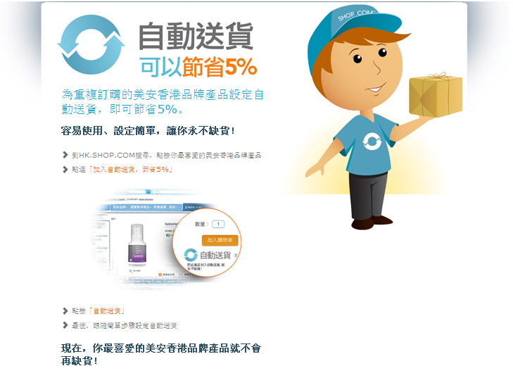

Slide 53
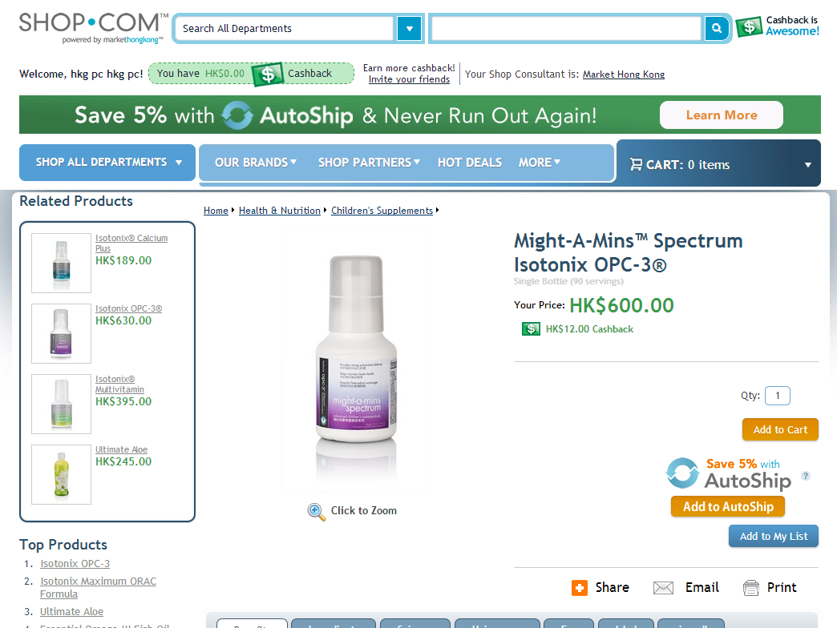
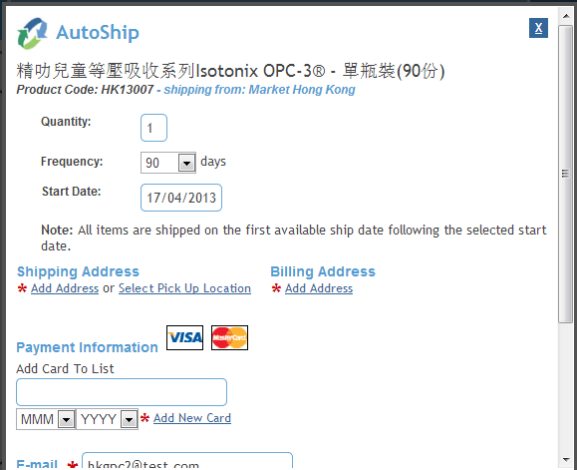
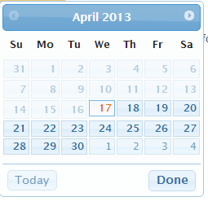

Slide 54
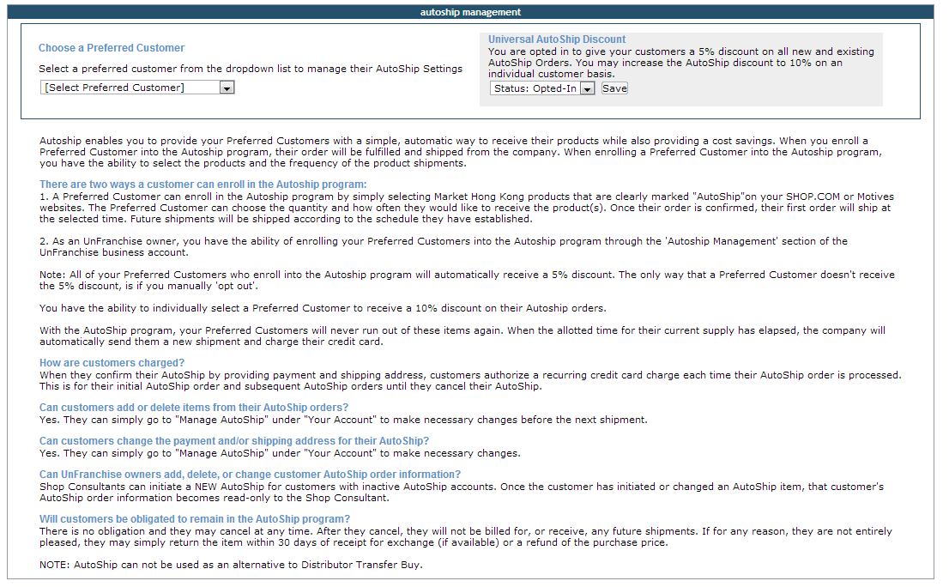
超連鎖自動送貨 UnFranchise AutoShip

Slide 55
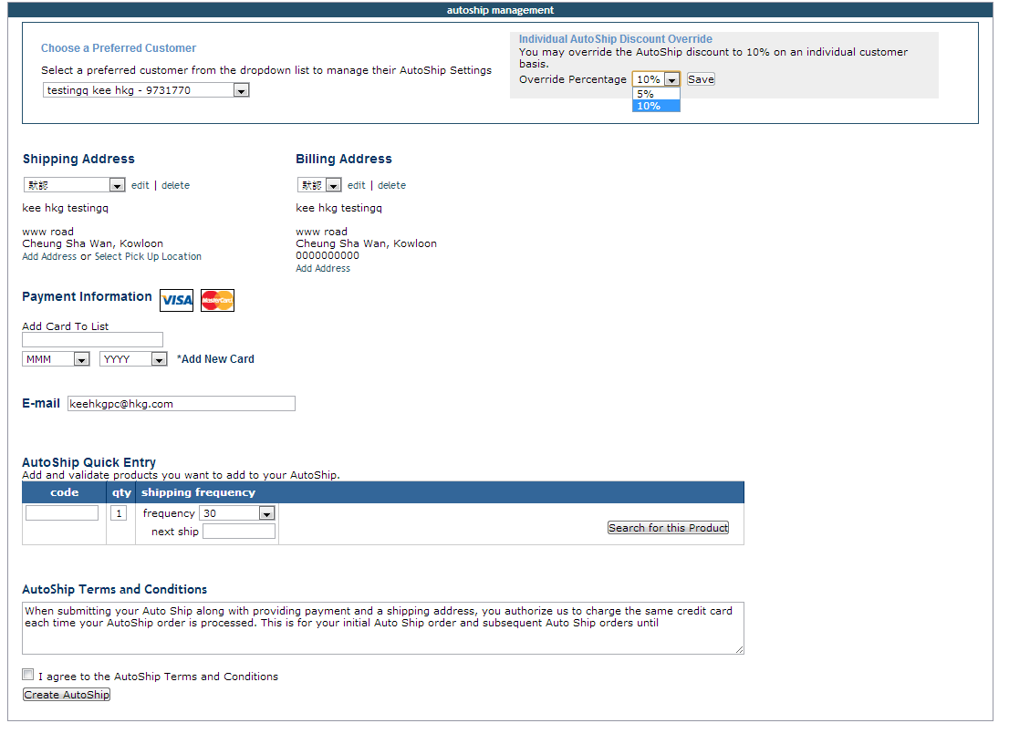
超連鎖自動送貨 UnFranchise AutoShip

Slide 56
New HK.SHOP.COM
Redesign site
Shop Platform
- e-gifts
- gifts registry
- enhanced search

Slide 57
你想看到更多！ So Do You Want to See More!
美安香港最新消息
New to Market Hong Kong

Slide 58
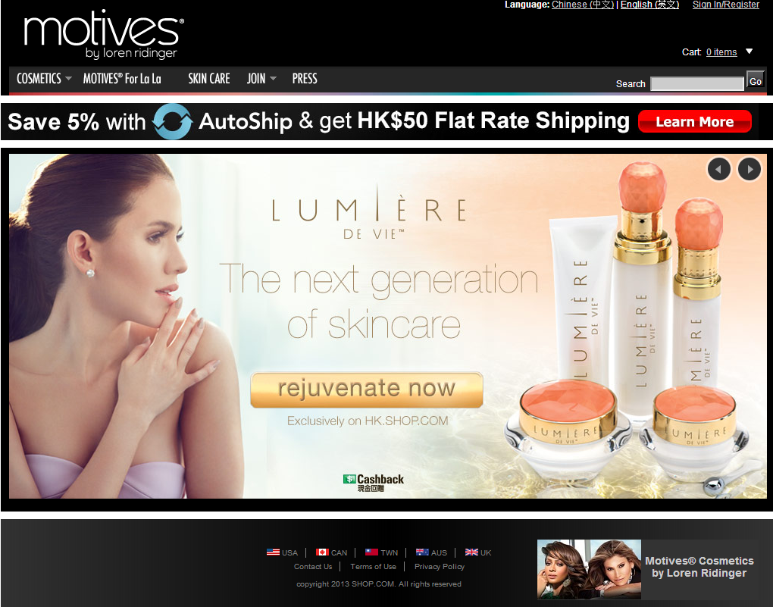

Slide 59
Motives.com.hk
香港的活躍獨立購物顧問可免費使用Motives.com.hk！
Motives.com.hk支援電子商務，包含互動的網站廣告橫額、詳盡的產品資訊，以及「立即加入」等建立事業元素，讓你一次過獲得所有必備美容產品！
Motives.com.hk is FREE to all active Independent Shop Consultants within Hong Kong!
Motives.com.hk is e-commerce-enabled and has features such as interactive web banners, detailed product information, business-building elements, such as “Join Now” and much more. Get all your beauty must-have products in one place!

Slide 60
Motives.com.hk
獨立購物顧問可透過超連鎖事業帳戶進入Motives.com.hk網站。我們已自動為你設定網站，訪客可透過你HK.SHOP.COM的相同名稱瀏覽Motives.com.hk網站。
你的Motives彩妝網址
motives.com.hk/your_portal_name
Independent Shop Consultants can find access to their Motives.com.hk website within their UnFranchise Business Account. The site has been automatically set up for you and is live to the public using the same address as your HK.SHOP.COM website.
Your new motives address: motives.com.hk/your_portal_name

Slide 61
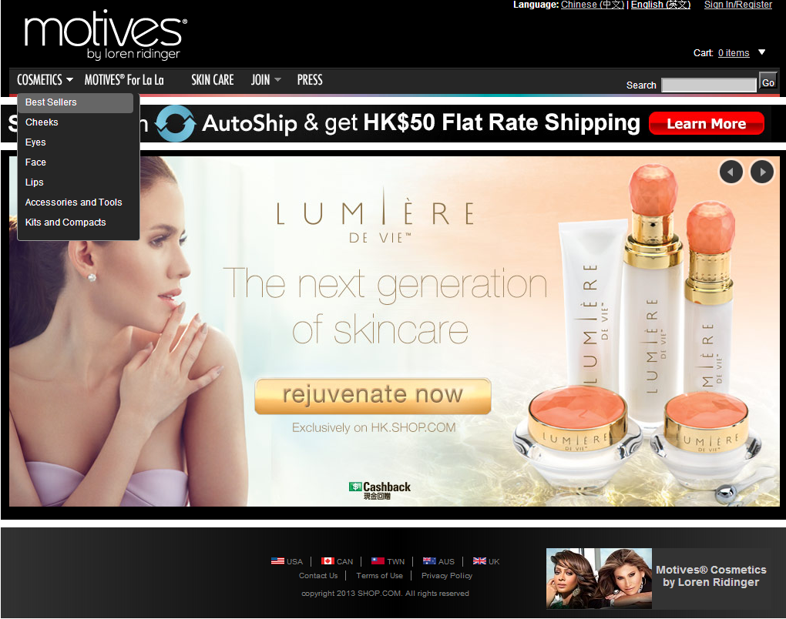

Slide 62
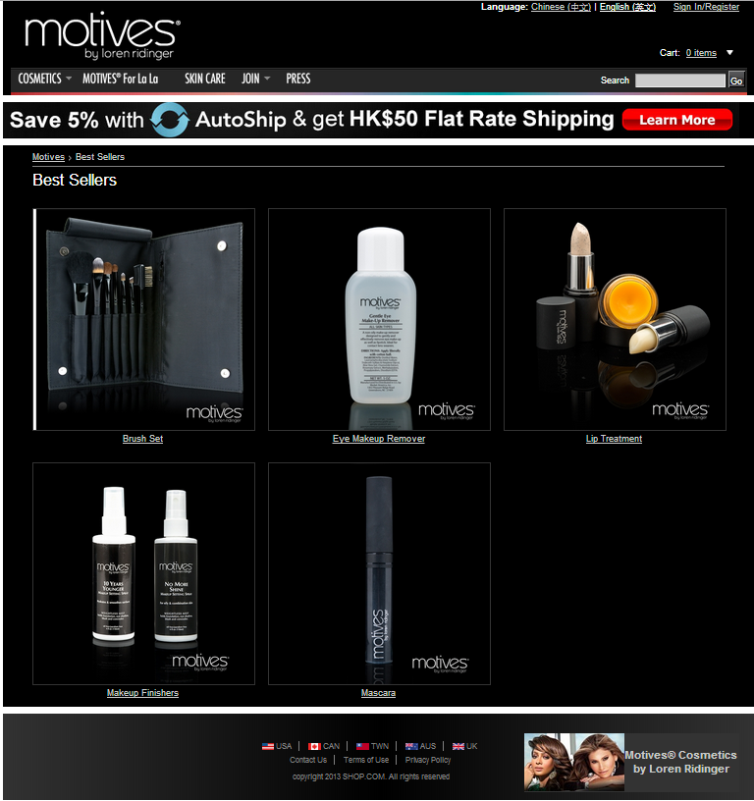

Slide 63
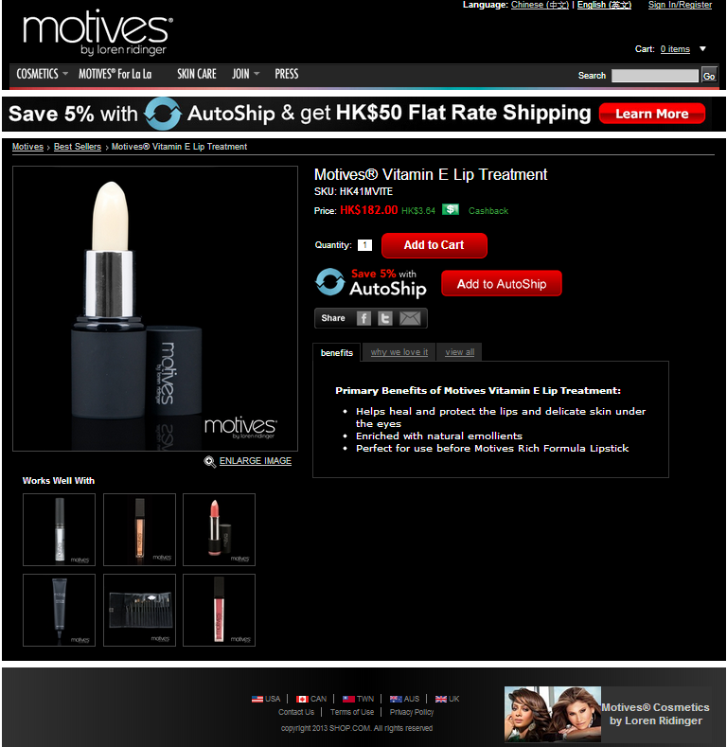

Slide 69
美安公司 MARKET AMERICA INC. - 1992
一個夢想誕生...
創造一個計劃...
計劃可行...
夢想成真！
A dream is born...
A plan is created...
The plan worked...
A dream becomes a reality!

Slide 70
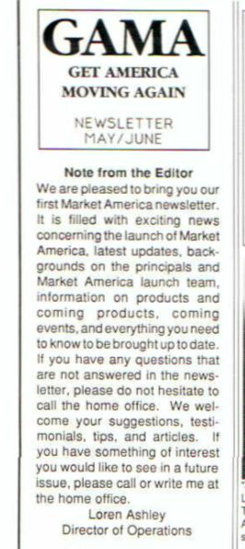
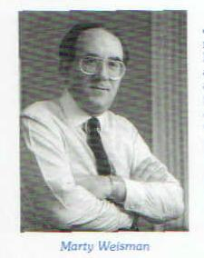
公司成立早期
Corporate
The Early Years

Slide 71
產品和服務
Products & Services
LaCreme
Lite
(個人護理產品)

Slide 72
產品和服務
Products & Services
Trim Drops
(減重產品)

Slide 73
產品和服務
Products & Services
Xtend Car Care
(汽車保養產品)

Slide 74
產品和服務
Products & Services
Quitter’s Friend

Slide 75
產品與服務
的種類
非常有限！
PRODUCTS
AND
SERVICES
WERE VERY LIMITED!

Slide 76
信念一直以來都是我們最好的產品
Our best product was and is belief

Slide 77
早期的挫折
高層人員開設新公司
Early Set Backs
Top Executives Start a New Company

Slide 78
早期的挫折 Early Set Backs
資金短缺 Running Low On Capital

Slide 79
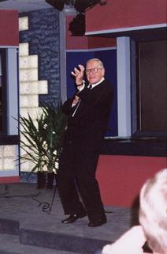
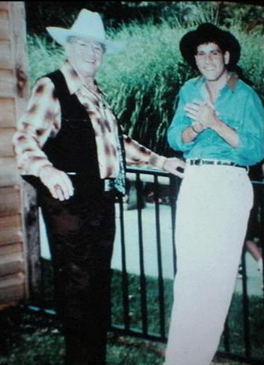

Slide 80
動力逐漸建立
新產品 - Thermochrome
Momentum is Building
New Products - Thermochrome

Slide 81
動力逐漸建立
新產品 - Isotonix
Momentum is Building
New Products - Isotonix

Slide 82
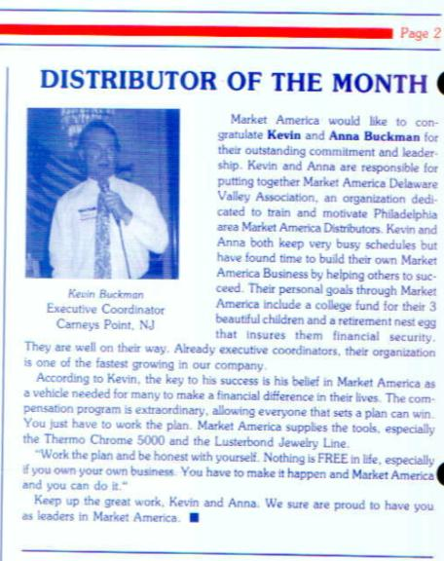
動力逐漸建立
新超連鎖店主
Momentum is Building
New Unfranchise Owners
1993年5月 May, 1993: Elizabeth Weber - 總顧問經理級 Supervising Coordinator Sam Pitts - 經理級
Executive Coordinator
1993年5月 May, 1993: Kevin Buckman –
本月最佳經銷商和晉升至經理級
Distributor of the month & Executive Coordinator

Slide 83
新系統準備就緒
New Systems in Place
自動購貨
四個步驟的行銷計劃
會議聯盟系統
授證訓練員課程
Transfer Buying
Four Step Marketing Plan
NMTSS
Certified Training Program

Slide 84
兩至三年計劃 The Two-to-Three Year Plan
The UnFranchise®
Business Development System
超連鎖事業發展系統
左邊銷售組織
右邊銷售組織
Left Sales
Organization
Right Sales
Organization
兩種賺取收入的方式
Two Ways to Earn Income:
1. 銷售產品
- 服務10-15位優惠顧客
- 享受30-100%零售利潤
- 每個商業發展中心*每星期可賺取
2. 善用時間
- 複製你的努力
- 建立及管理兩個銷售組織
1. Provide Products
2. Time Leveraging
Service 10-15 Preferred Customers
30 – 100% Gross Retail Profit
$2,300-$27,600 Earn $300 - $3,600 Per Week Per BDC*
Duplicate Your Efforts
Develop & Manage Only Two Sales Organizations
Notes:
Talking Points
Plan for you financial success with Market America’s UnFranchise® Business Development System
A perfected, standardized, and uniform system that combines many marketing systems to facilitate the duplication of independent business success
Combines the advantages of direct sales, franchising, home shopping, network marketing, discount buying, internet sales/e-commerce, one-to-one marketing, and mass customization
Like a franchise:
A proven business plan
- Systemization
- Standardization
- Uniformity
State-of-the-art management systems
Merchandising and marketing tools
Growing visibly
Own multiple business locations
Standardized training systems
Unlike a franchise:
No franchise fees
No monthly royalties
No territorial restrictions
Start part-time (8-15 hrs/wk)
Minimal start-up expense
Little to no risk

Slide 85
兩至三年計劃 The Two-to-Three Year Plan
The UnFranchise®
Business Development System
超連鎖事業發展系統
左邊銷售組織
右邊銷售組織
Left Sales
Organization
Right Sales
Organization
有史以來最出色的革命性的計劃
THE MOST INCREDIBLE & REVOLUTIONARY PROGRAM EVER CREATED
根據證實普通人都可做到的而設計
是現時最實際可行及最具盈利能力的計劃
需要的人和交易量不需太多，但可賺更多的錢！
Based on what average people statistically have been proven to do.
The most realistic and profitable plan in existence today.
Requires fewer people and less volume to make more money!

Slide 86
訓練與支援
TRAINING & SUPPORT
我們大家一起努力，助你成功
按照我們既定的成功藍圖行動
專業手冊和必要的訓練
通向成功的工具：文獻資料、影片、
圖冊和錄音
會議聯盟系統
We All Work Together To Help You SUCCEED
Follow Our Established
BLUEPRINT for SUCCESS
Career Manual & Required Training
Tools for Success:
Literature, Videos,
Flip Charts, and Audios
National Meeting, Training, and Seminar System

Slide 87
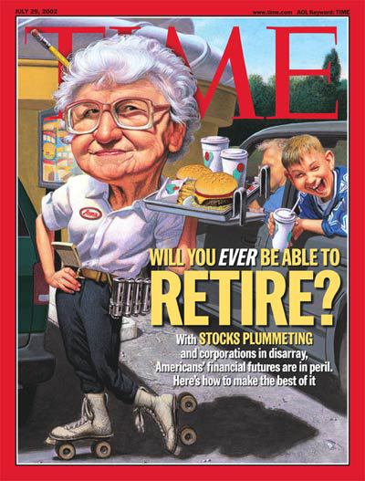
我們一直在說的......
We’ve been saying it…
主流媒體終於也報導... Mainstream media is finally reporting it…

Slide 90
永續收入就是答案
The answer is residual income

Slide 91
收入
需要持續 才有意義！
RESIDUAL INCOME Only Meaningful With Longevity!

Slide 92
一個利潤豐厚的
商機建基於
A Lucrative Business Opportunity built on
盈利
和
穩定性
A Lucrative Business
Opportunity built on
PROFITABILITY
and
STABILITY
PROFITABILITY
and
STABILITY
Notes:
10

Slide 93
Company is Strong
公司擁有雄厚實力
Company is Strong
Over 700 employees
Be the best in the world
Continue to expand
Accuracy rates
Quality assurance
Internet / Computerized Marketing
Expand Internationally
超過700位員工
追求成為世界上最好的公司
持續增長
準確度
品質控制
互聯網行銷
積極拓展國際市場
Over 700 employees
Be the best in the world
Continue to expand
Accuracy rates
Quality assurance
Internet / Computerized Marketing
Expand Internationally

Slide 94
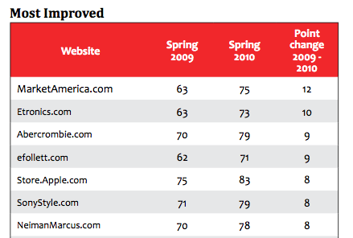
有關美安公司新聞報導 ma in the news
美安公司為網上零售網站進步最快排名第一！
Market America Ranked #1 Most Improved Online Retail Site!
美安公司於2012年首500間
互聯網零售商中排名第七十！
Market America Ranked #70 on Internet Retailer’s Top 500 Guide for 2012

Slide 95
有關美安公司新聞報導 ma in the news
「美安集團被消費者保護協會確認為信譽良好的公司」
“Market America recognized as an accredited company by the Better Business Bureau”
「截至2010年6月23日，美安集團所提供的現金回贈已高達35％」 “Market America ups cash back reward to 35% June 23, 2010”
兩個人的力量 The Power of Two

Slide 96
有關美安公司新聞報導
ma in the news

Slide 101
`

Slide 102
作為一家私營公司，我們的資訊仍然公開
As A Private Company Our Books
Are Still Open To You
年度報告
Annual Report

Slide 103
Continually Investing in Your Future
為你的未來
不斷作出投資

Slide 104
平方呎
平方呎
平方呎
建設規劃
概念圖
平方呎
平方呎
平方呎
倉庫/生產設施
平方呎
平方呎
平方呎
平方呎

Slide 111
我們一直聆聽你的需要
公司一直找尋新的方法
去簡化及統一
你每日營運的超連鎖事業
We are listening to you
The Company is always looking for new ways simplify, Streamline and Standardize the day- to- day operations of your UnFranchise Business.
Notes:
71
62
53
53

Slide 112
我們對你的
承諾與支持
Our Promise and Commitment to You
Notes:
71
62
53
53

Slide 113
承諾將事情做對
及每天做得更好!
A Commitment To Do Things Right and Get Better Every Day!
Notes:
71
62
53
53

Slide 114
我們不會妥協
只會為你提供最好的
WE WILL NOT SETTLE FOR ANYTHING LESS THAN THE BEST

