Slide 1


Slide 2
留意美安香港的最新動態
Follow Market Hong Kong
facebook.com/markethongkong

Slide 3
留意我的最新動態
Follow me
@andrewweissman
facebook.com/andrewjweissman

Slide 4

留意我的最新動態
Follow me
@andrewjweissman

Slide 5
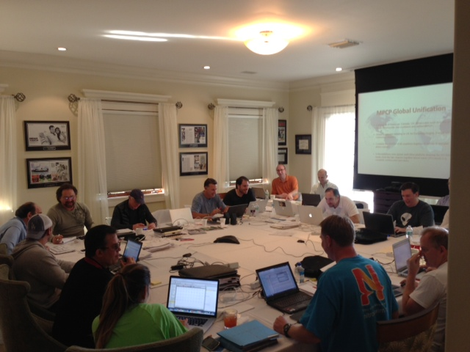

Slide 6
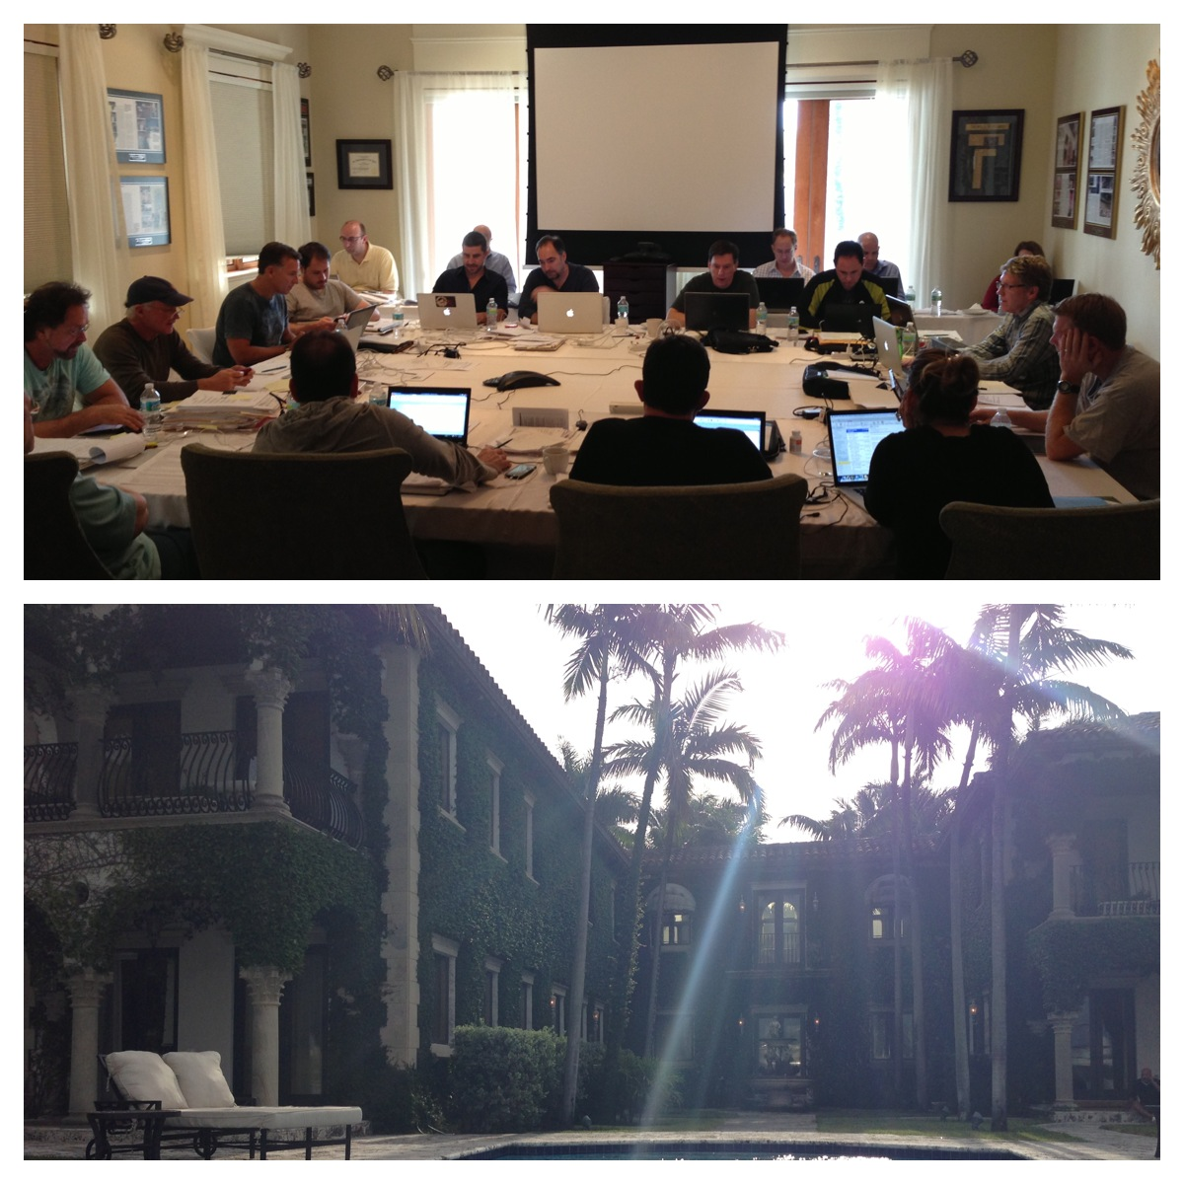

Slide 7
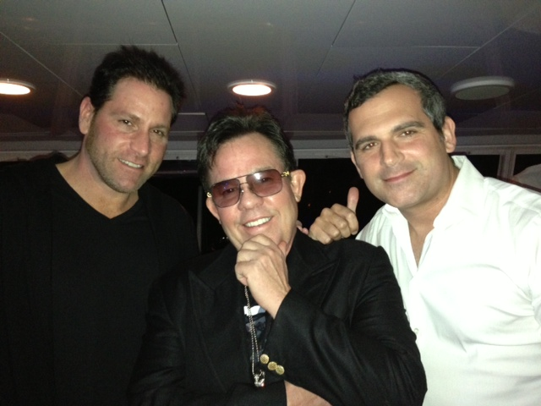

Slide 8
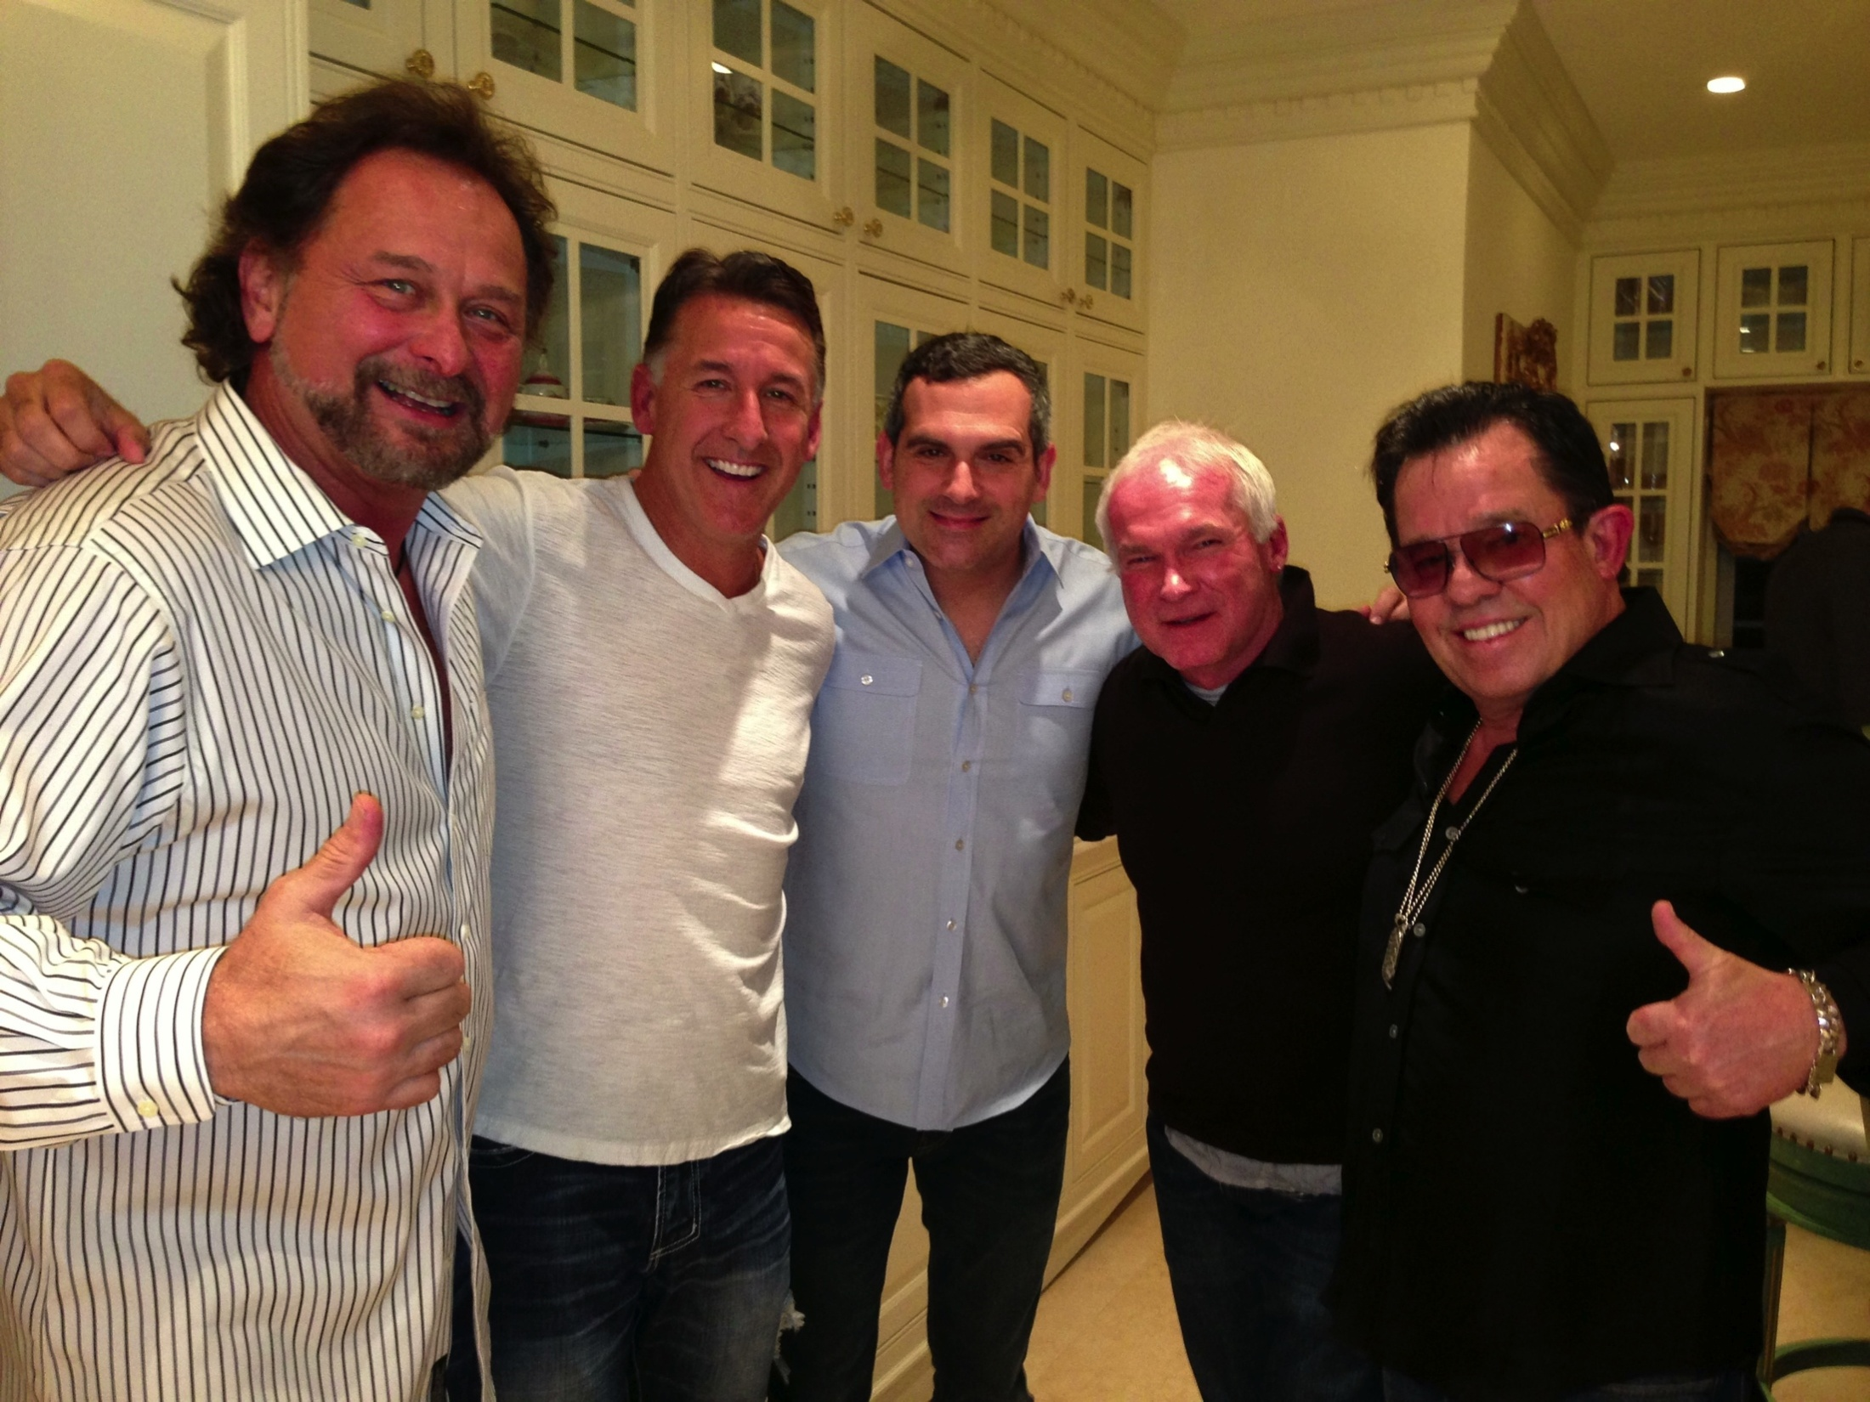

Slide 9


Slide 10
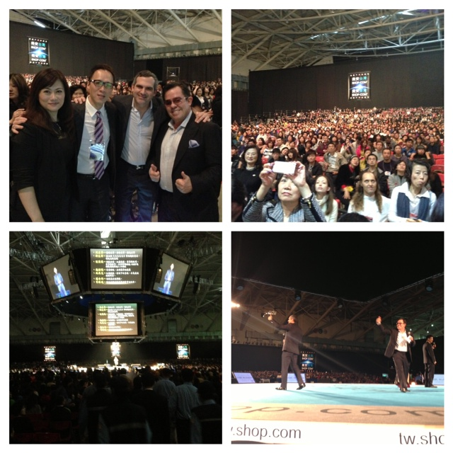

Slide 11


Slide 12



Slide 14
為甚麼？
Why?

Slide 15





Slide 16
目標：
並非向需要你的產品的人銷售，而是向相信你所信的人銷售。
The Goal:
Not to sell people who need what you have, but to sell people who believe what you believe.

Slide 17
別人不因你做的事相信你，而因你做事背後的原因相信你
People don’t buy what you do, they buy why you do it.

Slide 18

企業家
Entrepreneurs
具有不同規模、型態和個性 Come in every size, shape and
personality
看到別人看不到的 See things other people do not see
企業家的兩個需要： The only two needs of an
信念和知識 entrepreneurs are: belief
and know how

Slide 19
大部份人都困在盒子裡生活
Majority of People Live in a Box
吃以盒子盛載的早餐
駕駛盒子一樣的車子，回到盒子一樣的公司
坐在盒子一樣的電腦前
午餐又是盒子
駕駛盒子回家
坐在盒子一樣的電視機前
第二天起身又重複
Eat a box for breakfast
Drive in a box to get to a box
Where we sit in front of a box
Have a box for lunch
Drive home in our box
Where we sit down in front of another box
Then, we get up and do it again

Slide 20


Slide 21


Slide 22


Slide 23


Slide 24


Slide 25
美安香港只是將事情變得更廣、更佳、更快、更易，以改變人們購物的方式和經濟模式，讓所有人都可以創造自己的經濟，變得財務獨立。
Market Hong Kong is simply making things bigger, better, faster, and easier to change the way people shop and change the economic paradigm where anyone can become financially independent by creating our own economy.

Slide 26
成功五要訣
Basic 5

Slide 27
產生效益的活動
銷售產品
宣傳事業
賣票
Result Producing Activities
Sell the Products
Sell the Business
Sell Tickets

Slide 28
化繁為簡及提升
持續令招募、推薦及發展事業變得更簡單的
程序和計劃
Simplification
and
Improvement
Ongoing process and plan of making it easier to recruit and sponsor and grow the business.

Slide 29
化繁為簡的各項措施：
快速起步套裝（基本、Motives、TLS健康生活纖營計劃）
全新UBP簡報
全新超連鎖事業發展系統圖冊
自動年度續約
全新起步指南
全新簡化入會窗口
自動購貨產品預設
全新簡化起步窗口
在入會窗口購買主要會議門票
產品組合套裝
1000表格提交截止時間11:59pm
網上訓練（新經銷商訓練、
成功五要訣）
顧客免費送貸
Accomplishments to simplify the business:
Fast Start program (General, Motives and TLS)
New UBP PowerPoint presentation
New Flip Chart
Auto Annual Renewal
New Getting Started Guide
New, simplified Sign Up Wizard
Transfer buying autofill
New, simplified Getting Started Wizard
Major event ticket purchase within sign up wizard
Product kits
Form 1000 due at 11:59pm EST
Online training (NDT, B5)
Free shipping for customers

Slide 30
程序
分辨出無意建立事業的人，從而找出有意建立事業的人
Working thru the people who do not want to build the business to find the people who do
目標
建立兩個銷售及分銷組織，每個產生 > 5000 GBV 及 5000 GIBV
Build two sales and distribution organizations that generate > 5000 BV & 5000 IBV

Slide 31
建立事業核心
Core Business Building
Meet people & Cultivate Relationships
Develop Curiosity, Interest
Present the business, show the plan
認識朋友，建立關係
介紹事業，
展示計劃
引起興趣

Slide 32


  九年前Mark Zuckerberg找了五個人到他在哈佛的宿舍房間談生意。只有兩個人來。今天這兩人都成為了億萬富翁。
  他們是Dustin Moskovitz （65億美元身家）和Eduardo Saverin（34億美元身家）
  Mark Zuckerberg invited 5 people to his Harvard dorm room 9 years ago to discuss a business. 2 showed up and they got in. Today those two are billionaires. Dustin Moskovitz $6.5B & Eduardo Saverin $3.4B
Notes:
32

Slide 33











Notes:
33

Slide 34
建立事業核心
Core Business Building
多年前 Years Ago
現在 Today
我們利用記事本展示計劃
面對面會談是唯一方法
我們逐家逐戶去做
We showed the business on a yellow legal pad
The only option was to sit down face-to-face
We worked door to door and kitchen table to kitchen table
我們利用DVD、精美圖冊和簡報展示計劃
參加會議、網上約見
有了科技，任何地方都是你的辦公室
We show the business with DVD’s, full color flip charts, PowerPoint presentations
Gotomeeting, Online Appointments
With Technology your office is anywhere you are

Slide 35










Slide 36
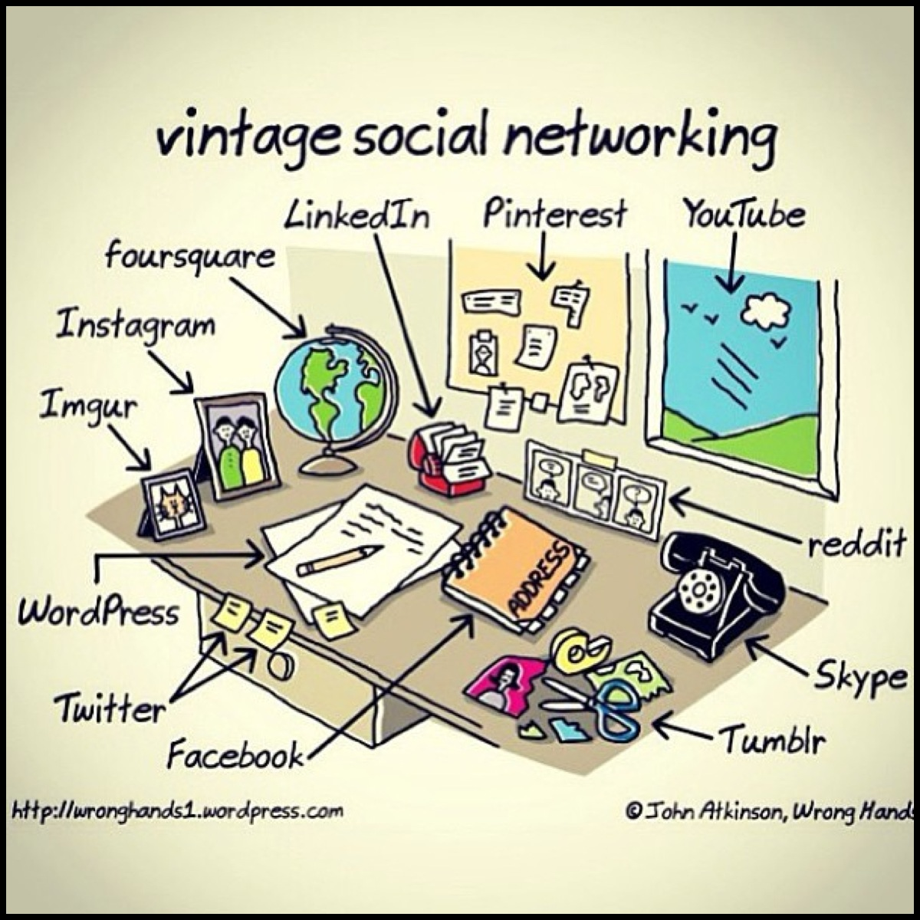
Notes:
36

Slide 37

你在聽嗎？ Are you Listening?
這可能會讓你失去潛在夥伴、BV、IBV和利潤…
這是個問題！
It could be costing you prospects, BV, IBV and profits…
that’s a problem!

Slide 38

建立關係
Cultivating Relationships
使用網路並不代表要你 忘記如何與人建立關係
建立關係的過程是相同的
Just because we’re talking about the Internet doesn’t mean you forget everything you’ve learned about building relationships
It’s fundamentally the exact same process

Slide 39

我又老、又肥、又醜，你可以讚下我嗎？
你的眼力很好

Slide 40


Slide 41
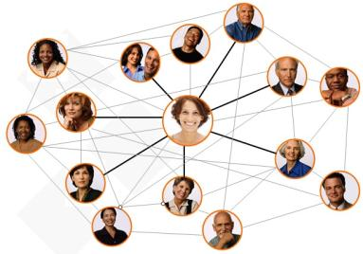

建立關係
Cultivating Relationships
於網上與人接觸就如現實生活，
只是網絡令所有人變成鄰居一樣：
重新聯絡舊朋友、同學、親人
與有共同興趣的人溝通，展開對話
Meeting people online works the same as real life, except, it’s as if everyone still lives right around the corner:
Reconnect with old friends, classmates, family
Meet people who share your interests and develop conversations

Slide 42
2-3年計劃有甚麼吸引人之處？
The attraction to the 2 to 3 Year Plan?
永續收入 Residual Income
長壽 Longevity
安穩 Stability & Security

Slide 43

如果你了解永續收入的概念，你會不惜一切嘗試得到它

Slide 44
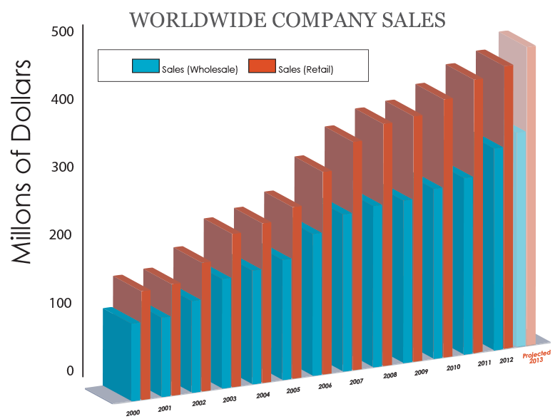
集團營業額
百萬美元
估計累積零售額：
Estimated accumulated retail sales†:
$4,981,921,792*
*As of December 31, 2012 (since the company’s inception)
†Estimated accumulated retail sales bases on suggested retail price
Notes:
44

Slide 45

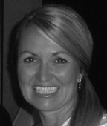









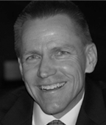
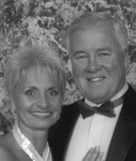

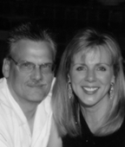
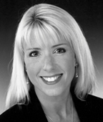



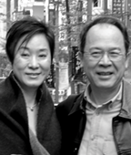


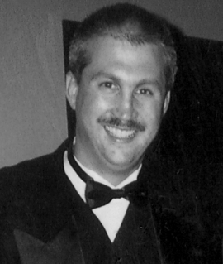
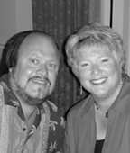

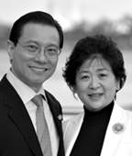









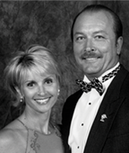
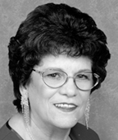
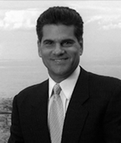
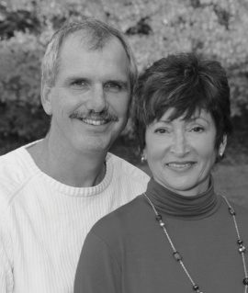





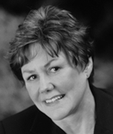
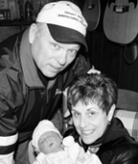
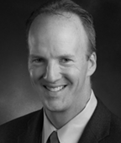


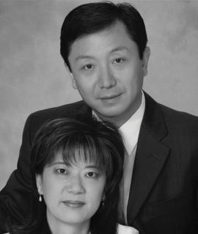



佣金收入超過百萬美元
Market Hong Kong™| SHOP.COM™正改變人們購物的方式，並改變經濟型態，打造我們自己的經濟，使其中每個人都能夠達到財務獨立。
估計總零售利潤†:
US$1,355,191,701
+
總佣金:
US$1,337,640,120
=
經銷商總收入:
$2,692,831,822 *
*截至2012年月31日止，估計零售利潤根據建議零售價計算

Slide 46
成功與失敗的差別…
The Difference Between Success and Failure…
成功的人只不過是做了那些失敗的人
未能做到或不想做的事情
The individual who succeeds simply does what the individual who failed did not do
or was not willing to do.
Notes:
46
46
46

Slide 47

有能力的話，跑
需要的話，行
沒有選擇的話，爬
總之不要放棄
- 馬拉松選手Dean Karnazes

Slide 48
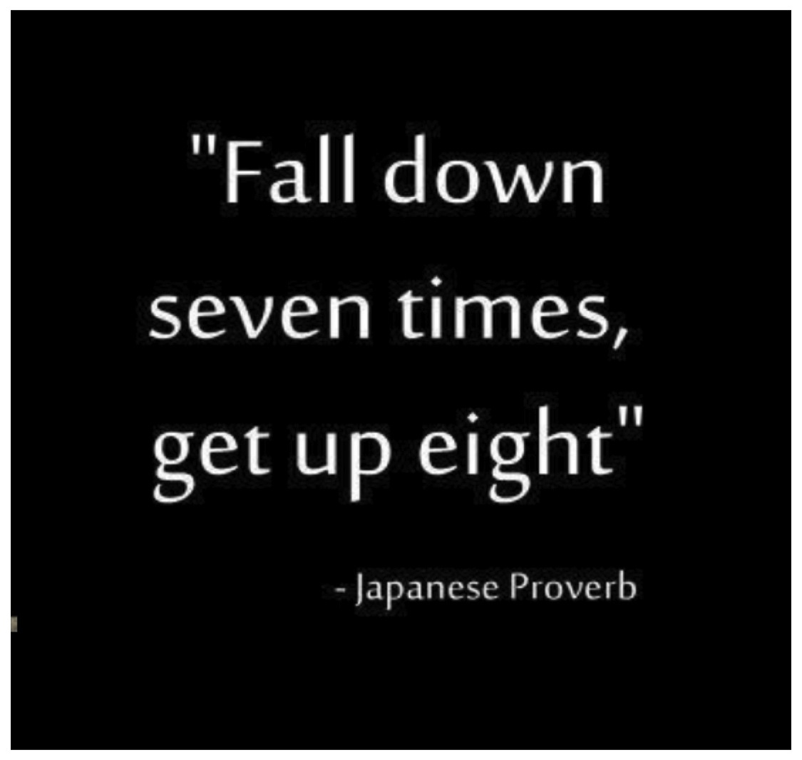
跌倒七次
第八次便爬起來
- 日本諺語

Slide 49
習慣
我們90%的行為都是習慣！ABIT
90% of our
behavior is habitual!

Slide 50

重複做的事讓我們變成今天的自己，因此做到最好不是行為，而是習慣
哲學家亞里士多德

Slide 51
Napolean Hill
「每個人都可希望變得富有，而大部份人都希望；但只有少數人了解擁有明確的計劃，加上對財富的熱切渴望，才是累積財富的唯一可靠途徑」
– 美國作家Napoleon Hill
“Anybody can wish for riches, and most do, but only a few know that a Definite Plan, plus a Burning Desire for wealth, are the only dependable means of accumulating wealth.”
– Napoleo人n Hill
Notes:
51

Slide 52
重點在於「行動」
很多人知道人生要做甚麼事，但很少人實際做他們知道要做的事情
單單知道是不夠的，你 需要行動
做你知道要做的事
In life lots of people know what to do, but very few actually do what they know
Knowing is not enough, you have to take action
Do what you know

Slide 53

思考
意念
成功
嘗試
一直行動
行動
再行動
再行動

Slide 54
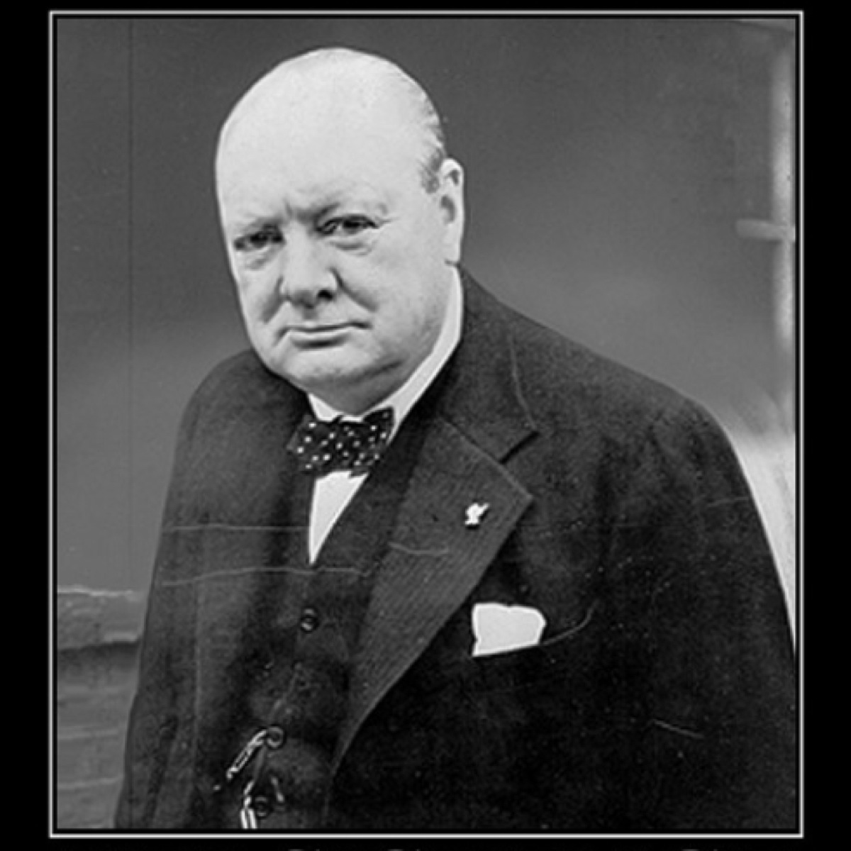


你的現況和你想成為的狀況之間的距離，在於你的行動
而你要為達到目標而做的事未必容易

Slide 55
你要做甚麼？
消除阻礙你前進的障礙
－「我做不到」
成功五要訣
產生效益的活動
－銷售產品
－銷售事業
－賣票
Remove the things that may impede progress through the process
- “I can’t”
The Basic 5
Result Producing Activities
- Use and sell the products
- Introduce the business
- Sell tickets

Slide 56

你腦海中有聲音告訴你無法做到，那並不是真的

Slide 57

別再說
明天做
但是…
我做不到
太難了
我太累了
容易些才做
放棄了
我不夠錢
我不夠好
如果我…，我會做
不要再找藉口

Slide 58


Slide 59

昨天你說明天
  拖延是機會的天敵。
  Procrastination is opportunities natural assassin.

Slide 60

  「你可以拖延，但是時間不會等你」 – Benjamin Franklin
  “You may delay, but time will not.” – Benjamin Franklin

Slide 61

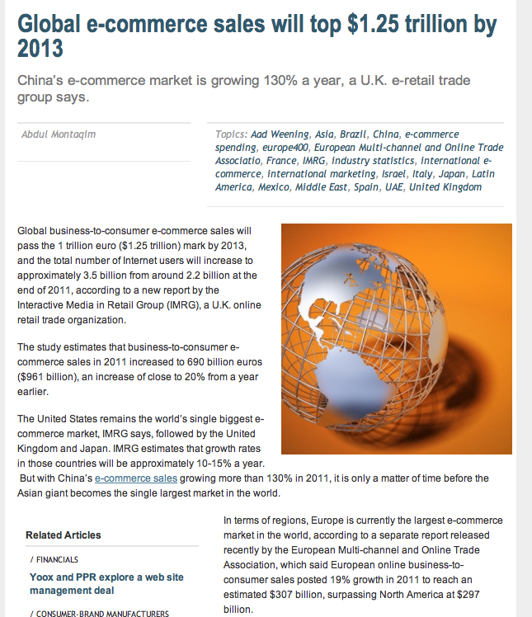
2013年全球電子商務銷售額將達1.25萬億
根據最近歐洲多渠道與網上貿易協會的報告，按地區計，歐洲現時為全球最大電子商務市場，其網上企業對顧客的銷售額於2011年增長19%，估計達3,070億，超越北美的2,970億元

Slide 62
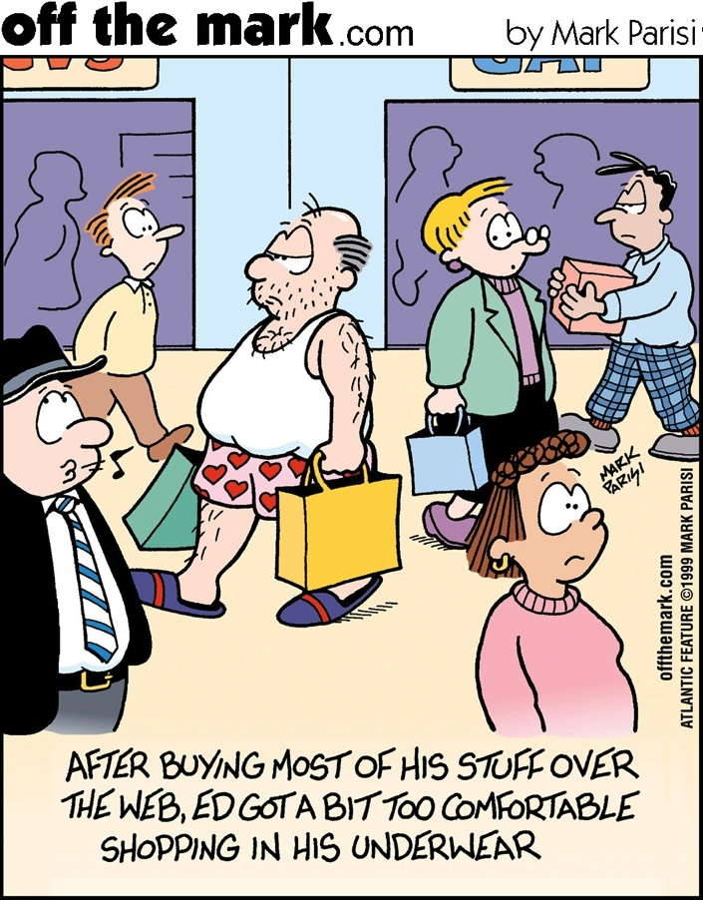
Ed太習慣在網上購物，就算外出購物，亦像在家一樣穿著內衣

Slide 63
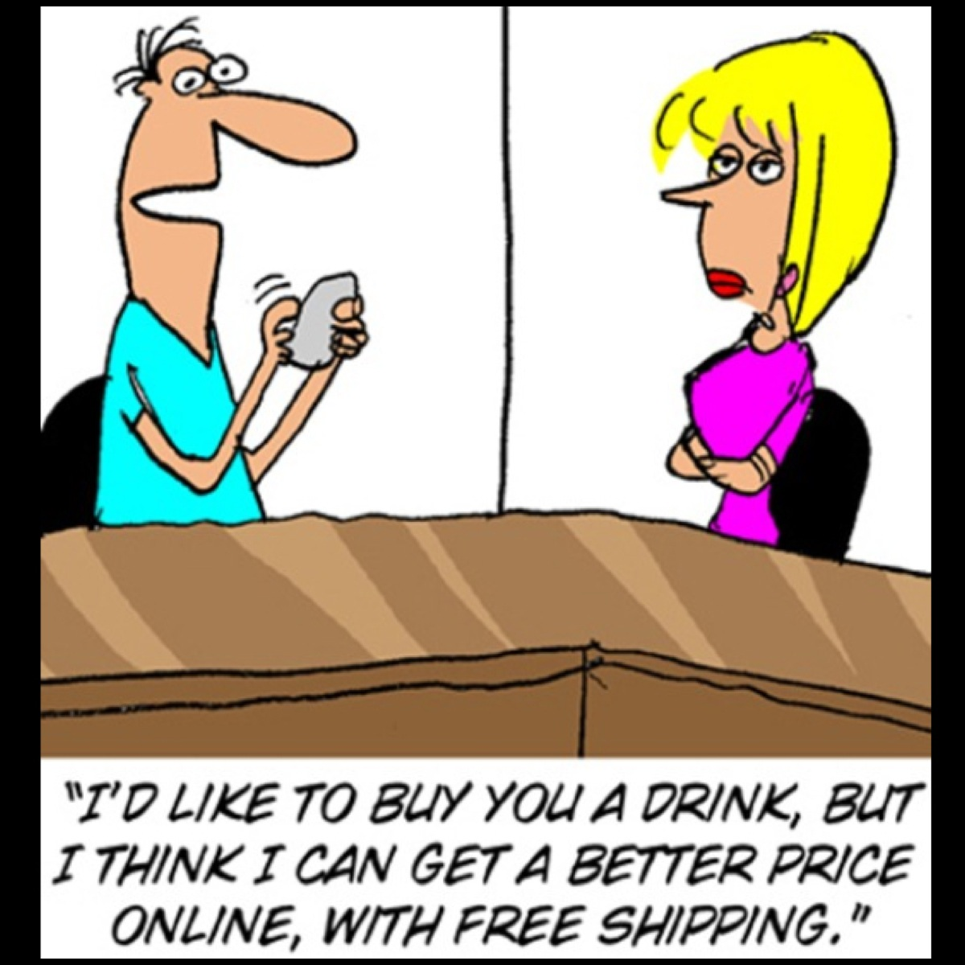
我想請你喝東西，但在網上購買大概更便宜，還免費送貨呢！

Slide 64
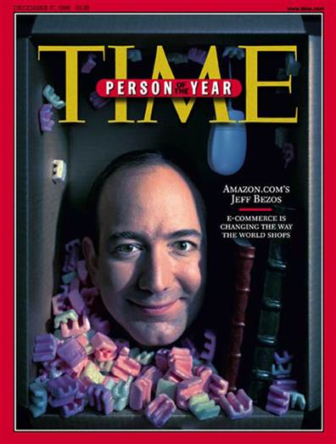
購物網站Aamzon創辦人Jeff Bezos 1999年獲選美國時代雜誌年度人物

Slide 66
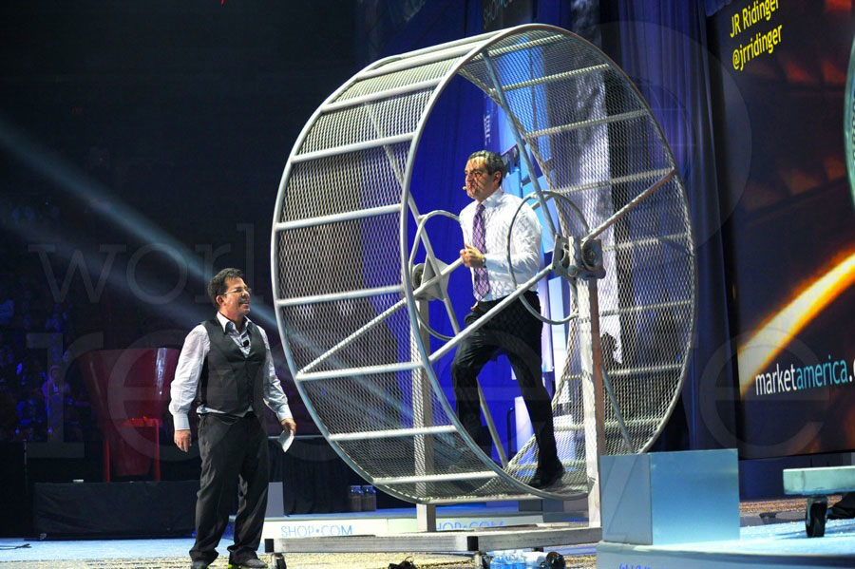

Slide 67
在2-3年中要達到每星期HK$16,100的步驟
Goal Staircase to $2100/week in 2-3 Years
每週目標
Weekly Goal
和5-15人談話 Talked to 5-15 People
約五次會面Booked 5 Appointments
可能名單中加入10人 Added 10 Possibilities
每天的步驟
Daily Steps
5
4
3
每日目標 EVERY DAY STEPS
和1-3人談話 Talk to 1-3 People
約一次會面Book 1 Appointment
在可能名單中加入2人 Add 2 Possibilities
朗讀目標宣言 Read Goal Statement
聽錄音檔案 Listen to Audio
2
1
Notes:
67
67

Slide 68

  「如果你夢想打敗我，你最好醒來並且向我道歉」
  “If you even dream of beating me, you’d better wake up and apologize.”

Slide 69


增加機會的方法
Sources to Feed Possibilities
Possibilities 機會
Cultivate 培育關係
Top Ten List 前十人選
Approach 接觸
Show Plan展示計劃
Sponsor 推薦
Commit 承諾
3呎規則 3 Foot Rule
工作Work
參加新活動Join New:
健身Gymnasium
教會Church
課程College Course
公益Charity
俱樂部Club
認識的人Acquaintances
親戚Relatives
夥伴Associates
工作Work
俱樂部Clubs
教會Church
學校School
顧客Customers
可能名單Names List 300
試用產品Try Products
轉介Referrals
多層次傳銷人脈
MLM Contacts
廣告Ads
社交媒體Social Networking
你只需要2至4個人！
這只是數字遊戲，數字越多，機會越多
YOU ONLY NEED 2 to 4!
It’s Strictly a Numbers Game. The Law of Probability Works in Your Favor when dealing with Large numbers
4
1
3
2

Slide 70
ABC法則由
學習實踐試做開始
The ABC Pattern Begins with Learning to Implement a Trial Run.
Notes:
YOU GET PEOPLE TO LEAD YOU TO THE RIGHT PEOPLE THROUGH TRIAL RUNS>>>>TEST MARKETING
USING EVALUATION APPROACH
SHOW THE PROGRAM
DETERMINE IF THEIR CONTACTS KNOW THE RIGHT PEOPLE
TEST MARKET THE PRODUCT

Slide 71
動力源於人才
Powered by People
兩項產品：
1. 具體的 – 美安香港品牌
2. 無形的 – 超連鎖事業
展示計劃!
Two Products:
1. Tangible - mhk Brands
2. Intangible – UnFranchise Business
Show the plan!

Slide 72
ABC法則的目的在於：
使潛在夥伴介紹更多潛在夥伴，
同時展示建立事業與複製的最好方法
The Objective of the ABC Pattern is to get our Prospects to lead to other Prospects while demonstrating the best practices to build the Business and Duplication.
Notes:
YOU GET PEOPLE TO LEAD YOU TO THE RIGHT PEOPLE THROUGH TRIAL RUNS>>>>TEST MARKETING
USING EVALUATION APPROACH
SHOW THE PROGRAM
DETERMINE IF THEIR CONTACTS KNOW THE RIGHT PEOPLE
TEST MARKET THE PRODUCT

Slide 73
Trial Run
Definition
試做的定義
「用以評估某人是否適合經營事業和評估事業是否適合那個人的過程。透過這個過程，那些人會帶來更多潛在夥伴和顧客，或於最後過程淘汰他們自己。」
-JR Ridinger
“The process used to see if someone is right for the business and if the business is right for them. Through which they will lead to potential prospects and customers or in the final process disqualify themselves.”
-JR Ridinger

Slide 74
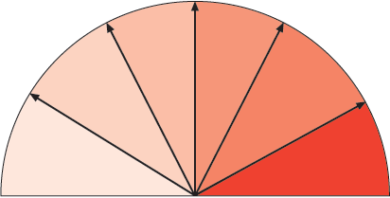
潛在夥伴選擇2-3年計劃，而不是45年計劃
Prospect chooses 2-3 year plan over 45 year plan
沒有決定/試做
No Decisions/Trial Run
和他們一起與人會面
Go with them to see people
提供更多資訊Provide more information
餐桌聚會
Meeting around kitchen table
介紹人選
Gives Referrals
開始ABC法則
ABC Pattern
Begins
家庭事業說明會
HBP
調整強度，讓潛在夥伴感到自在
Adjust to the Prospects comfort level

Slide 75
會議／科技種類
Types of Meetings / Technology
一對一
二對一
網上簡報
觀看超連鎖事業簡報會(UBP)影片及回答問題
廚桌
家中會議
UBP
網上研討會／Skype
遙距簡報
One-on-One
Two-on-One
Online Presentation
Watch UBP Video & Answer Questions
Kitchen Table
Home meeting
UBP
Webinar / Skype
Dual Screen Presentation remotely

Slide 76
推薦人 SPONSOR
你YOU
A
A
B
B
C
C
會後會：
1.約見跟進
2.提供更多資料
3.使用產品
（家居購物清單）
4.帶領出席UBP
5.銷售門票
6.消費即賺
Meeting after
the Meeting:
1.Book Follow-up
2.Provide more info
3.Use Products
(Home Shopping List)
4.Bring to UBP
5. Sell Ticket
6. Paid to Shop
A1
A1
B1
B1
C1
C1

Slide 77


Slide 78
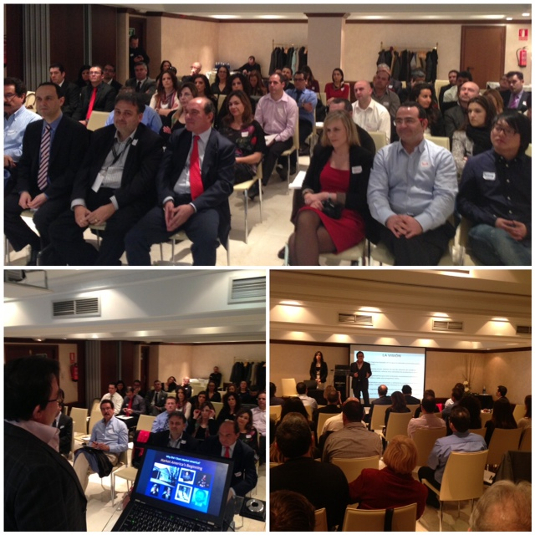

Slide 79
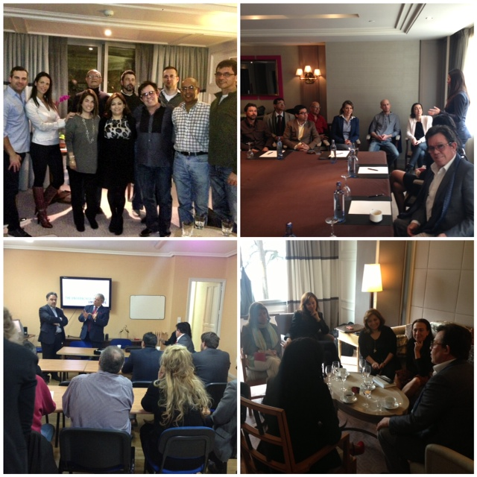

Slide 80


Slide 81
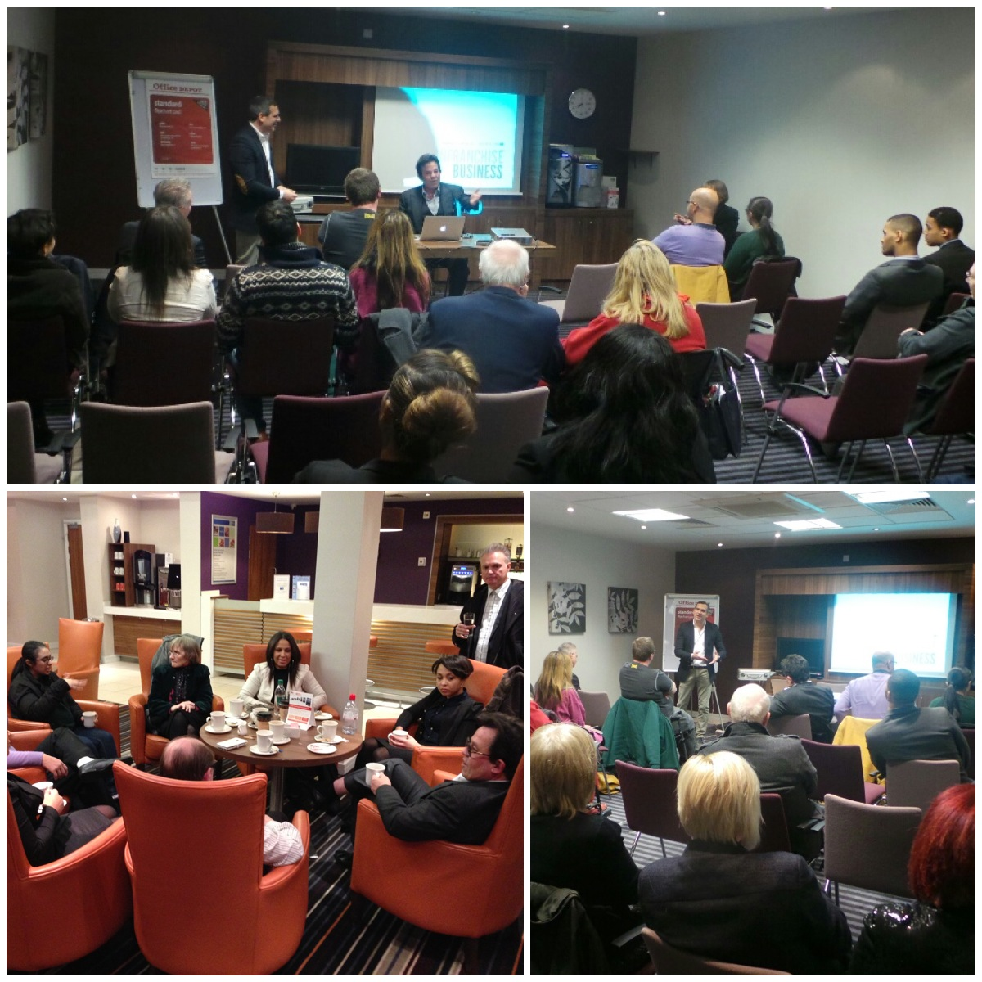

Slide 82


Slide 83
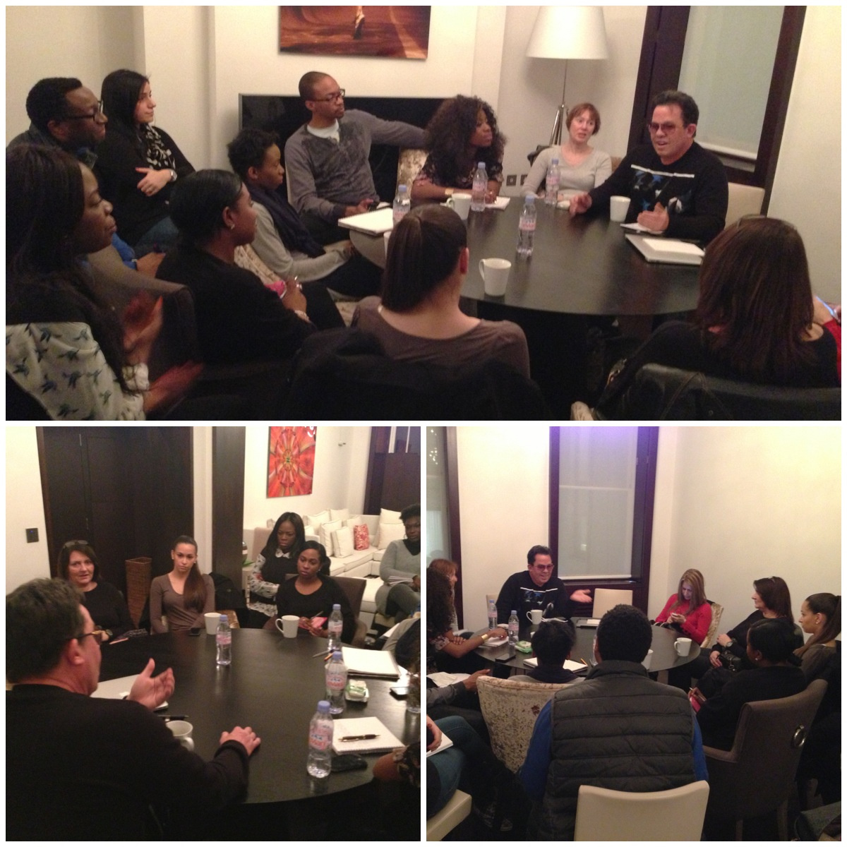

Slide 84


Slide 85
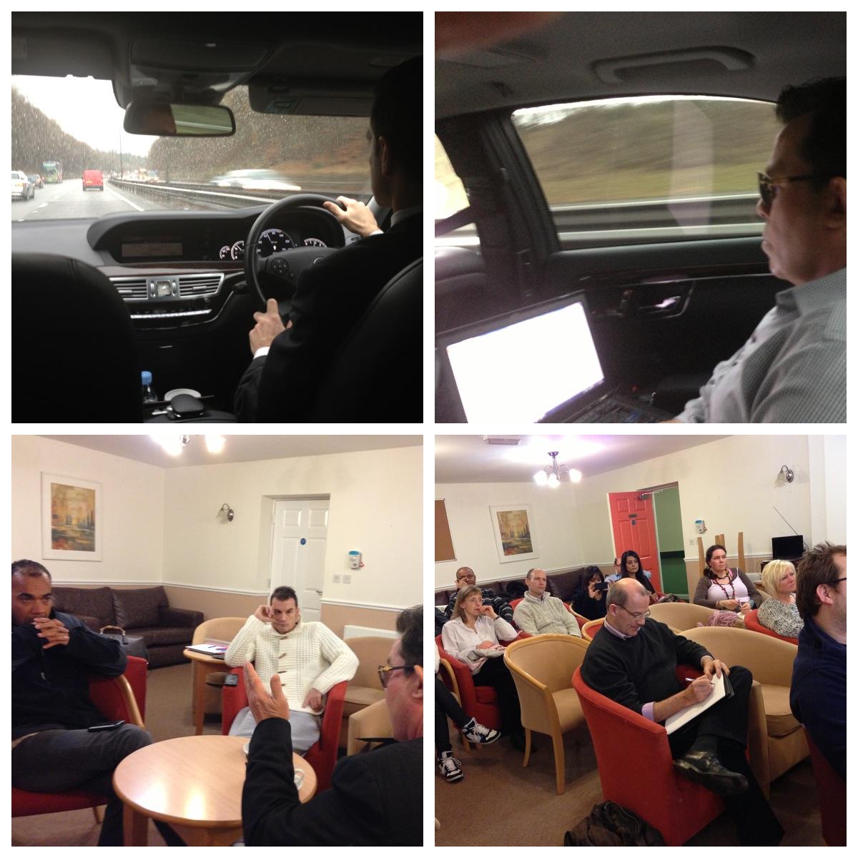

Slide 86
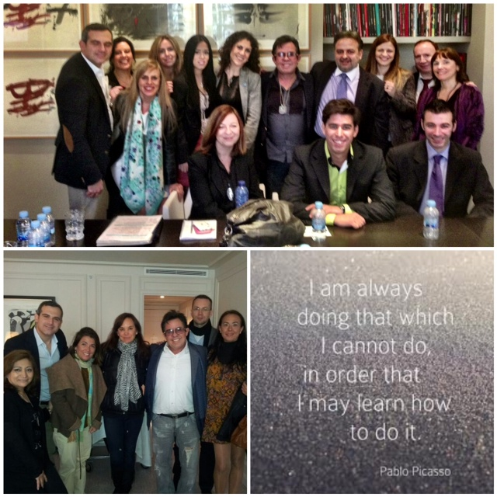

Slide 87
零售目標 - 基本十顧客，七人強
零售 – 首12週每週2位顧客（10位重複購物的優惠顧客）
每邊組織招募4位「Go Now」夥伴
發展領導能力 – 以身作則，指引和協助「Go Now」夥伴成長
管理 – 培養可靠和會複製的「Go Now」夥伴（起步指南）
Retail – 2 customers per week for the first 12 weeks (10 repeat preferred customers)
Recruit – 4 ‘Go Nows’ per leg
Leadership development – lead by example, direct and empower ‘Go Nows’ to grow
Manage – hold your ‘Go Now’ Distributors accountable and duplicate (Getting Started Guide)

Slide 88

零售目標
每月最少300 BV及20 IBV
300 BV and 20 IBV Monthly Minimum
你
C -
C -
C -
C -
C -
- C
- C
- C
- C
- C
  C = 30 BV & 20 IBV
  300 BV及200 IBV由每月最少10位優惠顧客購買30 BV及20 IBV產生
  300 BV and 200 IBV to a base of at least 10 Preferred Customers ordering 30 BV and 20 IBV per month.

Slide 89
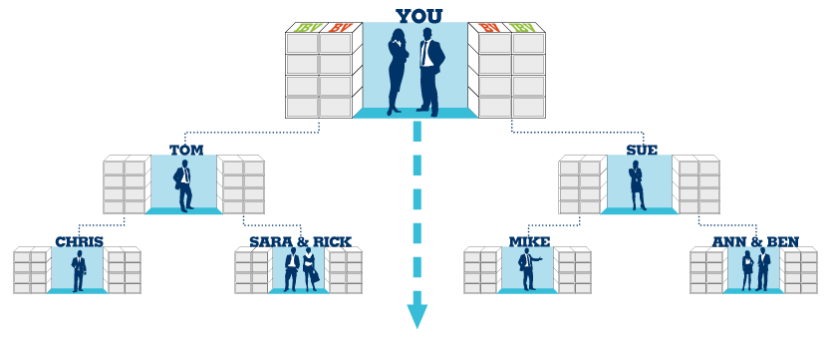
零售目標 - 基本十顧客，七人強
三至六個月後，每月至少賺取港元$2,300(BV)及每兩個月賺取
港元$2,300(IBV)
After Three-Six Months, Earn > HK$2,300/Monthly (BV) and Earn $2,300 every 2nd month (IBV)
你
C -
C -
C -
C -
C -
- C
- C
- C
- C
- C
1200 BV & 600 IBV
1200 BV & 600 IBV
400 BV & 200 IBV
C -
C -
C -
C -
C -
- C
- C
- C
- C
- C
C -
C -
C -
C -
C -
- C
- C
- C
- C
- C
400 BV & 200 IBV
400 BV & 200 IBV
C -
C -
C -
C -
C -
- C
- C
- C
- C
- C
C -
C -
C -
C -
C -
- C
- C
- C
- C
- C
C -
C -
C -
C -
C -
- C
- C
- C
- C
- C
C -
C -
C -
C -
C -
- C
- C
- C
- C
- C
400 BV & 200 IBV
400 BV & 200 IBV
400 BV & 200 IBV
400 BV & 200 IBV

Slide 90

Copyright © 2012美安公司

Slide 91


Slide 92

在年滿65歲的每100個人中…
4%財務穩健
1%富有
5%仍在工作
62%貧窮/身無分文
28%已逝世

Slide 93

與連鎖事業相同之處：
• 系統化、標準化、一致化
• 最先進的管理系統
• 商品陳列與行銷工具
• 標準化的訓練系統
• 潛在的稅務優勢
• 日益增高的知名度
與連鎖事業不同之處：
• 無需繳付連鎖權利金
• 無需繳付月費
• 沒有地域限制
• 可兼職創業，時間彈性
• 創業成本低
• 低風險

Slide 94
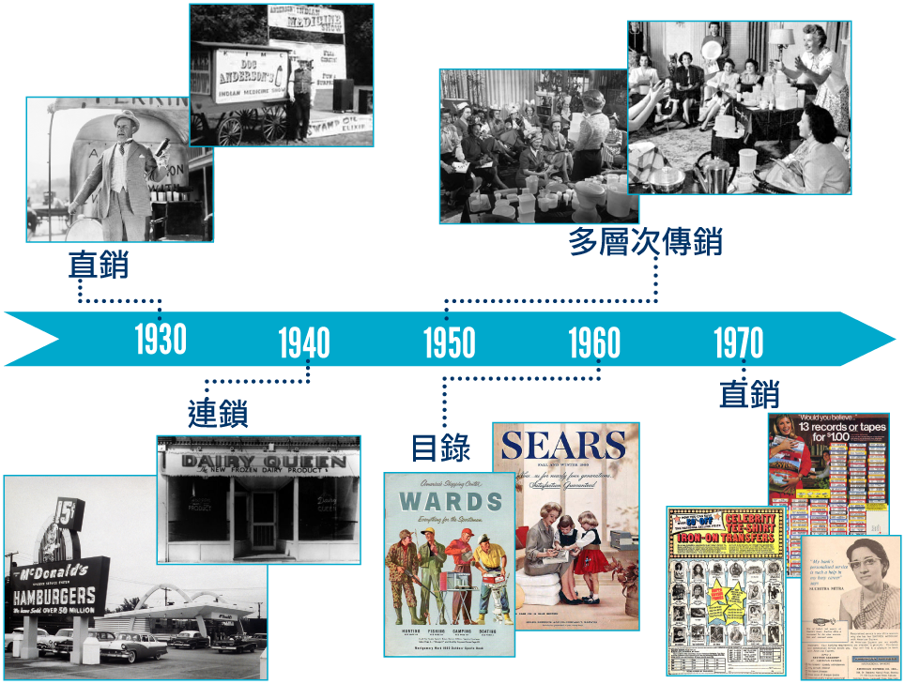
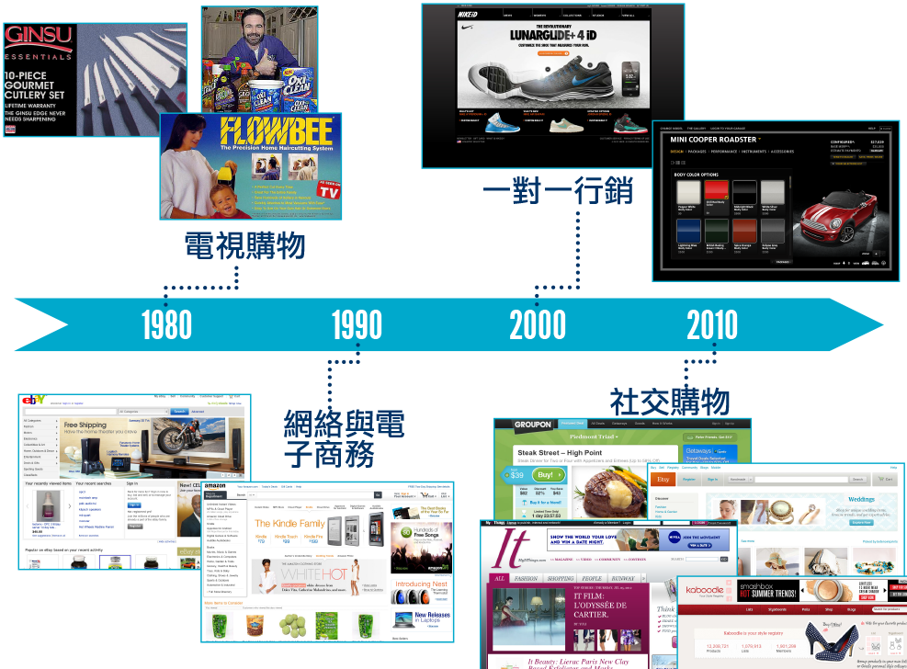

Slide 95




營養與健康
打造你自己的事業
社交購物
網絡／流動購物
提供社交媒體與網絡購物的力量
結合高科技與緊密接觸
提供觸及數百萬顧客的能力
幫顧客找到合適的產品，並幫產品找到合適的顧客

Slide 96


Slide 97

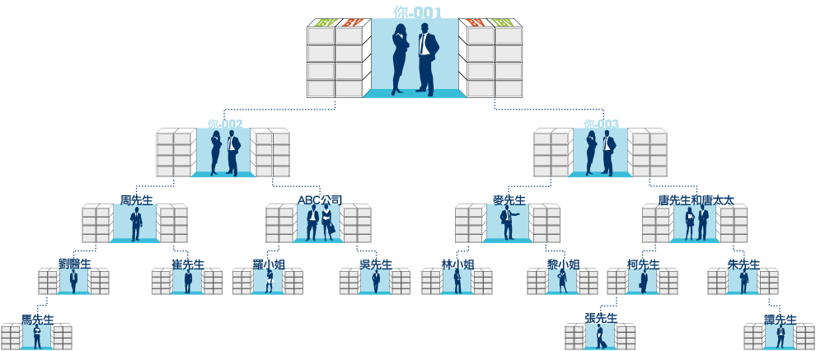

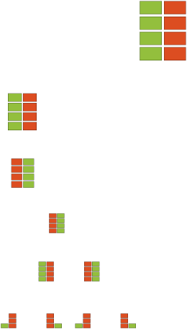










開設更多商業發展中心以增加你的佣金
200 BV
200 BV

Slide 98
新的超連鎖事業簡報會影片
New UBP Video

Slide 99
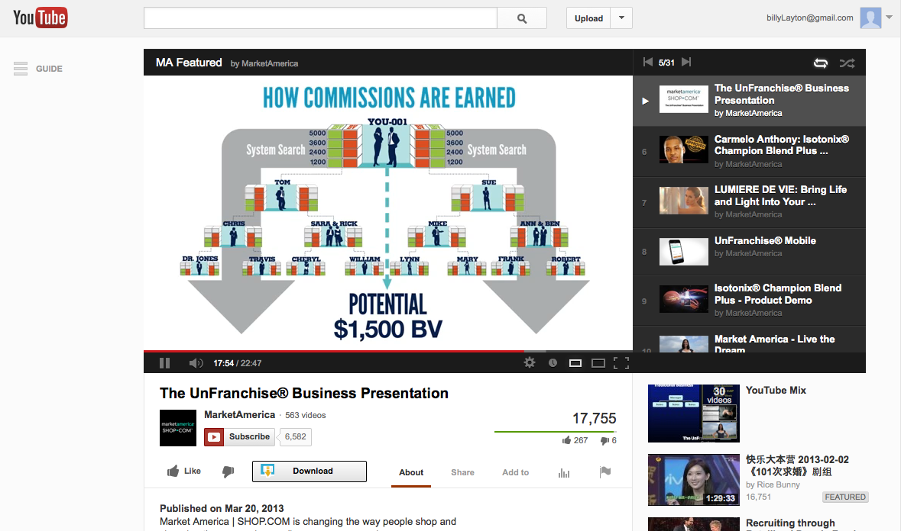
超連鎖事業簡報會

Slide 100
化繁為簡及提升
持續令招募、推薦及發展事業變得更簡單的
程序和計劃
Simplification
and
Improvement
Ongoing process and plan of making it easier to recruit and sponsor and grow the business.

Slide 101
快速起步計劃
The Fast Start Program

Slide 102
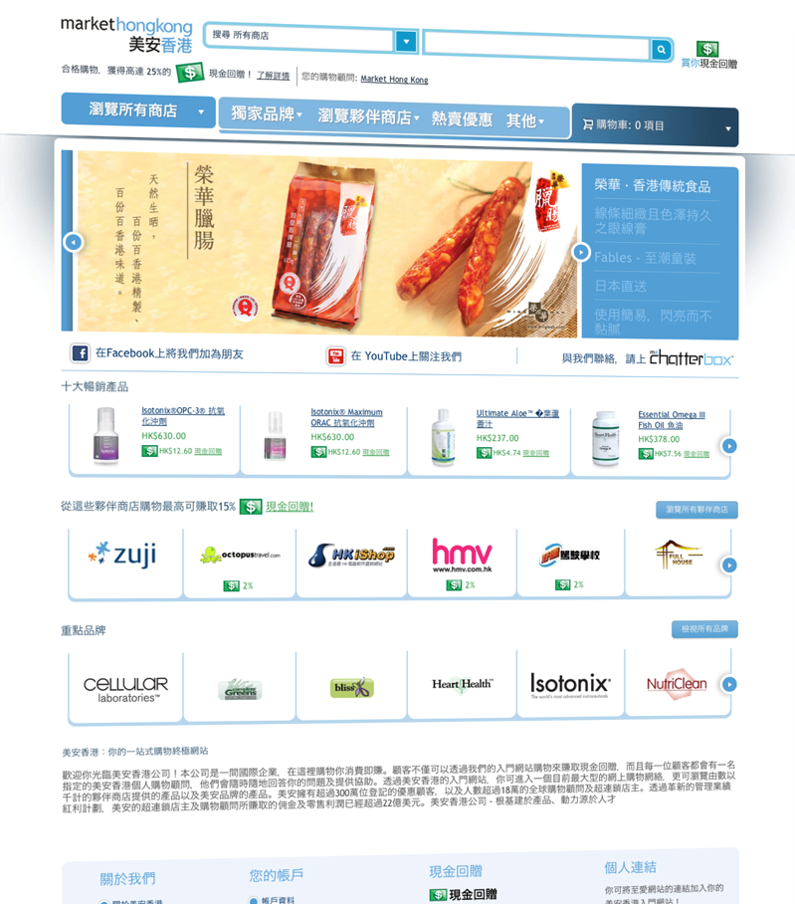

















超過
HK$5,000的價值
另有
Also available

Slide 103



快速
起步套裝
只需HK$3,237
即可開展事業
超過
HK$4,500
的價值
免運費

Slide 104
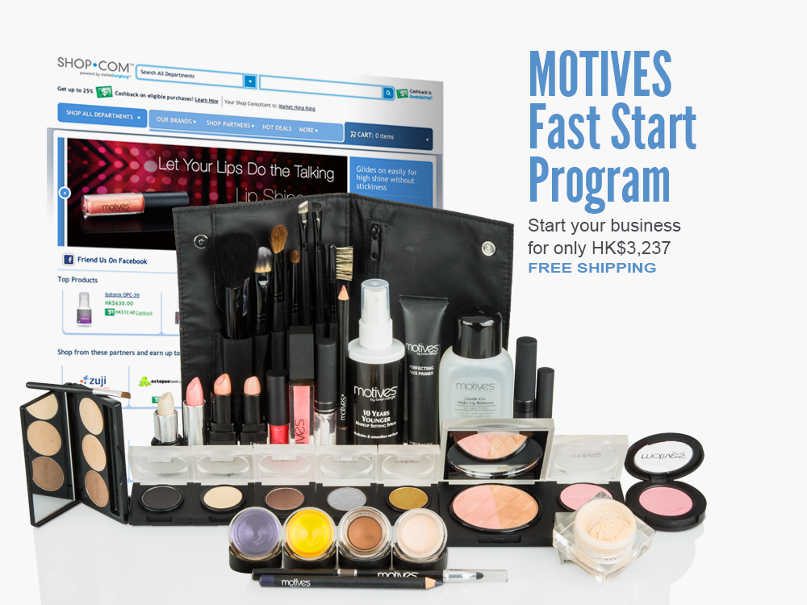


快速
起步套裝
只需HK$3,237
即可開展事業
超過
HK$5,500
的價值
免運費

Slide 105
化繁為簡及提升
持續令招募、推薦及發展事業變得更簡單的
程序和計劃
Simplification
and
Improvement
Ongoing process and plan of making it easier to recruit and sponsor and grow the business.

Slide 106

放假
Relaxing

Slide 107

工作
Working ☺

Slide 108
化繁為簡及提升
持續令招募、推薦及發展事業變得更簡單的
程序和計劃
Simplification
and
Improvement
Ongoing process and plan of making it easier to recruit and sponsor and grow the business.

Slide 109
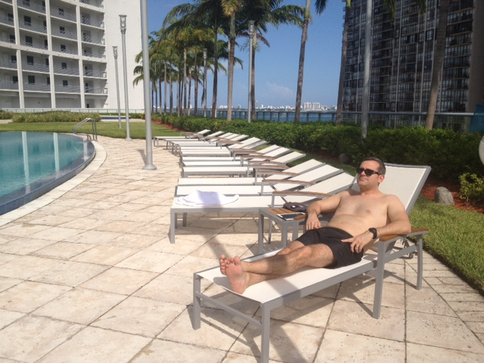
放假
Relaxing

Slide 110
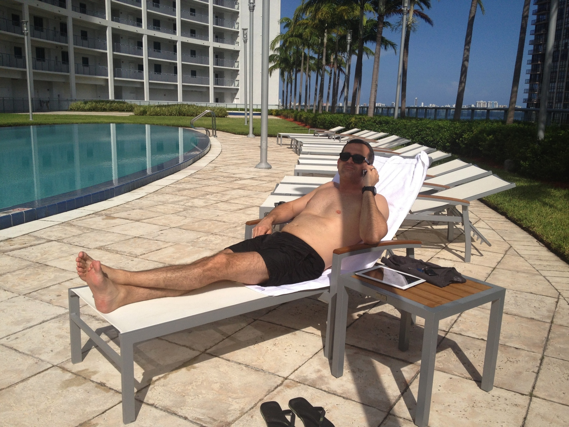
工作
Working ☺

Slide 111
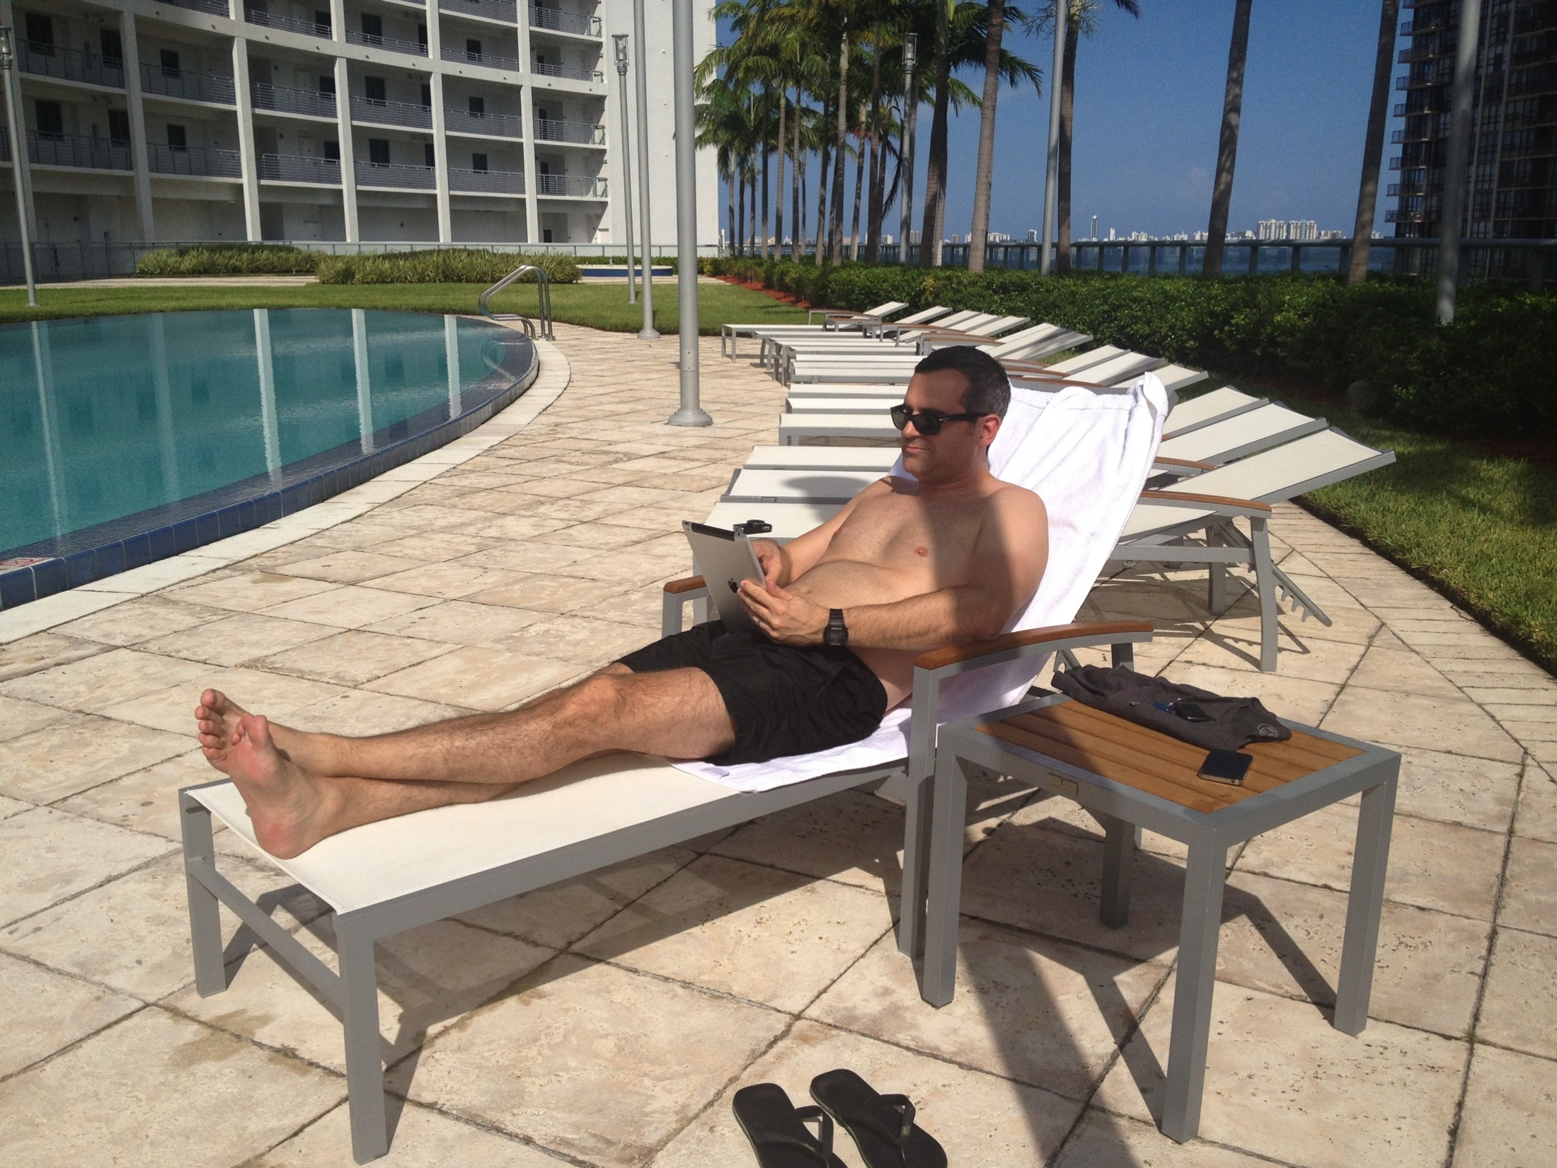
又有優惠顧客設定自動送貨
Another PC on autoship ☺
Simplify

Slide 112
放假
Relaxing

Slide 113
不僅如此…
That’s not all…
我們還可以進一步簡化登記程序
There is still more we can do to simplify the registration process

Slide 114

立即加入
邀請工具
立即加入
等候室
建立事業策略
Partner Now Process
Invite Tool
Partner Now
Waiting Room
Business Building Strategies

Slide 115
立即加入概覽
Overview of Partner Now
及背後的理念
and the “Why” behind it.
避免潛在夥伴披露私隱資料，如社會保障碼(美國)、駕駛執照號碼、地址和聯絡資料等
Eliminate the need to have a prospect share sensitive information like SSN and driver’s license number along with their address and contact details
資料保密
Keep Private Information private
由於網絡不受地域限制，遙距工作越見重要。我們需要一種無需Gotomeeting或分享螢幕功能等第三方科技的更好方法。
Working at a distance is more and more important as the Internet removes geographical limitations. There needed to be a better way without requiring a third-party technology like Gotomeeting or screen sharing
簡化遙距工作程序
Simplify Working at a Distance.
當有些人出席在家進行的事業簡介後準備起步，讓每個人都成功起步是很難的。立即加入有助簡化和加快過程、消除很多以前容易遇到的問題
When a number of individuals are all ready to get started after a Home Business Presentation, for instance, getting everyone started can be challenging. Partner Now helps to streamline and accelerate the process, eliminating many of the pitfalls and issues that existed before
簡化與大夥團隊工作過程
Streamline Working with Large Groups

Slide 116

邀請工具 Invite Tool
立即加入的第一步 –
向潛在夥伴發送邀請
輸入潛在夥伴姓名和電郵地址
自訂訊息(變更會自動出現於右方)
點擊發送郵件
This is the first step in the Partner Now process – Sending the invite to the prospect
Enter the prospect’s name and e-mail address
Customize the message (the changes will automatically display on the right)
Click Send Email

Slide 117

邀請工具 Invite Tool
立即加入的第一步 –
向潛在夥伴發送邀請
輸入潛在夥伴姓名和電郵地址
自訂訊息(變更會自動出現於右方)
點擊發送郵件
This is the first step in the Partner Now process – Sending the invite to the prospect
Enter the prospect’s name and e-mail address
Customize the message (the changes will automatically display on the right)
Click Send Email

Slide 118

立即加入程序 Partner Now Process
模擬潛在夥伴會完成的立即加入程序
收到電郵邀請，點擊連結
看到的第一頁是這樣的
可選擇本國，然後去到下一步
Let’s step through the Partner Now Process that your prospect will complete
They recieve the email invite and click the link
The first page they see will be this one
The prospect selects their home country and it takes them to the next step

Slide 119


立即加入 Partner Now
潛在夥伴填寫資料，就像一般的申請。
如他們有配偶，可於「經銷商會籍額外姓名」一欄輸入
請記著，首次訂單會送至這裡輸入的送貨地址
請留意，他們不可於此選擇成為零售商或HP或HP1
完成後按提交經銷商申請，進入下一步
The prospect fills in their information similar to a normal Application
If they have a spouse or partner that information can be entered in the “Additional Name on Distributorship” section
Remember that the initial order will be sent to the Shipping address being entered here
Also notice that they do not get the option to get started as a Sales Rep or an HP or HP1 through this interface.
When they are finished they click Submit Distributor Application to continue with the next step

Slide 120

立即加入 Partner Now
他們同意超連鎖事業管理帳戶(UFMS)訂購同意書，然後按「訂購超連鎖事業管理帳戶會籍」
They agree to the UFMS Purchase agreement and click “Purchase UFMS Membership”

Slide 121

立即加入 Partner Now
他們於首次訂單選擇想訂購的快速起步套裝
請注意，潛在夥伴必須訂購快速起步套裝作為首次計單。這一步不可跳過，因為它是立即加入內的必要步驟，以確保真的有一位新夥伴根據此步驟加入
They select the Fast Start Kit they would like to purchase on their initial order.
Note that the prospect must purchase a Fast Start Kit as their initial order. It cannot be skipped and an order is mandatory through the Partner Now process to insure that real people are signing up through this process.

Slide 122

立即加入 Partner Now
按「加入/管理信用卡」輸入信用卡以完成訂購，支付費用
就此項訂購輸入的信用卡亦會設定為自動購貨使用的信用卡，這可於自動購貨版面更改
請留意，他們的送貨和郵寄地址會被列出，但地址可以更改
They complete the order by entering a credit card using the “Add/Manage Credit Cards” button to pay for the order.
The credit card that they enter for this order is also set as the default credit card used for their Transfer Buying order, but it can be changed in the Transfer Buying Screen
Note that their shipping and billing address are listed but cannot be changed

Slide 123

立即加入 Partner Now
自動購貨已根據所選的快速起步套裝而預設產品。這些只是建議產品，潛在夥伴可加入或剔除產品
可於此更改郵寄地址，而郵寄方法可按所選國家而更改
完成後按提交訂單，進入最後一步
The Transfer Buying order is preloaded with products based on the Fast Start Kit they’ve selected. Products can be added or removed, these are just a suggested set of products.
The shipping address can be changed here, and the billing methods can be changed depending on the country that was picked.
When they are done they click Submit Order and they continue to the last step

Slide 124

立即加入 Partner Now
最後一步是填寫結合的925/1001表格，點按提交後會連結至恭喜成功加入版面，這位新夥伴現放置於你的等候室內
The last step is the combined 925/1001 form, when they click submit they are presented with the congratulations page and the individual is now in your Waiting room.

Slide 125

立即加入 Partner Now
最後一步是填寫結合的925/1001表格，點按提交後會連結至恭喜成功加入版面，這位新夥伴現放置於你的等候室內
The last step is the combined 925/1001 form, when they click submit they are presented with the congratulations page and the individual is now in your Waiting room.

Slide 126

等候室
Waiting Room

Slide 127

等候室
Waiting Room

Slide 128
等候室
Waiting Room

Slide 129

等候室
Waiting Room

Slide 130
提升入會登記程序
Improved Signup Process
記著，你所有潛在夥伴都因入會登記程序改變而得益
  所有人都擁有3個商業發展中心
  你無需於UFMS都可使用信用卡訂購產品
  快速起步套裝讓你更易進行合格訂購
  自動購貨計劃因選擇快速起步套裝而預設產品
  經銷商的自動購貨訂單可少於50BV
Remember, all your prospects benefit from the new changes to the signup process
  Everyone gets 3 business development centers
  You don’t need to be on UFMS to use credit cards to order products
  Fast Start kits make qualifying orders really easy
  Transfer Buying is pre-loaded with product suggestions based on the Fast Start Kit selected
  Distributors can have less than 50BV on their Transfer Buying order

Slide 131

在家進行事業簡報
立即加入策略
Home Business Presentations
Partner Now Strategies
利用立即加入程序和邀請工具，配合在家進行事業簡報、ABC法則和開拓新市場，協助招募新夥伴
Use the Partner Now process and Invite Tool to help get new business partners started from a Home Business Presentation when working in Combinations and the ABC Pattern with Cross-pollination.

Slide 132

遙距推薦
立即加入策略
Long Distance Sponsoring
Partner Now Strategies
透過立即加入程序，遙距建立和推薦變得更容易，現在介紹一下部份策略。
Building at a distance and long distance sponsoring becomes much easier through the Partner Now process. Let’s go through some strategies.

Slide 133


Global Expansion
(A Global Company & Opportunity)
The World is discovering us…
MA was originally built as a ‘one country at a time’ model
Over the last 2 years we have retooled and changed our thinking, objectives, infrastructure, plan, Internet sites architecture, design, product selection, distribution, tracking of volume, MPCP and UBP to expand Internationally and be a Global Company.
全球擴展
(全球化集團與商機)
世界已看到美安的潛力…
美安公司原先以「每次發展一個國家」的理念建立
過去兩年，我們重新裝備自己，並改變我們的思維、目標、基建、計劃、網站結構、設計、產品選擇、分銷、業績點數記錄、管理業績紅利計劃與超連鎖事業簡報會，以發展成為一間全球化的公司。
Notes:
This slide has been modified.

Slide 134

超連鎖事業
新興市場計劃–美洲
Copyright © 2013 MA Global

Slide 135


現有市場
新興市場計劃國家
美安公司於全球營運，美國、加拿大、墨西哥、澳洲、台灣、香港及
英國皆設有事業據點。新興市場計劃國家包括西班牙、哥倫比亞、
多米尼加共和國、厄瓜多爾及哥斯達黎加
THE COMPANY OPERATES GLOBALLY IN THE UNITED STATES, CANADA, MEXICO, AUSTRALIA, TAIWAN, HONG KONG AND THE UNITED KINGDOM, EMERGING MARKETS INCLUDE SPAIN, COLUMBIA, DOMINICAN REPUBLIC, ECUADOR AND COSTA RICA.

Slide 136


Slide 137
全球一體化管理業績紅利計劃
創造全球商機
Becoming a Global Opportunity with the Unified Global MPCP
Notes:
This slide has been modified.

Slide 138

每個人都獲得一個IRC (國際再次加入中心)
Everyone is awarded an IRC (International Re-entry Center)
於你的超連鎖™事業帳戶進入IRC
Access IRC within your UnFranchise™ Business Account
Notes:
2ND OF 2 SLIDES SPLITTING PREVIOUS– ADDED TEXT

Slide 139








全球一體化管理業績紅利計劃
New Global Unified MPCP
亞太區
Asia Pacific
每週US$2,100-3,600
美洲
The Americas
於連接至美洲本國較弱組織的接合點(IRC)，亞洲BV會轉化為美洲BV，並作為美洲BV向上累積。
The Americas (BV) volume converts to Asia Pacific (BV) volume at the connection point (IRC) to your weak leg in the home country The Americas and accrues up as Asia Pacific volume.
每週賺取佣金，發展你本國的商業發展中心(BDC)
Completes your home country BDC by earning commissions weekly
Notes:
Please check animation.

Slide 140


Slide 141

激活肌膚
散發傳奇亮澤
PUT LIFE
AND LIGHT
INTO YOUR
SKIN

Slide 142


Slide 143


Slide 144


Slide 145
不可能？
不可能只是那些目光短淺的人所用的詞。他們覺得活在既有的世界比較容易，而不想嘗試用他們的力量改變世界
不可能不是事實，而只是一種意見
不可能不是一項宣言，而是一項挑戰
不可能是潛在的
不可能是暫時的
Impossible?
Impossible is just a big word thrown around by small men who find it easier to live in the world they’ve been given, then to explore the power they have to change it.
Impossible is not a fact, it’s an opinion
Impossible is not a declaration, it’s a dare
Impossible is potential
Impossible is temporary

Slide 146
不可能？
沒有甚麼是不可能的
Impossible is nothing.
Impossible?

Slide 147


Slide 148

Henry Ford

Slide 149

Bill Gates

Slide 150
「大膽認為自己可以改變世界的人，往往真的改變世界。」
"The people who are crazy enough to think that they can change the world are the ones who do."

Slide 151


Slide 152
如果沒有人認為你做得到，你就要向他們證明

Slide 153

追隨你的夢想，否則你只會一生都為其他追隨自己夢想的人工作

Slide 154

不要再說「我希望」
開始說「我會」

Slide 155


Slide 156


