Slide 1
2013美安香港年會 Market Hong Kong 2013 Annual Convention
透過網路中心建立成功的超連鎖™事業
Building a Successful UnFranchise™ Business as a WebCenter Owner 90日創造現金流/開拓新市場 Create cash flow & develop your potential prospects/markets
in 90 days

Slide 2
透過網路中心建立成功的超連鎖™事業
Building a Successful UnFranchise™ Business as a WebCenter Owner
根基建於產品，動力源於人才
更容易幫新人起步的產品
更快速幫新人接觸潛在夥伴
備有更好的資源
賺取的零售利潤更大
每月的BV更穩定又更多！
Build on Product, powered by People
EASIER to help new start-ups
FASTER to help newcomers contact potential candidates
BETTER resource/ support
BIGGER retail profit
MORE stable monthly BV

Slide 3
併購SHOP.COM - 從馬路到網路 Since the acquisition of SHOP.COM > OFF-line to ON-line

Slide 4
網上購物潮流 On-line shopping trend: HK.SHOP.COM
有買
BUY
有賣
SELL
商家們利用這平台推廣生意
A powerful channel for advertising
Notes:
Talk about the climate, why on-line shopping, Internet marketing is the trend and we are leading the parade

Slide 5
用網路中心製作的網站 Websites built by Webcenter > HK.SHOP.COM
享用每日免費關鍵字更新
Enjoy FREE keywords submission daily

Slide 6
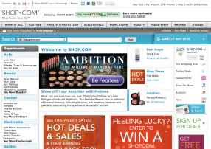
5贏的解决方案！ 5 Win Solutions!
mhk SHOP.COM
零售商
Retailers
客戶
Customers
客戶的朋友
Friends of Customers
經銷商
Distributors
=
業務員Sales
www.markethongkong.com.hk
HK.SHOP.COM
賺取高達2％-25％現金回贈
Earn up to 2%-25% Cashback
0.5%現金回贈cashback
英國、香港、台灣…
UK.SHOP.COM
TW.SHOP.COM
HK.SHOP.COM
賺取高達2％-25％
現金回贈
Earn up to 2%-25% Cashback

Slide 7
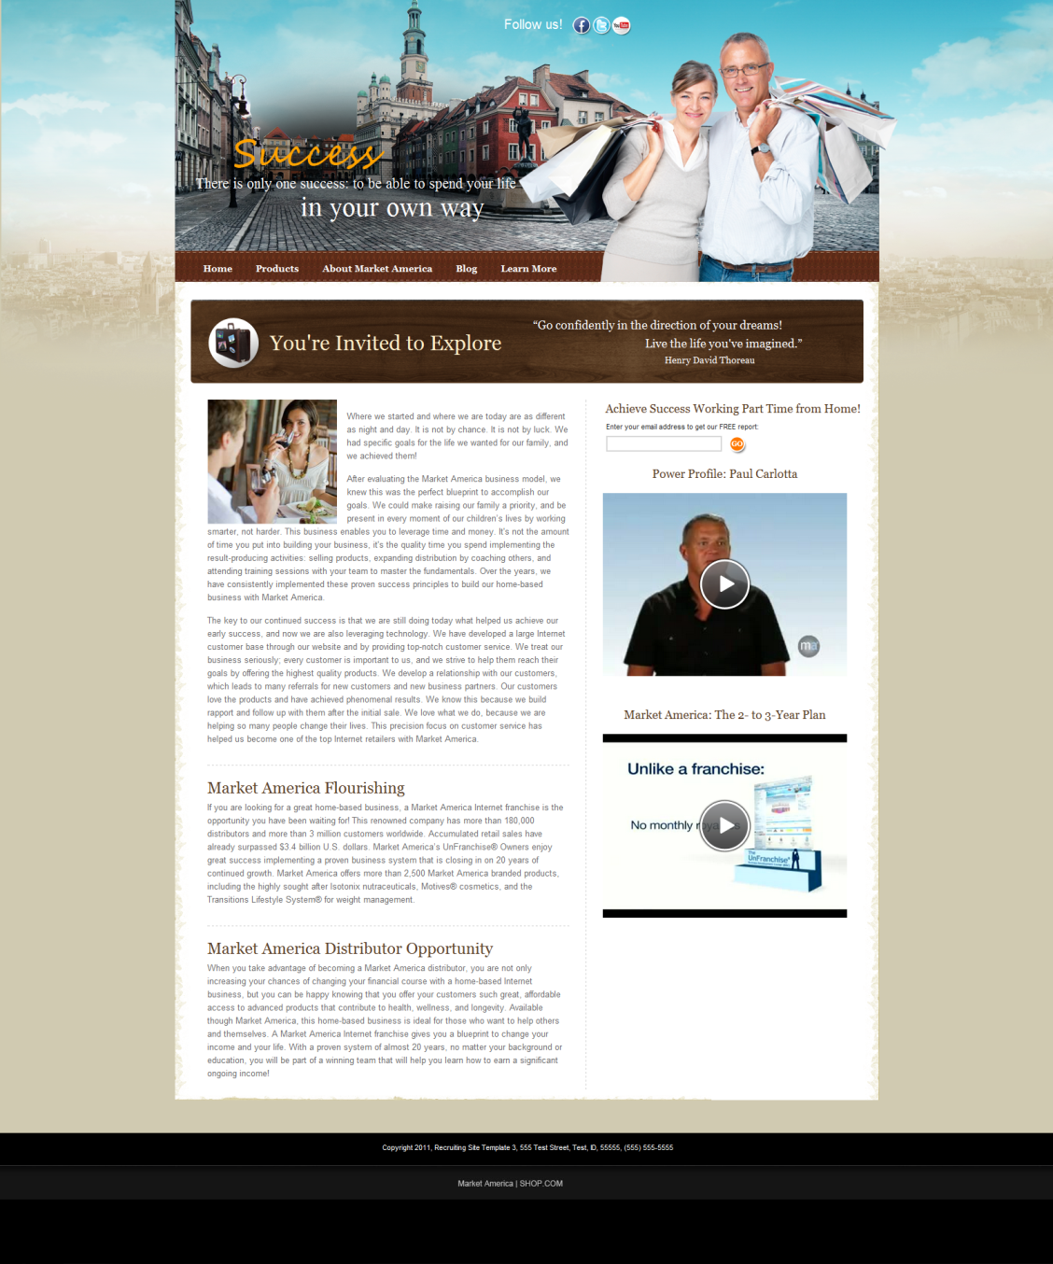
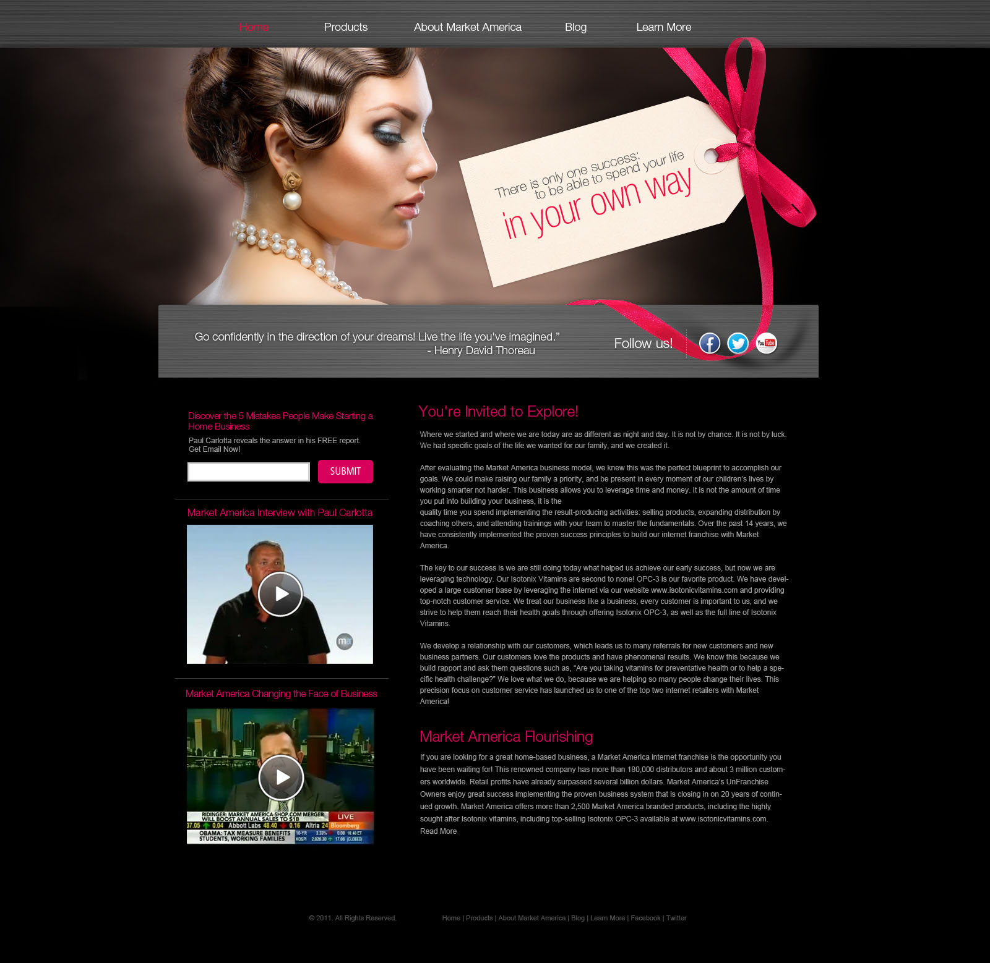
我們的經銷商也可擁有個人網站
Even our distributors can have their own personal websites

Slide 8
用的是網路中心的先進科技 Using cutting edge webcenter technology

Slide 9
好的系統任何人都可運作 A good system allows anyone to work on it
「如果你就是你自己的業務， 你若不在了，會怎樣呢？」
“If you are your business, what happen if you are not there?”
「可行的系統，就算 沒有技術人員也能運作」
“The System works when no technician is around”
~ Michael Gerber
美國商業技巧培訓公司創辦人 Author of The E-myth revisited
Notes:
good system works- just like webcenter- no need to be a web developer or designer

Slide 10
我們有良好的系統 We already have a great supporting system
一個能創造永續收入的系統 A system that brings residual sales
Notes:
we already had a system in place- system to sell and distribute, system to duplicate

Slide 11
網路中心 更容易幫新人起步的產品 EASIER to help new start-ups
適合潛在生意夥伴
適合想評估網路中心的潛在生意夥伴
適合想加入但需要資金的潛在生意夥伴
For potential business partners
For potential business partners who want to evaluate network center
For potential business partners who want to join but need funding

Slide 12
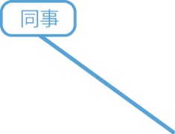
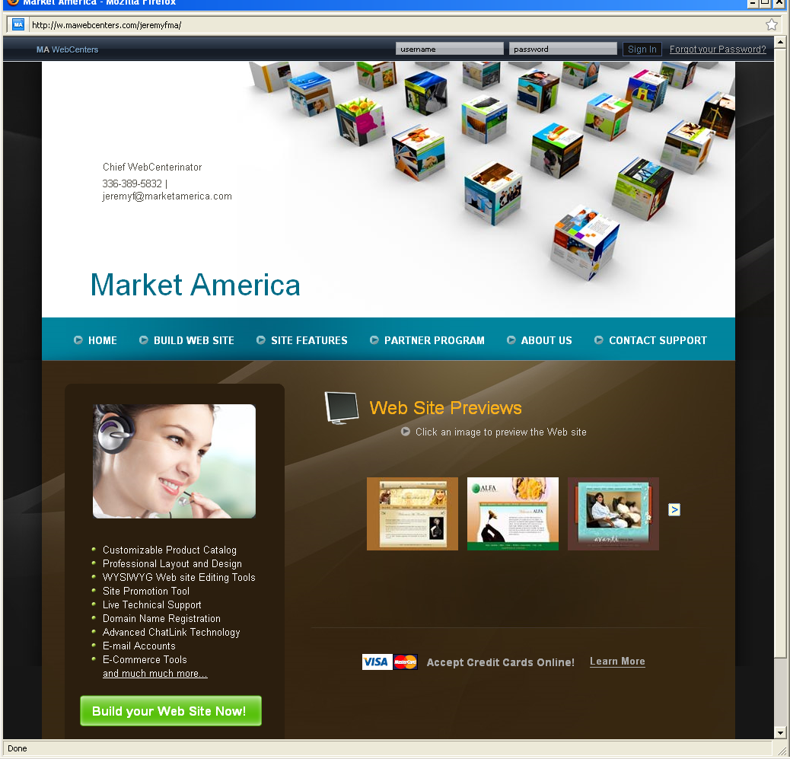
更快速幫新人接觸潛在夥伴 FASTER for newcomers to contact potential candidates
Friends
Neighbor
Co-worker
Technician
Uncle
Doctor
Teacher
Lawyer
Parents Association
Social Media
Hair Stylist
Notes:
12

Slide 13
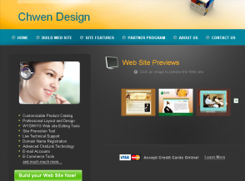
美安香港網路中心備有更好的資源 mhk WebCenters provide BETTER resources / support
Notes:
Webcenters program is an unique platform in MA university- where full range of supports are provided

Slide 14
一個有零售利潤潛力的銷售系統 A selling system with great retail profit potential
可賺取的零售利潤更大 美安公司最高零售利潤的產品 BIGGER retail profit
The product with the highest retail profit
平均網站售價= HK$10,000-12,000
零售利潤= 約HK$8,000
將你的目標分拆成HK$8,000增量
估計要銷售多少網站才能實現目標？
Average website sale = hk$10k and hk$12k
Retail profit = approx. hk$8k
break them down into hk$8k increments
how many website sales? = to achieve your goals
Notes:
Webcenter generates huge retail profit

Slide 15
每月的BV更穩定又更多！ 自動循環業績點數(BV) MORE stable monthly BV Auto-cycling BVs
每個網站銷售產生首次的225 BV和每月25 BV
類似傳統的「自動購貨」計劃
每月可將BV放置到組織中， 產生更大的利益
Each website sale = 225 BV initially and 25 BV/month
Just like “autoship” program = use constantly every month!
you can assign the BV = in your organization to maximize the benefit
就像「自動購貨」計劃
Like an “Autoship” system
Notes:
Webcenter System – great autoship selling system

Slide 16
邊賺現金，邊建立財富系統 Earn Cash flow while building a wealth system
Friends
Neighbor
Co-worker
Technician
Uncle
Doctor
Lawyer
Teacher
Parent Association
Social Media
Hair Stylist
Notes:
網路購物 ┼ 加盟連鎖
非常有威力，但是卻又非常簡單。
目前全世界只有美安事做得到。

Slide 17
每間公司都需要一個網站的原因 Why every Company needs a Web Site
網站是最有經濟效益的廣告形式
7個工作日，每天24小時，沒有任何額外的開銷，銷售潛力卻增加數倍
顧客可以輕鬆在網站上購買你的產品和服務，不需要親自到商店
在過去6年，全球網上銷售增長了近400％，所以提升你的業務網絡是最好的捷徑
你的生意會顯得更加專業
most cost effective form of advertising.
7 days, 24 hours a day, without any additional overhead, and your sales potential will be increased several times.
Does not require the customer to the store in person, you can easily purchase your products on the website and services
In the past six years, the global network of nearly 400% increase in sales, enhance your business network is the best shortcut
Your business will look more professional

Slide 18
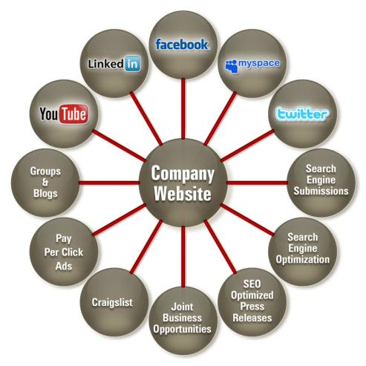
不可忽略的公司網站功能
The Powerful of Company Website
公司網站
群組與網誌
搜尋引擎登入
點擊付費廣告
搜尋引擎優化
求職網站
搜尋引擎新聞稿
合作機會

Slide 19
了解我們的平台Understanding Our Solution
“大部份人對自動變速器的 運作原理毫無概念， 但他們卻知道如何駕駛。
你無需研究物理學， 都可以知道如何操作汽車。”
Most people have no concept of how an automatic transmission works, yet they know how to drive a car.
You don't have to study physics to understand the laws of motion to drive a car.
-喬布斯 Steve Jobs -

Slide 20
客戶自製或用現成平台？ Technician vs Ready- made
買零件 - 自己動手砌？
Build by yourself
買現成 - 拿鑰匙就好？
Buy ready made

Slide 21
客戶自製或用現成平台？ D.I.Y vs Turn-key solution
自己建設？ Build by yourself
用現有系統？
Buy ready made system

Slide 22
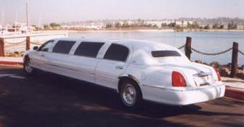
你的顧客要怎樣的車？
多種車款，包括房車、卡車、客貨車和SUV
What kind of cars does your customer want?
There are many kinds, e.g. limo, truck, lorry and SUV
溫飽三餐的 豪華型房車
A limo
展現英姿、身份的跑車
A sports car that shows your style.
Notes:
我們提供針對各式各樣型號、品牌、樣式的汽車零件服務，這些只是我們許多服務的其中幾項。

Slide 23
實例：我的朋友要買車 Example: my friend wants to buy a car
推介開始 >上路試車 > 問題解答 Referral > Test Drive > Q&A
美安網路中心的專業銷售人員 Professional team from mhk WebCenters
可幫你向顧客講解及展示 help explain to your clients
可幫你成交、收錢 help collect $$ from your clients
可幫你回答顧客的問題 help answer any of your clients’ questions

Slide 24
我的任務 What do I need to do?
陪朋友買車時： 你坐在車后，跟着兜風就好了！
網站功能示範時： 你在電話上旁聽，跟着學就對了！
During test drive: Sit back & relax!
During Website Demo: Listen & Learn!

Slide 25
就算你 不是專業網頁設計師
也能做這事！！
Even if you are
not a professional webpage designer, you can still do it!!

Slide 26
知道自己的身分 Know WHO you are
不要假裝是建築師，你興建的房子可能不合規格 Don’t pretend to be a architect, you may not build the house properly.
不要假裝是醫生，你可能會開錯藥，害死人 Don’t pretend to be a doctor, you may prescribe the wrong medication and kill lives
不要假裝是汽車技工，你自製的汽車可能隱藏很多問題 Don’t pretend to be a auto-mechanic, you may build a car with lots of hidden problems

Slide 27
最重要做回自己 Be WHO you are is crucial,
不要當自己是網頁設計師， 壓力太大了 Why pretend to be a Web designer… too much stress for you..
不要當自己是網頁編寫員， 吃力不討好 Don’t pretend to be a Web developer … you may be overwhelmed
不要搞錯了！ Don’t get mixed up & messed up!

Slide 28
最重要做回自己！ Be yourself!
如果你是一個家庭主婦，就做個擁有互聯網事業的家庭主婦
如果你是一個銷售主管，就做個專業的銷售主管，提供專業的網絡解決方案
如果你是一個服務供應商，就做個真誠的服務供應商，提供有效的網絡解決方案
If you are a Stay home mom, be a stay home mom that owns an internet business.
If you are a Sales Executive, be a professional Sales Executive that sells professional web solution
If you are a Service Provider, be a caring Service Provider that provide effective web solution

Slide 29
你的顧客要怎樣的網站？ What kind of website does your client need?
形象網站？
電子商務？
客戶自製？
現有平台？
拿資料！
拿資料！
A static website?
E-commerce?
DIY?
Ready made platform?
Get more information!
Data mining!

Slide 30
你的顧客要怎樣的網站？ What kind of website does your client need?
展示產品/服務的 形象網站
A static website that displays products / services
買賣產品/服務的 電子商務網站
An e-commerce website that
sells products/services

Slide 31
我們已有專業團隊 你要做的只是配合！ Our Team of Professionals All you have to do is Plug In!
你
約見會面
YOU Set the Appointment
產品專家
為你面談,銷售網站！
Product Specialist does the appointment / Sells the Website for YOU !
顧客服務
為你的顧客處理所有技術支援！
Customer Care handles all Technical Support for your customer!
你
賺取零售利潤、225 BV 及每月25 BV、活躍顧客 YOU Earn Retail Profit, 225 BV & 25 BV / Month , active customer

Slide 32
很容易就可作出選擇！ The Choice is Simple!
傳統 Traditional | 自己建立 Do it Yourself | 出版公司 Publishing Companies | 網站寄存 Discount Hosting | 網路中心 解決方案 mhk WebCenters Solution
首年$7,608 + 運用社交媒體、鞏固方案的時間 第二年起每年$2,808 $7,608 in the first Year + Time for Social Media, Securing these Solutions. $2,808 Per Year after first year | 首年$4,825.95 +運用社交媒體、鞏固方案、學習程式的時間, 第二年起每年$2,208 $4,825.95 in the first Year + Time for Social Media, Securing these Solutions, Learning Programs. $2,208 Per Year after first year | 首年$5,300 + 運用社交媒體、鞏固方案、學習程式的時間 之後每年$4,908，假設網站該年增加一頁 $5,300 in the first Year + Time for Social Media, Securing these Solutions, Learning Programs. $4,908 per Year after that, assuming you add one page that year. | 首年$3,611 +運用社交媒體、鞏固方案、學習程式、尋求支援的時間 第二年起每年$2,311 $3,611 in the first Year + Time for Social Media, Securing these Solutions, Learning Programs, Outsourced Support $2,311 Per Year after first year | 首年$2,499 之後每年$600 無限及無可比擬的顧客支援！ $2,499 first Year $600 per Year Unlimited & Unparalleled Customer Support!
** 根據10/12進行的研究估計
Estimates based on research on 10/12

Slide 33
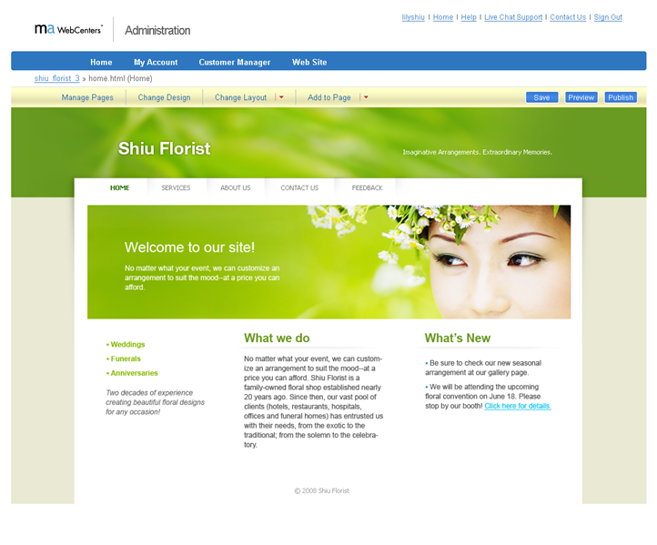
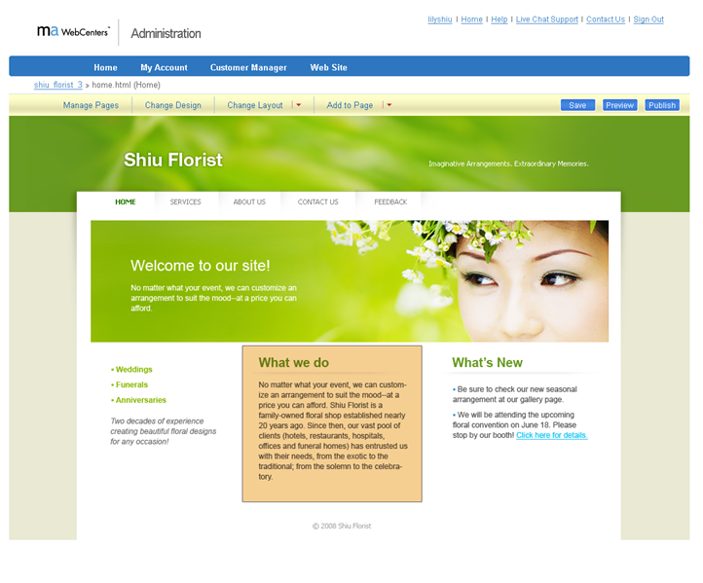
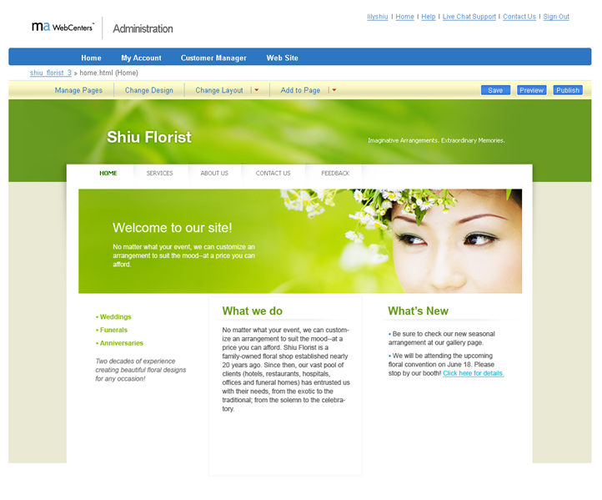
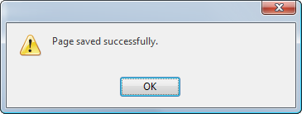
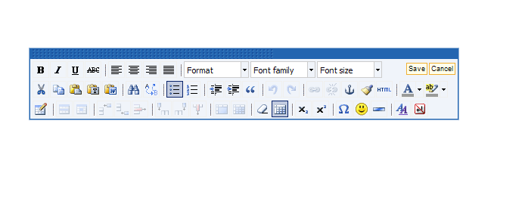
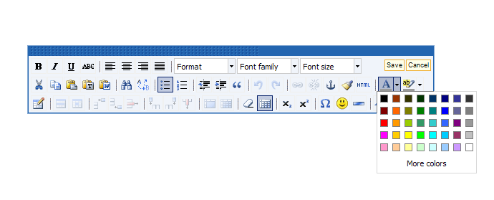
文字編輯
Editing Text
What we have
Various designer's packages, delivery service, design by you

Slide 34
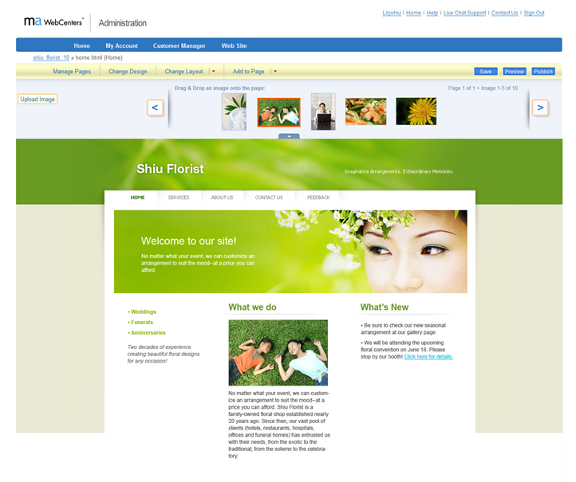
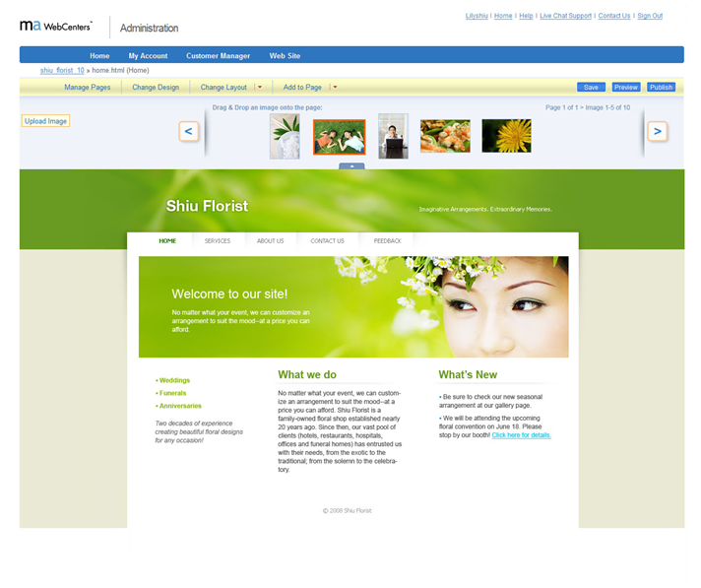
加入圖片
Adding an Image

Slide 35
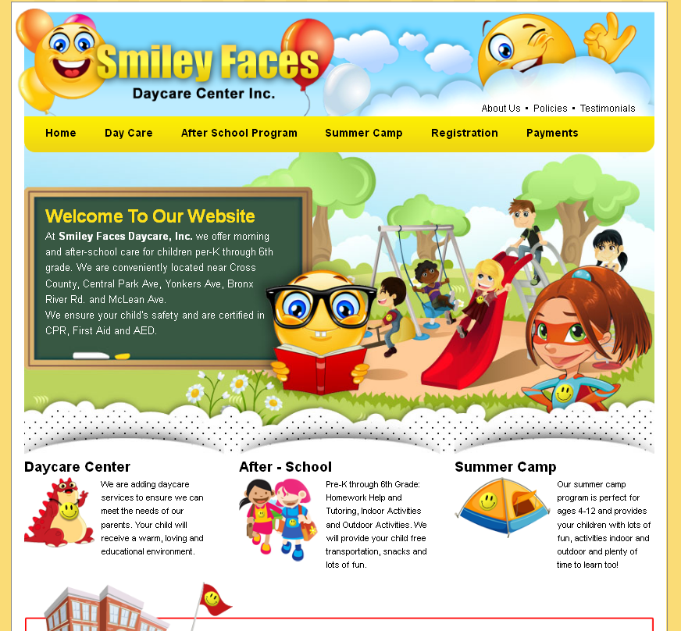
設計中心 Design Team
Notes:
35
TRAINER’S NOTES:
Here are some examples of sites done with our design center.
You can see how professional these designs look.
Any business owner would be proud to have one of these websites for their own.

Slide 36
社交媒體行銷 Social Media Marketing
美安香港網路中心專心地協助你的顧客 涉足社交媒體行銷市場
透過利用社交媒體的力量，我們可掌握網絡潮流的動向
maWebCenters is focused on helping your clients tap into Social Media marketing
By leveraging the power of social media, we are able to tap into the pulse of what drives the Internet today

Slide 37
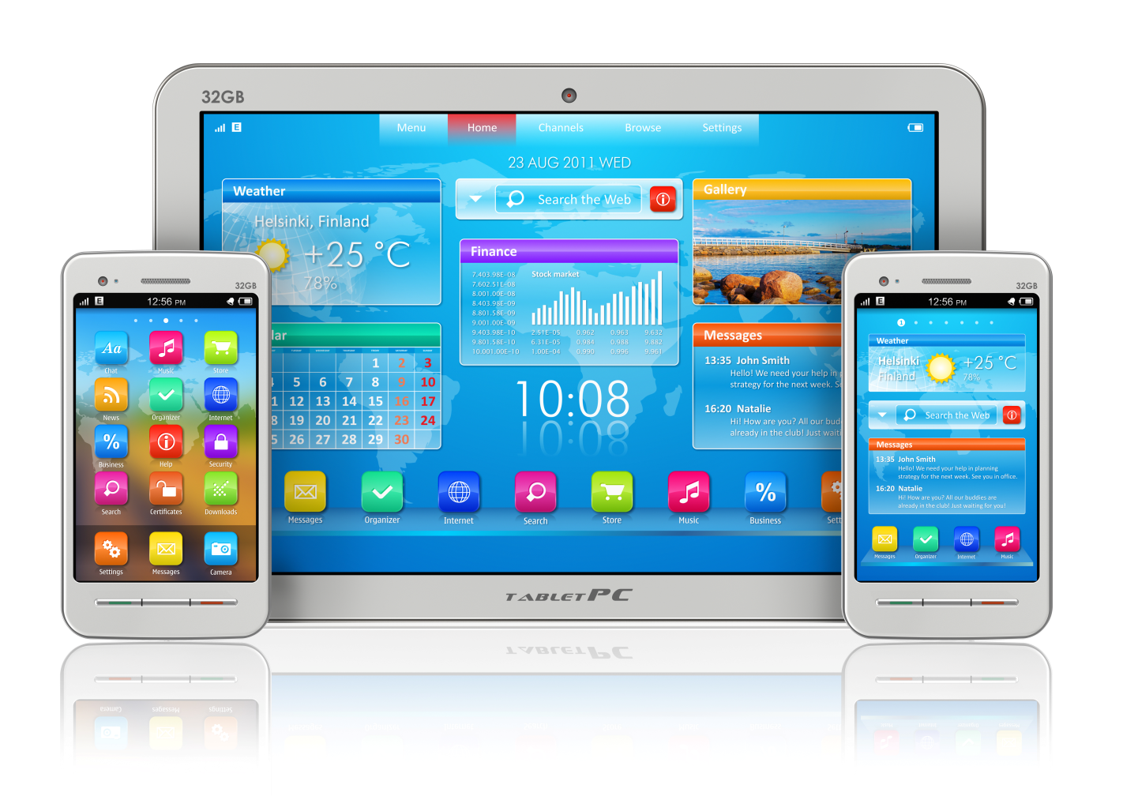
免費的流動網站 Free Mobile Sites
流動網站是免費的， 客戶可到他們的後台，啟動它， 就可在流動版本上更新 Mobile Web sites are included for free, all your clients need to do is login to their administration area, enable it and update anything they want on the mobile version.

Slide 38
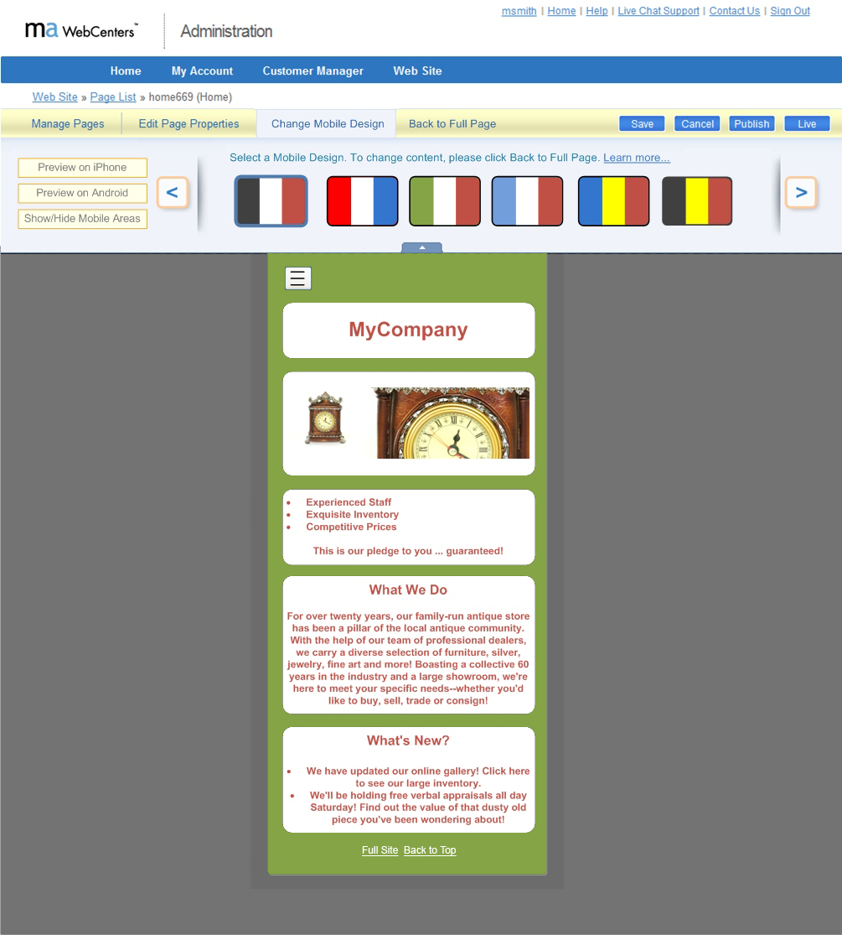
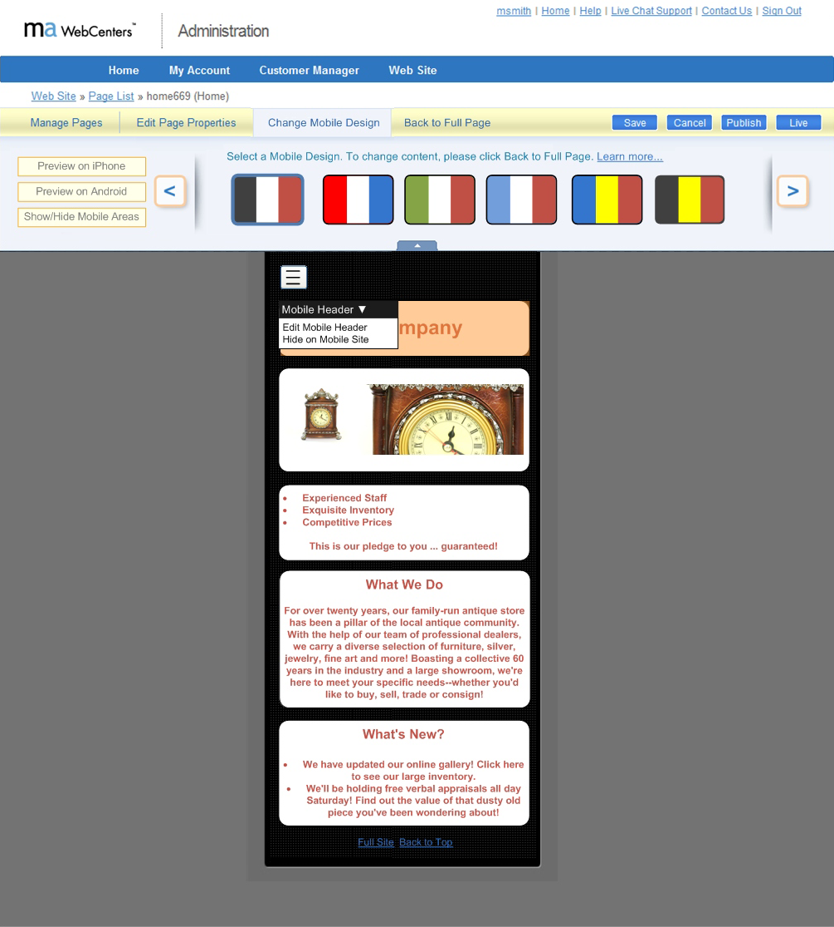
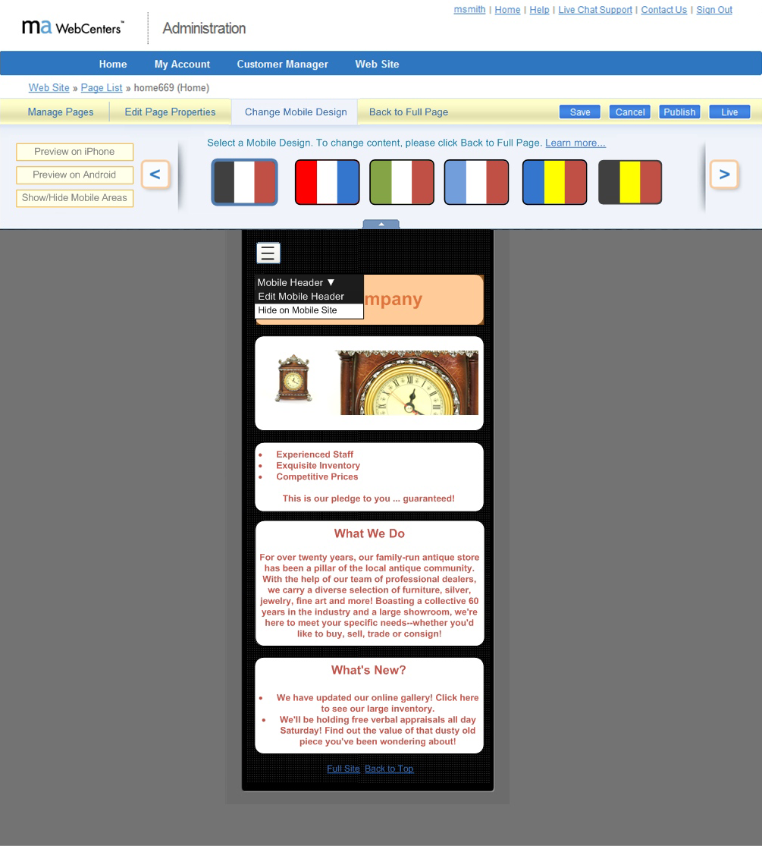
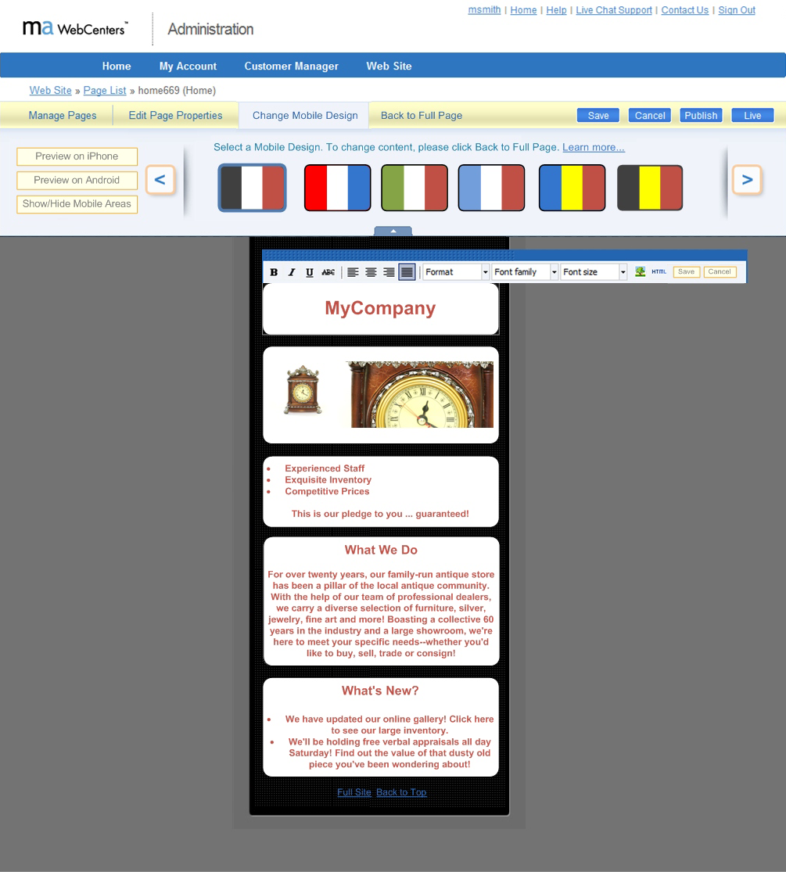
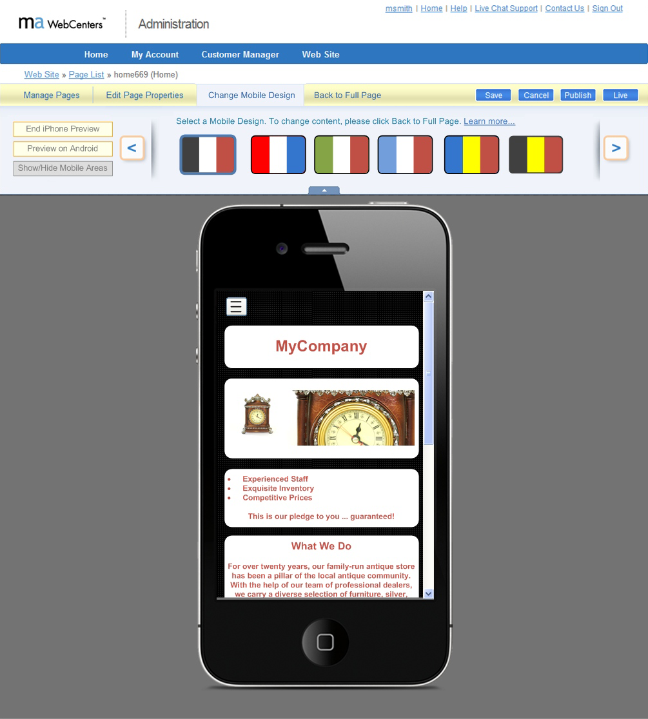
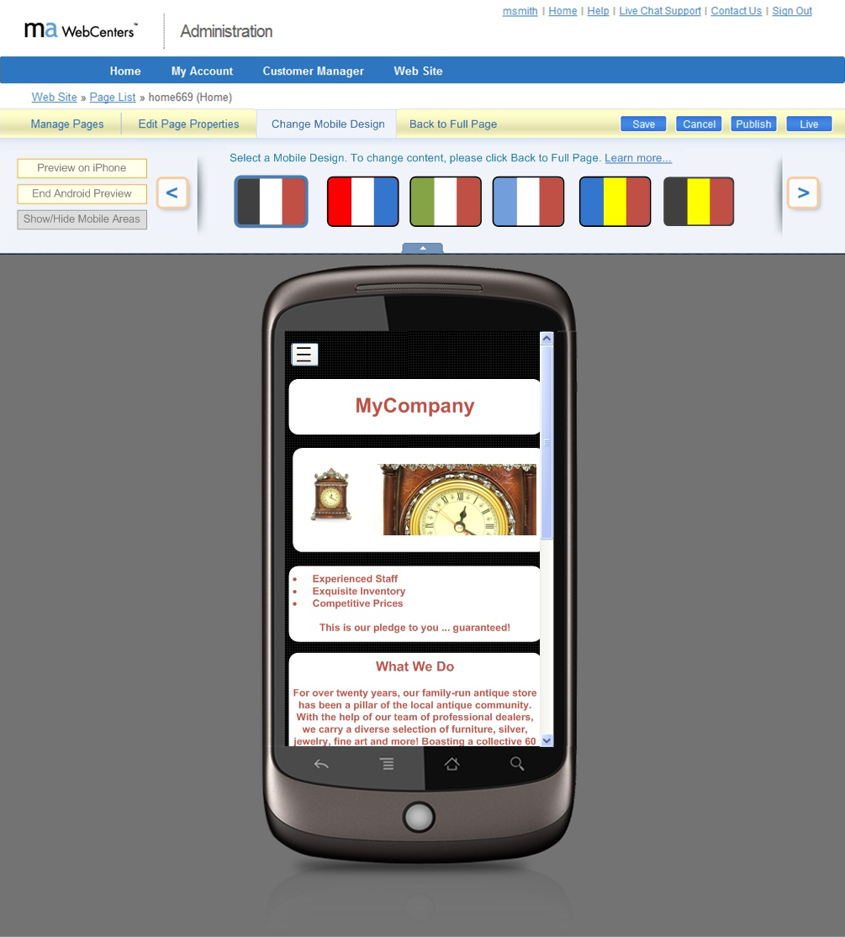
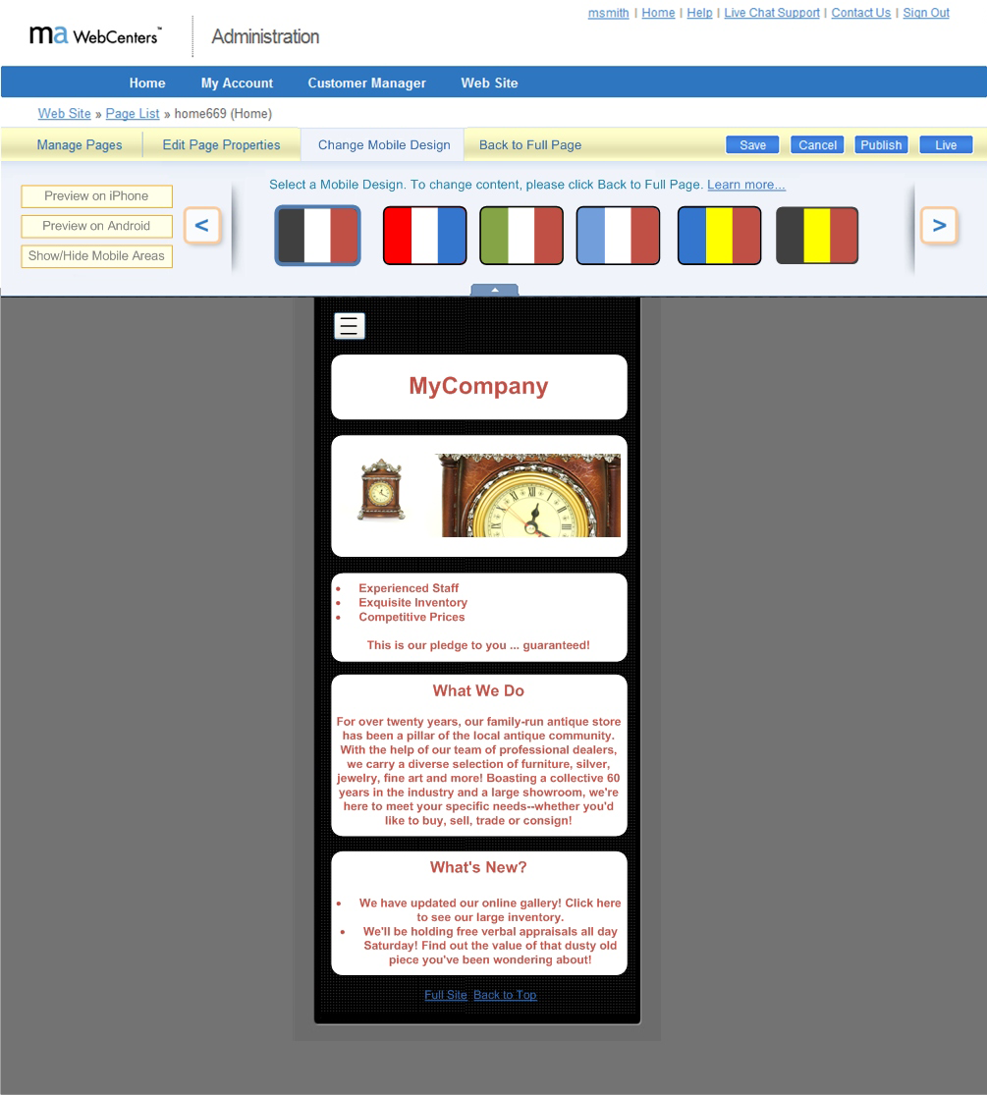
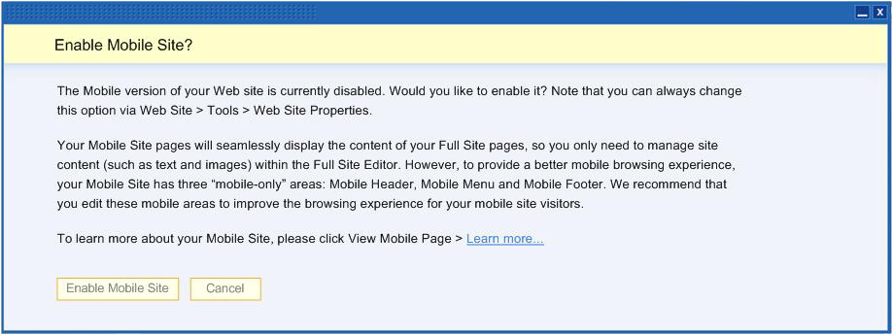
流動網站 Mobile Sites
內容背景顏色Content background color
主要背景顏色
Main background color
文字顏色
Text color
這不是意大利國旗，而是你改變流動網站顏色的方法No, that’s not an Italian flag, its how you change the Mobile sites color scheme

Slide 39
請記得… Remember
你的工作是協助客戶，在網路上搶回失去的訂單，
而不是『讓自己跟客戶』 變成架設網站的高手！
Your job is to help your clients gain back their missing orders online,
but not to become “Web Masters” with your client

Slide 40
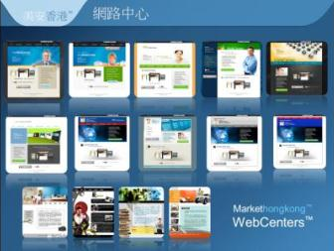
要知道你和 甚麼人合作 Know WHO you are partnering with
網路中心為我們提供了以下支援：
銷售/產品/網絡專家
技術支援
– 搜尋引擎優化、網站編輯、電子郵件專家、社交媒體專家等
設計中心
mhk Webcenters provides us with the following support:
Sales / Product / Web specialist
Technical Support – SEO, Web editing, email specialist, Social Media specialist, etc
Design Center

Slide 41
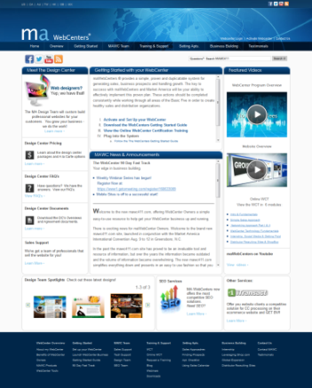
如何起步 Getting Started
下載 Downloadable:
起步指南 The WebCenter Getting Started Guide
90日快軌計劃 The 90-Day Fast Track
免費網上課程 Online WebCenter Certification Training (WCT) free
現場認證課程HK$275 WCT In person HK$275
這個網站已重新設計了， 資料也更完善了！ We’ve completely redesigned and improved our information site at www.mawc411.com
Notes:
We may want to have the talking point that this system was beta tested , saw great results and is now on running on a large scale!

Slide 42
Webcenter 課程Curriculum
WebCenters 90 days
Fast Track Program
90日快軌計劃
For more Info: www.mawc411.com
Notes:
42

Slide 43
發展超連鎖™事業 一個可以複製的系統
Growing Your UnFranchise a system that allows others to duplicate
每邊組織3位夥伴 = 每年銷售6個網站，以平均 售價售出（HK$10,000-12,000）
每位夥伴賺取HK$48,000元，抵銷世界大會與 國際年會門票的開支
於你的團隊產生8,100 BV = 約額外HK$7,000佣金
這個顧客數目令你的左右組織每月產生額外450BV
3 people on your both sides = sold just 6 websites in a year each at average sale price.( hk$10k- hk$12k)
Each of them earned $48k each, covered their expenses to get to World Conference and International Convention
Generated 8100 BV in your group = extra $7k in commissions
Just that small handful of clients = result in an extra 450 BV each month on both your left and your right.
8100 BV (6x225BV) x6 每月450 BV per month
銷售6個sold 6 150 BV/mth月
銷售6個sold 6 150 BV/mth月
銷售6個sold 6 150 BV/mth月
銷售6個sold 6 150 BV/mth月
銷售6個sold 6 150 BV/mth月
銷售6個sold 6 150 BV/mth月
Notes:
may skip this– too much maths ^_^

Slide 44
90日快軌計劃中期成績 （美國） 90 Day Fast Track Mid-way Results (USA)
整體成績（第1-8週）
銷售網站91個
網站銷售額$163,310
網站零售利潤$116,725
其他產品銷售$195,243
個人推薦經銷商118名
新增事業夥伴198名
Overall Results (weeks 1 - 8)
91 Website Sales
$163,310 in Website Sales
$116,725 in Website Retail Profit
$195,243 In Other Product Sales
118 Personally Sponsored
198 Additional Group Business Partners
Notes:
Need updated numbers

Slide 45
90日 快軌計劃 中期成績 （美國） 90 Day Fast Track Mid-way Results (USA)
新經銷商級別：
43名助理級
51名經理級
9名主管經理級
1名專業經理級
New Pin Levels:
43 New Coordinators
51 New Executive Coordinators
9 New Master Coordinators
1 New Professional Coordinator

Slide 46
現行90日 快軌計劃 中期成績 （美國） Current 90 Day Fast Track Mid-way Results (USA)
整體成績（第10週）
銷售網站12個
網站銷售額$20,590
網站零售利潤$11,699
其他產品銷售$13,179
個人推薦經銷商8名
新增事業夥伴16名
新經銷商級別： 3名助理級, 1名經理級
Overall Results (weeks 10)
12 Website Sales
US$20, 590in Website Sales
US$11,699 in Website Retail Profit
US$13,179 In Other Product Sales
8 Personally Sponsored
16 Additional Group Business Partners New Pin Levels:
3 Coordinators, 1 Executive Coordinators
Notes:
Need updated numbers

Slide 47
90日快軌計劃 （香港試行版) 90 Days Fast Track
(Beta-Hong Kong)
Notes:
Need updated numbers

Slide 48
90日快軌計劃(香港版) 90 days fast track Implementation
必須擁有網路中心
必須提交每週報告 （錯過了兩次提交就取消資格）
網上研討會 （每週星期日9:30 PM-HK）
每週支援 - 自組自選
Must owe a Webcenter
Must submit report every week (disqualified after two missed submission)
Webinars - weekly (Sunday 9:30pm - HK)
Weekly call workshop- optional but recommended

Slide 49
成功的行動計劃：香港 Your Action Plan for Success Hong Kong
每週網絡研討會系列：
Chwen Lim 專業經理級 網路中心授證訓練員
Clemant Siu 主管經理級 網路中心授證訓練員
Weekly Webinar Series (TBA)
Chwen Lim Professional Coordinator Certified WebCenter Trainer
Clemant Siu Master Coordinator Certified WebCenter Trainer

Slide 50
90日快軌計劃成績（香港） 90 Day Fast Track Results (Hong Kong)
整體成績（第1-12週）
網站约见1220個
網站三线通203個
網站零售$73,387
其他產品銷售$238,550
分享商業計劃 762次
新增事業夥伴102名
Overall Results (weeks 1 - 12)
1220 Website Appointment
203 WebCenter Sales appointment
HK$73,387 in Website Sales
$238,550 In Other Product Sales
Show Plan 762 times
102 Additional Group Business Partners
Notes:
Need updated numbers

Slide 51
成功的行動計劃： 起步清單 Your Action Plan for Success Getting Started Checklist
利用網路中心計劃 的力量… To take advantage of the power of the WebCenter program in your business…
你需要網路中心！
You need a WebCenter!

Slide 52
保持姿態！ Posture speaks!
要知道這系統可幫我們
要運用已建立好的系統
別期待另一個更好的系統出現
你將會錯過很多利用系統的機會
We need to KNOW that the system can help us
We need to USE the existing system created
Don’t WAITS for a better system to exist
You will MISSED a lots of opportunities to leverage the systems

Slide 53
成功的行動計劃：起步清單
Your Action Plan for Success Getting Started Checklist
2013美安香港年會特別優惠Annual Convention SPECIAL
只限本週末
到網路中心攤位，立即起步！
This weekend only.
Come to the WebCenters Booth and get started today!
HK$2730 & 300 BV
* 網路中心月費為港幣275元
WebCenter monthly service fee is HK$275/month

Slide 54
網路中心快速起步計劃！ WebCenter Fast Start Kit!
一個協助新夥伴正確以網路中心起步的全新工具即將推出
全新網路中心快速起步計劃
新經銷商以網路中心起步的最簡單方法
網路中心
WebCenter (HK6040)
經銷商入門資料套裝
Distributor Subscription Kit
美安香港產品目錄
Hong Kong maCatalog
美安集團年報
Global Annual Report
起步指南
Getting Started Guide
超連鎖事業系統發展圖冊
Small Flip Charts
超連鎖事業系統DVD
HK “The System” DVD
超連鎖事業管理帳戶(2個月) 2 months UFMS
Soon there will be a brand new option to help someone get a WebCenter right when they get started
The all new WebCenter Fast Start Kit
The easiest way to get a new distributor started in the WebCenter program

Slide 55
2013美安香港年會 Market Hong Kong 2013 Annual Convention
透過網路中心建立成功的超連鎖™事業
Building a Successful UnFranchise™ as a WebCenter Owner
See you at the top!

