Slide 1



Slide 2
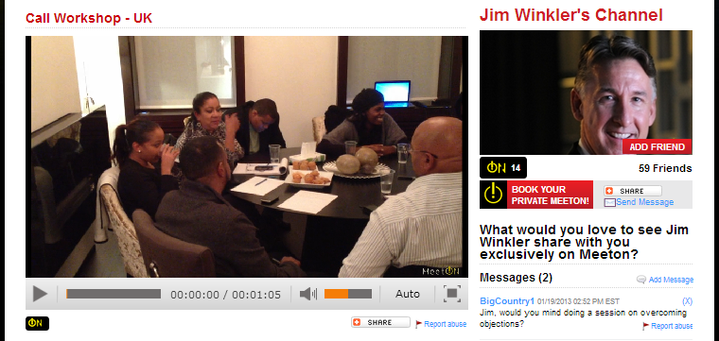
想像一下…
置身於精英超連鎖店主的團隊核心會議...
Sitting in on an elite UnFranchise Owner’s personal group coring...

Slide 3
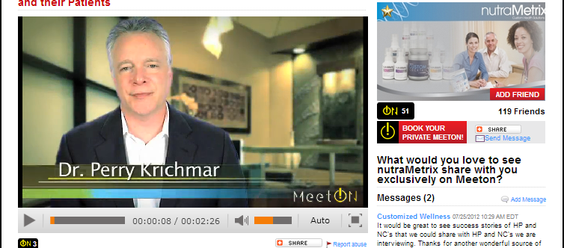
想像一下…
有公司的醫學人員為你的顧客講解美安產品的獨特性和卓越質素...
Having a corporate medical officer explain the unique benefits and superior quality of an ma product to your customers...

Slide 4
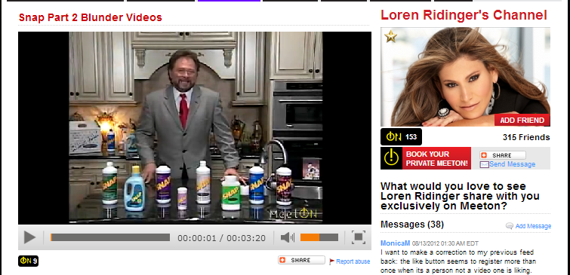
想像一下…
你可從公司和經驗豐富的夥伴得到持續、緊貼最新情況的建立事業貼士和產品資訊...
Having access to ongoing, up-to-the-minute business-building tips and product updates from corporate and field experts...

Slide 5
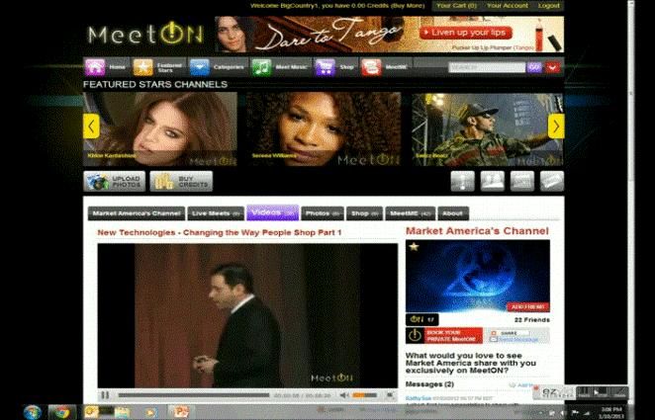

想像一下…
安坐家中，於千里以外參與研討會，聆聽最成功超連鎖店主分享...
Attending a seminar, featuring the most successful UnFranchise owners, 1,000 miles from your home without leaving your living room...

Slide 6
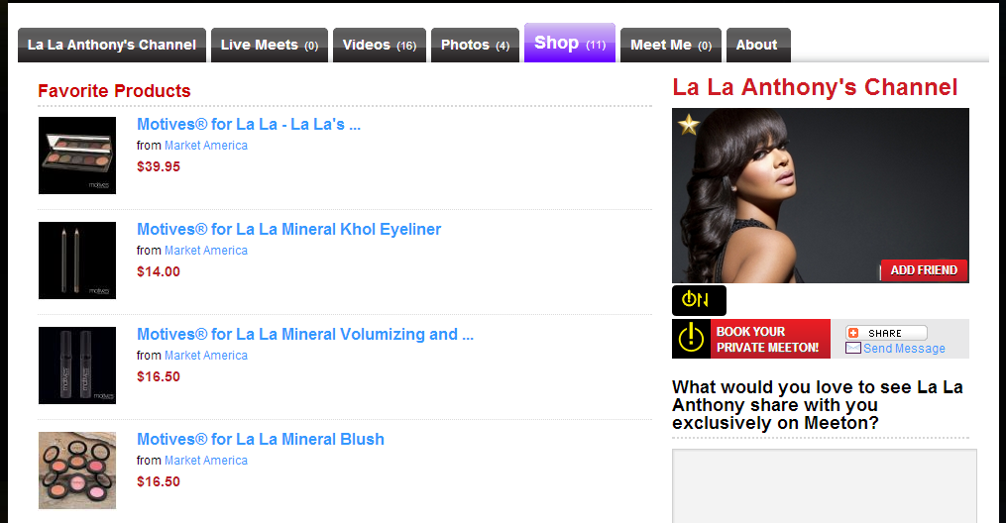
想像一下…
你的顧客可隨時觀看最喜愛的名人宣傳美安產品...
Your customers seeing their favorite celebrity promoting ma products 24/7...

Slide 7
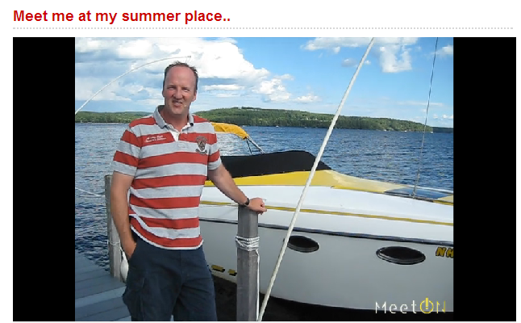
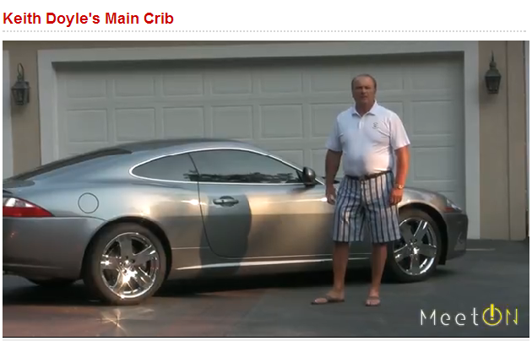
想像一下…
只需一按，即可向潛在夥伴展示成功超連鎖店主享受的生活方式...
Being able to expose prospects to the lifestyles of successful UnFranchise Owners at the click of a button...

Slide 8



想像一下…
…全無地域限制
…having NO boundaries
…了解詳情
…and now the details

Slide 9
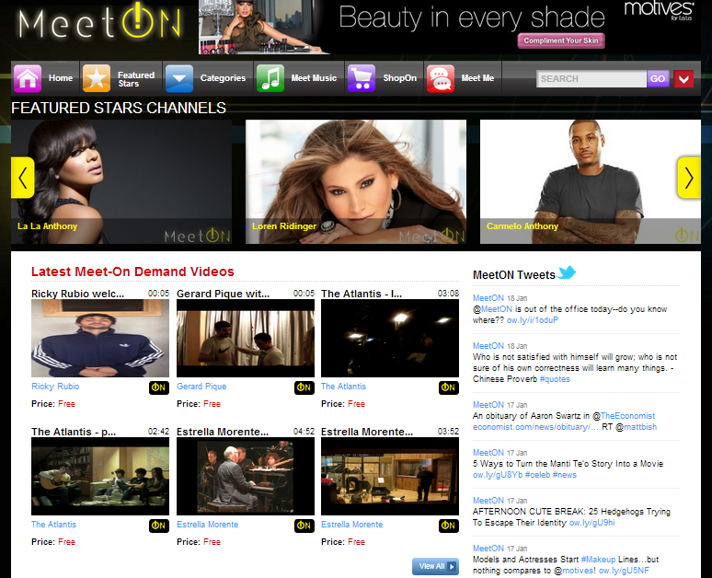
• Entertainment • Sports • Music
• Movies • Comedy • Style
• Education • Spiritualism • Networks
• Media & Publications • Do It Yourself • Travel
• Food & Cooking • Business • Gaming
• Arts & Crafts • Shopping • Health &Wellness
• Pets • Market America • SHOP.COM
Notes:
Add new slide with MA Subcategories

Slide 10
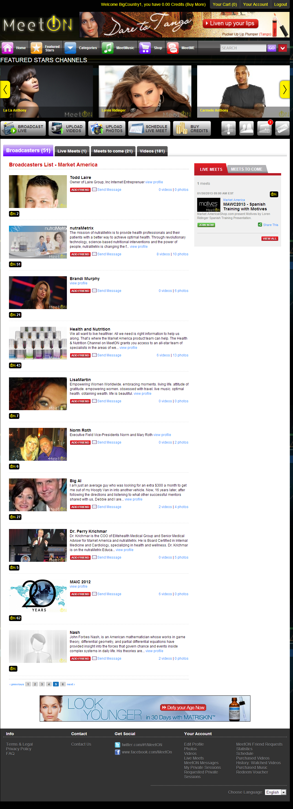

Slide 11
公司頻道Corporate Channels
健康與營養Health & Nutrition
SHOP.COM
網路中心WebCenters
maCapital Resources
Motives
及更多And much more!
Notes:
Longer scroll before
Make box below listing channels
Done!

Slide 12
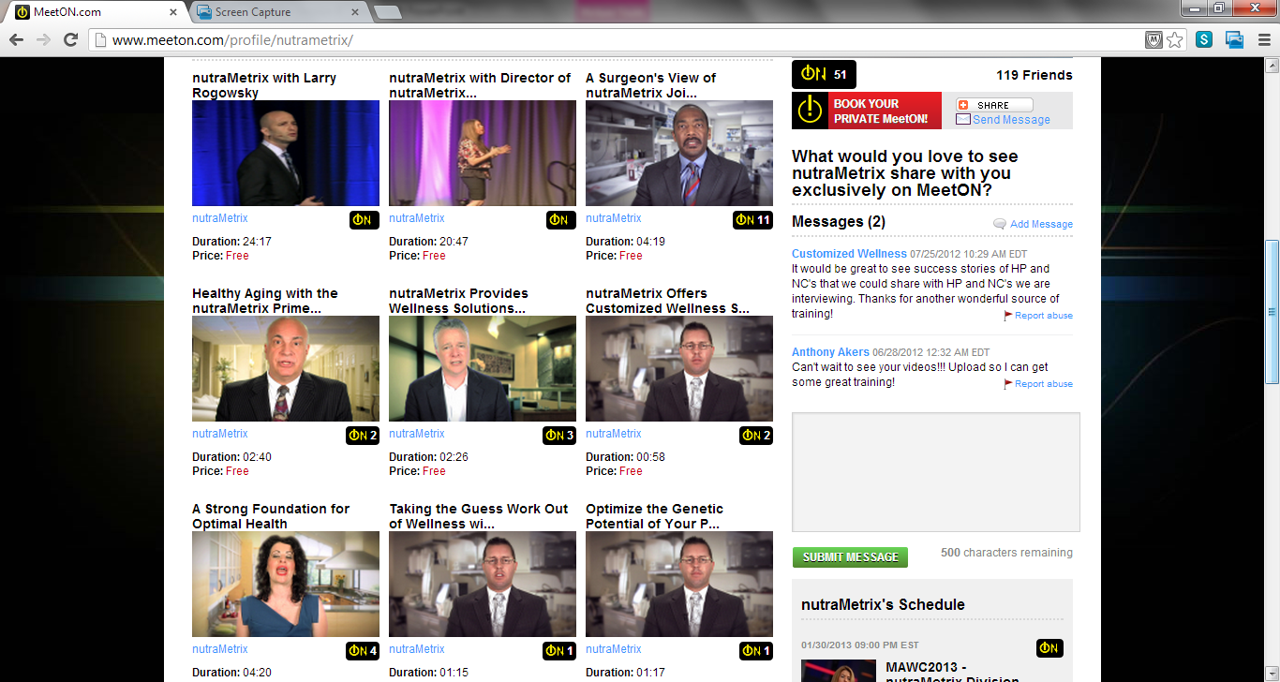

Slide 13
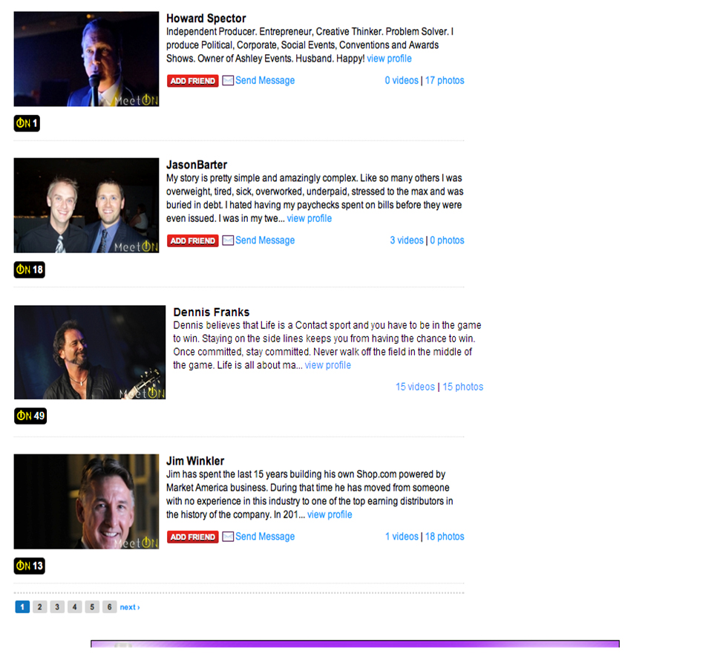
Notes:
Get a better screen shot of this image (Category:MarketAmerica:Scroll down to JIM)
Box around Jim
Done!

Slide 14
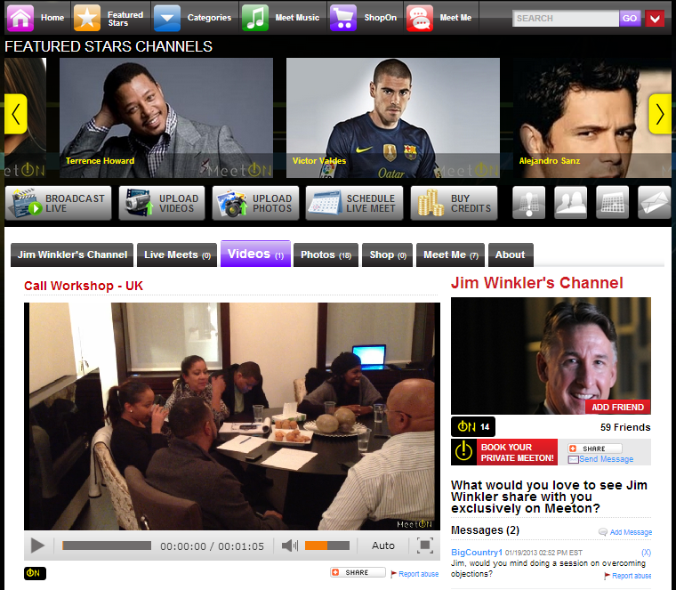

Slide 15
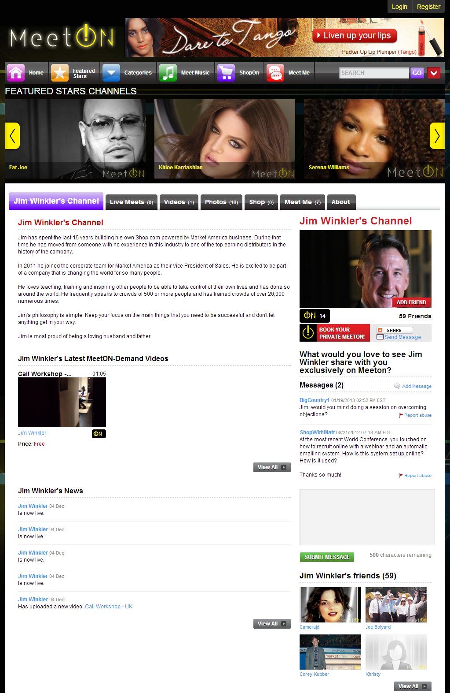

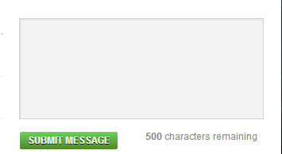
Jim, would you mind doing a session on over coming objections?

Slide 16
無限議題
Limitless Topics
    高效銷售
    購物年金
    建立行動設劃
    如何銷售
    約見的四個步驟
    Impact Selling
    Shopping Annuity Sessions
    Developing Plan of Action
    How to Sell
    Four Steps to Making Appointments
Notes:
Specialized Topics
Impact Selling
Call Workshops
Developing Plan of Action
How to Sell
Four Steps to Making Appointments

Slide 17
想像一下…
一個地點包含以下所有：
  新經銷商訓練與成功五要訣
  授證經理級訓練
  網路中心訓練
  產品訓練
  美安主修概覽 – 訓練
    TLS
    網路中心
    Motives
    入門網站
All of these at one location:
  NDT & Basic 5
  ECCT
  WebCenter Trainings
  Product Trainings
  UMO – Training
    TLS
    WebCenter
    Motives
    Web Portal
    Anti-Aging
    Health & Nutrition
    抗衰老
    健康與營養
Notes:
Non-Blackout Slide
Don’t worry about affecting ticket sales to their event, talk about the blackout of the events

Slide 18

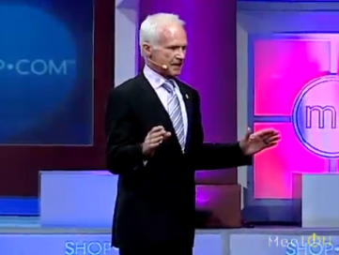

Slide 19
想像一下…
想像一下，一個地點包含以下所有：
  本地研討會
  轄區大會
  地區大會
  產品研討會
本地 / 地區媒體暫停播放
Just imagine, all these at one location:
  Local Seminars
  District Rallies
  Regional Conventions
  Product Symposium
Local / Regional Market Blackouts
Notes:
Blackout Slide
Don’t worry about affecting ticket sales to their event, talk about the blackout of the events
Local Market Blackouts

Slide 20

360 Experience

Slide 21
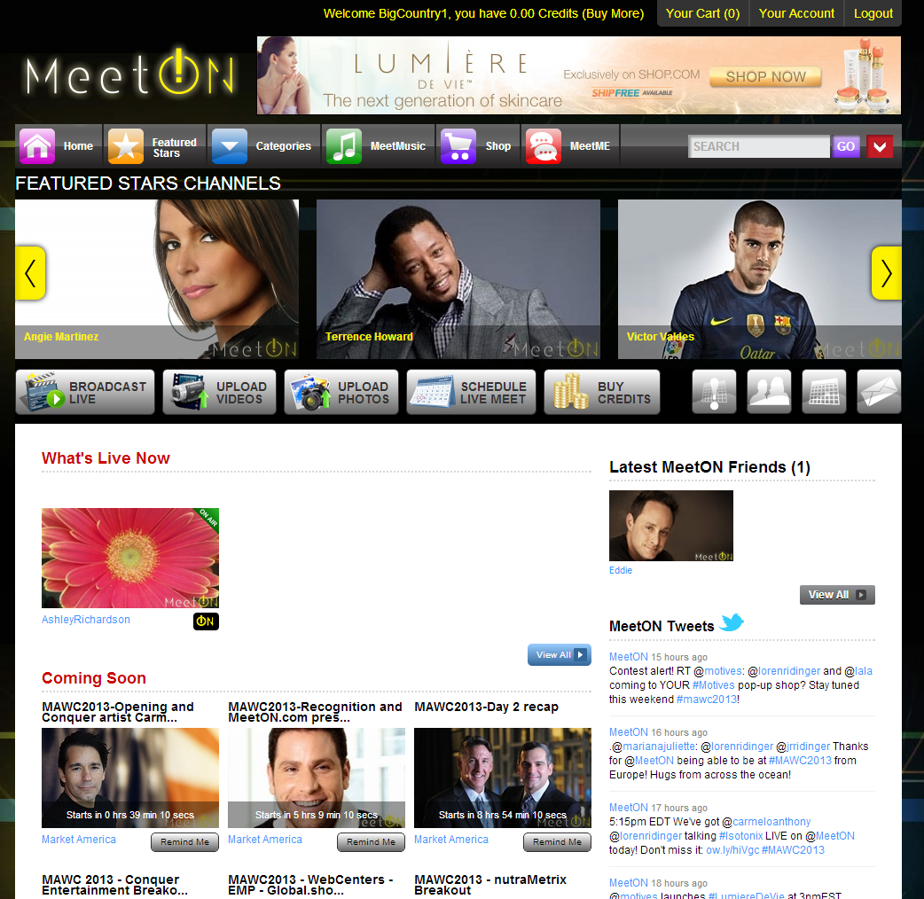
讓你的顧客輕易購買美安及OneCart購物車產品
為現有顧客創造更多現金回贈，並為你帶來更多BV/IBV
Easy way for your customers to purchase Market America & OneCart products.
Creates more Cashback for your existing customers and more BV/IBV for you.
Notes:
Need new screen shot as it’s not called shopon any more. It’s just shop.
Done.

Slide 22
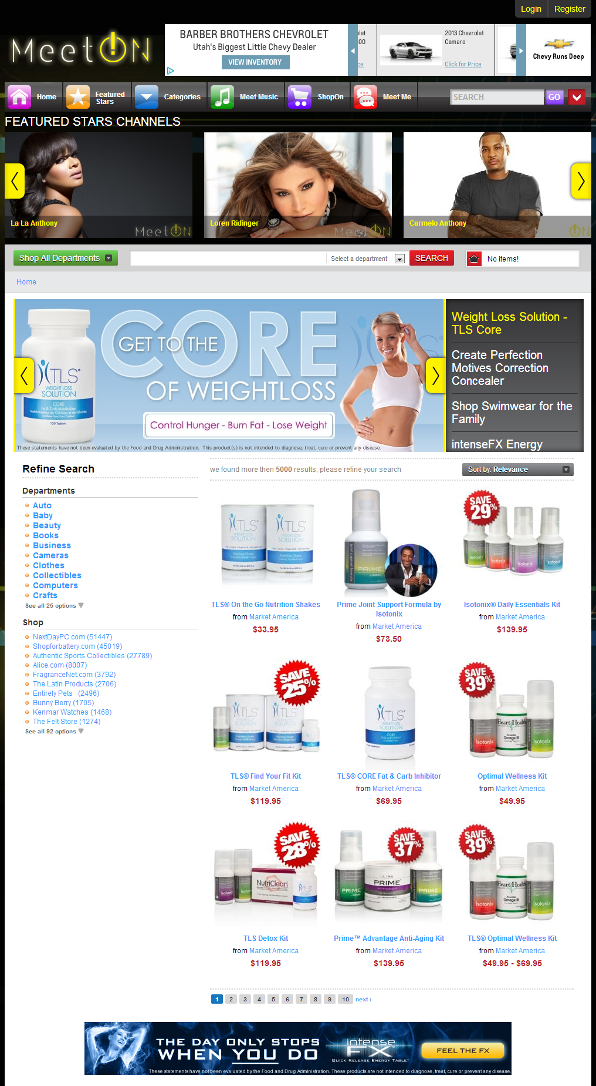

Slide 23
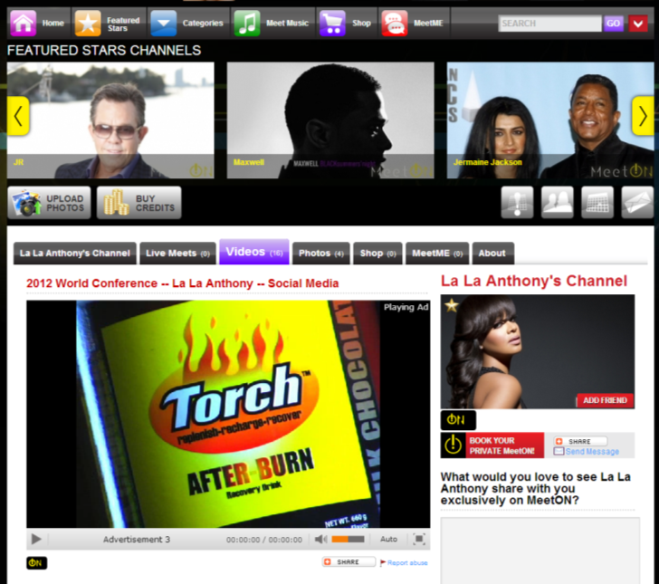

增加美安品牌的曝光率！
Creating more Market America brand exposure!
播放免費內容前
均會加入美安產品
的廣告
ma product
commercials
before all free
content

Slide 24
不要錯過任何資訊！
Don’t miss ANYTHING!

Slide 25
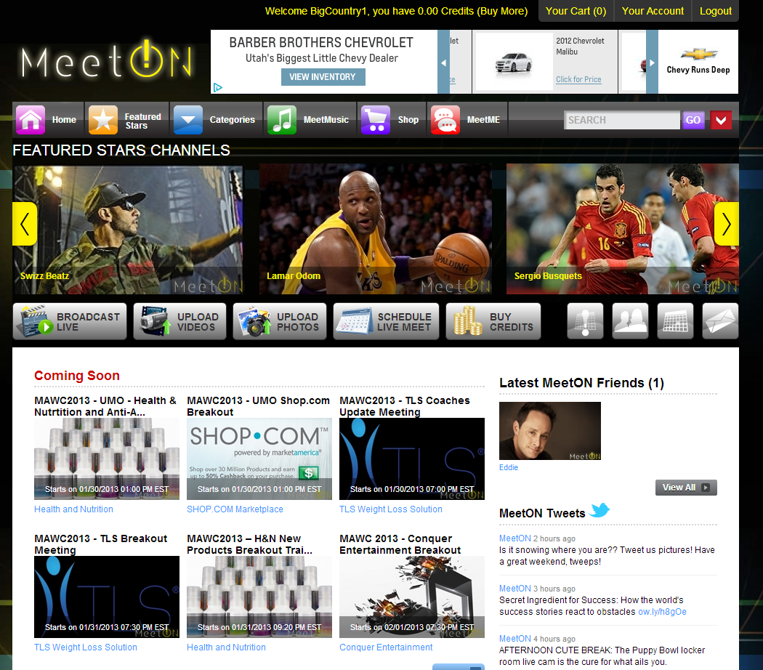

Slide 26
分享即將播放的視頻點播
SHARE upcoming broadcasts & VODs

Slide 27
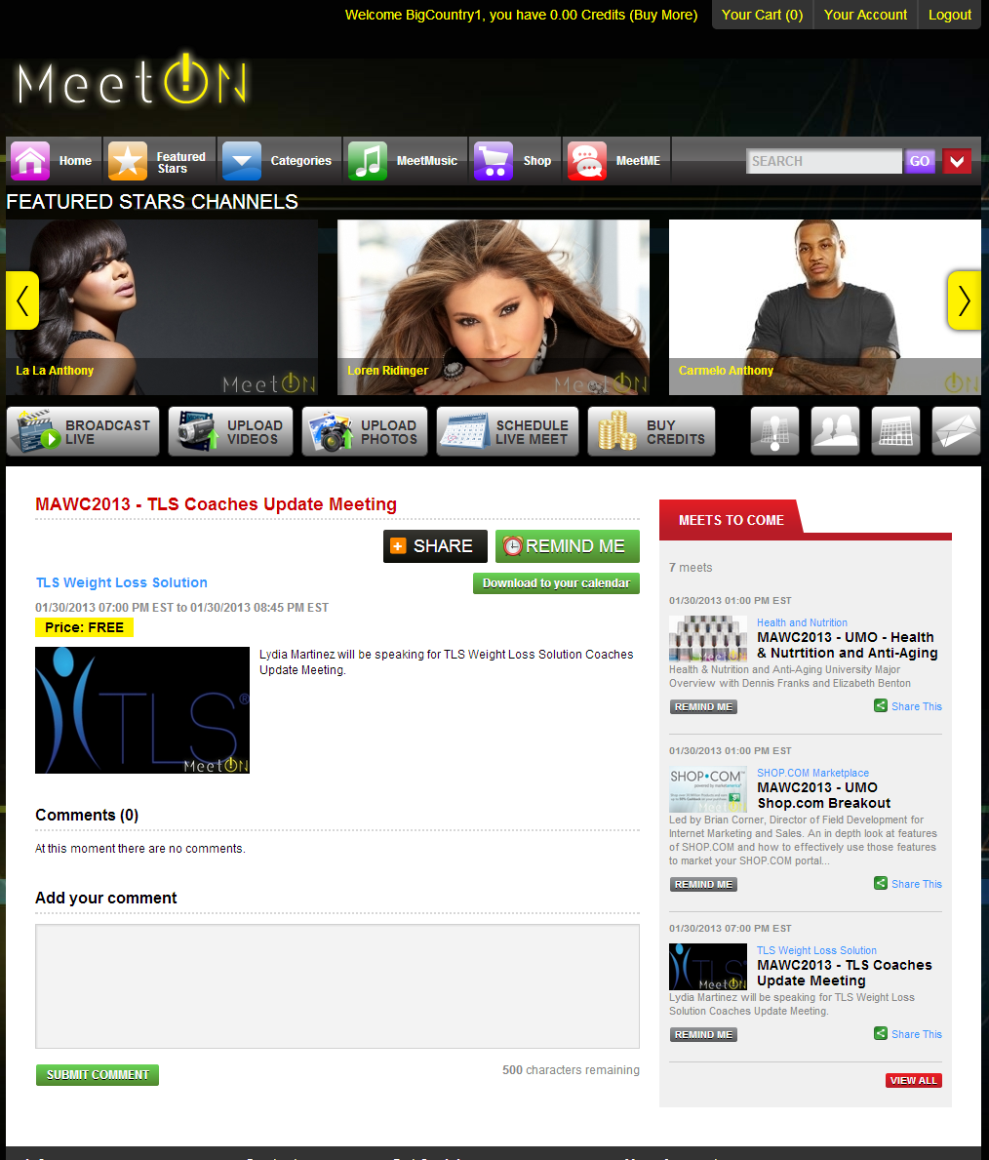
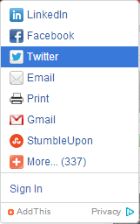

Slide 29
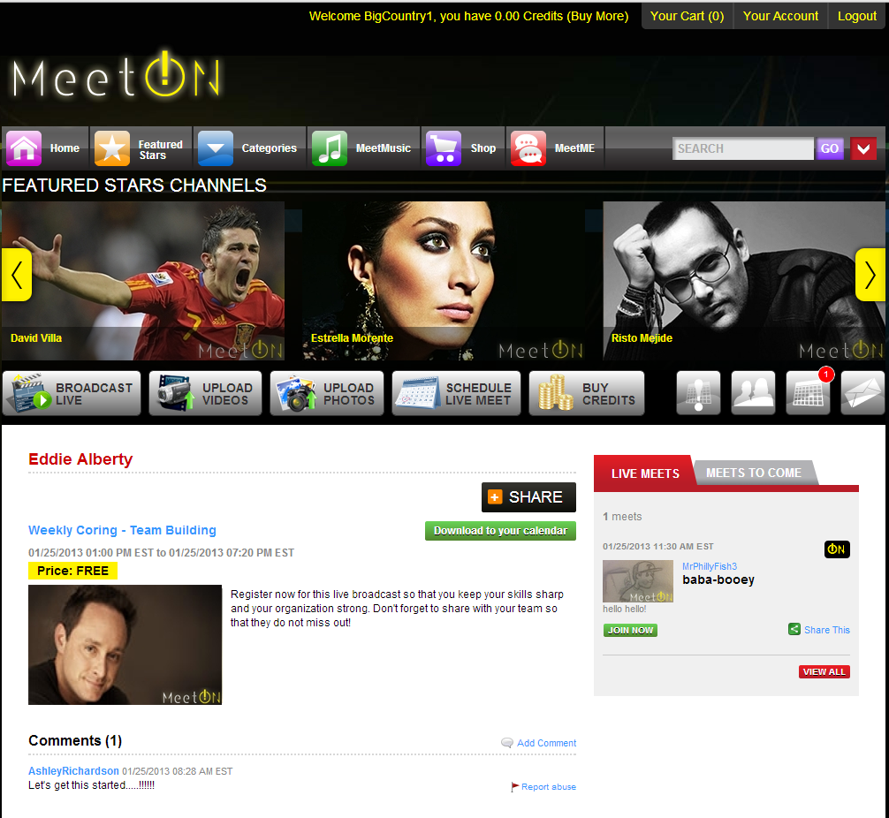

Slide 30
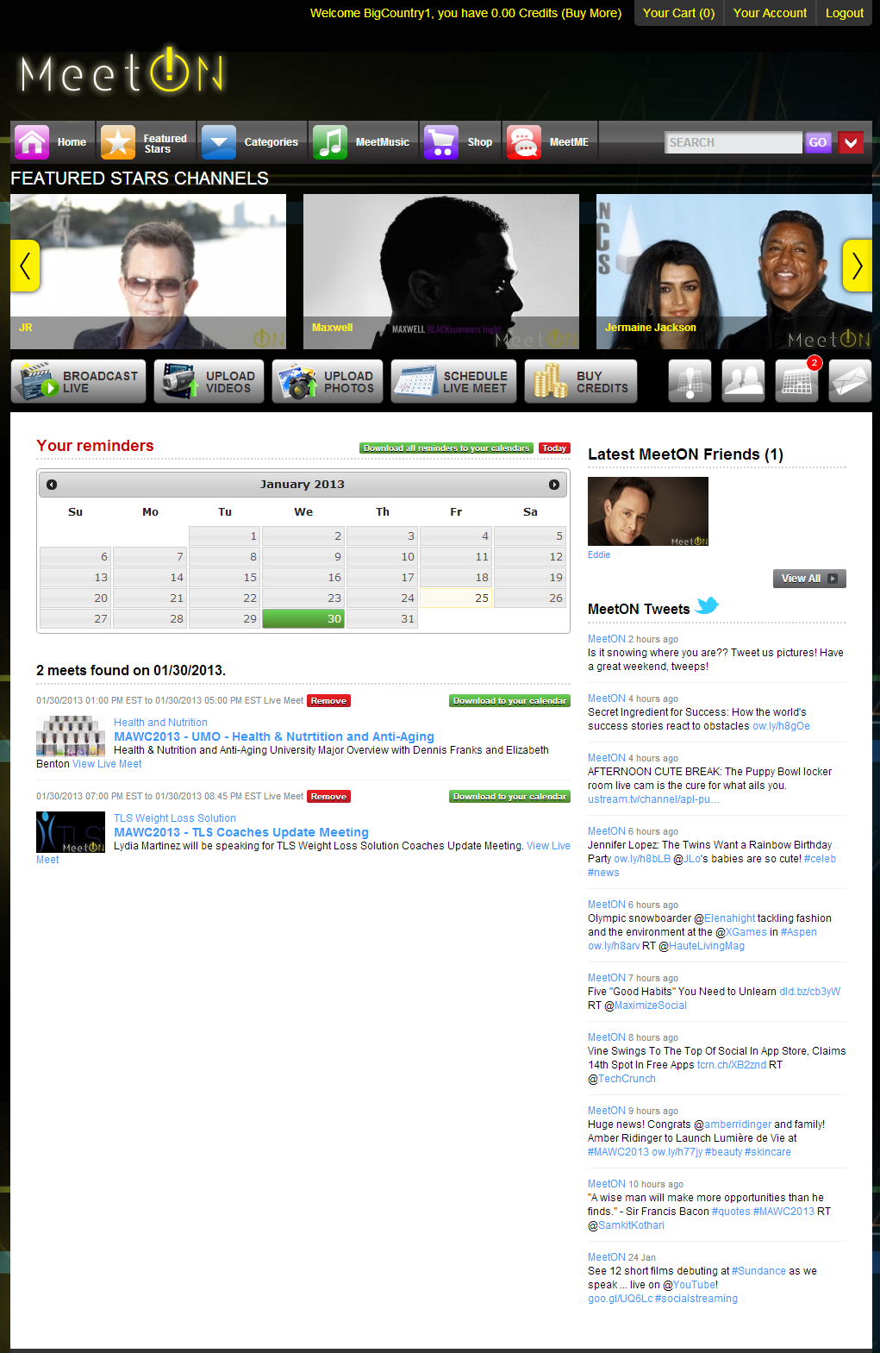

Slide 31
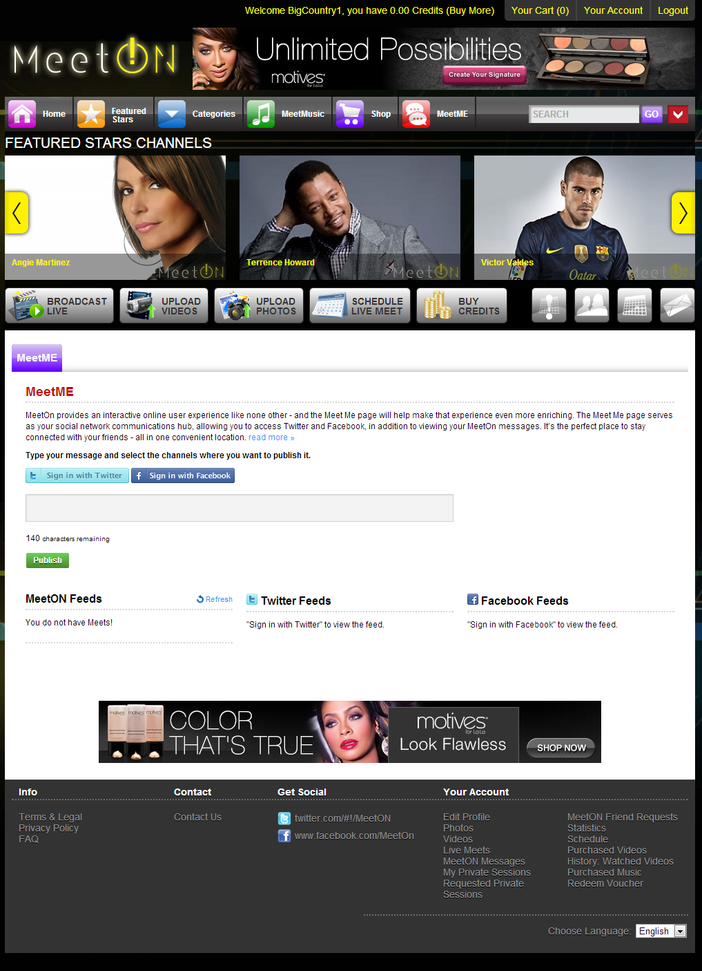

Slide 32
名人元素
Celebrities Components
數以億計支持者及追隨者
極具影響力
支持者會聽取他們的推介
Hundreds of Millions of Fans & Followers
Incredible Influencers
Their fans act upon their recommendations
Notes:
Add pics of celebs with some data about their followers embedded.
Eva
Serena williams
Shakira
David Beckham

Slide 33
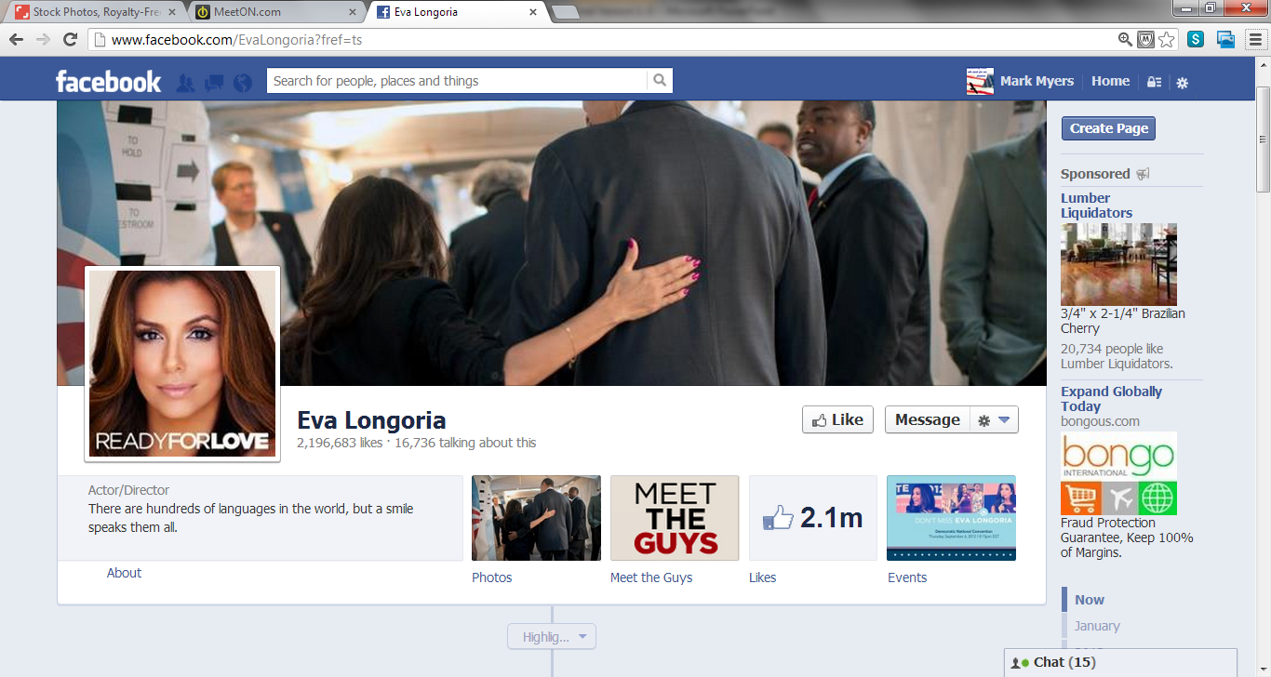
7,237,609
追隨者Followers
7,237,609

Slide 34
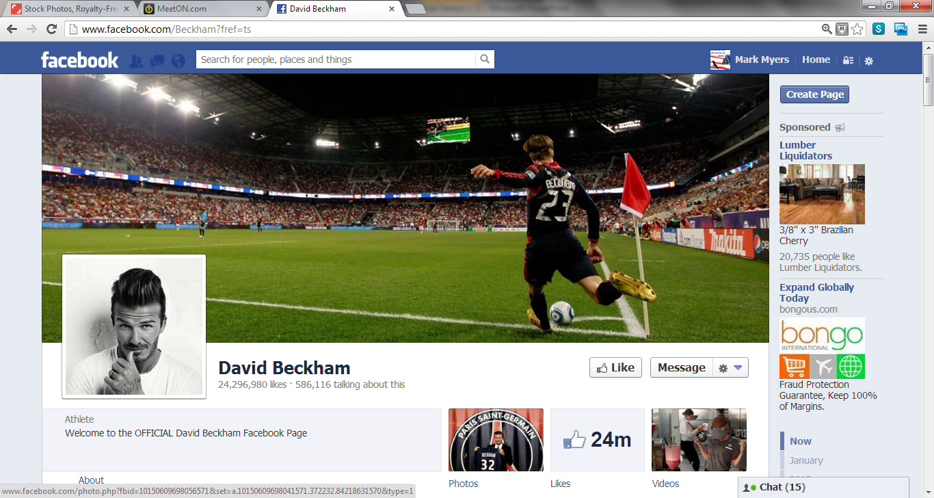
24,295,055追隨者Followers

Slide 35
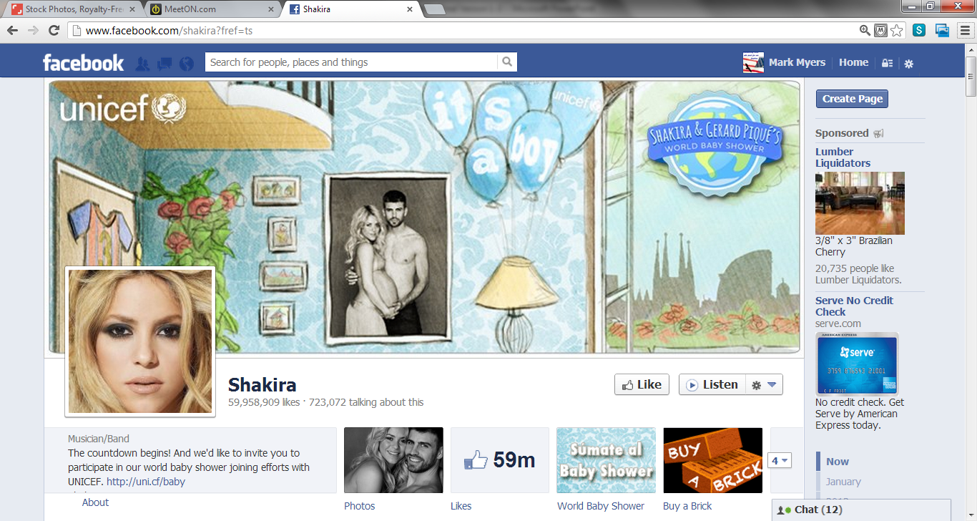
79,569,245
追隨者Followers

Slide 36
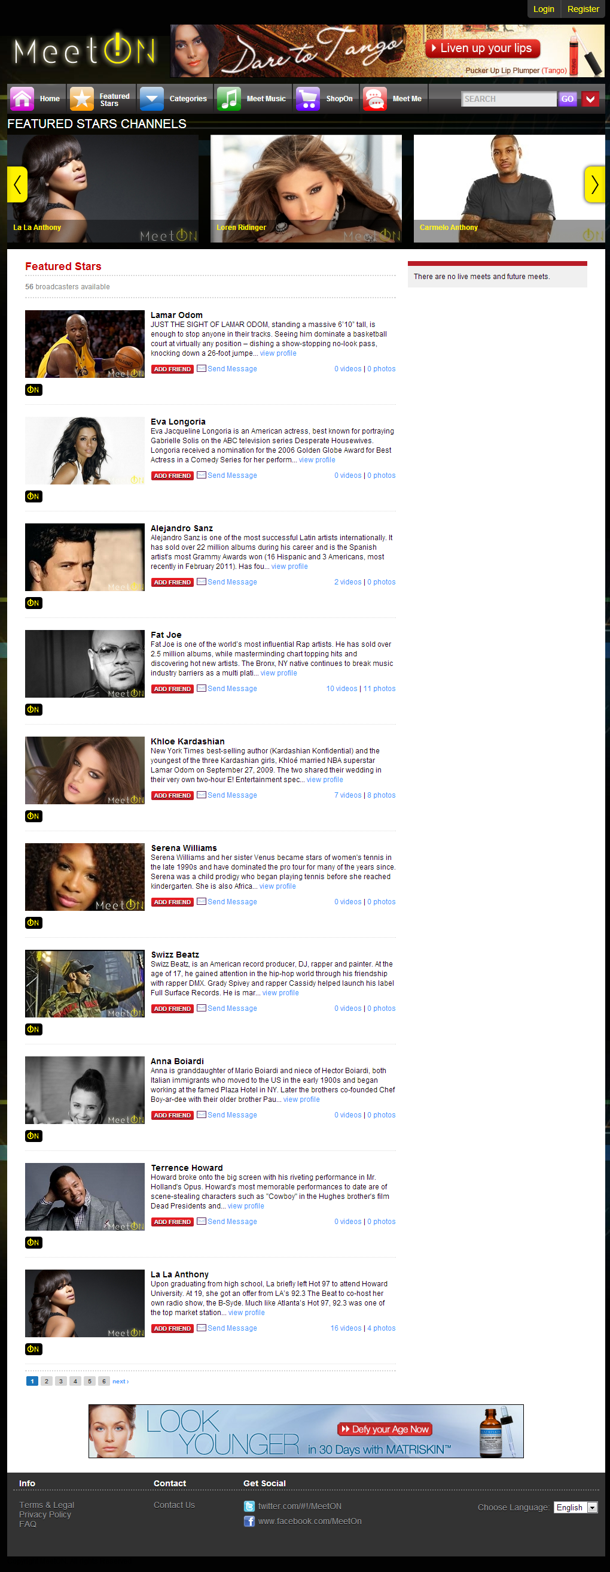

Slide 37
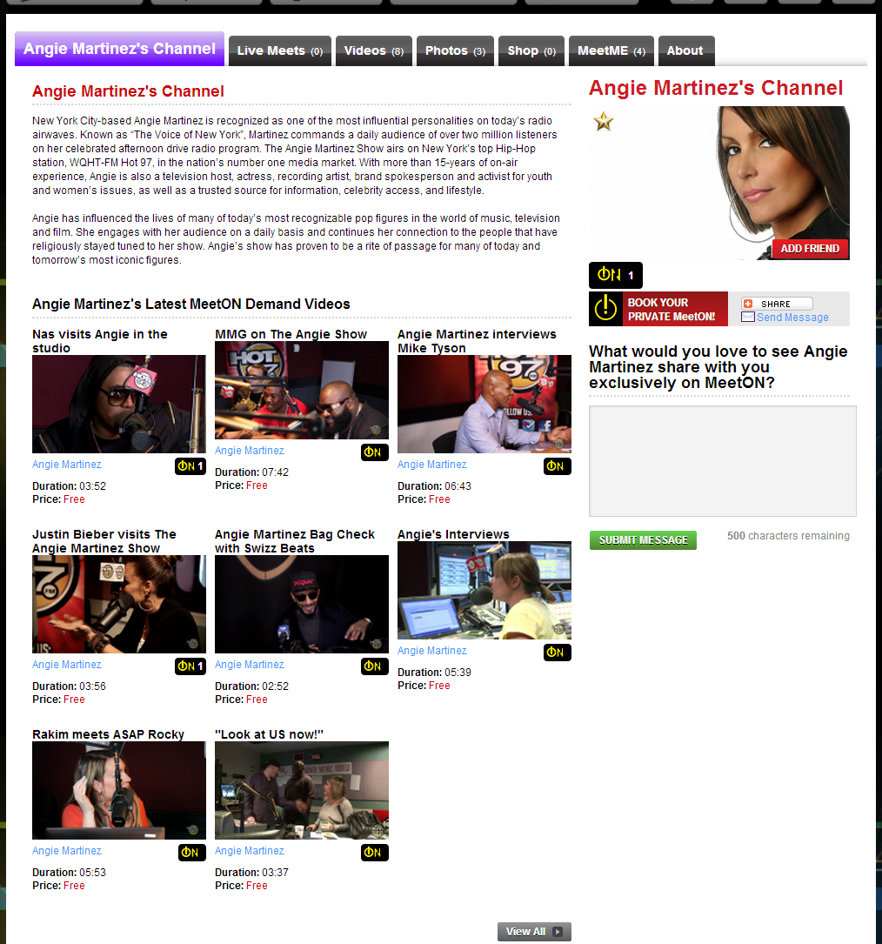

Slide 38
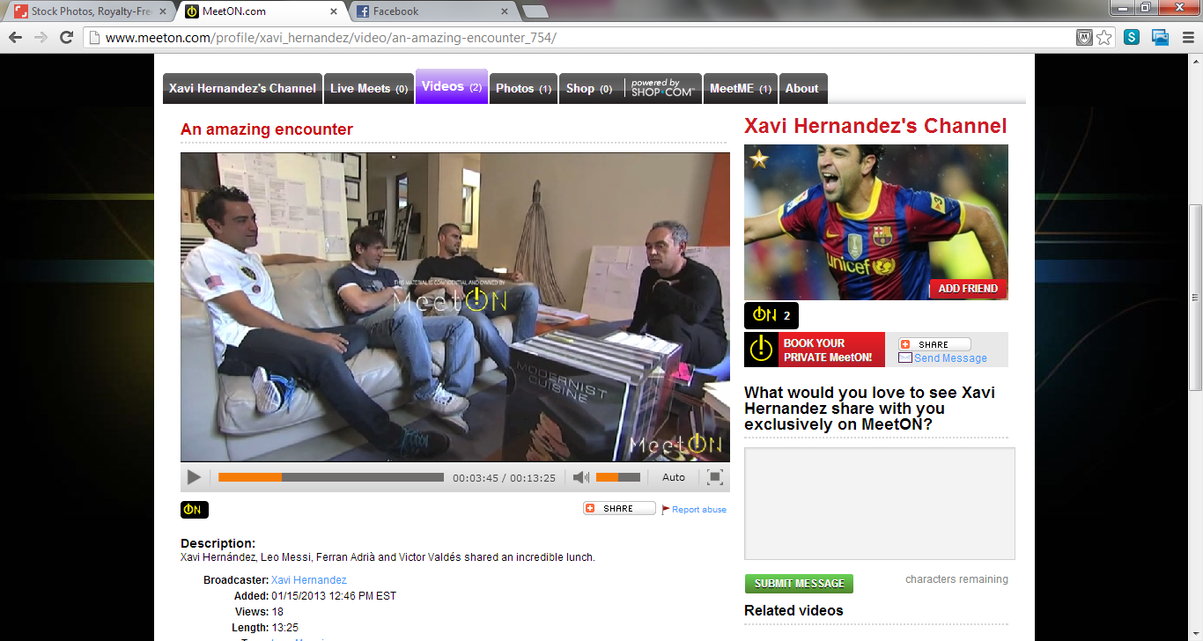

Slide 39
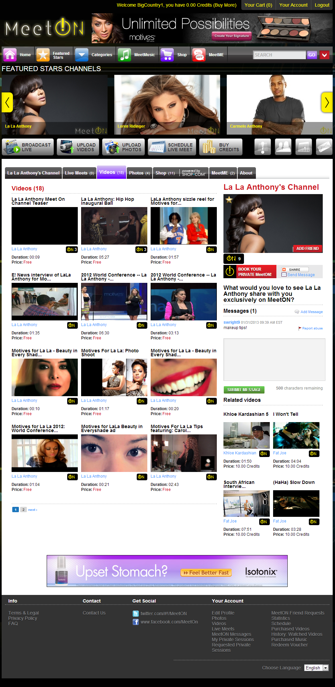
Notes:
Need new screen shot

Slide 40
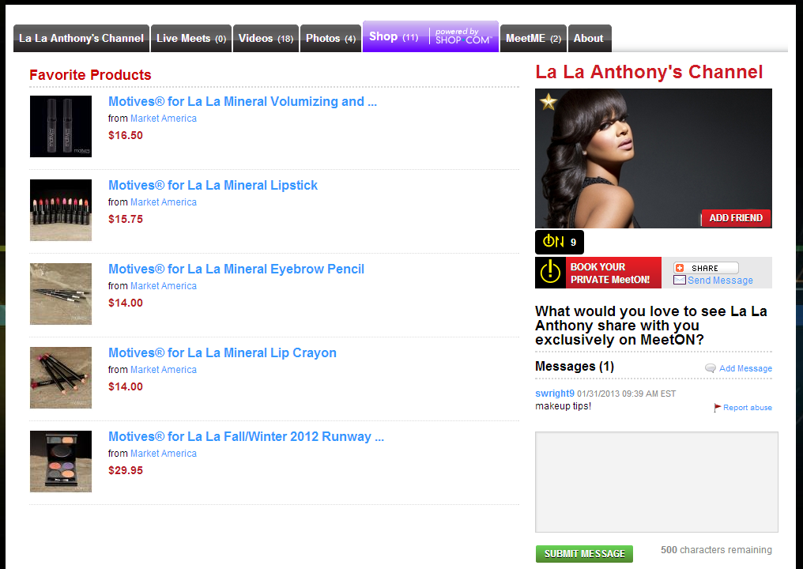
Screen shot of la la product
Notes:
Screen shot of products

Slide 41
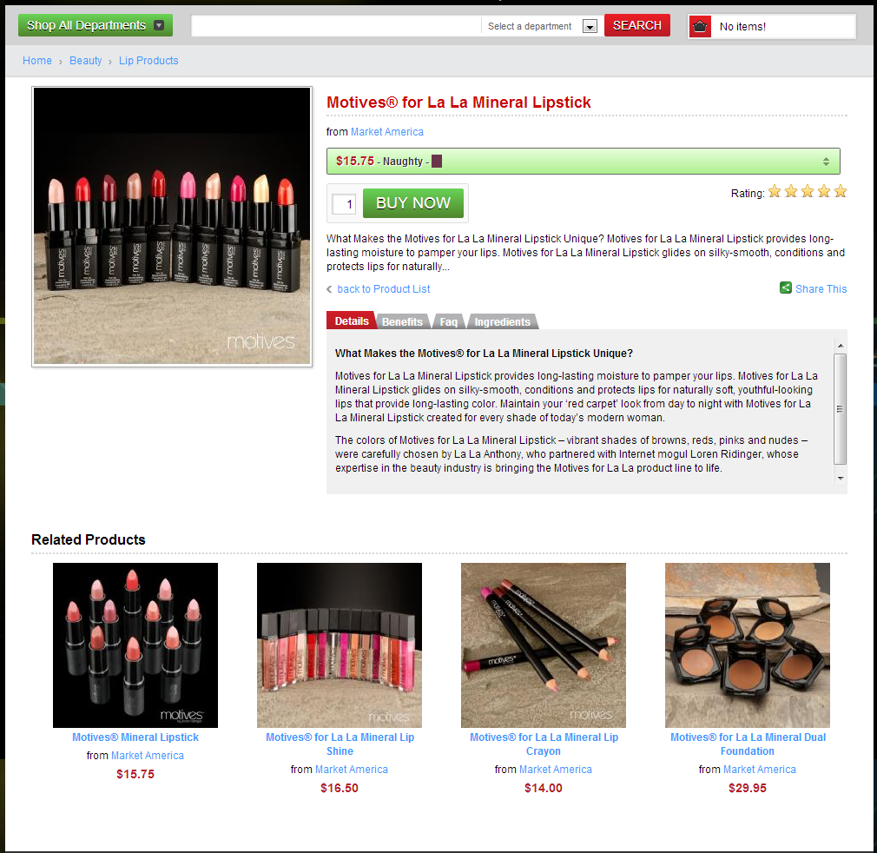
Screen shot of la la product drill down page
Notes:
Screen shot of products

Slide 42


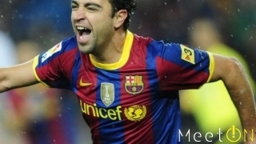

MeetON是未來的娛樂
MeetON is the Future of Entertainment
Notes:
Change out angie with xavi
Change la la to eva for the last one

Slide 43
想像一下…
Notes:
Just make this text pretty and stand out.

