Slide 1
極緻妍亮護膚系列

Slide 2
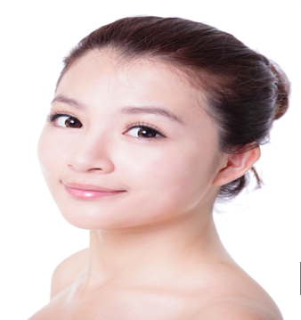

Slide 3
Put life and light into your skin with Lumière de Vie
Lumiére de Vie 極緻妍亮護膚系列─激活肌膚散發傳奇亮澤的奧秘

Slide 4
Gorgeous skin is just a few simple steps…
只需幾個簡單步驟，
動人肌膚即時擁有

Slide 5
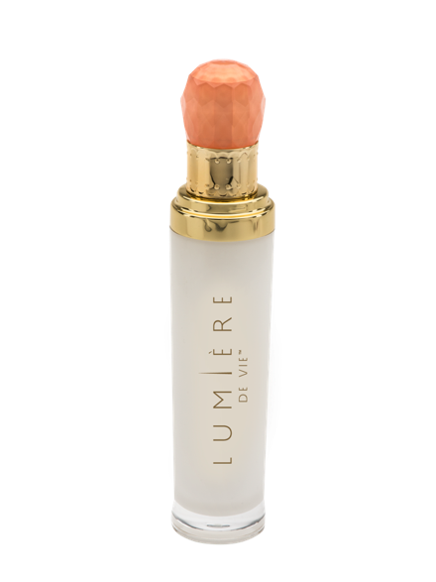
極緻妍亮淡斑液 ILLUMINATING FADING FLUID
Illumiscin：
縮小並淡化現有色斑，令膚色更均勻，煥發光彩
Illumiscin 正申請專利，功效經數項研究證實
Illumiscin:
Reduces the appearance of existing age spots so skin appears more even-toned and radiant
The application and efficacy of Illumiscin is verified in several studies
Code: HK12203 DC: $350 SR: $490 BV: 35

Slide 6
極緻妍亮淡斑液 ILLUMINATING FADING FLUID
Illumiscin：
有效減少色素過度沉澱的現象
在一項為期8周的實驗中，實驗對象的肌膚在顯著明亮
明顯改善泛紅情況及紓緩發炎或過敏皮膚
Illumiscin:
Reduces the appearance of hyper-pigmentation
In an 8 weeks study, participants saw dramatic improvement in skin brightening
Reduces the appearance of redness by calming irritated skin

Slide 7
極緻妍亮淡斑液 ILLUMINATING FADING FLUID
Illumiscin：
玻尿酸鈉的分子比透明質酸還小，含水量能高達其重量的1,000倍 ─ 比任何天然物質都高
由於玻酸酸鈉體積細小，其滲透力特別強
Illumiscin:
Smaller molecular size than hyaluronate acid, Sodium Hyaluronate is able to hold up to 1,000 times its weight in water
Due to its small size, Sodium Hyaluronate penetrates effectively

Slide 8
極緻妍亮淡斑液 ILLUMINATING FADING FLUID
Synovea HR（乙基間苯二酚）：
減淡色斑和黑斑
紓緩肌膚泛紅問題
促進肌膚柔軟嫩滑，更顯年輕
Synovea HR:
Reduces the appearance of dark spots and age spots
Reduces the appearance of redness
Promotes softer and smoother skin for a youthful appearance

Slide 9
極緻妍亮淡斑液 ILLUMINATING FADING FLUID
效果：
令肌膚顯著明亮，膚色更年輕、有活力
滋潤肌膚，令肌膚更柔軟、嫩滑
Results you can expect:
Dramatically brightens your skin for a more radiant, younger-looking complexion
Moisturizes to give skin a smoother and softer appearance

Slide 10
極緻妍亮淡斑液 ILLUMINATING FADING FLUID
效果：
局部使用可深入肌膚真皮層，混和、吸引和維持肌膚水份
促進健康肌膚微循環，有助維持正常肌膚代謝與營養吸收
減淡皺紋
Results you can expect:
Applied topically, it reaches deep into the dermis layer of the skin to mix with, attract and maintain water
Promotes healthy skin microcirculation, helps maintain normal skin metabolism and nutrient absorption
Reduces the appearance of wrinkles

Slide 11
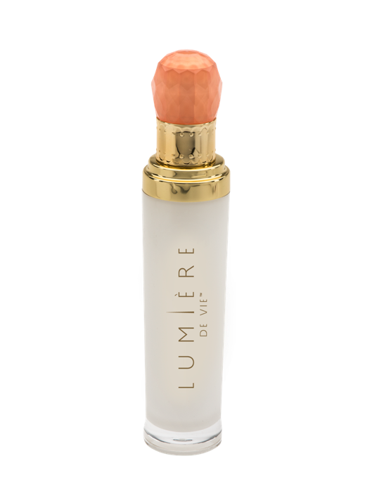
極緻妍亮精華液
SERUM CONCENTRATE
Juvenessence
來自海洋的海藻萃取物
支援健康、正常的肌膚細胞能量水平
Juvenessence
An algae extract from the sea
Supports a healthy, normal cellular energy level in the skin
Code: HK12204 DC: $495 SR: $690 BV: 50

Slide 12
極緻妍亮精華液
SERUM CONCENTRATE
真正為熟齡肌膚修復老化結果：
Juvenessence 能令肌膚回復緊緻、光滑及有彈性
支援健康的肌膚防禦屏障功能，維持肌膚水份充足
延緩年輕肌膚的老化過程：
減慢加速的老化過程
Real aging repair for mature skin:
Juvenessence supports firmness, elasticity, smoothes the skin
Supports a healthy skin barrier function to keep skin hydrated
Real age delay for younger looking skin:
Delays the look of accelerated aging

Slide 13
極緻妍亮精華液
SERUM CONCENTRATE
Sytenol A
是補骨脂葉中分離出的天然成份，其中主要的有效成份為補骨脂酚
是抗氧化與抗炎複合物，提供廣泛的抗老化功能
Sytenol A
Natural ingredient isolated from the leaves of Psoralea corylifolia, the active principal of which is bakuchiol
Provides broad spectrum anti-aging benefits as antioxidant and anti-inflammatory compounds

Slide 14
極緻妍亮精華液
SERUM CONCENTRATE
Sytenol A
促進膚色剔透、健康
有效減淡細紋及皺紋
功效獲廣泛研究支持
Sytenol A
Promotes a clear, healthy-looking complexion
Powerful effects in reducing the appearance of fine lines and wrinkles
Their activities are supported by extensive test data

Slide 15
極緻妍亮精華液
SERUM CONCENTRATE
Synovea HR（乙基間苯二酚）：
有效減少色素過度沉澱的現象
在一項為期8周的實驗中，實驗對象的肌膚在4周後亮白50%
Synovea HR:
Very effective in reducing the appearance of hyper-pigmentation of the skin
In an 8 week study, participants saw dramatic improvement in skin brightening after 4 weeks

Slide 16
極緻妍亮精華液
SERUM CONCENTRATE
Synovea HR（乙基間苯二酚） ：
保護細胞健康
DNA保護 ─ 在紫外線下
蛋白質保護 ─ 抗醣化作用
Synovea HR:
Supports cell health
Promotes healthy DNA under UV-light
Helps support healthy collagen function

Slide 17
極緻妍亮精華液
SERUM CONCENTRATE
Synovea HR（乙基間苯二酚）：
於臨床實驗中不經動物測試
加強皮膚的天然保水作用
抗氧化物有助抵禦環境壓力的影響
經臨床實驗證實
Synovea HR
Not tested in animals in clinical studies
Enhances skin’s natural moisture retention
Antioxidants help protect against the effects of environmental stresses
Verified in clinical studies

Slide 18
極緻妍亮精華液
SERUM CONCENTRATE
Synovea HR（乙基間苯二酚）：
肌膚緊緻度提升
28天後，光滑程度明顯改善
使膚色看起來健康年輕
增加膠原蛋白
Synovea HR:
Helps maintain skin firmness
Noticeably improves skin smoothness in 28 days
Promotes a healthy, younger-looking complexion
Supports healthy levels of collagen

Slide 19
極緻妍亮精華液
SERUM CONCENTRATE
效果：
減慢加速的老化過程
支援健康的膠原強白水平
減少肌膚色素沉澱
促進膚色剔透明亮
Results you can expect:
Delays in the look of accelerated aging
Supports healthy levels of collagen
Reduces the appearance of hyper-pigmented skin
Promotes a clear-looking complexion

Slide 20
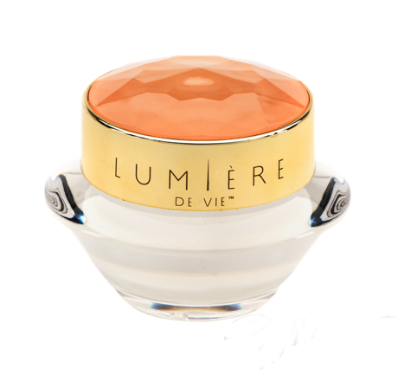
極緻妍亮逆齡面霜
INTENSE REJUVENATION CRÈME
五胜肽(Matrixyl synthe’6™)：
減淡皺紋
有助減淡色斑，令膚色更剔透明亮
提供必要脂質，為肌膚保濕，令其更柔軟、嫩滑
Matrixyl® synthye’6:
Reduces the appearance of wrinkles
Helps reduce the appearance of age spots for a brighter-looking complexion
Hydrates the skin exceptionally with essential lipids for softer, smoother-feeling skin
Code: HK12201 DC: $350 SR: $490 BV: 35

Slide 21
極緻妍亮逆齡面霜
INTENSE REJUVENATION CRÈME
Granactive AR-1423 ：
支援正常、健康的膠原蛋白與彈力蛋白水平，讓肌膚維持柔軟、年輕
紓緩肌膚泛紅問題
具抗炎功效
Granactive AR-1423:
Supports normal, healthy collagen and elastin to keep the skin feeling supple and looking youthful
Reduces the appearance of redness
Anti-inflammatory effects

Slide 22
極緻妍亮逆齡面霜
INTENSE REJUVENATION CRÈME
12 週：
肌膚明亮度提升
膚色、彈性與緊緻度提高
促進健康膠原蛋白製造
12 weeks:
Significant increase in skin radiance and brightness
Improves the appearance of skin tone, promotes healthy skin elasticity and firmness
Promotes healthy collagen production

Slide 23
極緻妍亮逆齡面霜
INTENSE REJUVENATION CRÈME
12 週：
促進熱休克蛋白（環境壓力因素）的正常活動
促進肌膚正常修復
促進正常玻尿酸製造
12 weeks:
Promotes the normal function of heat shock proteins (environmental stressors)
Promotes normal skin healing
Promotes normal Hyaluronic acid production

Slide 24
極緻妍亮逆齡面霜
INTENSE REJUVENATION CRÈME
五胜肽(Matrixyl synthe’6™)：
脫氧脂肽，能刺激皮膚基質和真表皮交界處六種主要成份之合成
從內支援肌膚，有助減淡皺紋
Matrixyl synthe’6
Deoxygenated lipopeptide that promotes the synthesis of six major ingredients in the skin’s matrix and dermal-epidermal junction.
The result is that skin is supported from the inside, helping to reduce the appearance of wrinkles

Slide 25
極緻妍亮逆齡面霜
INTENSE REJUVENATION CRÈME
五胜肽(Matrixyl synthe’6™)：
動力肽(Powerhouse Peptide)能顯著撫平肌膚，並使皮膚細緻
臨床研究顯示，使用2個月後，前額及眼尾肌膚更平滑
Matrixyl® synthe’6
Powerhouse Peptide dramatically smoothes and refines skin
Clinical studies demonstrate that after two months, forehead and crow’s feet appear smoother

Slide 26
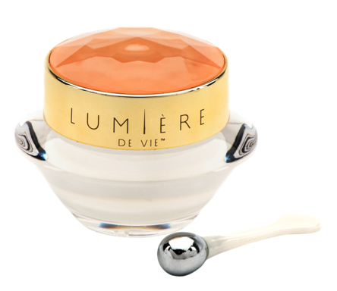
極緻妍亮眼霜
EYE BALM
Pinoxide® ：
支援正常、健康的肌膚微循環
有助減淡黑眼圈
Pinoxide ®
Supports normal, healthy microcirculation of the skin
Helps reduce the appearance of under-eye dark circles
Code: HK12200 DC: $240 SR: $335 BV: 23

Slide 27
極緻妍亮眼霜
EYE BALM
效果：
減淡黑眼圈
緊緻眼底肌膚
支援肌膚彈性
滋潤肌膚，令肌膚更柔軟、嫩滑
Results you can expect:
Reduces the appearance of under eye dark circles
Promotes under-eye skin firmness
Supports the resiliency of skin
Moisturizes for skin that looks and feels softer and smoother

Slide 28
極緻妍亮眼霜
EYE BALM
效果：
加入柔光因子，使眼周肌膚細緻無瑕
改善膚質
有助維持柔滑、年輕的肌膚
促進健康的膠原蛋白水平
Results you can expect:
Light-diffusing pigments promote a flawless-looking appearance
Improves the appearance of skin texture
Helps maintain smooth young-looking skin
Promotes healthy collagen levels

Slide 29
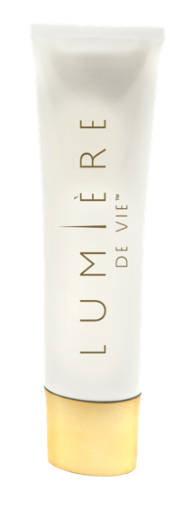
極緻妍亮火山泥去角質面膜
VOLCANIC EXFOLIATING MASK
PerfectionPeptide P3：
破壞皮膚表面死掉細胞之間的鏈結
去除角質，使肌膚光滑、煥發光彩
減淡皺紋
PerfectionPeptide P3:
Specifically breaks the bonds between dead cells at the surface of the skin
Exfoliates the skin for a smoother, more radiant complexion
Reduces the appearance of wrinkles
Code: HK12202 DC: $305 SR: $425 BV: 32

Slide 30
極緻妍亮火山泥去角質面膜
VOLCANIC EXFOLIATING MASK
PerfectionPeptide P3：
多項臨床研究證實，PerfectionPeptide P3的天然去角質功效可改善肌膚瑕疵、不平滑與衰老跡象
促進健康細胞更新，令肌膚外表更年輕健康
PerfectionPeptide P3:
As verified in several clinical studies, the natural peeling effect of PerfectionPeptide P3 can minimize the appearance of imperfections, irregularities and aging signs
Promotes healthy cell renewal for fresher, more vibrant-looking skin

Slide 31
極緻妍亮火山泥去角質面膜
VOLCANIC EXFOLIATING MASK
效果：
尿囊素、甜杏仁油、橄欖油和葡聚多醣體等成份有助紓緩肌膚
綠茶及歐洲藍莓中的抗氧化成份有助抵抗環境壓力對肌膚造成的影響
Results you can expect:
Soothes the skin with allantoin, sweet almond oil, olive fruit oil, and beta-glucan
Antioxidants from green tea and bilberry help protect against the effects of environmental stress on the skin

Slide 32
極緻妍亮火山泥去角質面膜
VOLCANIC EXFOLIATING MASK
效果：
加速細胞更新，讓肌膚更加光滑透亮
密集滋潤，為肌膚保濕
淡化肌膚紋路，減少皺紋深度
令肌膚煥發重生光彩
Results you can expect:
Promotes cell renewal for fresher and more vibrant skin
Hydrates the skin intensely
Refines skin texture and reduces the appearance of wrinkles
Skin that reflects light with new radiance

Slide 33
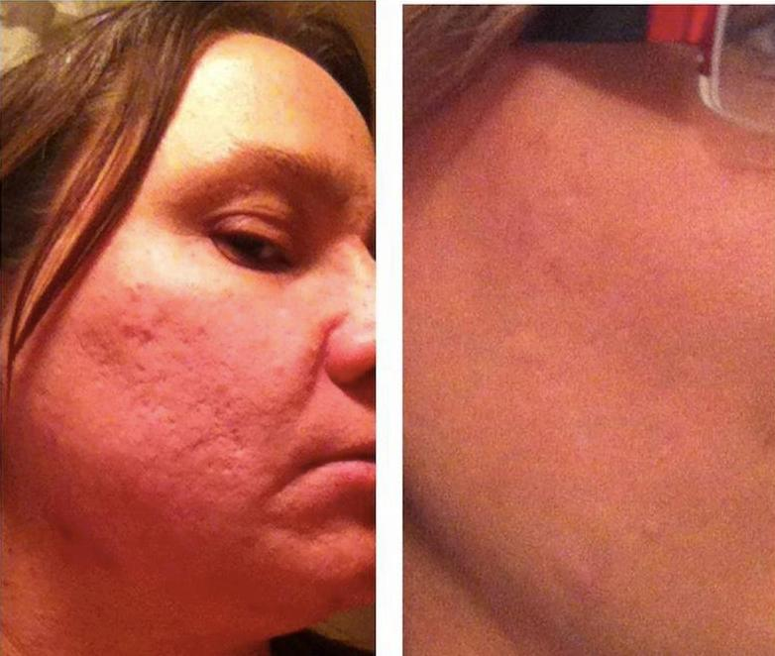
顯著的效果
AMAZING RESULTS

Slide 34
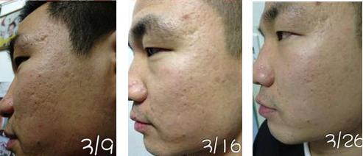
顯著的效果
AMAZING RESULTS

Slide 35
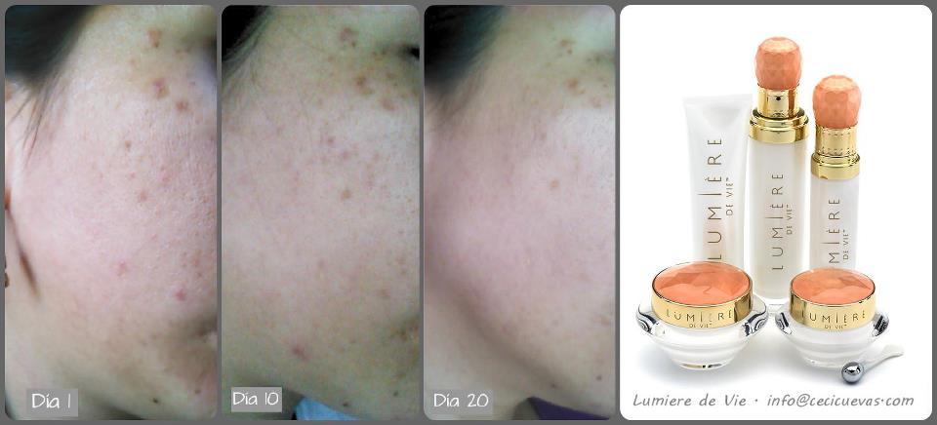
顯著的效果
AMAZING RESULTS

Slide 36
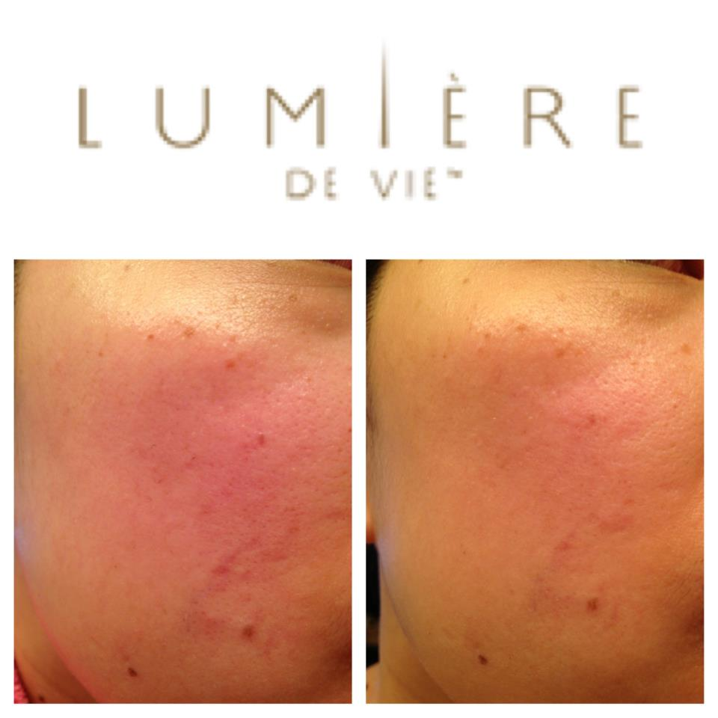
顯著的效果
AMAZING RESULTS

Slide 37
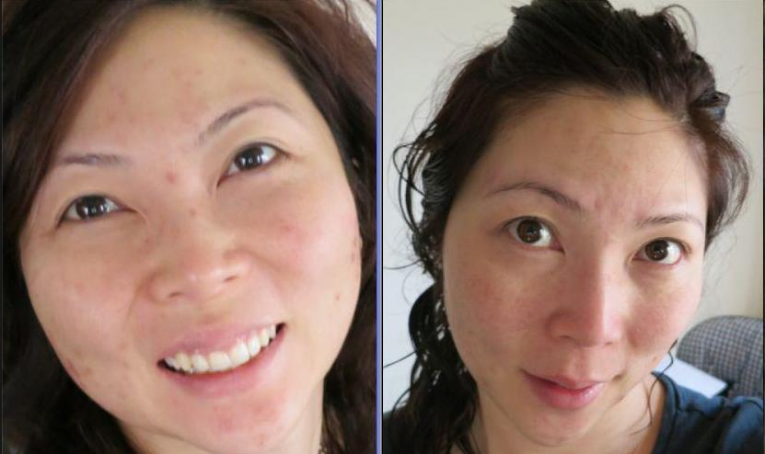
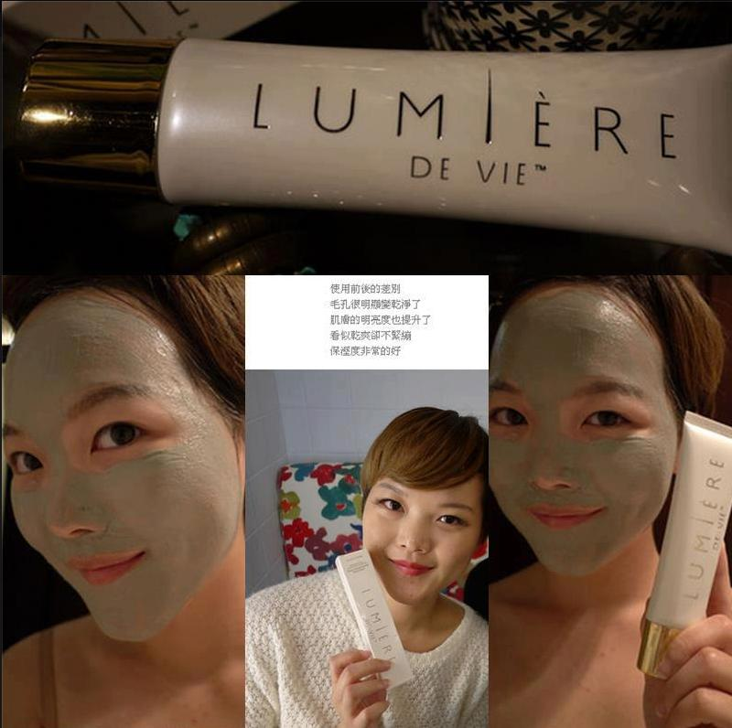
顯著的效果
AMAZING RESULTS

Slide 38
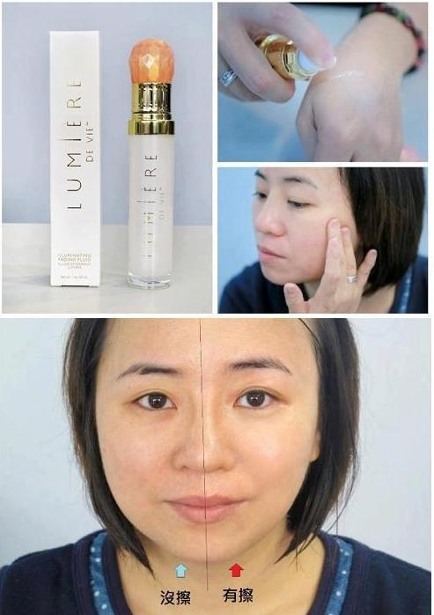
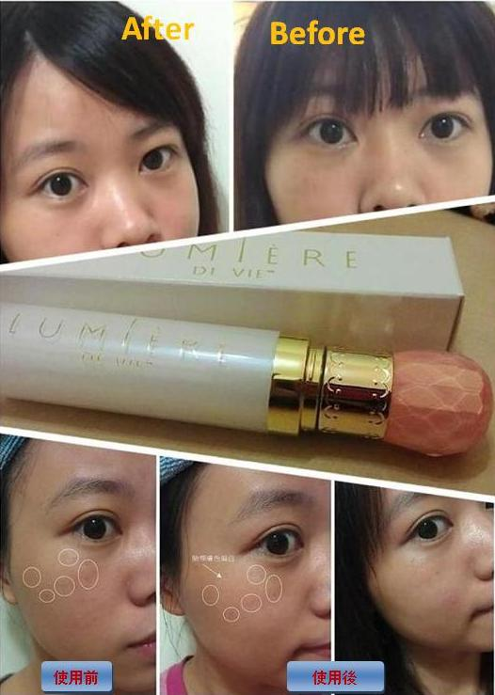
顯著的效果
AMAZING RESULTS

Slide 39
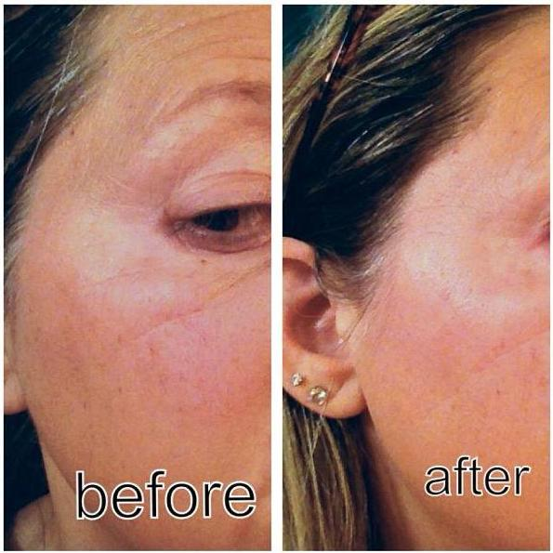
顯著的效果
AMAZING RESULTS

Slide 40
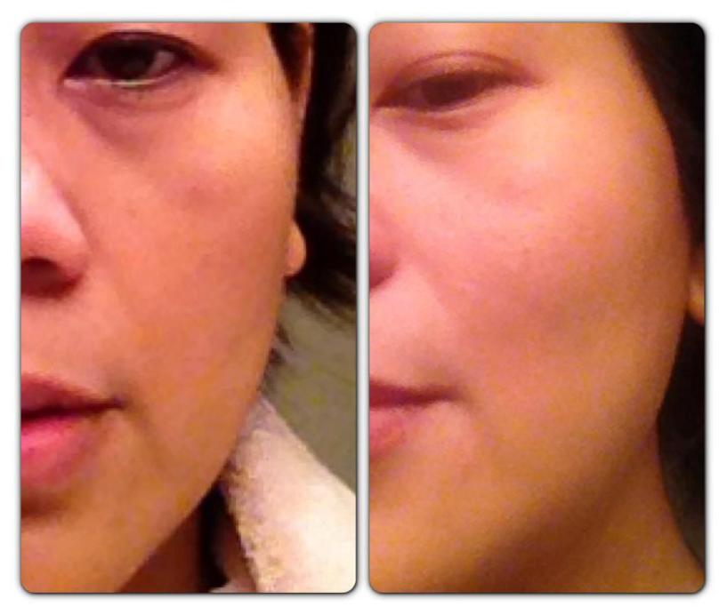
顯著的效果
AMAZING RESULTS

Slide 41
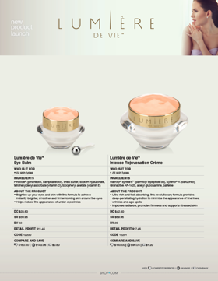
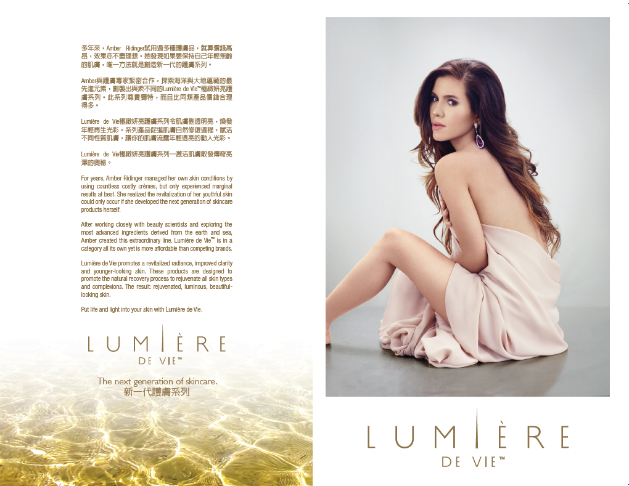
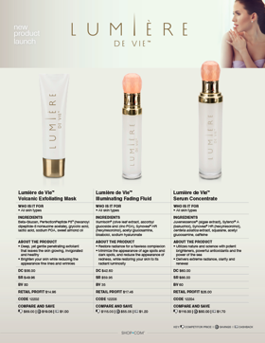
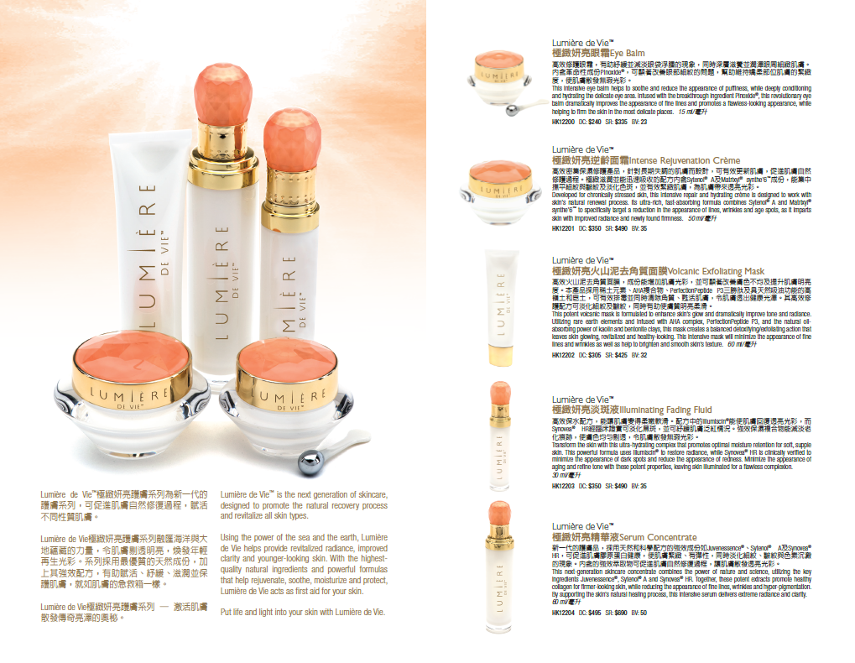
護膚圖表
Lumiere de Vie™ 極緻妍亮護膚系列
銷售輔助工具 －即將推出
Sales Aids – COMING SOON!
REGIMEN HANDOUT
COMING SOON
講義可以下載
Handouts
Available on Downloads
Skincare Chart

Slide 42
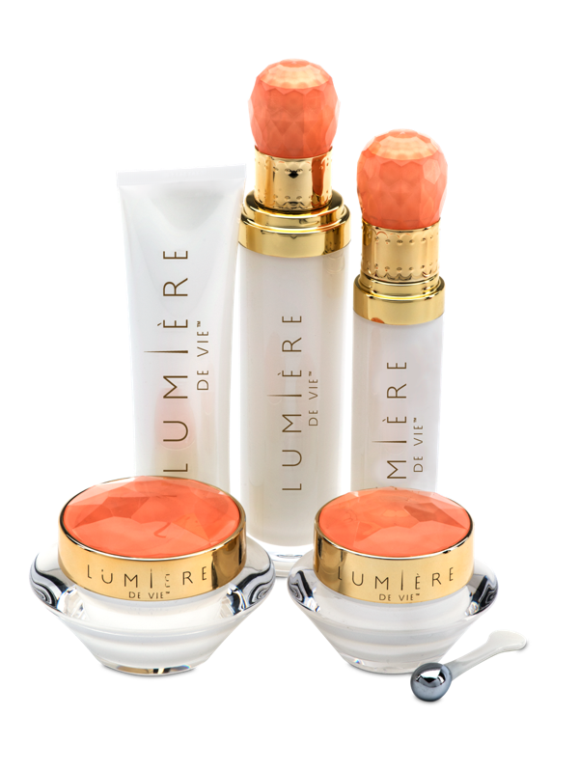
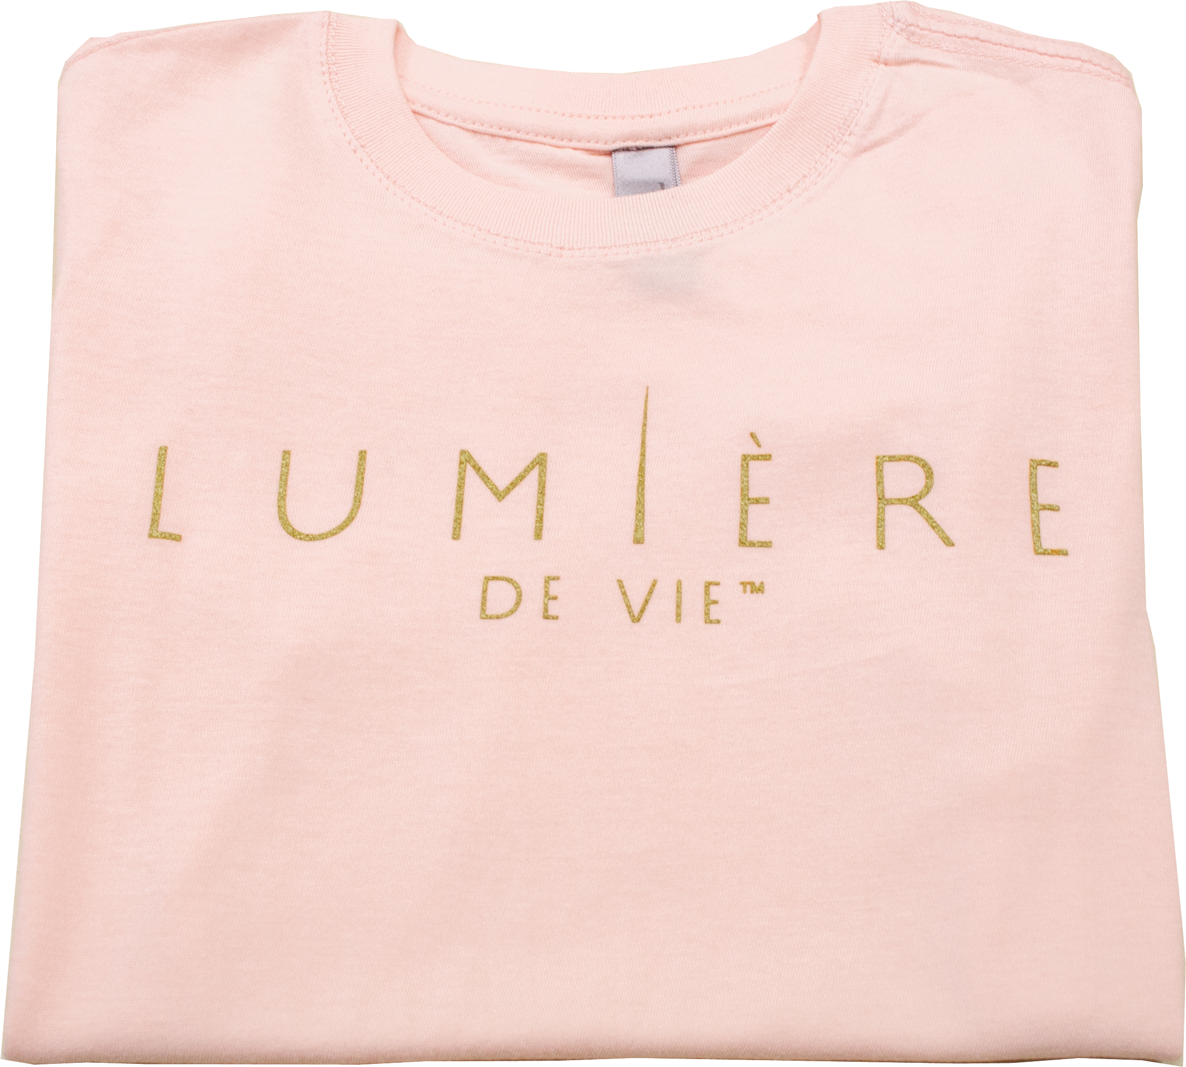
現場限量套裝優惠
SPECIAL LIMITED PROMOTION
免費！
FREE!

Slide 43
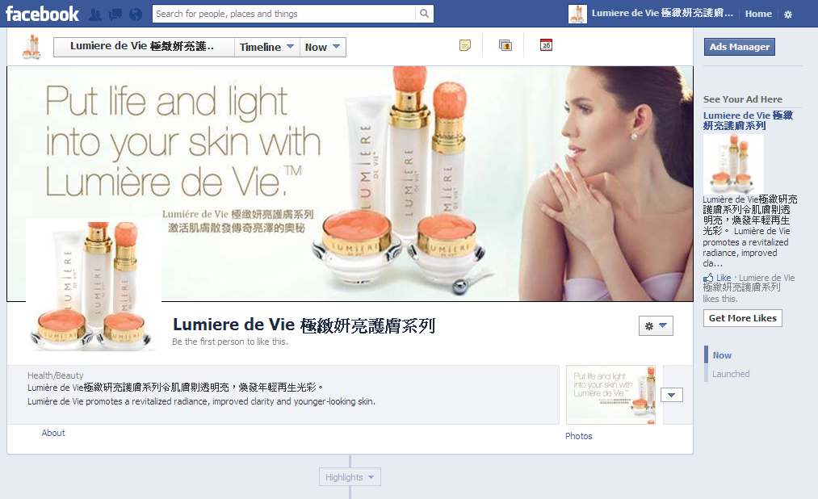
贏取全套Lumière de Vie產品！
Chance to win A SET of Lumière de Vie!

Slide 44
激活肌膚 散發傳奇亮澤的奧秘
PUT LIFE AND LIGHT INTO YOUR SKIN

