Slide 1
Motives® 事業華麗綻放 Taking Motives® to the Next Level
夏日水漾系列
Spring / Summer Watercolor

Slide 2
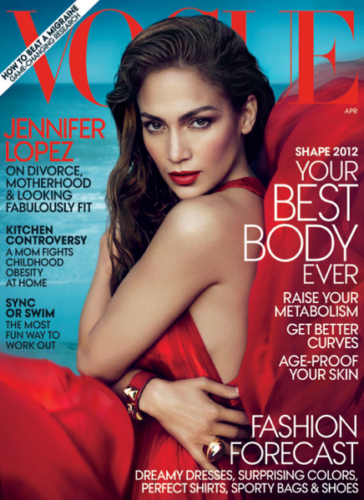
Motives® By Loren Ridinger®獲媒體廣泛報導：
Motives® By Loren Ridinger® has been featured in:

Slide 3
Motives for La La獲媒體廣泛報導： Motives for La La has been featured in:

Slide 4
產品：
化妝品
眼部
唇部
工具
指甲
套裝
fixx Solution-Oriented Products®
PRODUCTS:
Cosmetics
Eye
Lips
Tools
Nails
Kit
fixx Solution-Oriented Products®

Slide 5
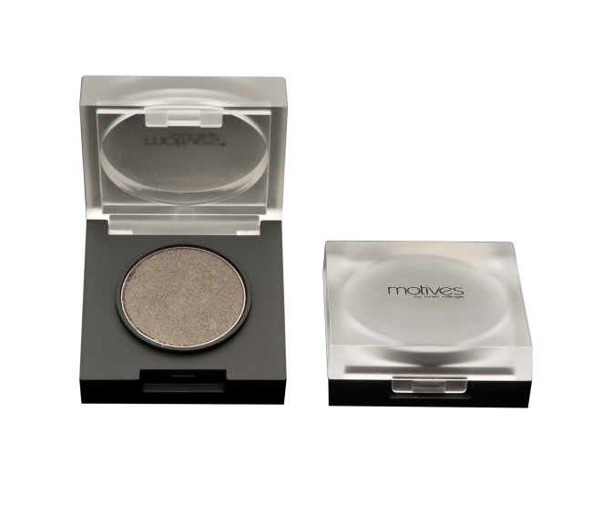
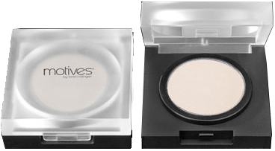
眼影 Pressed Eye Shadow
DC: $95.00 SR: $133.00 BV: 7.5
Crème Fresh
HK116MES
Cat Walk
HK182MES
眼部 FOR EYES
高清睫毛液
增長睫毛外觀
革命性採用橡膠刷毛的高清刷頭，讓每一根
睫毛都可散開和增長
Lustrafy High Definition Mascara
Lengthens your lashes
Revolutionary high-definition brush
with rubber bristles that fans out and
lengthens each lash
Oxyn
HK100MHDM
Midnight Blue
HK103MHDM
DC: $110.00 SR: $150.00 BV: 10

Slide 6
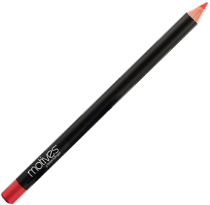
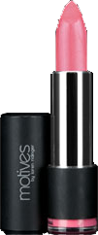
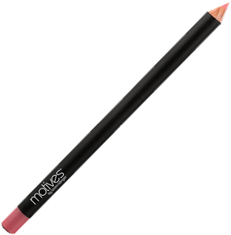
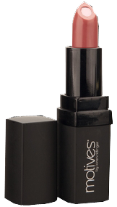
持久色澤唇線筆
Lip Crayon
Coral Kiss, Pink Lady
HK40MLP, HK41MLP
DC: $109.00
SR: $153.00
BV: 8.5
極緻滋潤唇膏
Rich Formula Lipstick
Lolita Pink
HK200ML
DC: $109.00
SR: $153.00
BV: 8.5
瞬間豐盈唇彩
Pucker Up Lip Plumper
Enchanted
HK06MP
DC: $130.00
SR: $182.00
BV: 11
膠原抗氧修護唇膏
Collagen Core Lipstick
Optimistic
HK10MCL
DC: $155.00
SR: $220.00
BV: 12.5
唇部 FOR LIPS
礦物唇彩
Mineral Lip Shine
Peach Glaze, Rose Glaze
HK59MLG, HK114MLMG
DC: $125.00
SR: $175.00
BV: 9

Slide 7
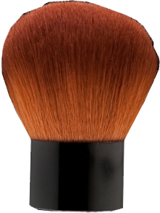
蘑菇掃
尼龍掃毛細滑柔軟，讓你順滑、全面掃上化妝品
讓你輕易將碎粉、胭脂和光影粉掃上面部和身上
掃柄較大，讓你更易握緊和控制
工具 TOOLS
Kabuki Brush
Contains luxuriously soft, nylon bristles for a
smooth, full coverage application
Easily sweeps powder, blush and bronzer onto
the face and body
Large handle to allow for firm grip and more
control over application
HK41MBR DC: $92.00 SR: $128.00 BV: 4

Slide 8
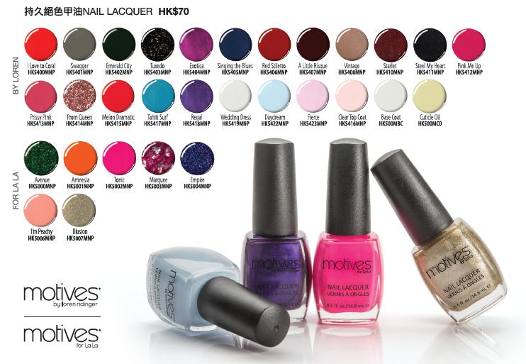
持久絕色甲油
色澤持久
配方出色、不易剝落
可輕易順滑塗上
包括迷人、時尚的顏色，可配合
不同形象風格
不含甲苯、甲醛和鄰苯二甲酸酯
二丁酯
指甲 FOR NAILS
Nail Lacquer
Long-lasting color
Brilliant, chip-resistant finish
Easy, smooth application
Sexy, trend-setting colors for
every look
Free of toluene, formaldehyde
and dibutyl phthalate
DC: $50.00 SR: $70.00 BV: 3.5

Slide 9
護甲底油
Base Coat
HK500MBC
DC: $50.00
SR: $70.00
BV: 3.5
護色面油
Clear Top Coat
HK5416MNP
DC: $50.00
SR: $70.00
BV: 3.5
指甲 FOR NAILS
甲部角質護理油
維他命E及紅花油可滋潤甲部角質
有助保護指甲，防止斷裂
HK500MCO
DC: $50.00
SR: $70.00
BV: 3.5
Cuticle Oil
Vitamin E and safflower oil hydrate and
moisturize the cuticle
Helps protect nail from splitting and cracking

Slide 10
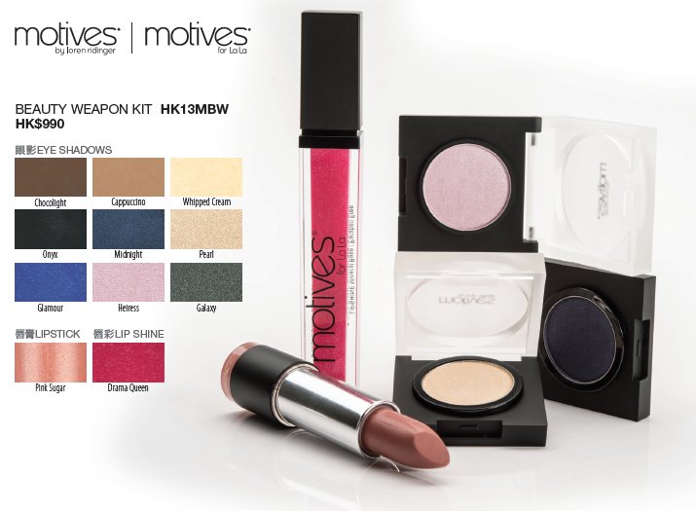
節省超過
Saving Over 35%
Beauty Weapon Kit
9盒眼影
1支極緻滋潤唇彩
1支礦物唇膏
9 Pressed Eye Shadows
1 Rich Formula Lipstick
1 Mineral Lip Shine
Beauty Weapon Kit
玩味 Fun | 自然 Natural | 煙燻 Smokey
Midnight | Cappuccino | Onyx
Glamour | Chocolight | Galaxy
Heiress | Whipped Cream | Pearl
HK13MBW DC: $705.00 SR: $990.00 BV: 65.5

Slide 11
個人護理行業
Personal Care Industry
男士美容業每年增長8%
預測2015年前，男士美容產品銷售額將超過332億美元
單是2010年上半年，L’Oreal男士護膚系列的銷售額已上升30%
The men’s grooming industry is growing 8% a year
Men's grooming products are projected to exceed $33.2 billion by the year 2015
In just the first half of 2010, sales for L’Oreal’s men’s line were up 30%

Slide 12
get
your
Solution-Oriented Products

Slide 13
Successful. Sophisticated. Solutions.
利用科學為本、針對解決
肌膚問題的產品提升外表，
讓你型格出眾
Enhance your appearance
with style and sophistication
using science-based,
solution-oriented products.

Slide 14
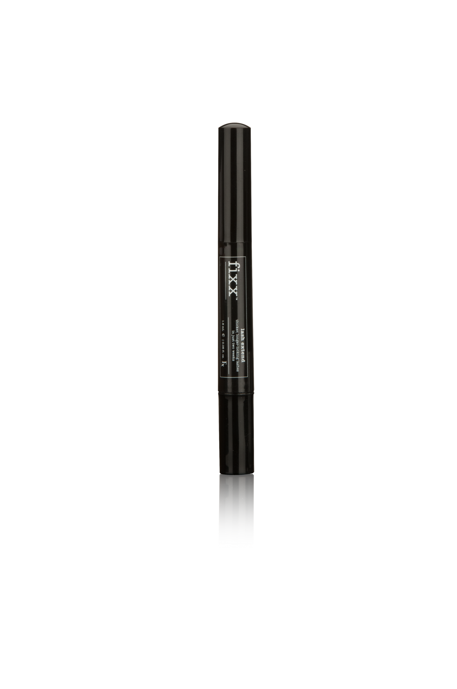
Successful. Sophisticated. Solutions.
速效豐盈睫毛精華
Lash Extend
兩星期令睫毛和眉毛更顯豐盈纖長
THICKER LONGER LOOKING LASHES & BROWS IN JUST TWO WEEKS
好處：
SymPeptides™勝肽複合物於14天內顯著提升睫毛及眉毛量25%，效果快速明顯
水解黏多糖促進睫毛健康、纖長
Why You Want It:
SymPeptides™ increase visible volume of lashes and eyebrows
by 25% in just 14 days for fast, dramatic results
Hydrolyzed glucosaminglycans promotes healthy, long lashes
同類產品
需 6星期
Code: HK12520 DC: $148.00 SR: $200.00 BV: 12.5

Slide 15
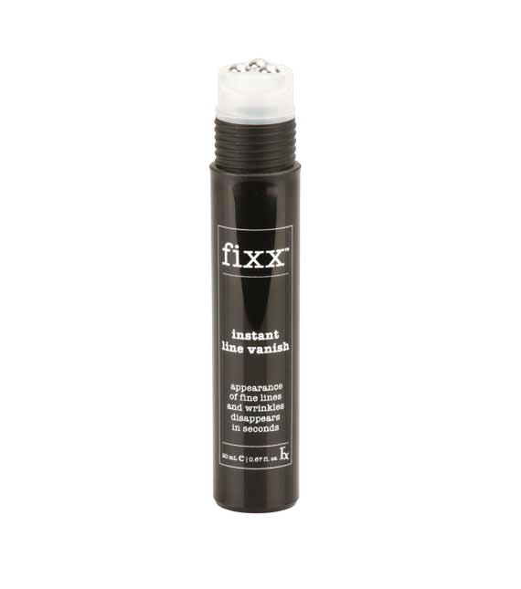
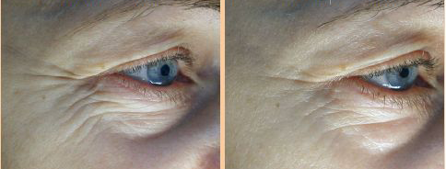
Successful. Sophisticated. Solutions.
瞬間無痕緊緻液
Instant Line Vanish
迅速撫平細紋與皺紋
FINE LINES & WRINKLES DISAPPEAR QUICKLY
好處：
棕櫚醯寡肽即時撫平細紋與皺紋
具抗皺及緊緻的效果
減少浮腫感
明顯緊緻肌膚
Why You Want It:
Palmitoyl oligopeptide instantly smoothes away the appearance of fine lines and wrinkles
Anti-wrinkling and lifting effect
Reduces the look of puffiness
Visibly firms skin
Code: HK12522 DC: $122.00 SR: $170.00 BV: 9.5

Slide 16
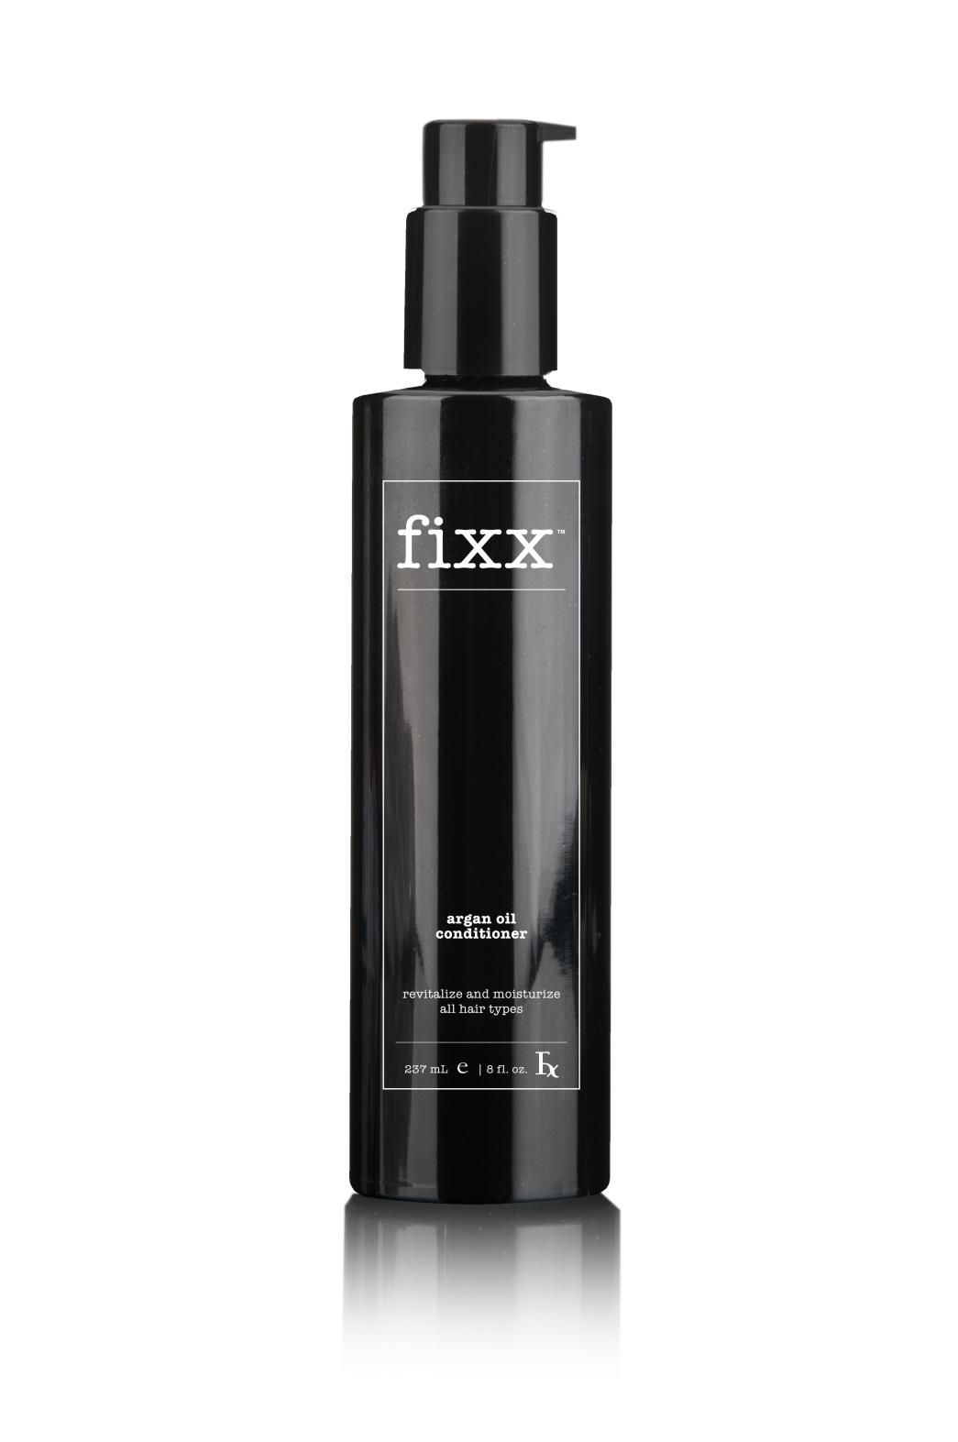
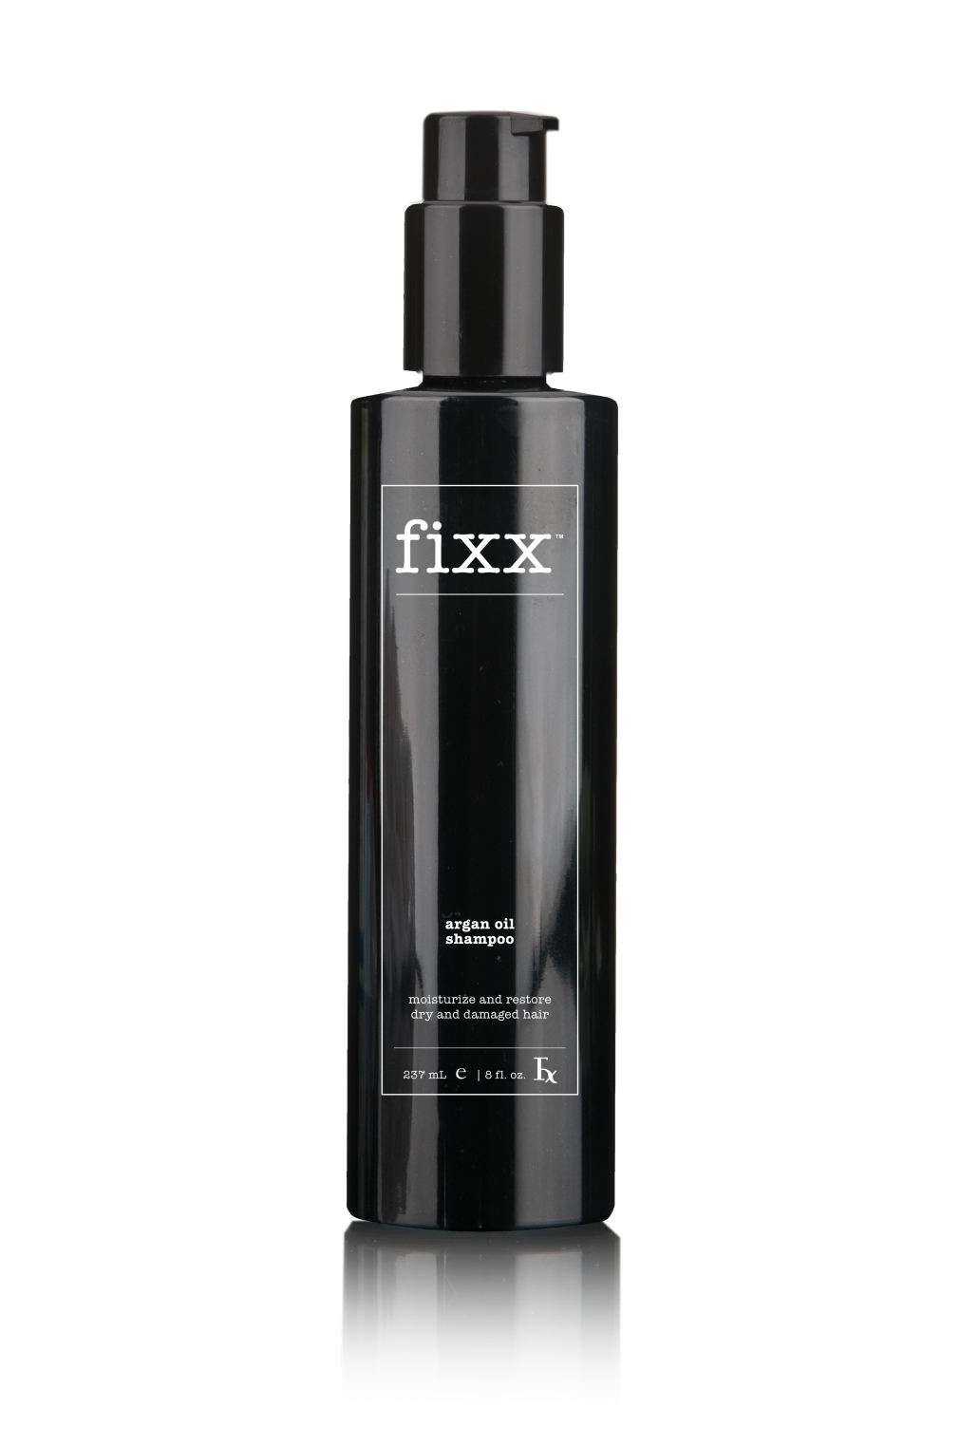
Successful. Sophisticated. Solutions.
摩洛哥堅果油洗髮乳及護髮素
好處：
摩洛哥堅果是珍貴罕有的個人護理產品成份
有助強化髮絲，令秀髮更顯健康
減少頭髮打結，容易整理
能為各種髮質增添光澤
Argan Oil Shampoo & Conditioner
Why You Want It:
Moroccan Argan Oil, one of the rarest and most sought-after ingredients in the personal care industry
Helps fortify each strand for visibly healthy-looking hair
Reduce tangles to keep hair manageable
Provides shine and luster to all hair types

Slide 17
Successful. Sophisticated. Solutions.
摩洛哥堅果油洗髮乳及護髮素
摩洛哥堅果油
取自摩洛哥堅果樹的種子
不油膩
富含天然生育醇（維他命E）、脂質與脂肪 酸、胡蘿蔔素及鮫鯊烯
Argan Oil Shampoo & Conditioner
Moroccan Argan Oil:
Derived from the seeds of fruit of Moroccan Argan tree
Non-greasy & non-oily
Rich in natural tocopherols, lipids and fatty acids, carotene and squalene

Slide 18
Successful. Sophisticated. Solutions.
摩洛哥堅果油洗髮乳及護髮素
蘆薈葉汁
令頭髮柔軟、健康、強韌
有助保留水份，令髮絲柔滑、有光澤
Argan Oil Shampoo & Conditioner
Aloe Barbadensis Leaf Juice
Makes hair soft, healthy and strong
Helps to retain moisture, body, shine and smoothness

Slide 19
Successful. Sophisticated. Solutions.
摩洛哥堅果油洗髮乳
好處：
滲透皮膚與毛囊，達到保濕效果
含有獨特的維他命與礦物質配方
含有摩洛哥堅果油、蠶絲氨基酸和水解小麥蛋白，令頭髮強韌、閃亮和容易整理
香氣怡人
Argan Oil Shampoo
Why You Want It?
Penetrates skin & hair follicles to help moisturize
Contains unique blend of vitamins and minerals
Promotes strength, shine, and manageability with Argan Oil, Silk Amino Acids and Hydrolyzed Wheat Protein
Delicious scent
Code: HK12502 DC:$120.00 SR:$168.00 BV: 11

Slide 20
Successful. Sophisticated. Solutions.
摩洛哥堅果油洗髮乳
主要成份：
摩洛哥堅果油
蘆薈葉汁
茶樹花/葉/莖萃取物
水解小麥蛋白
蠶絲氨基酸
Argan Oil Shampoo
Key Ingredients:
Argan Oil
Aloe Barbadensis Leaf Juice
Melaleuca Alternifolia (Tea Tree) Flower/Leaf/Stem Extract
Hydrolyzed Wheat Protein
Silk Amino Acids
Code: HK12502 DC:$120.00 SR:$168.00 BV: 11

Slide 21
Successful. Sophisticated. Solutions.
摩洛哥堅果油護髮素
好處：
滋潤頭髮與頭皮
減少頭髮打結，容易整理
含獨特維他命與油品配方，保持頭髮健康
高效護髮素，摩洛哥堅果油與蘆薈成份有效滋潤頭髮
Argan Oil Conditioner
Why You Want It:
Moisturizes hair & scalp
Reduce tangles to keep hair manageable
Keeps hair healthy with unique blend of vitamins and oils
Intensive conditioner delivers rich moisture with Argan Oil and Aloe Vera
Code: HK12500 DC: $120.00 SR:$168.00 BV: 11

Slide 22
Successful. Sophisticated. Solutions.
摩洛哥堅果油護髮素
主要成份：
蘆薈葉汁
摩洛哥堅果油
氨基封端二甲基聚矽氧烷
山崳基三甲基硫酸甲酯銨
Argan Oil Conditioner
Key Ingredients:
Aloe Barbadensis Leaf Juice
Argan Oil
Amodimethicone
Behentrimonium methosulfate
Code: HK12500 DC: $120.00 SR:$168.00 BV: 11

Slide 23
Successful. Sophisticated. Solutions.
品牌 Brand | 容量Volume (公升mL) | 零售價 Retail Price | 每公升價格 $ per mL
Fixx Shampoo & Conditioner | 237mL | $168.00 | $0.71
Kiehl’s Argan oil Shampoo | 250mL | $220.00 | $0.88
Moroccanoil Repair Shampoo & Conditioner | 250mL | $230.00 | $0.92
Melvita Argan Oil | 50mL | $280.00 | $3.60

Slide 24
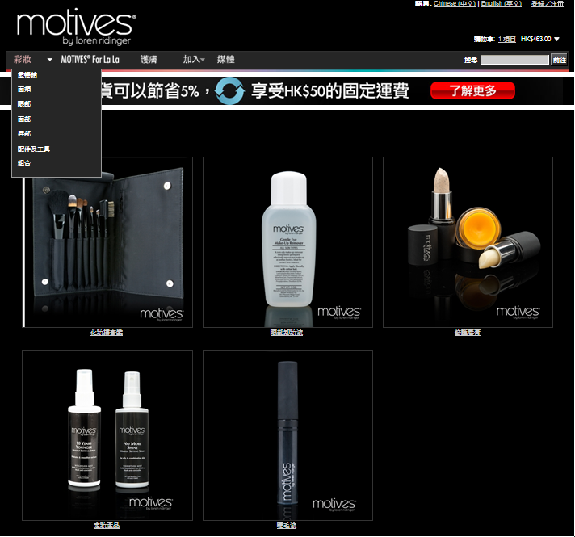
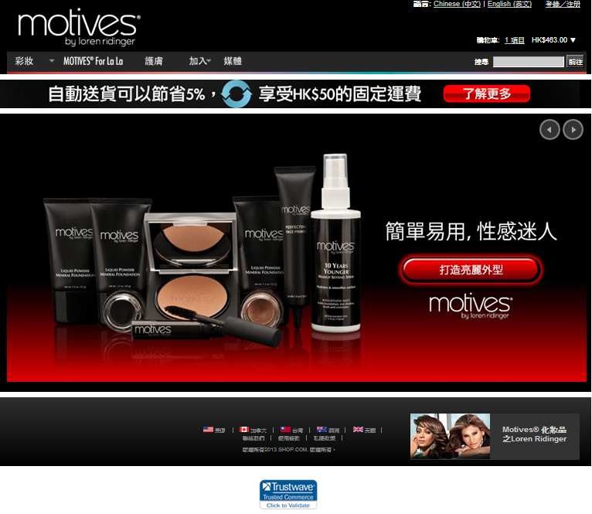
motives.com.hk
行銷工具 MARKETING
免費使用！FREE!

Slide 25
motives.com.hk
專門為Motives® by Loren Ridinger及Motives® for La La產
品而設，同時包括精選護膚產品
讓更多顧客接觸Motives®化妝品
更多BV與零售利潤
詳盡產品資訊
「立即加入」 功能
免費使用！
行銷工具 MARKETING
Features Motives® by Loren Ridinger & Motives® for La La products, as well as select skin care products
Enables more customers to access Motives® Cosmetics
More BV and retail profits
Detailed product information
“Join Now” button
FREE!

Slide 26
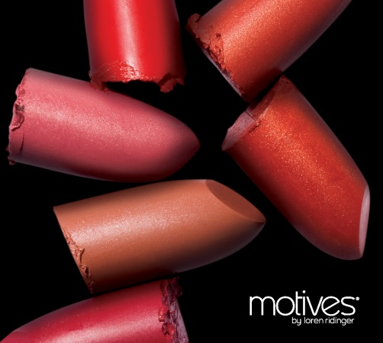
Motives®產品目錄
Motives® Catalog
介紹各項產品、價格及色調
介紹事業機會
將可於超連鎖™事業管理系統免費下載
行銷工具─即將推出
MARKETING – Coming Soon
Provides an overview of each product, pricing and color swatches
Business opportunities are highlighted
Will be available for FREE in your UnFranchise™ System

Slide 27
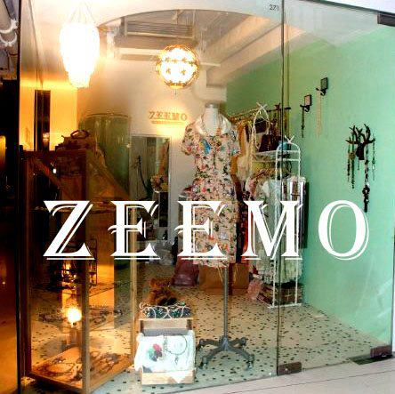
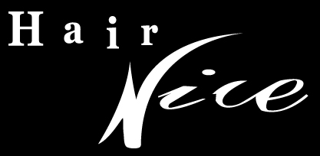
特別鳴謝
Special Thanks

Slide 28
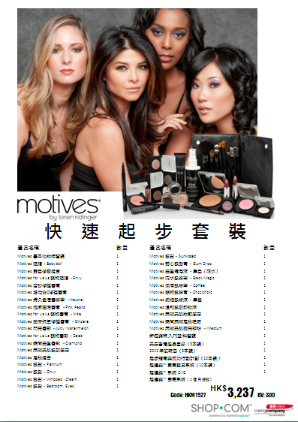
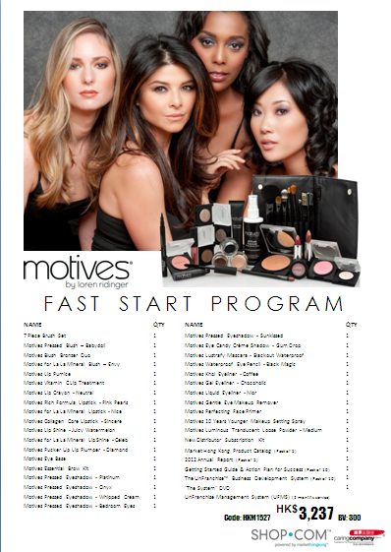
快速起步套裝
Motives® Fast Start Program

