Slide 1
最強組合：
Isotonix®等壓傳輸系統與抗氧化物
The Most Powerful Combination: Isotonix® and Antioxidant
此演講的內容並未受美國食品及藥物管理局評核。此產品並非作為診斷、醫療或預防任何疾病或狀況之用途。
The statements contained in this presentation have not been evaluated by the Food and Drug Administration. This product is not intended to diagnose, treat, cure or prevent any disease.

Slide 2
何謂等滲壓(isotonic)?
What does isotonic mean?
如果用來形容一種要吸收的溶液，「等滲壓」就表示與人類體液的液壓相同，即是，食物經過胃部消化變成溶液，準備進入小腸被吸收的狀態。
Broken down to its roots, iso means "pressure or tone." When used to describe solutions that are meant for consumption, isotonic means having the same fluid pressure as body fluids.

Slide 3
Isotonix®傳輸系統
Isotonix® Delivery System
Isotonix產品配方中的果糖、葡萄糖、檸檬酸、碳酸氫鉀及其他主要成份搭配均衡，以確保正確調配飲用時達到等滲狀態。
Isotonix products are formulated with the proper balance of fructose, d-glucose, citric acid, potassium bicarbonate and other key ingredients to assure that they are isotonic when properly prepared.

Slide 4
Isotonix®－最卓越的營養補充品之一
Isotonix®－One of the Best Supplements
產品為粉狀，無需如片劑般加入添加劑、粘稠 劑、膜衣和潤滑劑
不含膠囊或其他添加劑
吸收營養補充品所需的時間和工作便大大減少
Powders, none of the fillers, binders, coatings and lubricants that are common to tablet manufacturing are necessary
No gelatin capsules or fillers
Amount of time and work necessary to absorb a supplement is greatly decreased

Slide 5
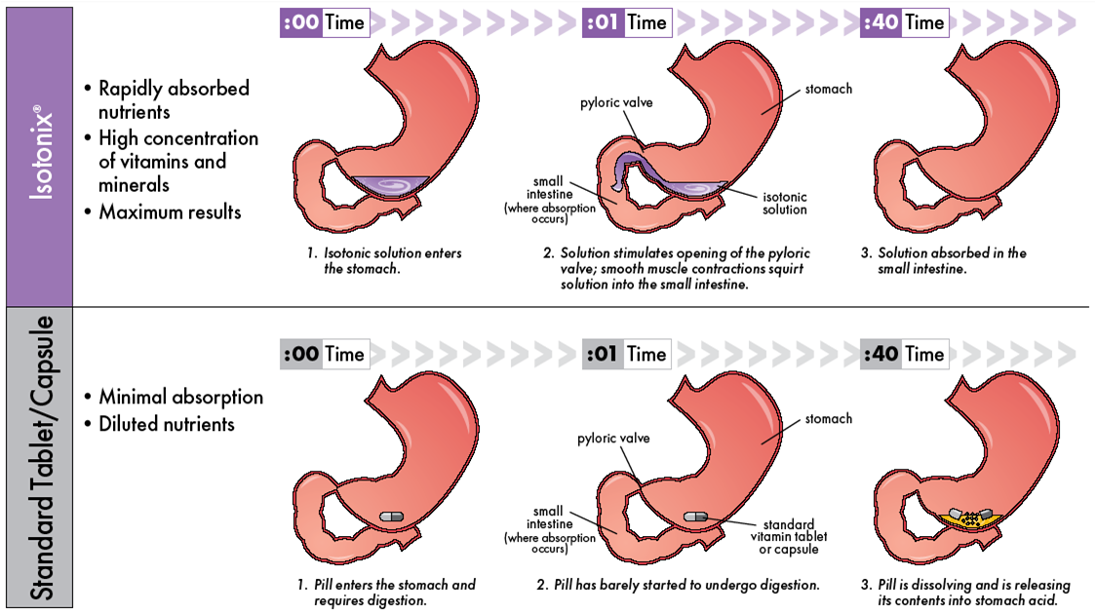
Isotonix®傳輸系統
Isotonix
迅速被人體吸收
Rapidly absorbed by the body
高濃度的維他命和礦物質
High concentration of vitamins and minerals
效果顯著
Maximum results
吸收率較低
Minimal absorption
一般片劑/膠囊/軟膠囊
tablet/ capsule/ softgel
營養素被稀釋
Dilated nutrients

Slide 6
為甚麼我們需要抗氧化物？
Why do we need Antioxidants?
人體需使用氧氣，自由基於過程中產生
外來因素
抗氧化物是「自由基清除劑」，可阻止／修復自由基造成損害
心臟病、老年黃斑病變、糖尿病和癌症等健康問題，均由氧化損害造成
Body cells use oxygen, free radicals are produced
External factors
Act as ‘free radical scavengers’ and hence prevent /repair damage done by free radicals
Health problems such as Heart Disease, Macular Degeneration, Diabetes & Cancer are all contributed by oxidative damage

Slide 7
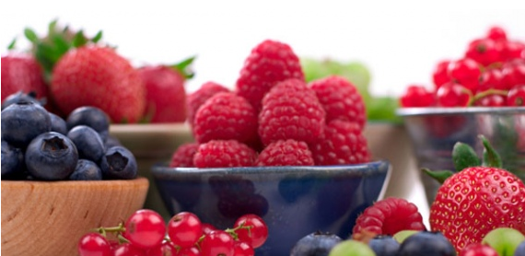
甚麼是抗氧化物？
What are Antioxidants?
食物中可阻止或減慢氧化過程對人體造成損害的物質或營養
包括：維他命A、C及E、類黃酮、β胡蘿蔔素、葉黃素、茄紅素、硒及穀胱甘肽
Substances or nutrients in foods that can prevent or slow the oxidative damage to our body
Include: Vitamin A, C & E, Flavonoids, Beta-carotene, Lutein, Lycopene, Selenium and Glutathione

Slide 8
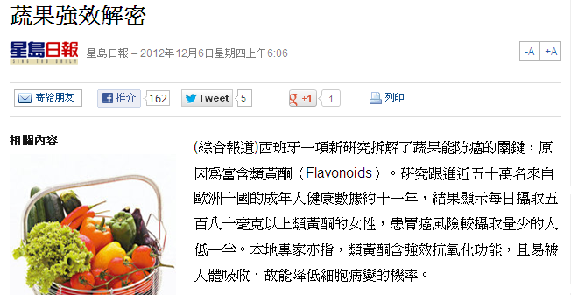
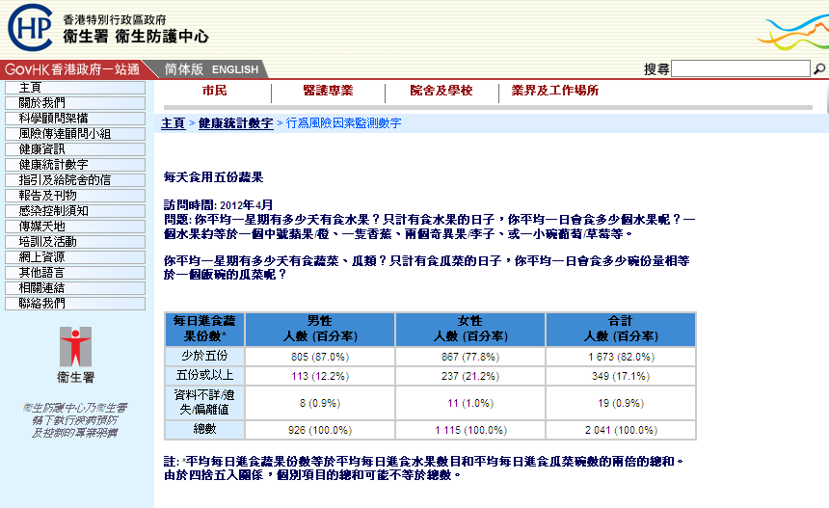
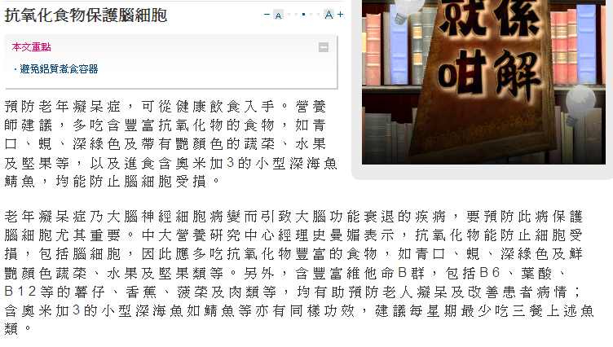

Unlocking the secrets of apples
Antioxidants protect brain cells
How many servings of fruit do you eat a day?
Over 5

Slide 9
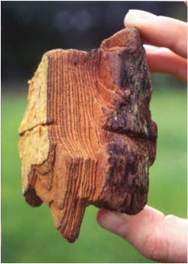
有關碧容健®
About Pycnogenol®
四大基本功用：強效的抗氧化物、天然的抗炎劑、能選擇性地與膠原蛋白和彈力蛋白結合及有助產生一氧化氮，幫助血管舒張
~400篇科學文章與臨床實驗證實安全、不含毒素及具臨床功效
4 basic properties: a powerful antioxidant, a natural anti-inflammatory, selectively binds to collagen and elastin and aids in the production of endothelial nitric oxide, which helps to dilate blood vessels
~400 scientific articles and clinical trials have confirmed Pycnogenol’s safety, absence of toxicity and clinical efficacy
碧容健®為賀發研究機構(Horphag Research Ltd.)的註冊商標，使用此產品受一項以上美國專利和其他國際專利的保護。
*Pycnogenol® is a registered trademark of Horphag Research Ltd. Use of this product may be protected by one or more U.S. patents and other international patents.

Slide 10
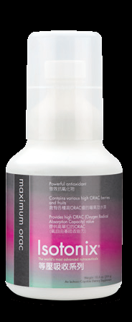
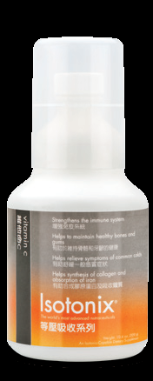
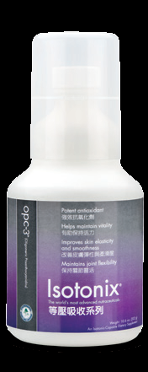
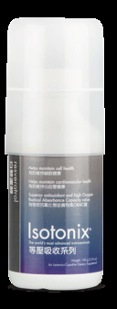
抗氧化產品
Antioxidant Products

Slide 11
方法
The Method
10位研究對象（5男、5女），年齡24-45歲，健康，非吸煙人士，血漿氧化壓力較高
研究對象：
  第1週服用等壓狀態 OPC-3，1週後服用片劑 OPC-3（及相同份量水份）
血漿氧化壓力每4小時量度一次
10 subjects (5 male, 5 female), 24-45 years, healthy, non-smokers with elevated plasma oxidative stress
Subjects took:
  OPC-3 first in isotonic form, then 1 week later OPC-3 in tablet form (with equivalent water)
Plasma antioxidant effect was monitored over a 4 hour period.
等壓狀態的OPC-3®生物類黃酮的抗氧化生物可用性較高
Accelerated antioxidant bioavailability of OPC-3® bioflavonoids administered as isotonic solution
Cesarone et al. Phytotherapy Research 23, 775-777(2009)

Slide 12
Isotonix OPC-3® 的吸收率
Isotonix OPC-3® Absorption
Cesarone et al., Phytother Res, in print 2008
3
抗氧化物
作用率增加
單位／分鐘
Increase of
antioxidant
impact rate
units/ minute
2
OPC-3
等滲透壓 Isotonic
1
OPC-3
片劑 tablet
0
10
min
20
min
30
min
40
min
50
min
60
min
70
min
80
min
90
min
2
h
2½
h
3
h
3½
h
4
h
分鐘
分鐘
分鐘
分鐘
分鐘
分鐘
分鐘
分鐘
分鐘
小時
小時
小時
小時
小時

Slide 13
結果
The Results
「總括來說，研究顯示就抗氧化功能而言，等壓狀態OPC-3® 內的類黃酮於人體的生物可用性遠高於相同份量的片劑混合物。」
“In conclusion the findings demonstrate that the flavonoid mixture provided in isotonic OPC-3® is significantly more bioavailable in humans, in terms of antioxidant activity than an equivalent mixture in tablet form.”
等壓狀態的OPC-3®生物類黃酮的抗氧化生物可用性較高
Accelerated antioxidant bioavailability of OPC-3® bioflavonoids administered as isotonic solution
Cesarone et al. Phytotherapy Research 23, 775-777(2009)

Slide 14
結果
The Results
服用Isotonix OPC-3® 後，血漿氧化壓力大幅降低10.1%
所有主要心血管健康風險因素均有改善，血壓、膽固醇及空腹血糖水平均降低
Plasma oxidative stress status was significantly lowered by 10.1% with Isotonix OPC-3 ®
All major cardiovascular risk factors were improved with blood pressure, total cholesterol, and fasting blood glucose lowered

Slide 15
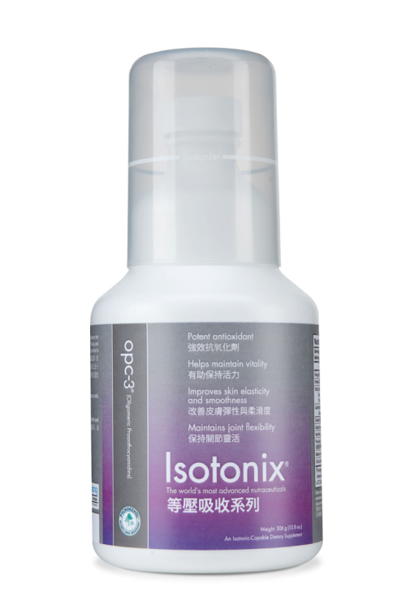
Isotonix OPC-3®
^{285 – 290}
^{milliosmoles/kg}
^{(滲透壓單位）}
^{無可比擬的卓越產品！}
^{THERE IS NO COMPETITION!}

Slide 16

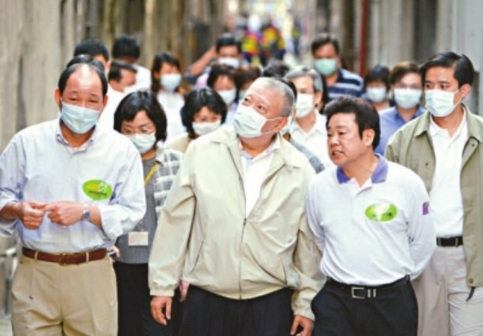
沙士十年
10 Years after SARS
2003年沙士襲港，1,700多人受感染，
299人被奪去性命
世紀疫症
十年過去，沉痛的記憶仍然歷歷在目
SARS attacked Hong Kong in 2003,
causing over 1,700 cases and 299
deaths
A deadly epidemic
10 years have passed, the terrible
memories still linger

Slide 17
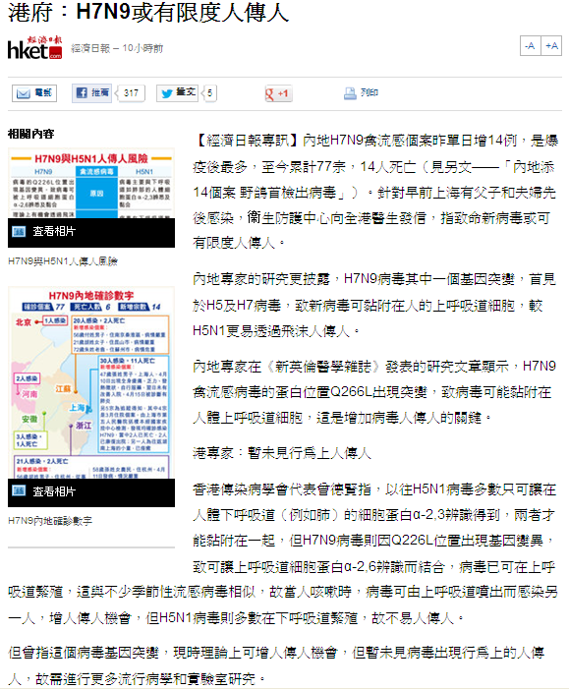
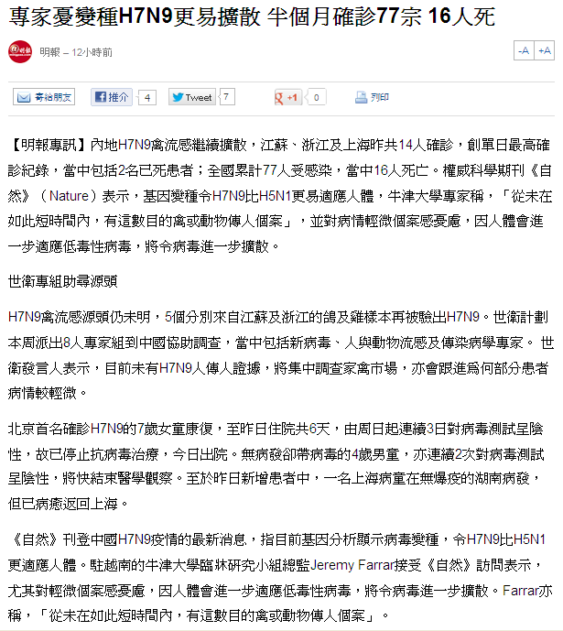
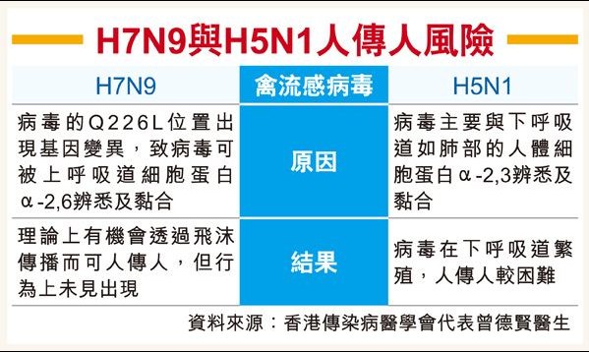
Limited human-to-human transmission of H7N9 is possible
Experts worry H7N9 may mutate and become more virulent
Centre of Health Protection sent letters to all doctors stating limited human-to-human transmission is possible.
Mutations make H7N9 grow more adaptable to the human body than H5N1.
The risks of human-to-human transmission of H7N9 and H5N1

Slide 18
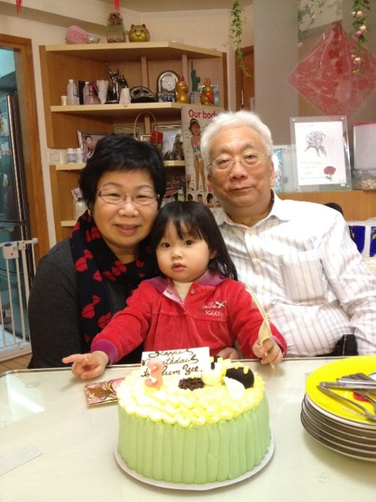

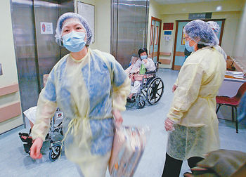
難忘的2003 年 3月14日
March 14, 2003 – A day I will never forget
女兒患上普通肺炎
入住私家醫院
我開始發高燒
3月17號惡夢正式開始... 醫生宣佈確診「沙士」
病房外漆黑一片，深夜轉往瑪嘉烈醫院
My daughter was diagnosed with pneumonia.
She was admitted to a private hospital.
I had a fever.
On March 17, my nightmare started. I was diagnosed with SARS.
It was complete darkness outside the ward. I was transferred to Princess Margaret Hospital at midnight.

Slide 19

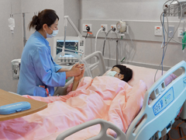
在ICU的日子
My days in the ICU
人生的斷層
醒來后一切都改變
全賴醫護人員照顧
決心做一個幫人的人
It was blank part of my life.
When I came to, nothing was the same.
I was glad to have health care workers taking care of me.
I was determined to be someone who offers help.

Slide 20
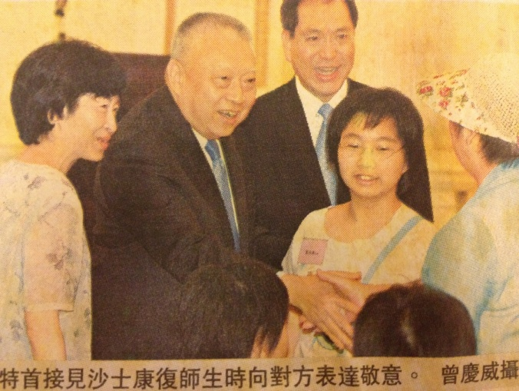
有幸離開醫院
I was discharged from the hospital
因用藥太多關節退化
遍尋名醫「結果」是關節退化「無得醫」
人生又到另一個低潮
一瓶「抗氧化OPC3」改變我的下半生
Excessive medications led to joint degeneration.
I went to many doctors, who told me my joint degeneration is incurable.
I hit the lowest point in life.
A bottle of antioxidant Isotonix® OPC-3 changed the rest of my life.

Slide 21
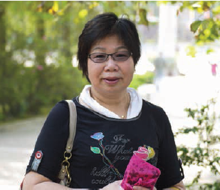
OPC-3抗氧化燃起我的新生
Antioxidant OPC-3 – the rebirth of my life
  不知不覺間「骨質退化消失了」
  輕鬆從港鐵站行樓梯上地面
  由那時開始從未離開OPC-3抗氧化產品
  現在我生活過得更充實、更有意義
  Joint degeneration disappeared unknowingly.
  I walked up a long staircase and realized I no longer suffered from knee pain.
  From then I never stop taking Isotonix® OPC-3.
  I now live a more fulfilling and meaningful life.

Slide 22
了解更多…
To Learn More…
產品研討會 – 7月14日（星期日）
Isotonix®科學理論和好處
補充抗氧化物的重要性
碧容健®於護膚的功效
情緒病
TLS健康生活減重計劃的科學理據
Product Seminar – July 14 (Sunday)
Theories & Advantages of Isotonix®
Importance of Supplying Body with Different Antioxidants
Pycnogenol® Benefits on Skin/Beauty Care
Mood Disorder
Sciences behind TLS Weight Loss Solution

