Slide 2
FIND YOUR FIT
健康生活纖形比賽
FIND YOUR FIT
CHALLENGE

Slide 3
獎金及獎品總值
超過HK$24,000!!!!!
Awarding HK$24,000+
CASH & PRIZES!!!!!

Slide 4
TLS™ 健康生活纖形比賽 TLS™ FIND YOUR FIT CHALLENGE
比賽日期
2013年6月14日星期五
至2013年9月5日星期六
獎金及獎品總值
超過HK$24,000!!!!!
Challenge Dates
Friday June 14, 2013 –
Saturday September 5, 2013
Awarding
$24,000+ CASH & PRIZES!!!!!

Slide 5
TLS™ 健康生活纖形比賽 TLS™ FIND YOUR FIT CHALLENGE
比賽：
•12週個人比賽
Challenge:
•12-Week Individual Challenge

Slide 6
TLS™ 健康生活纖形比賽 TLS™ FIND YOUR FIT CHALLENGE
優勝資格：
優勝者將按以下2個標準選出：
70% - 減重前後照片
30% - 減重故事分享
減重前後照片：
參賽者必須提交3張減重前照片及3張減重後照片(全身：正面、背面、側面各1張)
減重故事分享：
參賽者必須提交350-500字的故事分享，描述成功減重為生活帶來甚麼改變
Criteria to Win:
Winners are selected based on 2 criteria:
70% - “Before” & “After” Pictures
30% - Testimonial Essay
“Before” and “After” photos:
Each participant must submit 3 “Before” and 3 “After” full body shots (one frontal, one profile, one back photo)
Written Essay:
Each participant must submit an essay of 350-500 words describing how body transformation has improved their life

Slide 7
TLS™ 健康生活纖形比賽 TLS™ FIND YOUR FIT CHALLENGE
個人比賽：
第1名：現金HK$5,000 + 6支TLS CORE高效修身配方 + 1張2013領袖訓練會議門票
教練獎品：HK$2,500 (只適用於第1名優勝者的教練)
優勝者與教練同樣獲得豐富獎品！
第2名：現金HK$3,000 + 6支TLS CORE高效修身配方 + 1張2013領袖訓練會議門票
第3名：現金HK$2,000 + 6支TLS CORE高效修身配方 + 1張2013領袖訓練會議門票
Individual Challenge:
1st Prize: HK$5,000 Cash + 6 months supply of TLS CORE + 1 Ticket to 2013 Leadership School
Coach Prize: HK$2,500 (1st place winner only)
If the Individual Winner won with the help of a coach, they win big too!
2nd Prize: HK$3,000 + 6 months supply of TLS CORE + 1 Ticket to 2013 Leadership School
3rd Prize: HK$2,000 + 6 months supply of CORE + 1 Ticket to 2013 Leadership School

Slide 8
TLS™ 健康生活纖形比賽 TLS™ FIND YOUR FIT CHALLENGE
參加方法：
下載TLS FIND YOUR FIT纖形比賽申請表
提交表格至 tls@markethongkong.com.hk
報名日期：
2013年5月15日 – 2013年6月10日
(報名費用HK$250)
報名截止時間：5月31日11:59PM
How To Enter:
Download TLS FIND YOUR FIT CHALLENGE Application Form
Submit your form to tls@markethongkong.com.hk
Registration Periods:
May 15, 2013 – June 10, 2013
(Registration Fee HK$250)
Registration ends May 31 at 11:59PM

Slide 10
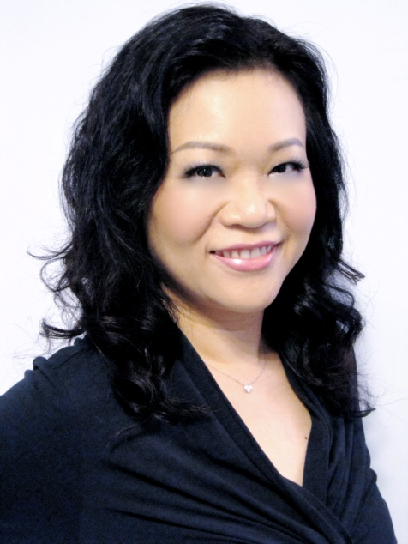
TLS健康生活纖營計劃 TLS Weight Loss Solution
May Lun Mei Wah
資深主管經理級經銷商 Senior Master Coordinator
四個佣金週期共賺取HK$23,000
HK$23,000 in 4 Commission weeks
本簡報中提到的收入等級純屬舉例說明，無意代表美安香港經銷商的一般收入，也無意表示任何經銷商皆可賺取同等收入。美安香港經銷商的成功與否，取決於其在發展事業時的努力、才能與投入程度。The income levels mentioned in the following presentation are for illustration purposes only. They are not intended to represent the income of a typical Market Hong Kong Distributor, nor are they intended to represent that any given Independent Distributor will earn income in that amount. The success of any Market Hong Kong Independent Distributor will depend upon the amount of hard work, talent, and dedication which he or she devotes to building his or her Market Hong Kong Business.

Slide 11
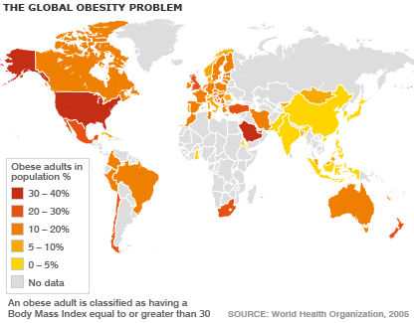
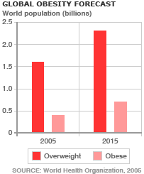
肥胖及超重 Obesity and Overweight
重要資訊：
自1980年起，全球肥胖人數增加超過一倍
2008年，超過14億成年人超重，其中超過2億男性屬肥胖，接近3億女性屬肥胖
肥胖是可以避免的
Key facts:
Worldwide obesity has more than doubled since 1980
In 2008, more than 1.4 billion adults were overweight; of these over 200 million men and nearly 300 million women were obese
Obesity is preventable

Slide 12
超重和肥胖的定義是甚麼？ What are Overweight & Obesity?
可能損害健康的不正常或過多脂肪積聚
體重指數(BMI)是反映體重健康的指數，常用於界定成年人是否超重或肥胖
BMI = 體重（公斤） / 高度 （米² ）
根據香港標準：
超重 = BMI 23.0 – 24.9
肥胖 = BMI 25+
Defined as abnormal or excessive fat accumulation that may impair health
Body mass index (BMI) is a simple index of weight for health that is commonly used to classify overweight and obesity in adults
BMI = weight (kg) / height (m²)
Hong Kong definition is:
Overweight = BMI 23.0 – 24.9
Obesity = BMI 25+

Slide 13
脂肪比例
Fat Percentage
男性：14 – 20% (30歲以下正常比率)
17 – 23% (30歲以上正常比率)
>25% (肥胖)
女性：17 – 24% (30歲以下正常比率)
20 – 27% (30歲以上正常比率)
>30% (肥胖)
Male：14 – 20% (Below 30 years old)
17 – 23% (Above 30 years old)
>25% (Obesity)
Female：17 – 24% (Below 30 years old)
20 – 27% (Above 30 years old)
>30% (Obesity)

Slide 14
甚麼是TLS™健康生活纖營計劃？ What is TLS™ Weight Loss Solution?
全面、可根據個人需要設計的減重計劃，可配合你的：
個性
決心程度
目標
教你輕鬆維持減重成果
Comprehensive customizable weight loss program that is designed to fit your:
Personality
Commitment level
Goals
Guaranteeing you a lifetime of weight loss success

Slide 15
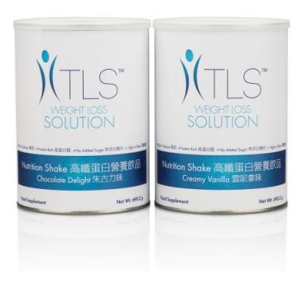
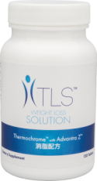
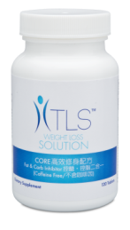
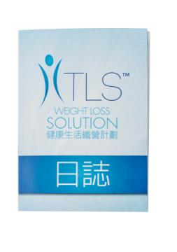
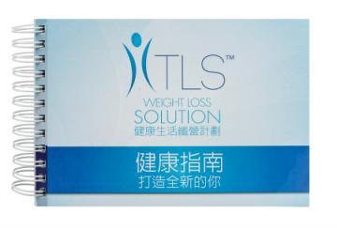
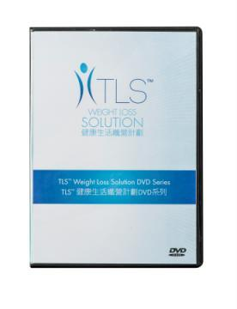
甚麼是TLS™健康生活纖營計劃？ What is TLS™ Weight Loss Solution?
低升糖飲食
有助減重及體重管理
維持瘦肌肉量
心血管健康
身體構成
修復及提升新陳代謝
運動
加速減重產品／補充品
支援健康新陳代謝
支援健康
Low Glycemic Impact Eating
Superior for weight loss and weight management
Maintaining lean muscle mass
Cardiovascular health
Body Composition
Repair and increase metabolism
Exercise
Weight Loss Accelerators / Supplements
Support healthy metabolism
Support health

Slide 16
TLS™ 健康指南 - 塑造全新的你 A Guide To A New You
TLS™健康指南
提供實踐TLS™健康生活纖營計劃的全面指引
涵蓋減重過程中的掙扎，並解釋為何TLS™健康生活纖營計劃是解決方法
6天建議餐單
包括TLS™日誌 (3本裝) 及TLS™成功個案分享DVD
TLS™ Health Guide
Comprehensive guide on how to follow TLS™ Weight Loss Solution
Covers the weight loss struggle and how TLS™ is the weight loss solution
Six days of sample meal plans
Include TLS™ Journals (Pack of 3) and TLS™ Testimonial DVD
Code: HK6478 DC:$ 116 SR:$163 BV:5

Slide 17
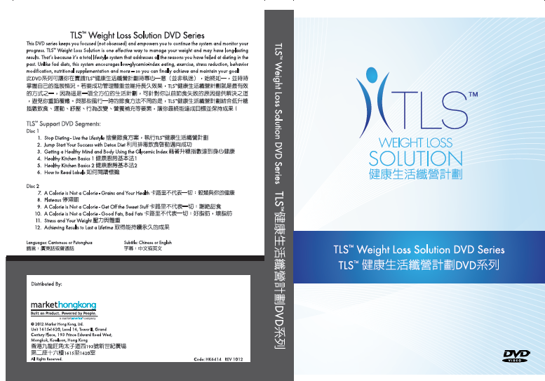
TLS™ DVD 系列 Complete DVD Series
DVD系列教導你如何將 TLS™融入你每天的生活。如你對此計劃有疑問，你可從這些 DVD中找到答案
DVD series demonstrate how you can incorporate TLS™ into your daily life. When you come across any questions, you can find the answers in these DVDs.
Code: HK6414 DC:$60 SR:$80 BV:0
Notes:
Transitions DVD的教育：了解你的身體對食物、運動及補充品有何反應，即是了解更佳的生活應包含甚麼、為甚麼這樣做，以及如何才能達到更佳生活。Transitions DVD系列教導你如何將 Transitions融入你每天的生活。每星期學習不同課題，包括飲食餐單及巿場說法、如何閱讀標籤、保持正確軌道，以及更多帶領你一直跟隨系統的資訊。

Slide 18
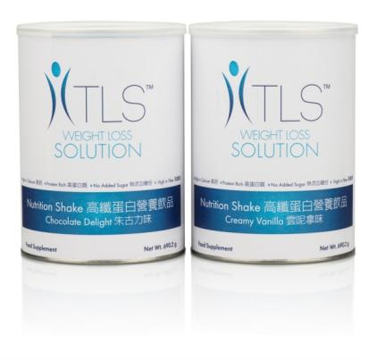
加速減重產品 Accelerators
食量很大？
TLS™ CORE 高效修身配方控醣‧控脂二合一有助抑制身體吸收碳水化合物
新陳代謝緩慢？
TLS™ 消脂配方提升能量及支援代謝以外的功能
健康小食？
TLS™ 高纖蛋白營養飲品含豐富纖維、蛋白質和鈣質
Big Appetite?
TLS™ CORE Fat & Carb Inhibitor helps inhibit carbohydrate absorption
Slow Metabolism?
TLS™ Thermochrome increases energy & supports non-metabolic functions
Snack Alternative?
TLS™ Nutrition Shakes are great source of fiber, protein and calcium

Slide 19
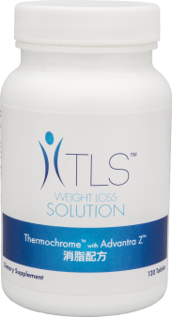
消脂配方 TLS™ Thermochrome™
主要好處：
有助提升能量
有助紓緩偶爾疲勞
促進生熱作用及脂肪分解作用
促進減重
Primary Benefit:
Helps increase energy
Helps to alleviate occasional fatigue
Promotes thermogenesis and lipolysis
Promotes weight loss
Code: HK6405
DC:$277.00
SR:$388.00
BV:28

Slide 20
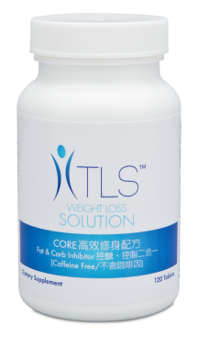
TLS™ CORE 高效修身配方控醣‧控脂二合一 CORE Fat & Carb Inhibitor
主要好處：
促進體量指數(BMI)下降
有助促進減重
抑制澱粉酵素，減慢碳水化合物吸收至血液
有助抑制身體吸收碳水化合物
有助增加飽足感
Primary Benefit:
Promotes reduction in body mass index (BMI)
Helps promote weight loss
Inhibits the amylase enzyme and slows the absorption of carbohydrates into the bloodstream
Helps inhibit carbohydrate absorption in the body
Helps promote the feeling of fullness
Code: HK6462
DC:$350.00
SR:$475.00
BV:31

Slide 21
TLS™ CORE 高效修身配方控醣‧控脂二合一 CORE Fat & Carb Inhibitor
LeptiCore® ：
臨床證實有助減低體重、脂肪、腰圍及臀圍
採用植物多醣及酯化脂肪酸天然複合物，顯示可促進減重
GreenSelect® Phytosome®無咖啡因綠茶葉萃取物：
混合標準無咖啡因綠茶葉萃取物及大豆磷脂
研究顯示，標準綠茶葉萃取物促進脂肪氧化過程
LeptiCore®:
Clinically proven to help reduce body weight, stored body fat and waist and hip size
Contains natural complex of plant-based polysaccharides and esterified fatty acids, which have demonstrated the ability to enhance weight loss
GreenSelect® Phytosome® Green Tea Decaffeinated Extract:
Combination of standardized decaffeinated green tea extract and soy phospholipids
Scientific research has demonstrated that standardized green tea extracts promote fat oxidation
Code: HK6462
DC:$350.00
SR:$475.00
BV:31

Slide 22
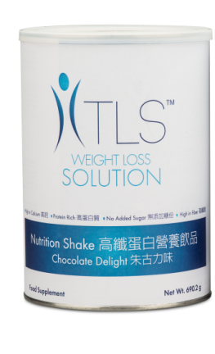
TLS™高纖蛋白營養飲品 Nutrition Shakes
提供營養豐富和飽肚的食選擇，讓你無需選擇快餐
需較長時間消化和吸收，增加飽足感，穩定血糖水平
Designed to provide an effective alternative to fast food, providing better nutrition and satiety
Digests and absorbs slowly for satiety and blood sugar stabilization
DC:$178.00 SR:$242.00 BV:5

Slide 23
TLS™高纖蛋白營養飲品 Nutrition Shakes
TLS™高纖蛋白營養飲品：
高鈣
高蛋白質
無添加糖份
高纖維
每份2匙(49.3克)：
18克蛋白質
10克膳食纖維
472毫克鈣質
TLS™ Nutrition Shake Claim:
High in Calcium
Protein Rich
No Added Sugar
High in Fiber
Serving Size 2 Scoops (49.3g):
18g Protein
10g Dietary Fiber
472mg Calcium

Slide 24
TLS™ 纖營修身套裝 TLS™ Weight Loss Solution Kit
CORE 高效修身配方
消脂配方
高纖蛋白營養飲品－雲呢拿味
高纖蛋白營養飲品－朱古力味
DVD 系列
健康指南
日誌 (1 本)
成功分享個案DVD
72折
28% Off!
CORE Fat & Carb Inhibitor
Thermochrome
Nutrition Shake－Creamy Vanilla
Nutrition Shakes－Chocolate Delight
Complete DVD Series
Health Guide
Journal (1 Booklet)
Testimonial DVD
DC: $825.00 SR: $1,150.00 BV: 40

Slide 25
全方位 DETOX 纖營組合
Complete Cleansing and Detoxification Kit
產品代號 Product Code ：
HK13144
(配Ultimate Aloe™士多啤梨奇異果味 Strawberry Kiwi Flavor)
HK13145
(配Ultimate Aloe™野莓蘋果味 Cranberry Apple Flavor)
HK13146
(配Ultimate Aloe™原味 Natural Flavor)
77折
23% Off!
DC: $600.00 SR: $830.00 BV: 45

Slide 26
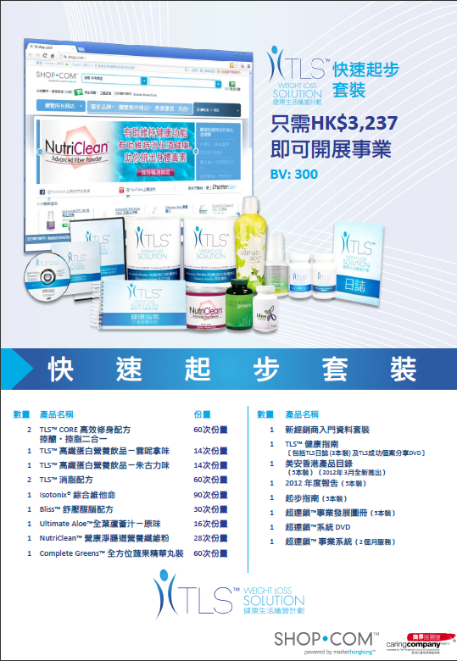
TLS™ 快速起步套裝 Fast Start Program

Slide 27
TLS™授證教練
Certified Coach
為令你保持在正確方向
鑒於TLS™銷售額迅速增長，美安香港已引入〝TLS™授證教練〞
此調整吸引更多夥伴以TLS™作為主修及發展其超連鎖™事業
To keep you on the right track.
In response to the rapid growth of TLS™ sales, Hong Kong has introduced “TLS™ Certified Coach”.
This helps more partners major in TLS™ and expand their UnFranchise™ businesses.

Slide 28
TLS™授證教練
Certified Coach
至2013年4月28日止TLS授證教練名單：
TLS Certified Coaches as of April 28, 2013:
Chan Kwan Cheung Candy
Cheung Yuk Wai Fanny
Chiu Wai Chun Elly
Ho Wing Lin Winnie
Ip Kwok Fun Calvin
Lam Tak Lam Rayon
Leung Yuen Suet Yee Meyond
Luk Ka Wai & Helen Lin
Lun Mei Wah
Su Po Ling Maggie
Tse Wa Mei

