Slide 1
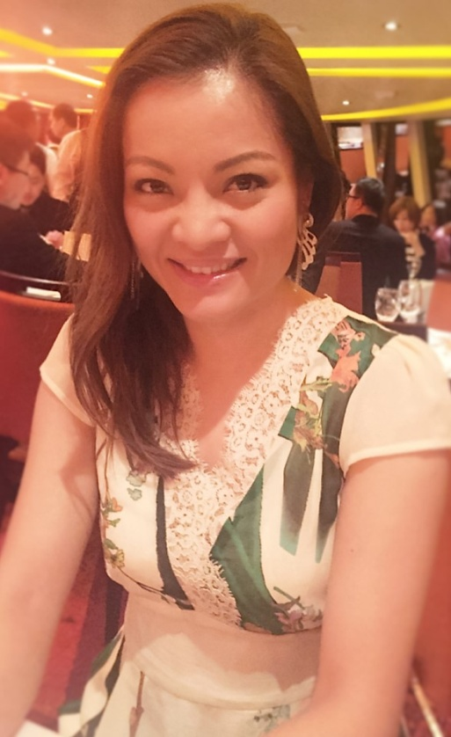
NMTSS力量:成功複製
The Power of the NMTSS
Lilian Chan
顧問經理級 Supervising Coordinator
四個佣金週期共賺取HK$57,500
HK$57,500 in 4 Commission weeks
本簡報中提到的收入等級純屬舉例說明，無意代表美安香港超連鎖™店主的一般收入，也無意表示任何超連鎖™店主皆可賺取同等收入。美安香港超連鎖™店主的成功與否，取決於其在發展事業時的努力、才能與投入程度。The income levels mentioned in the following presentation are for illustration purposes only. They are not intended to represent the income of a typical Market Hong Kong UnFranchise ™Owner, nor are they intended to represent that any given Independent UnFranchise ™ Owner will earn income in that amount. The success of any Market Hong Kong Independent UnFranchise ™ Owner will depend upon the amount of hard work, talent, and dedication which he or she devotes to building his or her Market Hong Kong Business.

Slide 2
Lilian Chan
NMTSS力量:成功複製
The Power of the NMTSS
2008年 9月加盟美安香港
現為顧問經理級超連鎖TM店主
多次Master UFO得主
現任本地研討會協調員
現任演講者機構成員
於體適能行業從事市場推廣工作十年
Joined Market Hong Kong in 2008 September
Supervisor Coordinator
Master UFO Qualifiers
Local Coordinator and Speaker Bureau member
Had worked in the marketing field in fitness industry for 10 years

Slide 3
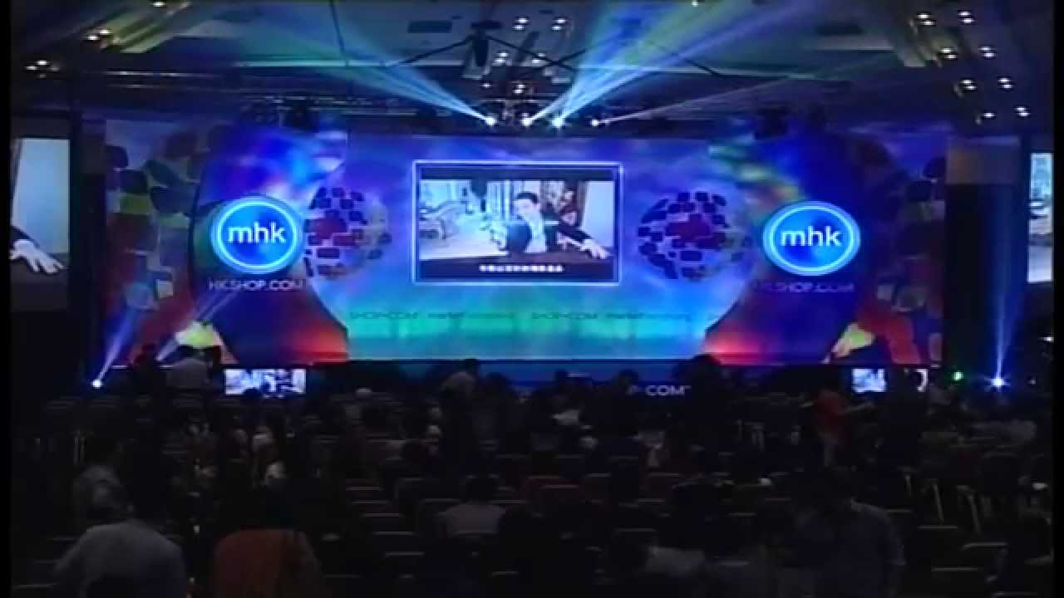
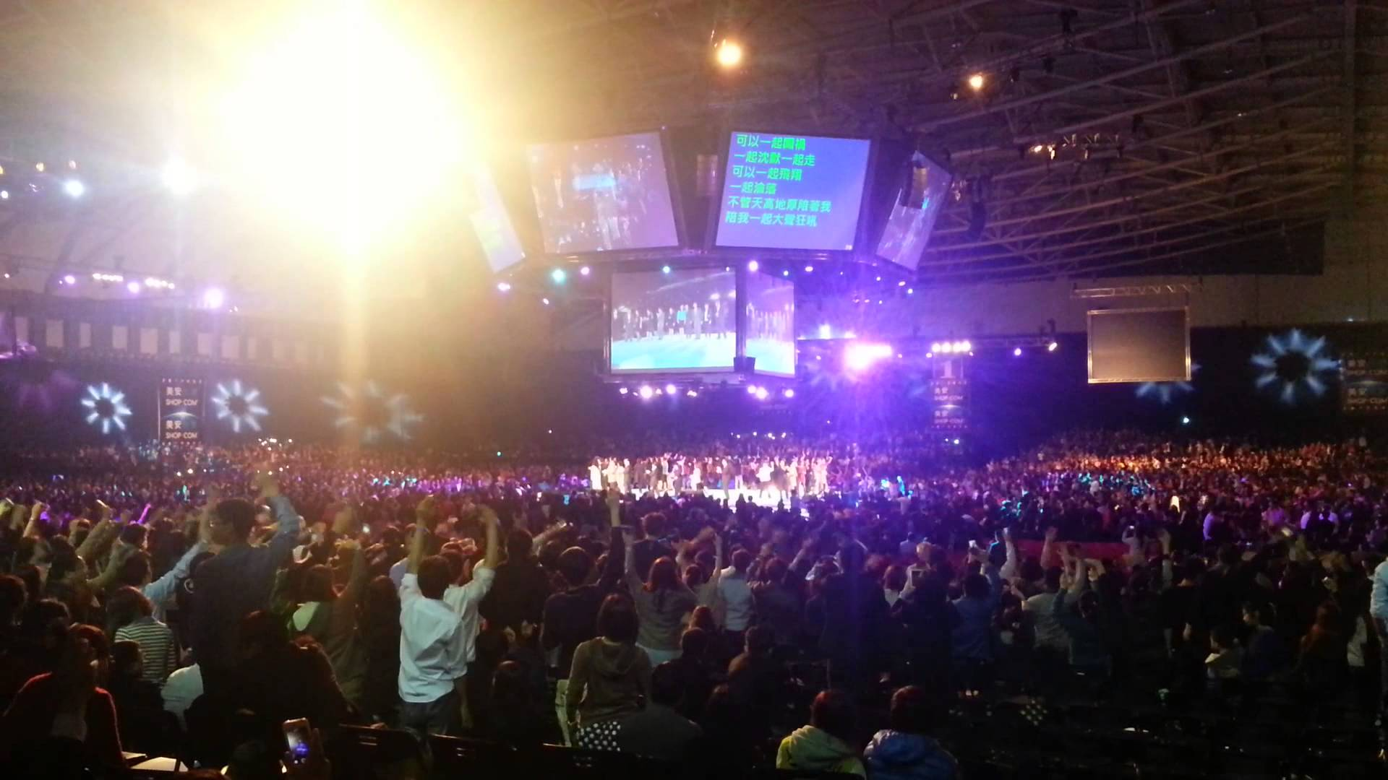

Slide 4
「靶心概念」
Target Concept
由外及內，
逐漸深入！
From the outside in,
Step by step
新超連鎖TM店主訓練NUOT
成功五要訣訓練 B5
授證經理級訓練ECCT
一對一介紹 One on Ones
超連鎖™事業簡報會 UnFranchise™ Business Presentations
本地研討會 L o c a l S e m i n a r s
美安香港年會 Market Hong Kong Convention
領袖訓練會議 Leadership
世界大會 World Conference
國際年會
Int'l Convention
你的目標應該是帶領更多「積極進取型」(Go Now)超連鎖TM店主參加下一次國際年會…但是一切要從外環做起…
三對一介紹，二對一介紹，一對一介紹
Your goal is to bring more “Go Now” UFOs to the next International Convention….but start from the outside, 3 to 1, 2 to 1 and 1 to 1 presentations.
Notes:
4
4

Slide 5
APPLY
CREATE
QUALIFY
ACTIVATE

Slide 6
TEACH, MANAGE & SUPPORT OTHERS
APPLY
CREATE
QUALIFY
ACTIVATE

Slide 7
我們要借力一個
系統
We need to
leverage
a
SYSTEM

Slide 8
永續收入最有效的工具
The most effective tool for earning ongoing income
會議聯盟系統(NMTSS)
一個凝聚組織向心力的系統
A system for building group cohesion in the organization
這是一個確實有效的系統，負責籌劃各種會議、研討會和大會活動，
提供新進超連鎖TM店主和原有超連鎖店主TM進修的機會，使其獲得
完整、標準且有效的訓練。
This is a system with proven success which provides UFOs opportunities to have a comprehensive, standardized and effective training
by organizing different meetings, seminars and conventions.

Slide 9
美安大學 = 會議聯盟系統 (NMTSS)
Market America University = NMTSS
入學先修科目Prerequisite
提供多個主修科及副修科選擇 Major & Minor
健康與營養
學系
Health & Nutrition
體重管理 學系
Weight Management
化妝品/
個人護理學系
Beauty & Personal Care
網絡設計
學系
WebCenter
商業學系
Business major
超連鎖™事業簡報會 UBP
新超連鎖店主訓練 NUOT
成功五要訣 B5
授證經理級訓練 ECCT
本地研討會 Local Seminar
香港年會/領袖訓練會議HK Annual Convention/ Leadership School
護膚及個人護理系列、產品知識及銷售技巧
Motives 品牌概覽、產品知識及銷售技巧
Motives工作坊: 進階肌膚保養
Motives工作坊: 眼部彩妝教學
Motives工作坊: 臉部彩妝教學
Motives工作坊: 網上派對計劃及SHOPBOX技術
Motives工作坊: 唇部彩妝教學
產品概覽
Product UMO
TLS®主修概覽
TLS® UMO
網絡中心 主修概覽
WCT UMO
消化系統健康
抗氧化與自由基
眼睛健康
心臟健康
TLS® 纖營健康生活計劃 Day 1 & Day 2
網絡中心訓練 101 和 201
WCT 101 & 201
MA Skin & Personal Care Product Knowledge & Marketing
Motives Brand Overview, Product Knowledge & Marketing
Motives Workshop: Advanced Skin Solutions
Motives Workshop: All About Eyes
Motives Workshop: Flawless Face
Motives Workshop: Online Party Program & Shopbox Technology
Motives Workshop: Perfect Pout
網絡中心授證訓練
CWT
Digestive Health
Antioxidant and Free Radical
Eye Health
Heart Health

Slide 10
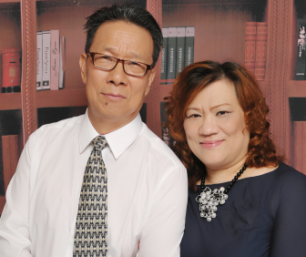
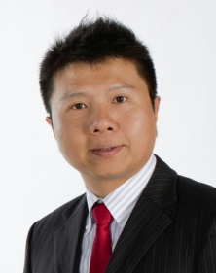
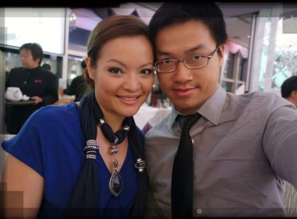
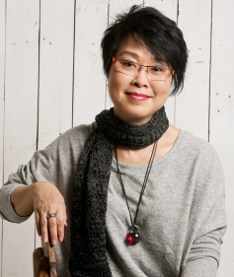
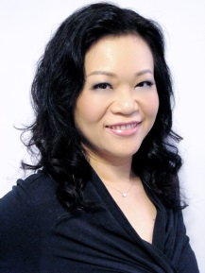
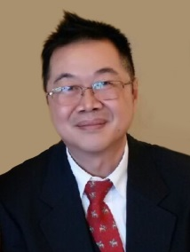
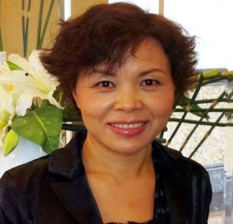
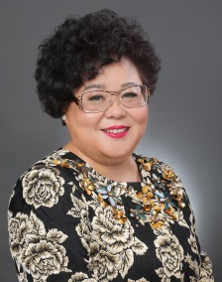
美安香港授證訓練員
Market Hong Kong Certified Trainers
Jones & Sam Chan
Margaret Chan
Michelle Chang
Calvin Chiang
Indy Ho & Lilian Chan
Rose Wong & Calvin Ip
Sandy Kam
Helen Lin
Alex Lam & Kawae Cheung
May Lun
Cindy Ngai
Frances Siu
Nora Siu
Randy Lynn Smith & Angela Smith
Joan Song
Simon Sze
YK Tam & Janice Lee
Pauline Tong
Candy Tsang
Mony Ung
Lily Wong
Lydia Wu

Slide 11
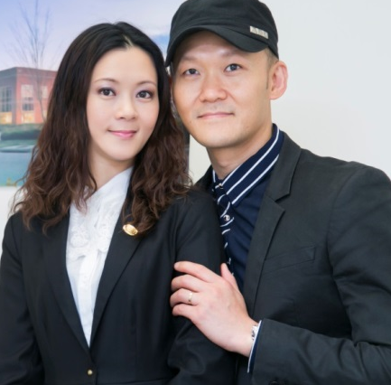
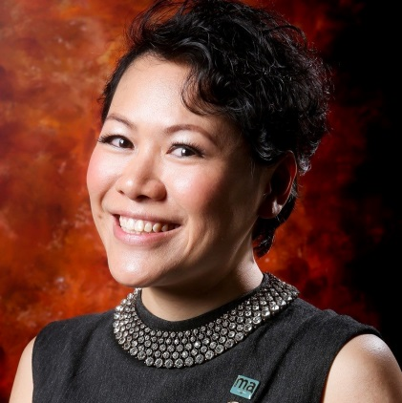
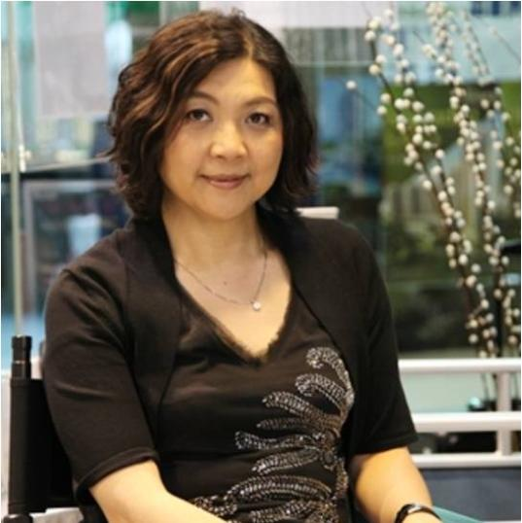
美安香港產品訓練講師
Market Hong Kong Field Product Specialist
Indy Ho & Lilian Chan
Alex Lam &
Kawae Cheung
Luk Ka Wai & Helen Lin
Thorine Mak
Cindy Ngai
Nora Siu
YK Tam
Reginia Wong
Rose Wong & Calvin Ip

Slide 12
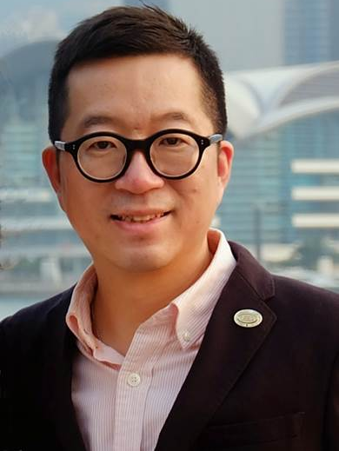
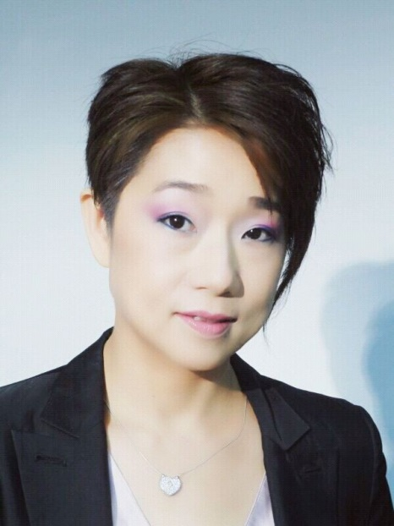
美安香港TLS®授證訓練員
Market Hong Kong Certified TLS Trainer
Calvin Ip
Luk Ka Wai & Helen Lin
Maggie Su

Slide 13
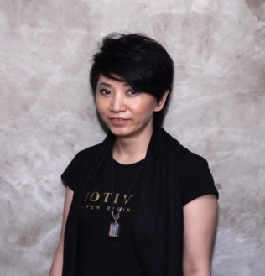
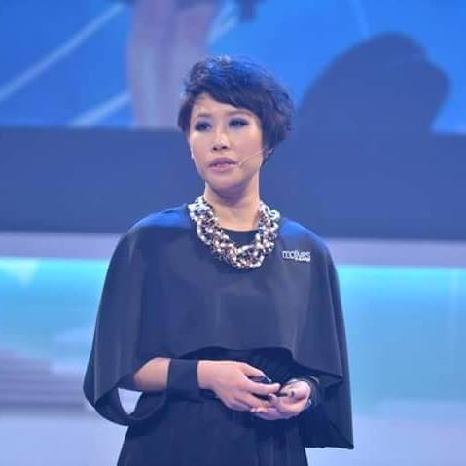
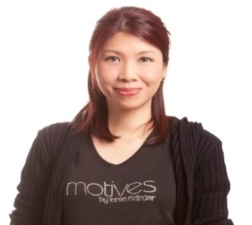
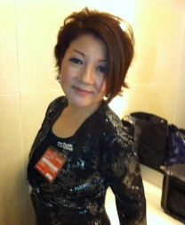
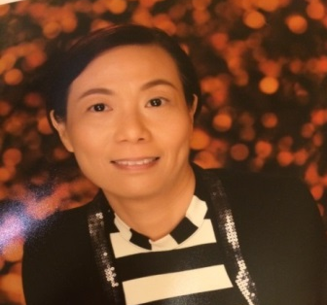
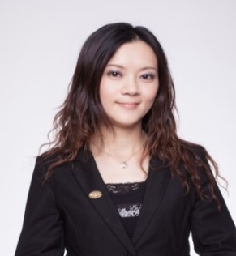
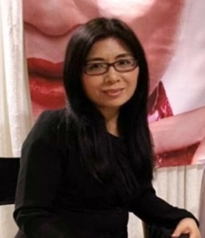
美安香港Motives®授證訓練員
Market Hong Kong Motives® Certified Trainers
Kero Chan
Pat Chan
Angie Chou
Claudia Chow
Jane He
May Ho
Sandy Kam
Andy Leung
Helen Lin
Tammy Lui
Asa Ng
Angela Smith
Mony Ung
Rose Wong
Reginia Wong

Slide 14
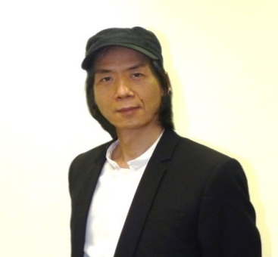
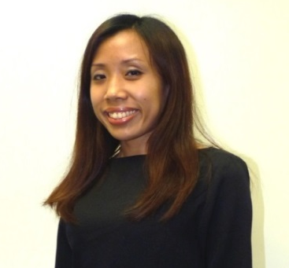
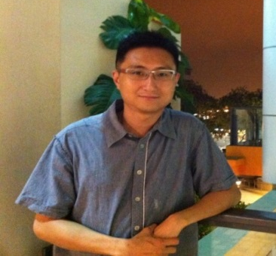
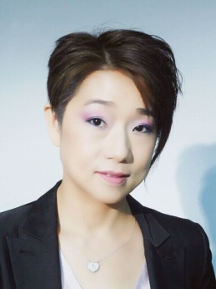
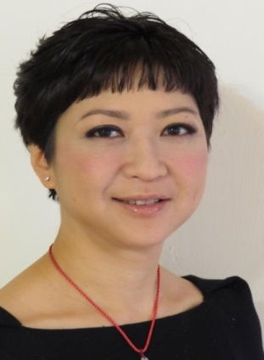
美安香港網路中心授證訓練員
Market Hong Kong WebCenter Certified Trainers
Calvin Chiang
Christine Ho
Kirk Kwok
Wing Kwok
Mark Li
Frances Siu
Maggie Su
Simon Sze
Hilda Wong
Reginia Wong

Slide 15
TEACH, MANAGE & SUPPORT OTHERS
APPLY
CREATE
QUALIFY
ACTIVATE

Slide 16
BV + BV = 零售利潤
人+ 人= 收入
領袖+ 領袖= 永續收入
BV + BV = Retail Profit
People + People = Active Income
Leader + Leader = Ongoing Income

Slide 17
永續收入的命脈 Lifeblood of Ongoing Income
讓團隊融入NMTSS
運用NMTSS的各類課程培育出不同專業的 Leaders
Make the full team join NMTSS
Utilize NMTSS to train up leaders as different professionals

Slide 18
