Slide 1
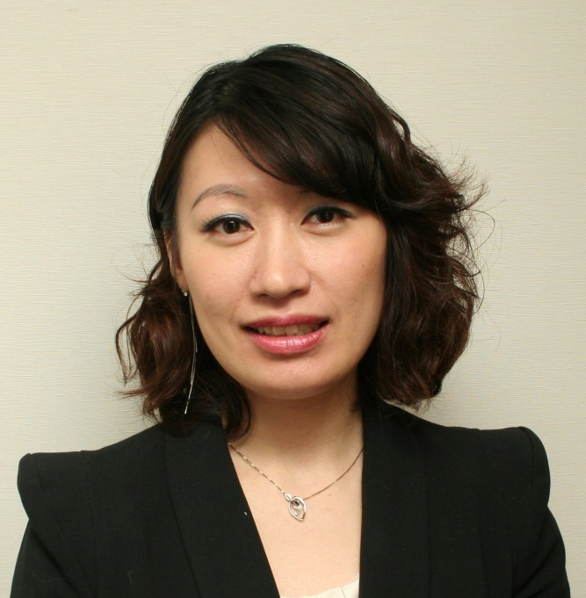
TLS健康生活纖營計劃
TLS Weight Loss Solution
Emmy Yeung
產品拓展經理
Product Manager

Slide 2




®
短期見效 長期方案
Short-Term Results
Long-Term Solution

Slide 3

TLS®產品業績增長
TLS® Product Sales Growth
2014產品總銷售增長
Total product sales growth in 2014
2015產品總銷售增長
Total product sales growth in 2015
↑50.7%
↑43.7%

Slide 4

體重管理商品的消費摸式
Consumer Trends in Weight Management
體重管理產品銷售數字
Weight Management Retail Sales
US$163
十億billion
亞太區比率
Represented by Asia Pacific
12%
Source: Euromonitor International
Notes:
http://www.slideshare.net/fullscreen/Euromonitor/consumer-trends-in-weight-management-in-asia/5

Slide 5
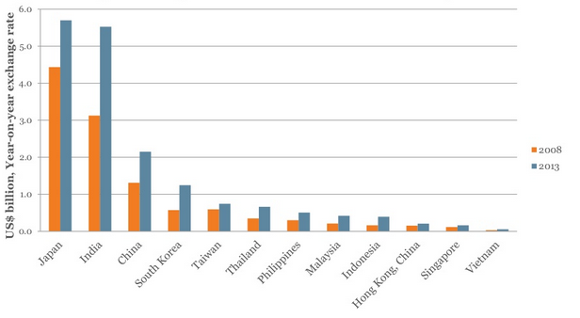
體重管理零售商品銷售數據
Weight Management Retail Sales
Source: Euromonitor International
Notes:
http://www.slideshare.net/fullscreen/Euromonitor/consumer-trends-in-weight-management-in-asia/5

Slide 6

科學實證‧減重新概念
WEIGHT LOSS ISN’T MAGIC,
IT’S SCIENCE.
®

Slide 7


4
科學元素
低升糖指數飲食
身體構成
補充品
教育
Science-based Components
Low-glycemic Impact Eating
Body Composition: Fat, Muscle & Metabolism
Supplements
Education
START LIVING WITH TLS® TODAY
#FINDYOURFIT
#TLSWEIGHTLOSS

Slide 8


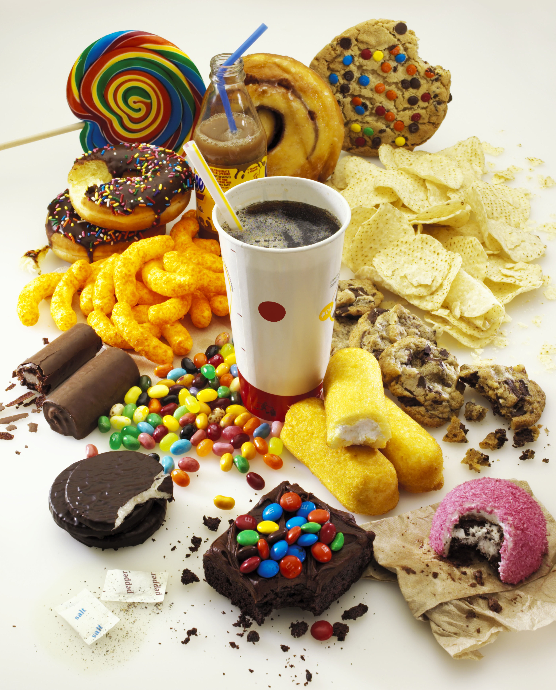
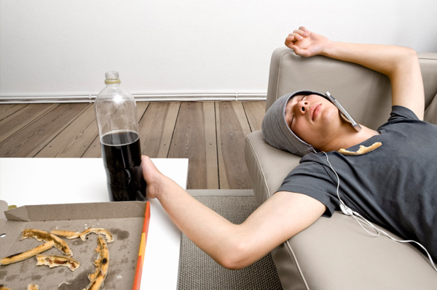

®
大部份人都仍然做一些錯的事情
We continue to do the wrong things...
不正確的食物選擇
Poor Food Choices
活動量不足
Not Active Enough
低頭一族
Too Much Screen Time
START LIVING WITH TLS® TODAY
#FINDYOURFIT
#TLSWEIGHTLOSS

Slide 9
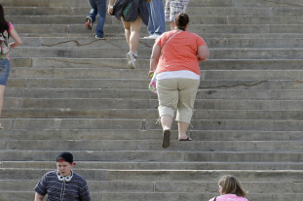
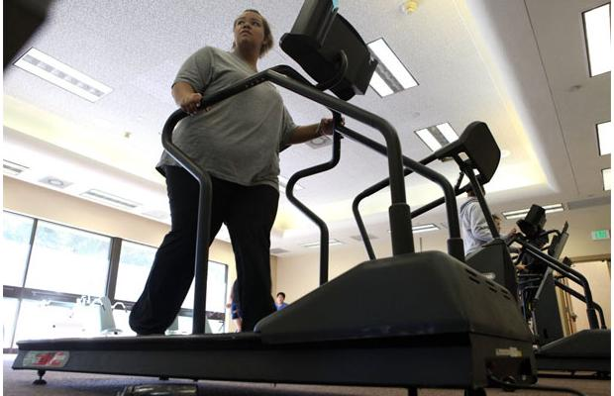
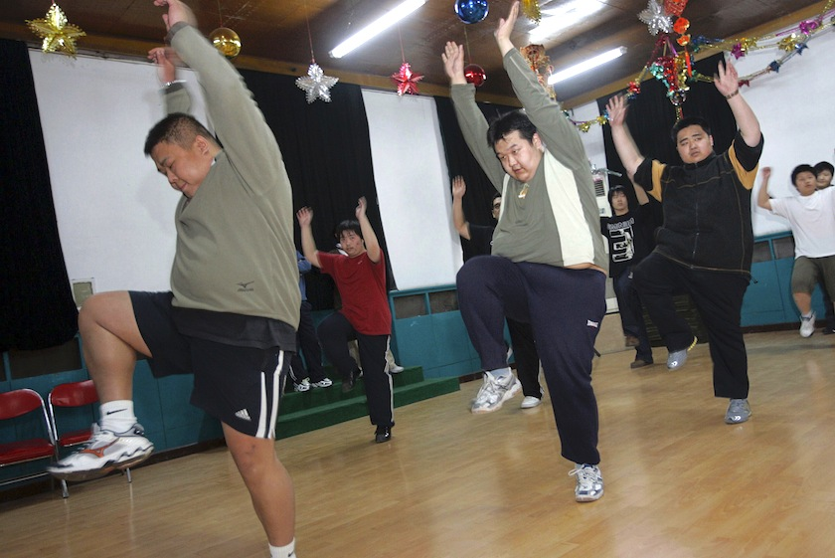
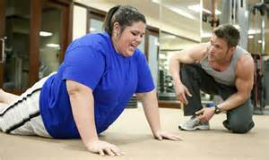
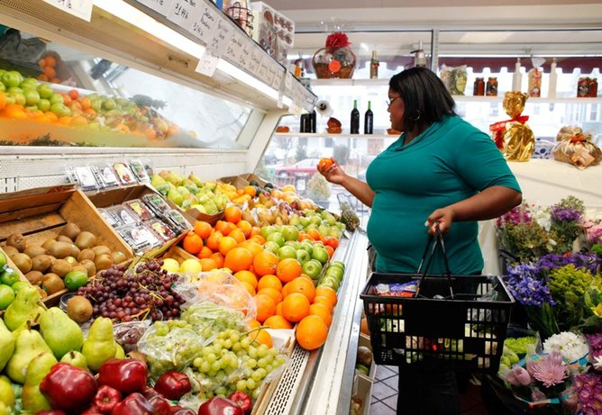
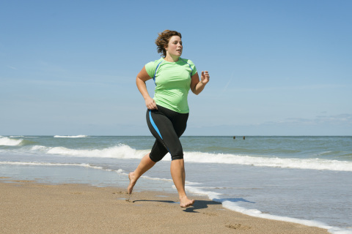

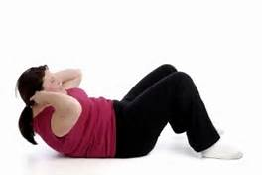
超重人士正在行動！
People overweight are taking action!

Slide 10
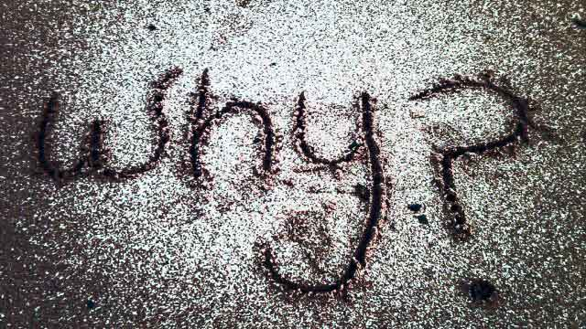
有希望…
There is hope and...
為何不是我？
WHY NOT ME?

Slide 11

行動及成功
Start
3 Months
6 Months
Take Action
And
Succeed!
START LIVING WITH TLS TODAY
#FINDYOURFIT
#TLSWEIGHTLOSS

Slide 12

®
這些都是讓TLS®成為你主修科目的最佳理由
There are good reasons
to make TLS® your major!

Slide 13
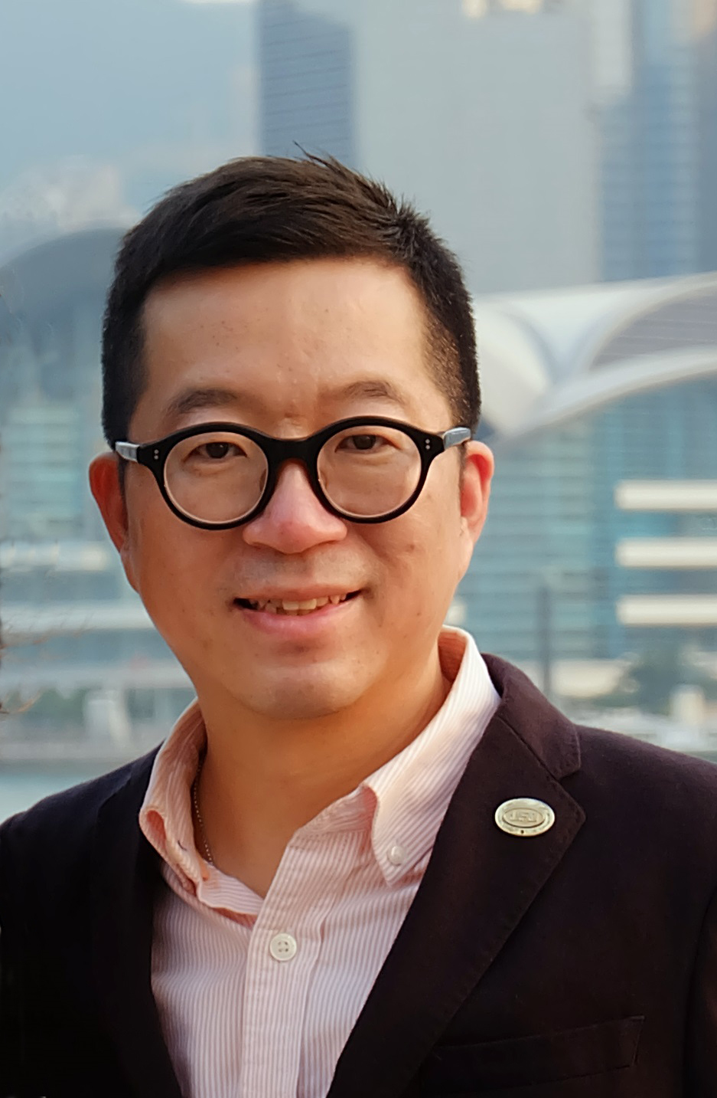
Calvin Ip
總顧問經理級
National Supervising Coordinator
四個佣金週期共賺取HK$76,600
HK$76,600 in 4 Commission weeks
本簡報中提到的收入等級純屬舉例說明，無意代表美安香港超連鎖店主的一般收入，也無意表示任何超連鎖店主皆可賺取同等收入。美安香港超連鎖店主的成功與否，取決於其在發展事業時的努力、才能與投入程度。The income levels mentioned in the following presentation are for illustration purposes only. They are not intended to represent the income of a typical Market Hong Kong UnFranchise Owner, nor are they intended to represent that any given Independent UnFranchise Owner will earn income in that amount. The success of any Market Hong Kong Independent UnFranchise Owner will depend upon the amount of hard work, talent, and dedication which he or she devotes to building his or her Market Hong Kong Business.

Slide 14

®
TLS® 21日修身挑戰
21–DAY CHALLENGE
START LIVING WITH TLS® TODAY
#FINDYOURFIT
S
#TLSWEIGHTLOSS

Slide 15
TLS® 21日修身挑戰
21-Day Challenge
®
不是TLS®健康生活纖形比賽
隨時進行
快速、有效、有趣－只需21日！
或可減去 5-20 磅，效果因人而異
Not a Find Your Fit Challenge
Starts any day you begin...
Fast, effective, fun and just 21 days!
May lose 5 – 20 lbs, result may very
START LIVING WITH TLS® TODAY
#FINDYOURFIT
S
#TLSWEIGHTLOSS

Slide 16
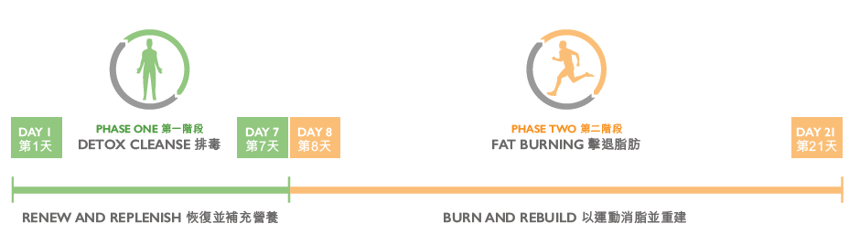

TLS® 21 日修身挑戰
21 DAY CHALLENGE
®
#TLS21DAYS

Slide 17

®
銷售
TLS® 21日修身挑戰是十分簡易！
SELLING
TLS® 21 Day Challenge is easy!
START LIVING WITH TLS® TODAY
#FINDYOURFIT
D
#TLSWEIGHTLOSS

Slide 18
銷售TLS® 21日修身挑戰
Selling the 21-Day Challenge
®
聽候機會...
問個簡單問題：「你有聽過TLS® 21日修身挑戰嗎？」
了解「TLS是甚麼？」的答案
懂得結束話題，機會不止有一個。
Listen for the opportunity...
Ask the simple question... “Have you heard of the TLS 21-Day Challenge?”
Know the answer to “What is it?”
Learn how to Close...Always more than one.
START LIVING WITH TLS® TODAY
#FINDYOURFIT
D
#TLSWEIGHTLOSS

Slide 19
它是什麼？
What is it?
®
TLS® 是TLS®健康生活纖營計劃。 只需21日，可減少5-20磅的多餘脂肪，令你擁有全新的你
你可隨時進行TLS 21日修身挑戰
TLS® stands for Transitions Lifestyle System. The 21-Day Challenge is taking 21 days to lose 5-20 pounds of unwanted fat and create a new you.
The 21-Day Challenge begins when you are ready to take the 21-Day Challenge!
START LIVING WITH TLS® TODAY
#FINDYOURFIT
S
#TLSWEIGHTLOSS

Slide 20
你認識TLS®健康生活纖營計劃嗎？
Have you ever heard of the TLS® program?
®
以科學為基礎的體重管理計劃，讓身體成為脂肪燃燒模式。
It is a science-based weight management program that turns your body into a fat-burning machine.
#FINDYOURFIT
D
START LIVING WITH TLS® TODAY
#TLSWEIGHTLOSS

Slide 21
®
如你希望了解更多，我可以寄一段短片給你參考。你的電郵地址是甚麼？可以給我你的電話號碼，讓我確定你已收到檔案嗎？
To learn more, I can send you a short video. What is your email address? Can I get your phone number to ensure you received it?
#FINDYOURFIT
D
START LIVING WITH TLS® TODAY
#TLSWEIGHTLOSS

Slide 22

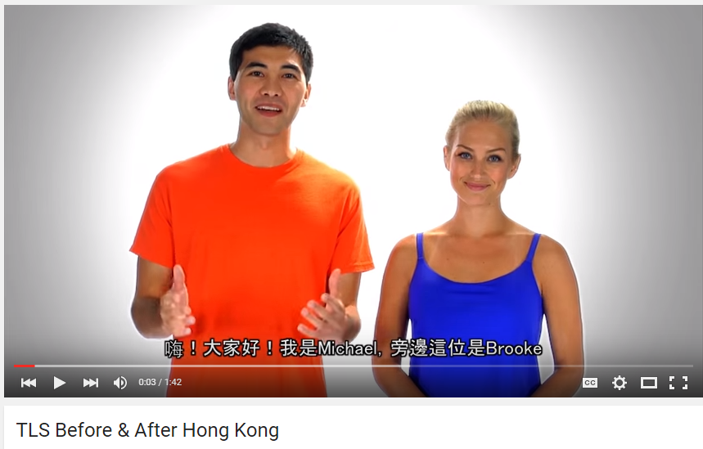


$$®$$
$$®$$

Slide 23
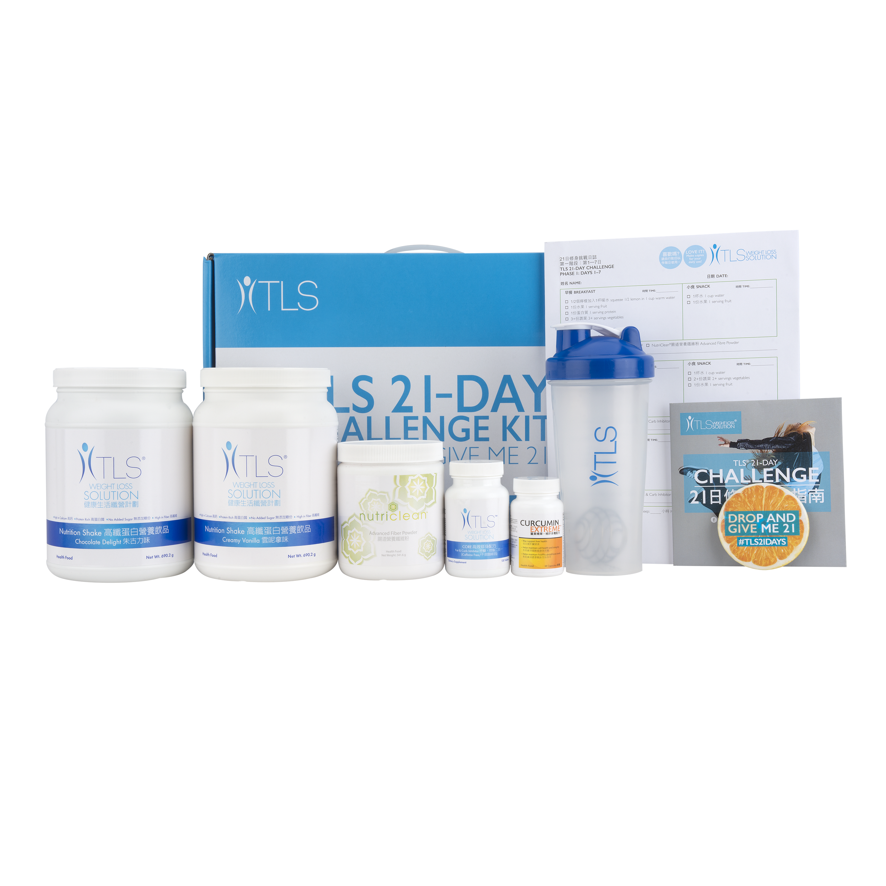
TLS® 21日修身挑戰套裝
TLS® 21-DAY CHALLENGE KIT
24%
HK21DAY | UC $1,038.00 | SR $1,452.00 | BV 25.0

Slide 24

讓超連鎖事業向前邁進
TLS® Pays It Forward
TLS®顧客
TLS® Customer
HK.SHOP.COM 顧客Customer
購物年金Shopping Annuity
TLS®
超連鎖店主UFO
START LIVING WITH TLS® TODAY
#FINDYOURFIT
#TLSWEIGHTLOSS

Slide 25



讓TLS®打造你的購物年金
TLS® FEEDS YOUR
SHOPPING ANNUITY™
START LIVING WITH TLS® TODAY. #FINDYOURFIT
S

Slide 26

恭喜你！你已成為一位新的TLS®夥伴！CONGRATULATIONS! You are now a new TLS® Business Partner.

Slide 27

®
成功個案
Successful Stories
S
Notes:
Bring out the TLS 21 day challenge Beta group

Slide 28
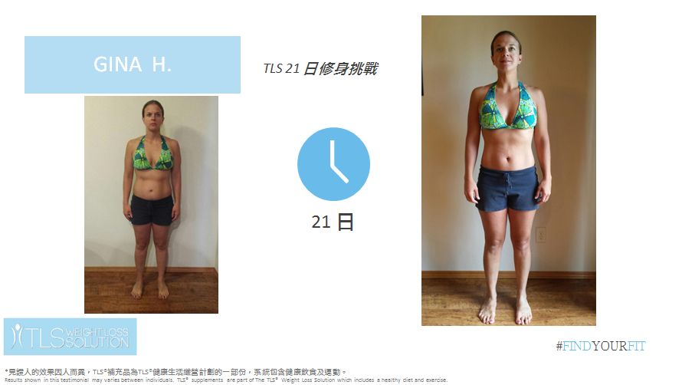
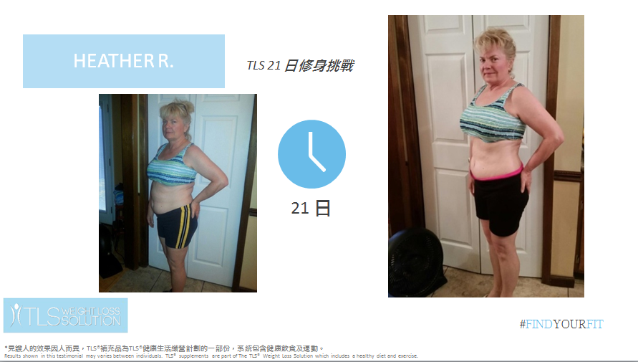
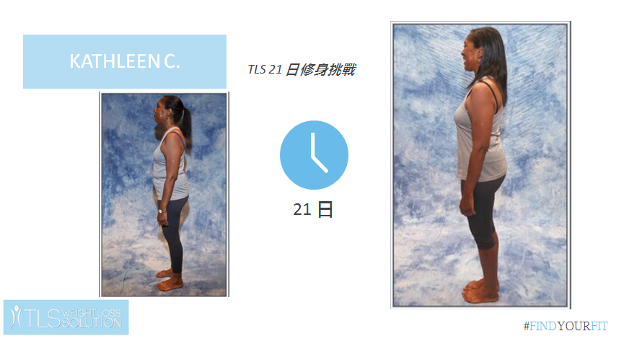
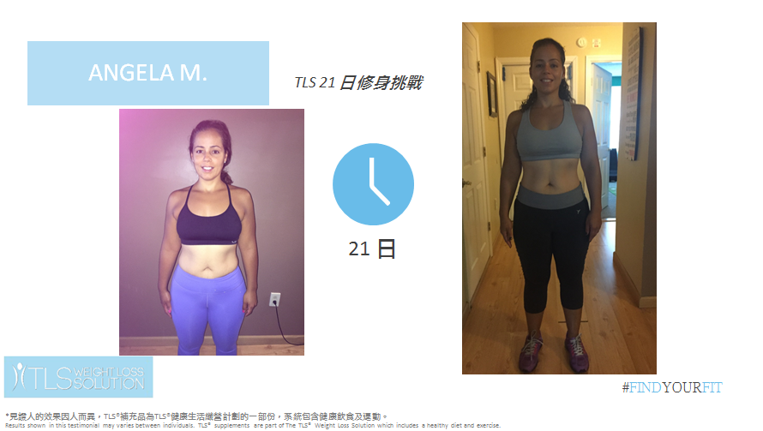

Slide 29
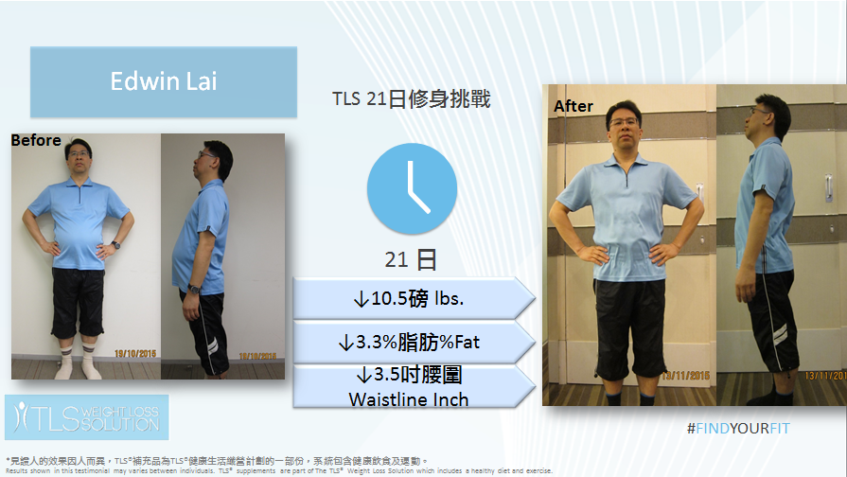
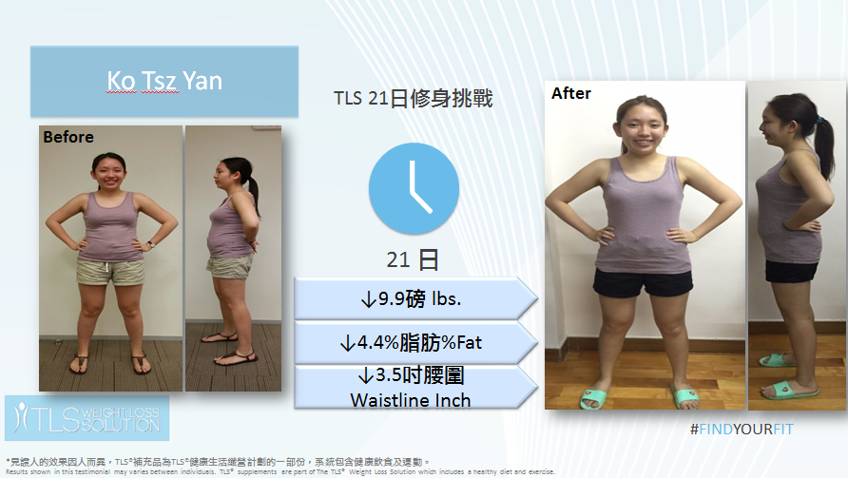
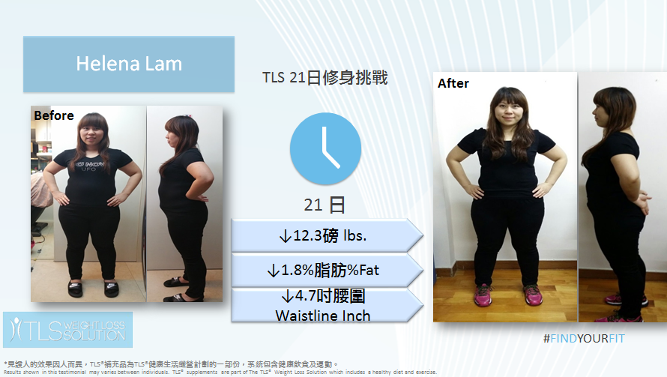
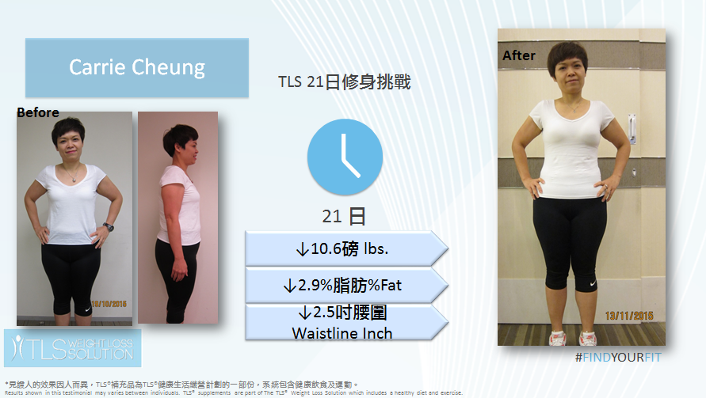

Slide 30
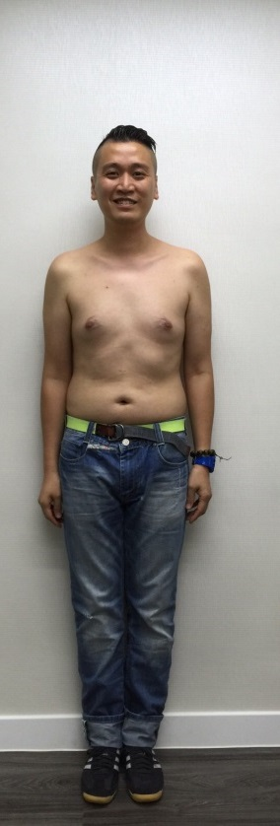
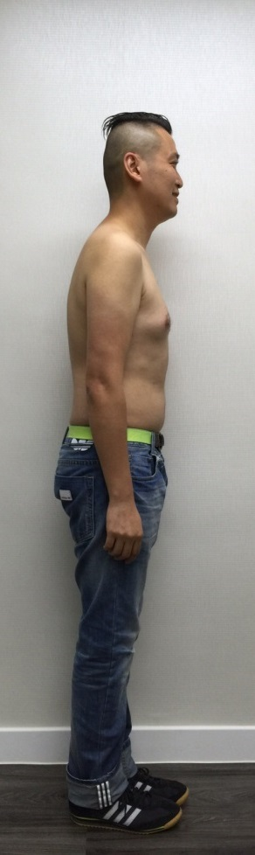
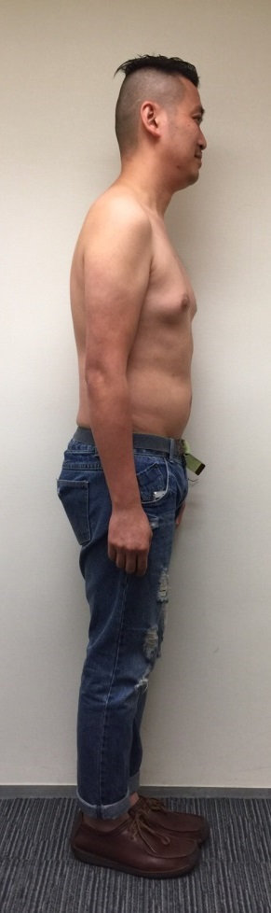
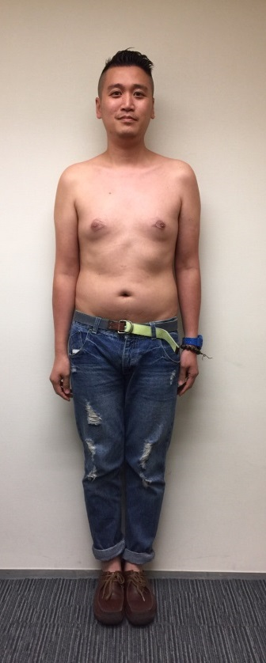
Man Fung
After
TLS® 21日修身挑戰
Before
21 日
↓1.9%脂肪%Fat
↓1.5吋腰圍
Waistline Inch
®
#FINDYOURFIT
*見證人的效果因人而異，TLS®補充品為TLS®健康生活纖營計劃的一部份，系統包含健康飲食及運動。Results shown in this testimonial may varies between individuals. TLS® supplements are part of The TLS® Weight Loss Solution which includes a healthy diet and exercise.

Slide 31
®
短期見效 長期方案
Short-Term Results
Long-Term Solution

Slide 32
®
2016
TLS®健康生活纖形比賽
Find Your Fit Challenge

Slide 33
TLS®健康生活纖形比賽
Find Your Fit Challenge
®
送出獎金及獎品 總值超過港幣$53,000
比賽日期：2016年5月2日– 2016年9月4日
報名截止日期：2016年6月11日11:59 p.m.
Win Over HK$53,000 Cash and Product Prizes
Challenge Period: May 2, 2016 – September 4, 2016
Registration Deadline: June 11, 2016 at 11:59PM
START LIVING WITH TLS® TODAY
#FINDYOURFIT
#TLSWEIGHTLOSS

Slide 34
TLS®健康生活纖形比賽
Find Your Fit Challenge
®
比賽類別：
12週計劃－男子組別
12週計劃－女子組別
Challenge Categories:
12-Week Individual Challenge – Male
12-Week Individual Challenge – Female
START LIVING WITH TLS® TODAY
#FINDYOURFIT
#TLSWEIGHTLOSS

Slide 35
TLS®健康生活纖形比賽
Find Your Fit Challenge
®
如何加入比賽？
滿18歲或以上人士及香港合法居民
取報名表格
繳交港幣$250報名費，報名費不作退還。
比賽期間必須購買最少港幣$2,000TLS®系列產品。每位參賽者必須於比賽完結日期前符合此要求。
填的報名表格電郵至tls@markethongkong.com.hk
Who and How to enter?
Adults 18 years of age and older and legal Hong Kong resident
Get the application form
HK$250.00 non-refundable registration fee
Purchase a minimum of HK$2,000 in official TLS® products throughout the Challenge period is required for participation
Send the application to tls@markethongkong.com.hk
START LIVING WITH TLS® TODAY
#FINDYOURFIT
#TLSWEIGHTLOSS

Slide 36
TLS®健康生活纖形比賽
Find Your Fit Challenge
®
優勝者挑選準則?
由美安公司TLS®團隊與美安香港公司團隊組成的公正評審團將挑選10位TLS®健康生活纖形比賽的優勝者
60% －「減重前」及「減重後」照片
20% －「減重前」及「減重後」體重和體圍尺寸
20% － 減重見證問卷
Selection of the Winner?
MA TLS® Corporate Team and MHK will select the winners based on:
60% Before & After photos
20% Measurements
20% Testimonial Questionnaire
START LIVING WITH TLS® TODAY
#FINDYOURFIT
#TLSWEIGHTLOSS

Slide 37
TLS®健康生活纖形比賽
Find Your Fit Challenge
®
比賽獎項（男女子組別 ）：
第1名 – 港幣6,000元 + 3瓶TLS® CORE
第2名 – 港幣3,500元 + 3瓶TLS® CORE
第3名 – 港幣2,500元 + 3瓶TLS® CORE
第4名及第5名 – 高效營養組合
第1名個人比賽優勝者之教練將可獲得3個月使用量的高效營養組合 (3套)。
所有優勝者將獲得2016美安香港成功領袖會議門票一張。
Challenge Prizes (Male & Female):
1st Place – HK$6,000 + 3 TLS CORE
1st Runner Up – HK$3,500 + 3 TLS CORE
2nd Runner Up – HK$2,500 + 3 TLS CORE
4th & 5th Places – 1 set of Optimal Wellness Kit
Coach of 1st place winner will win 3 months usage of Optimal Wellness Kit
All winners will also win a free ticket to MHK Leadership School 2016.
START LIVING WITH TLS® TODAY
#FINDYOURFIT
#TLSWEIGHTLOSS

Slide 38


TLS®健康生活纖形比賽
Find Your Fit Challenge
®
START LIVING WITH TLS® TODAY
#FINDYOURFIT
#TLSWEIGHTLOSS

Slide 39

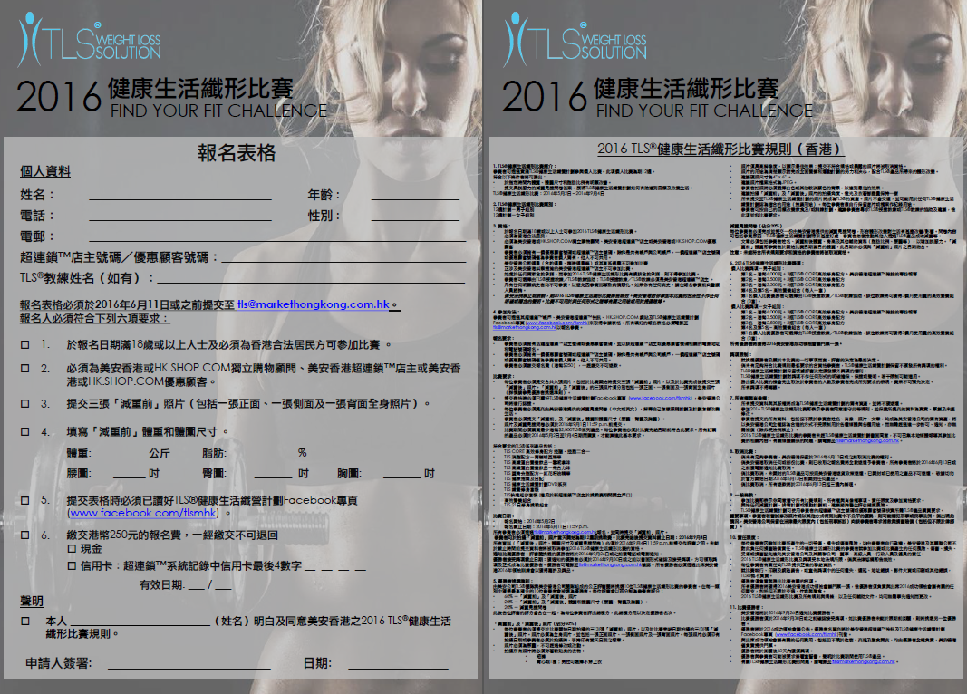
TLS®健康生活纖形比賽
Find Your Fit Challenge
®
START LIVING WITH TLS® TODAY
#FINDYOURFIT
#TLSWEIGHTLOSS

Slide 40
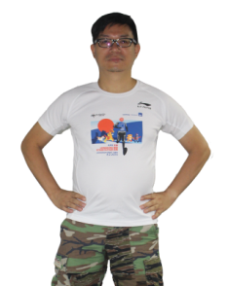
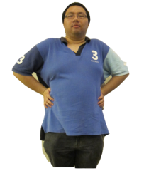



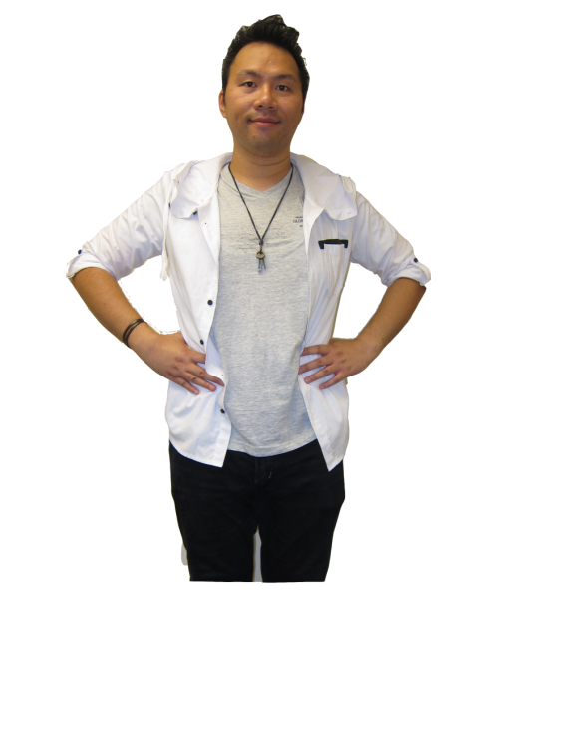
2015 TLS®健康生活纖形比賽
Find Your Fit Challenge
®
張錦嫦 Tina
↓41.6磅
↓12.1脂肪
↓8.5吋腰圍
李家龍 Brian
↓35.0磅
↓14.5脂肪
↓8.0吋腰圍
陸佑銓 Bryan
↓41.8磅
↓10.8%脂肪
↓13.5吋腰圍
亞軍
冠軍
季軍
*見證人的效果因人而異，TLS®補充品為TLS®健康生活纖營計劃的一部份，系統包含健康飲食及運動。Results shown in this testimonial may varies between individuals. TLS® supplements are part of The TLS® Weight Loss Solution which includes a healthy diet and exercise.

Slide 41

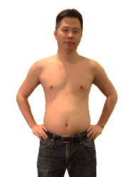
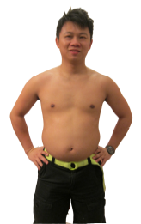
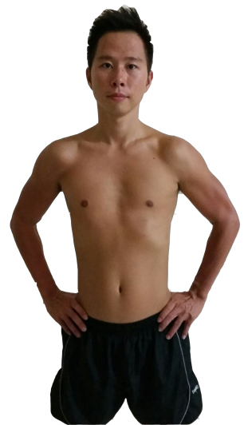
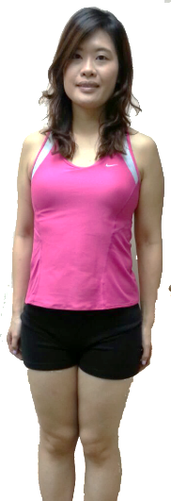
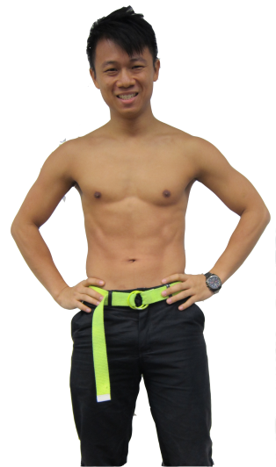
2014 TLS®健康生活纖形比賽
Find Your Fit Challenge
®
周安琪
↓26.4磅
↓8.3脂肪
↓8.0吋腰圍
陳國澤
↓35.6磅
↓13.6%脂肪
↓9.5吋腰圍
張浩昌
↓23.1磅
↓7.3脂肪
↓7.5吋腰圍
亞軍
冠軍
季軍
*見證人的效果因人而異，TLS®補充品為TLS®健康生活纖營計劃的一部份，系統包含健康飲食及運動。Results shown in this testimonial may varies between individuals. TLS® supplements are part of The TLS® Weight Loss Solution which includes a healthy diet and exercise.

Slide 42
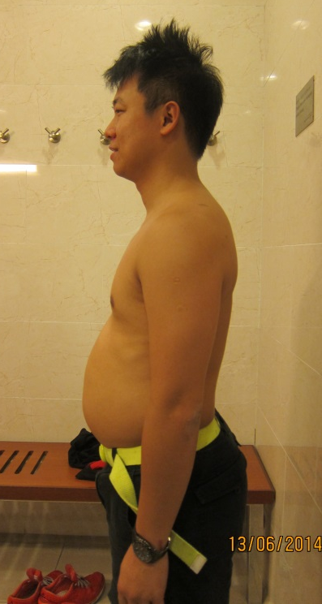
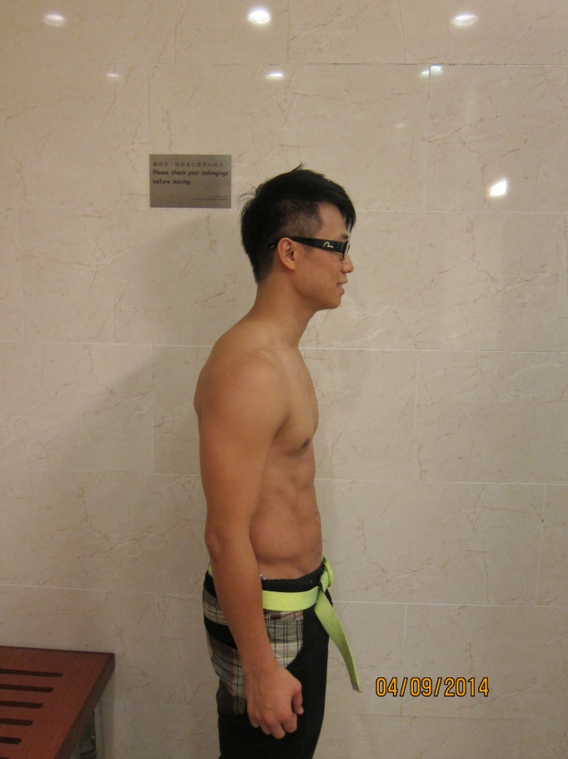
2014 季軍 – 張浩昌
3rd Place Winner – Patrick Cheung
®
↓23.1磅lbs
↓7.3%脂肪%Fat
↓7.5吋腰圍
Waistline Inch
*見證人的效果因人而異，TLS®補充品為TLS®健康生活纖營計劃的一部份，系統包含健康飲食及運動。Results shown in this testimonial may varies between individuals. TLS® supplements are part of The TLS® Weight Loss Solution which includes a healthy diet and exercise.

Slide 43
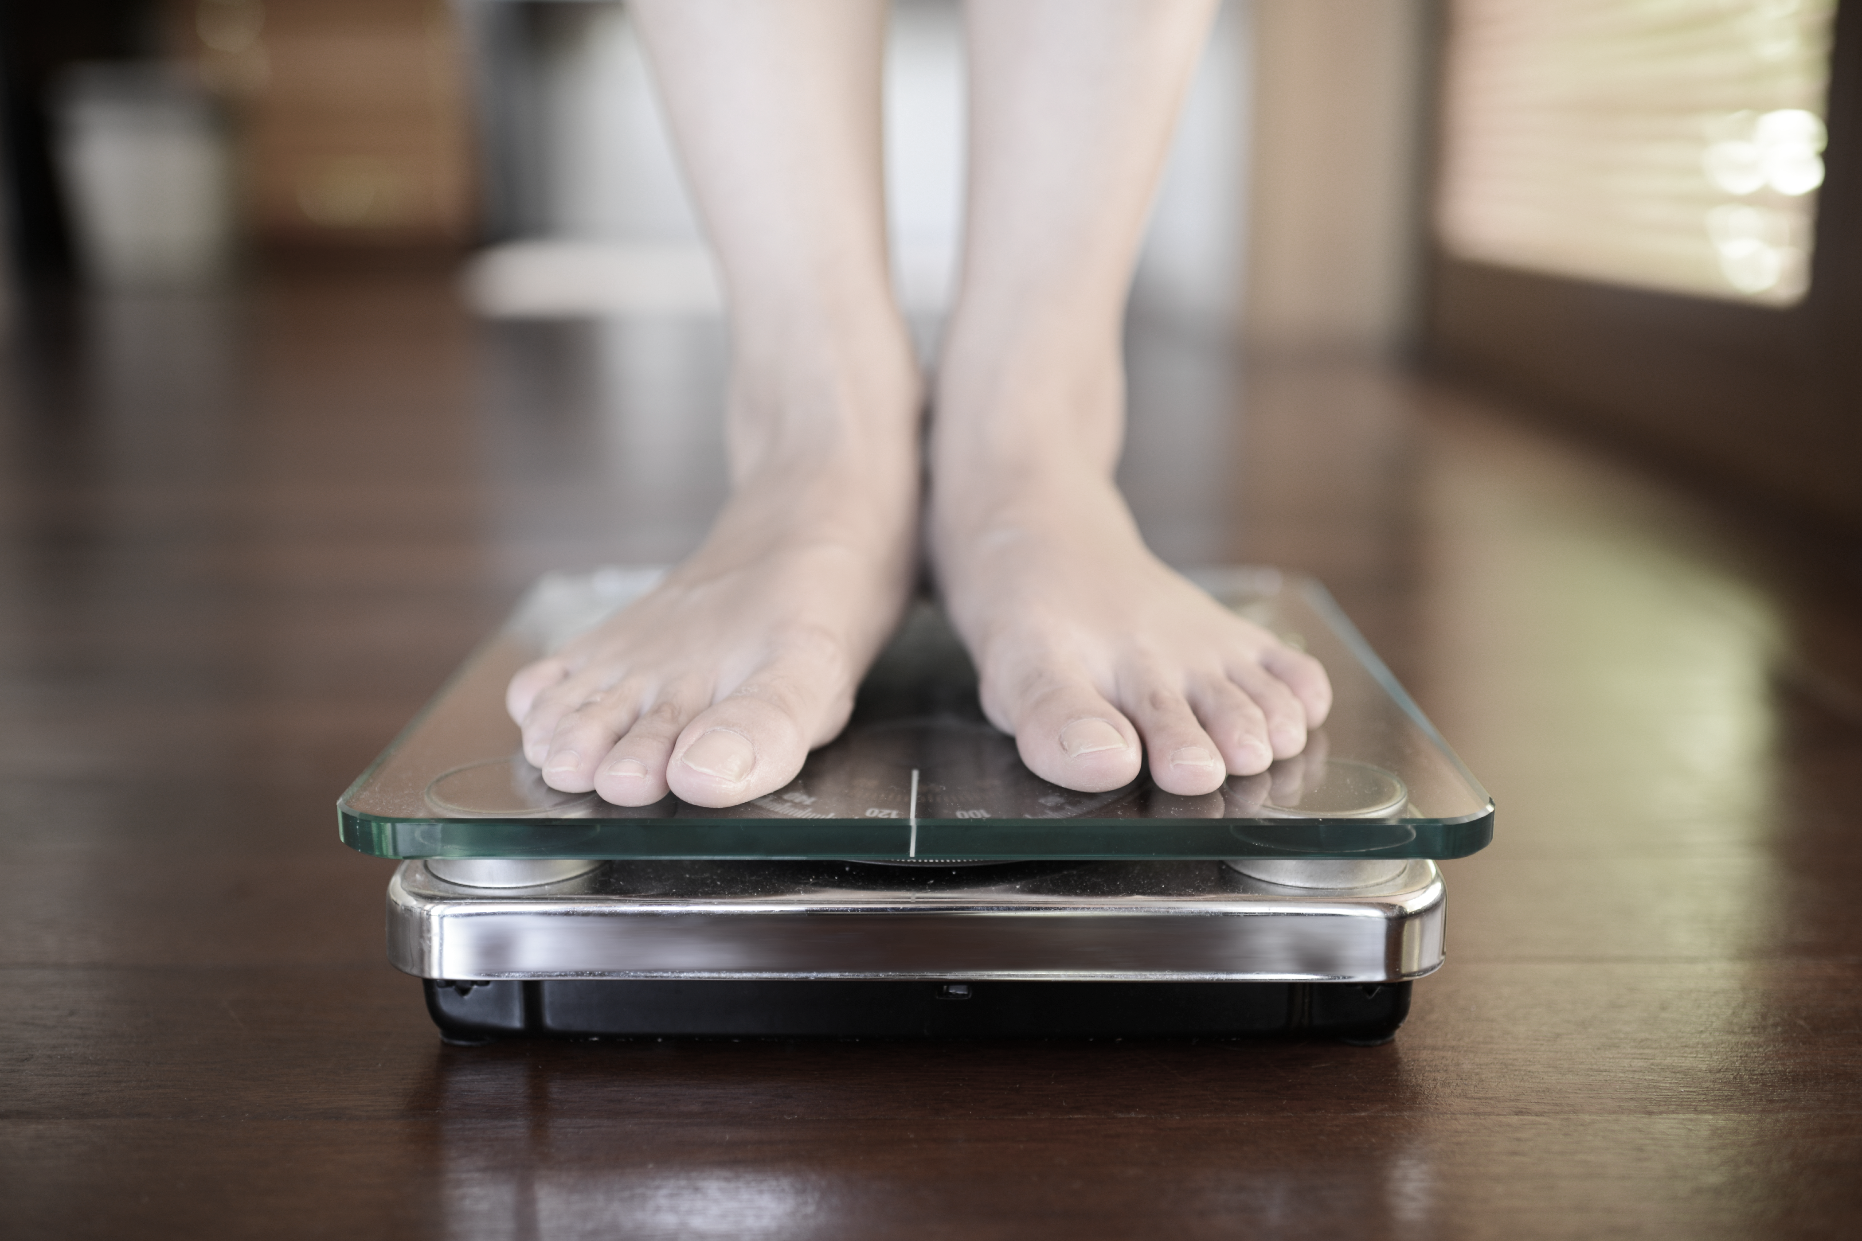
請到TLS®展覽攤位
VISIT THE TLS® BOOTH
新產品特別訓練
New Product Breakout
Tuesday, May 10
8:00 - 9:30 p.m.

Slide 44


