Slide 1

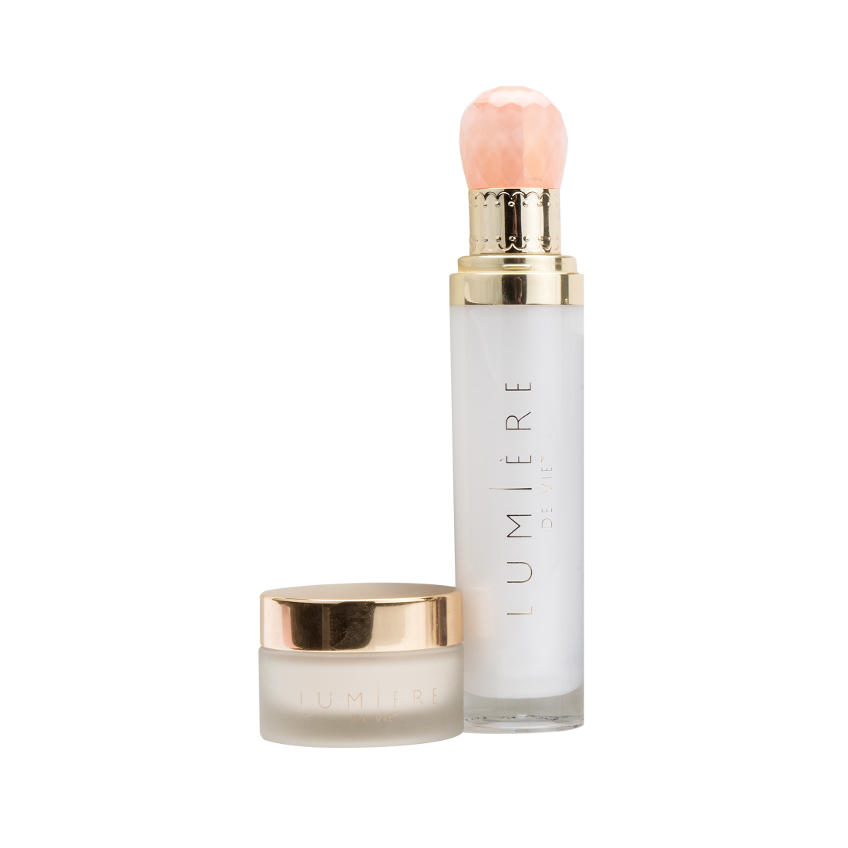
極緻妍亮透白組合Brightening Kit
包括極緻妍亮淡斑液及極緻妍亮美白淡斑霜
CODE: HK12218 | UC: $696.00 | SR: $975.00 | BV:60
Notes:
Includes Lumière de Vie Illuminating Fading Fluid and Super Crème

Slide 2


Slide 3
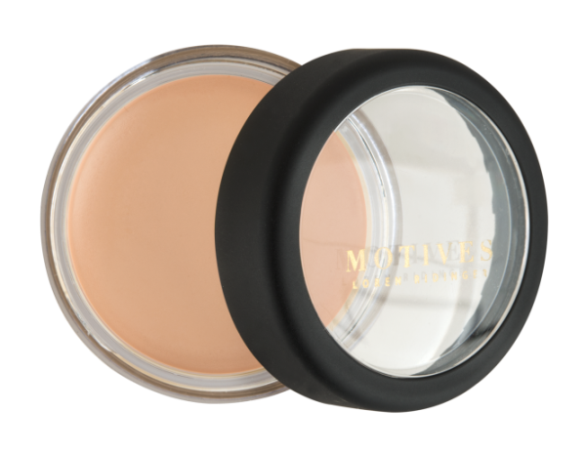
MOTIVES®新產品
遮瑕膏
Crème Concealer
Peach
CODE: HK005MC | UC: $123.00 | SR: $173.00 | BV:10

Slide 4

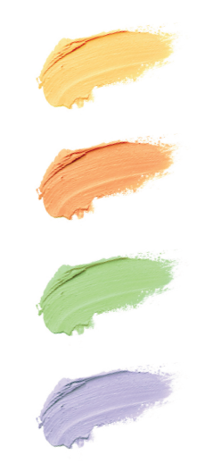
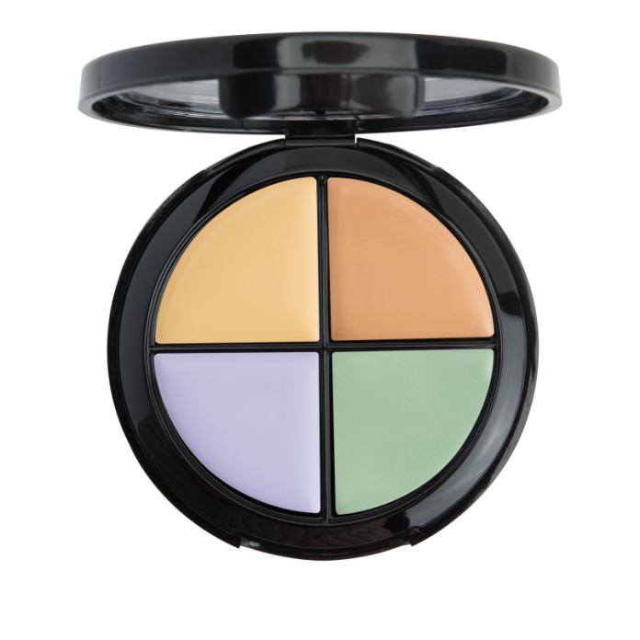
MOTIVES®新產品
Yellow 黃色
中和色素沉澱及色斑，適合所有膚色使用
四色膏狀修容組合
Color Correction Quad
Peach 桃紅色
修飾黑眼圈、色斑，並能提亮黯沉膚色，適合淺／中等膚色使用
Green 綠色
遮蓋泛紅膚色（例如：玫瑰斑、痘疤、紅血絲、曬傷所引起的泛紅肌膚）
Lavender 淡紫色
改善黯沉、無光澤膚色，適合淺膚色、古銅膚色或黃褐膚色使用
CODE: HK200CCW
UC: $223.00 | SR: $312.00 | BV:21
Notes:
Peach: Neutralizes dark under-eye circles, dark spots and brightens fair/medium skin tones
Green: Counteracts redness (i.e. from rosacea, acne, broken capillaries, and sunburn)
Lavender: Neutralizes dullness on light, tan, or olive skin with yellow undertone
Yellow: Neutralizes hyperpigmentation and dark spots on all skin tones

Slide 5
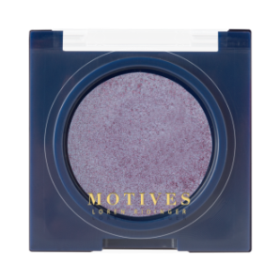
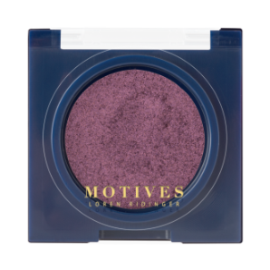
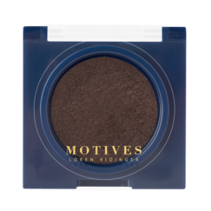
MOTIVES®新產品
瑰麗眼影
Eye Illusions
HK105MEIS – Chameleon
HK106MEIS – Odyssey
HK109MEIS – Perception
Chameleon
Odyssey
Perception
UC: $124.00 | SR: $173.00 | BV:11

Slide 6
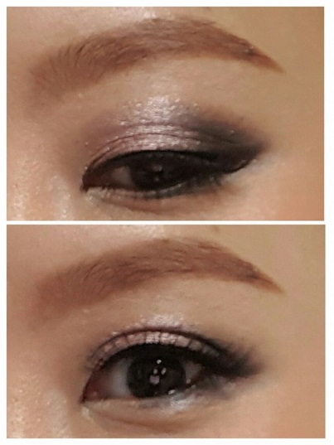
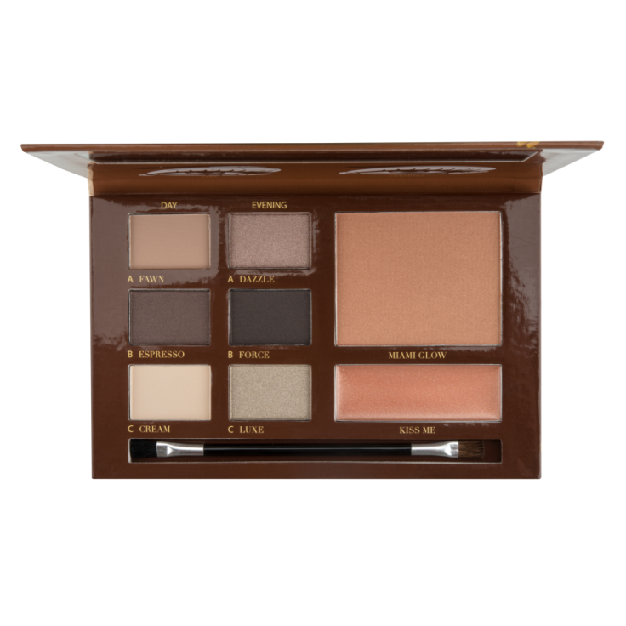
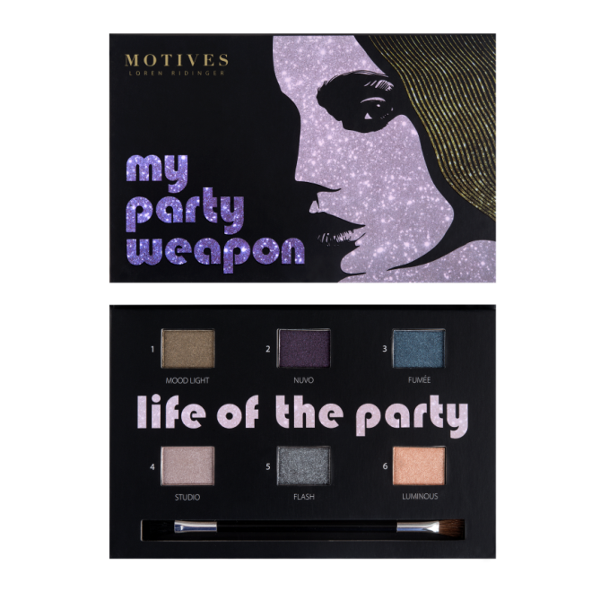
MOTIVES®新產品
眼影組合
My Party Weapon
彩妝組合
In the Nude
LIMITED
EDITION
CODE: HKPRESH16
UC: $295.00 | SR: $410.00 | BV:27
CODE: HKPRESH15
UC: $295.00 | SR: $410.00 | BV:27

Slide 7
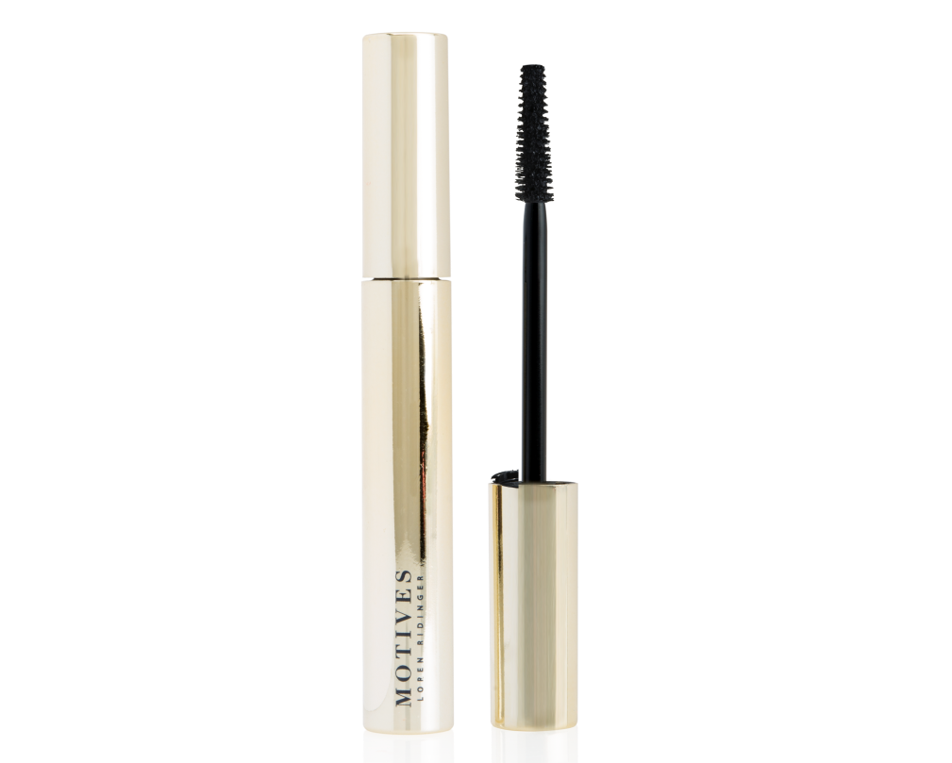
MOTIVES®新產品
濃密纖維睫毛液
Fiber Lush Mascara
CODE: HK100MFM | UC: $171.00 | SR: $239.00 | BV:15

Slide 8
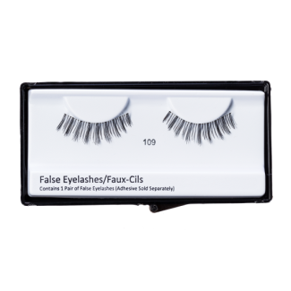
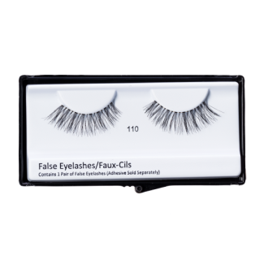
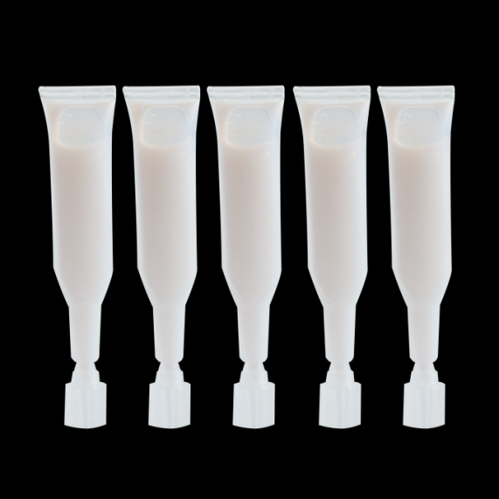
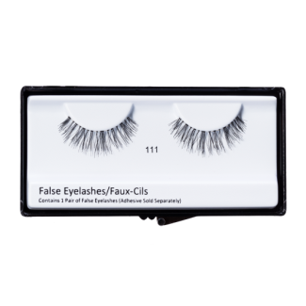
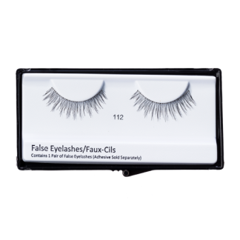
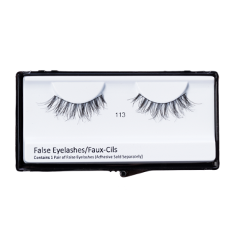
MOTIVES®新產品
假眼睫毛
False Eyelashes
假眼睫毛膠水
Lash Adhesive
每包含有5支
Packaged in five
CODE: varies
UC: $60.00 | SR: $85.00 | BV:4.25
CODE: HK105MLG
UC: $50.00 | SR: $70.00 | BV:0

Slide 9
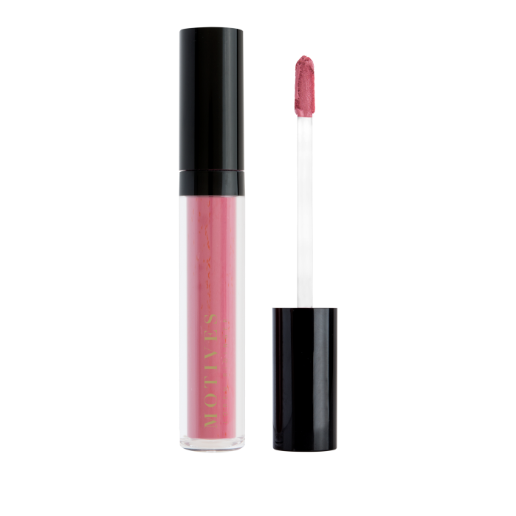
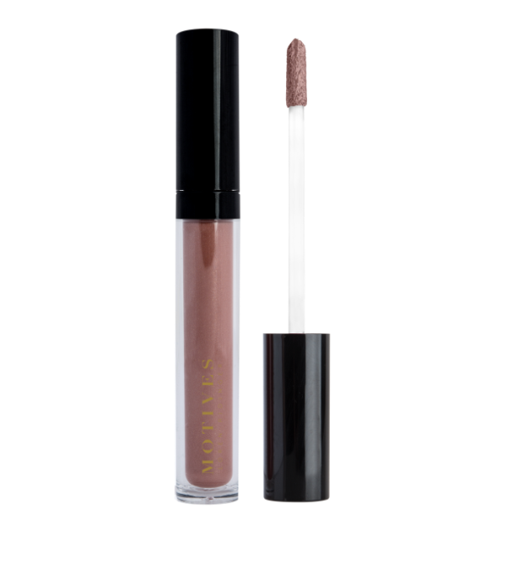
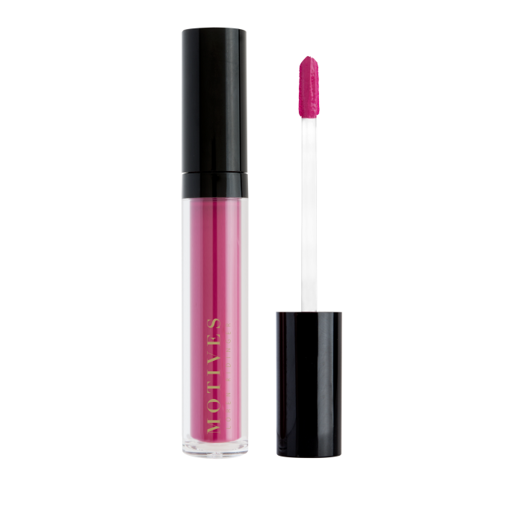

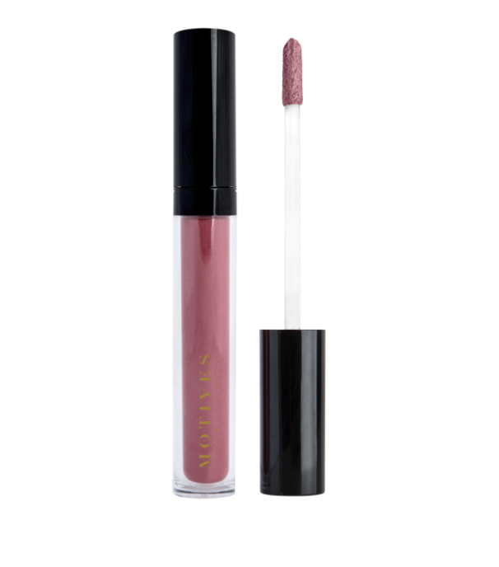


Coming
Soon
MOTIVES®新產品
閃爍水潤唇彩
Liquid Pout Plumper
持久啞緻唇蜜
All Day Liquid Mattes
CODE: varies
UC: $145.00 | SR: $200.00 | BV:12
CODE: varies
UC: $145.00 | SR: $200.00 | BV:12

Slide 10
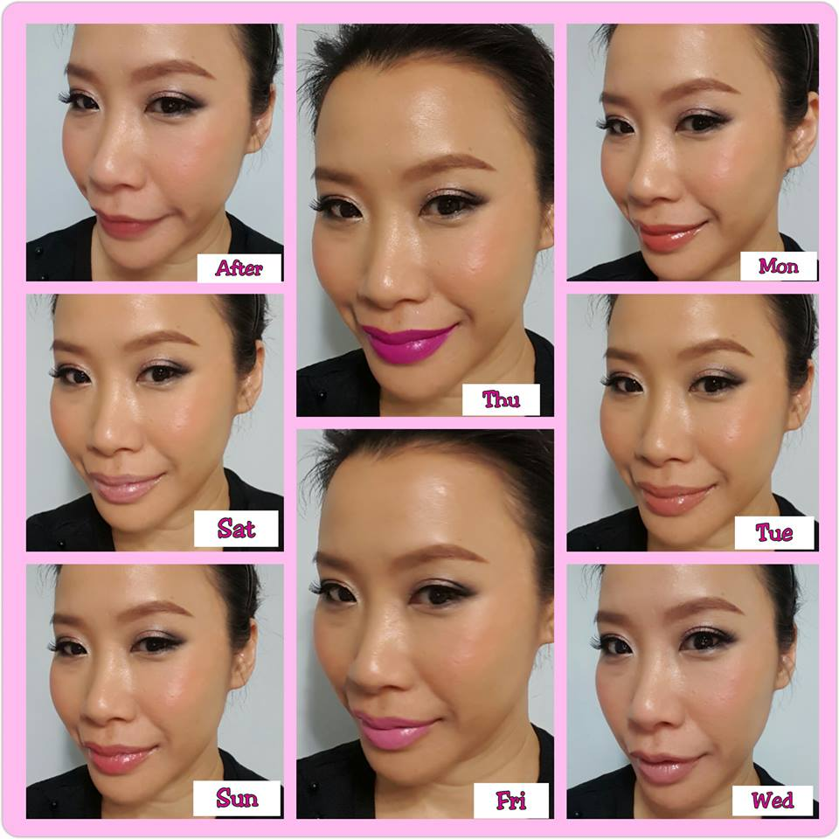
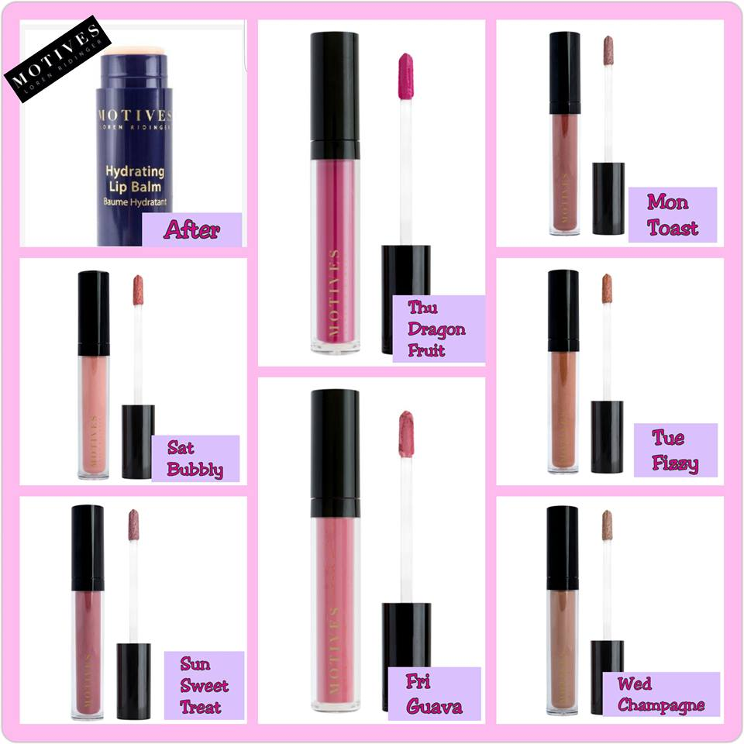

Slide 11
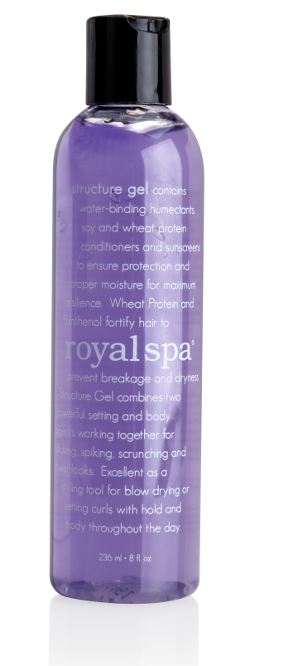
造型啫喱 Structure Hair Gel
Royal Spa™新產品
結合了兩種強效配方，含有保濕及蛋白質潤髮成分
主要成分：水解小麥蛋白、棕櫚酸視黃酯（維他命A）及生育醇（維他命E）
CODE: HK12018 | UC: $74.00 | SR: $104.00 | BV: 4.5
Notes:
combines two powerful setting
contains water-binding humectants and protein conditioners
Key Ingredients：Hydrolyzed Wheat Protein， Retinyl Palmitate (Vitamin A) and Tocopherol (Vitamin E)

Slide 12
產生的零售利潤及BV
 | BV | 零售利潤
Isotonix OPC-3®沖飲 | 43.5 | 180.00
Isotonix 美肌OPC-3®沖飲 | 43.5 | 178.00
Fixx 摩洛哥堅果油洗髮乳 | 11 | 52.00
Fixx 摩洛哥堅果油護髮素 | 11 | 52.00
Royal Spa 沐浴露 | 6.5 | 40.00
Lumière de Vie 極緻妍亮手部及身體潤膚霜 | 16 | 75.00
Skintelligence 深層潔膚乳液 | 7.25 | 52.00
Skintelligence pH 平衡爽膚水 | 7.25 | 49.00
Lumière de Vie 極緻妍亮眼霜 | 24 | 104.00
VitaShield 維他命C+E保濕修護組合 | 70 | 285.00
Cellular Laboratories 煥膚再生高效防曬乳霜SPF 50+ | 24 | 102.00
Motives 無瑕美肌妝前底霜 | 14 | 59.00
Motives 礦物粉底液 | 15 | 75.00
Motives 四色膏狀修容組合 | 21 | 89.00
Motives 無瑕美肌透亮碎粉 | 12 | 60.00
Motives 眉妝組合 | 18 | 83.00
Motives 瑰麗眼影 | 11 | 49.00
Motives極緻眼線筆 | 8 | 36.00
Motives 濃密纖維睫毛液 | 15 | 68.00
Motives 持久啞緻唇蜜 | 12 | 55.00
Motives In the Nude彩妝組合 | 27 | 115.00
Motives My Party 眼影組合 | 27 | 115.00
Motives 瞬間無瑕定妝噴霧 | 17 | 79.00
Motives 專業化妝掃套裝 | 50 | 337.00
Royal Spa 造型啫喱 | 4.5 | 30.00
Fixx 豐盈噴霧 | 9 | 45.00
總零售利潤 | 524.5 | 2464.00
Notes:
Retail Profit If You Sell …

Slide 13


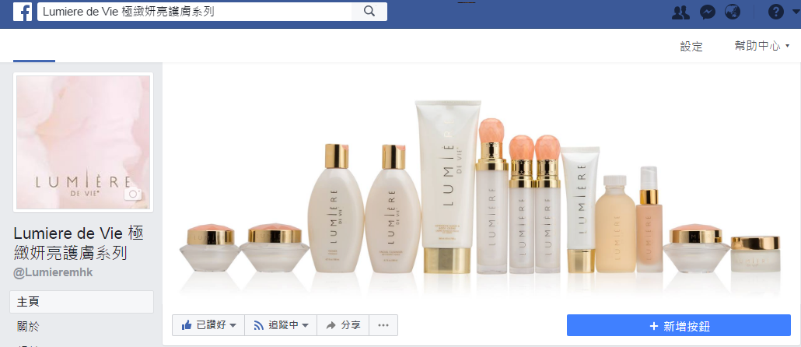

Stay Connected with Motives & Lumière de Vie
緊貼Motives及Lumière de Vie極緻妍亮護膚系列最新資訊
Motives by Loren Ridinger彩妝系列
Lumiere de Vie 極緻妍亮護膚系列
Notes:
Keep yourself updated by visiting our facebook fanpage

Slide 14
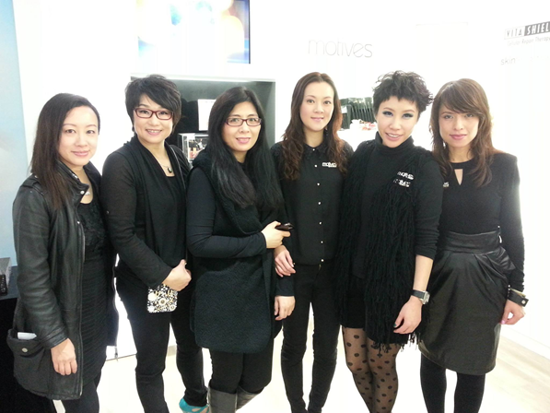
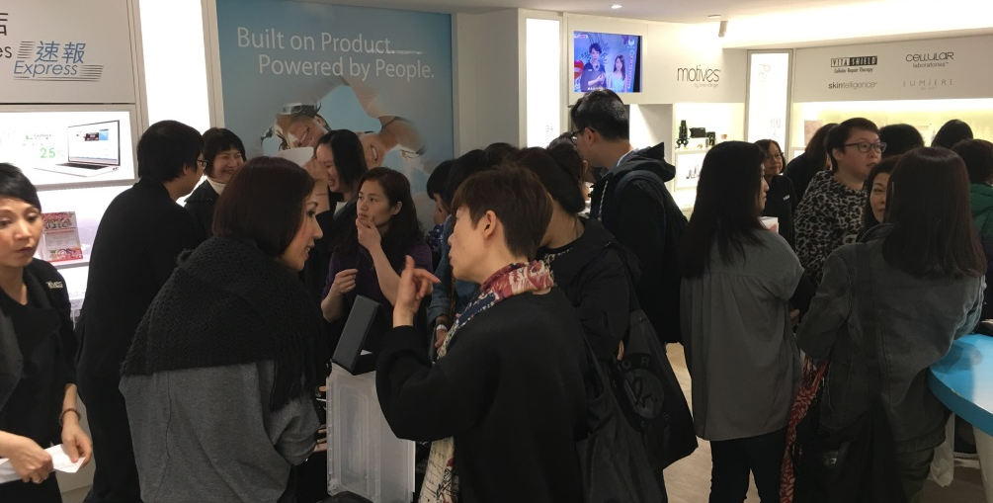
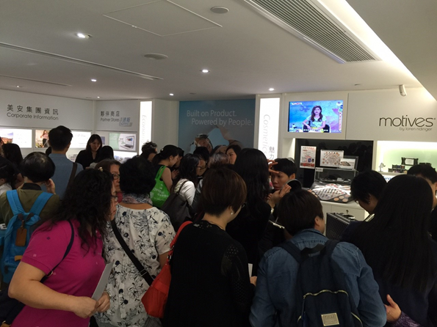
Motives®美麗盛會
夏日必備品‧體驗新彩妝
日期：2017年5月27日（六）
時間：2:00 - 4:30 p.m.
地點：美安生活廊
費用：免費入場
Notes:
Rose: 30秒

Slide 15

Motives®授證訓練
Lisa是一位高級顧問經理級超連鎖™店主和百萬美元俱樂部成員。她自2008年起成為Motives®授證訓練員，更於2012年贏得年度Motives®授證訓練員獎項。屆時Lisa將會與我們分享豐富的Motives®彩妝知識和經驗。
2017年5月12日（五），下午1時至6時：
Motives®品牌概覽、產品知識及銷售技巧
2017年5月13日（六），下午1時至6時：
護膚及個人護理系列、產品知識及銷售技巧
Lisa Martin
Motives®超連鎖™拓展總監
地點：美安生活廊
門票：HK$1,000.00 （代號: 2188_HKMCT17）
尚餘少量門票，
把握最後機會報名！
Notes:
only a few tickets remain!
Don’t Miss this Great Opportunity
Lisa is a Director and Million Dollar Club member. She has been working as a Motives Certified Trainer since 2008 and was named Motives Certified Trainer of the Year in 2012. She will share with participants her great knowledge and experience with Motives.
May 12, 2017 Friday (1:00 p.m. – 6:00 p.m.):
Motives Brand Introduction: Product Knowledge & Marketing
May 13, 2017 Saturday (1:00 p.m. – 6:00 p.m.):
MA Skin and Personal Care: Product Knowledge & Marketing
Location: mhk Showcase
Ticket Price: HK$1,000 (Code: 2188_HKMCT17)

