Slide 1
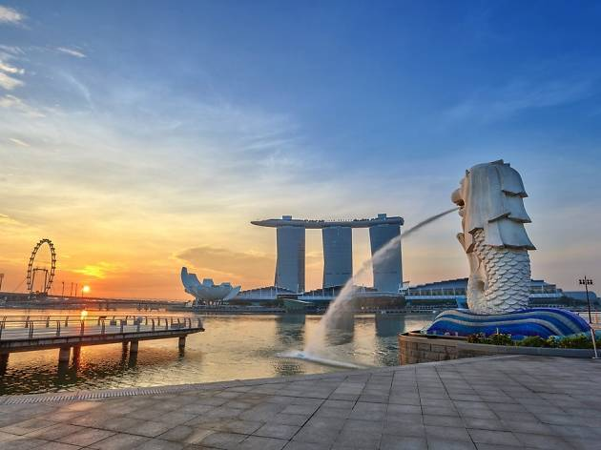
Asia Pacific Update
AUSTRALIA
TAIWAN
HONG KONG
SINGAPORE
2002
2005
2007
2014
Notes:
United States, Canada, Mexico, Bahamas, Columbia, Dominican Republic, Ecuador, Panama, Jamaica
United Kingdom, Spain
Australia, Taiwan, Hong Kong, Singapore, New Zealand

Slide 2
WHY Develop Overseas Market?
☞ Know anyone there ?
☞ Visit there occasionally ?
☞ You are SHOP.COM owner there!
☞ Earn more ?

Slide 3
Market Asia in 2016
Challenge Winner
 36 %
SABP Winners
83%
MUFO
58%

Slide 4
Market Asia in 2016
PartnerStore
Growth
 17 %
Recruitment
 19%
BV Commission
 33%

Slide 5
UFO Growth
SHOP.COM:
GMTSS, SABP, MUFO
SHOP.COM Card
Mobile Google Map
Promotion collaborative with UOB
2017 Highlight
SINGAPORE

Slide 6
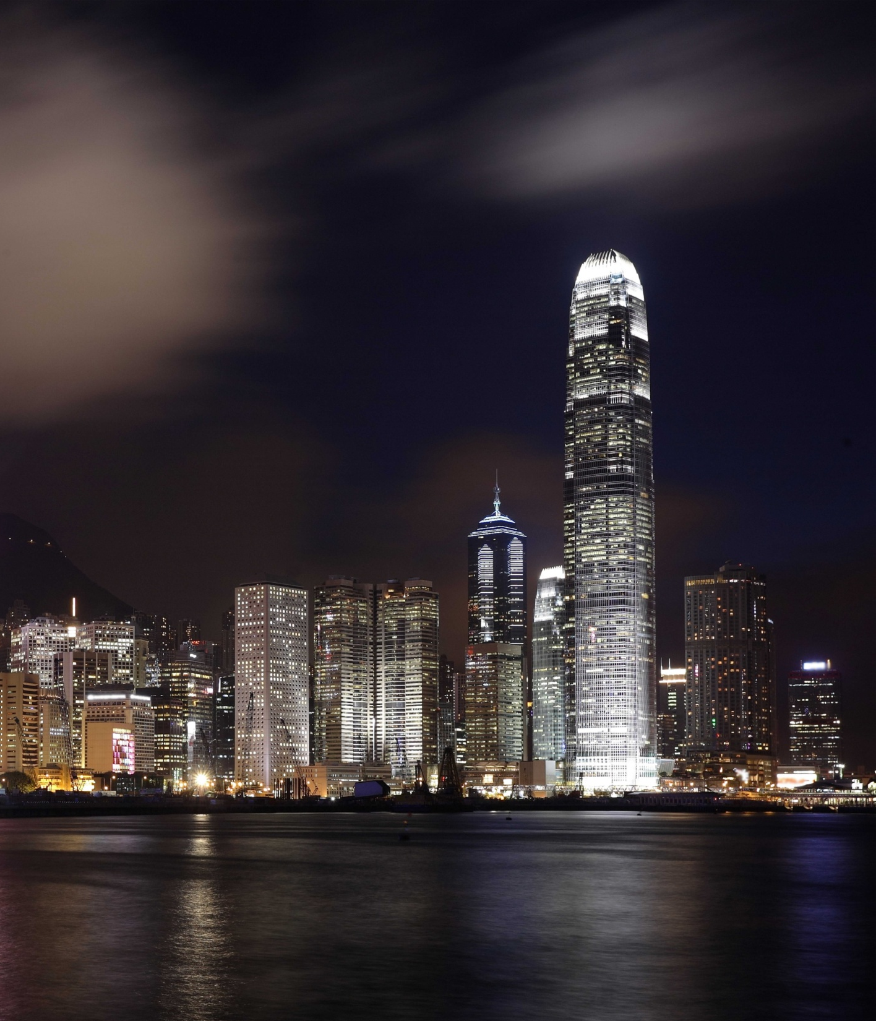
UFO Growth
SHOP.COM:
GMTSS, SABP, MUFO
Partnership with Ztore for charity event
2017 Highlight
SHOP.COM Booklet
Partner Stores Merchant APP
SINGAPORE
HONG KONG

Slide 7
UFO Growth :
GMTSS, SABP, MUFO
SHOP.COM:
Marketing Exposure
2017 Highlight
Save the Plant for Children Project
Engage more partner stores with famous brands
TAIWAN

Slide 8
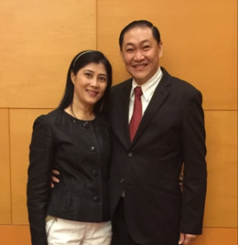
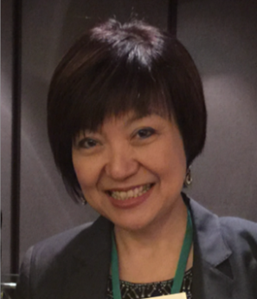
Leadership Council from Asia Pacific

Slide 9
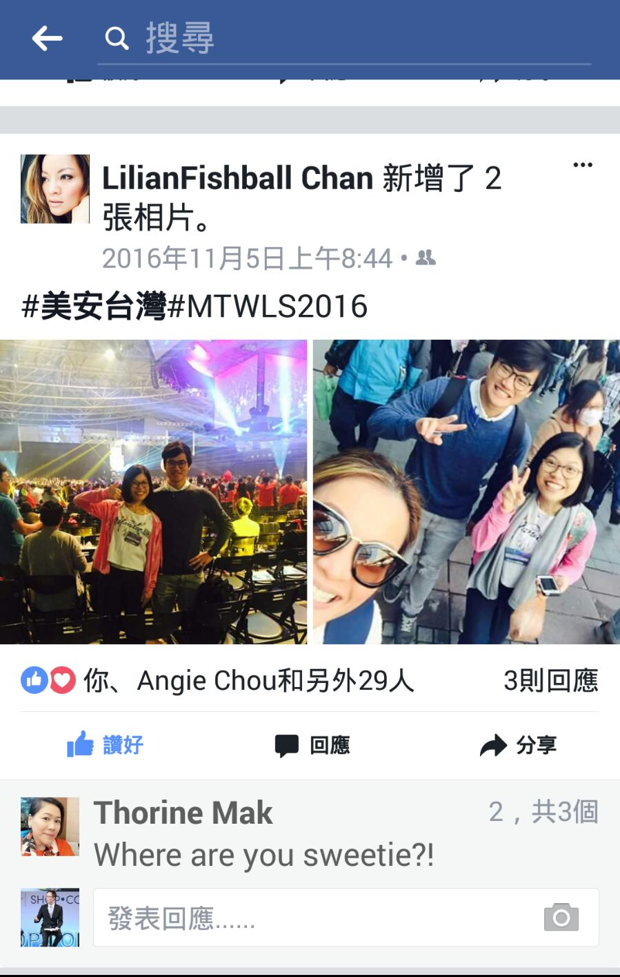
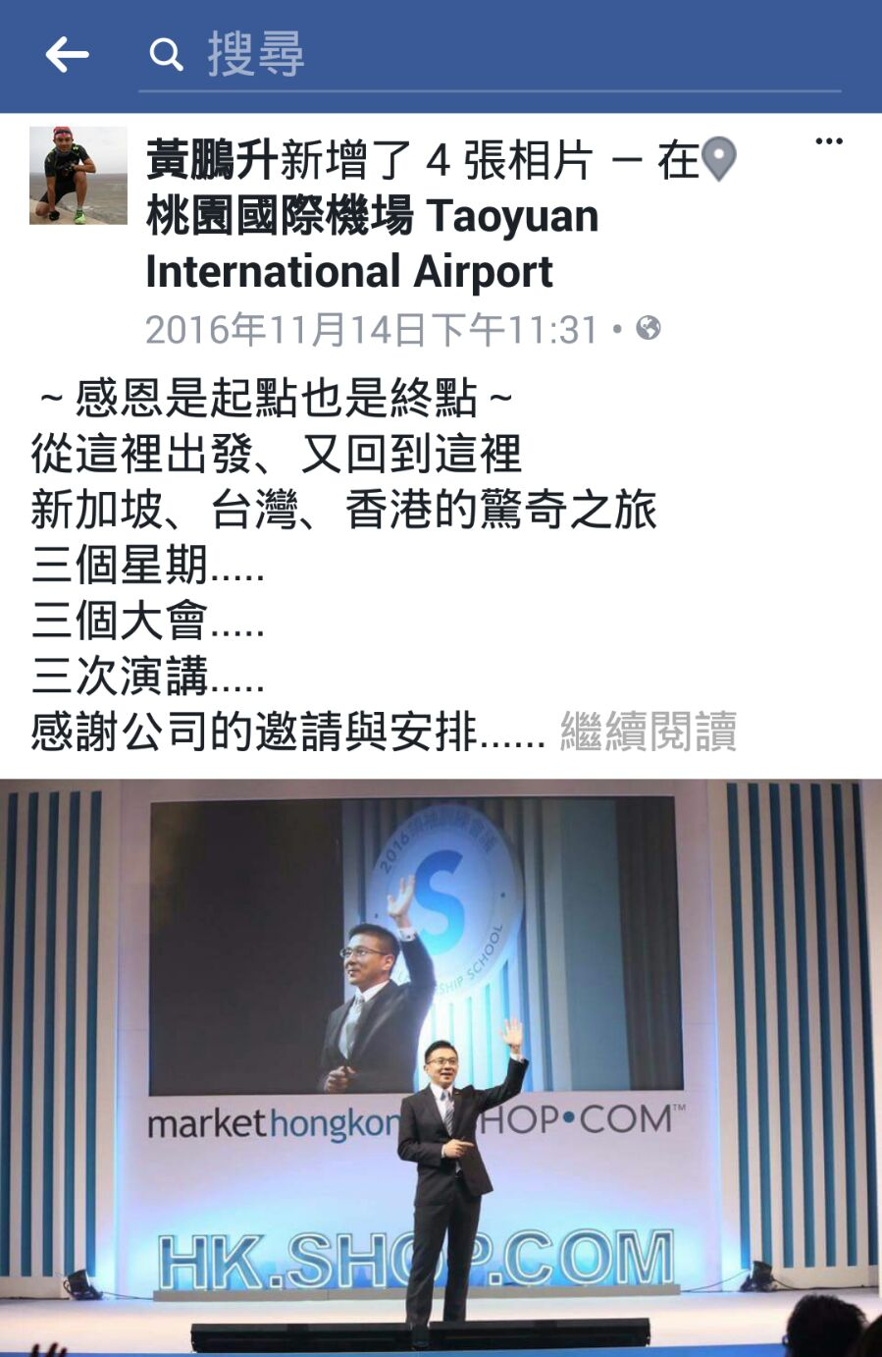
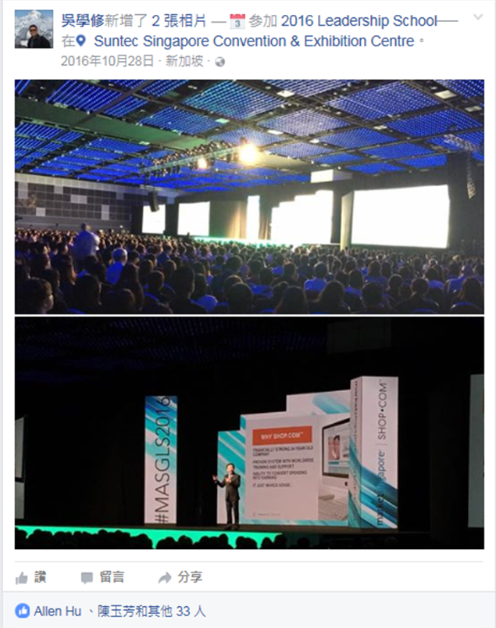
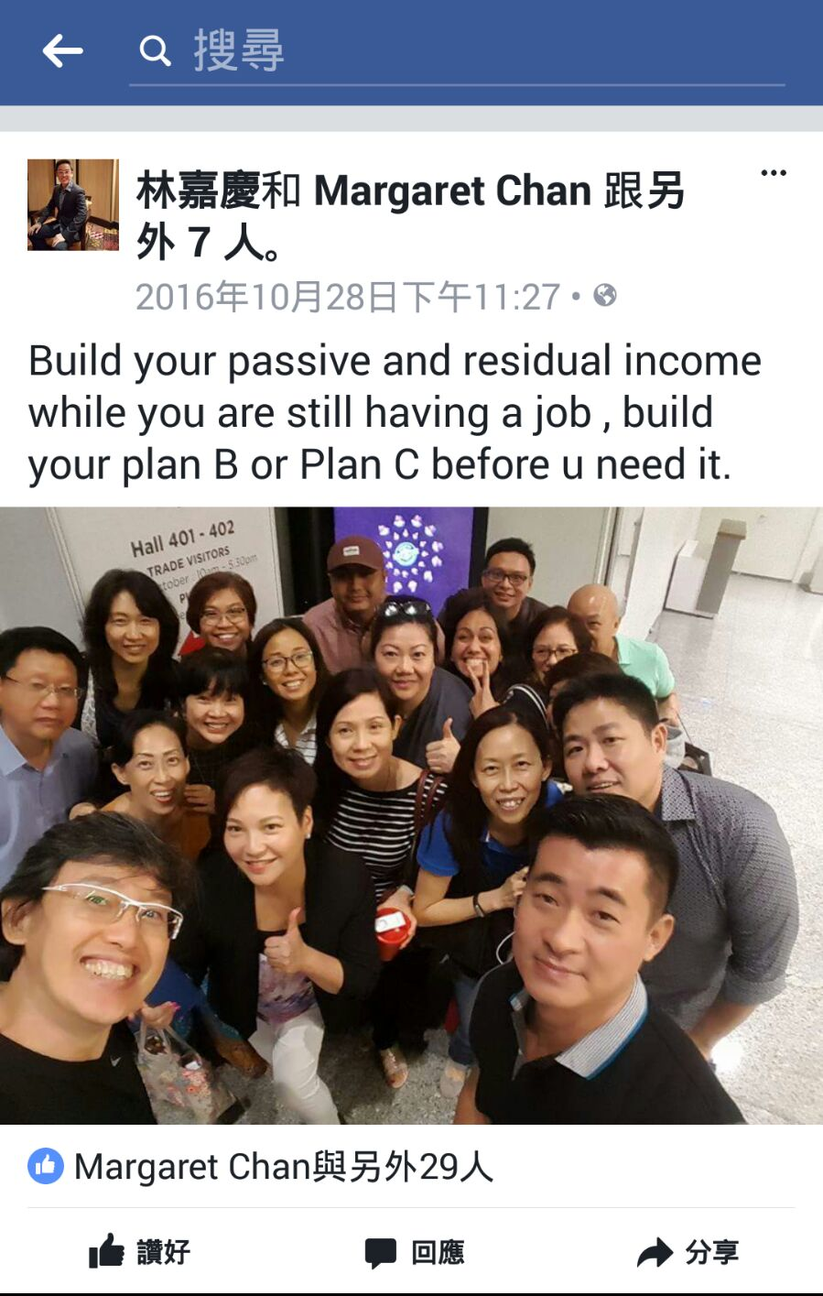
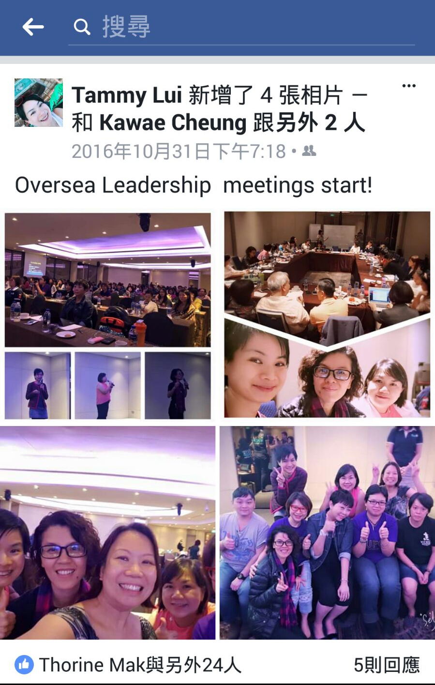
Leaders Developing Overseas Business

Slide 10
Next Page in Asia Pacific
AUSTRALIA
TAIWAN
HONG KONG
SINGAPORE
MALAYSIA
COMING
SOON
2002
2005
2007
2014
Notes:
United States, Canada, Mexico, Bahamas, Columbia, Dominican Republic, Ecuador, Panama, Jamaica
United Kingdom, Spain
Australia, Taiwan, Hong Kong, Singapore, New Zealand

Slide 11
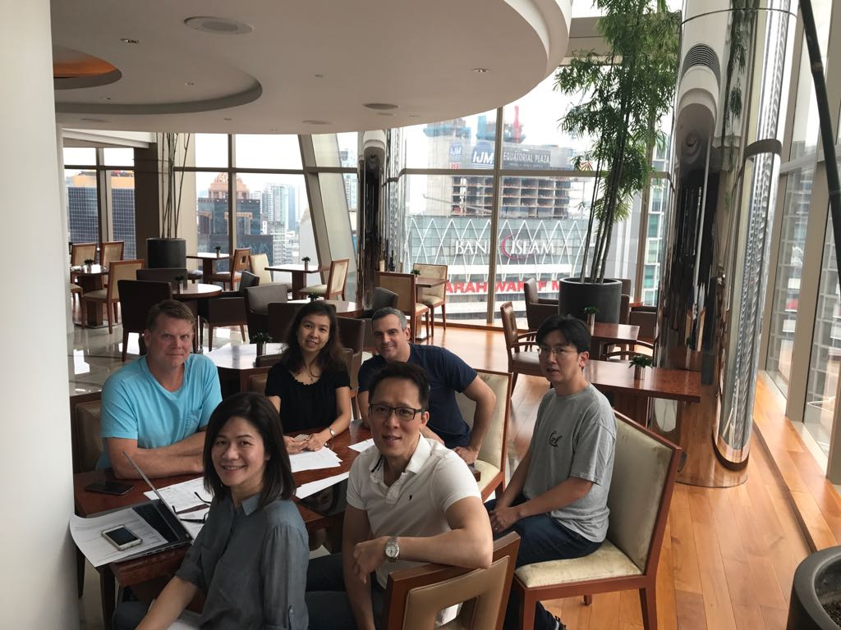
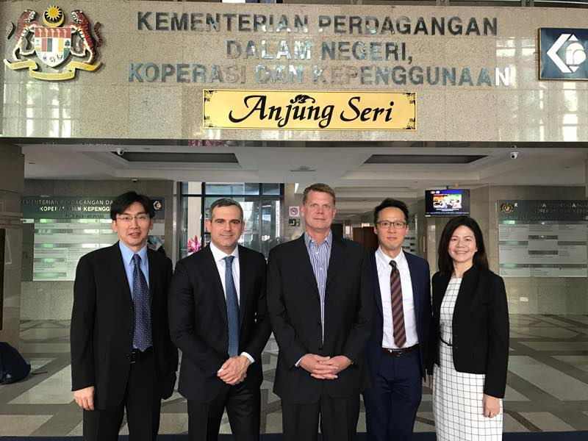

Slide 12
CHERIE FOONG
Market Malaysia
Country Manager

