Slide 1
Dai Ga Ho(Hello Everyone)
Duo Jie(Thank you)
Nay Day Ho Lack( You guys are awesome)

Slide 2
THE TIME IS NOW
The Right Time, The Right Company, The Right Business

Slide 3


The world is and has gone digital and... so has SHOPPING!

Slide 4

SINGAPORE is in transition...
More Singapore Shoppers are Shopping Online
86% of respondents said they had shopped online in the past 12 months
8 in 10 Hong Kong consumers shop online
Mobile phone dependency is growing

Slide 5
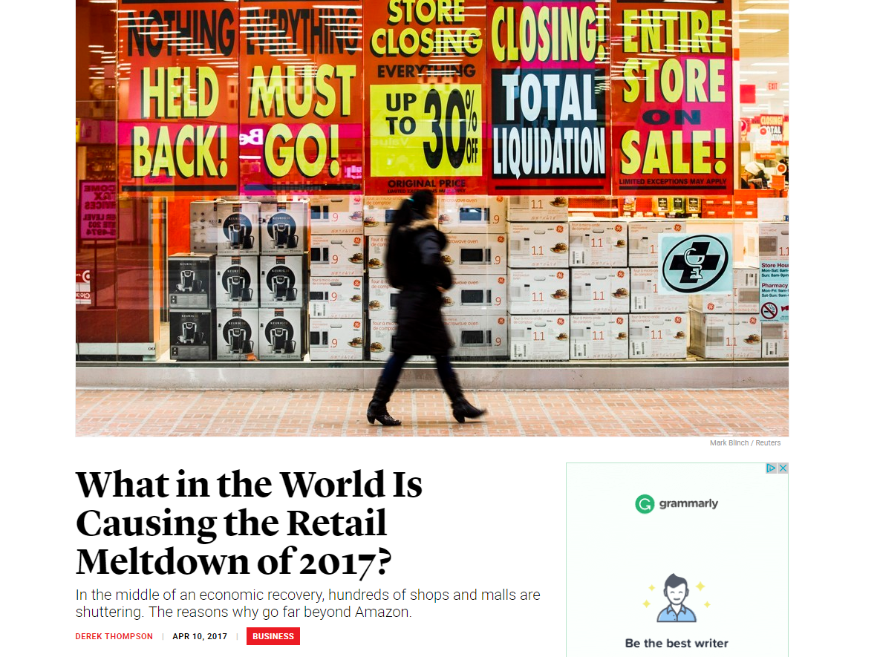

Slide 6

Entrepreneurism is at an all-time high!

Slide 7

BABY BOOMERS continue to work
and looking for a second career.

Slide 8

Millennials are looking for opportunities...
Hot Buttons
  Financial Shortcut
  Personal Independence
  Flexibility
  Community
  Connected to Experienced and Stable

Slide 9

Incomes are not keeping up with lifestyles.

Slide 10

Internet Popularity and Social Media is at an
ALL-TIME HIGH AND GROWING

Slide 11

Internet Shopping is a FAST-PACED Phenomena!

Slide 12

Market Hong Kong®|Shop.com™ … A Market America Company offers a proven way for Entrepreneurs to create wealth by owning an Unfranchise® Business.

Slide 13
Market Singapore® is a Product brokerage and Internet Marketing Company specializing in One to One Marketing and the Shopping Annuity®

Slide 14


4
CORNERSTONES
of

Slide 15
Product Brokerage & Shop.com™
Management Performance Compensation Plan
One-to-One Marketing and Shopping Annuity®
Unfranchise® Business Development Systems
The Four
CORNERSTONES

Slide 16
Cornerstone #1
PRODUCT BROKERAGE & Shop.com™

Slide 17

PRODUCT BROKERAGE
The Diversity of Products and Services
  Attracts a wide variety of consumers and partners
  Allows for marketing swings from changing consumer demands
  Eliminates the high costs of capitalization for manufacturing
  Allows to identify the best manufacturers
  Supports building Share of Customer and One-to-One Marketing

Slide 18
Product Brokerage and The Market America University
The Market America University was created to define and simplify the Product Brokerage concept into billion-dollar markets.
It also provides UFOs support in determining a business direction in starting their Unfranchise® Business. (The business within a business)
It also provides a curriculum for Unfranchise® Owner to advance their learning of products and application to develop a retail customer base and to recruit additional business partners.

Slide 19
The Market America University
Health and Nutrition
Age Management
Cosmetics
Weight Management
Personal and Skin Care
Web Design
Child Care and Health
Business Major
  The MPCP
  Shopping Annuity®
  Online Shopping
  Internet Marketing

Slide 20
Cornerstone #2
MANAGEMENT PERFORMANCE COMPENSATION PLAN

Slide 21
Management Performance Compensation Plan
Horizontal verse Vertical Marketing
Binomial Expansion...”The Power of Two”
The Structure
  Supports team work with an economic glue
BV and IBV Placement
Accrual of Volume (BV 365 days; IBV 730 days)
No Levels
Re-entry Feature of Business Development Centers

Slide 22












HORIZONtal Marketing Structure
Vertical Marketing Structure
ENCOURAGES TEAMWORK
ALL WORKING TOGETHER
EVERYONE RECEIVES 100% CREDIT FOR SALES AND VOLUME GENERATED
EARNING POTENTIAL IS NOT
DETERMINED BY POSITION
REAL ESTATE, INSURANCE, SALES, TRADITIONAL BUSINESS
ALL IN COMPETITION

Slide 23
Management Performance Compensation Plan
Horizontal verse Vertical Marketing
Binomial Expansion...”The Power of Two”
The Structure
  Supports team work with an economic glue
BV and IBV Placement
Accrual of Volume (BV 365 days; IBV 730 days)
No Levels
Re-entry Feature of Business Development Centers

Slide 24
Management Performance Compensation Plan
Global Unification (International Re-entry Center)
Income Based on Other UFOs Success
Limited Monthly Activity Requirements
  (50, 100, 150 BV; 10, 20, 30 IBV; UFMS Charge and Annual Renewal; Quarterly Sales Report)

Slide 25
Management Performance Compensation Plan
Profitability and Stability
A Business that can be passed on
A retail system verse a buying system
Built to pay the maximum commission
Built for success...what you can realistically and actually do

Slide 26


Systemized Selling of Products and Services
Theme, Market, Benefits, Value Proposition

Slide 27

Products and services drive our Unfranchise™ Business. Everybody wants new products.
Every Unfranchise Owner must be a product of the product.
Every Unfranchise Owner must sell products and build share of customer.
Every Unfranchise Owner must take the responsibility of success.
Teams become champions when everyone shares the load.

Slide 28
I.M.P.A.C.T.
Selling
Makes Selling The Product Easy

Slide 29

Investigate

Slide 30

Meet

Slide 31

Probe

Slide 32


Apply

Slide 33

  Convince

Slide 34

  Tie-up

Slide 35


Recovery, Rehabilitation, and Maintenance
Due to Body Discomfort
Isotonix®

Slide 36
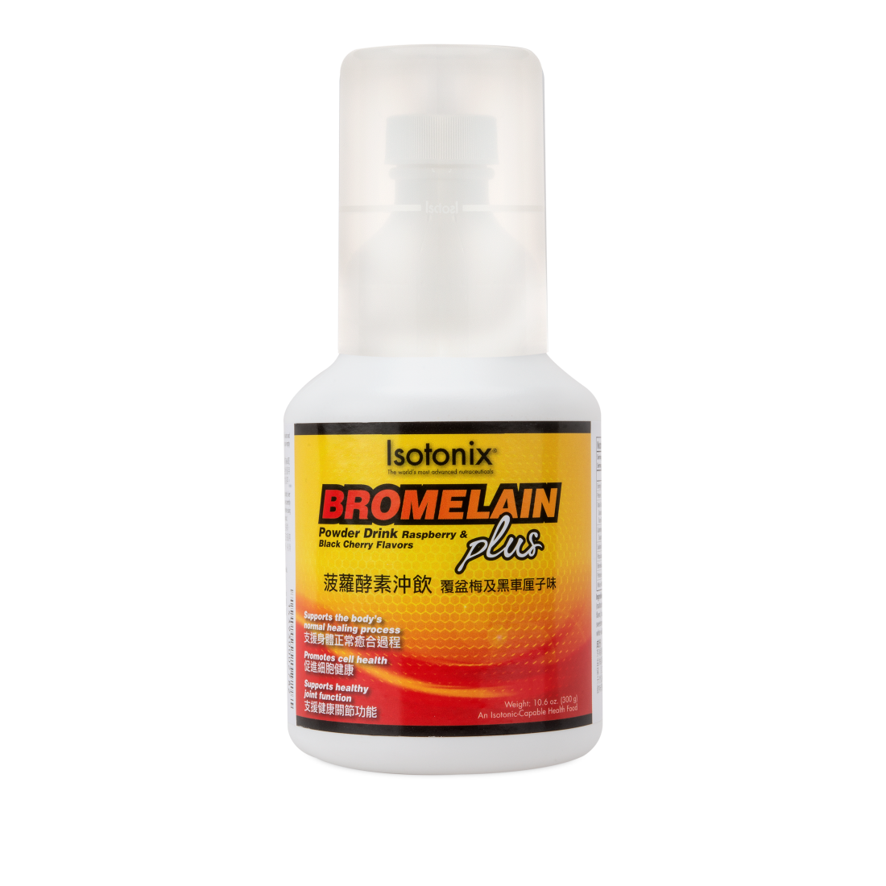


Market
1 in 5 people over the age of 18 experience joint discomfort
More than 5,000,000 people, annually, are sidelined due to sports related and recreational activities
More than 3,000,000 orthopedic surgeries each year
Anyone who wants to promote healthy inflammation levels

Slide 37
Benefits
Supports the body’s normal healing process
Promotes cell health
Supports the body’s tissue recovery and repair process
Supports healthy immune function
Supports healthy joint function

Slide 38
Value Proposition
UnFranchise Cost – HK$348
Suggested Retail – HK$486
Return on Cost of Goods - 40% (HK$138)
  BV- 33 / BV% - 73%
30 Servings (3 capfuls & HK$16.2 per serving)
Non Detectable GMO
Bromelain, White Willow, Protease

Slide 39
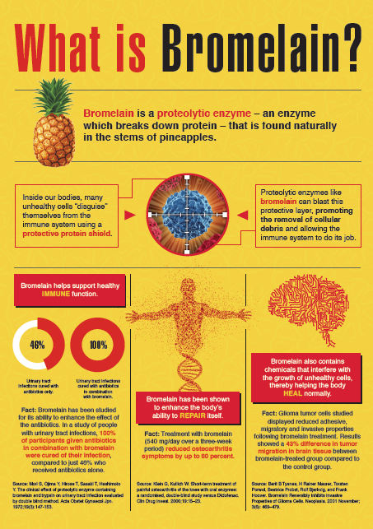
INFOGRAPHIC
Located on UFMS
Downloads
Support Materials
Category - Health & Nutrition
Notes:
In the study conducted it was 540 mg of bromelain per day. Our product offers 544 mg per day.

Slide 40

Code: HK13986
UC: HK$348
SR: HK$486
BV: 33

Slide 41


The Spice of Life
Wellness and Longevity

Slide 42



Market
Anyone 18 and Over
Eats a poor diet
Physical interaction with children and adults daily
Those that live and work in areas of environmental pollution
Travels frequently (Domestic and Internationally)

Slide 43
Benefits
May support liver health
Helps maintain cell health and integrity
Helps maintain healthy glutathione levels
Supports cognitive health as we age
Provides antioxidant support
Notes:
Crosses the blood brain barrier

Slide 44
Value Proposition
UnFranchise Cost-HK$280
Suggested Retail – HK$392
Return on Cost of Goods - 40% (HK$112)
  BV-25 / BV% -71%
30 Servings (daily cost HK$13.06)
7-8 times more Bioavailable than Turmeric
BCM-95, Broccoli Seed Extract, Selenium
Benefits usually occur within 4-6 weeks
Notes:
BCM – 95 , 100% natural , pure extract of tumeric, used most frequently for the scientific studies.

Slide 45
Code: HK13147
UC: HK$280
SR: HK$392
BV: 25

Slide 46


Longevity, Vitality, Vision and Performance

Slide 47



Market
49% of the population have high blood pressure, high LDLs, or smoke
31% of the American Male Adults have low levels of HDLs - (Good Cholesterol)
Endurance Athletes
Men and Women Over the Age of 40
Great for Longevity

Slide 48
Benefits
Supports cardiovascular Health
Promotes healthy vision
Helps to prevent oxidative stress in the eye
Supports healthy visual focus
Provides powerful antioxidant defense

Slide 49
Value Proposition
UnFranchise Cost – HK$258
Suggested Retail – HK$361
Return on Cost of Goods -40% (HK$103)
  BV- 23.5 / BV% - 72%
30 Servings – 6 mg (HK$12.03 per serving)
AstaREAL astaxanthin
Orac Value (28,222) to Super Foods
Super Antioxidant
Non Detectable GMO
Notes:
Oxygen Radical Absorbance Capacity method of measuring antioxidant capacities in biological samples in vitro.( artificial environment)
Asta Real Astaxanthin, cultivated micro algae in state of the art facilities
Super antioxidant, this is because it will not become a pro oxidant

Slide 50

INFOGRAPHIC
Located on UFMS
Downloads
Support Materials
Category - Health & Nutrition

Slide 51

Code: HK14500
UC: HK$258
SR: HK$361
BV: 23.5

Slide 52

Weight Loss, Excess Fat, and the Battle of the Bulge
“Burn Fat, Preserve Lean Muscle Mass”

Slide 53


Market
2.1 billion people in the world are overweight
39% of adults in Hong Kong are overweight
People eating poor diets
People with high BMI (Body Mass Index)
People looking to reduce Body Fat

Slide 54
Benefits
Supports healthy weight loss
Supports thermogenesis and lipolysis
May help increase energy
May help suppress appetite

Slide 55
Value Proposition
UnFranchise Cost – HK$313
Suggested Retail – HK$438
Return on Cost of Goods – 40% (HK$125)
  BV- 25 / BV% - 63%
60 Servings (3 capsules & HK$7.3 per serving
Gluten Free
Svetol – supported by studies on healthy weight management
Notes:
The 65% return on COGs is a result at a very good suggested retail price at $39.95

Slide 56

FLYER
Located on UFMS
Downloads
Category - TLS

Slide 57
TLS® Thermochrome™
with Green Coffee Bean Extract
Code: HK6406
UC: HK$313
SR: $438
BV: 25

Slide 58

TLS® CORE Fat & Carb Inhibitor
GET RID OF UNWANTED FAT AND CONTROL THE CARBOHYDRATES

Slide 59

Market
39% of adults in Hong Kong are overweight
Adults who need a lifestyle change
Adults with chronic health challenges
  Cardiovascular Health
  Diabetes
  Osteoarthritis
Adults with Body Mass Index (BMI) greater than 23

Slide 60
Benefits
Promotes reduction in body mass index (BMI)
Helps promote weight loss
Inhibits the amylase enzyme and slow the absorption of carbohydrates into the bloodstream
Helps inhibit carbohydrate absorption in the body

Slide 61
Value Proposition
UnFranchise Cost – HK$360
Suggested Retail - HK$503
Return on Cost of Goods - 40% (HK$ 143)
  BV- 32 / BV% - 71%
Cost Per Serving – HK$16.75
  (4 tablets per day / 2 times a day)
  Gluten Free
  Vegetarian
Notes:
The 65% return on COGs is a result at a very good suggested retail price at $39.95

Slide 62
TLS® CORE Fat & Carb Inhibitor
Code: HK6462 / HKIBV6462
UC: HK$360
SR: HK$503
BV: 32
IBV: 32

Slide 63

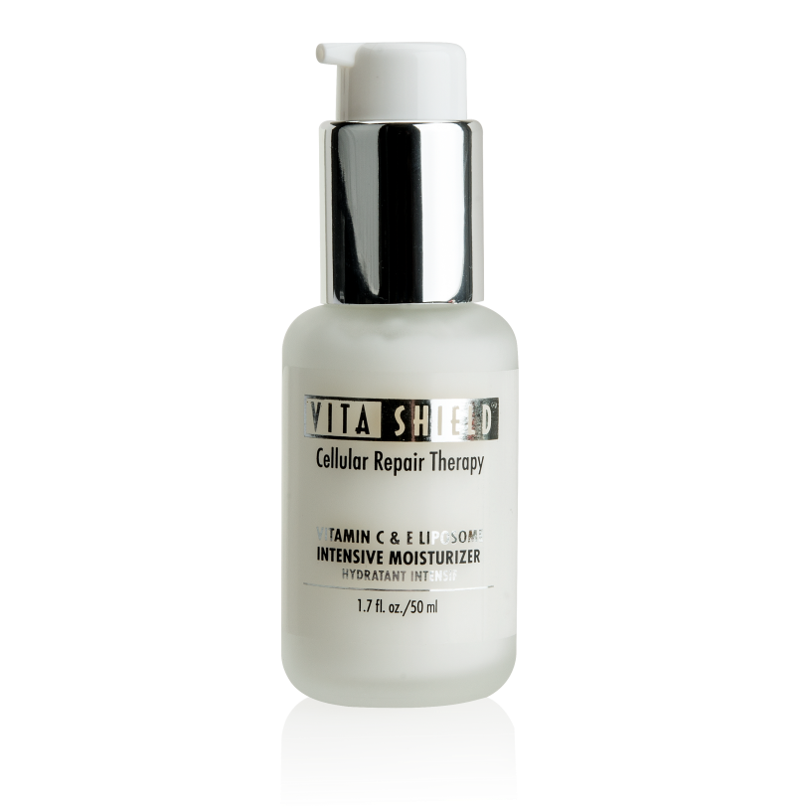
Vitashield
Vitamin C & E Intensive Moisturizer
KEEPS YOUR SKIN LOOKING YOUNGER!

Slide 64

Market
Anyone with aging skin
Adults with lost skin elasticity
Anyone that wants to slow the skin aging process
Adults who want to slow the appearance of fine lines and wrinkles

Slide 65
Benefits
Instantly absorbs and gives the skin a silky, smooth texture
Moisturizes and lessens the appearance of fine lines
Skin will look and feel younger; facial contours will look more youthfully defined
Minimizes the appearance of the effects of stress, fatigue, smoking pollution and environmental damage

Slide 66
Value Proposition
Code: HK1208
UC: HK$332
SR: HK$465
Returns on Cost of Goods – 40% (HK$133)
  BV: 34 / BV% - 80%
Liposome Delivery
Hyaluronic Acid

Slide 67
Vitashield
Vitamin C & E Intensive Moisturizer
Code: HK1208
UC: HK$332
SR: HK$465
BV: 34

Slide 68
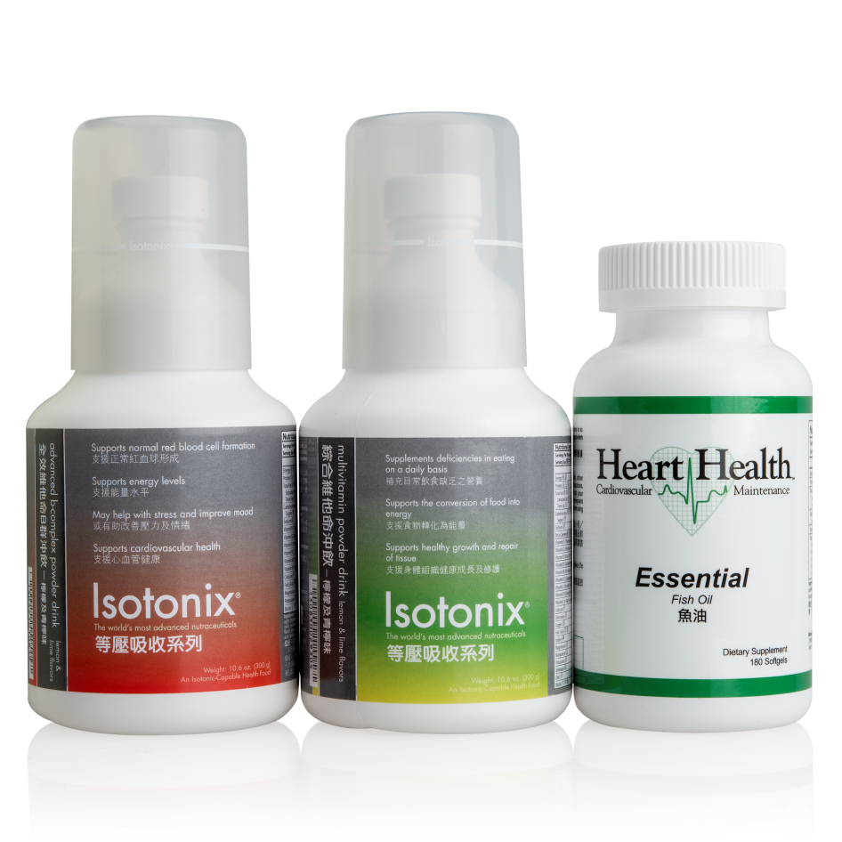
Optimal Wellness Kit
EXCELLENT FOUNDATION FOR LONG-TERM HEALTH AND OPTIMAL NUTRITION

Slide 69
Value Proposition
UnFranchise Cost – HK$702
Suggested Retail – HK$983
  Save 25% - Normally HK$1313
Return on Cost of Goods – 40% (HK$281)
  BV: 50 / BV% - 57%
90 Servings Multivitamin
90 Servings B-complex
60 Servings – Omega 3

Slide 70
Optimal Wellness Kit
Code: HK6475/HK6475IBV
UC: HK$702
SR: HK$983
BV: 50
IBV: 50

Slide 71
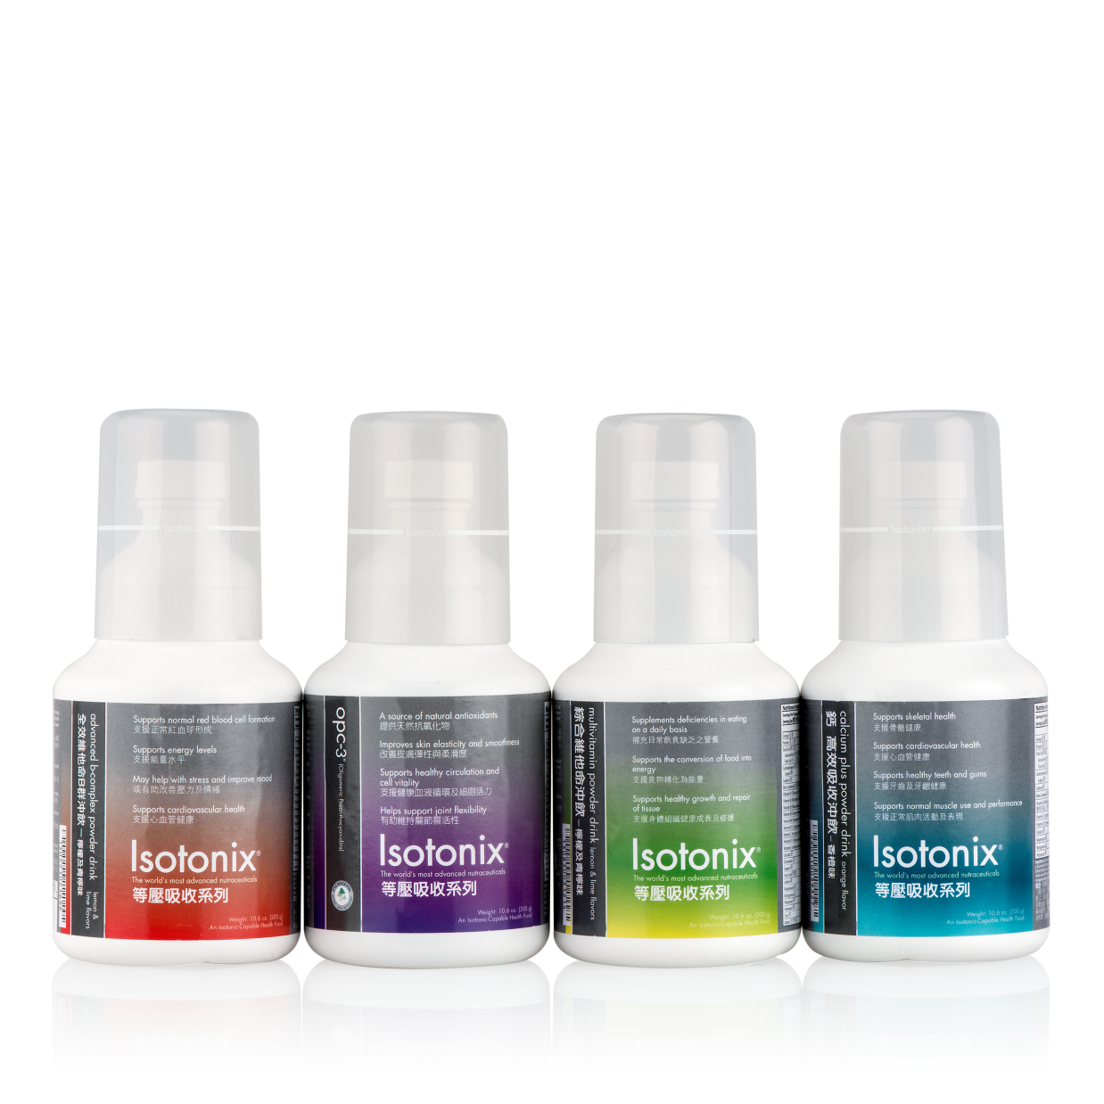
Isotonix® Daily Essentials Kit
PROVIDES THE BODY WITH ESSENTIAL VITAMINS, MINERALS AND NUTRIENTS

Slide 72
Value Proposition
UnFranchise Cost – HK$891
Suggested Retail – HK$1248
  Save 25% - Normally HK$1,664
Return on Cost of goods -40% (HK$357)
  BV – 66 / BV% - 60%
90 Servings Containers; except for Calcium – 45 Servings

Slide 73
Daily Essentials Kit
Code: HK6459/HK6459IBV
UC: HK$891
SR: HK$1,248
BV: 66
IBV: 66

Slide 74
Systemized Selling of Products and Services
Theme, Market, Benefits, Value Proposition

Slide 75
Cornerstone #3
ONE-TO-ONE MARKETING and Shopping Annuity®

Slide 76
One-to-One Marketing and Shopping Annuity®
One-to-One Marketing is customer relation management (CRM). It emphasizes personalized interactions with customers to build the share of that customer. It is easier to sell a product or service to an existing customer than to gain a new customer.

Slide 77
One-to-One Marketing and Shopping Annuity®
Dr. Martha Rogers and Don Peppers breakthrough in 1993. Technology would mandate a new approach to business, wrote the book, “The One To One Future”. It’s all about tracking each customer, creating a new shift from finding customers to products to finding products for customers. This is all about technology and people gathering information from customers.
Traditional mass markets develop a product and then try to find customers for that product.

Slide 78
Shopping Annuity®
The Shopping Annuity® is a revolutionary concept that helps smart shoppers convert their spending into earning through Shop.com™.
Unlike a typical annuity from a bank. You don’t have to invest a massive amount of money to get started. Your investment is what you already spend on every purchases. By shopping through Shop.com™, you can earn up to 50% cash back. CONVERT YOUR SPENDING INTO EARNING!

Slide 79
Cornerstone #4
UNFRANCHISE® BUSINESS DEVELOPMENT SYSTEMS

Slide 80
Unfranchise® Business Development Systems...
a powerful group of business systems that when followed, will lead you to Unfranchise® Business Success.
  The Basic 5
  Global Meeting Training Seminar System (GMTSS)
  Recruiting Systems / Getting Started Guide
  ABC Pattern of Duplication
  Retail Systems
  Management Performance Compensation Plan
  Registration System
  Certified Training System
  Master UFO Program
  Shopping Annuity® Master Member

Slide 81
1 on 1’s
1 on 1’s
1 on 1’s
1 on 1’s
1 on 1’s
1 on 1’s
1 on 1’s
1 on 1’s
1 on 1’s
1 on 1’s
1 on 1’s
1 on 1’s
Hbp/ubp
Hbp/ubp
Hbp/ubp
Hbp/ubp
Basic 5
nuot
Ecct’s
Basic 5
nuot
Ecct’s
Basic 5
nuot
Ecct’s
Basic 5
nuot
Ecct’s
locaL seminar
locaL seminar
Local seminar
Local seminar
Local seminar
Local seminar
Annual Convention

Slide 82


Slide 83
4
CORNERSTONES
of

Slide 84

2017
STRATEGIC PLAN

Slide 85


To focus on what will make the billion-dollar roll a reality and to have fun doing it .
Give everything we have into winning the game by making a historic impact in a paradigm shift that changes the way people shop.
Strategic Plan
Goals and Objectives

Slide 86

Strategic Thoughts...
25 years to now...
Next 5 years are the most important. Making the mark from the last 25 years of building the dream to reality.
What the next 10 are about? Making quantum leaps.
We as UFOs, should be able to enjoy life, the business and journey .
What we do day in and day out matters. Our UFO community is a living organism. We must be active and constantly moving forward.

Slide 87
Strategic Thoughts...
Our company focus is two (2) major points. The Market America University…the business within the business, and The Shopping Annuity®.
Shop.com™ originally was to create a second channel for sales revenue and growth. Integrating the Management Performance Compensation Plan (MPCP) to Shop.com™ was a gigantic undertaking.
Maximize the Cornerstones of Market America.
We need to as UFOs, focus on the Results Producing Activities.
All UFOs must understand the power “I am”.

Slide 88
Strategic Thoughts...
Our number one product is BELIEF.
Where does the volume come from. Where do the people come from? Is it automatic? It takes consistent action.
The competitive raids in the past year have cost us growth. We need to understand better what measures need to be taken.
We need the passion of the beginning. We need to be looking for that Passion today.
All UFOs must understand their “WHY”

Slide 89
Strategic Thoughts...
Shop.com™ will continue to attract cyber customers for lead generation and refinement of the shopping experience.
Grow the Global Meeting Training Seminar System (GMTSS).
Expand Market Distribution.
Continue the completion process of Global Unification.

Slide 90

Do you know your WHY?
Can you explain it right now?
The WHAT we do and HOW we do it are critical to be clear for others to follow. Your optimal success will not happen unless the WHY is clear.
Find Your Passion.

Slide 91


COMPANY FOCUS:
TWO VITAL PLACES
University Majors or Divisions. Businesses within a business
Shopping Annuity®

Slide 92

Resolution... “Revolution For Success”
The Team, The Team, The Team!
Together everyone accomplishes more.
The whole is bigger than the sum of the parts.

Slide 93

a multi-level marketing company
Amazon.com
a get rich-quick scheme
a deal
What We Are
NOT...

Slide 94

Herbalife Settles with the FTC
Source: https://www.nytimes.com/2017/03/16/movies/betting-on-zero-review.html
https://www.usatoday.com/story/tech/2016/05/05/herbalife-stock-jumps-possible-ftc-settlement/83986024/
https://www.usatoday.com/story/money/2016/07/15/federal-trade-commission-herbalife/87119208/
https://www.ftc.gov/enforcement/cases-proceedings/142-3037/herbalife-international-america-inc-et-al

Slide 95
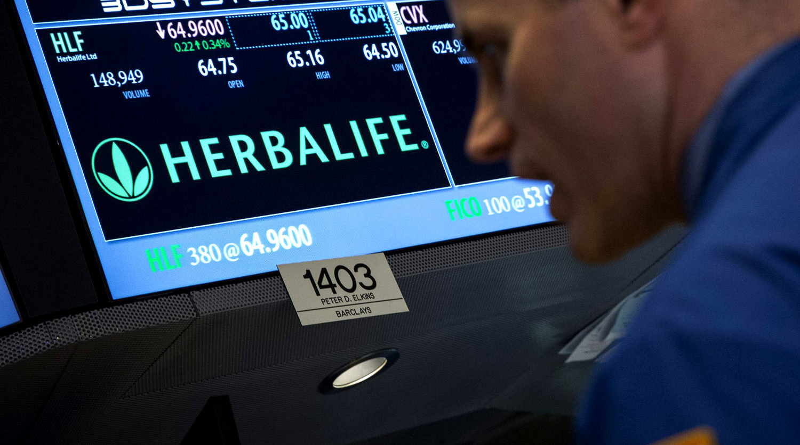
Herbalife Settles with the FTC
The outcome – $200 million settlement in July 15, 2016
Herbalife continues business, but not “business as usual”.
Direct selling news calls this “a unique moment in the history of direct selling. A moment of reflection and evolution.”
.
Source: https://www.nytimes.com/2017/03/16/movies/betting-on-zero-review.html
https://www.usatoday.com/story/tech/2016/05/05/herbalife-stock-jumps-possible-ftc-settlement/83986024/
https://www.usatoday.com/story/money/2016/07/15/federal-trade-commission-herbalife/87119208/
https://www.ftc.gov/enforcement/cases-proceedings/142-3037/herbalife-international-america-inc-et-al

Slide 96

Four Areas that Must be Examined
Focus On Retail Sales To Customers Outside The Compensation Plan
  Fact: a business built primarily on self-consumption is not sustainable. It is also not acceptable to regulators. New limits are now being put on commissions paid on personal consumption.
  The FTC alleged that Herbalife had a business practice that purports incentivized recruiting.
Segment Independent Contractors From Preferred Customers
  There must be a difference for failed consultants and independent contractors. Failed consultants can buy at discount but cannot recruit or sell products.
  It is clear that companies will have to come up with a new strategy where you either sign people on as preferred customers or as independent business consultants.
Source: https://www.nytimes.com/2017/03/16/movies/betting-on-zero-review.html
https://www.usatoday.com/story/tech/2016/05/05/herbalife-stock-jumps-possible-ftc-settlement/83986024/
https://www.usatoday.com/story/money/2016/07/15/federal-trade-commission-herbalife/87119208/
https://www.ftc.gov/enforcement/cases-proceedings/142-3037/herbalife-international-america-inc-et-al

Slide 97
Four Areas that Must be Examined
Be Wary Of Income Claims
  The FTC alleged that Herbalife included a number of allegations of misleading representations of how much money a participant was likely to earn in the Herbalife business.
Be a Forceful Advocate
  The need to put forth a stronger effort within the direct selling/MLM channel to do a better job in self-regulation.
  Companies need to be better in evaluating their business practices around customer service, marketing, product innovation and business ethics.
  “The MLM industry needs to focus on that they are not engaging in unfair and deceptive practices” – Edith Ramirez, Chairman FTC
Source: https://www.nytimes.com/2017/03/16/movies/betting-on-zero-review.html
https://www.usatoday.com/story/tech/2016/05/05/herbalife-stock-jumps-possible-ftc-settlement/83986024/
https://www.usatoday.com/story/money/2016/07/15/federal-trade-commission-herbalife/87119208/
https://www.ftc.gov/enforcement/cases-proceedings/142-3037/herbalife-international-america-inc-et-al

Slide 98

Jeunesse Top Distributors Face Pyramid Scheme, Corrupt Business Allegations and Truth in Advertising Complaint
Source: https://www.truthinadvertising.org/wp-content/uploads/2015/10/10-19-15-Letter-from-TINA-to-FTC-re-Jeunesse.pdf
https://www.truthinadvertising.org/wp-content/uploads/2016/08/Alboltin-v-Jeunesse-complaint.pdf
https://www.truthinadvertising.org/jeunesse-top-distributors-face-pyramid-scheme-racketeering-allegations/
https://www.truthinadvertising.org/wp-content/uploads/2017/01/Tsai-v.-Jeunesse-2-watermarked.pdf

Slide 99

Class Action Lawsuit filed against Florida based MLM Jeunesse Global puts high-level distributors as well as company executives in the cross hairs of pyramid scheme and racketeering allegations.
The lawsuit should serve as a wakeup call to stop focusing on recruitment over retail sales and making outrageous income claims.
Source: https://www.truthinadvertising.org/wp-content/uploads/2015/10/10-19-15-Letter-from-TINA-to-FTC-re-Jeunesse.pdf
https://www.truthinadvertising.org/wp-content/uploads/2016/08/Alboltin-v-Jeunesse-complaint.pdf
https://www.truthinadvertising.org/jeunesse-top-distributors-face-pyramid-scheme-racketeering-allegations/
https://www.truthinadvertising.org/wp-content/uploads/2017/01/Tsai-v.-Jeunesse-2-watermarked.pdf

Slide 100
Backroom Deals – big players being offered business development deals up to $200,000 a month while low-level distributors were not informed.
Buy in for Higher Commissions…
  Investing up to $1,849 to quickly earn the same percentages as “Diamond” Distributors earn.
Source: https://www.truthinadvertising.org/wp-content/uploads/2015/10/10-19-15-Letter-from-TINA-to-FTC-re-Jeunesse.pdf
https://www.truthinadvertising.org/wp-content/uploads/2016/08/Alboltin-v-Jeunesse-complaint.pdf
https://www.truthinadvertising.org/jeunesse-top-distributors-face-pyramid-scheme-racketeering-allegations/
https://www.truthinadvertising.org/wp-content/uploads/2017/01/Tsai-v.-Jeunesse-2-watermarked.pdf

Slide 101
Falsely recognized the big deal players at levels unearned but promoted as achievers that accomplished the levels easily.
Source: https://www.truthinadvertising.org/wp-content/uploads/2015/10/10-19-15-Letter-from-TINA-to-FTC-re-Jeunesse.pdf
https://www.truthinadvertising.org/wp-content/uploads/2016/08/Alboltin-v-Jeunesse-complaint.pdf
https://www.truthinadvertising.org/jeunesse-top-distributors-face-pyramid-scheme-racketeering-allegations/
https://www.truthinadvertising.org/wp-content/uploads/2017/01/Tsai-v.-Jeunesse-2-watermarked.pdf

Slide 102

Arizona-based Vemma Nutrition Company Settles with FTC Charges. Agrees to Ban Pyramid Scheme Practices – December 15, 2016
Source: https://www.forbes.com/sites/antoinegara/2015/08/26/federal-trade-commission-calls-vemma-a-pyramid-scheme-that-preys-on-young-adults/#1d45c0ec1ed3
https://www.usatoday.com/story/money/business/2015/09/02/energy-drink-firm-vemma-ended-feds-sights/71612288/

Slide 103

Vemma Agrees to Ban on Pyramid Scheme Practices to Settle FTC Charges
Will be prohibited under Federal Court order from paying an affiliate unless the majority of that affiliates revenue comes from sales to real customers rather than other affiliates.
Vemma must stop making deceptive income claims and unsubstantiated health claims.
Order imposes a $238 million judgement with certain conditions on Vemma Companies.
Order imposes on Vemma Affiliate a judgement of more than $6.7 million with certain conditions.
Source: https://www.forbes.com/sites/antoinegara/2015/08/26/federal-trade-commission-calls-vemma-a-pyramid-scheme-that-preys-on-young-adults/#1d45c0ec1ed3
https://www.usatoday.com/story/money/business/2015/09/02/energy-drink-firm-vemma-ended-feds-sights/71612288/

Slide 104
MLM Companies that are Still Pending FTC Outcome - (Racketeer Influenced and Corrupt Organizations Act Allegations)
  Steam Energy
  Visalis

Slide 105
Add to this list those that have made settlement out of court and the hundreds that just went out of business, you can see why the MLM industry has been tainted.
Market America is in its 25th year of operation, and we can celebrate its years of success taking the high road in its journey to create the UnFranchise Business success and the Economy of the Future.

Slide 106

a unique Hybrid of a traditional retail-driven distribution model that leverages Product Brokerage, Internet Marketing and One-to-One Marketing Philosophies.
a company that has experienced 90 consecutive quarters of growth.
What We
ARE...

Slide 107

The power is in the structure
The Management Performance Compensation Plan (MPCP) is tied to required trainings to earn
The MPCP insures that commissions are earned on retail volume tied to a system of checks and balances that include naturally agreed upon legal documents (Forms 927, 1001, 1000)
Sell through of product (70-30 rule)
Agreement to get take the Certified Executive Coordinator Training
The submission of a quarterly sales report of S$250 confirming sales of products to a minimum of two customers outside the compensation plan

Slide 108
The power is in the structure
Profitability and stability is based on new and regenerated business volume and internet business volume that accrues on a week to week basis without monthly resets. (this increases the probability of earning of residual income in addition to ongoing retail profit).

Slide 109
The power is in the structure
Customer sales are tracked and are rewarded with cash back and referral cash back with savings on hundreds of items each day.

Slide 110
The power is in the structure
No need to exaggerate claims – we can tell it like it is
Everyone carries their own weight, preventing passive income
Each UFO has management responsibilities

Slide 111
The power is in the structure
Systems in place to provide an accountability of the structure to insure long-term integrity of the compensation plan and compliance to the regulatory laws of each market we are operating.

Slide 112

Part II of the Career Manual Policy and Procedures
Market America is built on bedrock to insure your long-term profitability and stability.
Don’t let hype overshadow expertise.
JR has been masterful in building
Market America!
A well-rounded philosophy is based on real-life experience.

Slide 113

The Market America / Shop.com™ Advantage
The Market America University
The Shopping Annuity® (Turning Spending into Earning)
Shop.com™
Shop Local
Through Advanced Technology, the Internet and the Power of People, we will change the way people shop and create the Economy of the Future.

Slide 114

Market America | Shop.com™ Commitment
            To refocus its efforts to make the Shopping Annuity® more Customer Centric – making it easier for the UFO and Preferred Customer to transition from Shopping Annuity® Assessment to placing actual orders.

Slide 115

Market America in the Beginning and Now Today
Our number one product we sold was BELIEF!
We are on a mission, and we were passionate in sharing it.
We were “evangelistic” in our message because it applied to everyone.
Today our message is simpler, “turn your spending into earning”.
Our target: 50,000 Shopping Annuity® Master Members.
Become a Master Unfranchise® Owners
Notes:
This is where you can reference the Knute Rockne story of revolutionizing football with the forward pass, and then the Insurance company that said turn your whole life insurance to term insurance and invest the rest.

Slide 116

50,000 Shopping Annuity®
Master Members
Purchase 1500 BV in a calendar quarter
Purchase S$3750 online through Shop.com™ per Quarter
Shopping Annuity® Online Assessment
If the average family spends approximately HK$30,000 on items to run their household and of that amount they can spend as much as HK$12,000 of those same items through Shop.com™ by simply changing their buying habits...for Master UFOs.

Slide 117

The Master
Unfranchise® Program
A structured system that identifies and quantifies what successful Unfranchise® Owners do.

Slide 118

Prospects Want to Know
How much can I earn?
What do I have to do to earn ______?
How long does it take?

Slide 119

Master Unfranchise® Quarterly Qualifications – Original
Complete the Shopping Annuity® Online Assessment - (Become a Shopping Annuity® Master Member)
Must have a UFMS Subscription
Purchase a total of 1,500 BV of product for the respective calendar quarter
Generate HK$11,500 worth of partner store purchases between you and your Preferred Customers

Slide 120
Master Unfranchise® Quarterly Qualifications – Original
Enter the names of two personally sponsored UFOs that are qualified and active for the perspective quarter
6. a. Attend or conduct one New Unfranchise® Owner Training - (NUOT)
  b. Attend or conduct a Basic 5 Training - (B5)
  c. Attend or conduct one Executive Coordinator Training (ECCT) per calendar year
  d. Purchase a minimum of 3 tickets to Market Singapore® Annual Convention and a minimum of 3 tickets to the Market Singapore® Leadership School
7. Complete the Basic 5 Diagnostic Test in which you score greater than or equal to 50% and/or earn a minimum of HK$6,900 in commissions for the perspective quarter (BV and/or IBV)

Slide 121
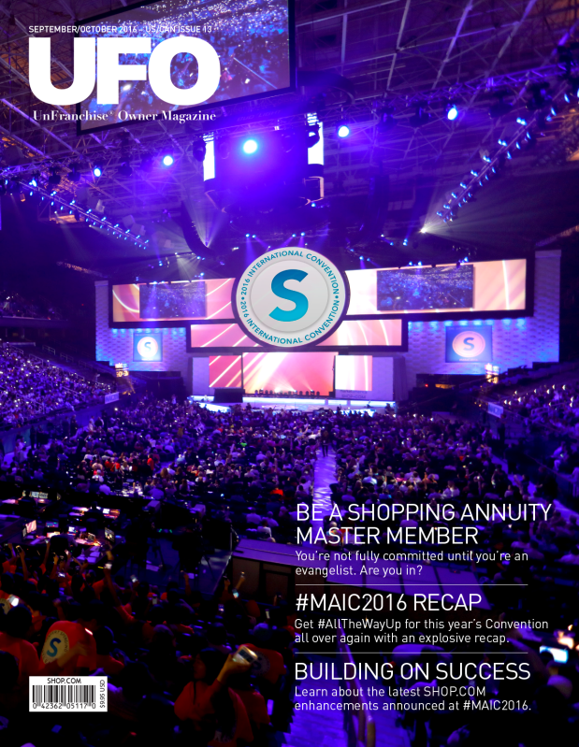

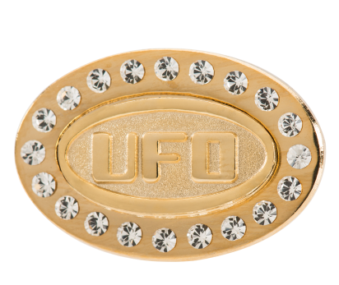
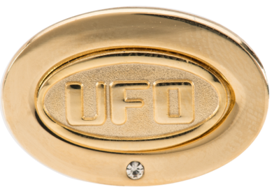

Master UFO Recognition
Upon qualifying first time, you will receive a UFO Pin and have your name published in the Unfranchise® Owner Magazine
Upon requalifying, your name will be published in the Unfranchise® Owner Magazine
Upon requalifying 3 out of 4 quarters in a calendar year, your name and photograph will appear in the Unfranchise® Owner Magazine and will receive your UFO Pin Jacket w/stone

Slide 122
Does Becoming a Master Unfranchise® Owner and a Shopping Annuity® Master Member make a Financial Difference?

Slide 123
Master Unfranchise® / SA Master Members
IT MAKES A DIFFERENCE
Criteria / Following Sample
Only UFOs who started prior to 01/01/2015 are included in the following sample
Analysis is based off of 2015 Commissions
Only UFOs who received a commission check in 2015 or 2016 are included in the following sample
Only UFOs on Autoship who have placed an Autoship order after 01/01/2015 are included

Slide 124
Master Unfranchise® / SA Master Members
IT MAKES A DIFFERENCE
Criteria / Following Sample
UFO Level - No additional criteria
Master UFO Level - UFOs designated as Master UFO
UFO SABP Level – UFOs who have qualified for SABP at least 2 Quarters
Master UFO- SABP Level – Master UFOs who have qualified For the SABP at least 2 Quarters

Slide 125
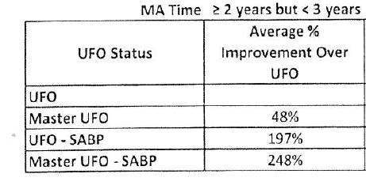

Master Unfranchise®

Slide 126
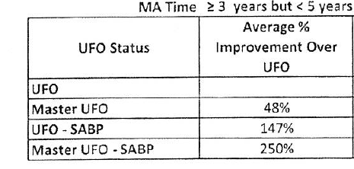
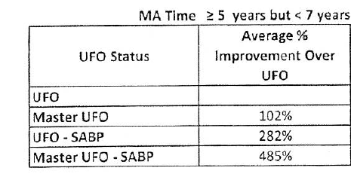
Master Unfranchise®

Slide 127
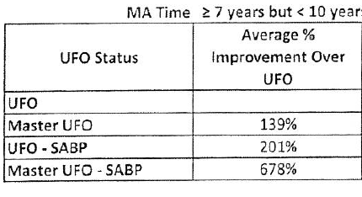
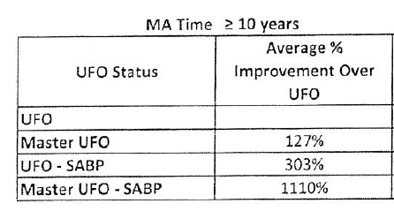
Master Unfranchise®

Slide 128


The Compensation Advantage MPCP³
MA University
Shopping Annuity®
Shop.com™
Unfranchise® Business Development Systems
EXPONENTIAL GROWTH
+
+
=
MA offers tracking system of Customers and UFOs, advanced technology, people power, and everybody shops and everybody spends
Tools are in alignment; Getting Started Guide, Virtual Partner, Master UFO Program , Shopping Annuity® Bonus Program, Shopping Annuity® Master Member

Slide 129
THE TIME IS NOW...
to build Your Unfranchise® Business and change the way people shop and create the ECONOMY OF THE FUTURE.

