Slide 1
TLS® stands for Transition Lifestyle System
Diets don't work, lifestyles do!
Notes:
We need to understand that the lifestyle is the solution, and the good health, vitality and weight loss is a by-product

Slide 2
The Obesity Epidemic is GLOBAL.
Nearly 30% of the world population is overweight...
2.1 Billion People!
Notes:
What else needs to be said. Unless you are living in a bubble, you know we have a self inflicted problem called being overweight and having an unusual lifestyle.

Slide 3
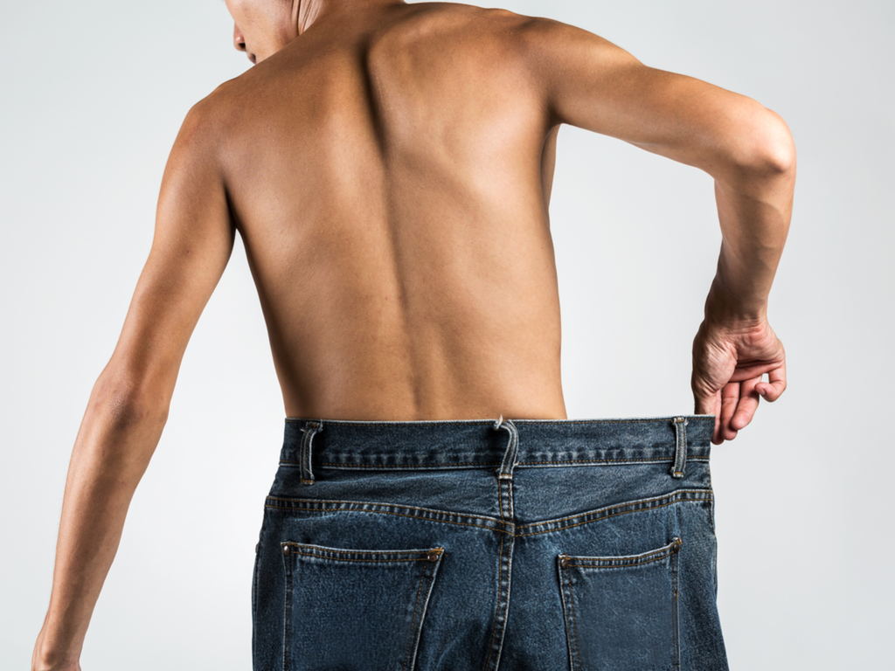
Weight loss is not magic. It’s just science.
TLS® has made it easy and simple!
Notes:
This has been a pipedream forever. There is no magic bullet. We are doubling our knowledge so fast these days and we understand better than ever how our body works and what effects the different kind of foods have on our body chemistry, as well as the activity levels we each have on a daily basis.

Slide 4
The 4 Components of TLS...
Low-glycemic Impact Eating
Supplementation
Body Composition
Education
#FINDYOURFIT
Notes:
Discuss the four components and keep it lite and lively. I want to make sure we discuss the supplement section as to why supplements and name the different supplements

Slide 5
TLS
21 Day Challenge Kit
TLS
Audios
TLS Videos/
Testimonials
Menu
Plans
Coaches
Guide
made
easy and simple!
12-week Program
hktlsslim.com
Approved
Food
Online
Parties
Business
Guide
Social
Media

Slide 6
The TLS® 21 Day Challenge Kit entered
TLS® Top 21 Global Sales Contest
The Golden Ticket Promotion
The Introduction of the hk.tlsslim.com
TLS 2016 was a
good year!

Slide 7
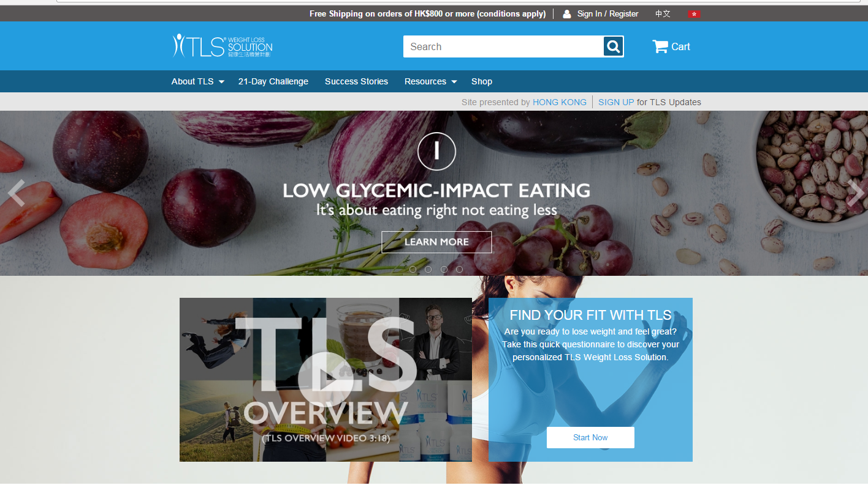
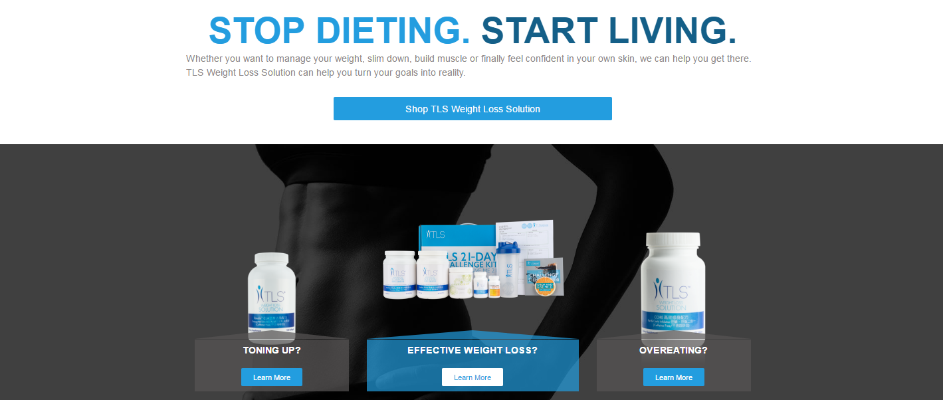
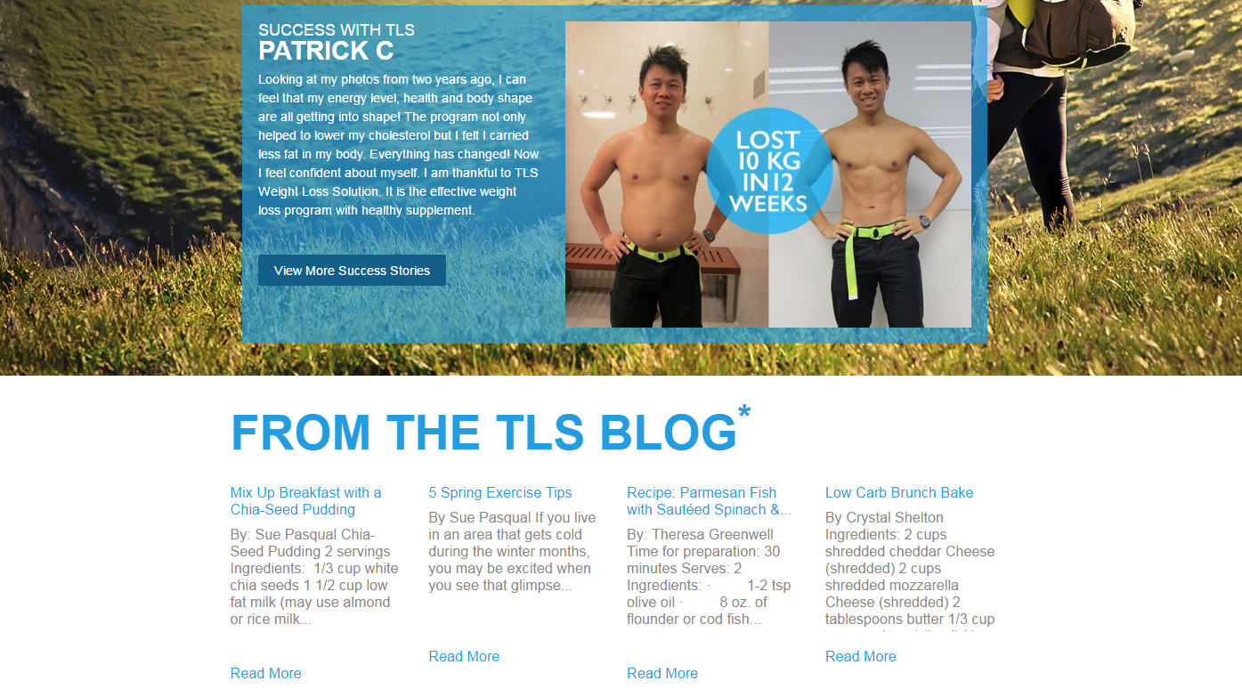
TLSSLIM.COM REDESIGN
Notes:
We have simplified this site to make it user friendly. The site is FREE and is available to any UFO. Tlsslim.com/____

Slide 8
TLS® 2017 will be a better year!
Do a better job working together
Social Media builds brand
Post original TLS content. It builds brand. Use the official TLS Hashtags: #weightloss, #findyourfit, #tls21days, #hktls
Post of workout, activities, shakes, meals, coaching sessions
Launch of new supplements and tools, including TLS ACTS, TLS Business Guide, TLS Coach Guide, TLS Recipes and more

Slide 9
TLS® 2017 will be a better year!
NEW
Introducing the new TLS ACTS Adrenal, Cortisol, Thyroid and Stress Support Formula

Slide 10
Stress Index in Hong Kong Reaches a New High
“Hong Kong Living Pressure Index Survey Research 2015”
Notes:
https://www.jmhf.org/jmhf-web/upload_files/journal/113/112.pdf

Slide 11
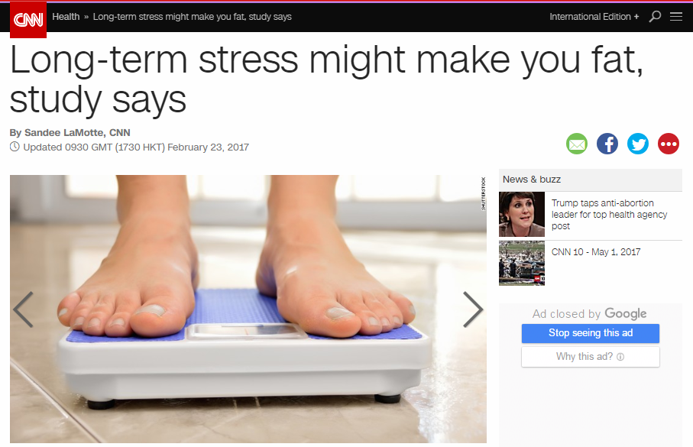
Source: http://edition.cnn.com/2017/02/23/health/stress-weight-gain-study/
Notes:
http://edition.cnn.com/2017/02/23/health/stress-weight-gain-study/

Slide 12
TLS® ACTS
NEW
Benefits:
Helps the body adapt to stress
Helps support better emotional responses to stress
May help in minimizing stress-related issues
Helps to support better mood changes
May help reduce occasional fatigue associated with stress
Supports mental clarity in times of stress

Slide 13
TLS® ACTS
NEW
Ingredients:
Eleuthero Root
Panax ginseng Extract
Ashwagandha Extract (Sensoril™)
Passionflower Extract
Rhodiola rosea Extract
Schisandra chinensis Fruit Extract

Slide 14
TLS® ACTS
NEW
Product Information
Code: HK6460
UC: HK$382.00
SR: HK$535.00
BV: 36
Use: Take 2 tablets once daily with 240 ml of water

Slide 15
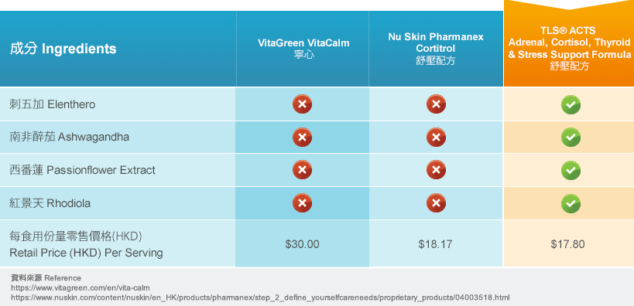
TLS® ACTS vs. Competitors

Slide 16
The New Tools, Coming Soon…
Business Guide, Coach Guide and Recipes…

Slide 17
The New TLS® Health Guide, Coming Soon…

Slide 18
The New TLS® Activity…
Date: May 24, 2017 (Wednesday)
Time: 6:30 – 8:00pm
Venue: mhk showcase
Free Admission
Welcome everyone who is interested in wellness and weight management. TLS Certified Coaches will be there to provide you with all the information you need for healthy weight loss.

Slide 19
TLS® 2017 will be a better year!
New TLS Trainings – TLS 101 & 201 (3.5 hours & HK$125 each)
TLS 101 - Learning the Basics to Living the TLS Weight Loss Solution Lifestyle
TLS 201 Learning How to Build your UnFranchise Business through the TLS Weight Loss Solution

Slide 20
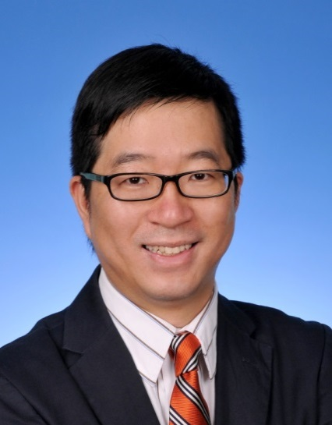
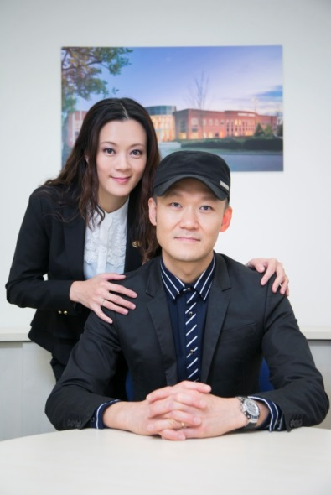
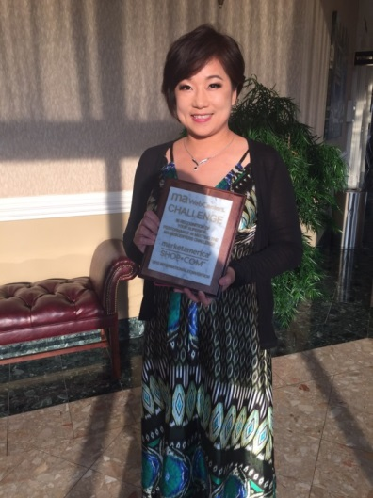
The New TLS 101 & 201 Trainings
TLS 101 Training:
Date: May 28, 2017 (Sunday)
Time: 9:30am – 1:00pm
Ticket Price: HK$125.00
TLS 201 Training:
Date: May 28, 2017 (Sunday)
Time: 2:30pm – 6:00pm
Ticket Price: HK$125.00
Calvin Ip
Helen Lin & Luk Ka Wai
Maggie Su
Be the first to learn about the new trainings. Details are located at hk.unfranchise.com!

Slide 21
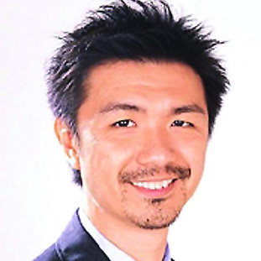
Learn more about TLS at the Breakout
New Product Breakout
Date: Tuesday, May 9, 2017
Time: 7:30 – 9:30pm
Venue: mhk showcase
Language: Cantonese
STEPHEN NGAN
JAS & Associates Head of Healthcare Marketing

Slide 23
TLS®
WEIGHT LOSS
SOLUTION
Taking Your Business
to Director or Above
“Information you can afford to pay attention to!”
– Dennis Franks

Slide 24
Get Your Head Right… solidify your mind set!
Identify your “WHY”
Make the Decision
Set Your Time Line…Determine your short, (90 days) intermediate, (12 Months) and long-term goals (5 years)
Determine your weekly hours and when you will work your business
Build Your Action Plan for each (Daily, Weekly and Monthly)
“ Goals are all about being able to focus on the details of your action plan” - Dennis Franks

Slide 25
Measure and Monitor to achieve desired outcome
Your business needs to produce 500 BV or more each month
Your business needs to produce 200 IBV or more each month
Your Resources…TLS Products, Programs, TLS Kits, Related MA Branded Products (Isotonix, Prime Products, Motives Products, Skin Care Products etc.) HK.Shop.com TLS-Friendly Partner Stores ( Foods, all clothing and fitness stores, electronic stores etc., Shopping Annuity)
SET
THE
BAR

Slide 26
Maintain your efforts daily, weekly and monthly
Utilize the Momentum Sheets - (Found on unfranchisetraining.com )
New UnFranchise Owner Training (NUOT) Tracking Sheet
Daily or weekly calls with your Sponsor or Mentor
The little things you do daily, add up to the big things you desire!
SET
THE
BAR

Slide 27
Become A Shopping Annuity Member
Base 10, Seven Strong
Build Your Shopping Annuity
Business Building Fundamentals...
DO NOT
re-create the wheel!

Slide 28
Become A Master Shopping Annuity Member
Become a Certified TLS Coach
Business Building Fundamentals...
DO NOT
re-create the wheel!

Slide 29
Building A Sales Organization
Know The Mechanics To Master The Plan
The objective is to have 4 Sales Organizations (Legs) feeding 3 Business Development Centers (BDCs) each producing 5000 BV each week and 5000 IBV each week.

Slide 30
Building A Sales Organization
Know The Mechanics To Master The Plan
Each organization must have 40 UFOs who each do on average 500 BV per month of any MA Branded Products (much of this volume is TLS Branded Product) and 40 UFOs committed to complete the Shopping Annuity averaging a minimum of HK$160,000 in HK.SHOP.COM purchases averaging 5% IBV. (40,000 IBV )

Slide 31
CONTROL YOUR OWN DESTINY
Master the Basic 5
Doing All 5 Components - Daily
Excelling at the Follow Up and The ABC Pattern of Duplication

Slide 32
Thinking About The Fundamentals
Each organization needs six UFOs building out Base 10, Seven Strong - (Producing a minimum of 500 BV and becoming a Master Shopping Annuity Member).
Building four sales organizations, you would need a total of 42 UFOs per leg, or a total of 24 UFOs building out Base 10, Seven Strong (Total of 168 UFOs, 24 x7) averaging 500 BV a month.
Hitting the Shopping Annuity with annual average purchases of $20,000. This would yield a range of $405,000 to $561,000 of residual income.

Slide 33
YOU
1
1
Your Organization
to DIRECTOR!
2
2
3
3
4
4
5
6
Each Leg, Build out Base 10, Seven Strong
for 6 Personally Sponsored x 7 or 42 UFOs
averaging 500 BV and 200 IBV each Month

Slide 34
Building A Sales Organization
Personal Sponsoring Goal: 2 new UFOs per quarter, 8 Personally sponsored a year. (Key commitment of the new UFO is to build Base 10, Seven Strong in the first 4-6 months.)
Determine your success (mathematical) formula.
Call 3 Prospects a day Monday through Friday. Catch up on the weekends.
Show the Plan twice each week - (8 new Plans a month)
Book your follow up calls according to your appointments and always follow up. Do what you say!

Slide 35
Building A Sales Organization
Identify their “WHY” before Showing the Plan… “Assuming what I share with you today will work for you, what amount of income on a monthly basis, in addition to what you currently earn, would put you where you want to be financially 5 years from now?”
Be interactive with your Prospect throughout the Showing of The Plan.

Slide 36
Building A Sales Organization
At the completion be sure to...
Ask them what they liked best.
Identify if they were thinking of other people that would be interested.
If Yes, immediately offer a date you are available to introduce the business to them. It is best to offer two separate dates and book it.
Provide them with more information, physical, and websites, videos, or favorite audios.

Slide 37
Building A Sales Organization
Share the next UBP, Basic Five, or Local Seminar date and look to sell a ticket to them.
Let them know if they are not a current customer, that part of the qualifying process includes experiencing a product or two, and do a bit of shopping online, supporting the Shopping Annuity. Sell a product and book a Shop.com visit or take them for a quick spin of the site.

Slide 38
Building A Sales Organization
Set and confirm the next date to speak to them. Be sure to give them one more homework assignment. Take out the Getting Started Guide and review Part 1.
Have them write 30 names of people they know
10 names of people into Health and Wellness and/or Weight Loss
10 names of people into Beauty
10 names of people who they know that would like additional income, free time or support a ministry or charity.

Slide 39
SUCCESS FORMULA
TIME^{Q} + GROWTH^{D} = BV and IBV = $$$

Slide 40
Schedule TLS® Activities
TLS Overviews
Start TLS 21 Day Challenges
Conduct TLS Online Parties
Daily be an Internet Marketer
Participate in TLS Social Media - Use Hashtags - #TLS WeightLoss, #TLS21Day, #HKTLS
Remember to put your TLS Customers on the TLS Weight Loss Facebook page for added support.

Slide 41
Know Your Business Building and Sales Tools...
Health Guide
TLS Flipchart
TLS 21 Day Challenge Booklet
TLS Menus Plan
TLS Weight Loss Profile Questionnaire
UFMS Downloads - TLS

Slide 42
LET’S BEGIN
Write the list of names. List everyone that has no preconceived notions. Everyone knows someone wanting to get fit, lose weight or eat healthier.
Be a professional, call them all!

Slide 43
LET’S BEGIN
Make your approach. Call, text or email. Simply begin with “Hello_____. I need your help.”
Already have scheduled dates for
TLS Overviews
TLS Find Your Fit Overview
Online Party

Slide 44
LET’S BEGIN
Remember to start every client right. They are your advertisement and potential business partner. There is definitely a “Lifetime Value” to every customer you start.
Measurements
Weight
Body Composition
Before and After Pictures
Notes:
Re

Slide 45
Thoughts of Advice
when becoming a TLS PROFESSIONAL
Embrace every question, comment and objection
There is a reason it was brought up and to the person making the comment, it is important to them.
Every person you approach is a learning experience and opportunity
Build Relationships
Keep it Simple
Take Massive Action

