Slide 1
Technology Solutions for your business

Slide 3
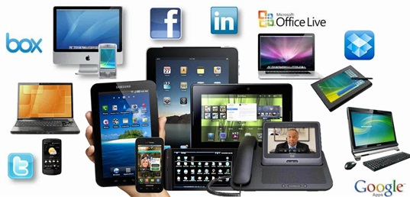
Technology is changing everything!

Slide 4
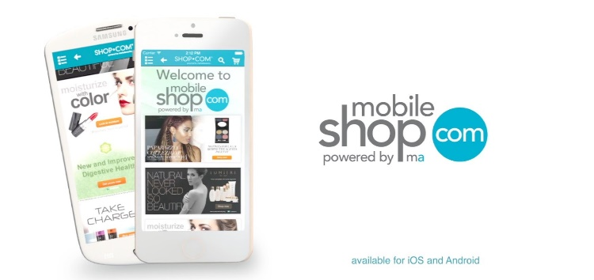
Market America has many great technologies that you can apply to your business to help make you successful.
SHOP.COM Affiliate Publisher Network

Slide 5
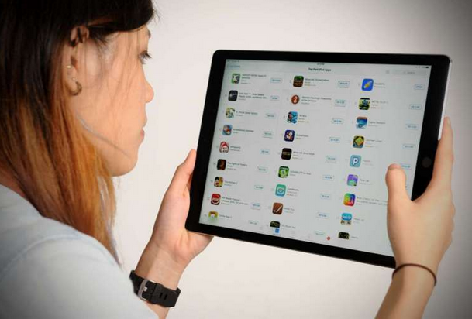
HOW WOULD YOU LIKE FOR US TO MAKE IT EASIER FOR YOU TO FIND THEM AND UNDERSTAND BETTER HOW THEY CAN BE USED FOR YOUR BUSINESS?

Slide 6
New Apps & Features Center
Will be launching in Singapore, Taiwan and Hong Kong on Unfranchise.com!
Launching At the 2017 International Convention in Greensboro!

Slide 8
App Store Features – Featured Apps
This area will provide some of the top featured apps we believe are important to your business and for you to know how to use them.

Slide 9
App Store Features – Explore by Categories
Business Development
Shopping

Slide 10
App Store Features – Filtering Options

Slide 11
App Store Features – App Details

Slide 12
App Store Features – App Details Screen
Provides detailed description about the app or feature.
Images available to help describe how the app functions.
Allow you to select the app and get the app directly from unfranchise.com.
Will provide useful tips on how to use the tool to help your business.
Can link directly to Apple or google store to get the app.

Slide 13
New Apps & Features Center
As we develop more site features and apps they will be entered here for you to find out about them and learn how they can help you and your business.
2017 International Conference in Greensboro!

Slide 15
Affiliate Publisher Program – http://affiliate.shop.com
So, what are you doing now to help drive traffic to your site?

Slide 16
Affiliate Publisher Program – http://affiliate.shop.com
Please go to my website!!!
Word of Mouth?

Slide 18
Affiliate Publisher Network
Currently Available in Taiwan
Coming to Singapore and Hong Kong Soon!

Slide 19
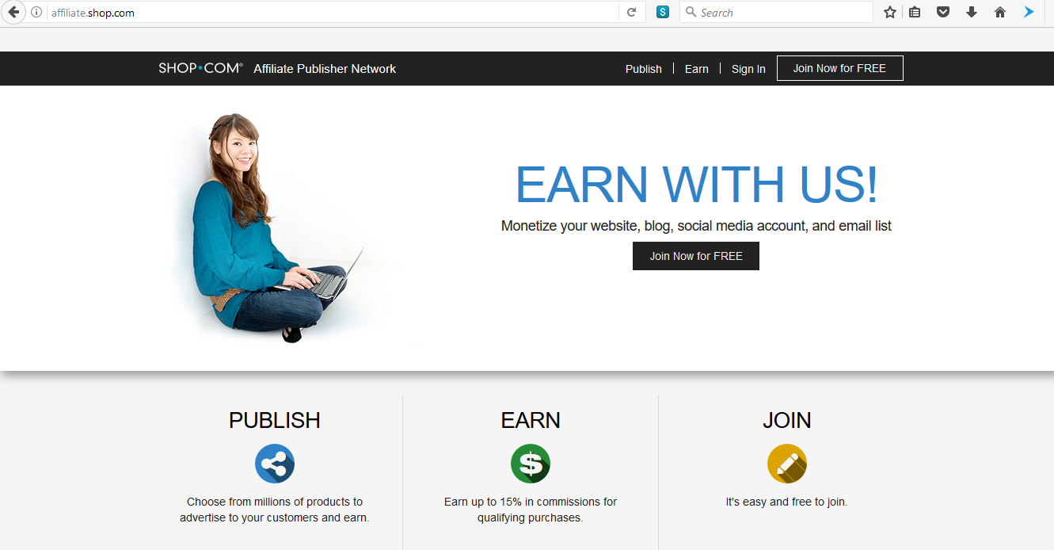
Affiliate Publisher Program – http://affiliate.shop.com
Provides several ways for you to advertise products and drive more customers to your SHOP.COM portal.

Slide 20
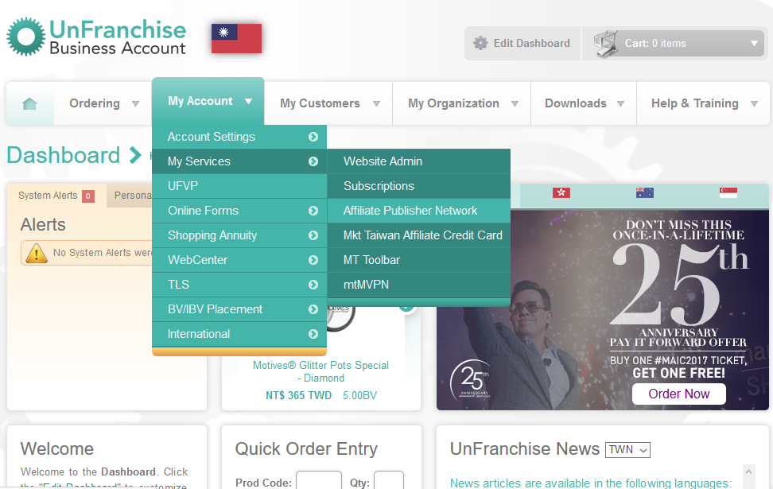
How to get started!

Slide 21
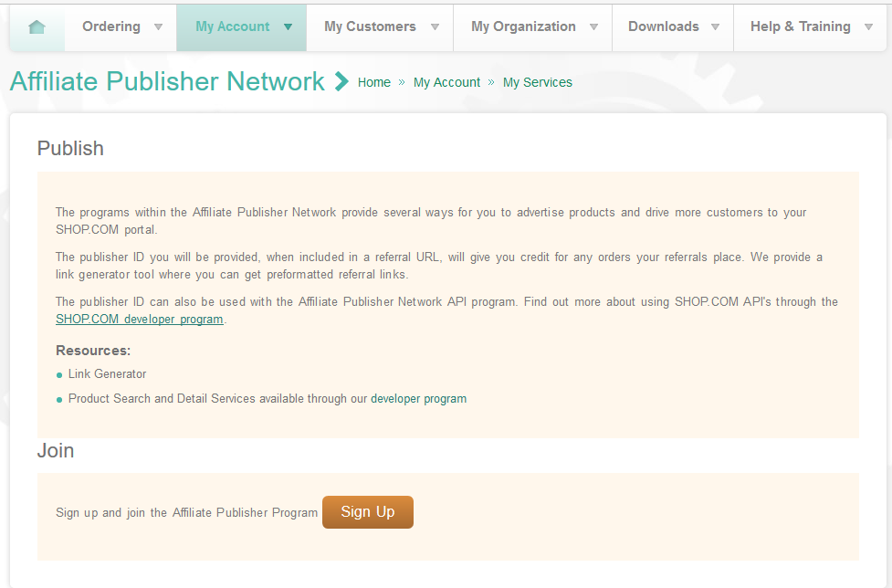
- Sign Up Page to get your Affiliate Publisher Number

Slide 22
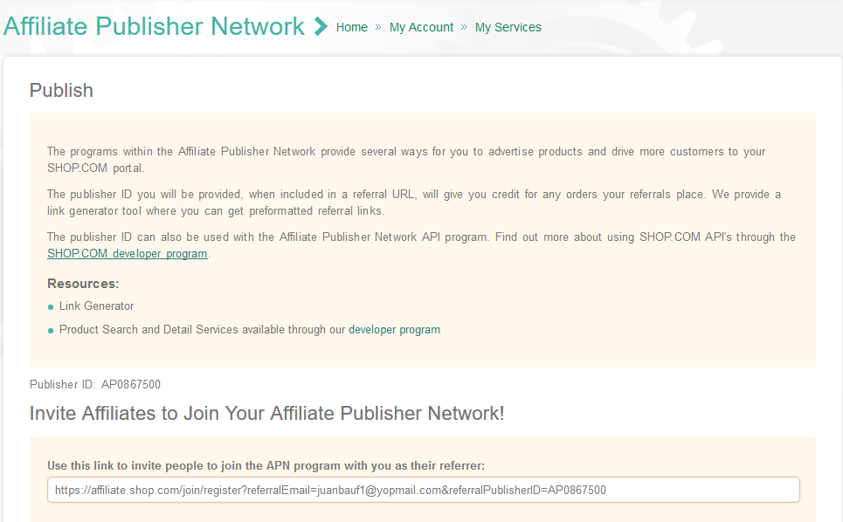
Publisher ID#: AP0867500

Slide 23
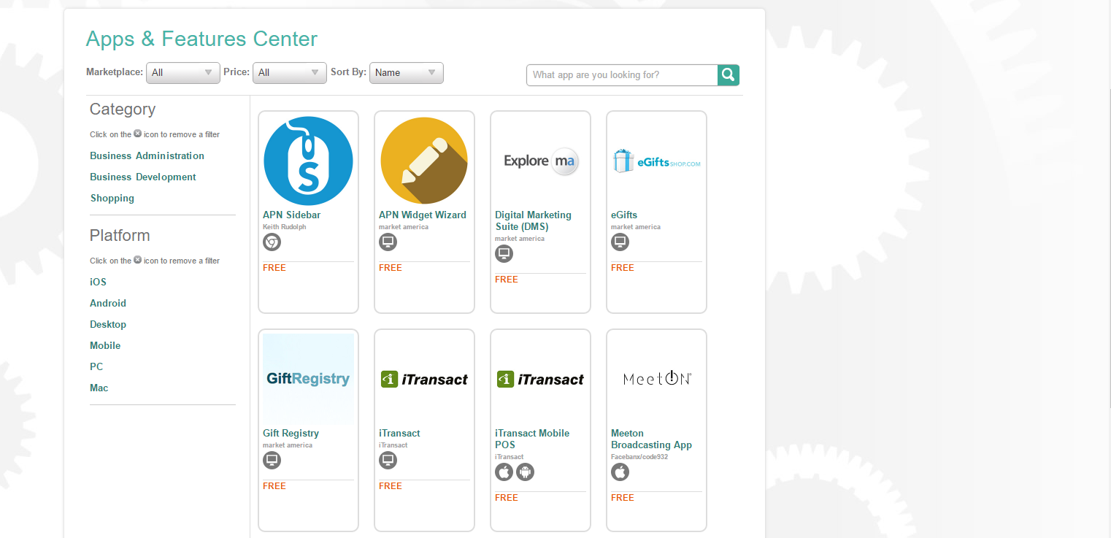
APN Sidebar App
How to leverage it to drive more traffic to your site.

Slide 24
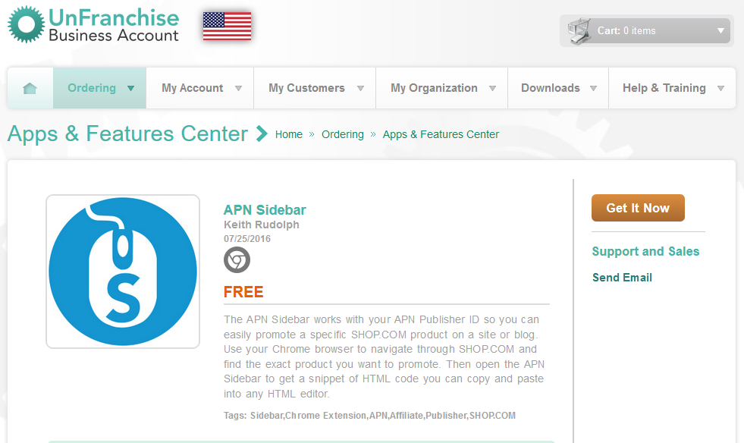

Slide 25
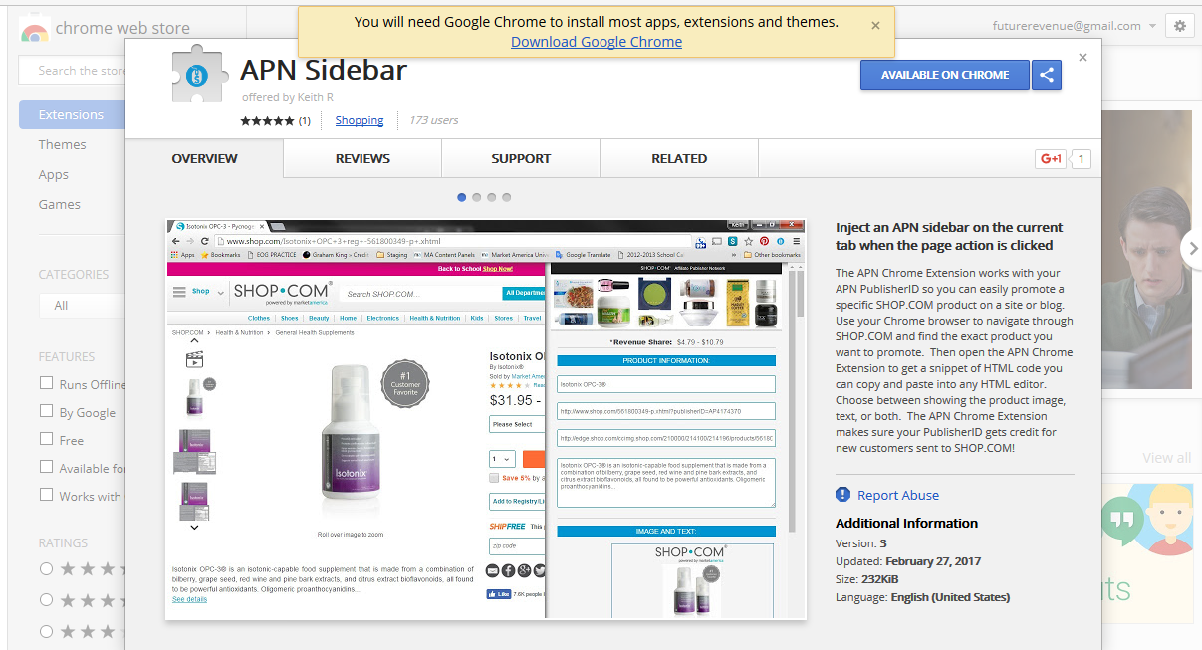
Affiliate Publisher Program – http://affiliate.shop.com

Slide 26
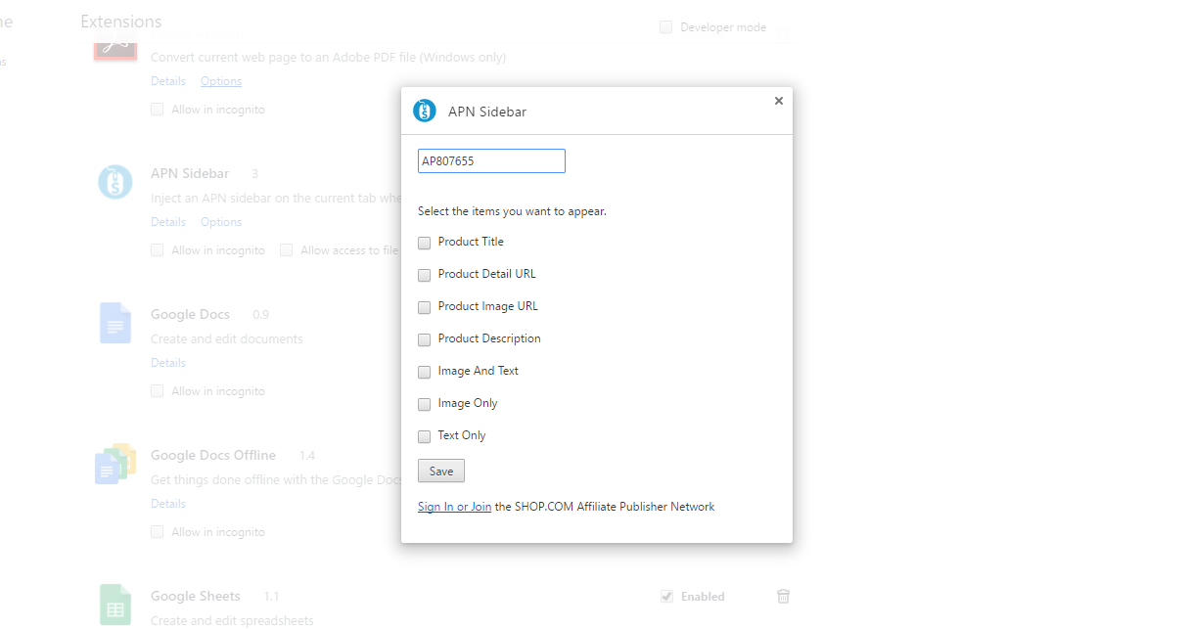
Type in your APN# here so that it will always give you credit when sharing

Slide 27
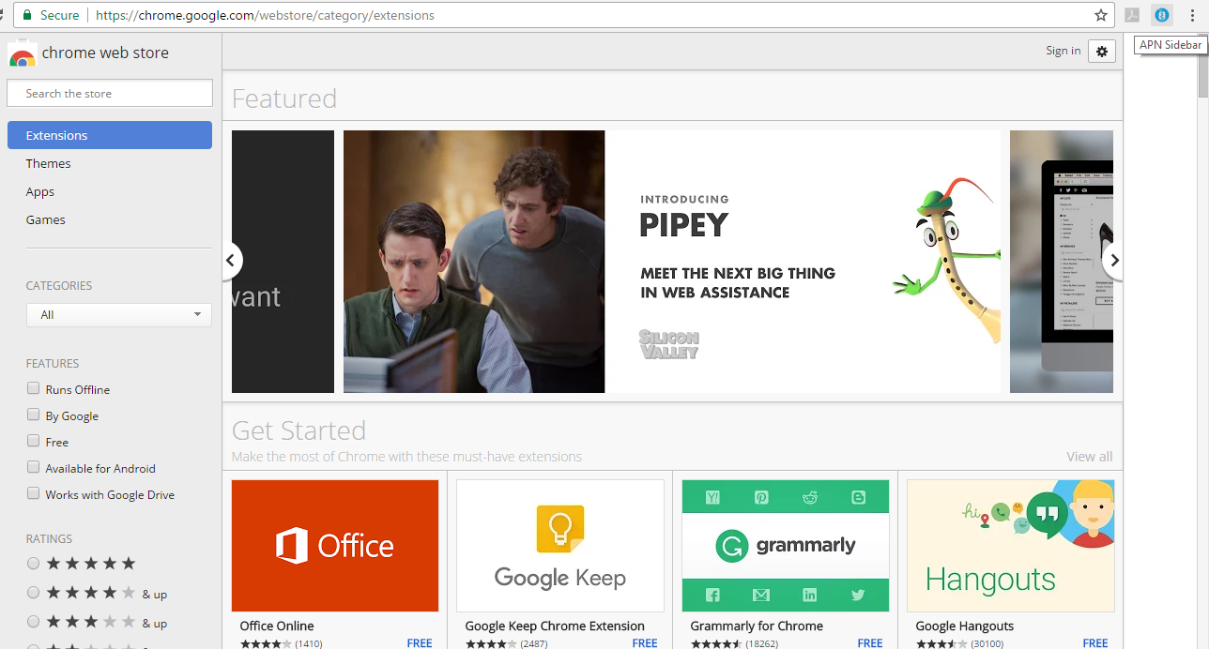
Once installed you will see a little icon at top right of browser

Slide 28
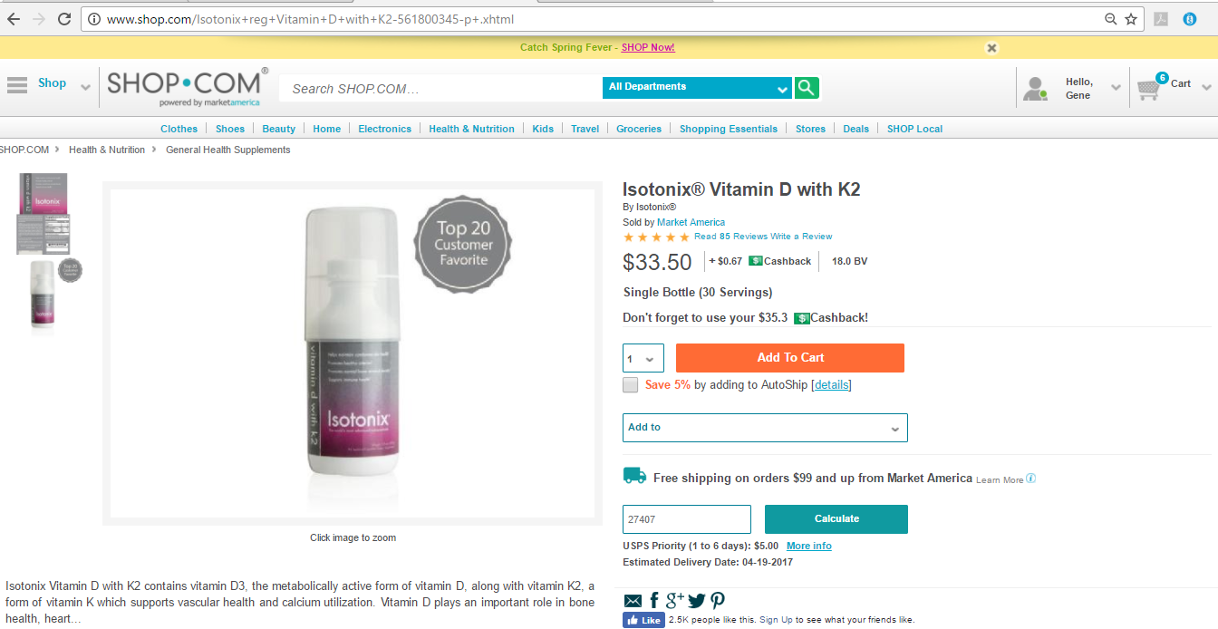

Slide 29
Automatically extracts all the information you need to share a product.
Provides Title of Product
URL of the product
Image URL of product
Product Description
- Product Image, Price and Cashback
Embed Code that can be used to place on any html supported site.

Slide 30
Example of a SPA site with the embedded code displaying the Isotonix product.
Clicking on it takes the customer back to your website to purchase the product.

Slide 31
APN Widget Wizard
How to leverage it to drive more traffic to your website.

Slide 32
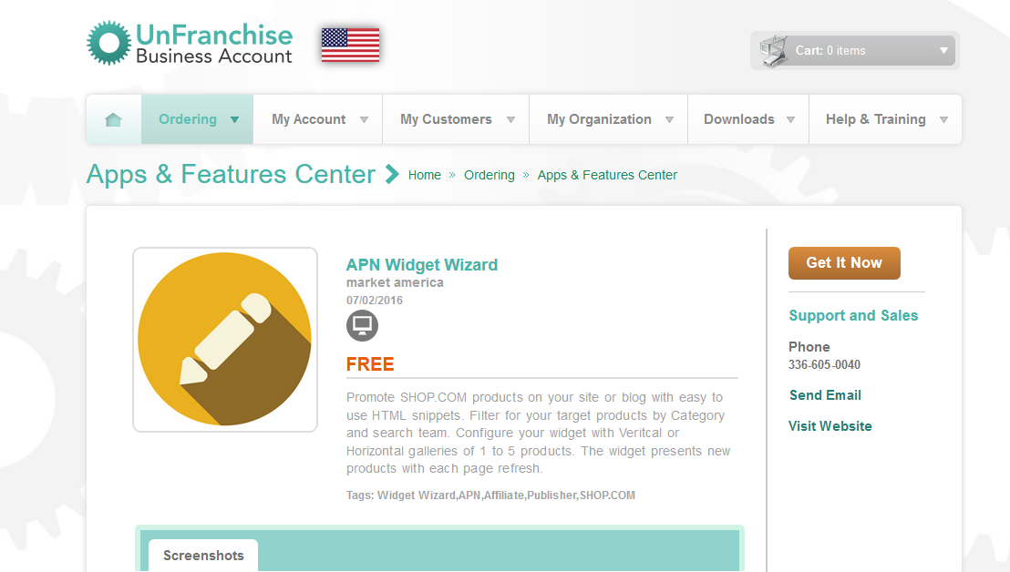

Slide 33
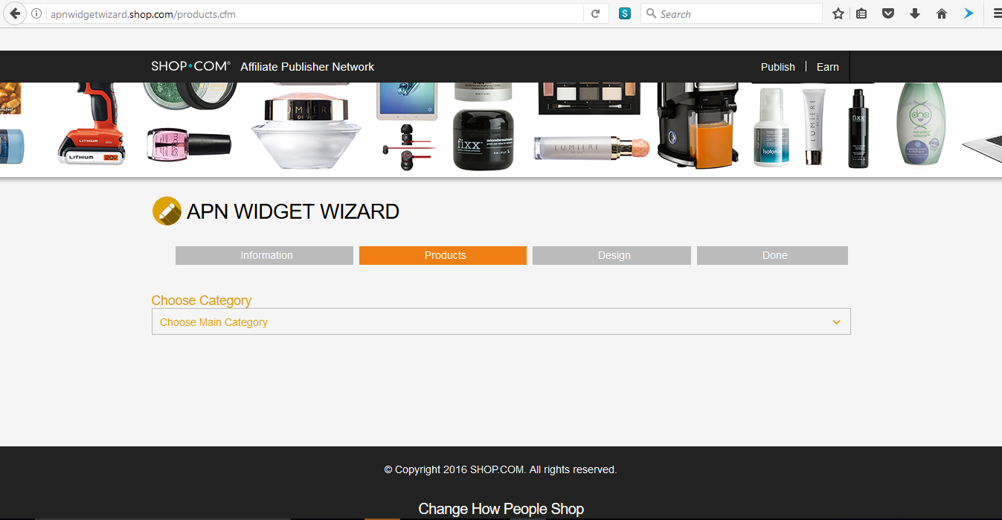

Slide 34
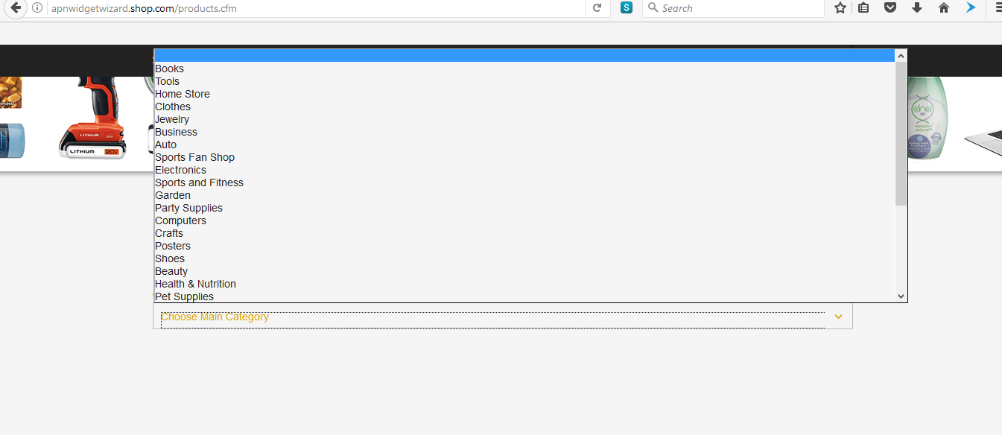
Once you select the Sub-Category it will display all the products that will rotate in your widget.

Slide 35
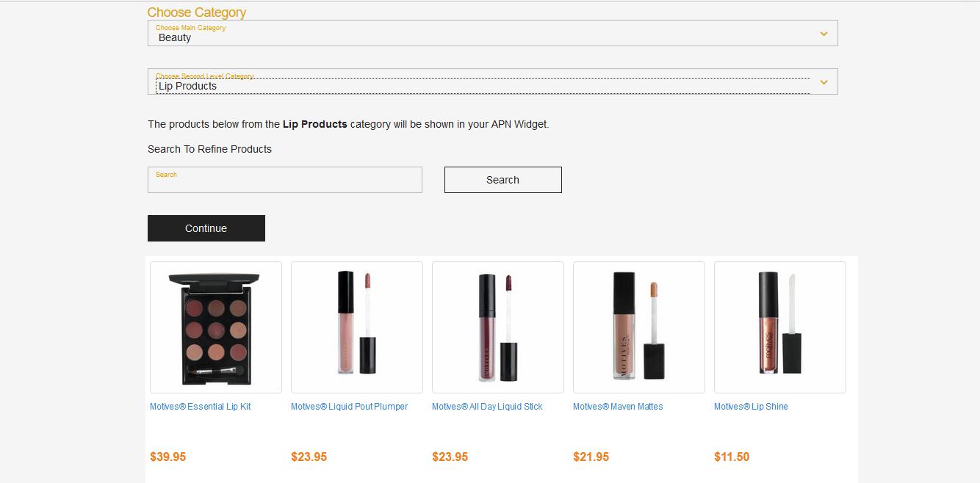

Slide 36
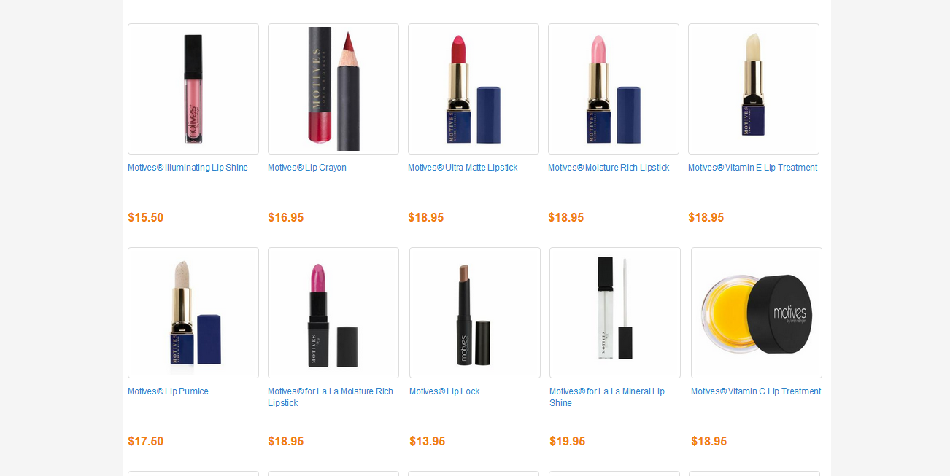

Slide 37
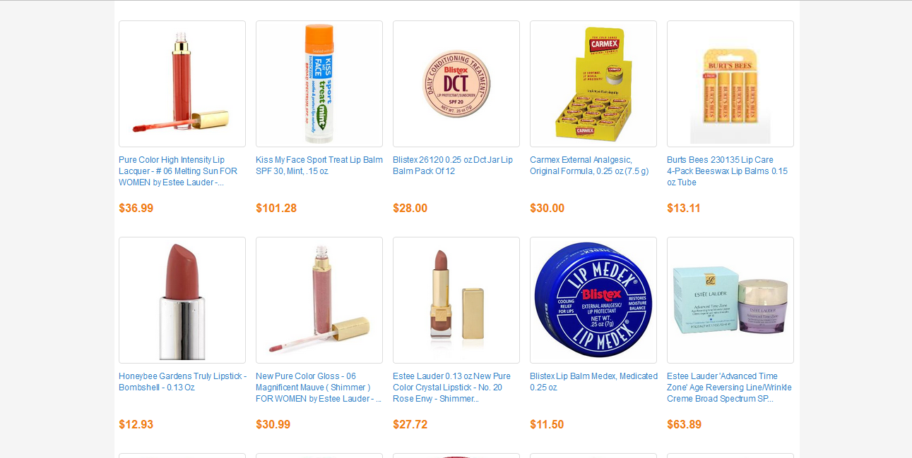

Slide 38
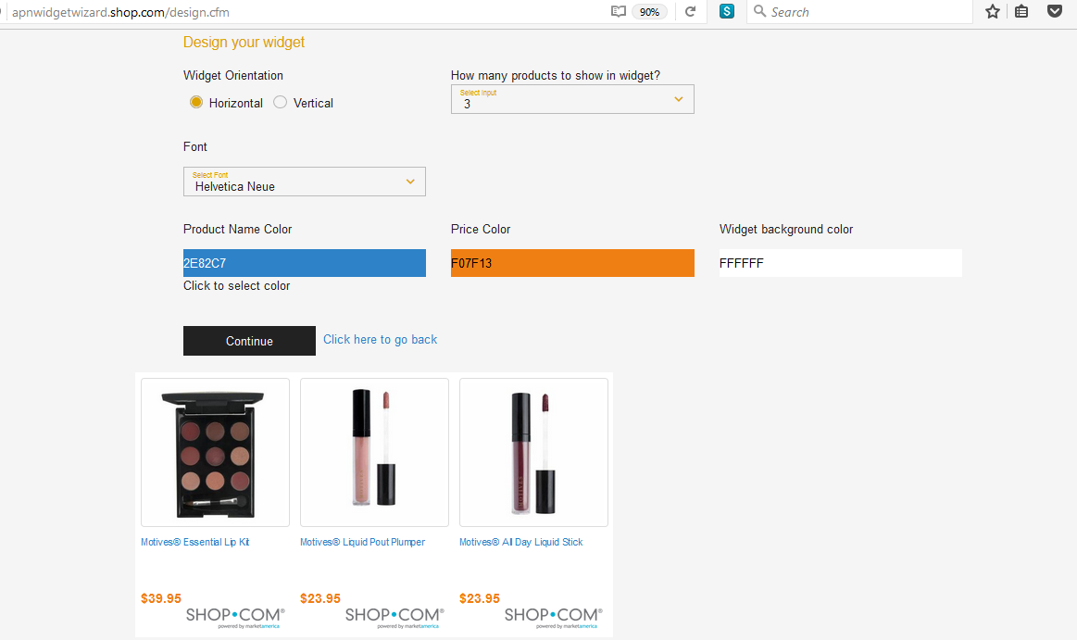

Slide 39
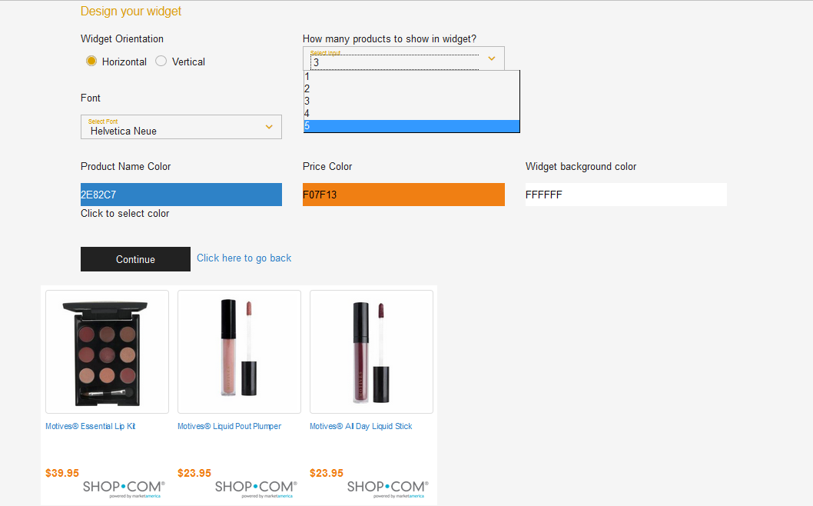

Slide 40
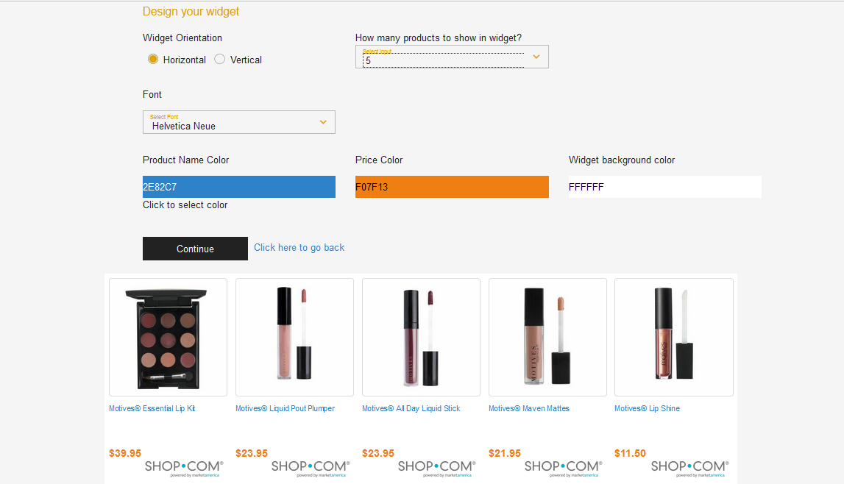

Slide 41
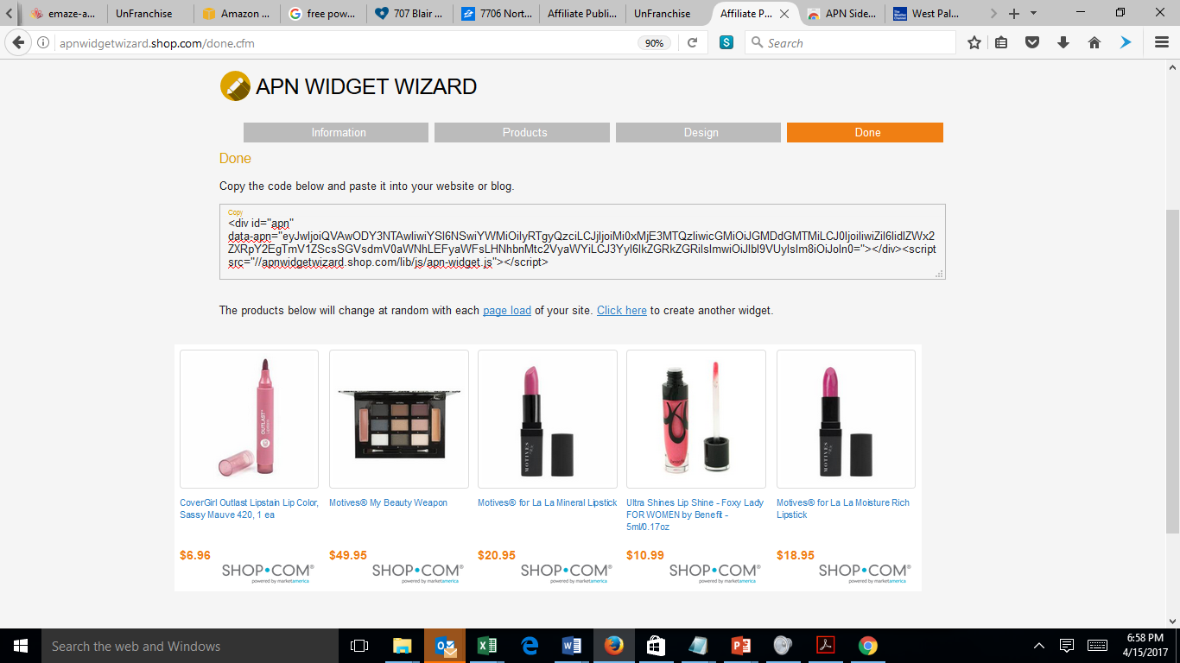
Copy and provide to blog or website owner

Slide 43
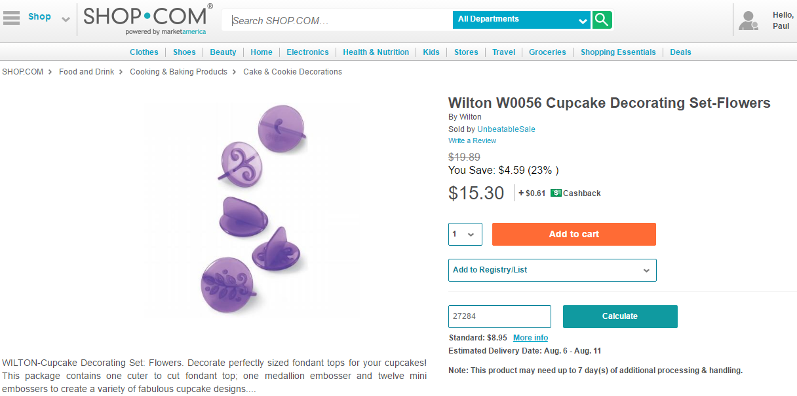
Site Visitor
UFO Earns BV, IBV
UFO gets a customer
SHOP Customer
Notes:
Affiliate Marketing is when a site or blog promotes a product, then when the user clicks they are directed to the location to purchase that product

Slide 44
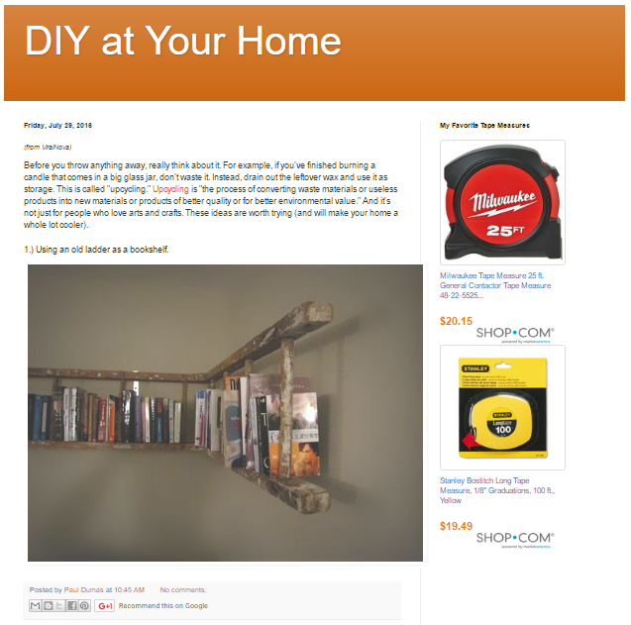
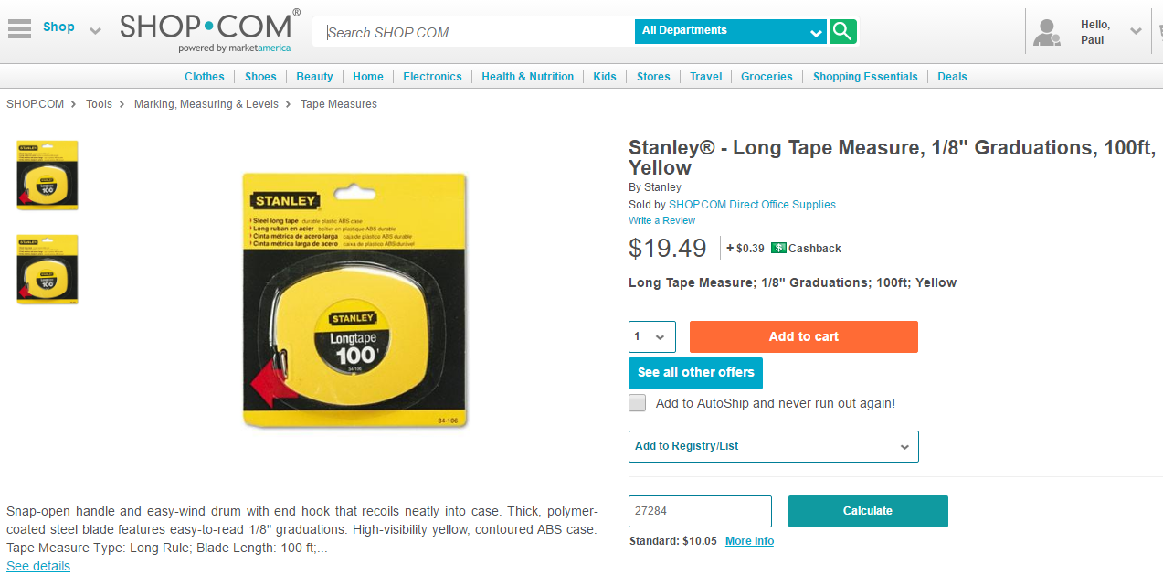
Site Visitor
UFO Earns BV, IBV
UFO gets a customer
SHOP Customer
Notes:
Affiliate Marketing is when a site or blog promotes a product, then when the user clicks they are directed to the location to purchase that product

Slide 46
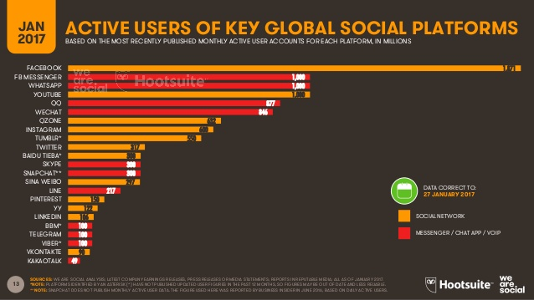

Slide 47
So what is Social Commerce?

Slide 48
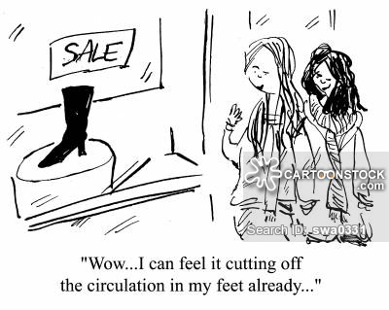
Social Commerce is simple…
Involves social media
Online Media
Social Interaction

Slide 49
Market America has positioned you for Social Success
A study by Marketing Week shows that Facebook is the most popular platform for direct purchasing. 19% of all survey respondents prefer to buy items directly on the Facebook network.

Slide 50
SHOPBOX is a patented & exclusive personalized product store front application that includes:
Login and registration Product Detail Information
Shopping Cart Shipping Options
Secure Credit Card Processing Checkout
Referral Tracking
Now Available on SHOP.COM and Motives!

Slide 51
SHOPBOX allows you to take a facebook user / friend

Slide 52
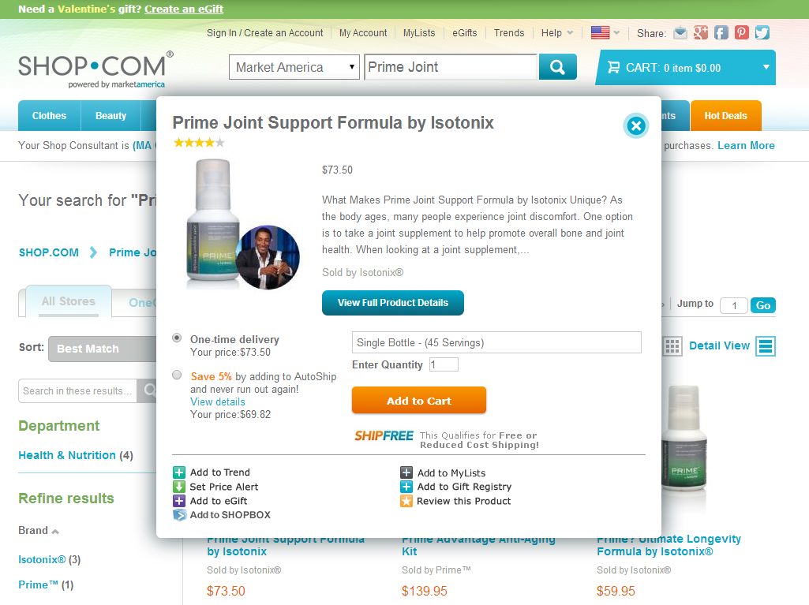
Add to SHOPBOX link available on every quick view and product page.

Slide 53
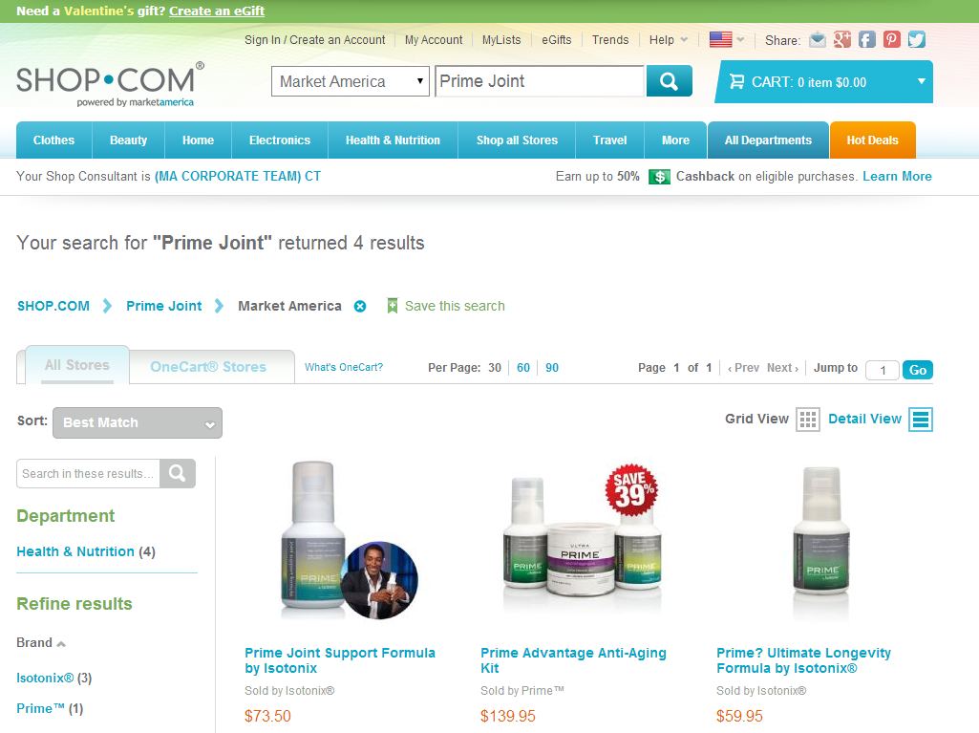
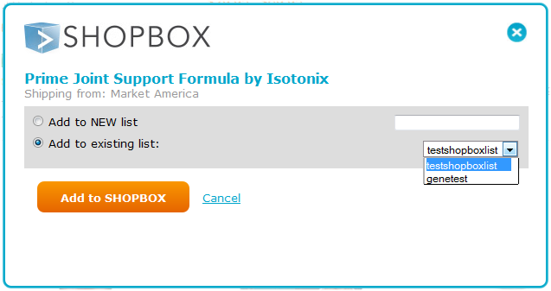
Displays a Pop Up to allow you to add products to a new SHOPBOX or Existing One.

Slide 54
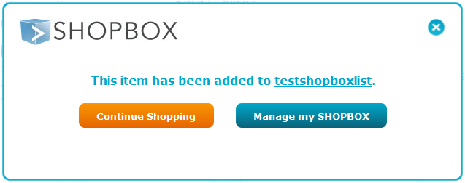
Clicking on Manage my SHOPBOX to display the SHOPBOX created

Slide 55
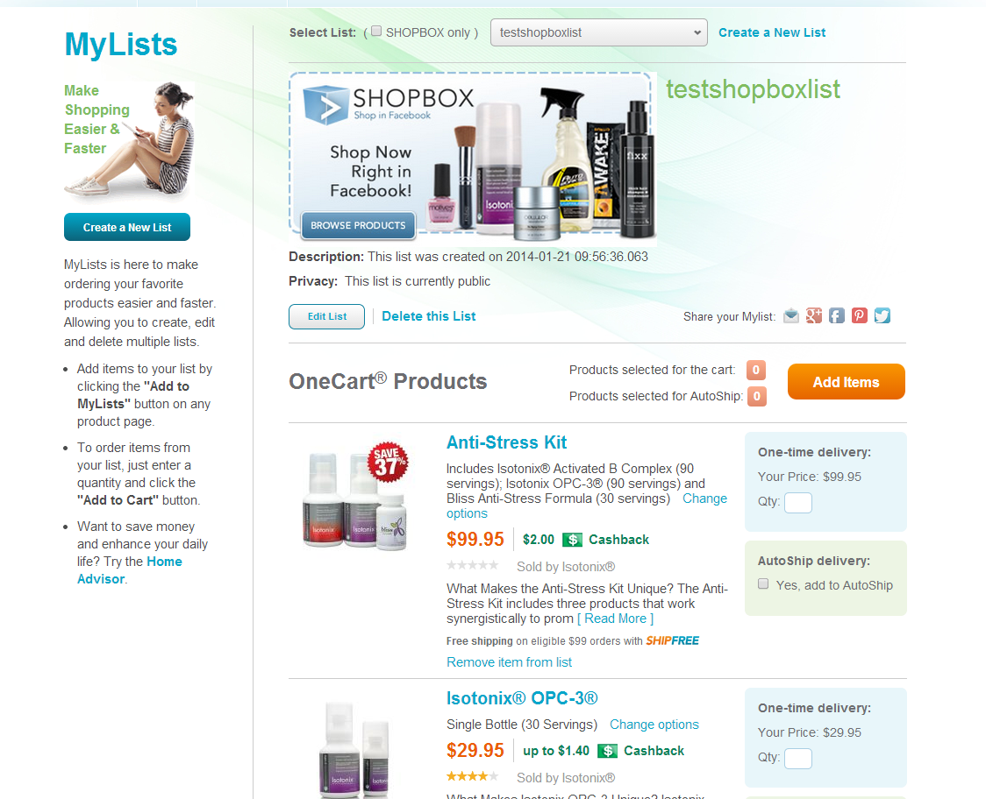
SHOPBOX admin area where you can select “Edit List” to see SHOPBOX share options.

Slide 56
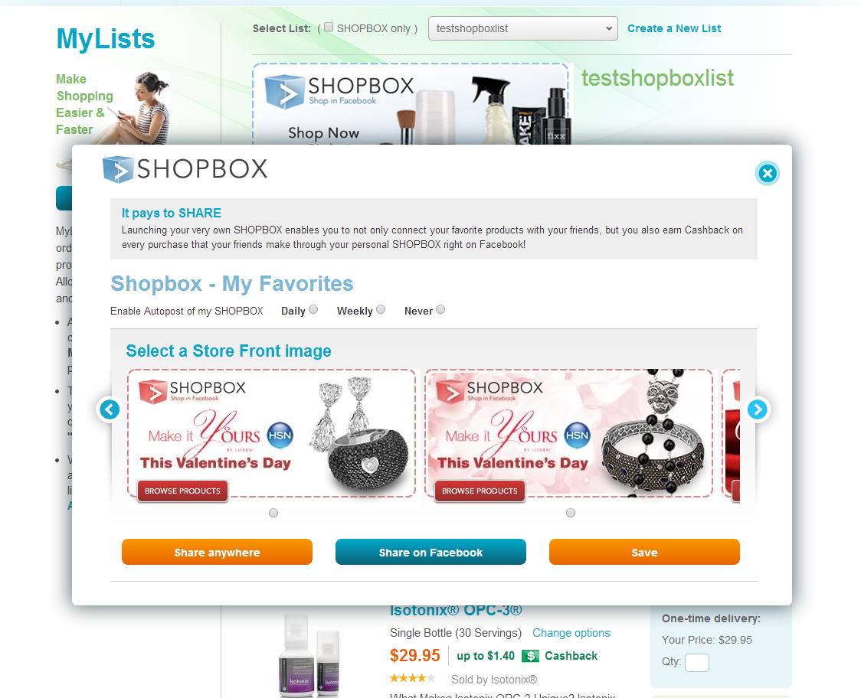
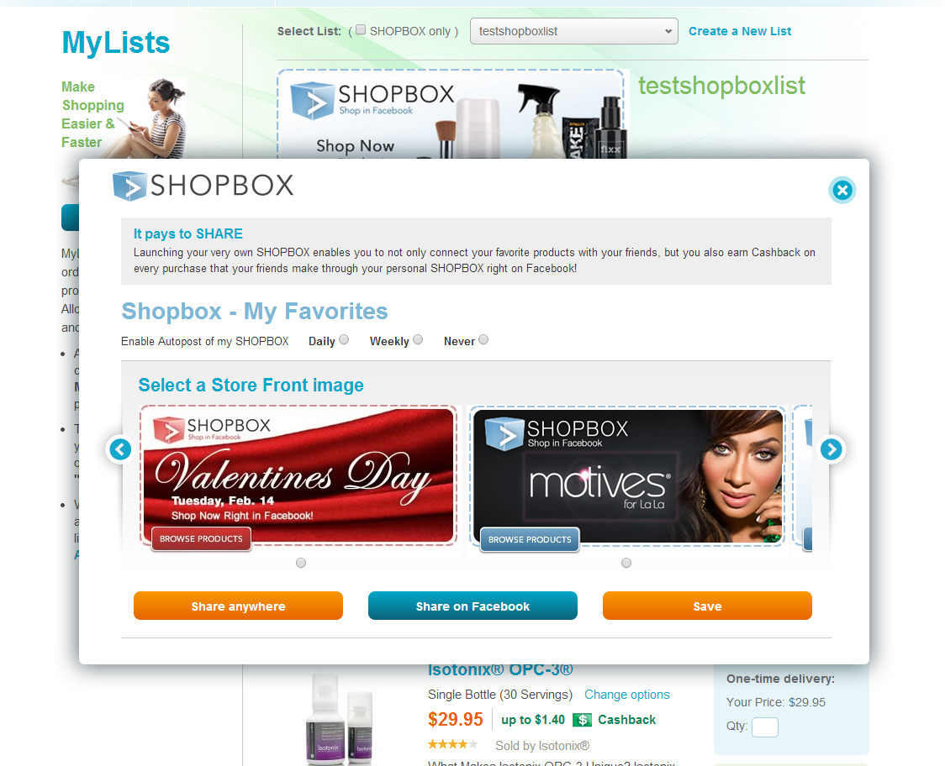
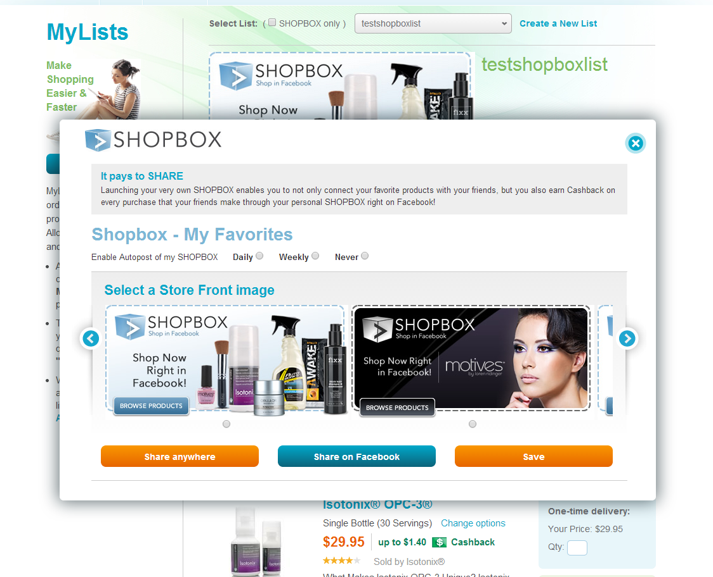
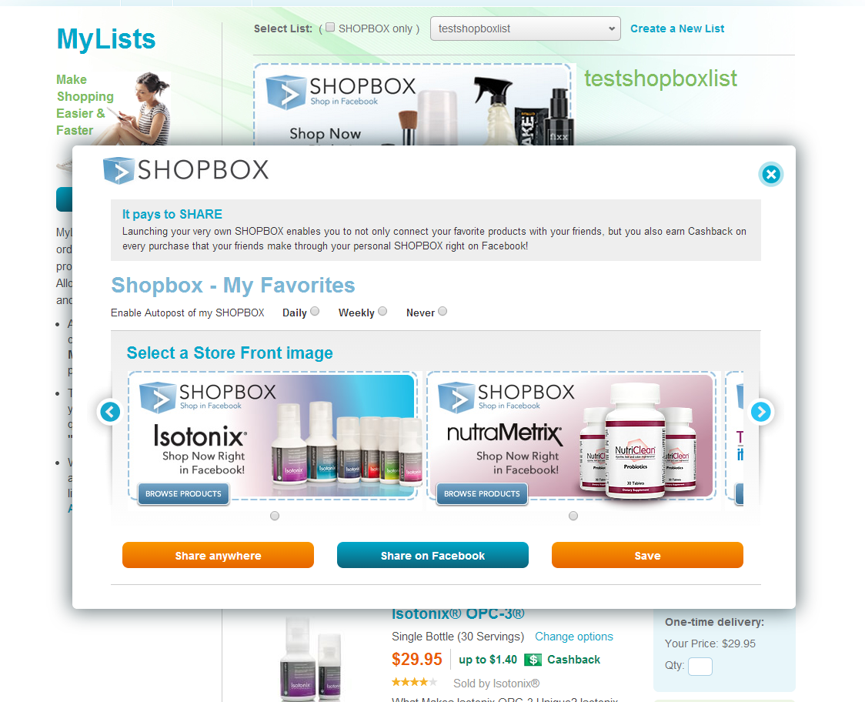
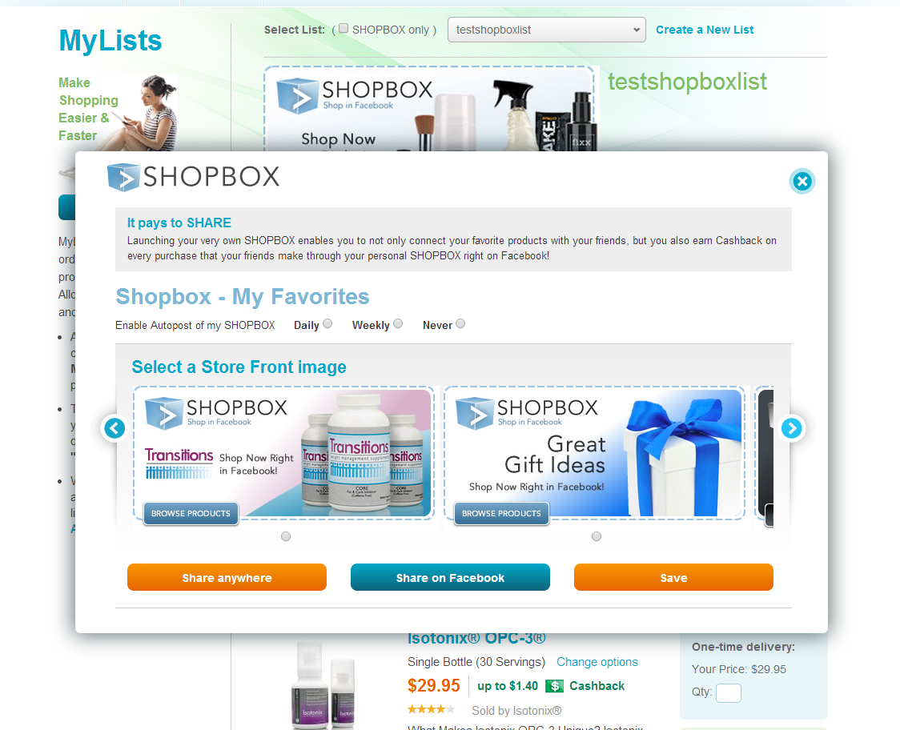
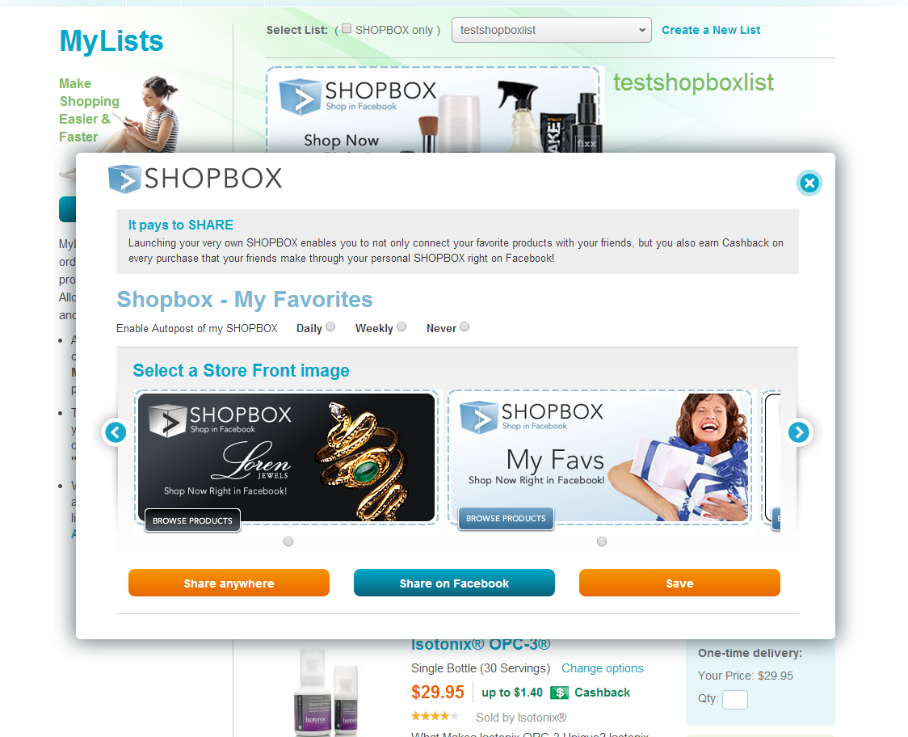
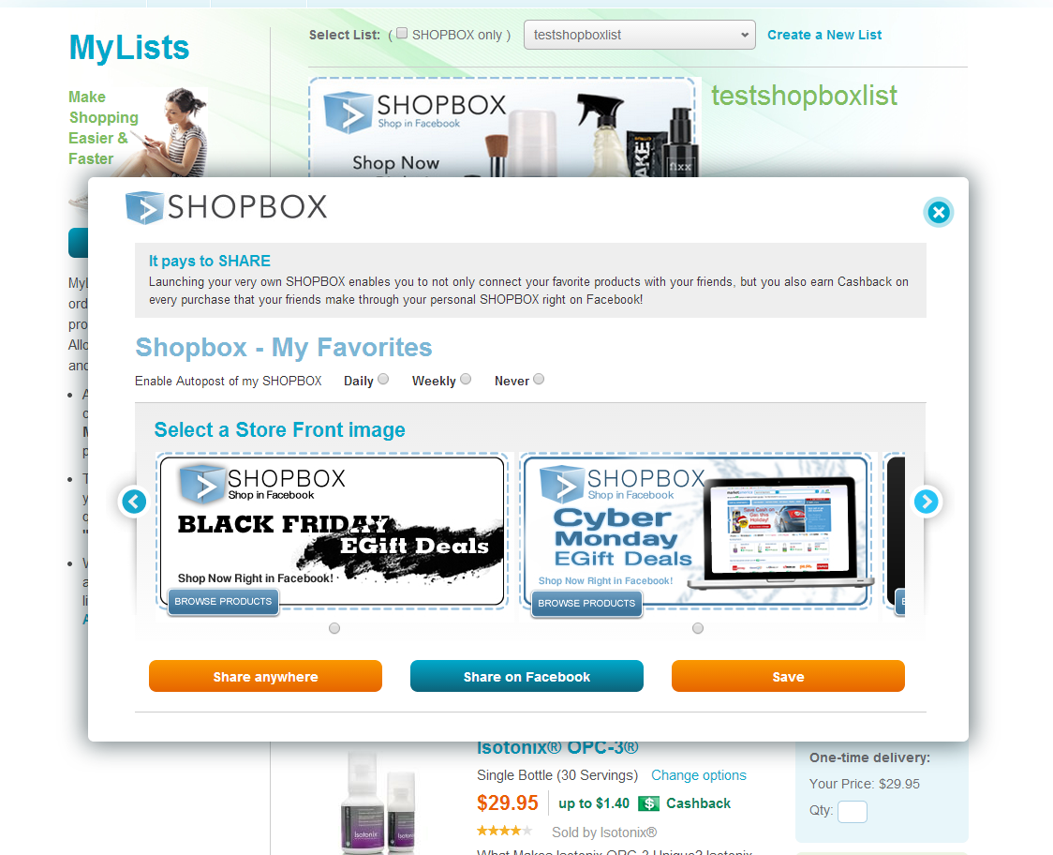
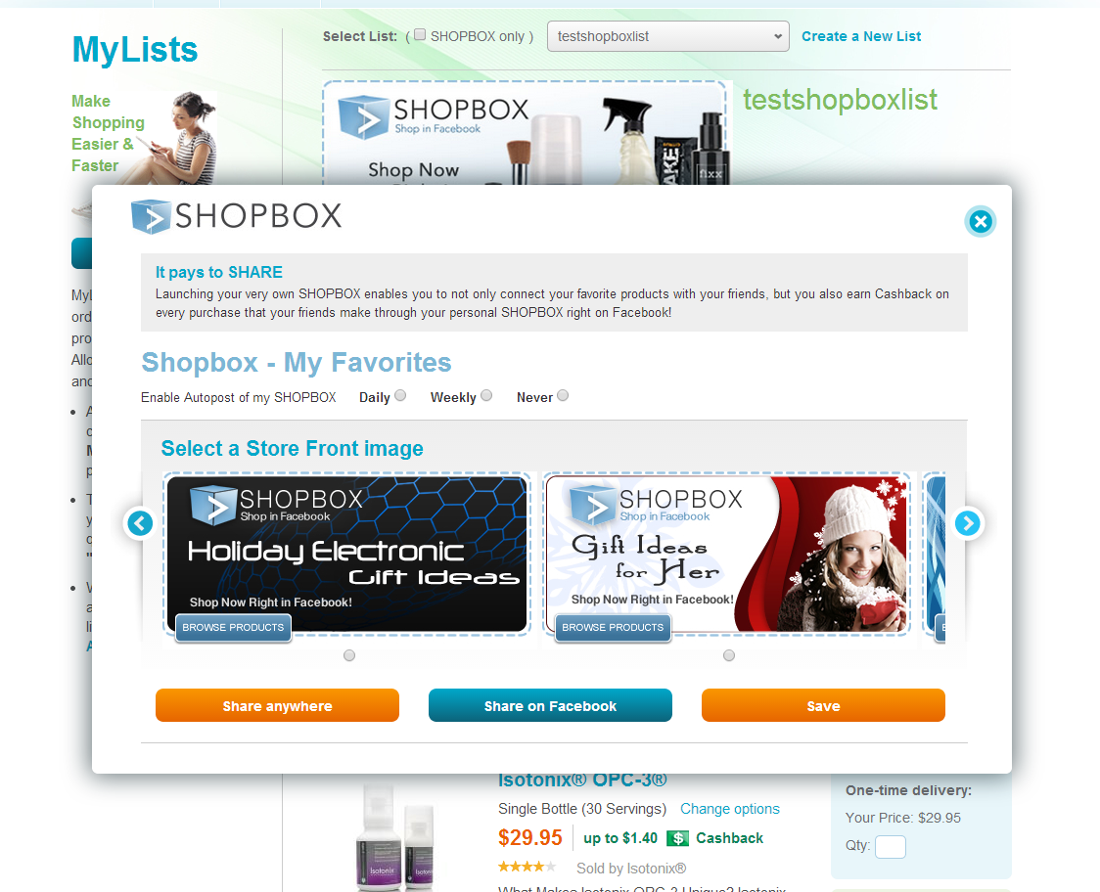
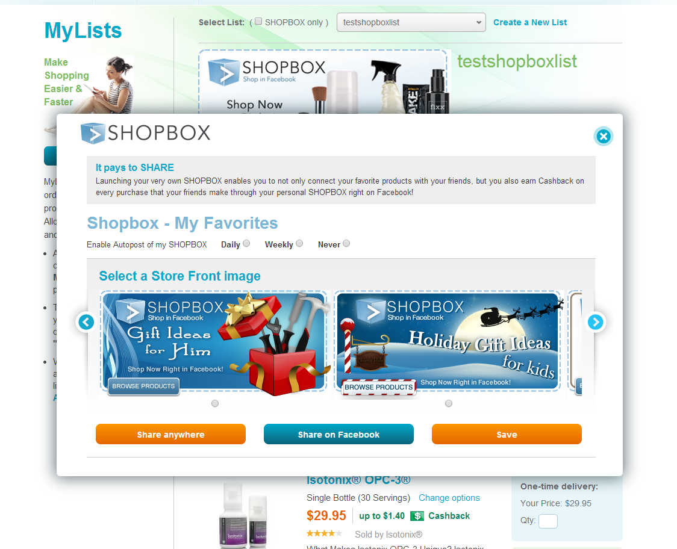
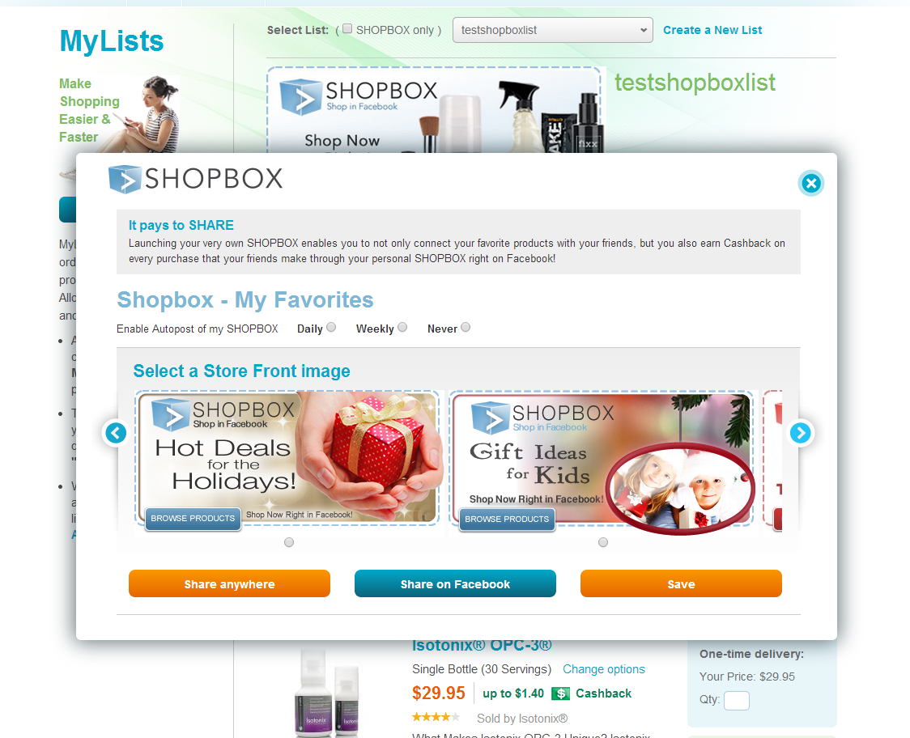
Pop Up allows you to select a store front image, select the frequency of how often you want to Autopost on Facebook.

Slide 57
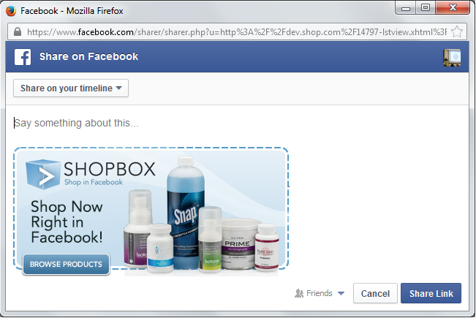
Facebook connect page to enter a statement and post to facebook

Slide 58
Post directly to your timeline profile

Slide 59
Opens up in your facebook page for purchase

Slide 60
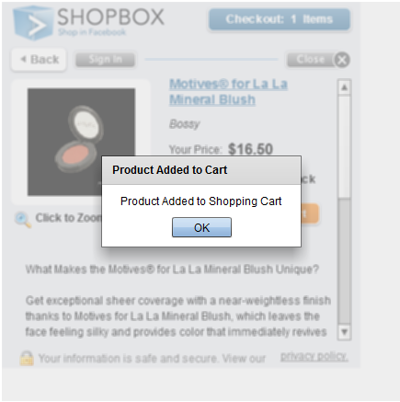

Slide 61
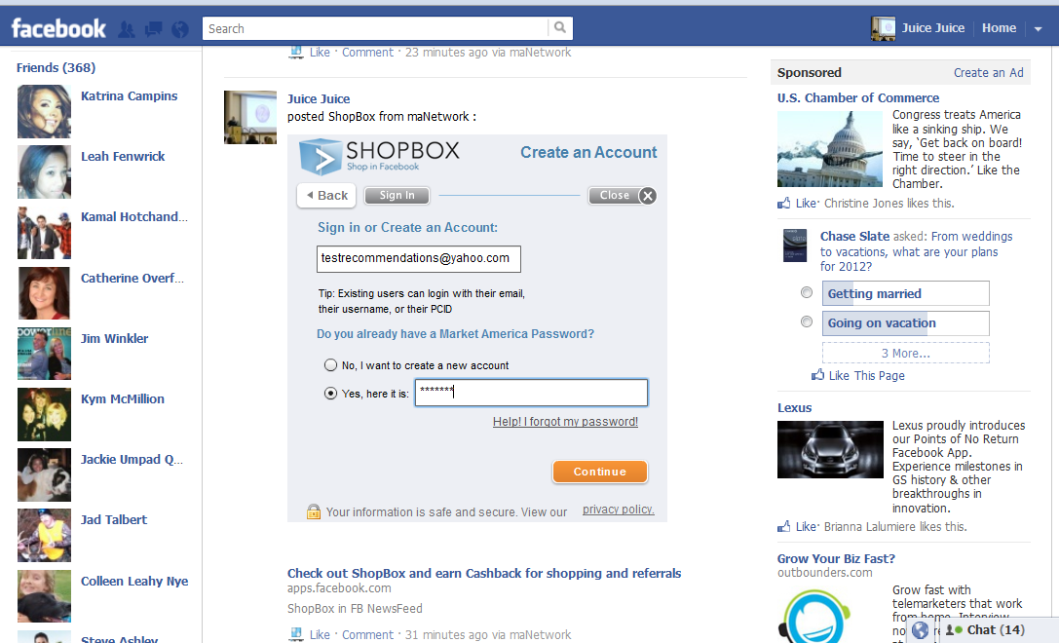
Login using your SHOP.COM login

Slide 63
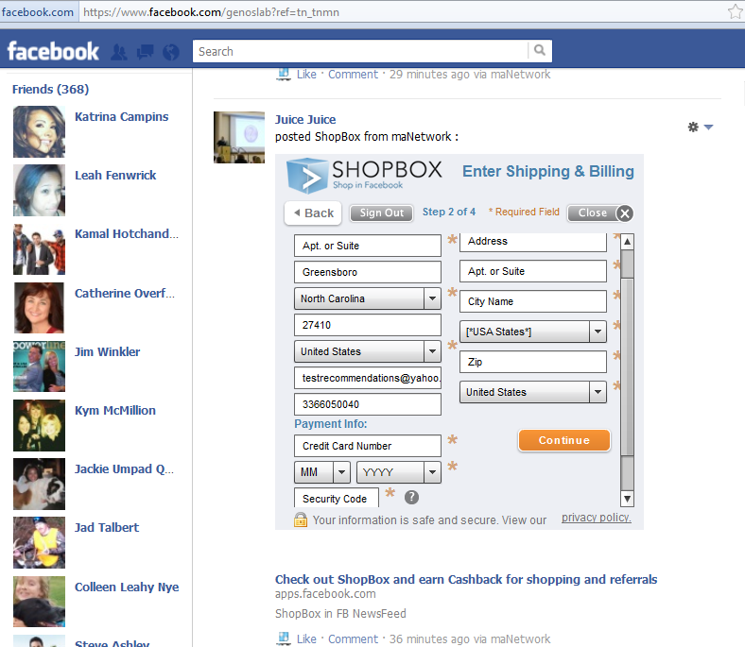

Slide 64
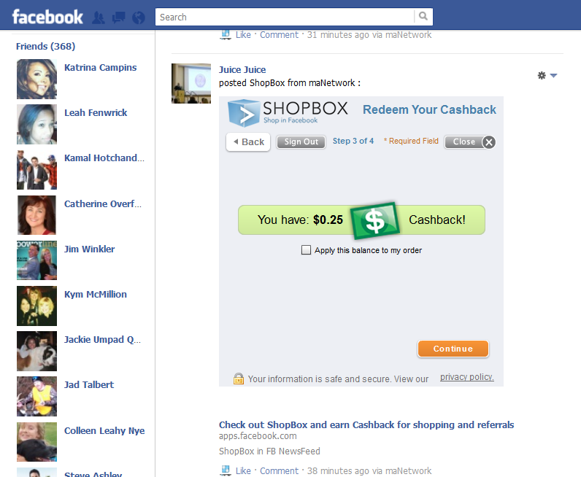

Slide 65
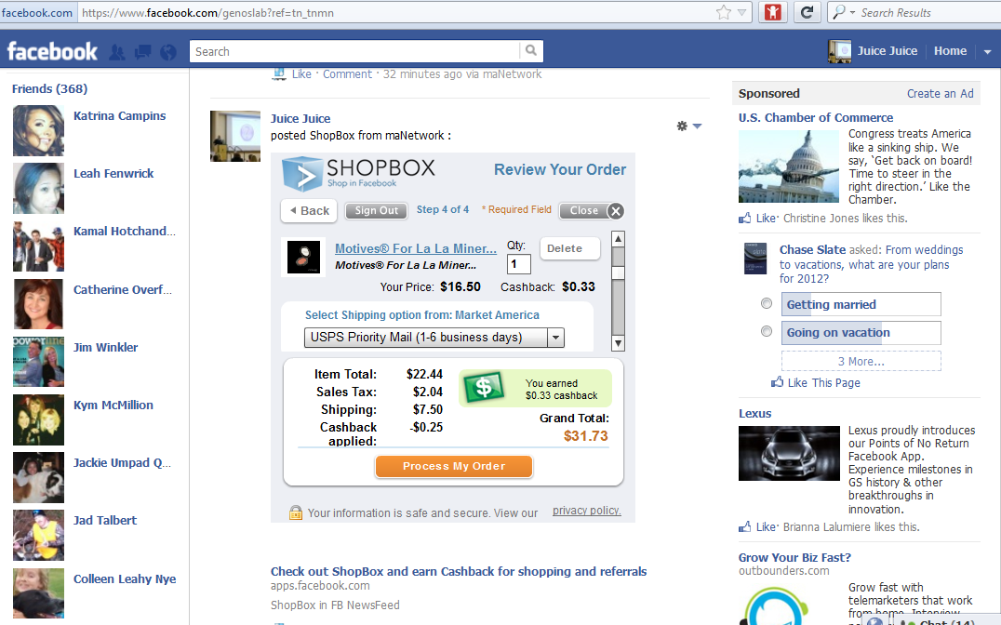
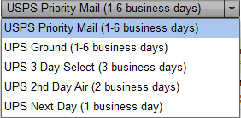

Slide 67
New SHOPBOX Store Front Images

Slide 68
How do I use this tool for my business?

Slide 69
Motives Favorites SHOPBOX
Products in Store
Store Front Image
News Post Image

Slide 70
Isotonix Favorites SHOPBOX
Products in Store
Store Front Image
News Post Image

Slide 71
TECHNOLOGY FOR YOUR BUSINESS

Slide 72
Voice Recognition – Leveraging speech to streamline you and your customers interaction with your business and shopping..
Future Research Development

Slide 73
Year 2000 - JR’S Vision
Future Research Development – Very First Market America Website

Slide 74
Mall without walls - categories

Slide 76
SHOP.COM - Virtual Mall of the Future

Slide 77
SHOP.COM - Virtual Clothing Store

Slide 78
SHOP.COM - Virtual Shoe Store

Slide 79
Virtual Reality - As virtual reality (VR) becomes more accessible, it could disrupt e-commerce and everything we know.
Future Research Development
Experiential Retail

Slide 80
Video

Slide 81
LEVERAGE THESE TOOLS TO JUMP START YOUR BUSINESS AND KEEP YOUR EYES OPEN FOR NEW INNOVATIONS!
Thank you!

