Slide 1

Building a strong Belief
Frank Chang

Slide 2

Breaking the misconception!
［What is belief?］

Slide 3
Breaking the misconception!
Belief is a vague and general concept.
It comes from a combination of your dissatisfaction (Attitude)
and desire to move forward.
The secret to strong BELIEF is not a slogan or simply daydreaming, but Attitude and Cogitation；
It is not fantasize or concern, it’s Action and Practice.
In simplest term, JUST DO IT！

Slide 4

What is Belief
Belief is anattitude
It determines your action,
determines your thought,
determines the way you do and the way you treat yourself

Slide 5
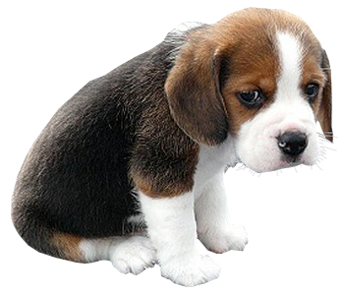


What is Attitude
Attitude can be temporary
can be forever
The key is…
do you know
the truth?

Slide 6
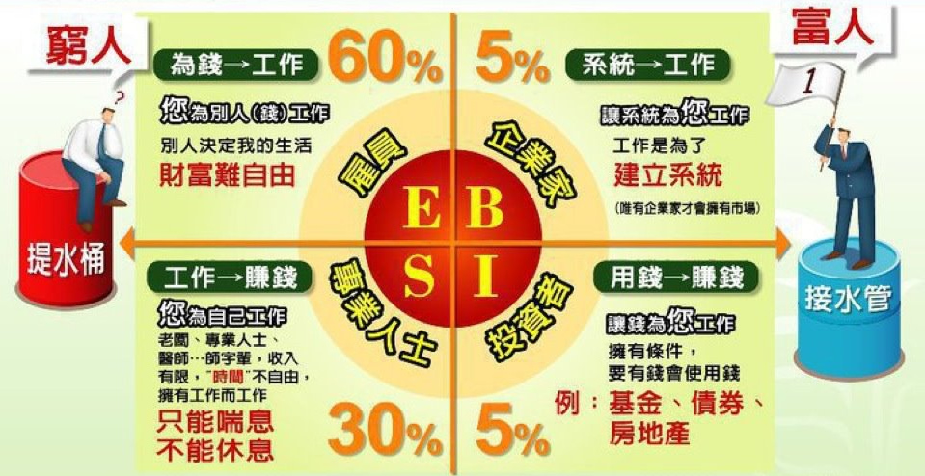

Slide 7




Life’s like this.
ESBI Quadrant is not a choice,
but a process
Salary for employee
Profit for boss
Revenue for entrepreneur
Character
Profession
System

Slide 8

We start to ENVY
soon it turns to Jealousy
“The scariest moment in life occurs
when we start to believe nothing we do
is ever going to make a difference,
so we just comfortably STOPPED doing anything.”
ENVY

Slide 9

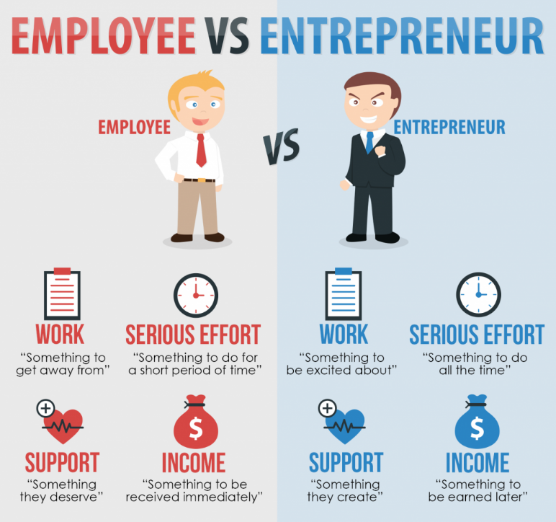
There is no difference between
ordinary people and successful people
The point is who starts

Slide 10

The road to
［BELIEVE］
Starts with you

Slide 11

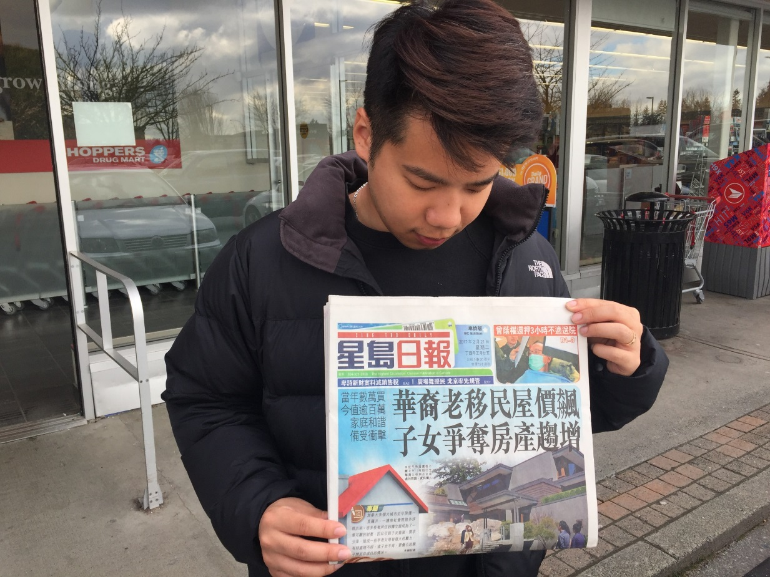
My biggest fear in life
CAME TRUE

Slide 12
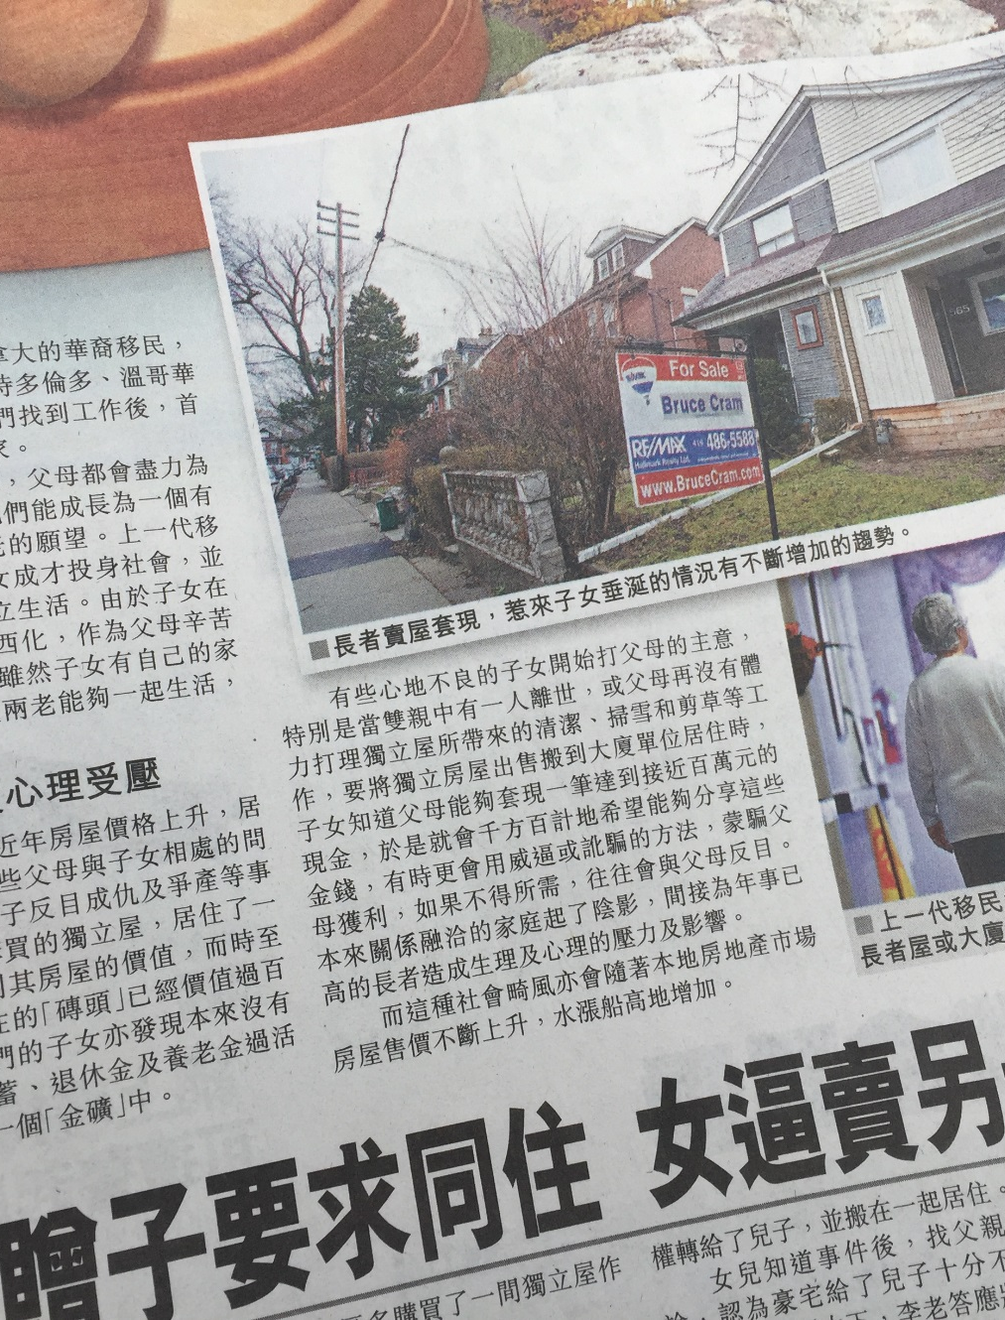


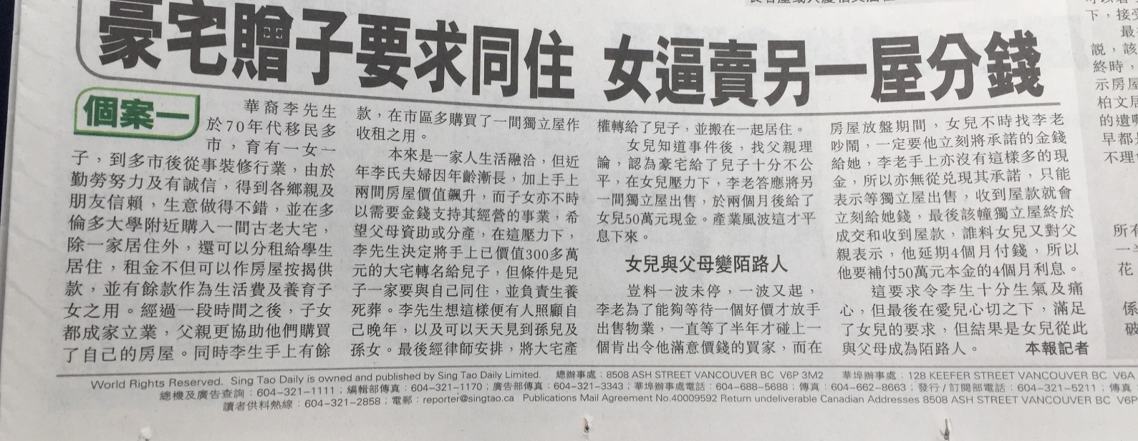

Slide 13



What is <Attitude>
It asks you to think, encourage you to change, draws you to learn

Slide 14

But we only got one target...
to gain more KNOWLEDGE

Slide 15

Knowledge comes from environment
The best environment
provided by
GMTSS

Slide 16


The best way to get into the environment

Slide 17

One Team One Dream is not only a slogan

Slide 18


Do you jot notes?
Do you attend
GMTSS?
Do you talk to senior partner?

Slide 19

捕夢者
我們的服務
If I take away you notebook, throw it away, what will you do?

Slide 20
The true meaning behind notes…
For you to
make from nothing
You are FREE !!

Slide 21

知識 Knowledge
Knowledge changes you from inside
Knowledge makes you feel confident and powerful!
All your attention goes to helping others

Slide 22


Attitude + Knowledge = Belief

Slide 23
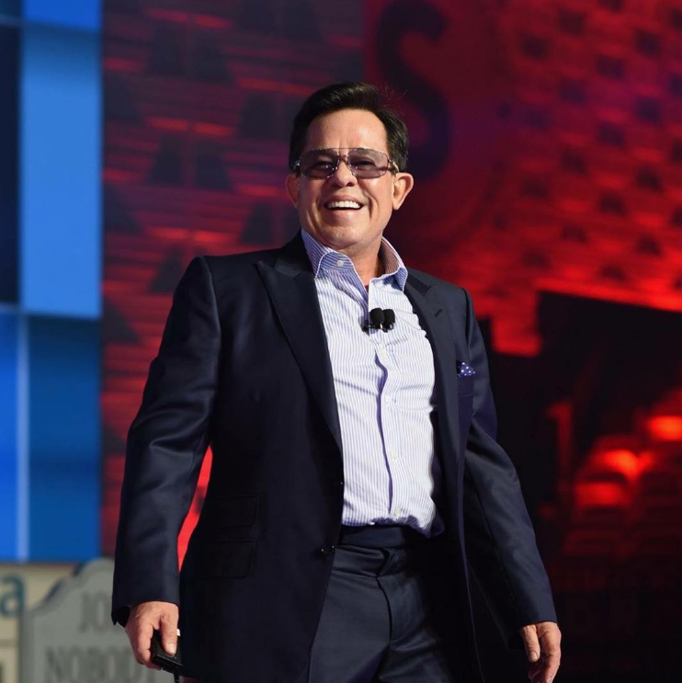
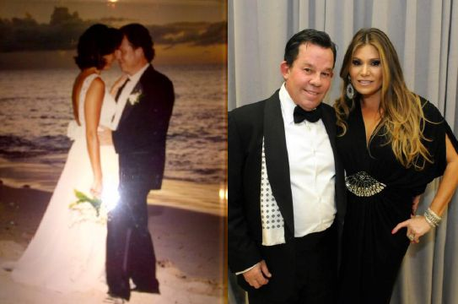
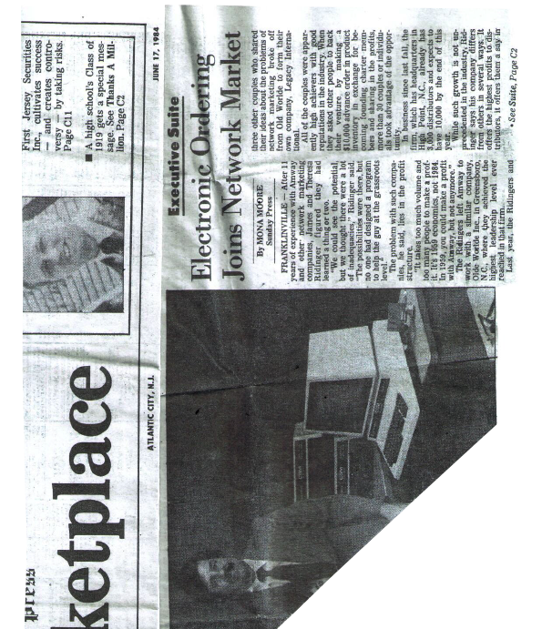

Slide 24

LET ME SPEAK FRANKLY FROM MY HEART HAVING DONE THIS 25 YEARS WITH MA and YOU and 35 years Total on this journey:

Slide 25
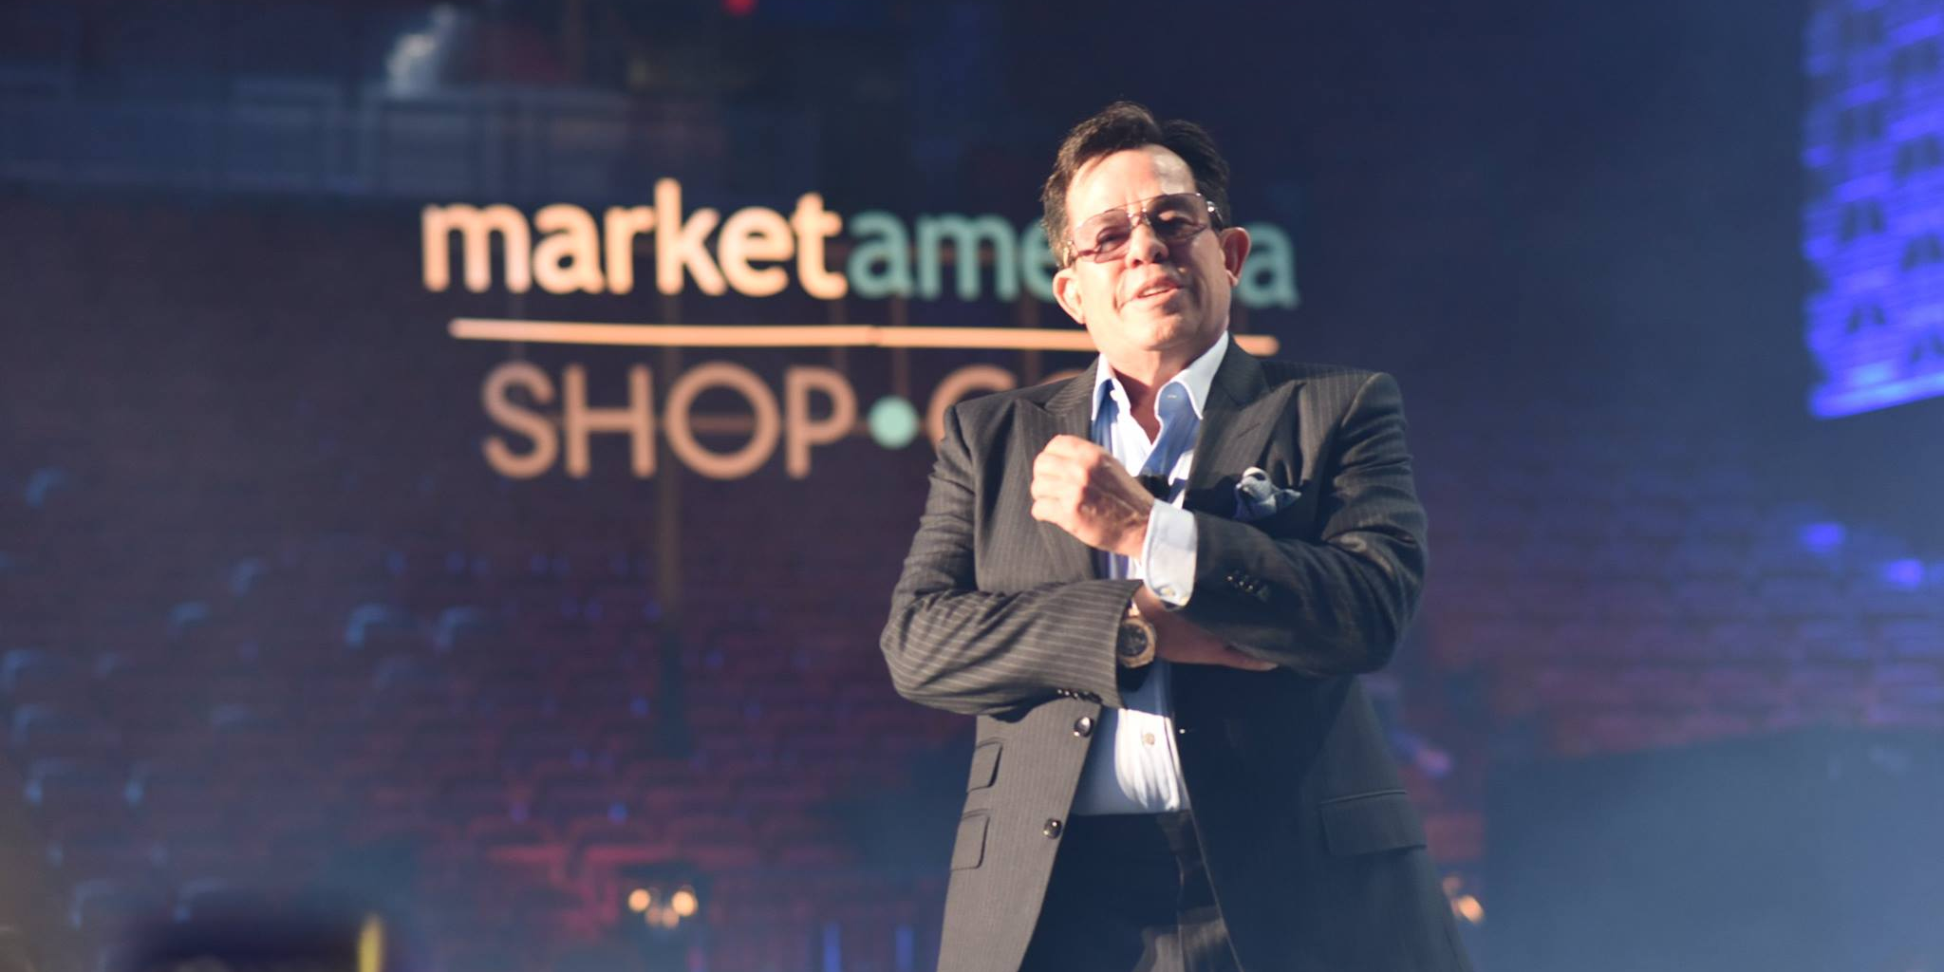

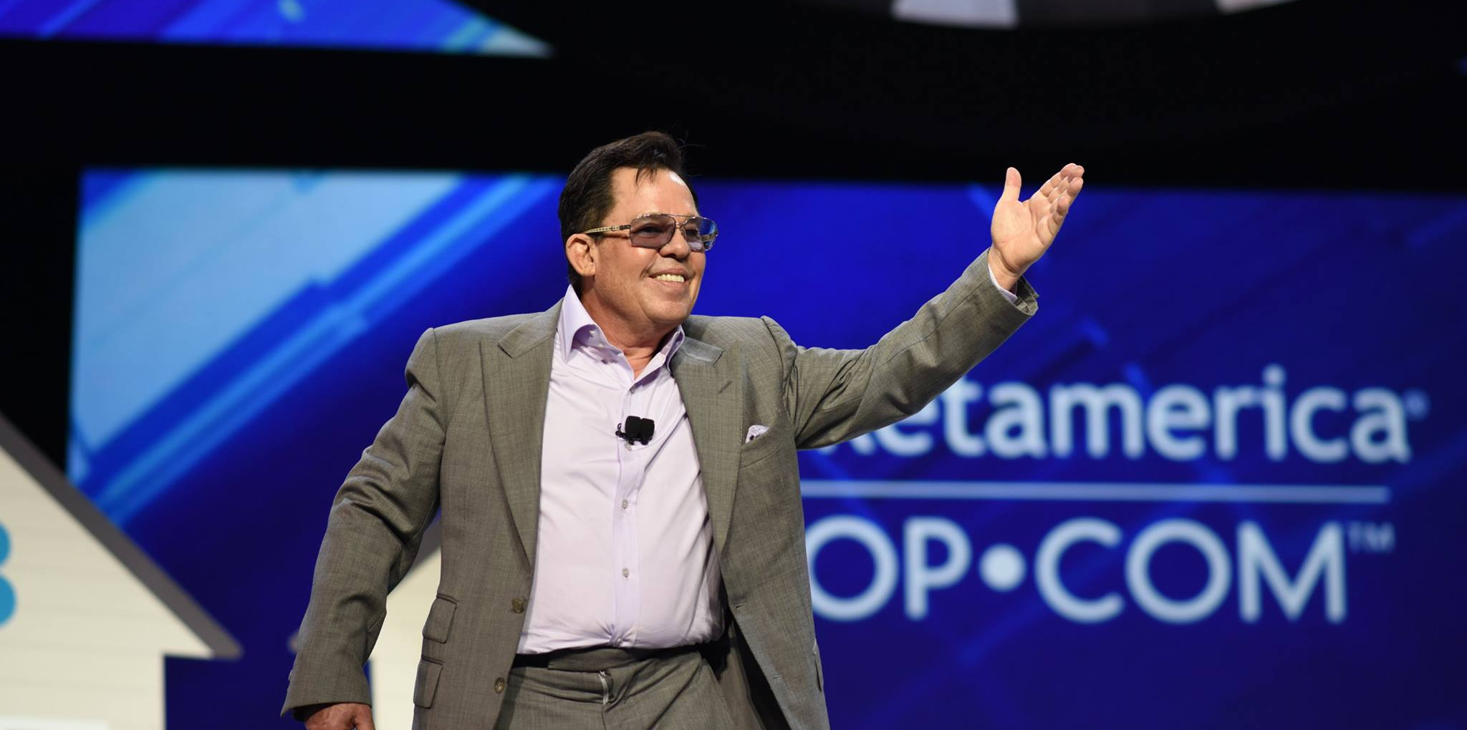
MARKET AMERICA’S MISSION STATEMENT
Market America is a Product Brokerage and Internet Marketing company specializing in one to one marketing through the Shopping Annuity providing a blue print for success with the UnFranchise Business Opportunity where average people can attain financial freedom by creating their own economy.

Slide 26
58 of these WC or IC events including Asia. Who else has a business like this, other than us. Who else fills arenas for 25 years 3 times a year with over 20,000 people.
Meetings or Show the plan: 11,200 MA, Overall 20,250
Show it 1:1 to 50 at a time – average 8/mtg. Show it to myself: 89,600
  Follow ups: 44,800
  Overall: 162,000
  Always sponsored the most important person- My self
Coring’s, Seminars, trainings: 2,600-MA, Career 4,888
Corporate meetings 2,260
Countless lives changed in the business or as a result of the experience.
  1,000’s of letters of gratitude
  Billions of dollars earned by average people
  100’s of millionaires
  100,000’s made end meet or improved their economic situation
  Products – 10,000’s of miracles

Slide 27

Winning over 50 games in 18 consecutive seasons
Spur never had advantage in draft picks since 1997 nor a big market like Los Angeles. It all depended on the vision of the management and coaches to build a powerful team. With the effort of scouts, they were still able to find real talents.

Slide 28


Slide 29
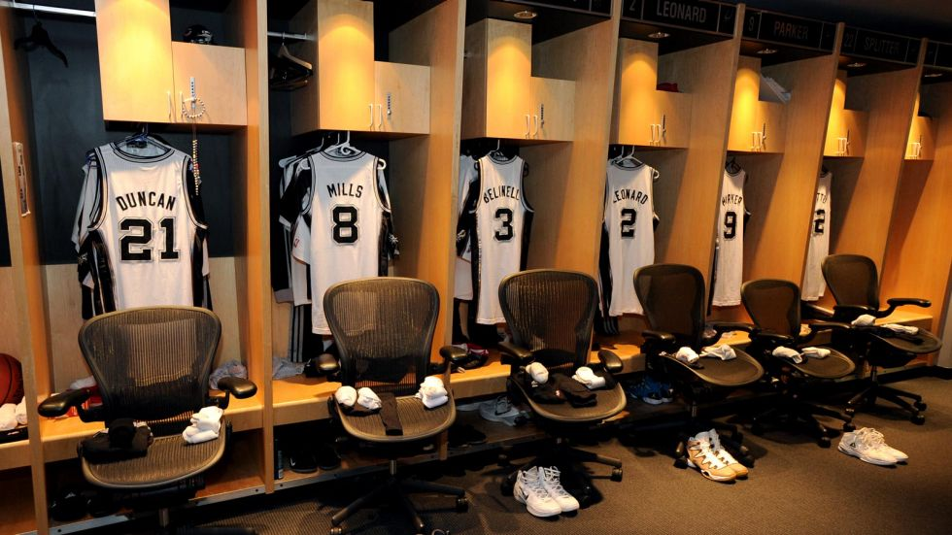
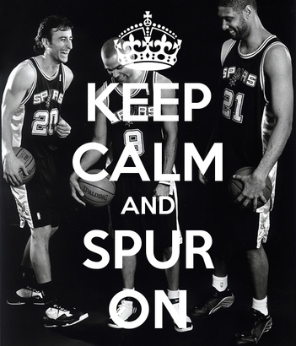
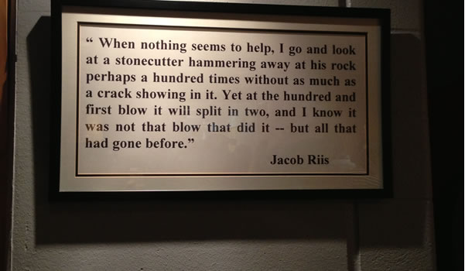
There is a photo frame sticking on the wall of San Antonio Spurs Team locker room. The famous motto written on it, is the spirit of Spurs Team.

Slide 30
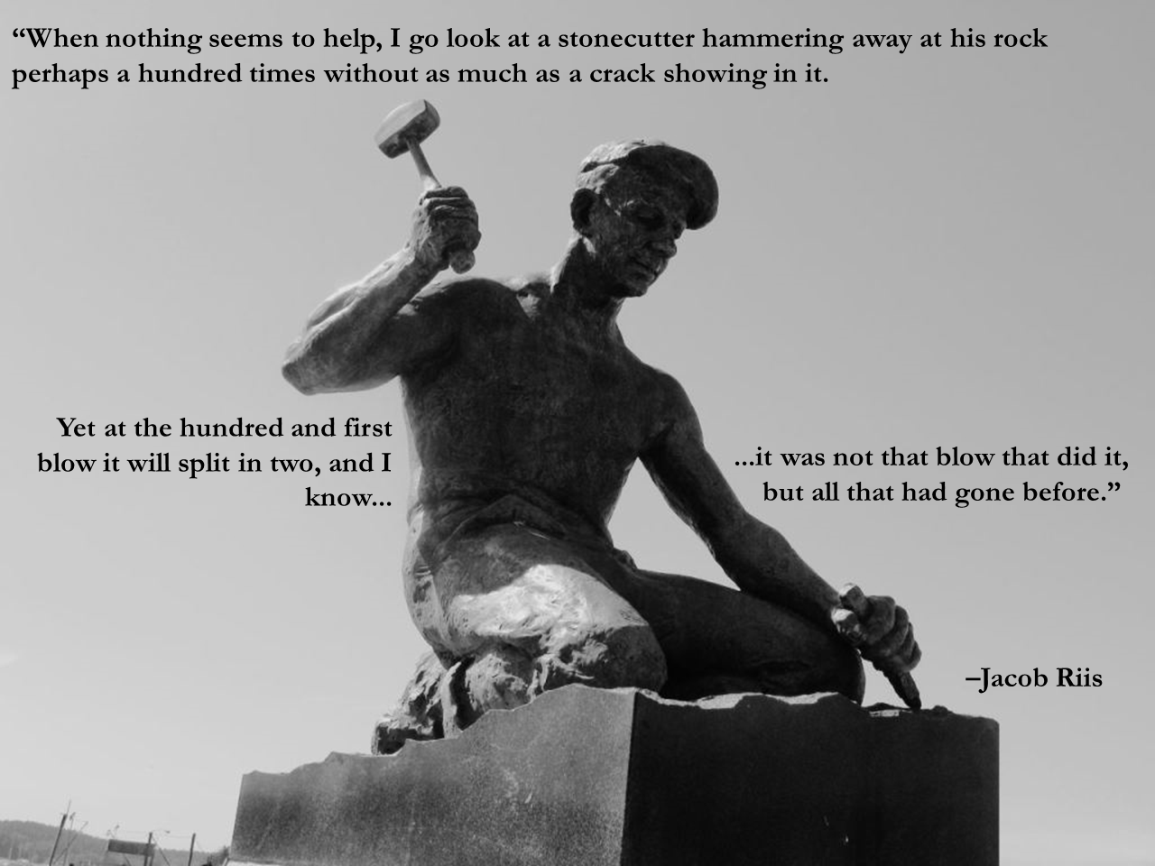
“During the time I felt all of my efforts were to no avail，I visited a mason who was hitting the stone. When he hit it for 100 times, the stone remained unchanged. After he hit for one more time, the stone split. I know the key is not the last hit, but the 100 times before it.”

Slide 31
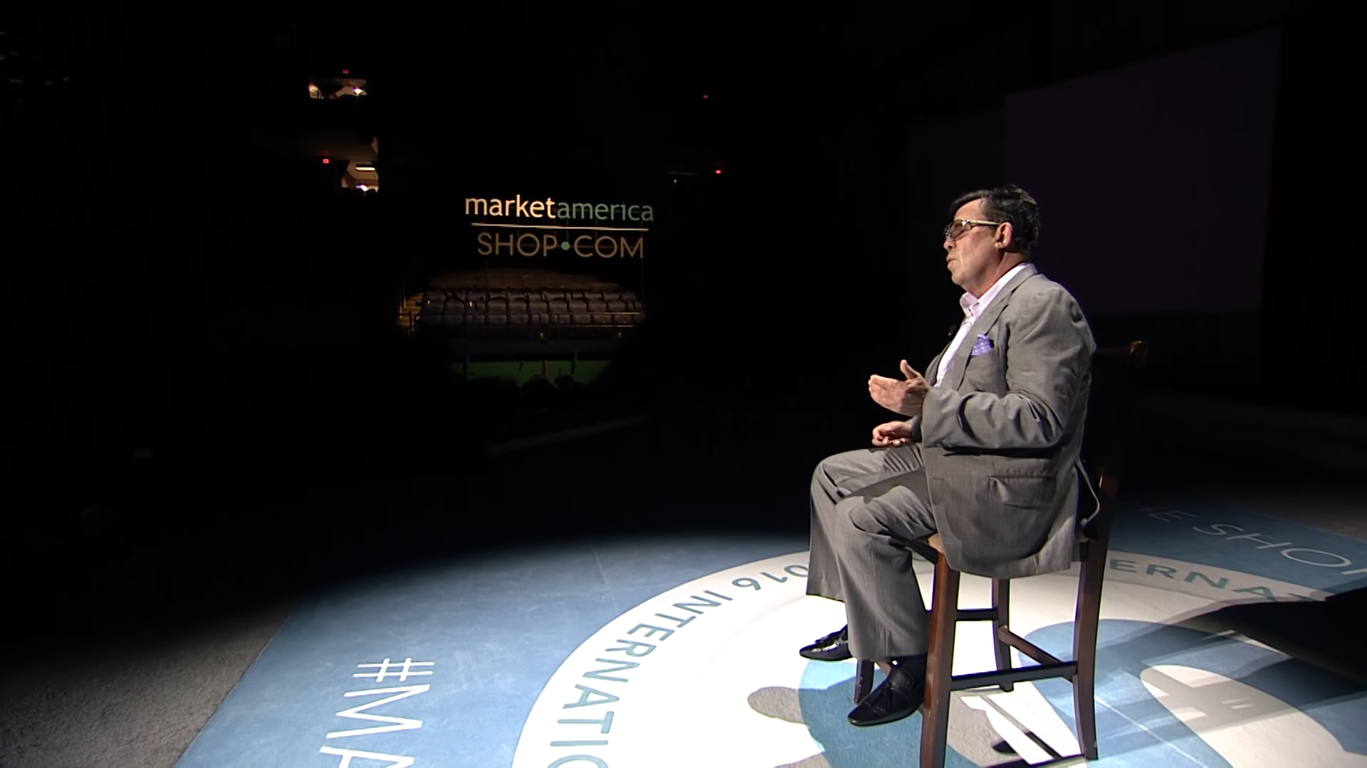
It’s the era of fast food culture, people seeking to succeed in a short period of time. UnFranchise Business becomes a contrarian in the society. Be humble. Never underestimate itself. Be honest and dedication and leave no stone unturned. Market America is passing a more simple and accurate philosophy of life to the society, respect, low-profile, hard work and persistence.These are what make Market America being so attractive.

Slide 32

We love UnFranchise Business, because it is so similar with ourselves
We found no difference between SHOP.COM and us, wandering in the society, without extraordinary background,
without remarkable appearance
work for our dream
sometimes we face difficulties
but we overcome and move forward
Being beaten black and blue cannot stop us
We have no other choice
We love SHOP.COM
just likeWe love ourselves

Slide 33
MythBuster!
The secret to belief has always been a vague and general concept.
The path to believing comes from a combination of your desire to be better and intolerance towards the current situation.
The secret to strong BELIEF is not a slogan or simply daydreaming,
it is Attitude and knowledge.
The secret to BELIEF is not fantasize or concern, it is Action and Practice.
In simplest term, JUST DO IT

Slide 34
We start to ENVY
soon it turns to jealousy
“The scariest moment in life occurs
when we start to believe
nothing we do is ever going to
make a difference，
so we just comfortably
STOPPED doing anything。”
ENVY

Slide 35
MARKET AMERICA’S
MISSION STATEMENT
WHAT IS IT?
Market America is a Product Brokerage and Internet Marketing company specializing in one to one marketing through the Shopping Annuity providing a blue print for success with the UnFranchise Business Opportunity where average people can attain financial independence by creating their own economy.
“Creating our own economy” has always been in there

Slide 36
The road to
[Entrepreneurship]
starts with YOU

Slide 37
My biggest fear in life
CAME TRUE !!

