Slide 1

Convert Spending into Earning and
Maximize the Power of MPCP

Slide 2
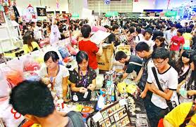

Spending money
Can make money??

Slide 3
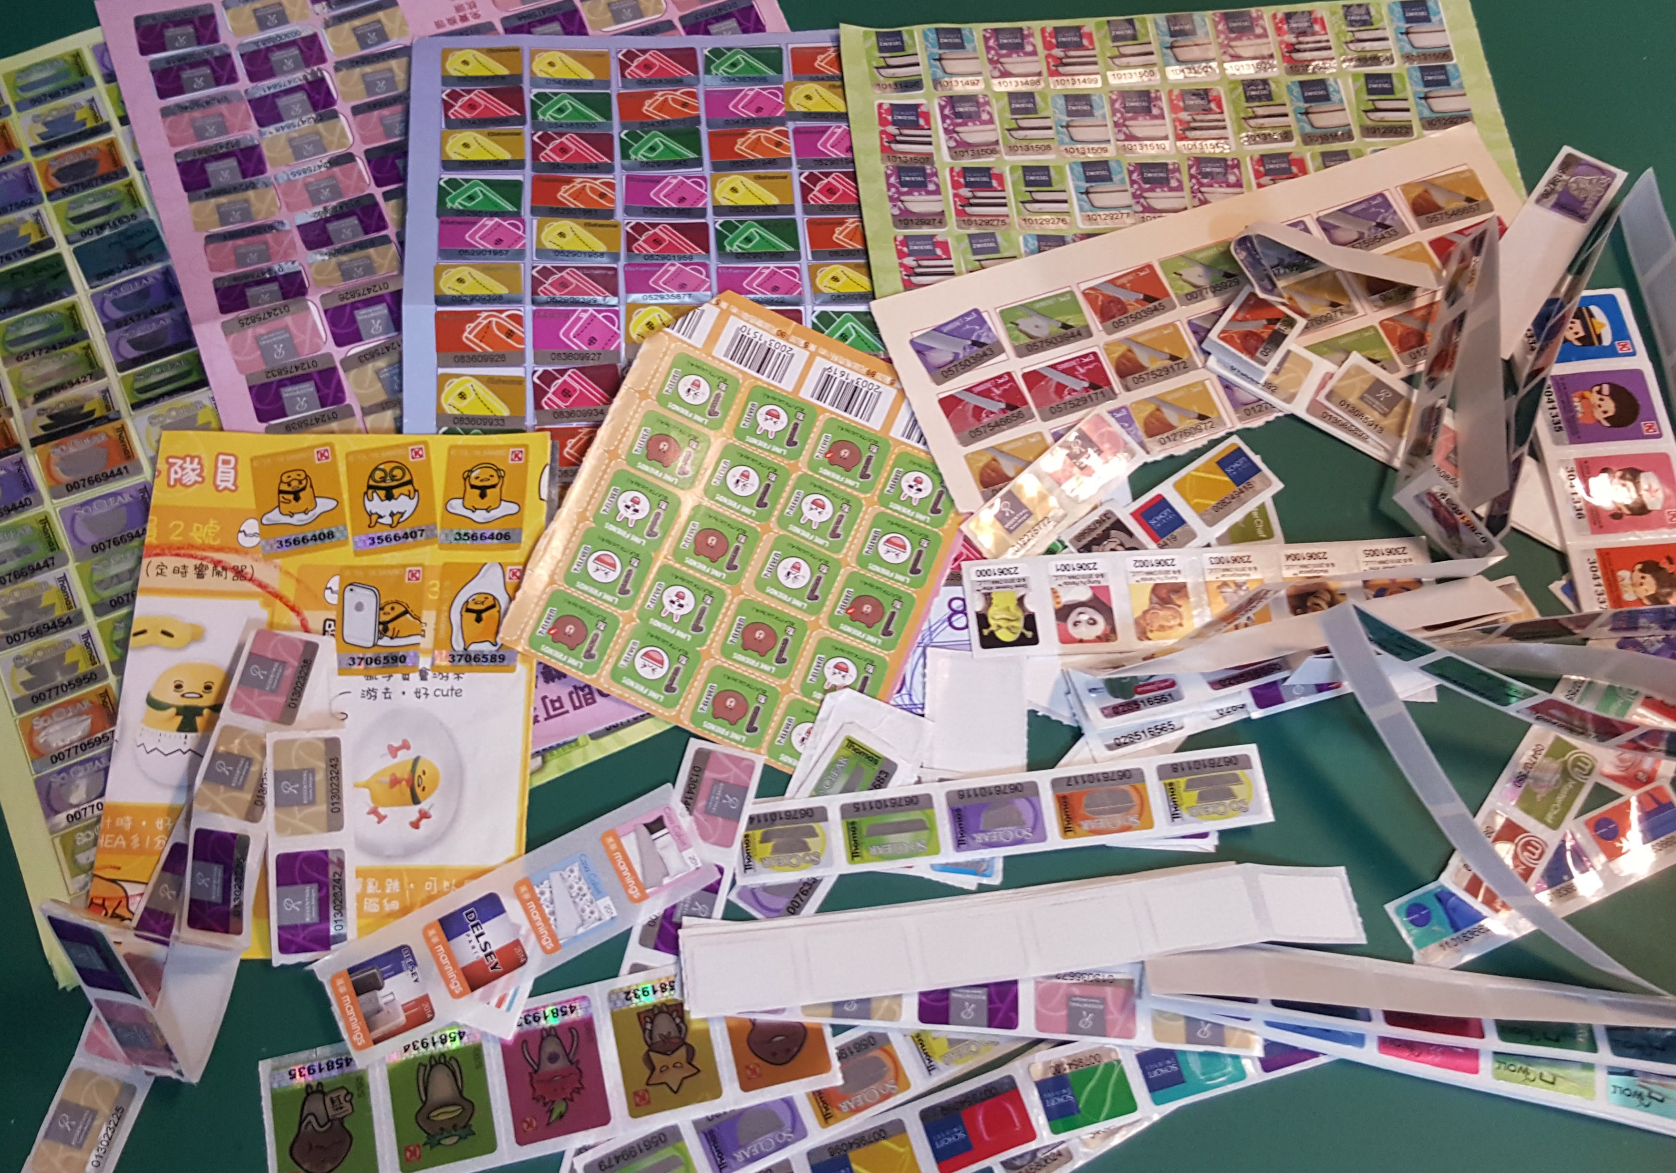
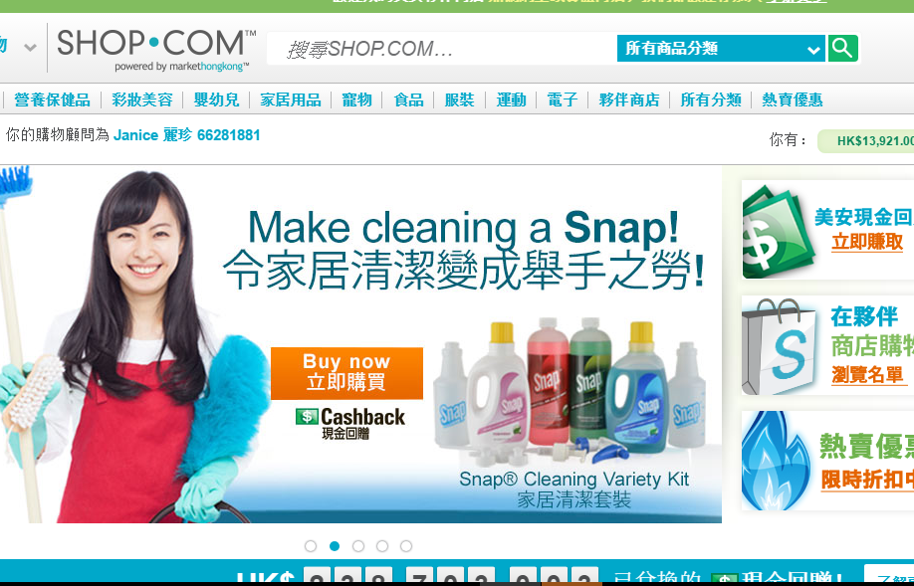

Before
After

Slide 4
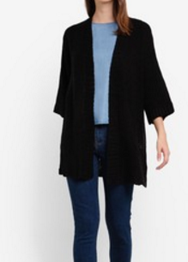

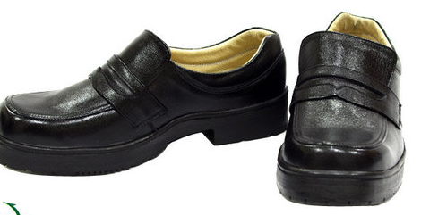


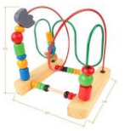
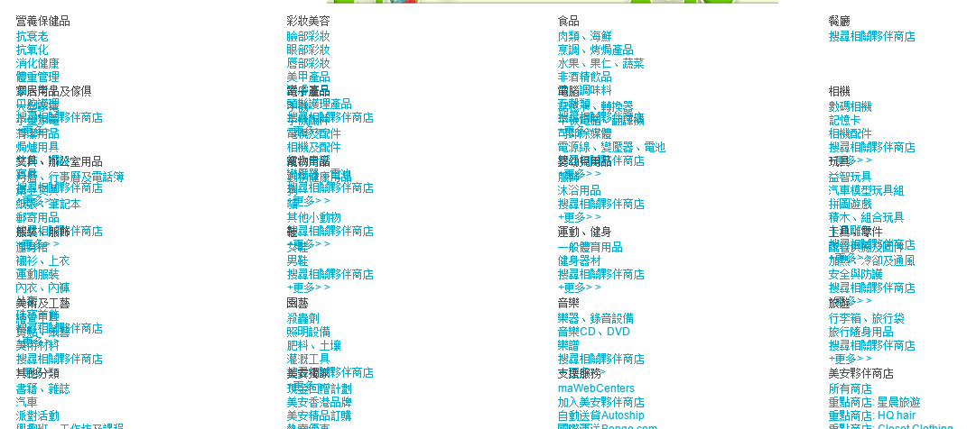

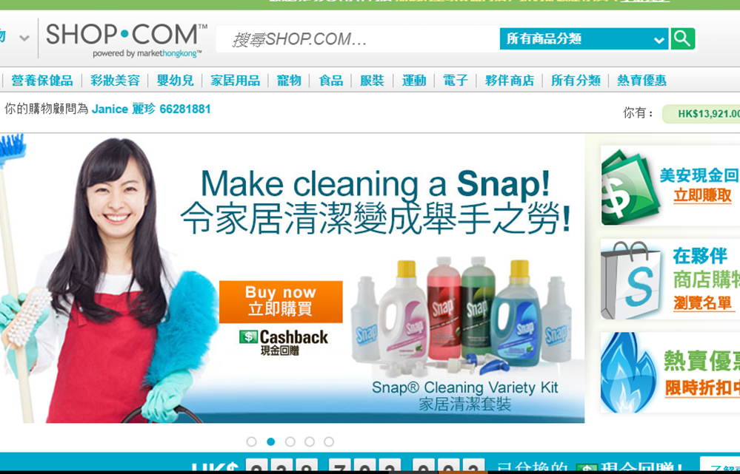
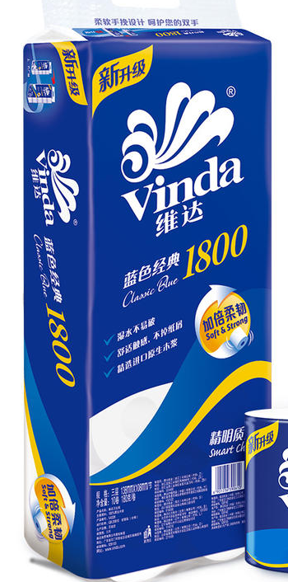


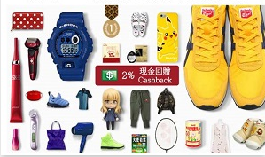
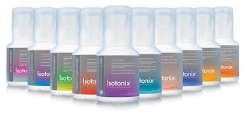
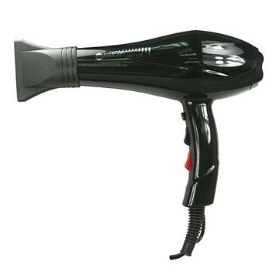

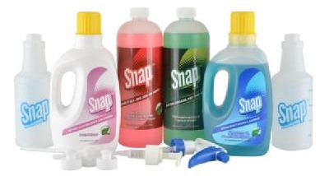


Slide 6
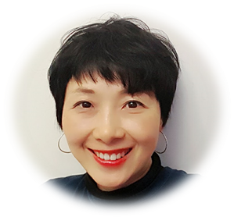


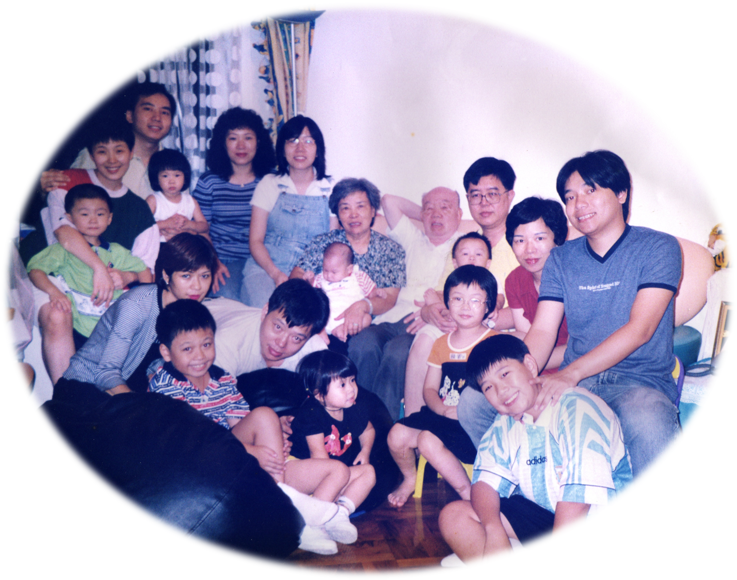
MY 500 BV / IBV
OPC-3 for calcium supplement, ; face cleaning, skincare
Basic health nutrition support
Bathing, hair-washing, ; laundry,
conditioning dish-cleaning, house-cleaning
Motives make-up; Nail care
TLS Weight Loss Solution; ……Gift (DNA, Fish oil..)
Perming, hair dryer, clothes, accessories, trousers, shoes, bags, snacks… 3 meals a day, gift, festival and birthday celebration, travelling, house maintenance, electronic products…
Recommend to your families and friends, and other UnFranchise Owners...
Notes:
好，那來看我勾選了哪些東西！ 有哪個人、哪個家庭不會需要這些事的！?

Slide 7
MY 500 BV / IBV
66+151
53+72
OPC-3 for calcium supplement, ; face cleaning, skincare
Basic health nutrition support
Bathing, hair-washing, ; laundry,
conditioning dish-cleaning, house-cleaning
Motives make-up; Nail care
TLS Weight Loss Solution; ……Gift (DNA, Fish oil..)
Perming, hair dryer, clothes, accessories, trousers, shoes, bags, snacks… 3 meals a day, gift, festival and birthday celebration, travelling, house maintenance, electronic products…
Recommend to your families and friends, and other UnFranchise Owners...
Monthly Basic Need | BV
Basic Set | 66
Curcumin Extreme | 22
Immune Powder Drink | 23
Fish Oil | 30
Co-Q 10 | 27
Detox | 49
Skintellegence Face Cleaning | 53
Timeless Face Cleaning | 72
Bathing set | 15
Snap Cleaning Kit | 22
Cosmetic | 65
Skincare | 67
Nail care | 18
TLS Kit | 80
DNA gift | 16
 | 625
22
15
65+67
16
80
16+…
Notes:
好，那來看我勾選了哪些東西！ 有哪個人、哪個家庭不會需要這些事的！?

Slide 8

Bang for the buck!
Free Delivery!
Bring my friends here and shop together!!

Slide 9
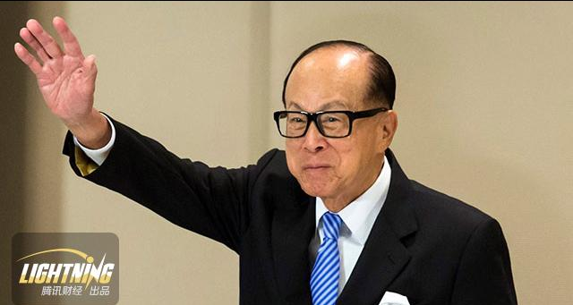

If Ka-shing Li said……Do all your shopping in the Paxk’N Shop, I pay you 2%---55% dividend for every order! Tell me anything you wanna buy, I choose for you, select for you. Let’s make the Paxk’N Shop to be the most power shopping mall in the world together!
Are you willing to
Tolerate…
Uphold…
To find the way……
Convert your spending!

Slide 10
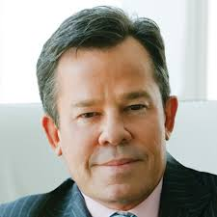

JR said……Do all your shopping on shop.com, I pay you 2%---55% dividend for every order! Tell me anything you wanna buy, I choose for you, select for you. Let’s make shop.com to be the most power online shopping mall in the world together !
Are you willing to
Tolerate…
Uphold…
To find the way……
Convert your spending?!

Slide 11
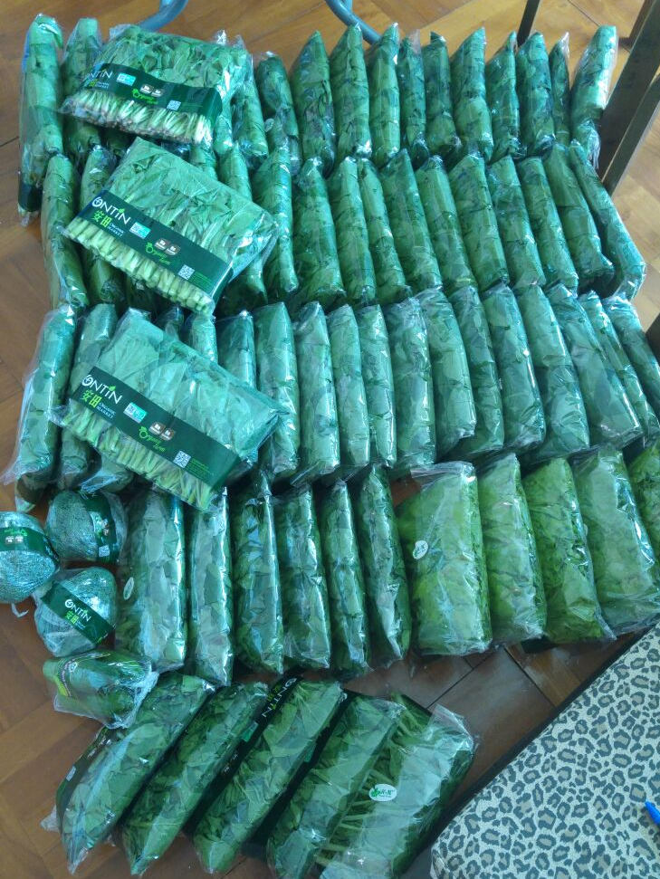
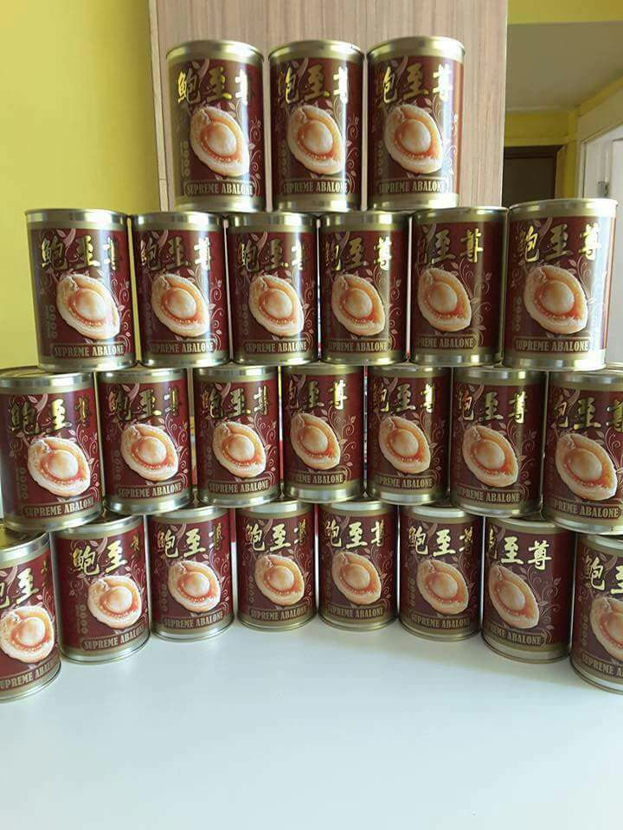
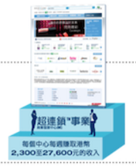
Duplicate➔Multiply
(200➔2200)

Slide 12
Before
After
I spend,
✔someone else earns.
I spend,
✔I earn!
Customers spend,
✔they save, the owners save, I earn!

Slide 13
Capital flow
Distribution
Population
The key….
MPCP

Slide 14
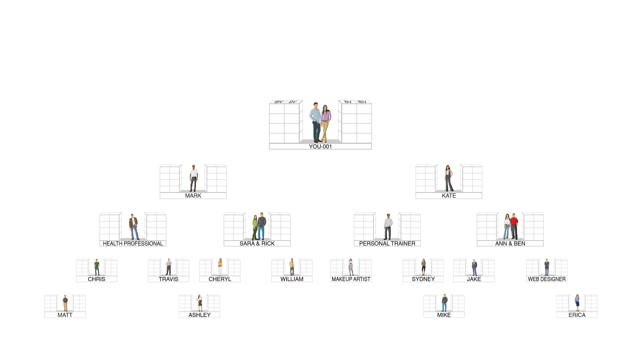


OUR TRACKING SYSTEM SEARCHES DAILY TO INFINITY
THE SYSTEM TRACKS PURCHASES AND SALES MADE BY YOU, YOUR CUSTOMERS AND YOUR TEAM. YOU RECEIVE 100% CREDIT FOR ALL VOLUME GENERATED WITHIN YOUR ORGANIZATION
20000 BV/Month=
50BV x 400 UFO
20000 BV/Month=
500BV x 40 UFO
20000 BV/Month=
50BV x 400 UFO
20000 BV/Month=
500BV x 40 UFO
健康專業人員
健身教練
化妝師
網頁設計師

Slide 16
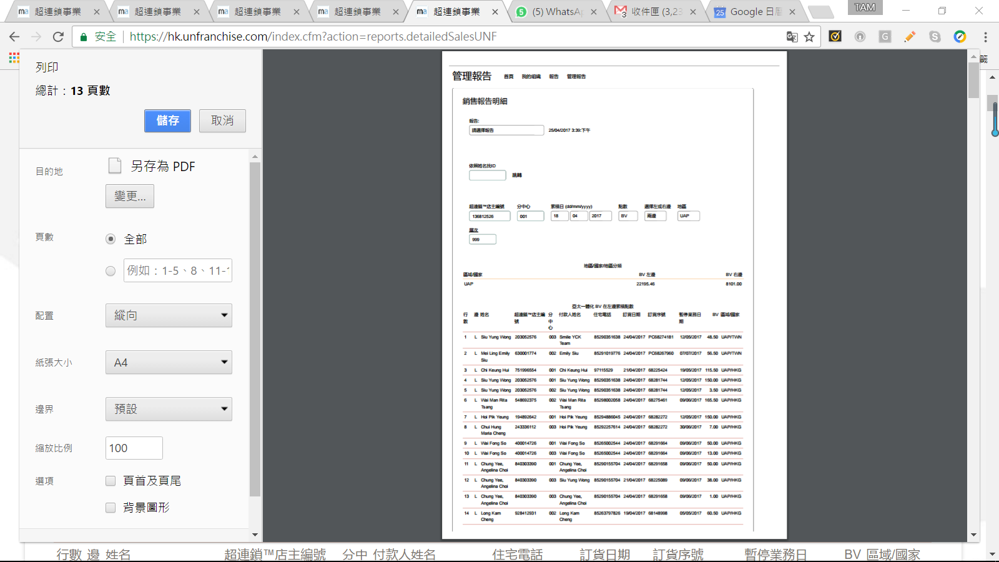

Slide 17
One week
What I do | What I earn from MPCP
3 orders | Over 400 orders
Around 400 BV | Almost 40000 BV

Slide 18
SABPx MUFO

Slide 19




購物年金
轉消費為收入

Slide 20
The affirmation of the future value of Shopping Annuity
Difficulty= Value
The HIGHER the Difficulty
The Higher the Value
Notes:
做給他們看

Slide 21


Slide 22

標題
內容
內容
內容
內容
Notes:
夢想正在倒數中.......

Slide 23


Slide 24
Differences between
Linear income & Residual income
Trade time for money
Control your own time
Linear Income
Exponential income growth
Stop working, income stops.
Residual income
No wealth accumulation
Wealth accumulation
No time freedom
Time freedom
Make a living
Create your own live style
Notes:
能力及自由

Slide 25
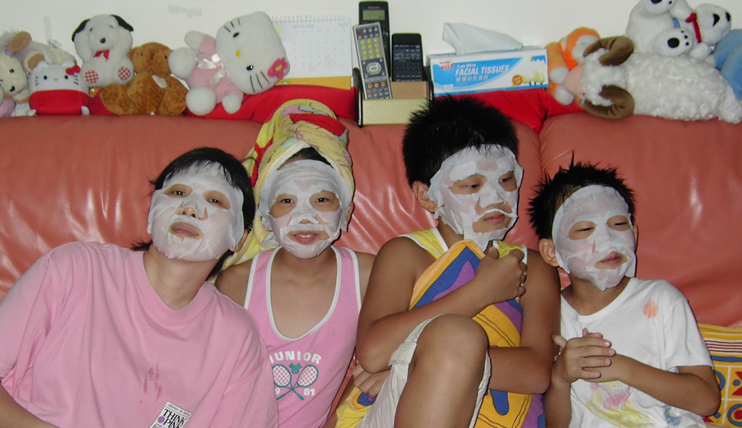
Life!
Not just money！
HEAlth / Family / wealth / friend

Slide 26
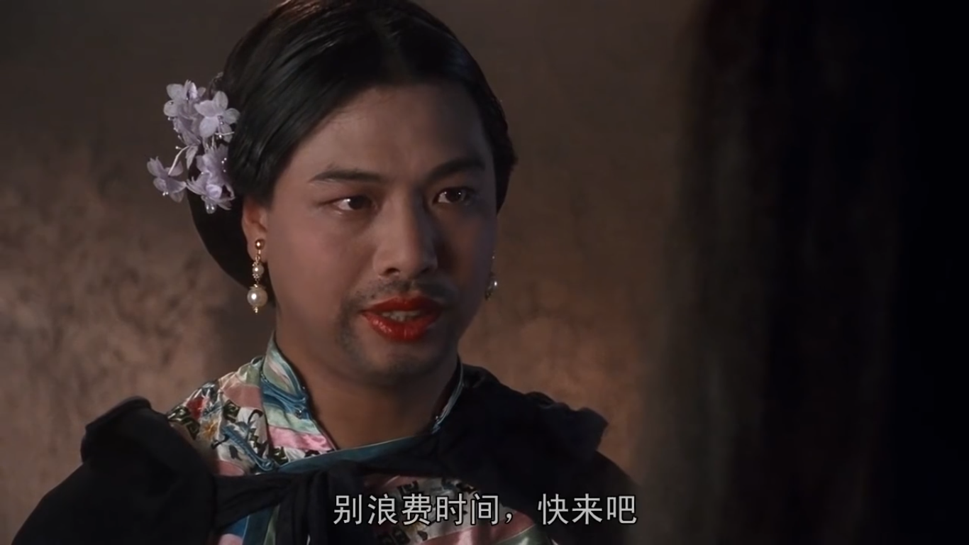
Let’s Participate in the global
wealth creation campaign!!

