Slide 1

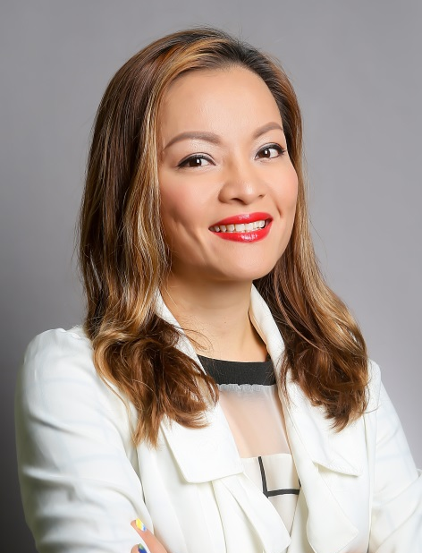

超連鎖™事業的信念與初衷
Why UnFranchise
Lilian Chan
總顧問經理級
National Supervising Coordinator
四個佣金週期共賺取HK$76,600
HK$76,600 in 4 Commission weeks
本簡報中提到的收入等級純屬舉例說明，無意代表美安香港超連鎖™店主的一般收入，也無意表示任何超連鎖™店主皆可賺取同等收入。美安香港超連鎖™店主的成功與否，取決於其在發展事業時的努力、才能與投入程度。
The income levels mentioned in the following presentation are for illustration purposes only. They are not intended to represent the income of a typical Market Hong Kong UnFranchise ™Owner, nor are they intended to represent that any given Independent UnFranchise ™ Owner will earn income in that amount. The success of any Market Hong Kong Independent UnFranchise ™ Owner will depend upon the amount of hard work, talent, and dedication which he or she devotes to building his or her Market Hong Kong Business.

Slide 2





歡迎在社交媒體上關注我
@lilian_shopcom
facebook.com/LilianFishball Chan

Slide 3

WHY?

Slide 4
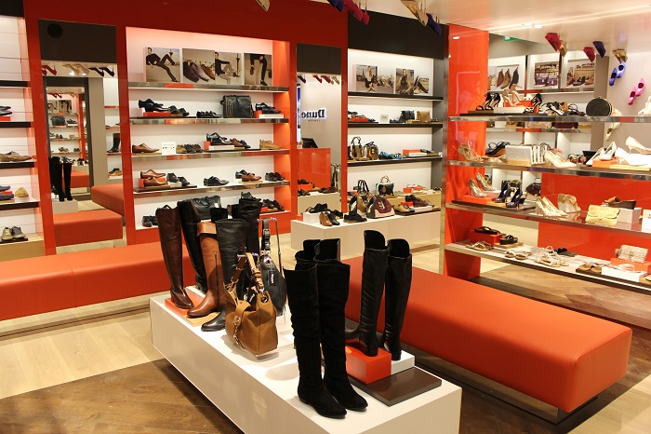





Slide 5



Slide 6
Notes:
做事講方法，行動有效率

Slide 7

Become an average but outstanding person

Slide 8


Slide 9



2006/03/24
2007/03/21
2008/03/21
2008/9/28

Slide 10
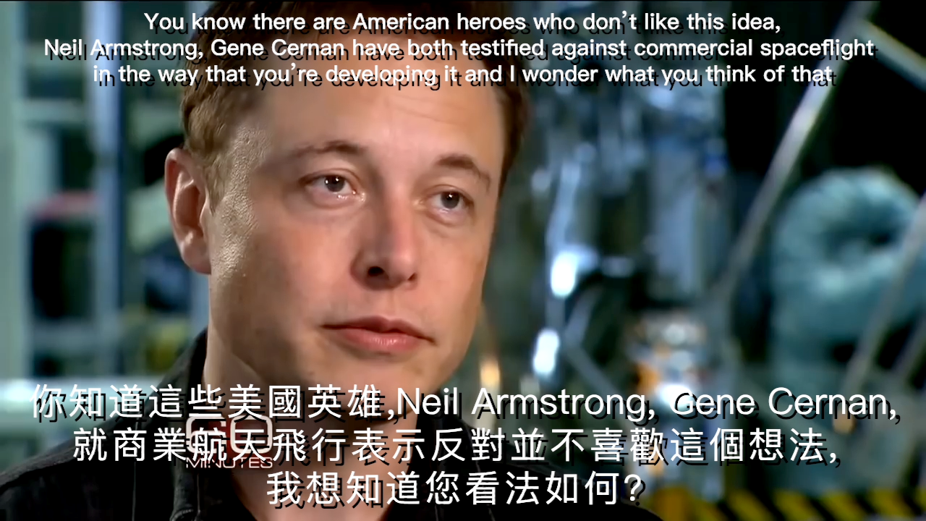

Slide 11
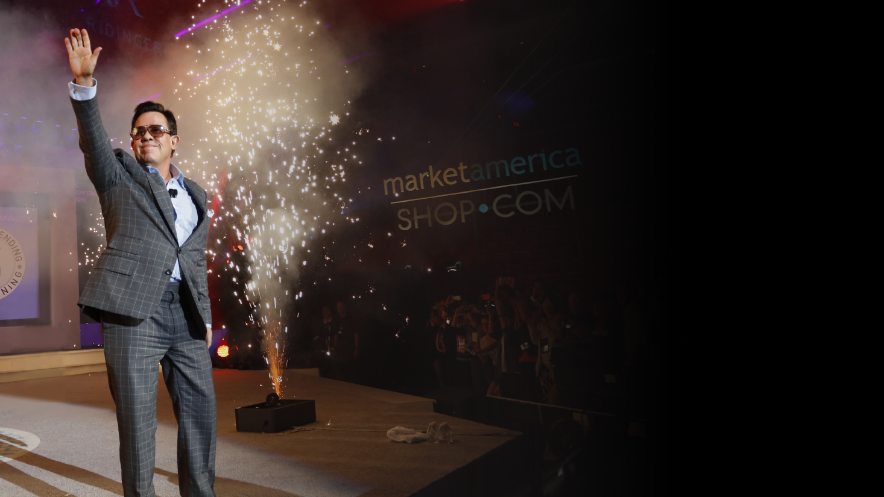
Market America provides a proven system.，
Through Shopping Annuity, we change the spending habits of people in the world , and provide those who want to become entrepreneur a chance to earn residual income.
People can obtain financial and time freedom, and create a new economic model in the future.
Market America
Enterprise Mission

Slide 12


Slide 13
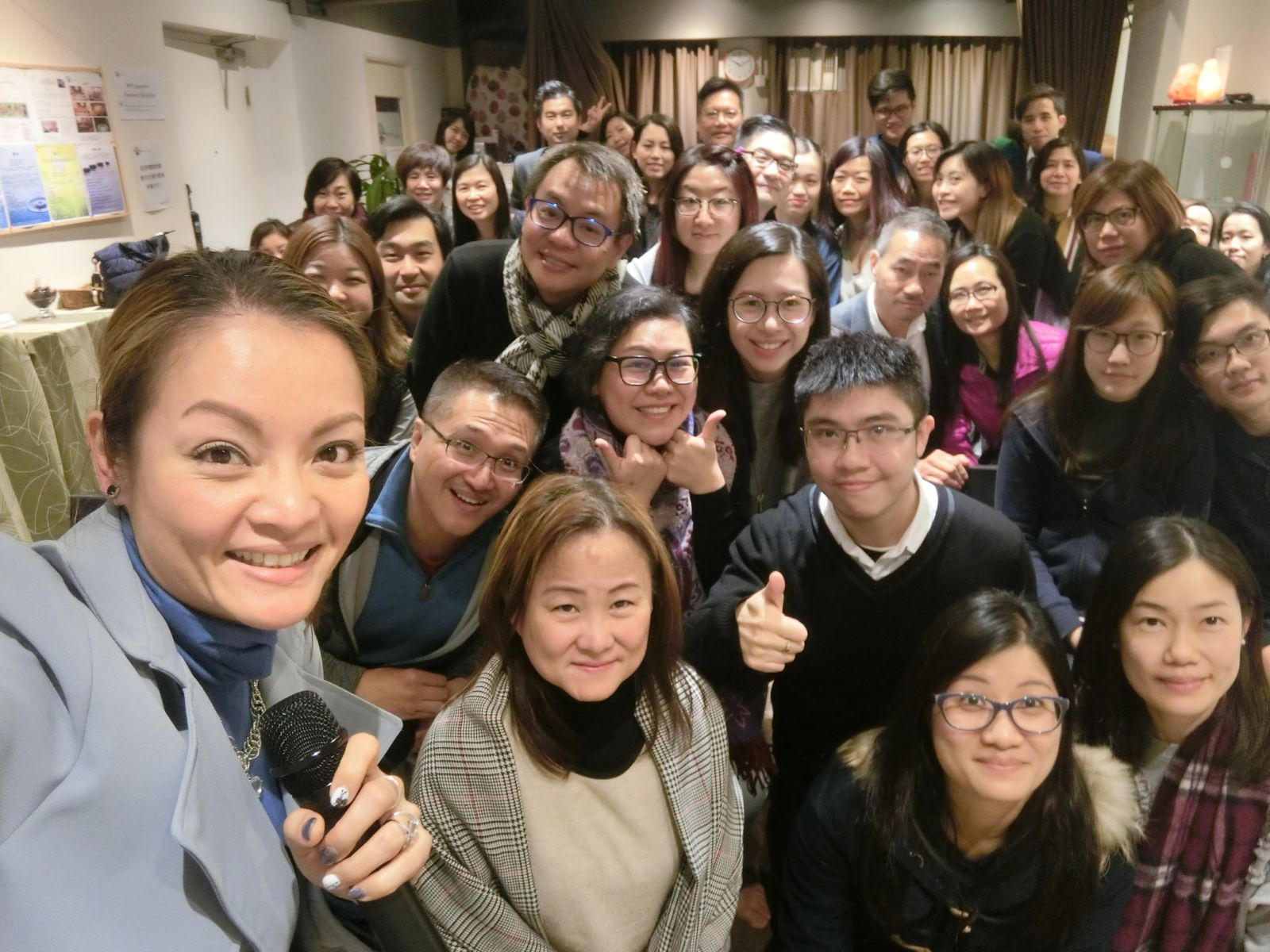
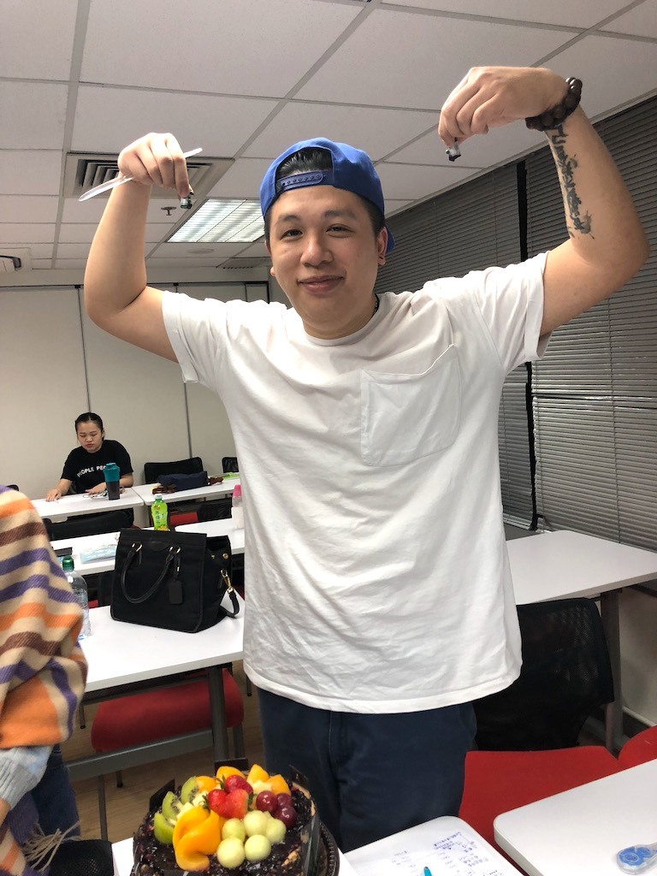

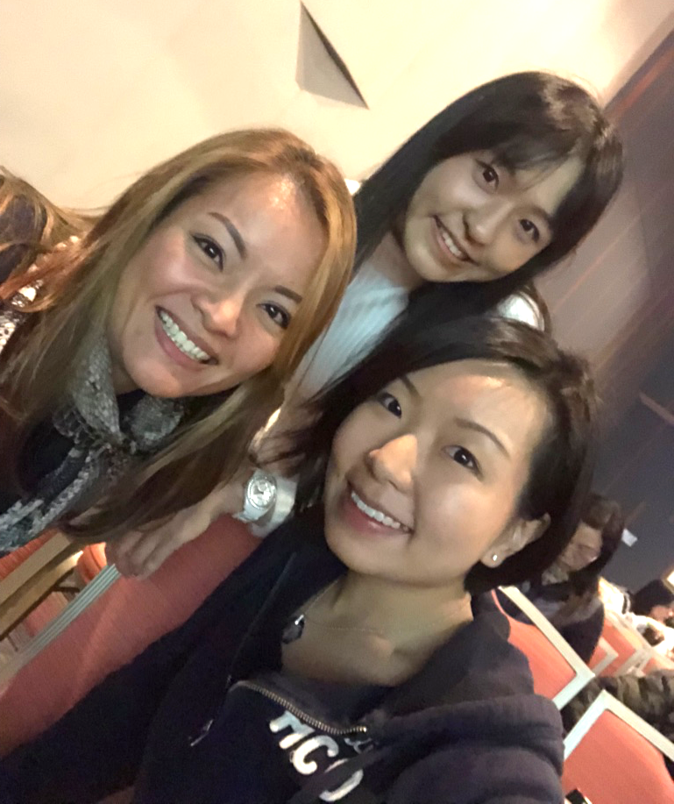
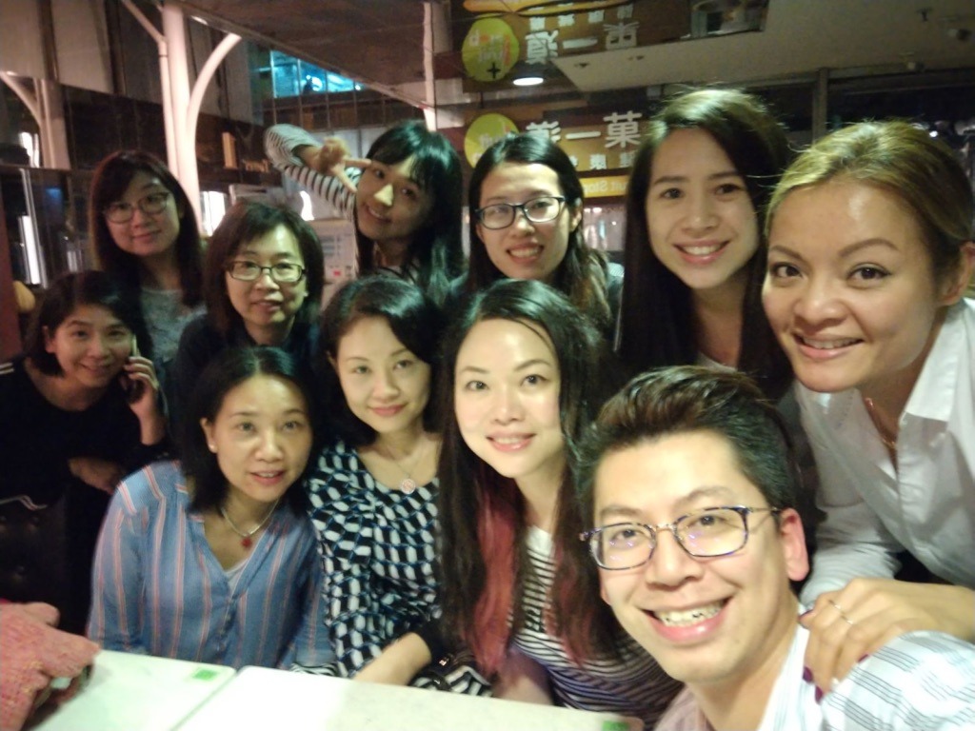
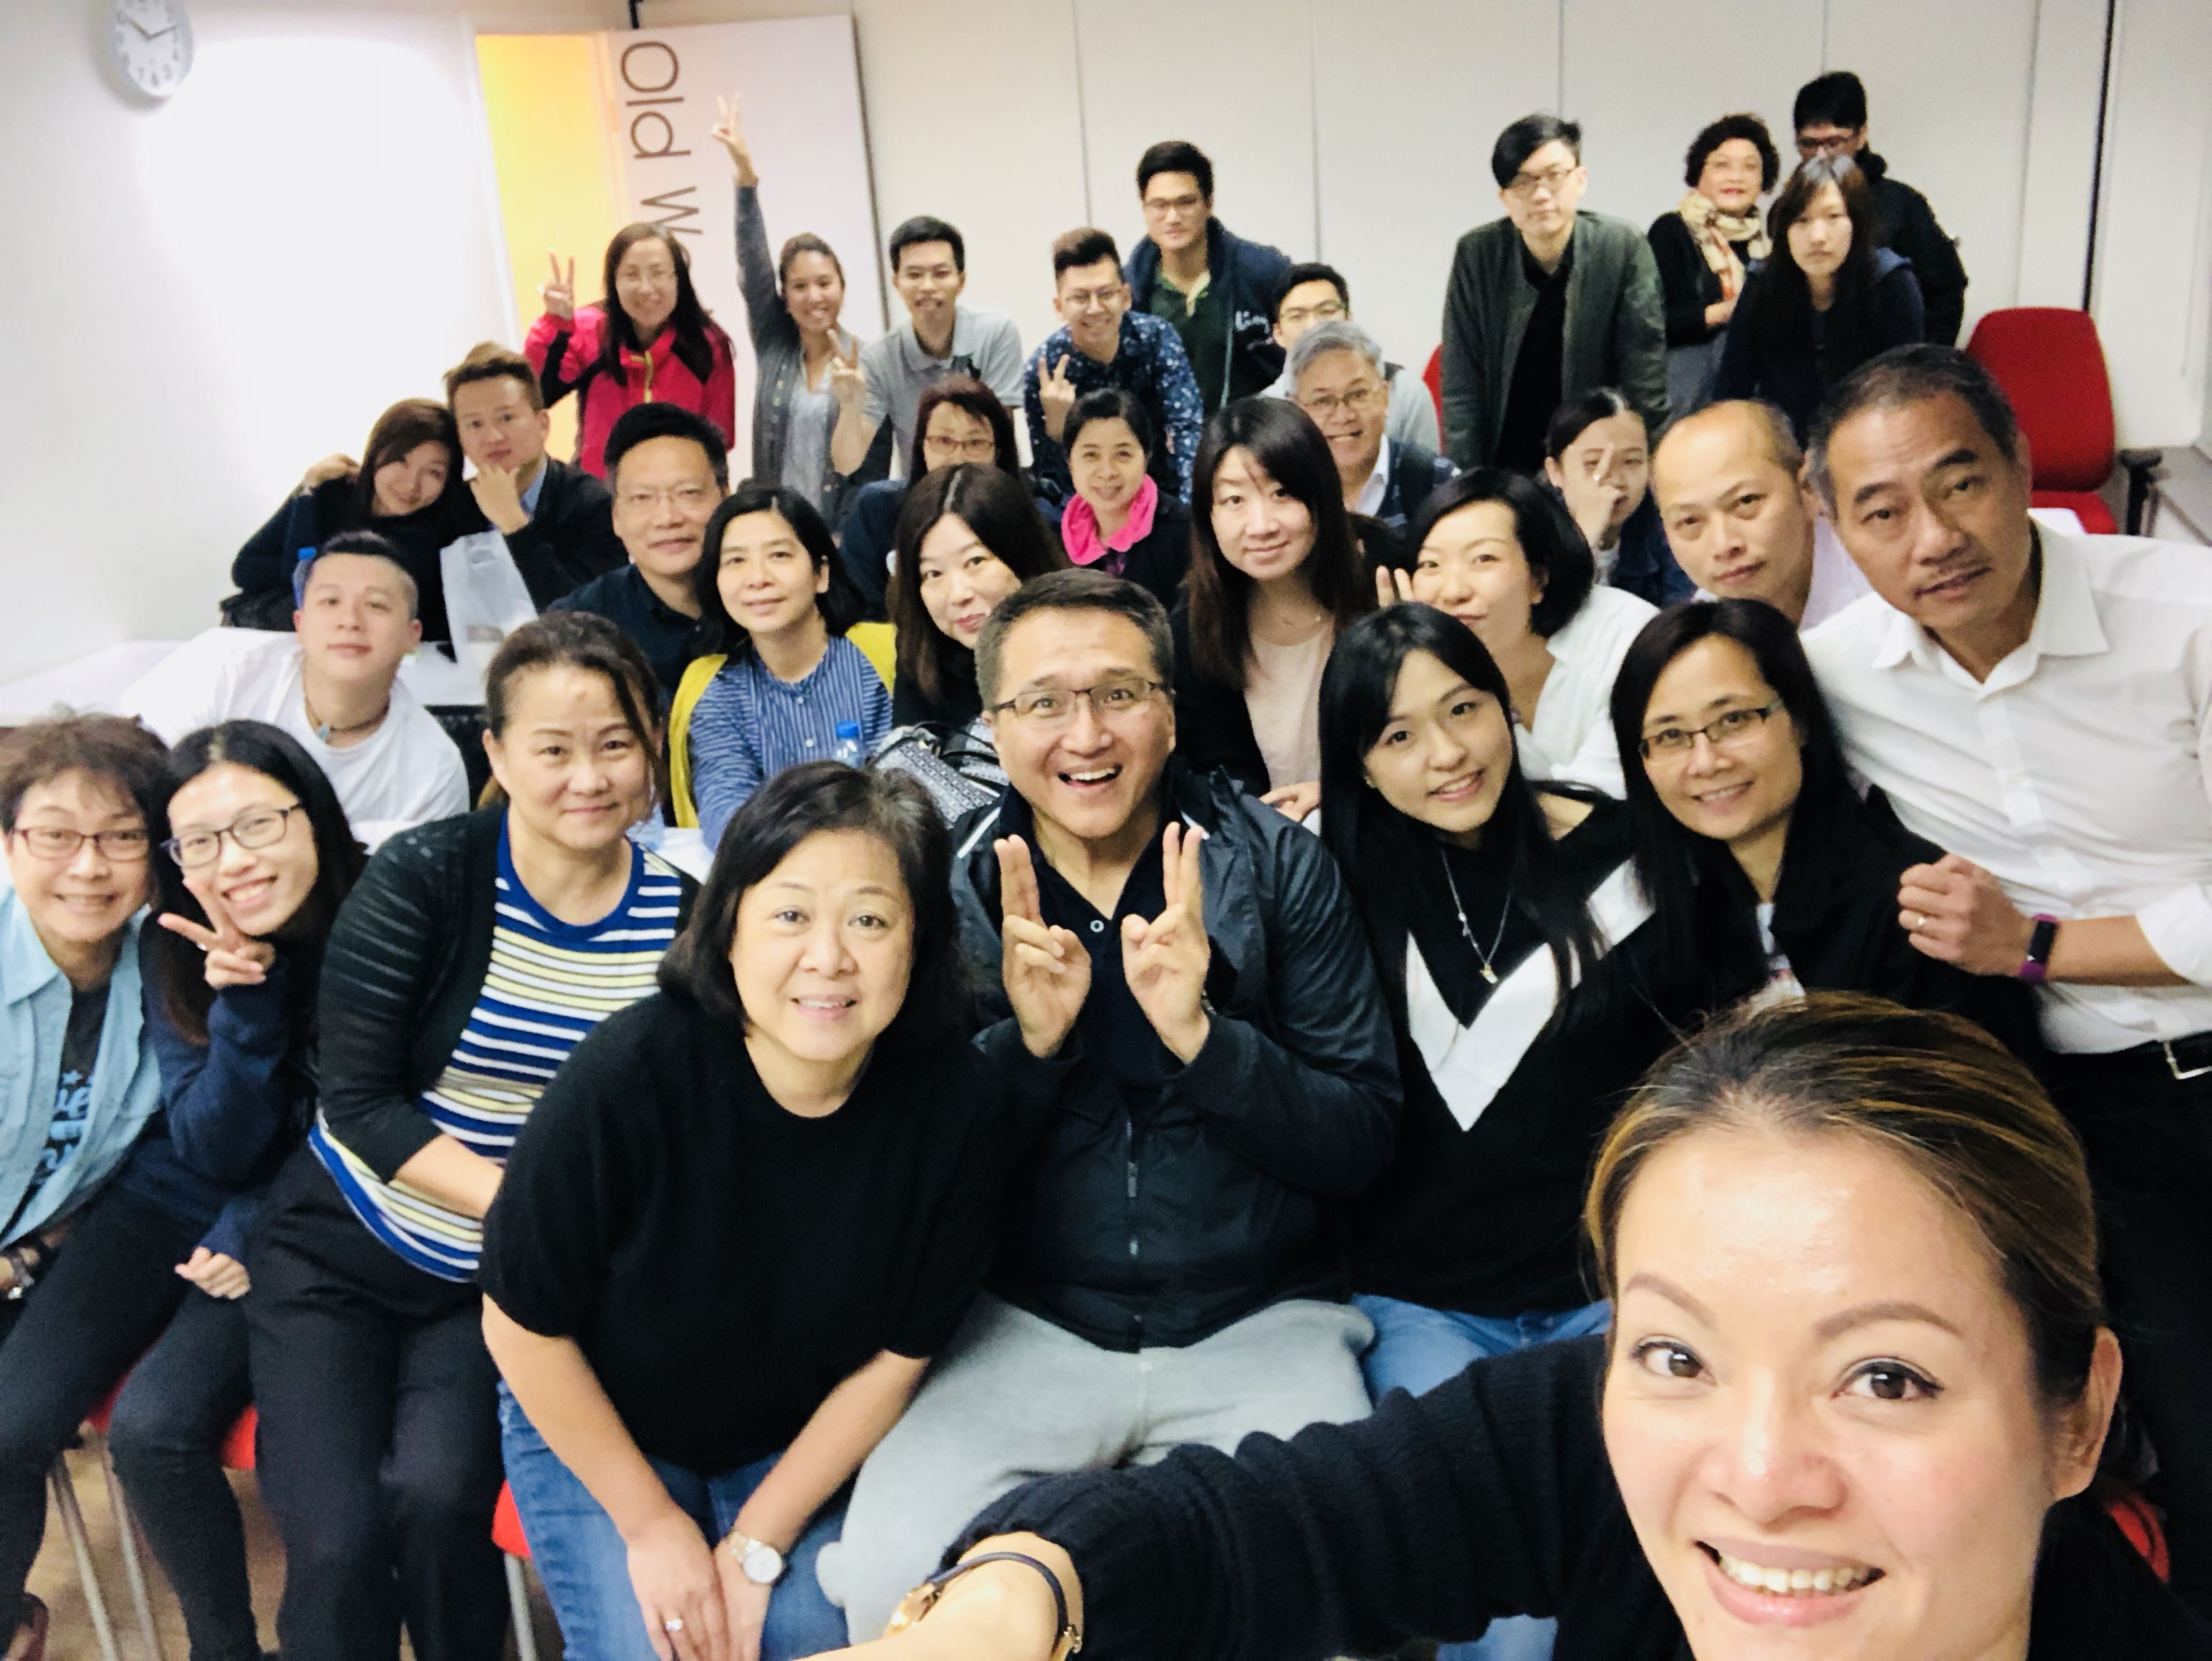
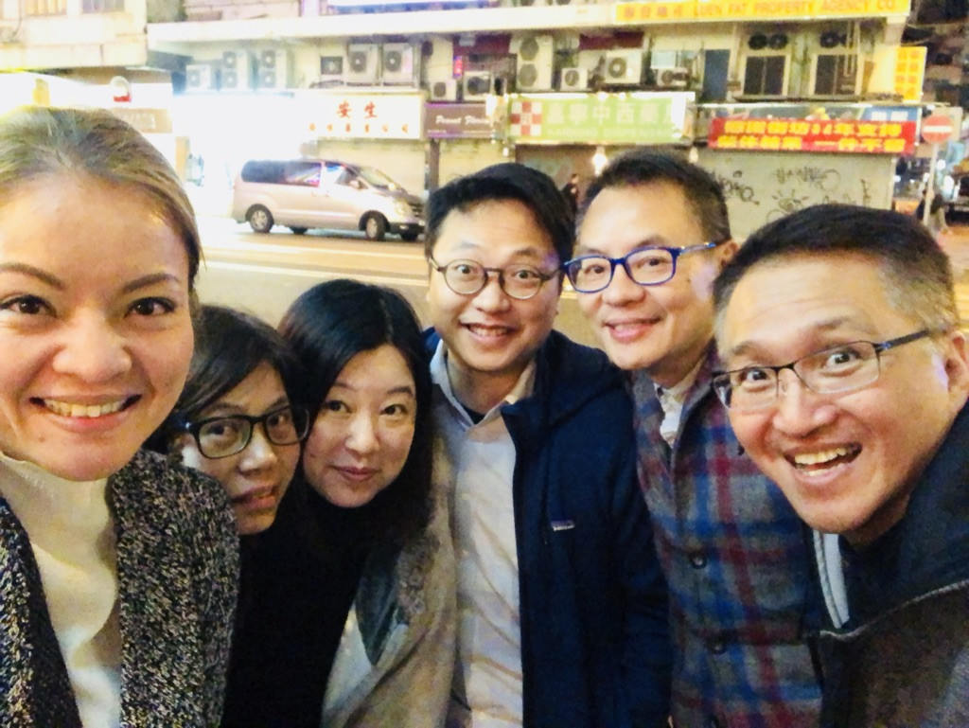
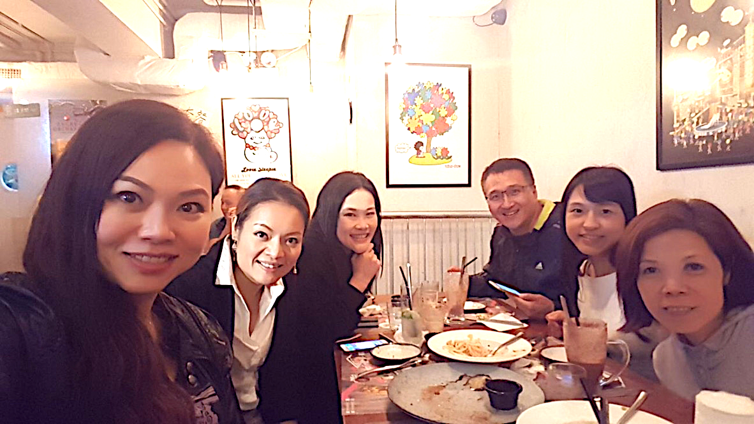

Slide 14
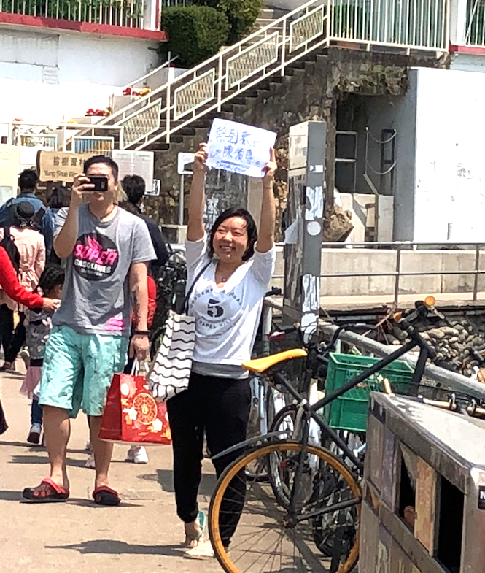
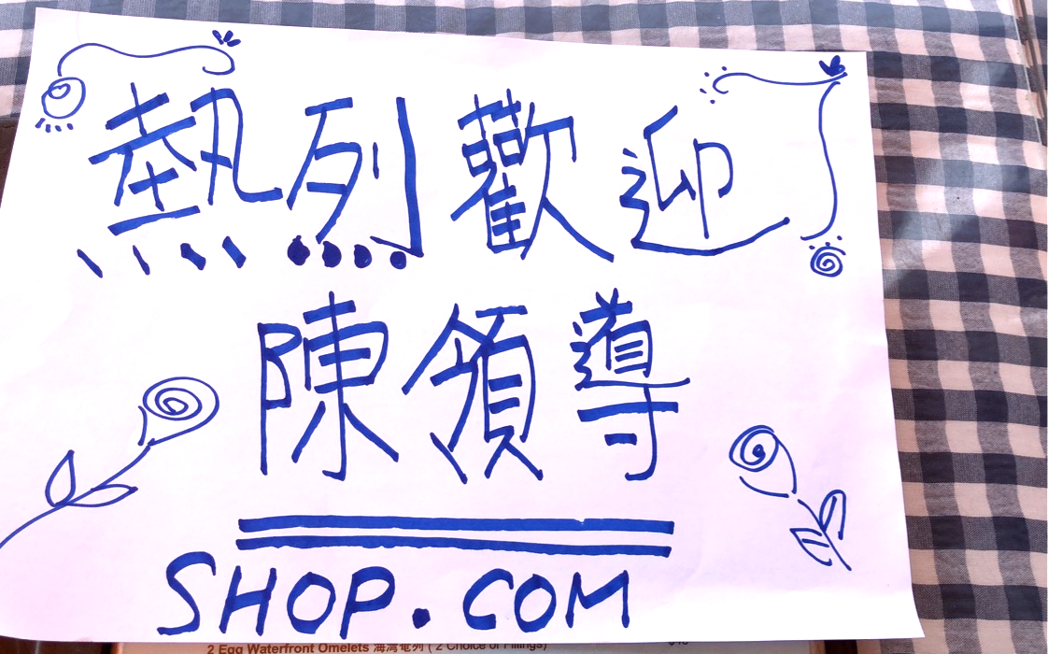


Lilian You can do it! Hang in there! Hayley loves you.
I will stand by you all the way.

Slide 15
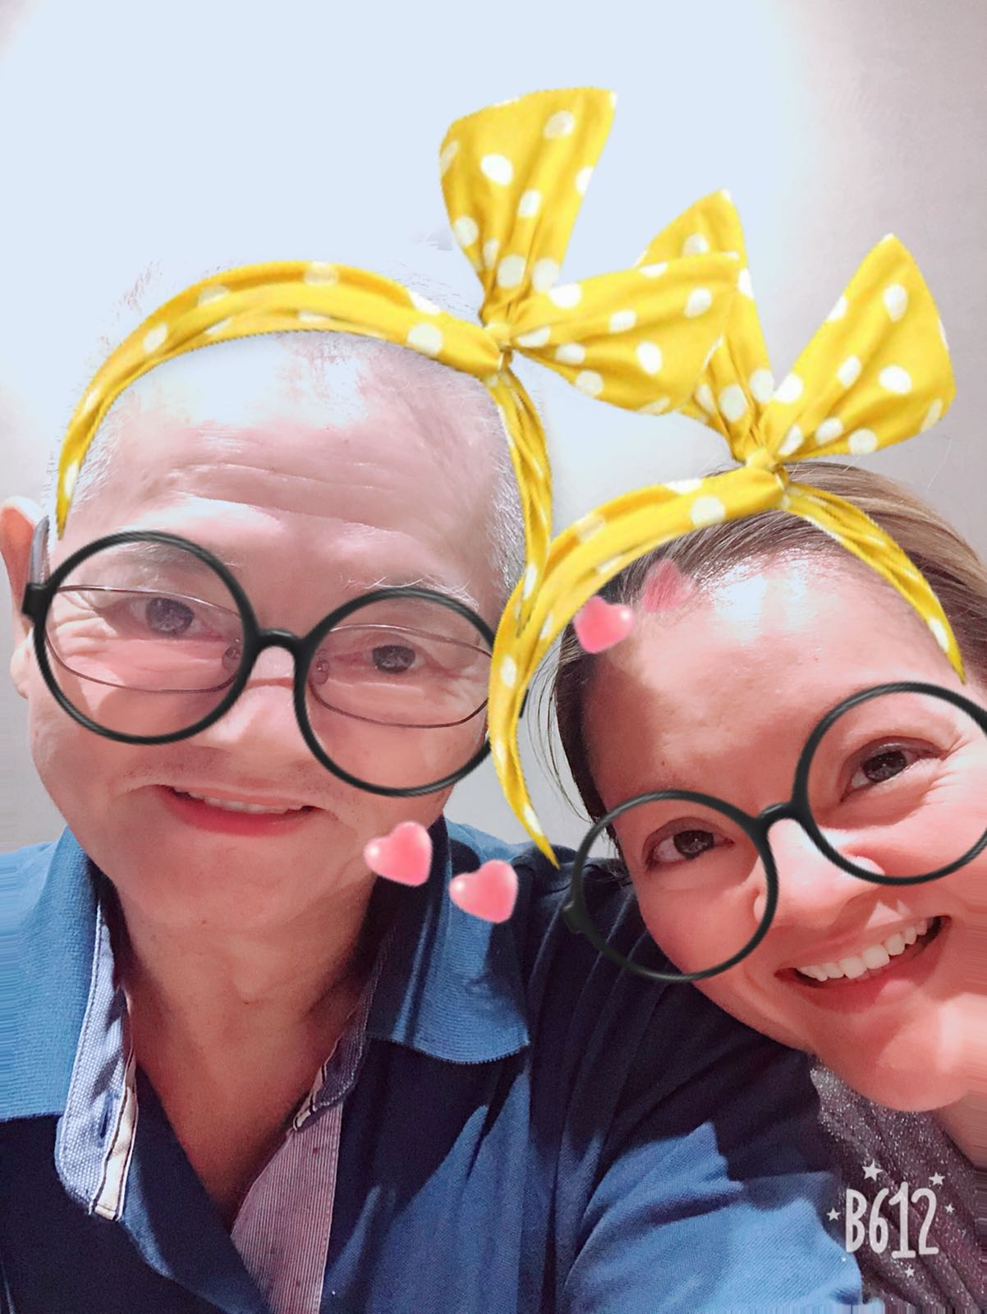
Do you know
you are
sooooo CUTE

Slide 16


Slide 17

WE CAN
CHANGE THE WORLD AND MAKE IT A BETTER PLACE. IT IS IN YOUR HANDS TO MAKE A DIFFERENCE.

