Slide 1
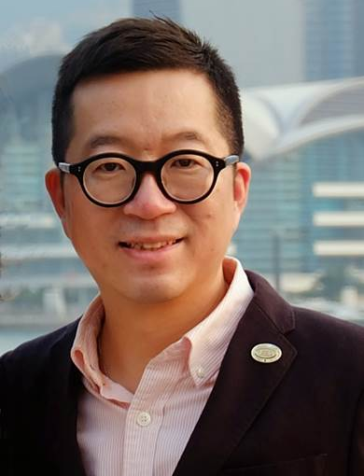
超連鎖事業的價值
Value of the UnFranchise™ Business
Calvin Ip
總顧問經理級
National Supervising Coordinators
四個佣金週期共賺取HK$76,600
HK$76,600 in 4 Commission weeks
本簡報中提到的收入等級純屬舉例說明，無意代表美安香港超連鎖™店主的一般收入，也無意表示任何超連鎖™店主皆可賺取同等收入。美安香港超連鎖™店主的成功與否，取決於其在發展事業時的努力、才能與投入程度。The income levels mentioned in the following presentation are for illustration purposes only. They are not intended to represent the income of a typical Market Hong Kong UnFranchise ™Owner, nor are they intended to represent that any given Independent UnFranchise ™ Owner will earn income in that amount. The success of any Market Hong Kong Independent UnFranchise ™ Owner will depend upon the amount of hard work, talent, and dedication which he or she devotes to building his or her Market Hong Kong Business.

Slide 2
簡介
總顧問經理級超連鎖™店主
從事IT軟件銷售及行政工作
ECCT授證訓練員
TLS®授證教練
曾任本地協調員
總裁挑戰獎
Motives ® 挑戰獎
TLS ® 挑戰獎
本簡報中提到的收入等級純屬舉例說明，無意代表美安香港經銷商的一般收入，也無意表示任何經銷商皆可賺取同等收入。美安香港經銷商的成功與否，取決於其在發展事業時的努力、才能與投入程度。The income levels mentioned in the following presentation are for illustration purposes only. They are not intended to represent the income of a typical Market Hong Kong Distributor, nor are they intended to represent that any given Independent Distributor will earn income in that amount. The success of any Market Hong Kong Independent Distributor will depend upon the amount of hard work, talent, and dedication which he or she devotes to building his or her Market Hong Kong Business.

Slide 3
以往的我

Slide 4
人生的風險

Slide 5
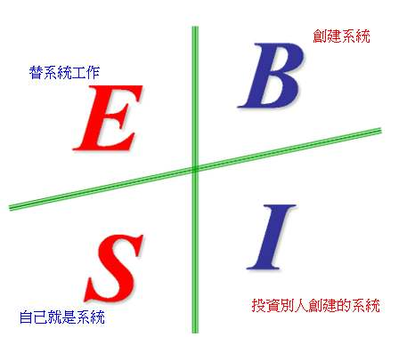
我的選擇

Slide 6
用消費來創業
打工收入
投資
儲蓄
支出
超連鎖™事業
SHOP.COM
『購物年金』Shopping Annuity

Slide 7
生活目標

Slide 8
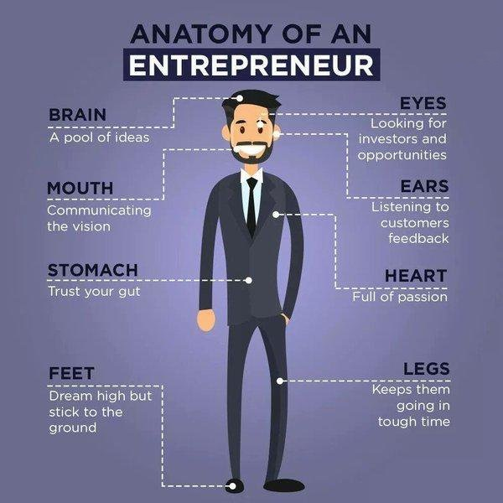
創業心態

Slide 9
突破+成長

Slide 10
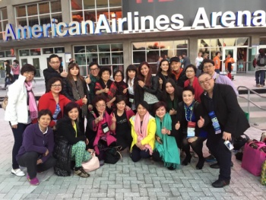
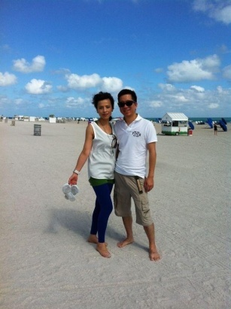
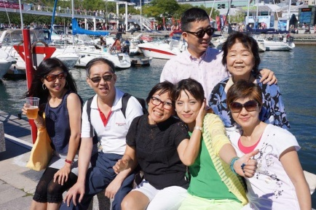
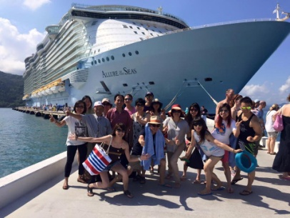
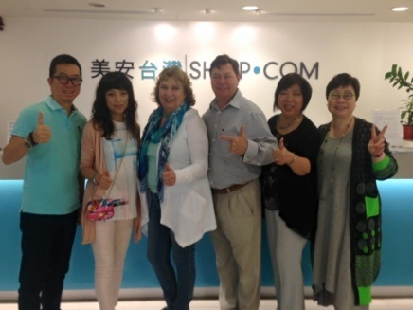
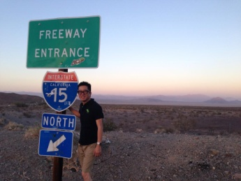
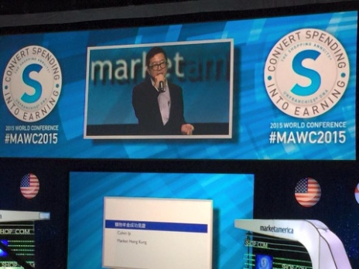
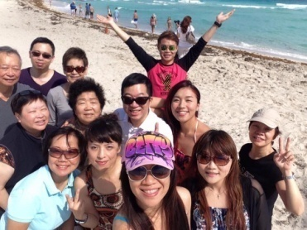
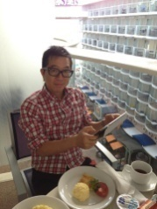
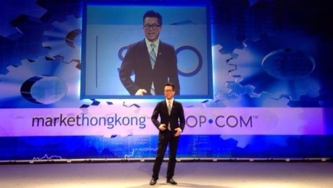
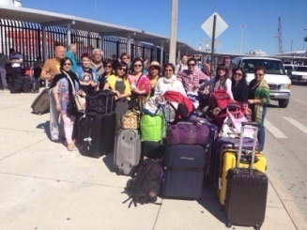
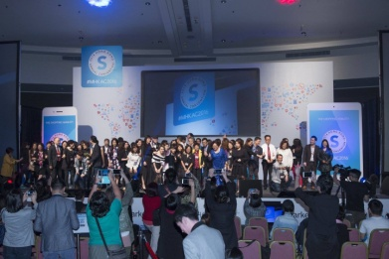
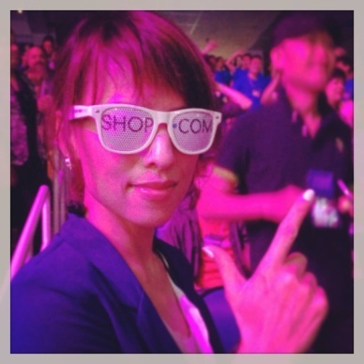
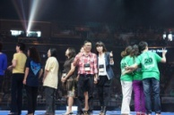
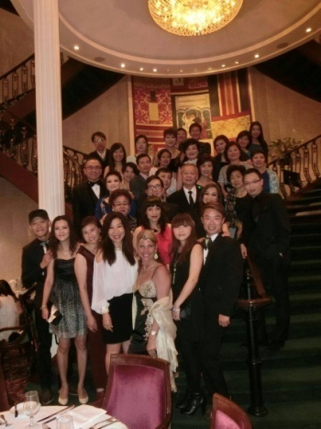
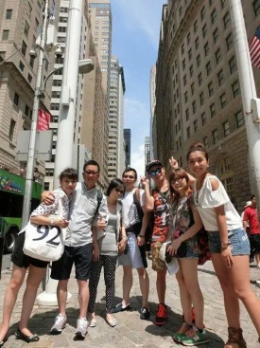
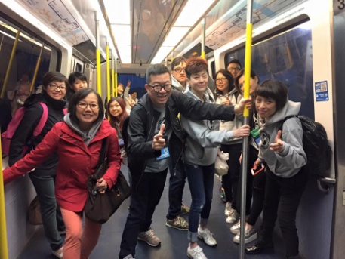
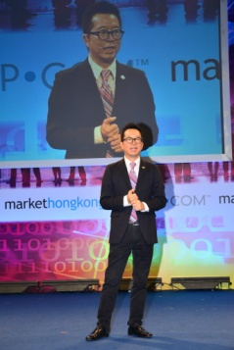
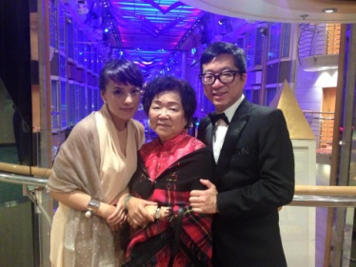
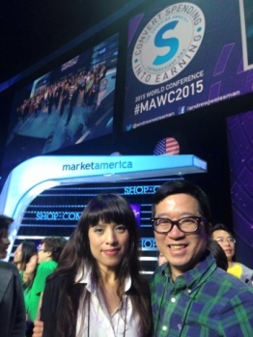
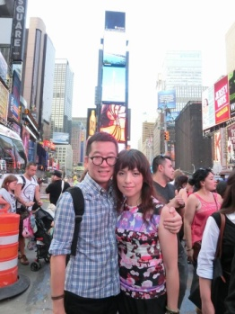
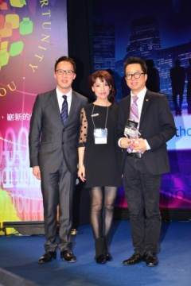
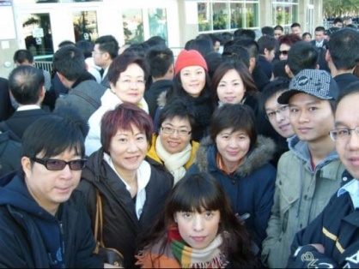
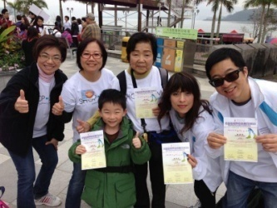

Slide 11
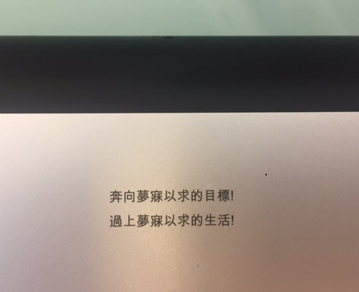
奔向你夢寐以求的目標
過上你夢寐以求的生活
梭羅

Slide 12
購物年金
轉消費為收入
Notes:
TRAINERS NOTES: Welcome guests. Let them know that why you’re excited to be sharing this revolutionary concept with them.
It gives everyone a chance to enjoy the benefits of annuity without having to fund it with discretionary income, but rather with money they are already spending
We are going to show you how you could create a residual income for yourself by simply changing how you shop and duplicating it with your team
This plan is essentially rocket fuel for the MPCP.
Share any of your personal success or team’s success with the Shopping Annuity

