Slide 1
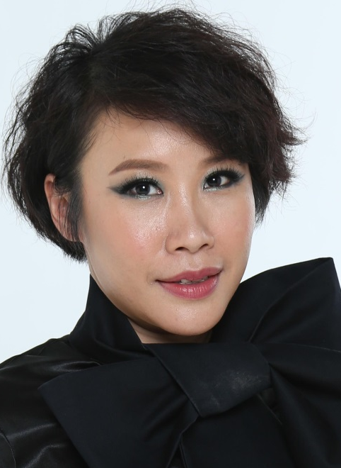

Motives 全新產品與彩妝示範
Motives - new products launch and makeover show
Angie Chou
專業經理級
Professional Coordinator
四個佣金週期共賺取HK$34,500
HK$34,500 in 4 Commission weeks
本簡報中提到的收入等級純屬舉例說明，無意代表美安香港超連鎖™店主的一般收入，也無意表示任何超連鎖™店主皆可賺取同等收入。美安香港超連鎖™店主的成功與否，取決於其在發展事業時的努力、才能與投入程度。
The income levels mentioned in the following presentation are for illustration purposes only. They are not intended to represent the income of a typical Market Hong Kong UnFranchise ™Owner, nor are they intended to represent that any given Independent UnFranchise ™ Owner will earn income in that amount. The success of any Market Hong Kong Independent UnFranchise ™ Owner will depend upon the amount of hard work, talent, and dedication which he or she devotes to building his or her Market Hong Kong Business.

Slide 2
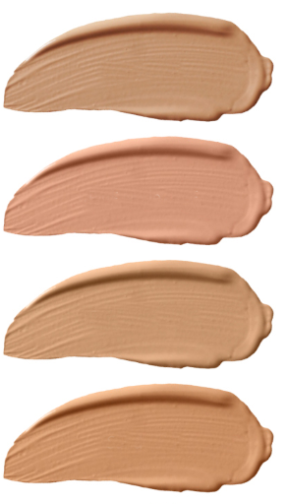
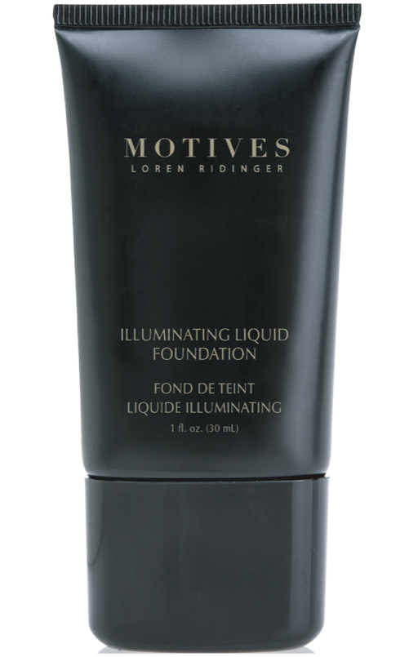
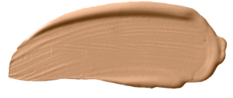
Ivory
HK40LF
COMING
SOON
Pink Nude
HK41LF
Soft Beige
HK42LF
NEW
Sand
HK43LF
Creamy Natural
HK45LF
Motives Illuminating Liquid Foundation
UC: HK$203.00 | SR: HK$284.00 | BV: 18

Slide 3
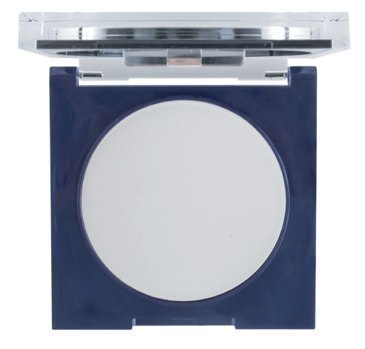
NEW
Motives Filter HD Powder
CODE: HK360HDP
UC: HK$175.00 | SR: HK$245.00 | BV:16
Notes:
HK113MMF Motives Mineral Dual Foundation 無瑕美肌兩用粉餅 - Fair Neutral $265.00

Slide 4
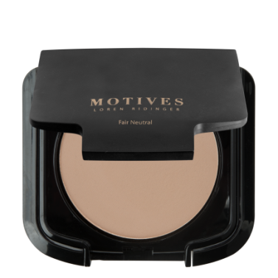
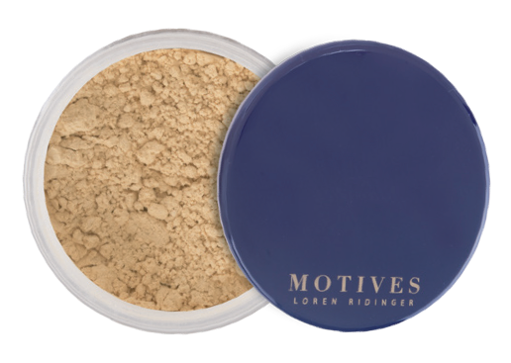
NEW
Banana
Fair Neutral
Motives Luminous Translucent Loose Powder
Motives Mineral Dual Foundation
CODE: HK360HDP
UC: HK$151.00 | SR: HK$211.00 BV:12
CODE: HK113MMF
UC: HK$190.00 | SR: HK$265.00
BV:15.5
Notes:
HK113MMF Motives Mineral Dual Foundation 無瑕美肌兩用粉餅 - Fair Neutral $265.00

Slide 5
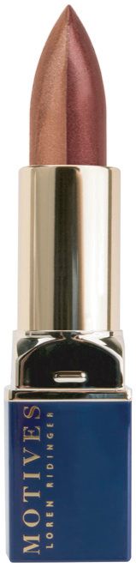
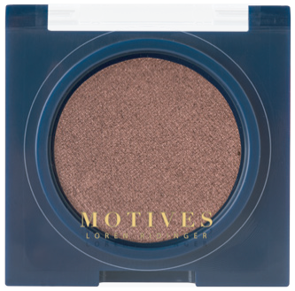

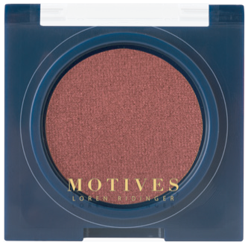
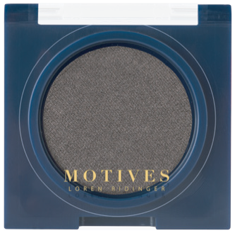

VENGEANCE
HK230MES
LIT
HK231MES
NEW
Royally Red
REBEL
HK232MES
STUDDED
HK233MES
HEADSTRONG
HK234MES
Motives Double Take Lipstick Duo
Motives Pressed Eyeshadow
CODE: HK30DTD
UC: HK$129.00
SR: HK$181.00 | BV:12
UC: HK$95.00 | SR: HK$133.00
BV: 7.75

Slide 6
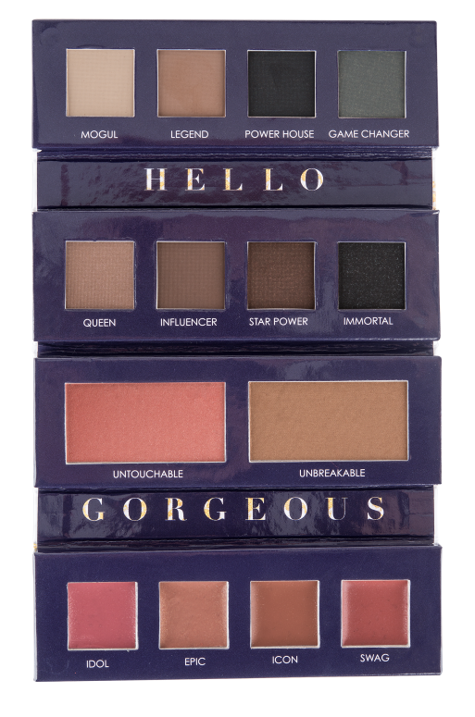

COMING
SOON
NEW
Motives Iconic Palette
CODE: HKPRESH17
UC: HK$284.00 | SR: HK$398.00 | BV: 25
Notes:
Motives Illuminating Liquid Foundation光采粉底液 $284.00
HK40LF Ivory
HK41LF Pink Nude
HK42LF Soft Beige
HK43LF Sand
HK45LF Creamy Natural

Slide 7
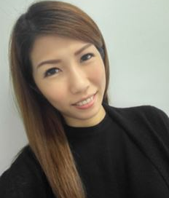
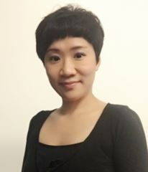
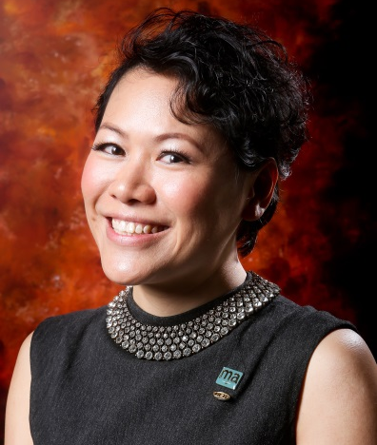
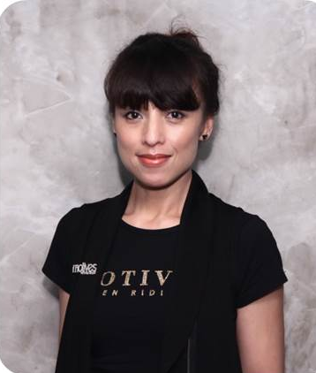
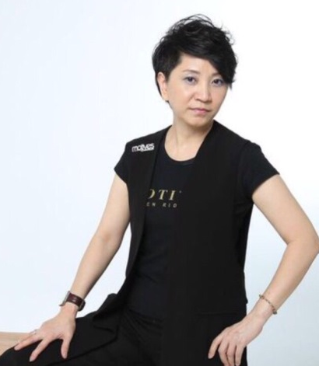
MOTIVES® CERTIFIED TRAINERS
Meko Lun
Mandy Ng
Thorine Mak
Rose Wong
Pat Chan

Slide 8
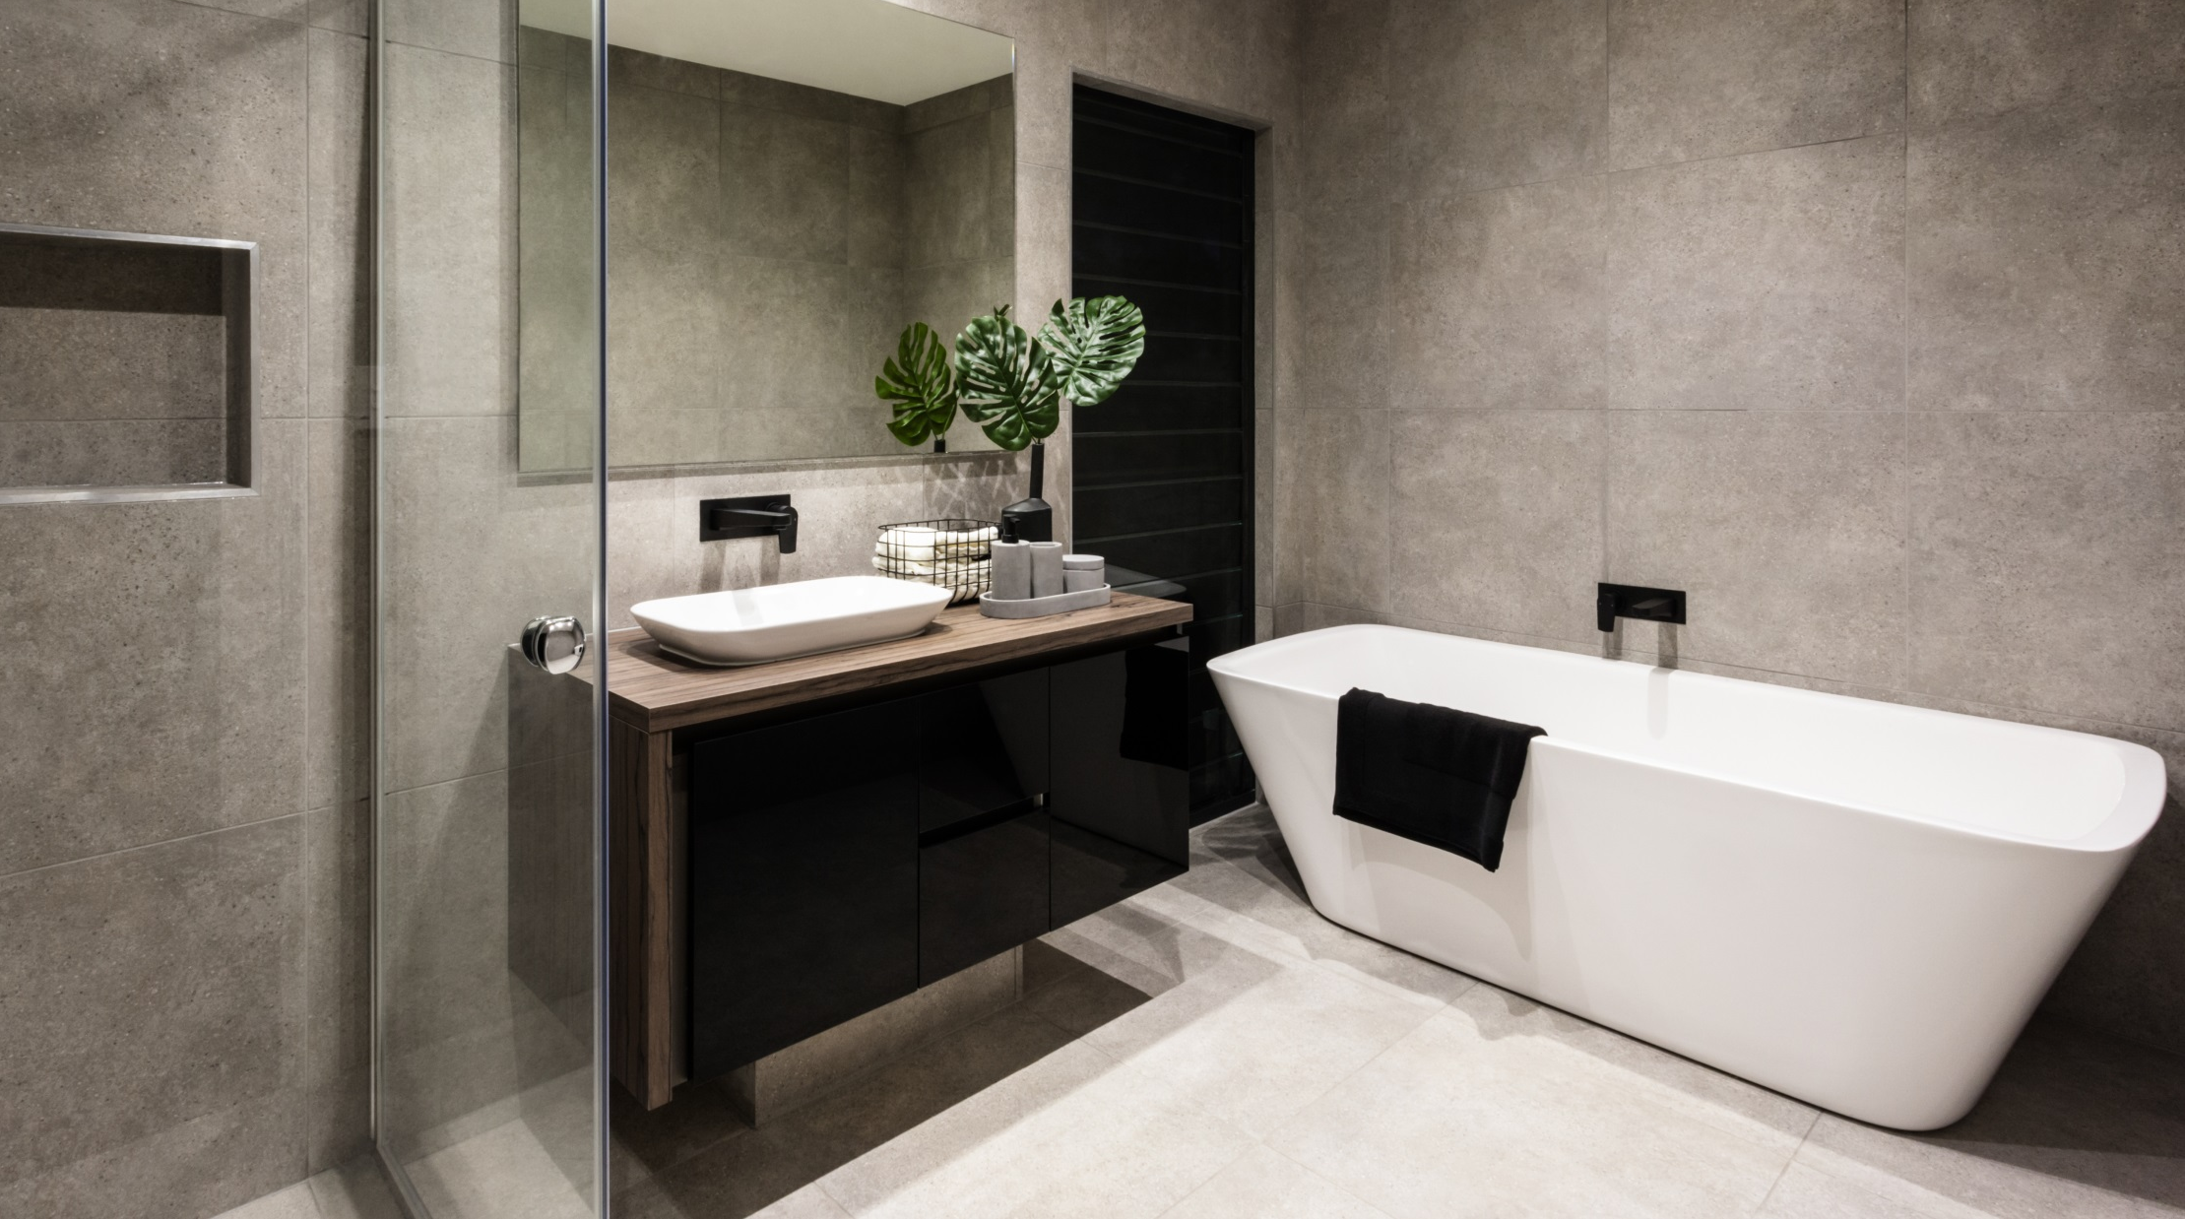

Slide 9
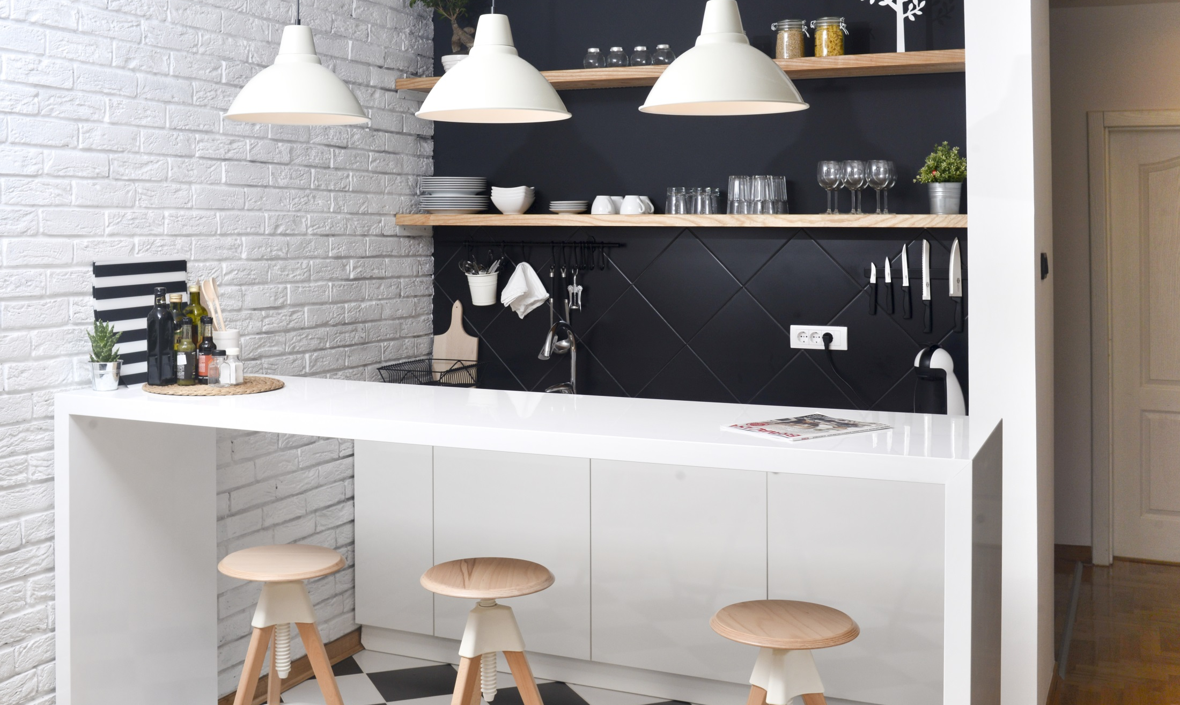

Slide 10
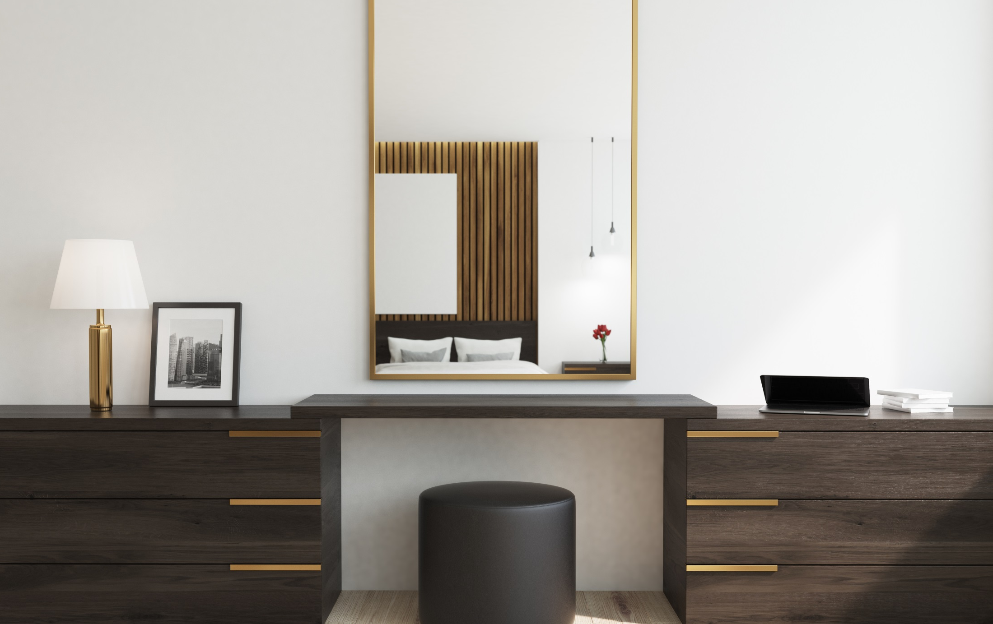

Slide 11
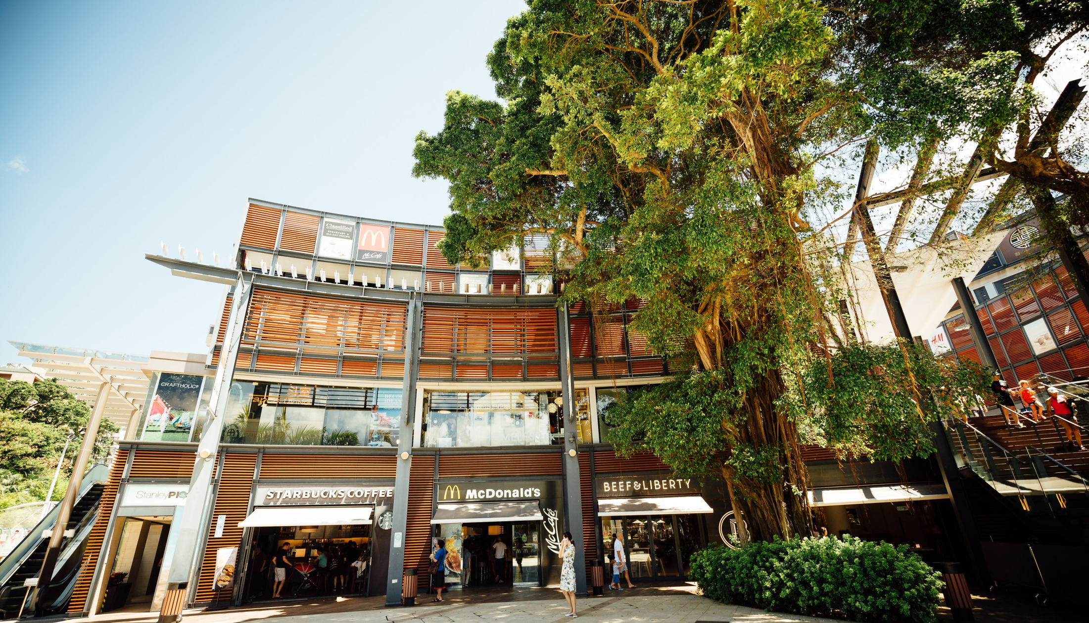

Slide 12
 | BV | Profit
Isotonix® OPC-3® Powder Drink | 43.5 | 180.00
Isotonix OPC-3® Beauty Blend Powder Drink | 43.5 | 178.00
Isotonix® Multivitamin Powder Drink | 28.5 | 121.00
Isotonix® Vitamin C Powder Drink | 16 | 84.00
Fixx™ Argan Oil Shampoo | 11 | 52.00
Fixx™ Argan Oil Conditioner | 11 | 52.00
Fixx™ Thick Hair Shampoo & Conditioner | 9.25 | 45.00
Fixx™ Argan Oil Intensive Hair Mask | 11 | 57.00
Fixx™ Microdermabrasion | 14 | 63.00
Royal Spa™ Imperial Blend Bath and Shower Gel | 6.5 | 40.00
Lumière de Vie® Full Regimen Kit | 200 | 1006.00
Skintelligence ®Hydra Derm Deep Cleansing Emulsion | 7.25 | 52.00
Skintelligence® pH Skin Normalizer | 7.25 | 49.00
Skintelligence® Daily Moisturizer | 11 | 66.00
Motives® Luminous Translucent Loose Powder | 12 | 60.00
Motives® Pressed Eyeshadow | 7.75 | 38.00
Motives® Mineral Dual Foundation | 16.5 | 75.00
Motives® Filter HD Powder | 16 | 70.00
Motives® Double Take Lipstick Duo | 12 | 52.00
Motives® Complexion Perfection Face Primer | 14 | 59.00
Motives® Liquid Powder Mineral Foundation | 15 | 75.00
Motives® 10 Years Younger Makeup Setting Spray | 17 | 79.00
Motives® 15-Piece Pro Brush Set | 50 | 337.00
Royal Spa™ Structure Hair Gel | 4.5 | 30.00
Royal Spa™ Awapuhi Mousse | 5 | 41.00
Total Profit | 589.5 | 2961.00
Retail Profit and
BV Generated …
Notes:


Slide 13
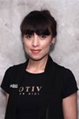
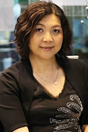
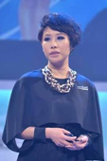
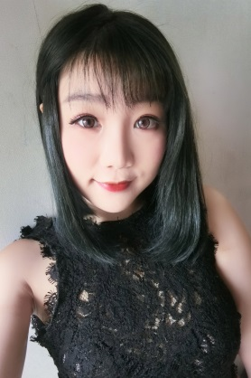
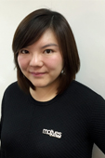
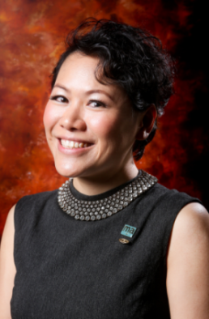
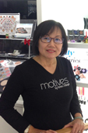

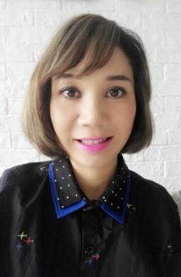
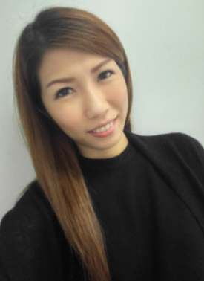
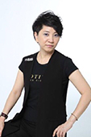
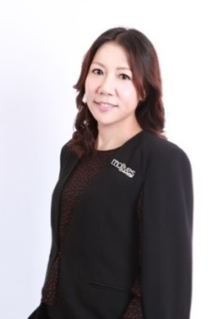


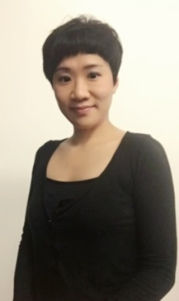
MOTIVES® CERTIFIED TRAINERS
Rose Wong
Reginia Wong
Angie Chou
Blair Lo
Kero Chan
Thorine Mak
Mony Ung
Claudia Chow
Ming Chung
Meko Lun
Pat Chan
Queenie Lau
Andy Leung
Yan Liu
Mandy Ng
Notes:


