Slide 1
夥伴商店計劃最新資訊
Updates on Partner Store Program
Marcus Chan
商業夥伴拓展經理
Affiliate Development Manager
本簡報中提到的收入等級純屬舉例說明，無意代表美安香港超連鎖™店主的一般收入，也無意表示任何超連鎖™店主皆可賺取同等收入。美安香港超連鎖™店主的成功與否，取決於其在發展事業時的努力、才能與投入程度。
The income levels mentioned in the following presentation are for illustration purposes only. They are not intended to represent the income of a typical Market Hong Kong UnFranchise ™Owner, nor are they intended to represent that any given Independent UnFranchise ™ Owner will earn income in that amount. The success of any Market Hong Kong Independent UnFranchise ™ Owner will depend upon the amount of hard work, talent, and dedication which he or she devotes to building his or her Market Hong Kong Business.

Slide 2
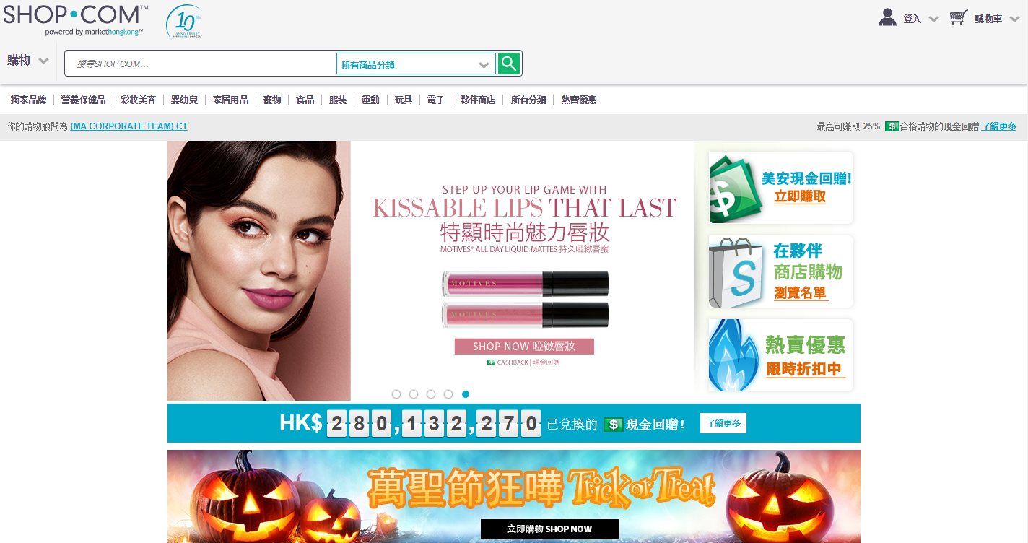
HK.SHOP.COM
Partner Store
夥伴商店

Slide 3
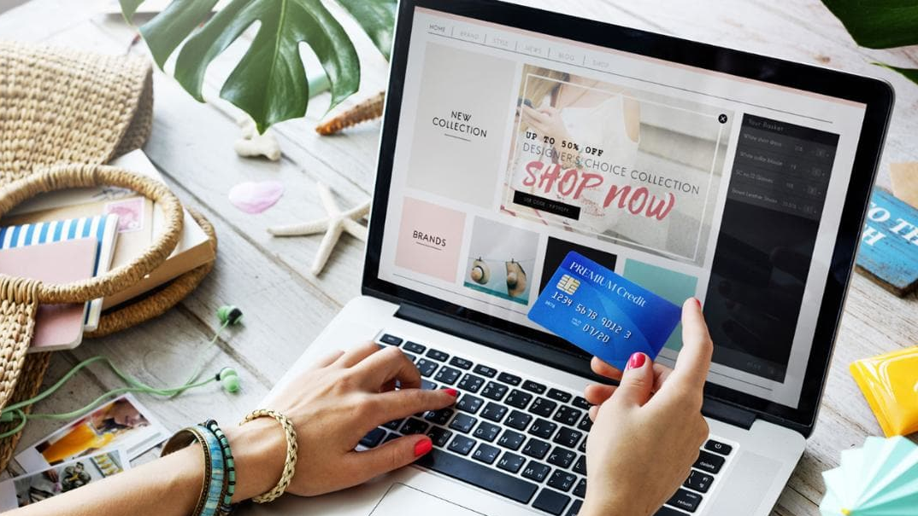
Online shopping trend

Slide 4
23%
Hong Kong people purchased online before
2004
2009
2014
7%
16%
23%

Slide 5
Online Shopping Spending amount forcast in the coming 6 years
Increase by 77%

Slide 6
80%
Search for non-consumer goods through internet
58%
Search for product information from internet before purchase

Slide 7
Average online
shopping amount
HK$790
49%
Increase in online shopping purchase in coming 2 years
HK$790

Slide 8
75%
71%
31%
31%
Air ticket
Hotel
Clothing
Car Insurance
26%
13%
9%
4%
Movie ticket
Electronics
Grocery
Home Appliance

Slide 9
No. of Partner store Product feeds
on HK.SHOP.COM
+30%
Total no. of partner store product feed
linked from hK.SHOP.COM
Over1 million

Slide 10
Over 80 online Partner Stores with
tracking transaction to be joined in HK.SHOP.COM
A Touch of Grace
Adelphi Grande Sukhumvit Hotel
Admiral Premier Hotel Bangkok
Admiral suites Hotel Bangkok
Aliexpress
Amari Hotel Reservation
Ananda Hua Hin Resort & Spa
Anantara Hotel Reservation
Arcadia Suites Bangkok
Art Mai Gallery Hotel
Ashford.com
Aspen Suites Bangkok Hotel
August Society
Bangkok Legacy Suites Hotel
Best Western Plus Berghotel Amersfort Hotel
BonBonTong.com Health Product
Caesars Entertainment (Global)
Charles & Keith
Citin Hotel Landkawi
Conson Service Office
Citin Hotel Masjid Booking
Citin Pratunam Bangkok Hotel
Citin Seacare Pudu Hotel
Citrus Johor Bahru Hotel
Citrus Parc Hotel Pattaya
Citrus Sukhumvit 13 Hotel
Columbus Direct International Travel Insurance
ComputerUniverse
Continent Bangkok Hotel
CustomMadeCase
Fenix Beach Resort Samui
Flower Advisor
Forzieri Fashion
Galleria 10 Bangkok Hotel
Galleria 12 Sukhumvit Bangkok Hotel
GearBest Electronics
Grand Swiss Hotel
Havanahotel.vn
HBX
HomeAway
Qatar Airways
Hotel.Info Hotel Reservation
Jack Wills Clothing
Kaligo
Kate Spade
Legacy Express Sukhumvit Hotel
London Pass
LOTUSmart
Luke+Lilly Kids Products
Mandkind
Melia Hotels International
Melissa Shoes - Mdreams.com
Melissa Dreams Fashion
Nancy Meyer
Omni Tower Sukhumvit Nana Hotel
On8 Sukhumvit Hotel
Otel.com Hotel Reservation
Pedro
Priority Pass Airport Lounge Membership
ProBikeKit
RentalCars.com
Resalaser Shooting Game Reservation
SmartBuyGlasses HK
Soufeel Jewelry
Soufeel Jewelry
Spartoo Fashion CN
Strathberry Fashion
Stuarts London Clothing
STYLEBOP.com
Tenso JAPAN
The Citrus Sukhumvit 11 Hotel
The Hut Store
The Key Bangkok Hotel
The Venetian Macao Resort Hotel
Travelio.com
Trichrome Eyewear
Trip Guru
Tripsle Tour
Yoho mall
Vinpearl Hotel Group
Zaful.com Fashion
ZenRooms (SEA)
ZUTTO Clothing

Slide 11
Preferred customer
UFO
More product and service options
Attract more customers
Build shopping annuity
More shopping DEALs
transfer spending to hk.shop.com

Slide 12
TIPS from Market Hong Kong
hk.shop.com merchant APP

Slide 13
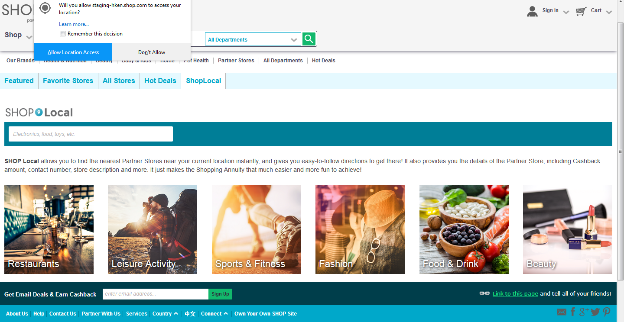

Slide 14
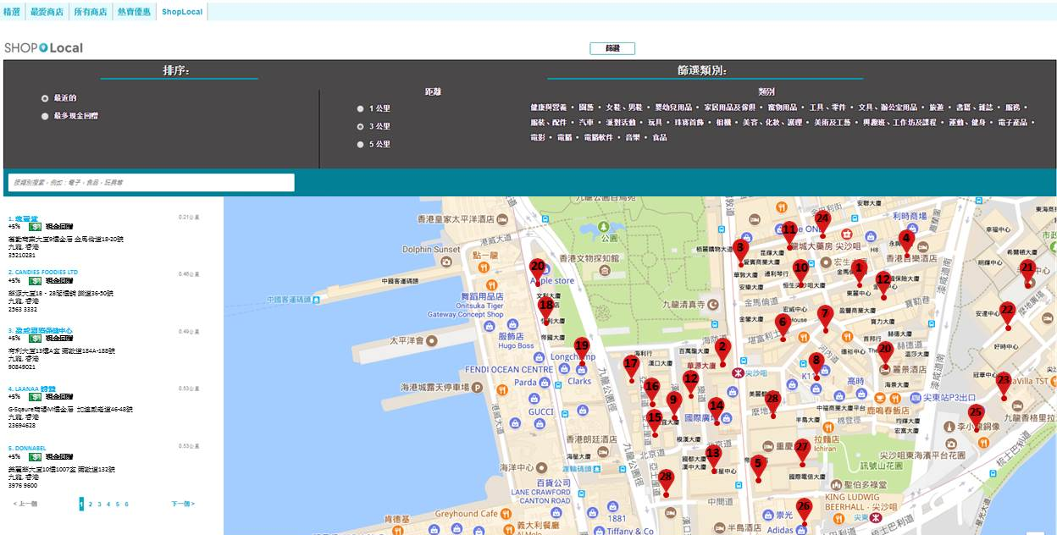

Slide 15
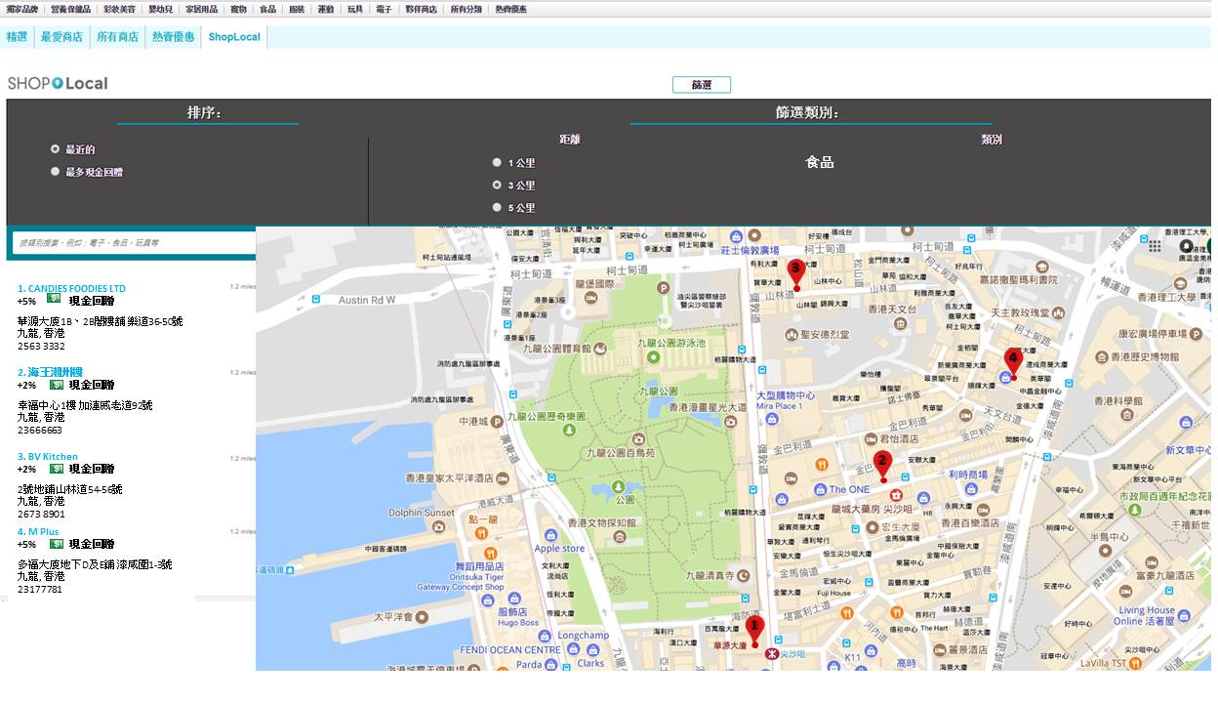

Slide 16
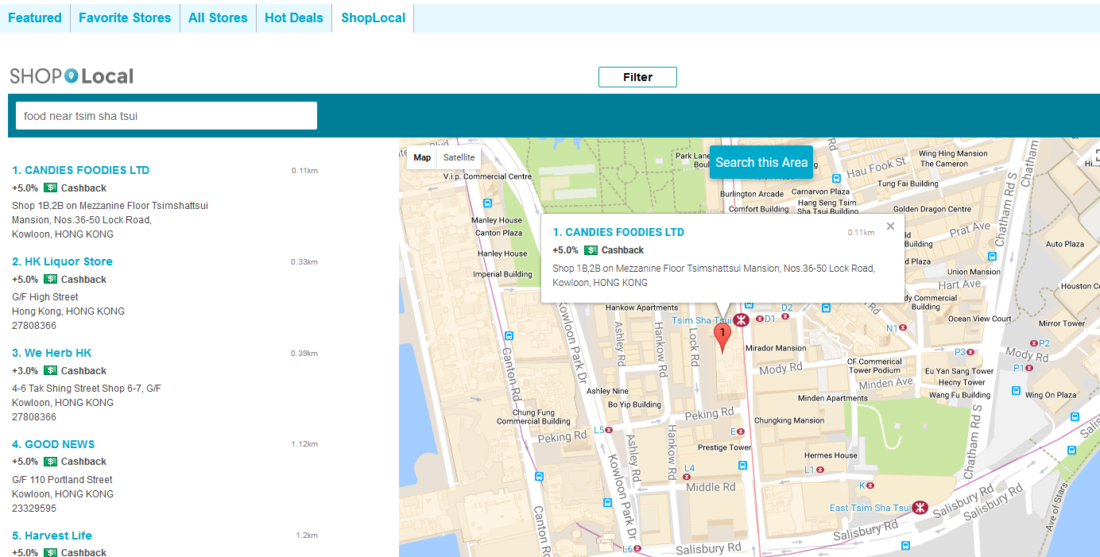

Slide 17
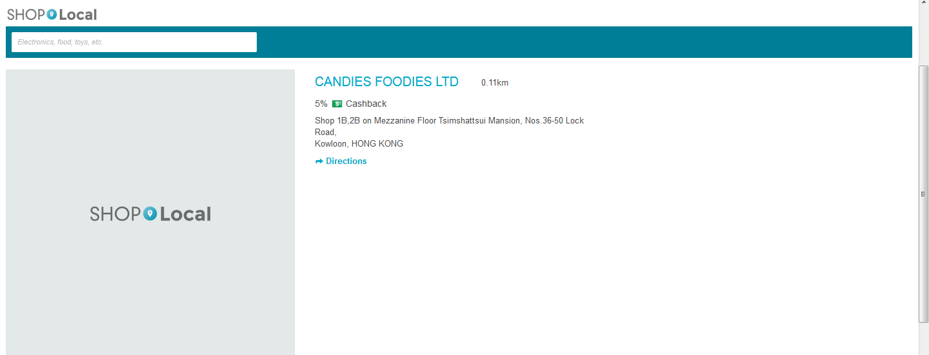
New functions will be added：
Photo
Video
Menu (for restaurant only)

Slide 18
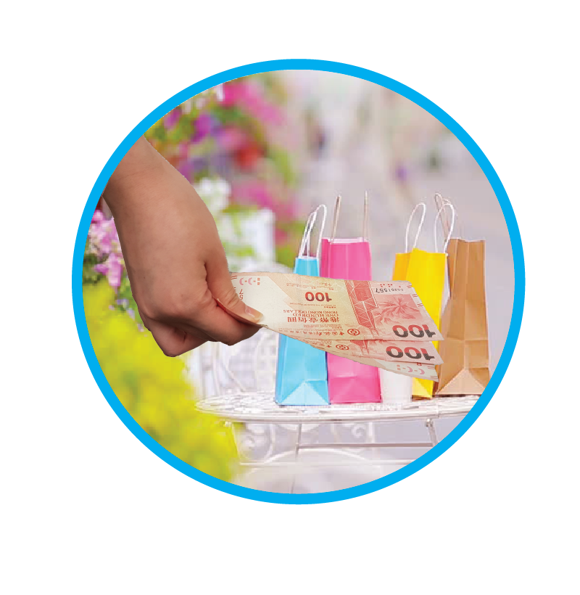
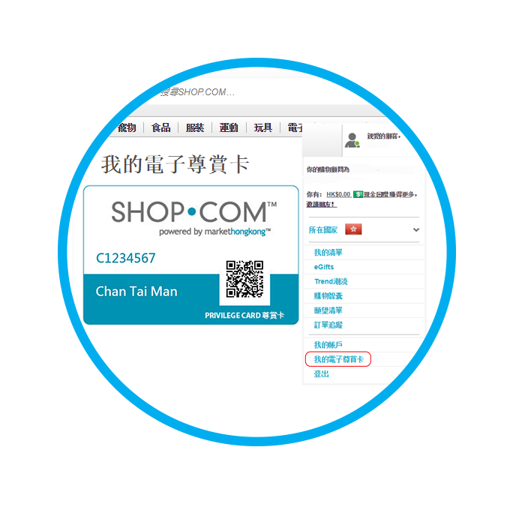
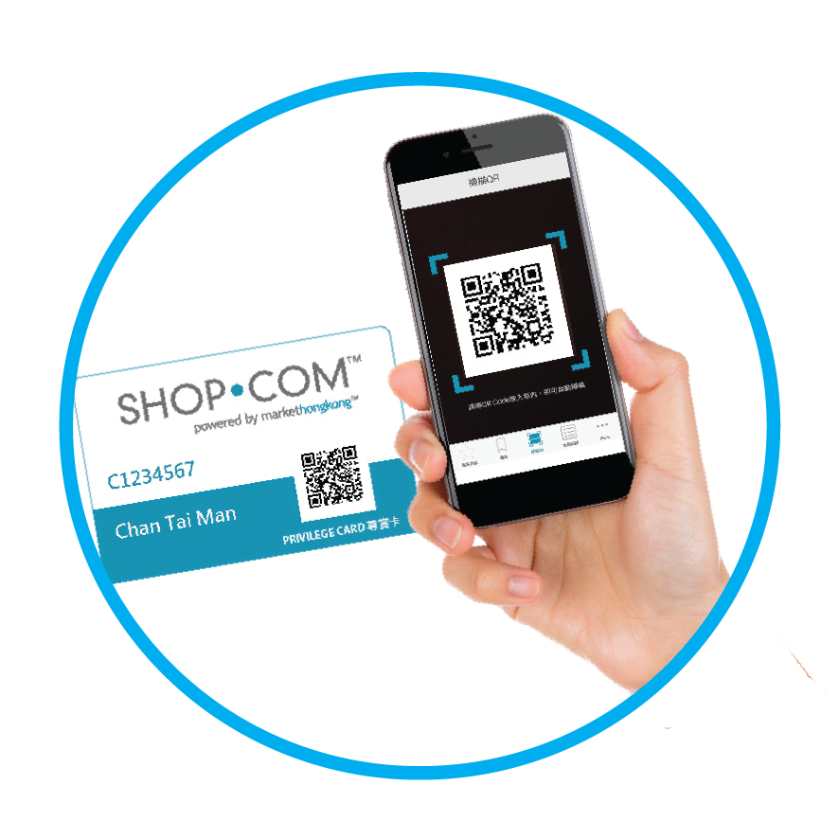
hk.shop.com Merchant APP
step1
step2
step3

Slide 19
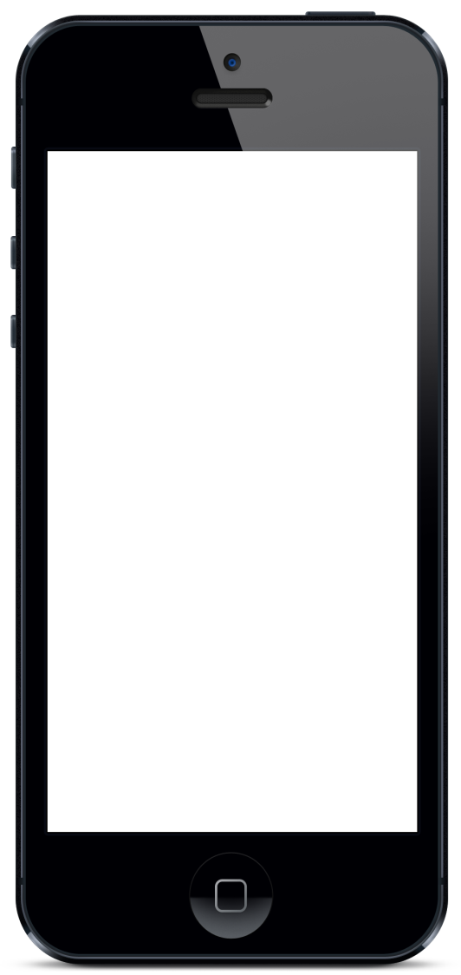
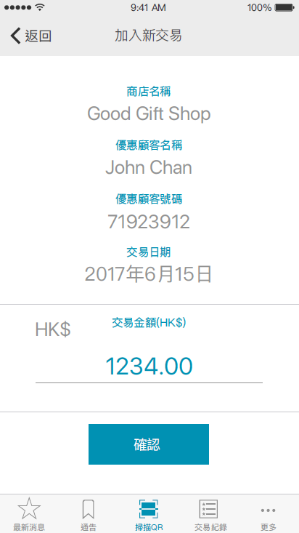
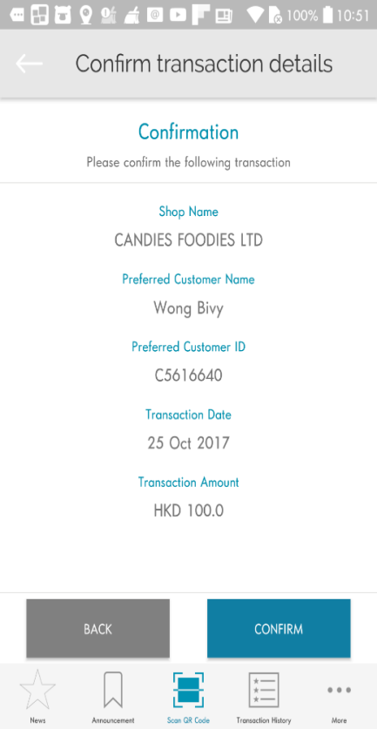
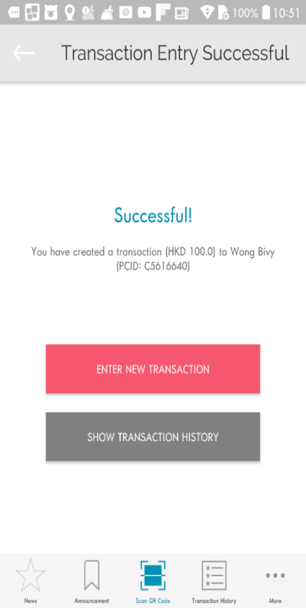
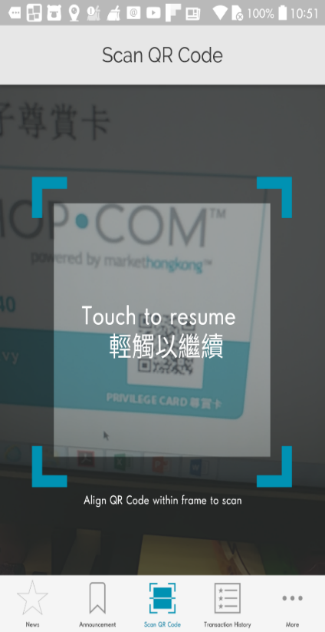
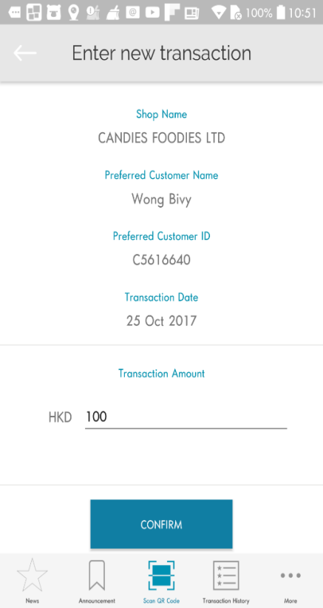
hk.shop.com Merchant APP
Partner Store input the transaction amount manually
Partner Store show and verify with Preferred customer
Transaction details cannot be amended after the submission

Slide 20
IBV and cashback will be credited within 5 days

Slide 21
How to earn more IBV??

Slide 22
3D2N Taiwan trip for 2
Air ticket + hotel HK$5,000
12.87 IBV
Partner Store 4% IBV

Slide 23
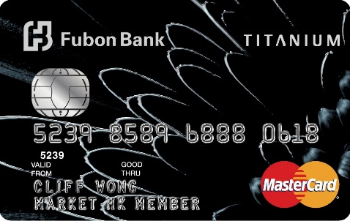
3d2n taiwan trip for 2
75.87 IBV
one Market Hong Kong Product (valued over HK$600)
Using master card for payment on sat or sun
Air ticket + hotel
HK$5,000
Spending in taiwan
HK$4,500
Using master card
for payment HK$4,500

Slide 24
Apply now!

Slide 25
You will have：
1. one Market Hong Kong Product (valued over HK$600)
(Fubon welcome gift)
2. Fubon bonus points 10,000 points
(transaction amount of HK$300 or
above made on Sat & Sundays, HK$1=2points)
(air ticket + hotel HK$5000 X 2 points)
Fubon bonus points
100,000 points
(20,000 points = 12.6 ibv)
3. Fubon bonus points 90,000 points
(Taiwan transaction，HK$1=20points)
(HK$4,500 X 20pts=90,000points)
63 ibv
+
12.87 ibv
75.87 IBV
4. 12.87 ibv
(IBV gained from Partner Store spending)

Slide 26
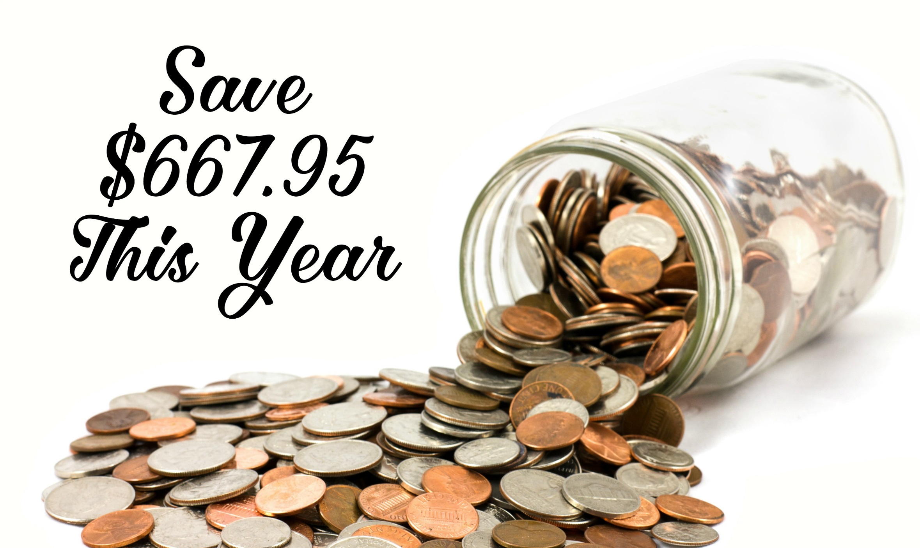
77.22 IBV
HK$30,000
75.87 IBV
HK$9,500
Save70%
夥伴商店 4%IBV

Slide 27
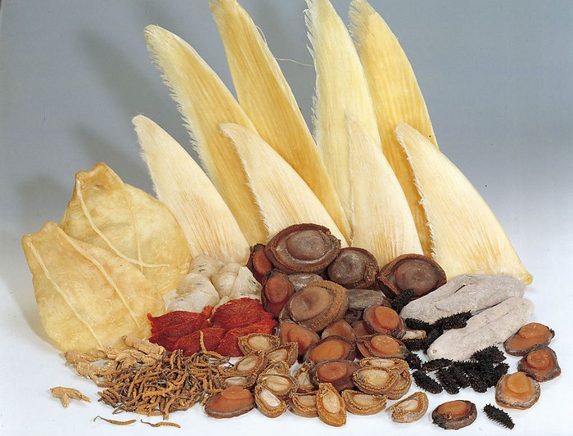
Mr. Alfred Kam
(Chief Operating Officer)
Kei Kei
(Director)
Mr. Jamie Lee
(President)

