Slide 1
夥伴商店計劃最新資訊
Updates on Partner Store Program
Marcus Chan
商業夥伴拓展經理
Affiliate Development Manager
本簡報中提到的收入等級純屬舉例說明，無意代表美安香港超連鎖™店主的一般收入，也無意表示任何超連鎖™店主皆可賺取同等收入。美安香港超連鎖™店主的成功與否，取決於其在發展事業時的努力、才能與投入程度。
The income levels mentioned in the following presentation are for illustration purposes only. They are not intended to represent the income of a typical Market Hong Kong UnFranchise ™Owner, nor are they intended to represent that any given Independent UnFranchise ™ Owner will earn income in that amount. The success of any Market Hong Kong Independent UnFranchise ™ Owner will depend upon the amount of hard work, talent, and dedication which he or she devotes to building his or her Market Hong Kong Business.

Slide 2
Your life journey……

Slide 3
Sport &
Fitness
Sport & Fitness
Notes:
TRAINERS NOTES:
The Shopping Annuity is a revolutionary concept which levels the playing field. Because of how it works, anyone can enjoy the same major benefits of an annuity (receiving income as a result of funding) but with One Major Difference!

Slide 4
Online Store

Slide 5
Sport &
Fitness
Clothing
Clothing

Slide 6
Online Store

Slide 7
Sport &
Fitness
Match
Service
Clothing
Match Service

Slide 8
Online Store
GIFT FLOWERS HK, is Hong Kong's premium online florist offering stylish bouquets, boxed flowers and floral arrangements. Our innovative flower range include roses, lilies, gerberas and tulips.
Hong Kong’s premium online shop for gift hampers and other treats, Gift Hampers Hong Kong is innovative and slick. With items geared toward the Mid-Autumn Festival, Valentine’s Day and everything in between, our gifts are perfect for any occasion.
Gift Something is the ultimate one-stop premium online retailer in Hong Kong.

Slide 9
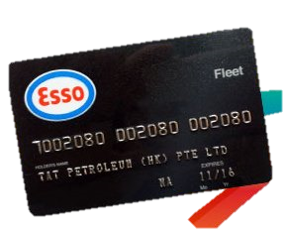
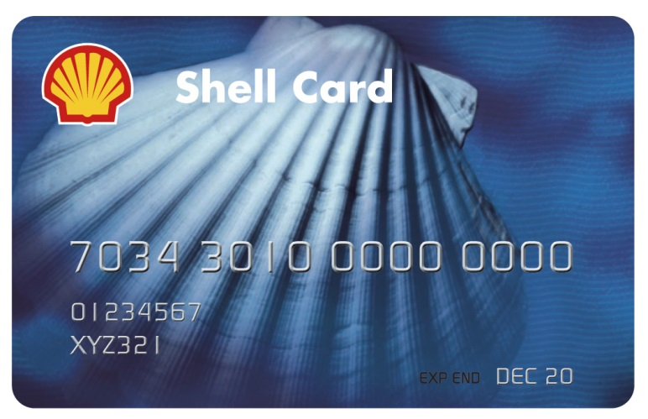
Sport &
Fitness
Match
Service
Clothing
Fuel card
Fuel card

Slide 10
[Walk-in Store]
Esso Fuel Discount Card offers services for smart car owners.
Not only to provide high discounts, but also ensure that discount with no any additional charges. Provide customers the best deal and service.

Slide 11
Sport &
Fitness
Match
Service
Food
Clothing
Fuel card
Food

Slide 12
Sport &
Fitness
Match
Service
Food
Clothing
Fuel card
Entertainment
Entertainment

Slide 13
Sport &
Fitness
Match
Service
Food
Wedding
Planning
Clothing
Fuel card
Entertainment
Wedding Planning

Slide 14
Sport &
Fitness
Match
Service
Food
Wedding
Planning
Clothing
Fuel card
Entertainment
Beauty
Beauty

Slide 15
Sport &
Fitness
Match
Service
Food
Wedding
Planning
Hair
Clothing
Fuel card
Entertainment
Beauty
Hair

Slide 16
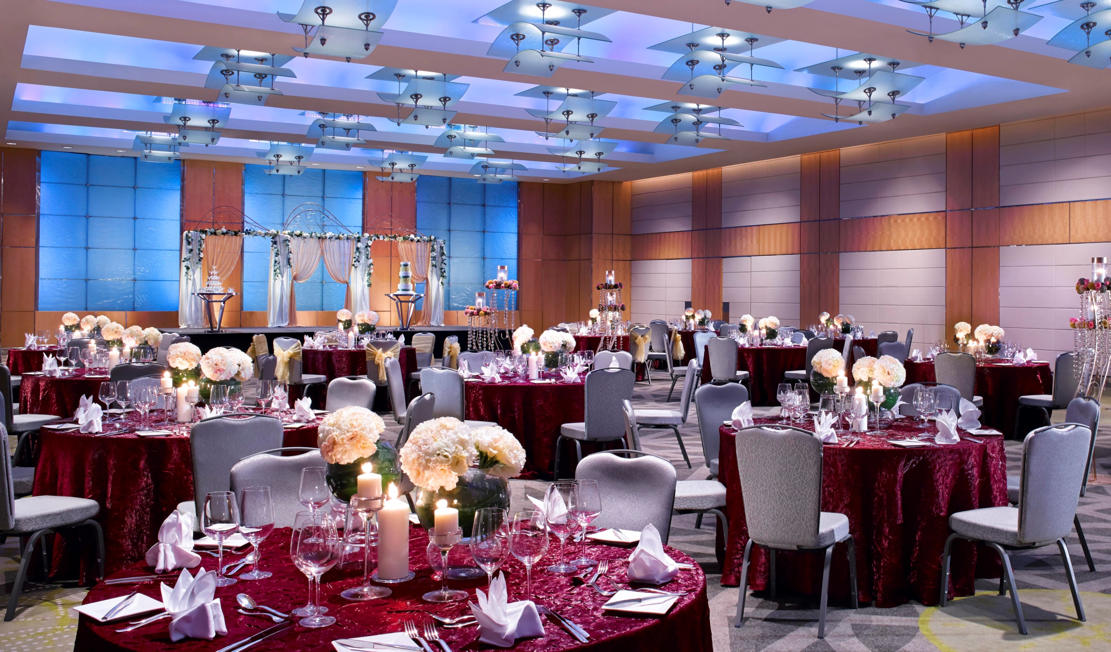
Sport &
Fitness
Match
Service
Food
Wedding
Planning
Hair
Clothing
Fuel card
Entertainment
Beauty
Wedding Banquet
Wedding Banquet

Slide 17
Online Store

Slide 18
Sport &
Fitness
Match
Service
Food
Wedding
Planning
Hair
Wedding
Photos
Clothing
Fuel card
Entertainment
Beauty
Wedding Banquet
Wedding Photos

Slide 19
Sport &
Fitness
Match
Service
Food
Wedding
Planning
Hair
Wedding
Photos
Clothing
Fuel card
Entertainment
Beauty
Wedding Banquet
Travel
Travel

Slide 20
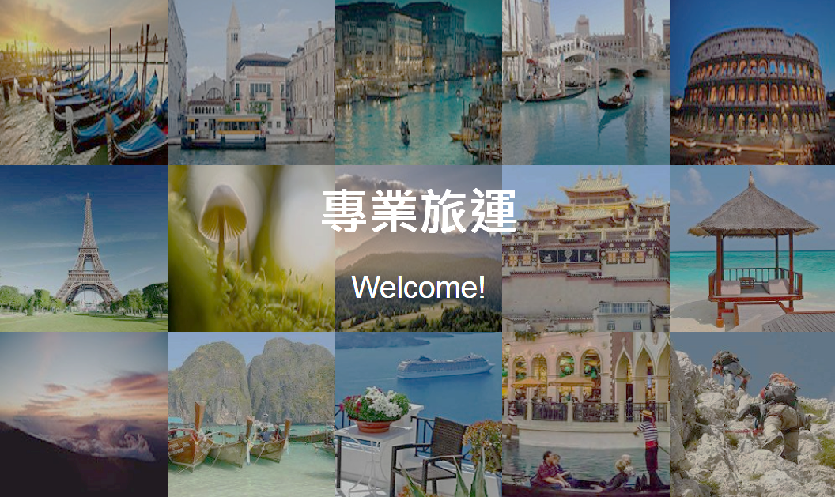
[Online Store]
texpert.com is an online booking engine operated by Bossfly Limited.
texpert.com is an user-friendly platform to search, compare and book all essential travel services and products, giving you a hassle-free experience when you plan your trip. You can design your own unique journey with just a few easy steps. They are aim at providing customers the best deal to travel anytime anywhere you want. Enjoy travelling!

Slide 21
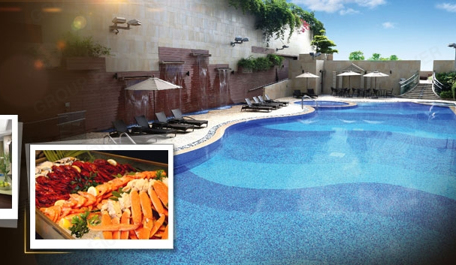
[Walk-in Store]
The award-winning Harbour Plaza 8 Degrees is located at the middle of Kowloon, near the Kai Tak Cruise Terminal and Mongkok area, it is minutes away from Tsimshatsui shopping and local sightseeing destinations, where are reachable through free hotel shuttle bus.
Features 704 tastefully designed guestrooms and suites with Wi-Fi access and handy Smartphone services, a renowned lobby with utmost innovation, stylish restaurant featuring international cuisine, outdoor bar & dining, well-equipped Fitness Centre, relaxing sauna and outdoor swimming pool surrounded by a lush landscape. Accomplished by the hospitable service and excellent facilities, the hotel is ideal for all business, MICE, leisure and family travelers who are looking for comfortable and attractive accommodation.

Slide 22
[Online Store]
Galaxy Macau is the World-Class Asian resort destination in Macau. Galaxy Macau includes more than 2,200 rooms, suites and villas across three World-Class Asian hotels: the award-winning and ultra-exclusive Banyan Tree Hotels and Resorts, Japan’s legendary Okura Hotels & Resorts, and the highly anticipated five-star Galaxy Hotel.
Facilities include a selection of more than 50 food and beverage outlets, including the widest selection of pan-Asian cuisine in Macau; distinctive retail shopping; lush oasis gardens covering 52,000 square meters, and the world’s largest Skytop Wave Pool covering 4,000 square meters and featuring a 350-ton white sand beach.

Slide 23
[Online Store]
Hilton Hotels and Resorts is an award-winning guest loyalty program with Hilton's top ten prestigious hotel brands, with 34 million members.
Offering more than 90 countries and over 4,000 Hilton hotels.

Slide 24
[Online Store]
Wifi Egg - Provides Wifi network to customers for their business or Leisure trips with the least expense, high-speed quality and reliable travel internet network by a pocket size Wifi Router.
Customer also can pick up the Wifi egg in 7-11 convenience stores or from the branches in Causeway Bay, Tsim Sha Tsui and Macau.

Slide 25
Sport &
Fitness
Match
Service
Food
Wedding
Planning
Hair
Wedding
Photos
Travel
Insurance
Clothing
Fuel card
Entertainment
Beauty
Wedding Banquet
Travel
Travel Insurance

Slide 26
Online Store
AIG insurance is an online insurance platform known as "Outstanding online travel insurance services“ with smooth and fast operation

Slide 27
Sport &
Fitness
Match
Service
Food
Wedding
Planning
Hair
Wedding
Photos
Travel
Insurance
Clothing
Fuel card
Entertainment
Beauty
Wedding Banquet
Travel
House
House

Slide 28
Sport &
Fitness
Match
Service
Food
Wedding
Planning
Hair
Wedding
Photos
Travel
Insurance
Transportation
Clothing
Fuel card
Entertainment
Beauty
Wedding Banquet
Travel
House
Transportation

Slide 29
Sport &
Fitness
Match
Service
Food
Wedding
Planning
Hair
Wedding
Photos
Travel
Insurance
Transportation
Clothing
Fuel card
Entertainment
Beauty
Wedding Banquet
Travel
House
Storage
Storage

Slide 30
Sport &
Fitness
Match
Service
Food
Wedding
Planning
Hair
Wedding
Photos
Travel
Insurance
Transportation
Electronic
Clothing
Fuel card
Entertainment
Beauty
Wedding Banquet
Travel
House
Storage
Electronic

Slide 31
Walk-in Store

Slide 32
Sport &
Fitness
Match
Service
Food
Wedding
Planning
Hair
Wedding
Photos
Travel
Insurance
Transportation
Electronic
Clothing
Fuel card
Entertainment
Beauty
Wedding Banquet
Travel
House
Storage
Supermarket
Supermarket

Slide 33
Sport &
Fitness
Match
Service
Food
Wedding
Planning
Hair
Wedding
Photos
Travel
Insurance
Transportation
Electronic
Magazines
Clothing
Fuel card
Entertainment
Beauty
Wedding Banquet
Travel
House
Storage
Supermarket
Magazines

Slide 34
Sport &
Fitness
Match
Service
Food
Wedding
Planning
Hair
Wedding
Photos
Travel
Insurance
Transportation
Electronic
Magazines
Clothing
Fuel card
Entertainment
Beauty
Wedding Banquet
Travel
House
Storage
Supermarket
Health
check
Health check
AXA Health Enquiry Form

Slide 35
Online Store

Slide 36
Sport &
Fitness
Match
Service
Food
Wedding
Planning
Hair
Wedding
Photos
Travel
Insurance
Transportation
Electronic
Magazines
Employment Agency
Clothing
Fuel card
Entertainment
Beauty
Wedding Banquet
Travel
House
Storage
Supermarket
Health
check
Employment Agency

Slide 37
Sport &
Fitness
Match
Service
Food
Wedding
Planning
Hair
Wedding
Photos
Travel
Insurance
Transportation
Electronic
Magazines
Employment Agency
Clothing
Fuel card
Entertainment
Beauty
Wedding Banquet
Travel
House
Storage
Supermarket
Health
check
Learning
Learning

Slide 38
Sport &
Fitness
Match
Service
Food
Wedding
Planning
Hair
Wedding
Photos
Travel
Insurance
Transportation
Electronic
Magazines
Employment Agency
Funeral Service
Clothing
Fuel card
Entertainment
Beauty
Wedding Banquet
Travel
House
Storage
Supermarket
Health
check
Learning
Funeral Service

Slide 39
HK.SHOP.COM
accompany you through every station
is the best companion in your life

Slide 40
Partner Store Lucky Draw
START NOW!

Slide 41
Partner Store Lucky Draw (Fifth Prize)
Total Prize Value HK$1,528
2 套<么鳳精品包>
清甜話梅, 果汁冬薑, 精選檸汁薑, 清心果, 南乳肉 $390
澳洲紅燒罐頭鮑魚 （4頭）$280
<山手作> 淮山粉 $140
8渡海逸酒店自助晚餐兩張100元現金券 $200
台灣5 日4G 無限數據卡 $168
洪師父孜然牛肉乾 $25
陳允宝泉土鳳梨酥 $75
思慕昔芒果酥10入 $130
黃源興招牌冠軍典雅禮盒組 $120

Slide 42
Partner Store Lucky Draw (Forth Prize)
Total Prize Value HK$1,720
2 套<么鳳精品包>
清甜話梅, 果汁冬薑, 精選檸汁薑, 清心果, 南乳肉 $390
澳洲紅燒罐頭鮑魚 （4頭）$280
<山手作> 淮山粉 $140
8渡海逸酒店自助晚餐兩張100元現金券 $200
台灣5 日4G 無限數據卡 $168
洪師父椒麻牛肉乾 $25
陳允宝泉原味鳳梨酥 $140
思慕昔芒果酥 $130
初心亭牛肉乾辣味 $60
黃源興招牌冠軍典雅禮盒組 $120
初心亭一起拌麵辣味 $67

Slide 43
Partner Store Lucky Draw (Third Prize)
Total Prize Value HK$1,843
2 套<么鳳精品包>
清甜話梅, 果汁冬薑, 精選檸汁薑, 清心果, 南乳肉 $390
澳洲紅燒罐頭鮑魚(2頭) $360
<山手作> 花旗參粉 $180
<Tongba@kiki> 花茶（玫瑰茉莉薰衣草花茶）$70
8渡海逸酒店自助晚餐兩張100元現金券 $200
台灣5 日4G 無限數據卡 $168
洪師父孜然牛肉乾 $25
陳允宝泉原味鳳梨酥 $140
思慕昔芒果酥 $130
初心亭牛肉乾辣味 $60
黃源興招牌冠軍典雅禮盒組 $120

Slide 44
Partner Store Lucky Draw (Second Prize)
Total Prize Value HK$2,053
2 套<么鳳精品包>
清甜話梅, 果汁冬薑, 精選檸汁薑, 清心果, 南乳肉 $390
澳洲紅燒罐頭鮑魚(2頭) $360
<山手作> 薑粉 $220
<Tongba@kiki> 花茶（玫瑰茉莉薰衣草花茶）$70
8渡海逸酒店自助晚餐兩張100元現金券 $200
台灣5 日4G 無限數據卡x2 $336
洪師父椒麻牛肉乾 $25
陳允宝泉土鳳梨酥 $75
思慕昔芒果酥 $130
初心亭牛肉乾原味 $60
黃源興招牌冠軍典雅禮盒組 $120
初心亭一起拌麵辣味 $67

Slide 45
Partner Store Lucky Draw (First Prize)
Total Prize Value HK$3,570
意式週末獨特禮物籃 $2,059
2 套<么鳳精品包>
清甜話梅, 果汁冬薑, 精選檸汁薑, 清心果, 南乳肉 $390
<Tongba@kiki> 花茶（玫瑰茉莉花茶） $70
8渡海逸酒店自助晚餐兩張100元現金券 $200
台灣5 日4G 無限數據卡 $336
陳允宝泉時光寳盒 $300
洪師父孜然牛肉乾 $25
思慕昔芒果酥 $130
初心亭牛肉乾原味 $60

