Slide 1
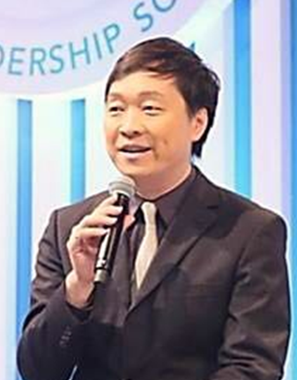
超連鎖事業的初衷
The Why
Marcus Tai
顧問經理級
Supervising Coordinator
四個佣金週期共賺取HK$57,500
HK$57,500 in 4 Commission weeks
本簡報中提到的收入等級純屬舉例說明，無意代表美安香港超連鎖™店主的一般收入，也無意表示任何超連鎖™店主皆可賺取同等收入。美安香港超連鎖™店主的成功與否，取決於其在發展事業時的努力、才能與投入程度。
The income levels mentioned in the following presentation are for illustration purposes only. They are not intended to represent the income of a typical Market Hong Kong UnFranchise ™Owner, nor are they intended to represent that any given Independent UnFranchise ™ Owner will earn income in that amount. The success of any Market Hong Kong Independent UnFranchise ™ Owner will depend upon the amount of hard work, talent, and dedication which he or she devotes to building his or her Market Hong Kong Business.

Slide 2
NLP Trainer , Clinical Hypnosis Therapist
Engaged in IT industry for 20 years, had been working in Microsoft, Sun Microsystems and Oracle
Being a full-time UnFranchise Owner of shop.com starting from 2015
Master Shopping Annuity Member
Member of mhk Speaker Bureau
Supervising Coordinator
4-week Commision HK$57,500
顧問
57500

Slide 3
WAIT
Waiting for…
weekend, holidays, retirement,
changing a better job, meeting a good partner,
being success, being rich,
having a better life

Slide 4
WHY ?

Slide 6
Rich Dad, Poor Dad?
Rich Kid!

Slide 7
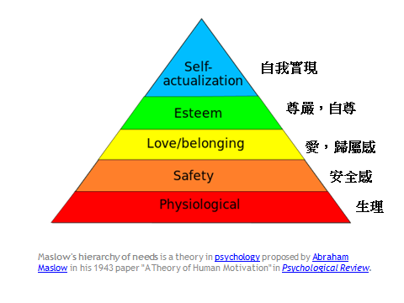

Slide 8
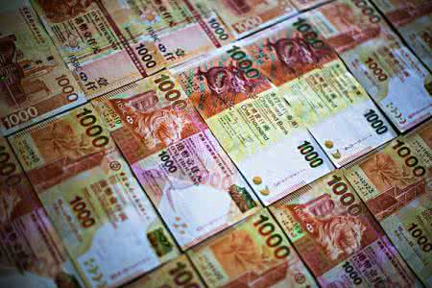

Slide 9
Wealth Quotient

Slide 10
The Trend
THE WORLD HAS GONE
Digitized
The number of entrepreneurship is unprecedented. People born in a baby boom (a period of high birth rate) are looking for another career opportunity.
People have more freedom, more needs.
Forever increasing rent
China's online shopping site "Taobao“ set a record from "Singles" shopping discount with a daily turnover of US $ 12 billion on November 11 last year
Notes:
Job security, make more money, five times the average worker, personal development to maximize your human potential. The dream – freedom. Seven thousands baby boomers a day turn 65. working from home creates an opportunity for Plan B.
You can make it happen. It is not easy. It takes effort. And, in a sick way...it feels like pleasure. You have a impact on the community and economic growth. And, you become part of the solution.

Slide 11
Notes:
JF will introduce SR

Slide 12
45 years plan vs 2-3 years plan
saving/investment
income
expenses
working
spending
earning
Ongoing spending vs Ongoing income

Slide 13
SHOP.COM
Converting Spending Into Earning
ma
cashback

Slide 14
NLP Trainer , Clinical Hypnosis Therapist
Engaged in IT industry for 20 years, had been working in Microsoft, Sun Microsystems and Oracle
Being a full-time UnFranchise Owner of shop.com starting from 2015
Master Shopping Annuity Member
Member of mhk Speaker Bureau
Supervising Coordinator
4-week Commision HK$57,500
顧問
57500

Slide 15
Dream, Mission

Slide 16
When you have a big dream, You can attract countless people who have dreams, to work together and achieve the dream together.

Slide 17
It all comes from…

Slide 18
Keypoint
Forget what you already know and start learning all over again, with your mind and heart

