Slide 1
夢想與目標規劃
Dreams and Goal Setting
Nora Siu
高級顧問經理級
Director
四個佣金週期共賺取HK$138,000
HK$138,000 in 4 Commission weeks
本簡報中提到的收入等級純屬舉例說明，無意代表美安香港超連鎖™店主的一般收入，也無意表示任何超連鎖™店主皆可賺取同等收入。美安香港超連鎖™店主的成功與否，取決於其在發展事業時的努力、才能與投入程度。
The income levels mentioned in the following presentation are for illustration purposes only. They are not intended to represent the income of a typical Market Hong Kong UnFranchise ™Owner, nor are they intended to represent that any given Independent UnFranchise ™ Owner will earn income in that amount. The success of any Market Hong Kong Independent UnFranchise ™ Owner will depend upon the amount of hard work, talent, and dedication which he or she devotes to building his or her Market Hong Kong Business.

Slide 2
Dreams and Goal Setting

Slide 3
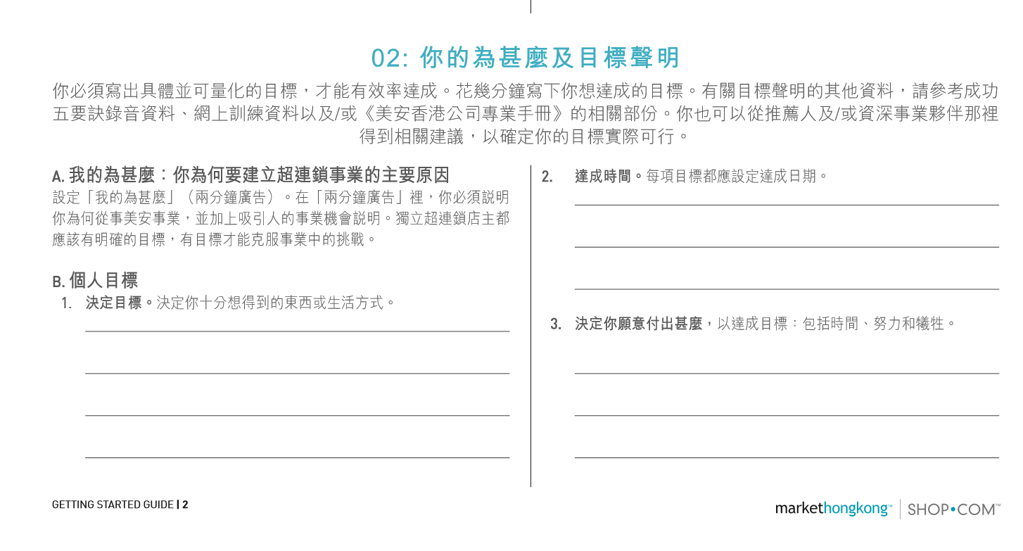

Slide 4
Can you answer YES to the question of
“what is my dream” ?

Slide 5
What is a Dream ?

Slide 7
Dream Board of Post-90s generation Partner－Lam

Slide 8
Lam’s Target Quantification
Family Expenses
40,000
Charity
100,000
Financial Support for Parents
40,000
10 years
HK$ 270,000.00
Housing Mortgage
40,000
Team Building
20,000
Travel & Savings
30,000

Slide 9
1. Develop One BDC- $57500/4 weeks
Business Development Center (BDC)
5000BV x 4 = 20000 BV
5000BV x 4 = 20000 BV

Slide 10
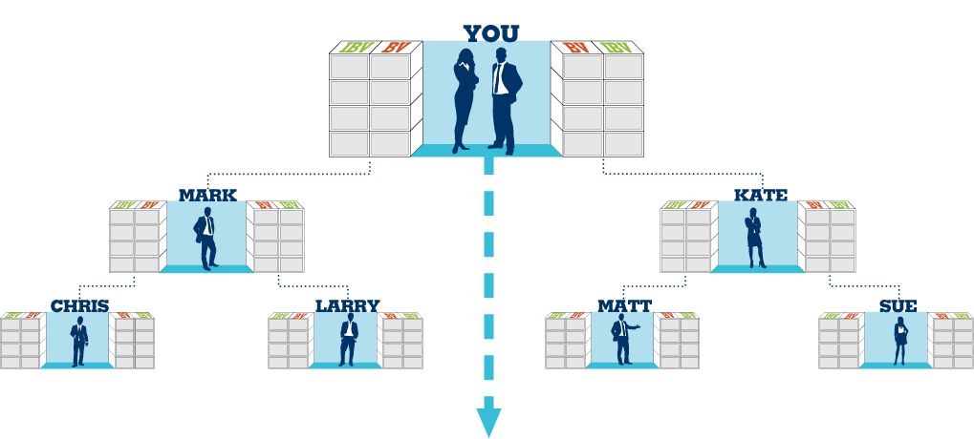
2. BasE 10 X Seven STRONG
7 UnFranchise OWNERS Develop a customer base of
10 Preferred Customers
500 BV x 7 = 3500 BV
Each UnFranchise Owner can create 500 BV per month
1500 BV
1500 BV
5 Preferred Customers (PC)
5 Preferred Customers (PC)
500 BV
5 PC
5 PC
5 PC
5 PC
500 BV
500 BV
5 PC
5 PC
5 PC
5 PC
5 PC
5 PC
5 PC
5 PC
500 BV
500 BV
500 BV
500 BV
此投影片上BV及IBV庫顯示週期業績累積

Slide 11
Develop One BDC- $57500/4 weeks
21000 BV
BDC
21000 BV
12 sales organisation
12 partners to start
7
1
3500BV
3500BV
3500 BV x 6 = 21000 BV
3500 BV x 6 = 21000 BV
2
3500BV
3500BV
8
3
3500BV
3500BV
9
4
3500BV
10
3500BV
5
3500BV
11
3500BV
6
3500BV
3500BV
12

Slide 12
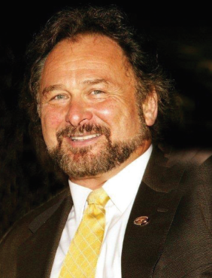
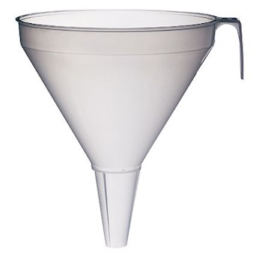
3. 12 sales organisation need 12 partners to start
How many people you need to finally sponsor 12 partners ?
16 potential customers x 12 partners
= 192 potential customers
Time: 10 years (120 months)
4 BDC x 192 people / 120mth
= 6.4 people /mth
6.4/4week = 1.6/week
16 people
8 FORMHD
4 shop.com
2 UBP
Get contact with 1.6 people per week
1 become a partner

Slide 13
Little Kero

Slide 14
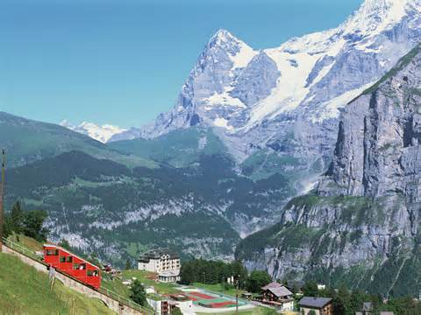
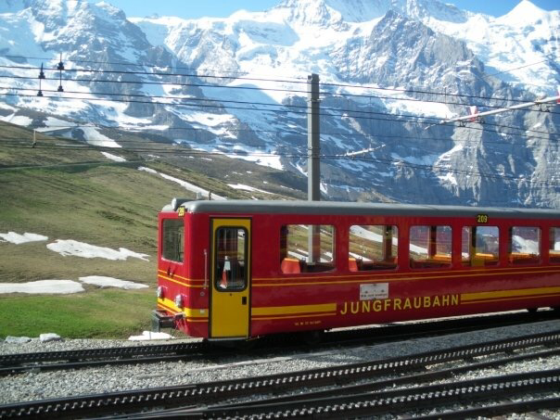
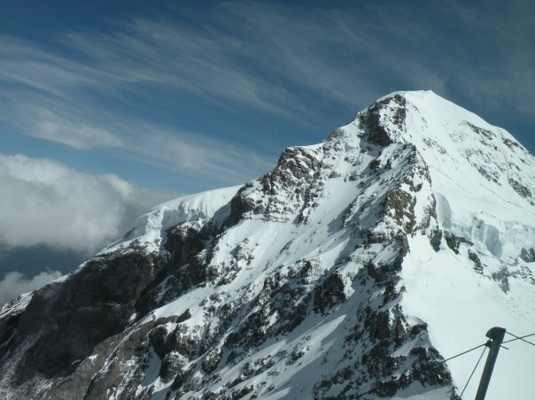
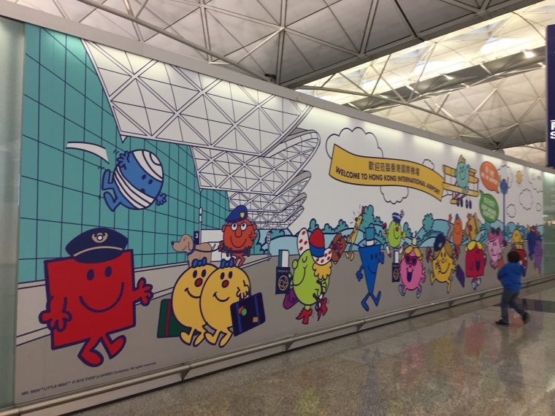
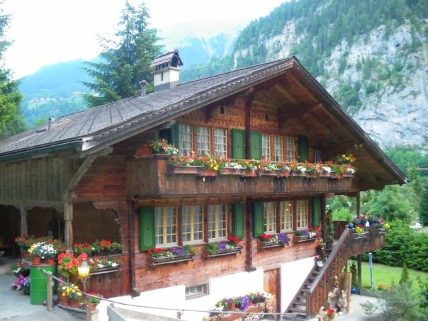
KERO DREAM BOARD

Slide 15
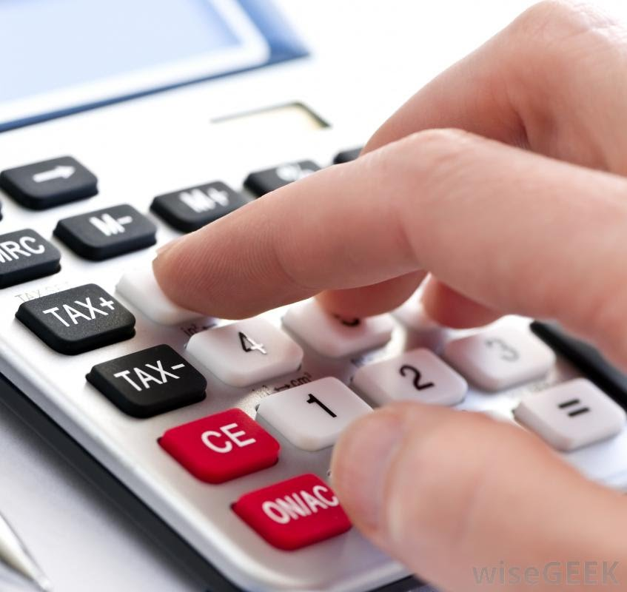
Kero’s Target Quantification
Travel with Mom HKD 35,000/month
Learning with Partners HKD 15,000/month
Charity HKD 10,000/month
Hobby HKD 10,000/month
Housing HKD 60,000/month
Total: HKD130,000/month

Slide 16
Daily/Weekly Action Plan

Slide 17
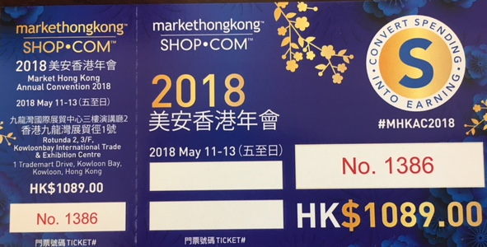
Before
After (Today)

