Slide 1
利用購物年金作招募
Recruiting with Shopping Annuity
William Chan
總顧問經理級
National Supervising Coordinator
四個佣金週期共賺取HK$76,600
HK$76,600 in 4 Commission weeks
本簡報中提到的收入等級純屬舉例說明，無意代表美安香港超連鎖™店主的一般收入，也無意表示任何超連鎖™店主皆可賺取同等收入。美安香港超連鎖™店主的成功與否，取決於其在發展事業時的努力、才能與投入程度。
The income levels mentioned in the following presentation are for illustration purposes only. They are not intended to represent the income of a typical Market Hong Kong UnFranchise ™Owner, nor are they intended to represent that any given Independent UnFranchise ™ Owner will earn income in that amount. The success of any Market Hong Kong Independent UnFranchise ™ Owner will depend upon the amount of hard work, talent, and dedication which he or she devotes to building his or her Market Hong Kong Business.

Slide 2
Recruiting with
Shopping Annuity

Slide 3
William Chan
Graduated from Chinese University
Major in Social work. Minor in Psychology
Supervisor of Social Welfare Association
1997 – 2012 Business Manager -
Multinational Insurance Company
2012 – Now Senior Consultant –
Insurance Broker Company
2013 Sep Joined in Market Hong Kong
2014 Jan Promoted to Coordinator
2014 Mar Promoted to Executive Coordinator
2014 Aug Promoted to Master Coordinator
2014 Oct Promoted to Senior Master Coordinator
2015 Apr Promoted to Professional Coordinator
2015 Oct Promoted to Supervising Coordinator
2016 Dec Promoted to National Supervising Coordinator

Slide 4
Now What is my WHY?
UnFranchise Owner：Learn to succeed
Guest：Assess the business

Slide 5
In the past 25 years
UnFranchise Owners all over the world
Gain their Success
Build up residual income Through SHOP.COM
UnFranchise system

Slide 6
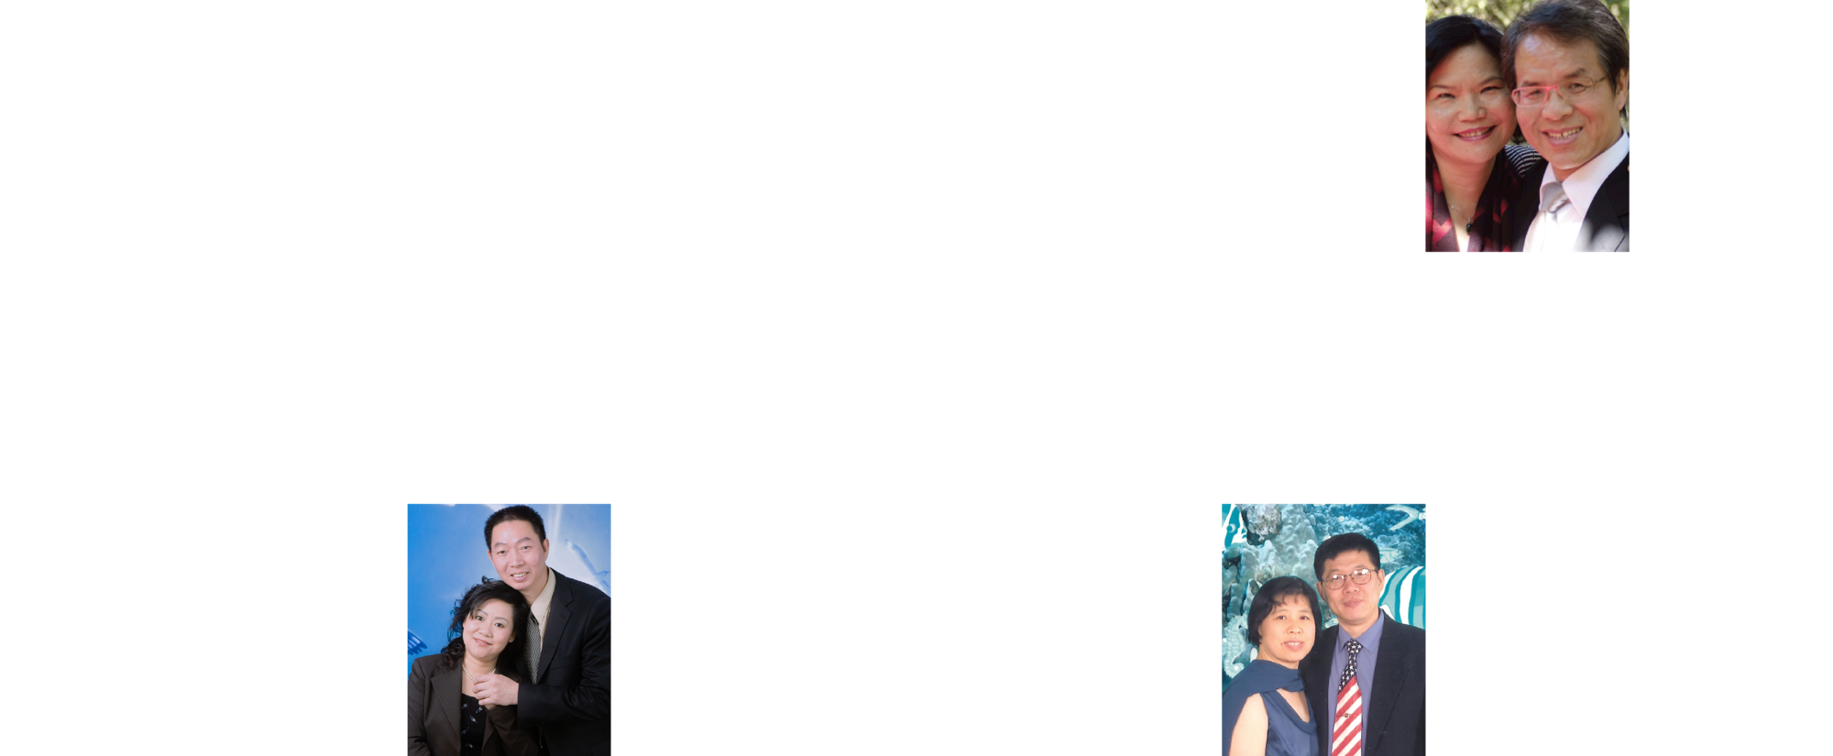
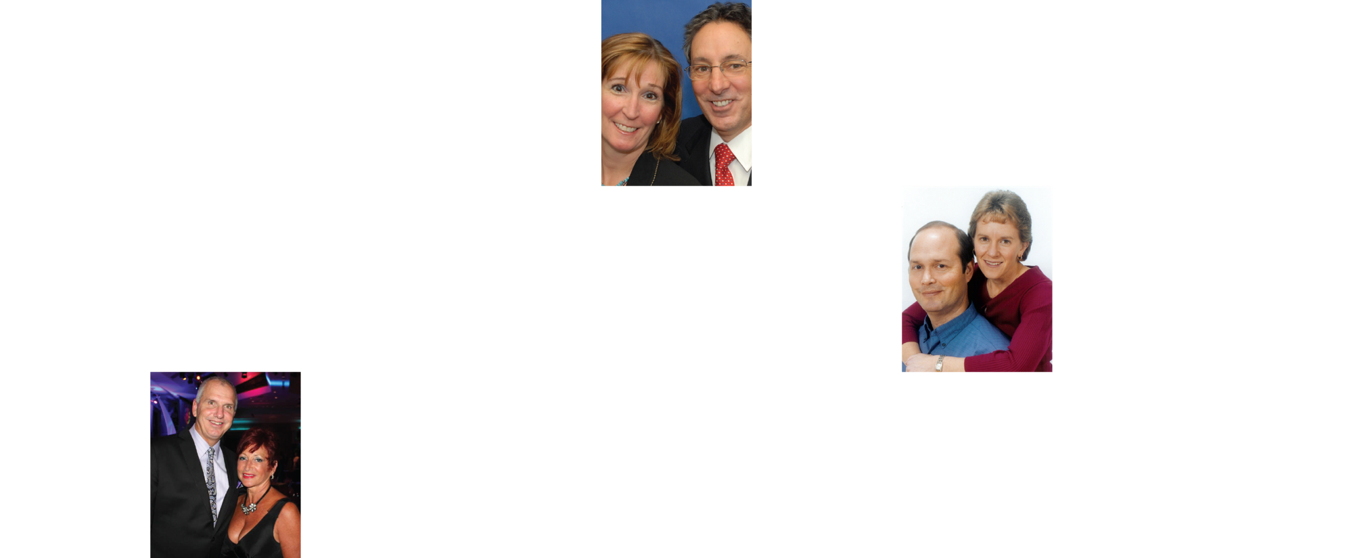
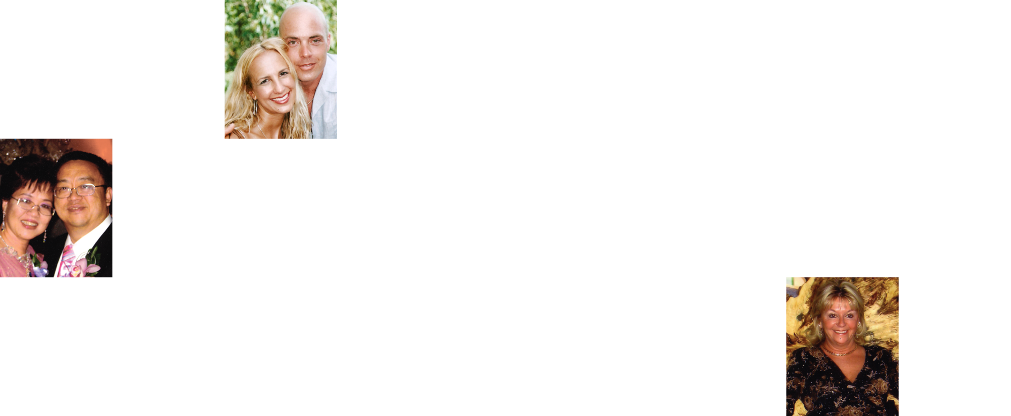
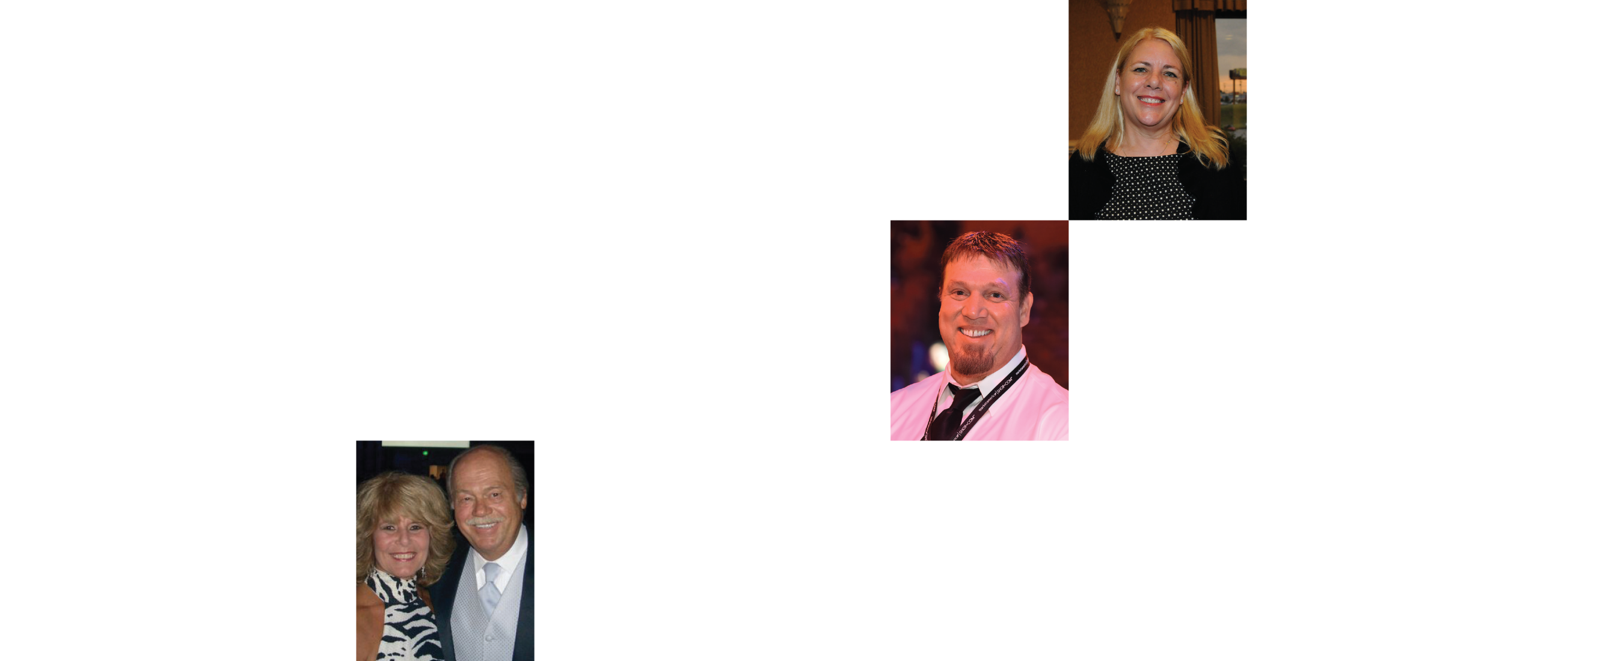
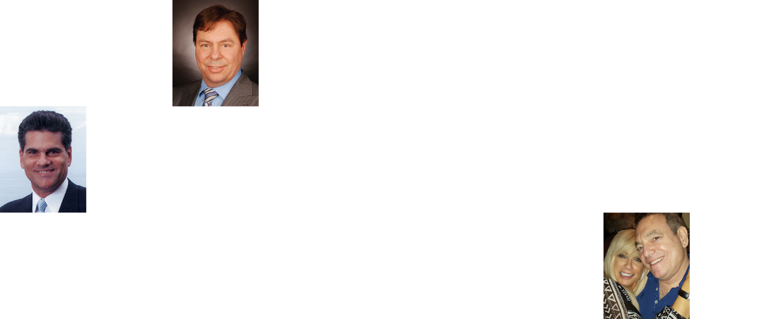
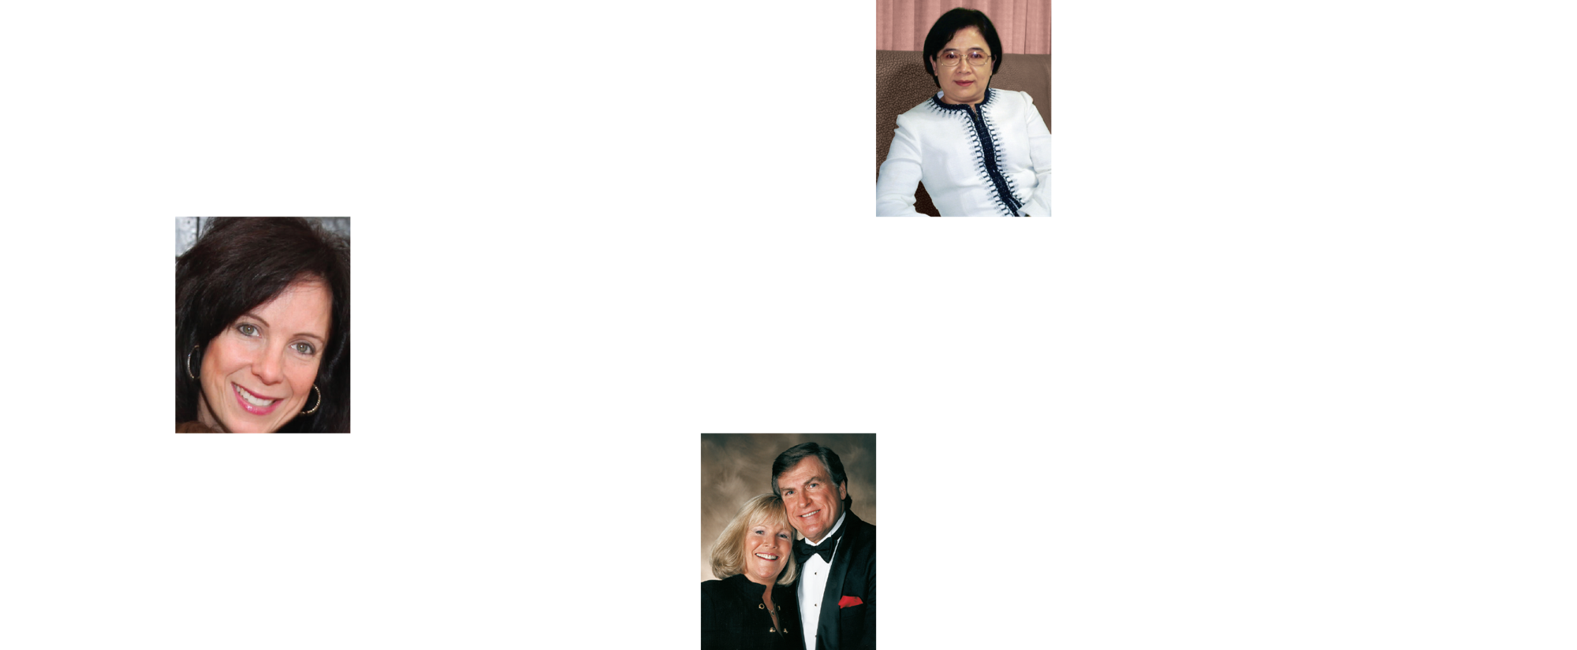
EARNED OVER ONE MILLION DOLLARS IN COMMISSIONS
MARKET AMERICA | SHOP.COM IS CHANGING THE WAY THAT PEOPLE SHOP SO EVERYONE CAN BECOME FINANCIALLY INDEPENDENT BY CREATING THEIR OWN ECONOMY

Slide 7
Formula of Success
${MPCP}^{1}$= Basic 5 ${MPCP}^{2}$= Shopping Annuity ${MPCP}^{3}$= digital leverage

Slide 8
Basic 5

Slide 9
Attitude and Knowledge
Goals and a Goal Statement
Retailing
Basic 5
Prospecting, Recruiting and Sponsoring
Follow Up and the ABC Pattern of Building Depth
Fundamentals of the Business

Slide 10
Prospecting, Recruiting and Sponsoring

Slide 11
Reason of recruiting
We live in a system.
Through recruiting, we create a system.

Slide 12
Reason of recruiting

Slide 13
UNFRANCHISE MANIFESTO
JR explained that he designed a tracking system. Through MPCP, everyone can build up and manage two business centers with their own effort. Finally they can get residual income.

Slide 14
MARKET AMERICA | SHOP.COM
UnFranchise system
Do you believe it?
Can you master it?

Slide 15
What
WHY
HOW
WHAT
How
Why

Slide 16
HOW
Full of faith
Confident
Calm
Bold
Professional
Focus and match
Law of large numbers
Enjoy the process

Slide 17
WHAT
Recruitment process
Start a topic
Understand the needs
Business opportunities of MHK
Commission system
Objection treatment
Sign up and join

Slide 18
Recruit with Shopping Annuity
${MPCP}^{1}$= Basic 5 ${MPCP}^{2}$= Shopping Annuity ${MPCP}^{3}$= digital leverage

Slide 19
TRADITIONAL ANNUITY:
You must have discretionary income to make fixed sum payments which fund your annuity.
Annuity
SHOPPING ANNUITY®: By redirecting money you are already spending to SHOP.COM, you create your “fixed sum payment” to fund your Shopping Annuity.
Notes:
TRAINERS NOTES:
This is a wrap up slide – a chance for you to summarize the key points side by side.

Slide 20
Recruitment with Shopping Annuity：Theme and Focus
Convert spending to income
the Midas touch
Economic Revolution
Digital Aggregation
Tracking system
Assessment Service
Successful Stories
Group buying power
Businessmen separate the customers

Slide 21
Convert Spending Into Earning

Slide 22
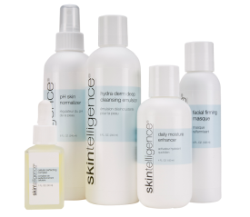
Help you get commission by all means!
Fubon Credit Card (MHK)
Connect with octopus card and online payment
Partner Stores
Basic necessities of life
Exclusive product （Dozens of brands）
Covering variety of shopping categories, helping customers to gain commission.
Customers becomes operators.

Slide 23
WHAT
Recruitment process
Start a topic
Understand the needs
Business opportunities of MHK
Commission system
Objection treatment
Sign contract and join

Slide 24
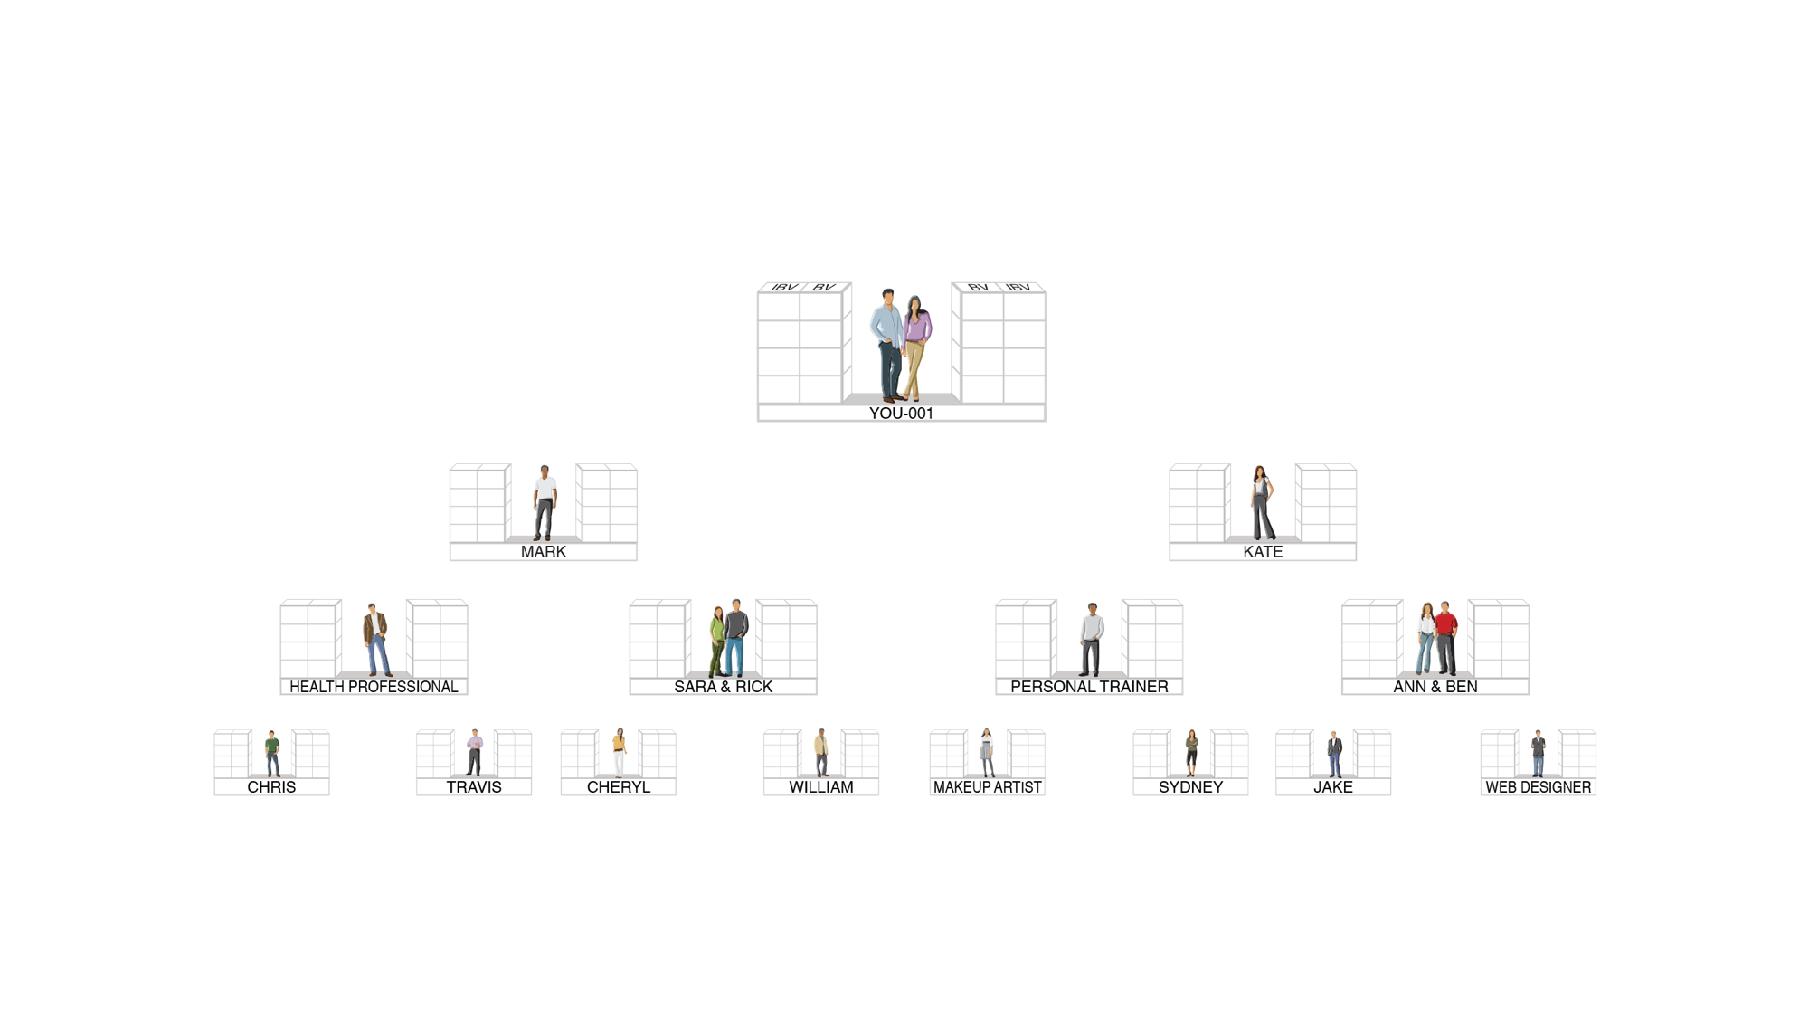
MPCP
BV AND IBV ARE TRACKED DAILY AND COMMISSIONS ARE CALCULATED WEEKLY
5000 / 5000 = $4,600
3600 / 3600 = $2,300
2400 / 2400 = $2,300
1200 / 1200 = $2,300
$11,500
5000 / 5000 = $4,600
3600 / 3600 = $2,300
2400 / 2400 = $2,300
1200 / 1200 = $2,300
$11,500
BV
5000
5000
IBV
3600
3600
2400
2400
1200
1200
HEALTH PROFESSIONAL
PERSONAL TRAINER
MAKE UP ARTIST
WEB DESIGNER
TOTAL WEEKLY POTENTIAL HK$27,600 PER BDC

Slide 25
According to the bank rate nowadays, do you have enough current cash for investment?
Shopping Annuity UnFranchise Residual Income | Investment rule of 4%
$4,600 / Month (Executive coordinator/ Master) | $1,380,000
$34,500 / Month (Professional coordinator) | $11,040,000
$76,600 / Month (National supervising) | $24,512,000
$138,000 / Month (Director) | $44,850,000
$276,000 / Month ( Field Vice President) | $92,000,000
Shopping Annuity UnFranchise Income
vs. Investment rule of 4%
Notes:
Celine:
Figures have been changed to HK amounts.
TRAINERS NOTES:
The 4% Rule is a popular investment-income strategy that says as long as you withdraw no more than 4% of your initial portfolio, adjusted for inflation, on an annual basis during your retirement years, you shouldn't run out of money.
Take a look at what it would take to create a $4,600/month payment to yourself at retirement, following this rule. It would take $450,000 in the bank! Would you have that money saved up by retirement?
Most Americans are living paycheck to paycheck with little to no savings. How will they get it done? The answer is that most won’t, and therefore will never have the 4% rule as a viable retirement option.
With Market America, you could create a $4,600 / month asset as an executive coordinator or master coordinator. And even more, after 2-3 years of following our proven plan you could create a residual income of $1,420,000 / year. That is the equivalent of living off of 4% of a $5MILLION asset in the bank!
Think even further – if you built the UnFranchise as a way to enjoy residual income because you didn’t have the savings to participate in the 4% rule, now you can create the savings and earn both – the Residual Income from your UnFranchise and the 4% off the income you save!

Slide 26
Recruit with Shopping Annuity
Understandable
Reasonable
Acceptable

Slide 27
Prospect and recruit with Shopping Annuity
Current Customers
People who want to save money when shopping
People want to improve financial situation
Conclude：All people

Slide 28
Start a conversation
with Shopping Annuity
Have you heard of Shopping Annuity?
If I tell you, shopping can convert spending into earning. Are you interested?
You are already spending…
Why don’t you convert it to earning?

Slide 29
We have:
Technology and system
Tracking system of transaction record
Digital Aggregation
E-Commerce
Correct shopping rewards
MPCP
Conclusion
Market America ...
Creating a future
for economy

Slide 30
Prospect and recruit those who want to be entrepreneurs
Create the future of economy with Shopping Annuity

Slide 31
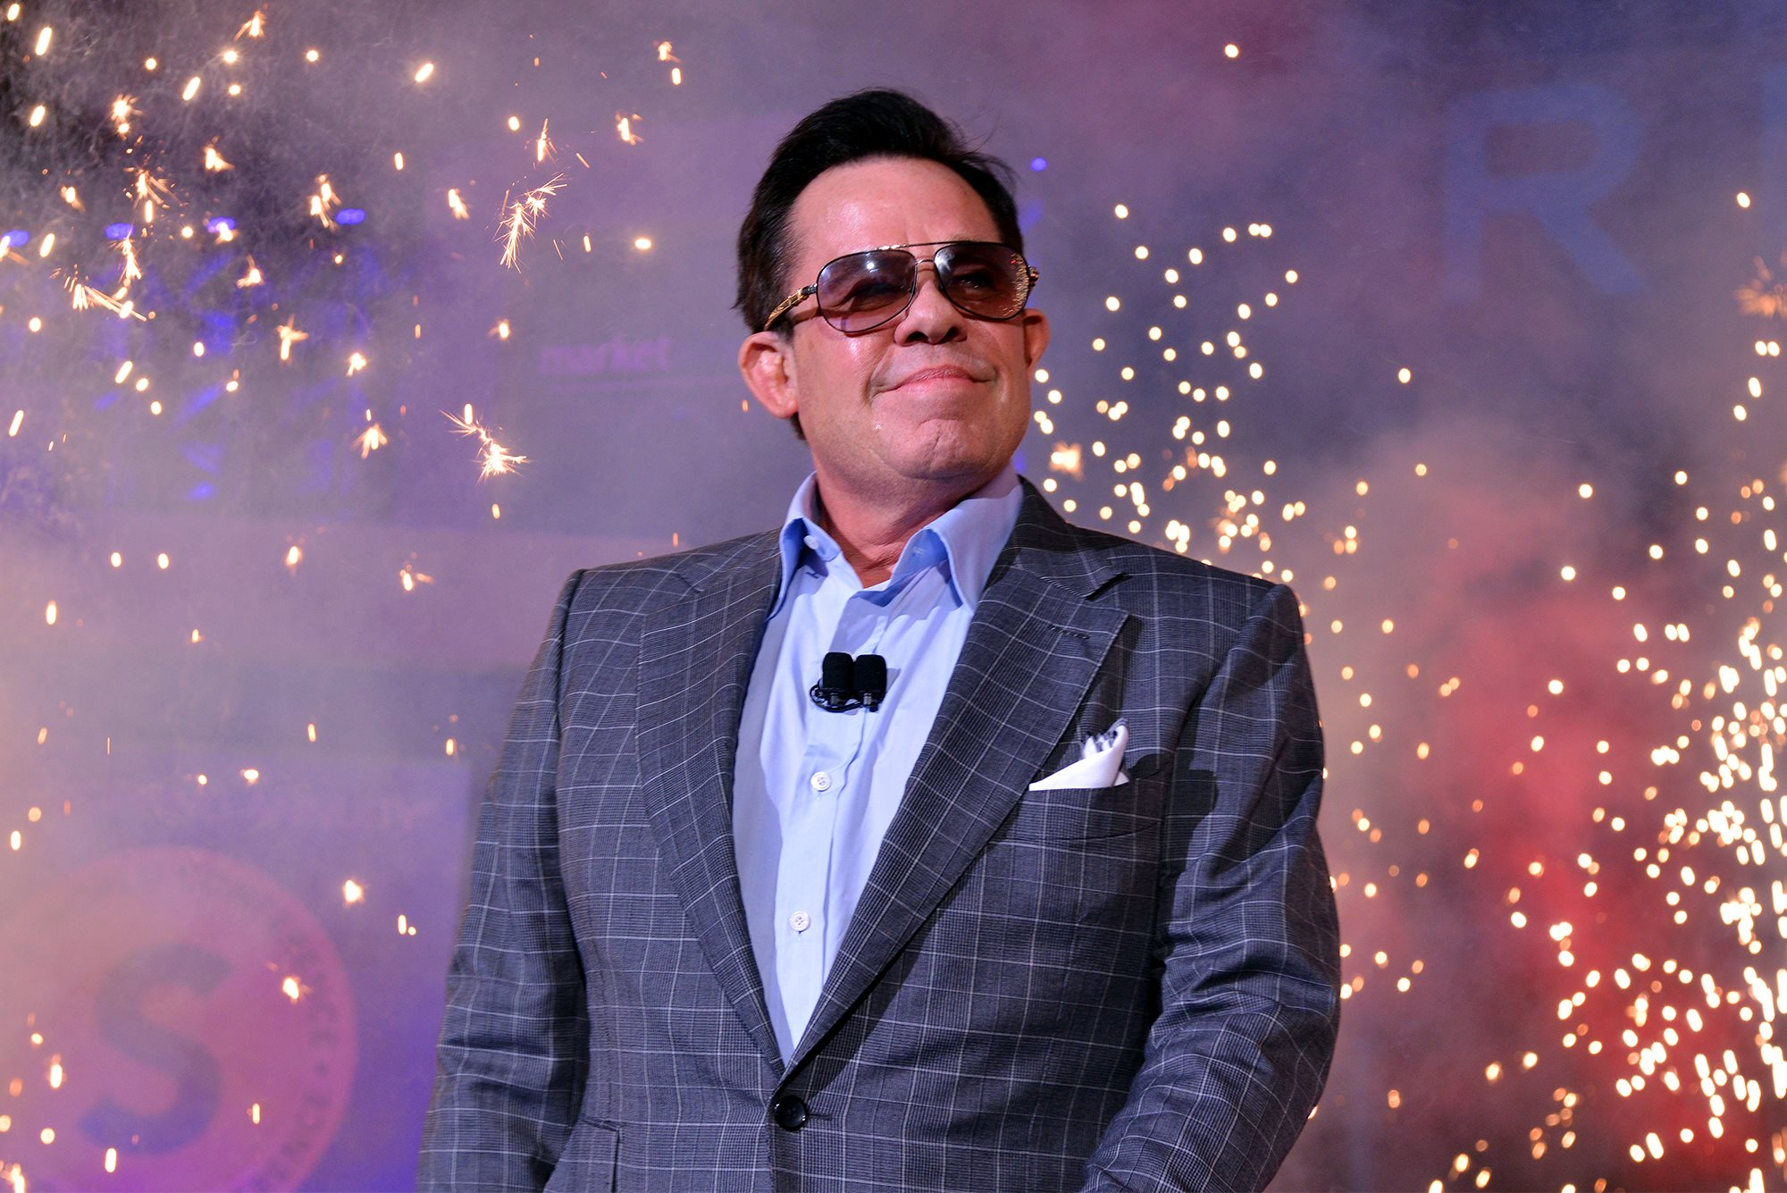
Will you join us?
This is the unique vision of Market America. It is just the beginning.
The success of shopping annuity are led by us!
We are changing the way that people shop and economy with shopping annuity.
JR Ridinger

Slide 32
Thank you!

