Slide 1
[
]
MAWEBCENTERS & MORSE CONNECT
B2B SOLUTIONS
Notes:
SR

Slide 2
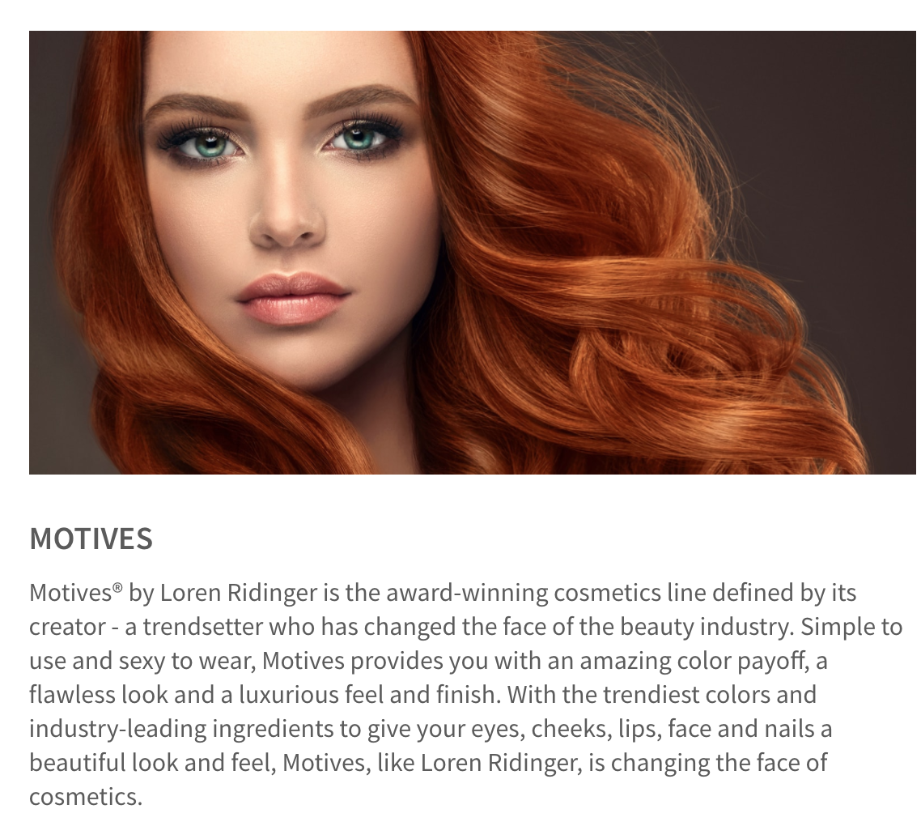
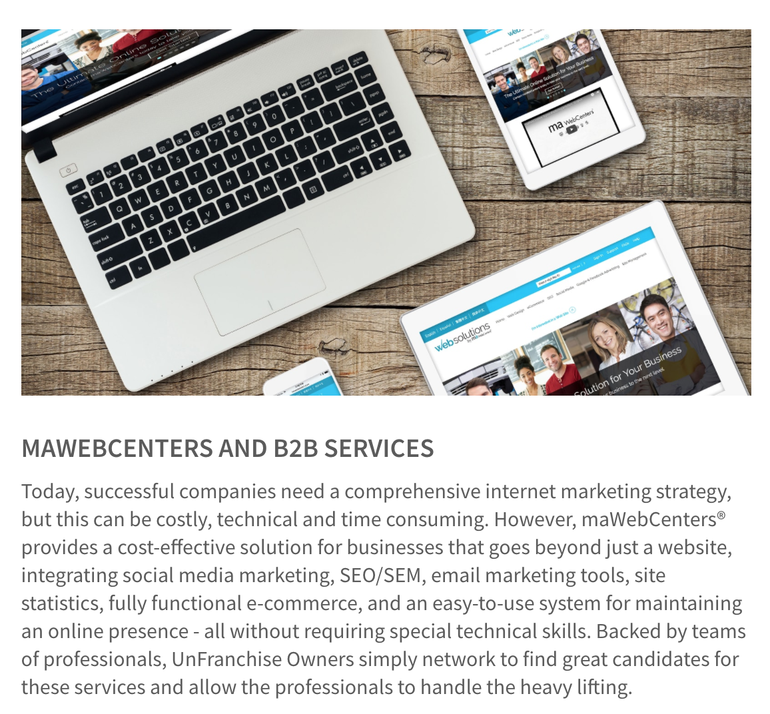
UNIVERSITY MAJORS & AREAS OF SPECIALIZATION
Exclusive Brands & Services
Proven sales system, support tools & education
Give & Get referrals within your team
PICK ONE OR TWO – LEARN TO EDIFY YOUR TEAM!
Almost every division touches the B2B sector in some way, at some points

Slide 3
A PROVEN, DUPLICATABLE, SYSTEM TO PROVIDE
SMALL BUSINESS OWNERS AN EFFECTIVE INTERNET PRESENCE
TOGETHER, WE HELP BUSINESSES AND ORGANIZATIONS WITH:
Increasing Revenues
STREAMLINING BUSINESS PRACTICES
Decreasing Expenses
INCREASING ENGAGEMENT
Increasing Customer Satisfaction
MARKETING THEIR BUSINESS
Notes:
SR

Slide 4
A PROVEN SYSTEM FOR SUCCESS
YOU TALK TO BUSINESS OWNERS & SET APTS.
OUR TEAMS
SALES,
DESIGN, DIGITAL
YOUR CLIENT
GREAT SITE & SUPPORT
Notes:
TRAINER’S NOTES:
We’ve all set some initial goals but did we take them seriously?
Did you hit your goals in the past? Why /Why not?
Was your action plan on track to help you get what you want?
Revising your goals will help to create smarter goals with proper action plans
Better action plans = better quality work time AND better quality play time

Slide 5
A COMPREHENSIVE DIGITAL STRATEGY
ONLINE SOLUTIONS
MERCHANT SERVICES
CUSTOMERS
WEBSITES
ECOMMERCE
GOOGLE
SOCIAL MEDIA
CONTENT
COMMUNICATION
BANKING SERVICE
LOGISTIC SERVICE
E INVOICE
SHOP.COM PARTNER
SHOP LOCAL
PREFERRED CUSTOMER PROGRAM
Notes:
TRAINER’S NOTES:
We offer Online Solutions, such as…..
We offer Merchant Services, such as…
And we offer clients the ability to become Shop.com Partners, ShopLocal customers, or Preferred Customers to save money on business expenses.

Slide 6
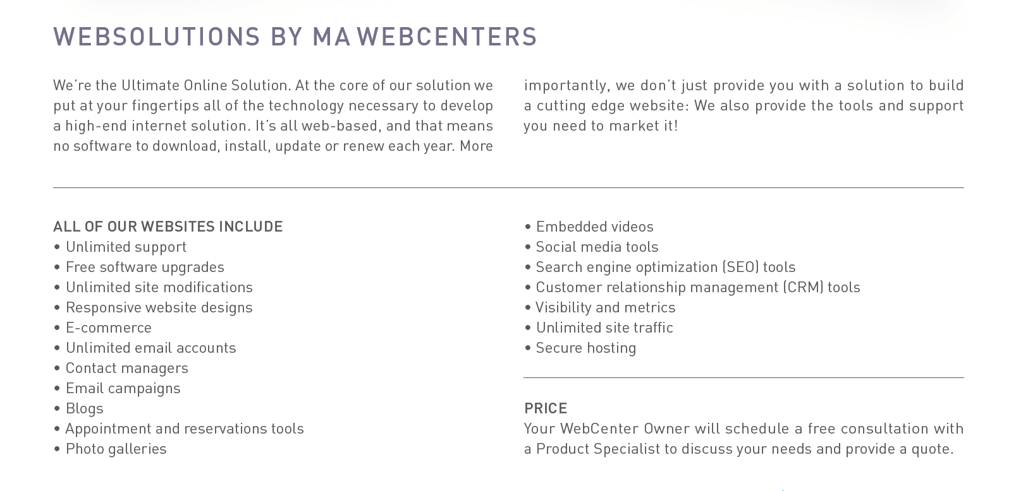
MORE THAN JUST A WEBSITE
DIGITAL MARKETING PRODUCTS
Design, SEO, Google Ads, Social Media Management, Facebook Ads, Online Reputation management, Content Writing
Notes:
Trainers Notes:
This is just an intro slide – The goal here is to get them excited about what we are going to talk about.
In brief, cover the big topics “Websites, Marketing Tools, Unlimited, Support, Security)
The goal is to paint a simple picture of how all –inclusive our solution actually is / Instill confidence in the product.
Spend 1 minute or less on this slide – the details are coming up!

Slide 7
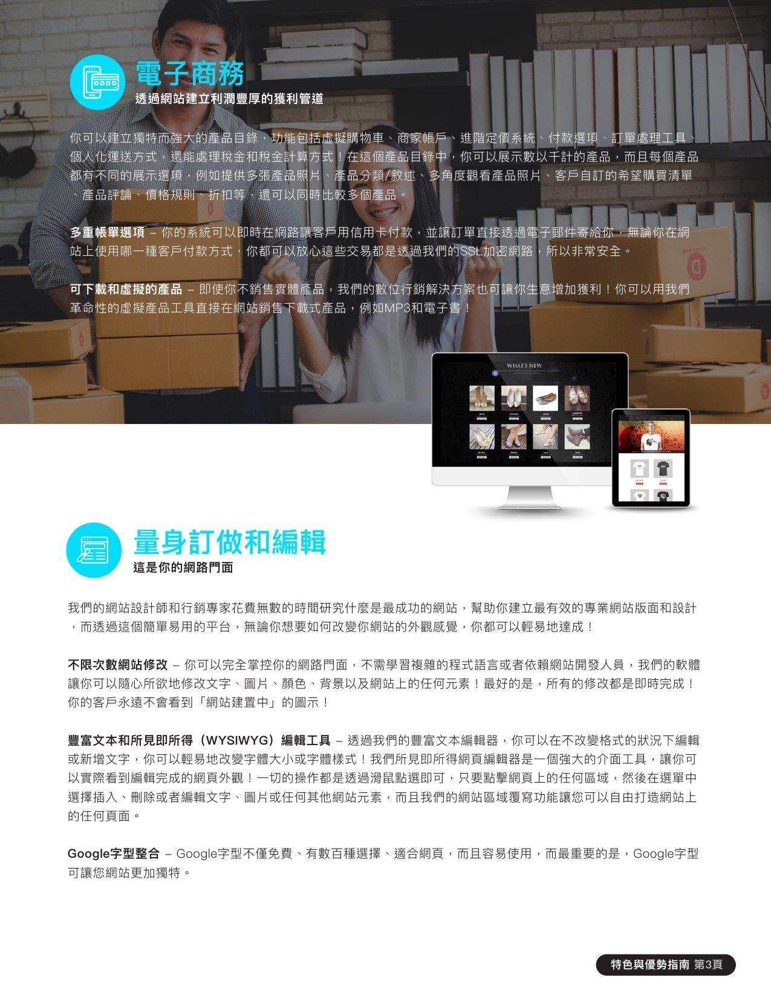
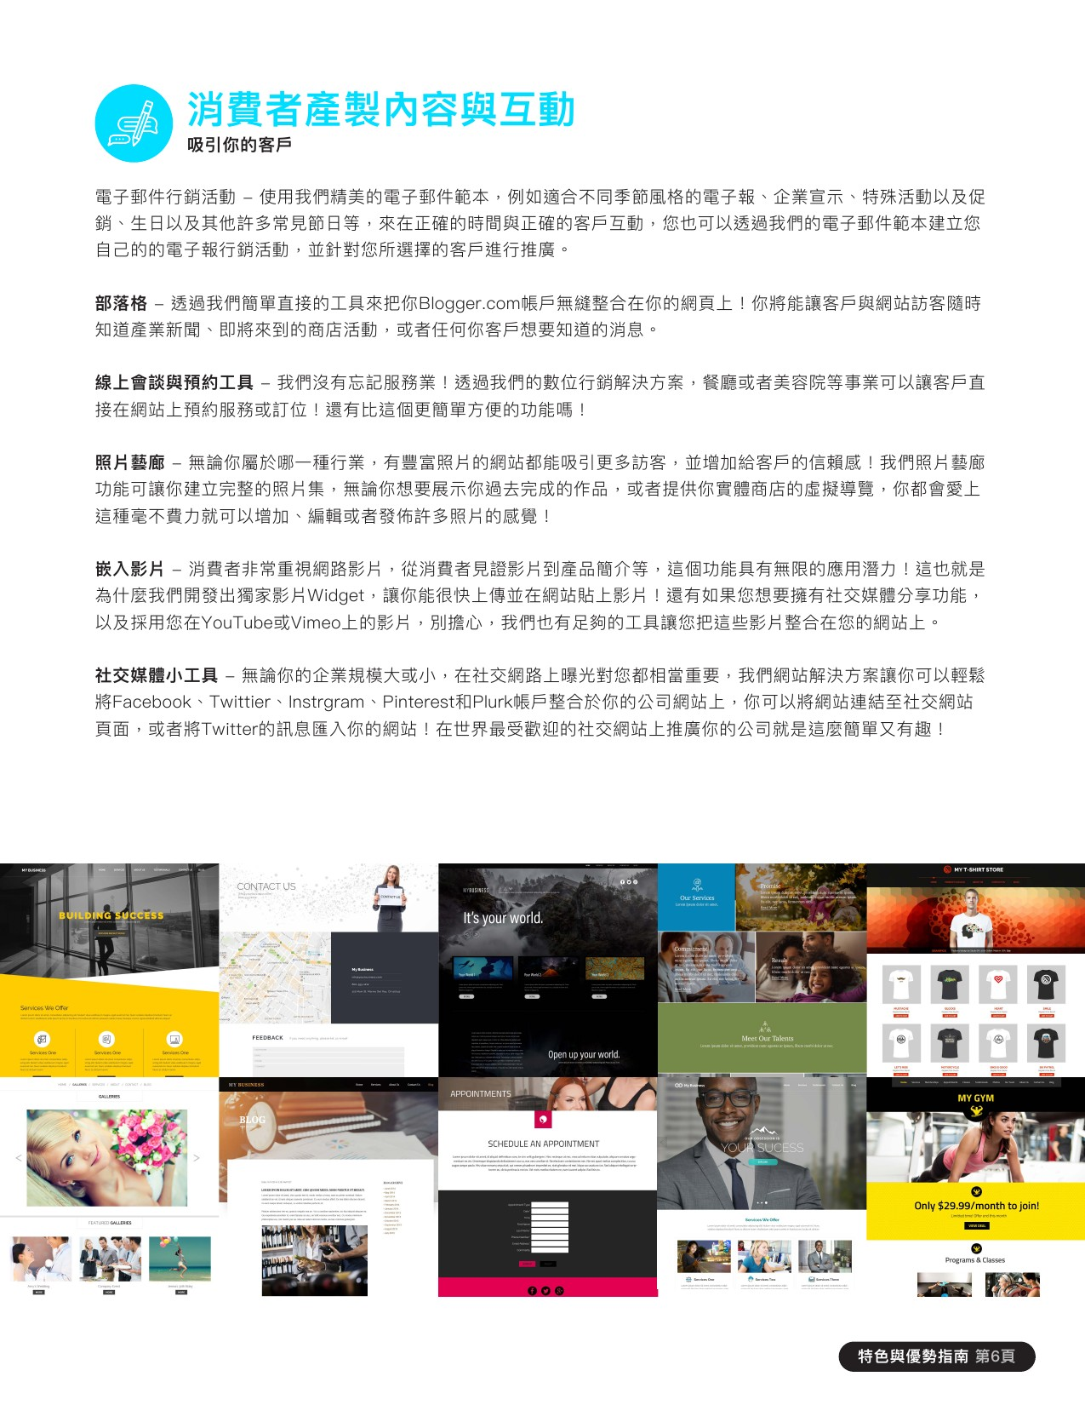
Web Site Features
and Benefits Guide

Slide 8
UFO PROFITABILITY
When considering any business venture, you want to evaluate how it can impact your income long & short term.
SHORT TERM GOALS
Your short-term financial goals can typically be handled by increasing cash flow (RETAIL PROFITS)
LONG TERM GOALS
Your long-term financial goals can typically be handled by increasing ongoing income (MPCP)

Slide 9
AVERAGE WEBSITE RETAIL PROFITS
USA, MX, CAN, AU: $500-$1,000
UK: £700
HK: HK $7,700
TW: NT $32,000
Let’s take a look at earning potential
Retail Profit
BV
BV
Website Sale: 230 BV
Active Website Client: 30 BV / mo.
Digital Marketing Sale: 5-100 BV & Profit/mo.
Growth Potential
The income levels mentioned in the following presentation are for illustration purposes only. They are not intended to represent the income of a typical Market Hong Kong UnFranchise ™Owner, nor are they intended to represent that any given Independent UnFranchise ™ Owner will earn income in that amount. The success of any Market Hong Kong Independent UnFranchise ™ Owner will depend upon the amount of hard work, talent, and dedication which he or she devotes to building his or her Market Hong Kong Business.
Notes:
TRAINER’S NOTES:
Earning potential will be demonstrated in terms of short term and long term growth potential

Slide 10
YOUR ORGANIZATION
In our business, you don’t want your “major” to distract from overall business building.
GROUP BUSINESS VOLUME
BV & IBV from customer sales is “Autoship” in nature. How does that add up?
(Group Business Volume)
SHOPPING ANNUITY
Do WebCenter Owners spend money?
How does your client’s spending compare to an average family spending?

Slide 11
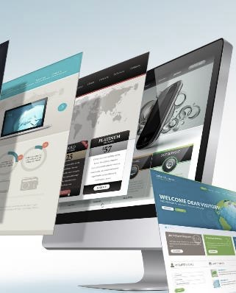
Each website sold
generates 230 BV
Each active client
generates
5, 30 or 35 BV / Mo.
DIGITAL MARKETING PRODUCTS GENERATE ADDITIONAL BV AND RETAIL PROFITS
Notes:
TRAINER’S NOTES:
Long Term Potential for WCOS = Ongoing BV and Retail Profits

Slide 12
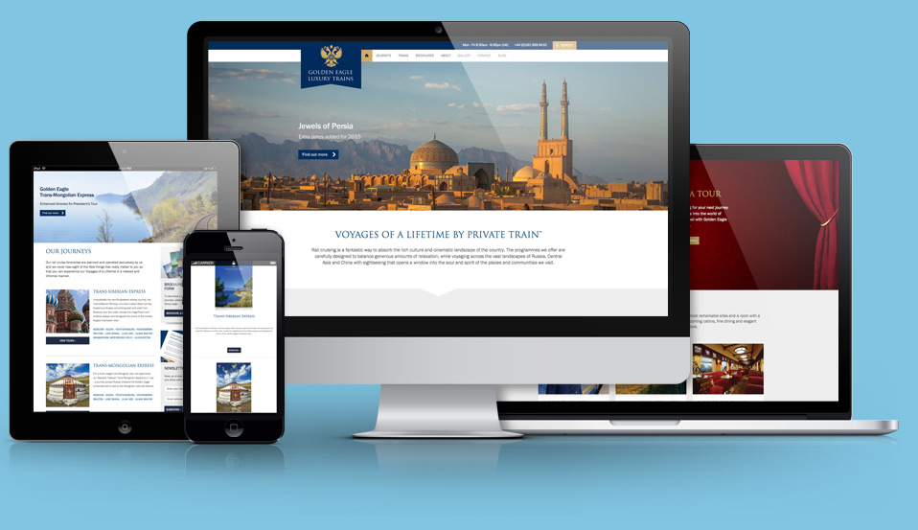
Brand New Customer Services in 2018

Slide 13
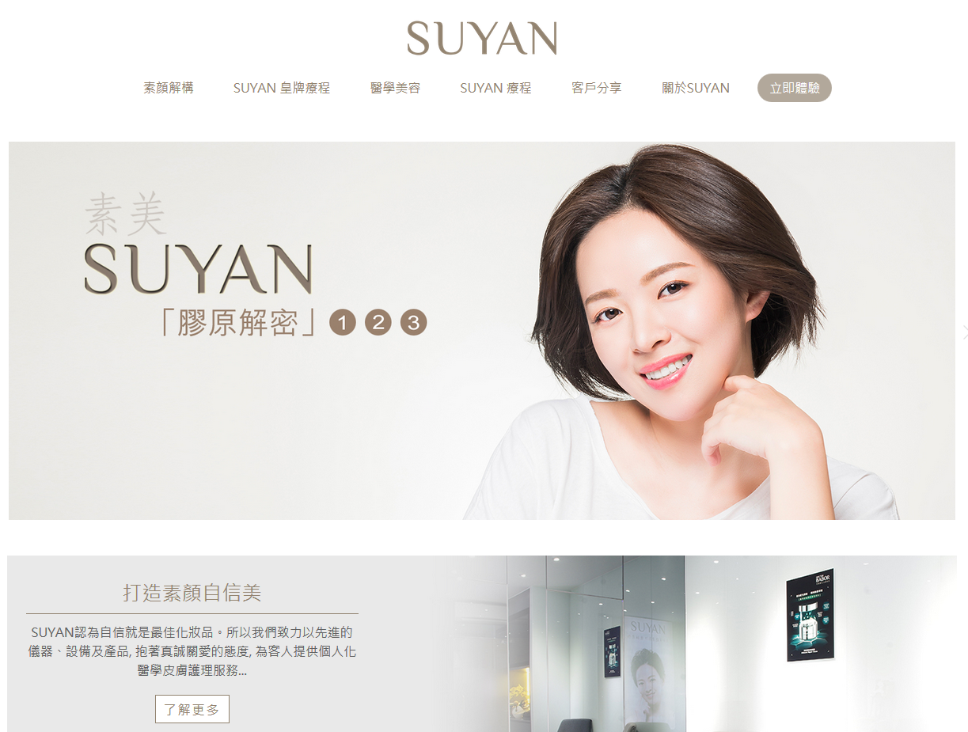
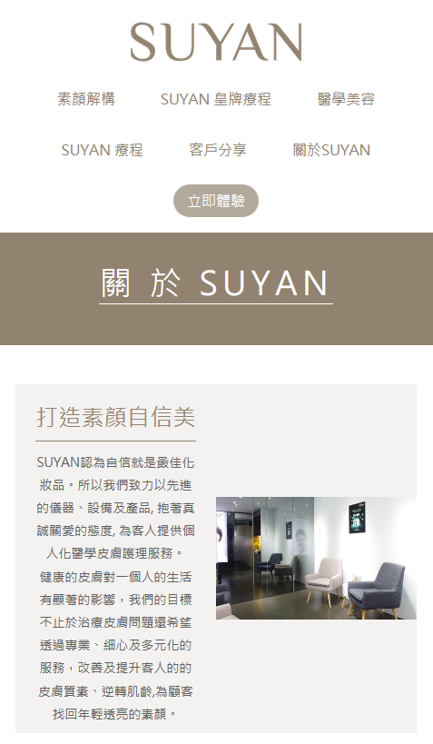
Customer’s Review:
Nice website design and style
Let new customers to learn others clients’ comments and experience in “Customers’ Testimonial” page
Increase customers’ confidence
Customers can…
understand the service and equipment
fill online questionnaire, complete booking and skin analysis
www.suyanbeauty.com

Slide 14
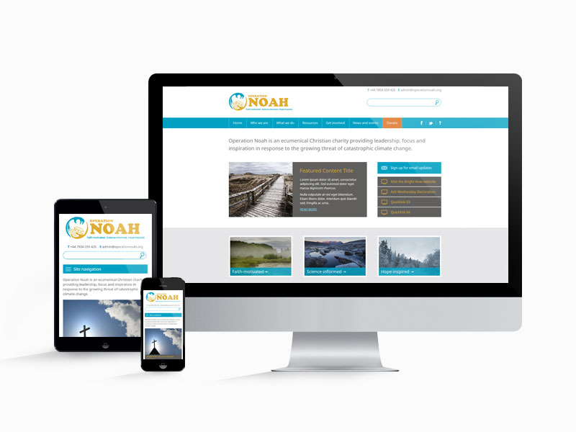
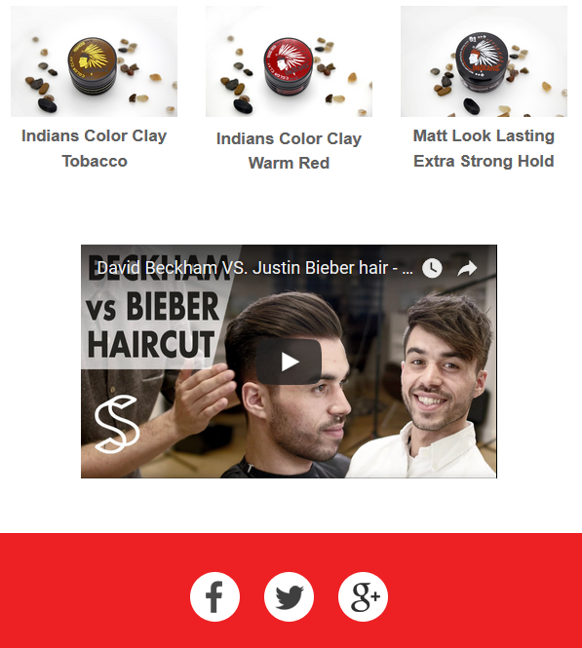
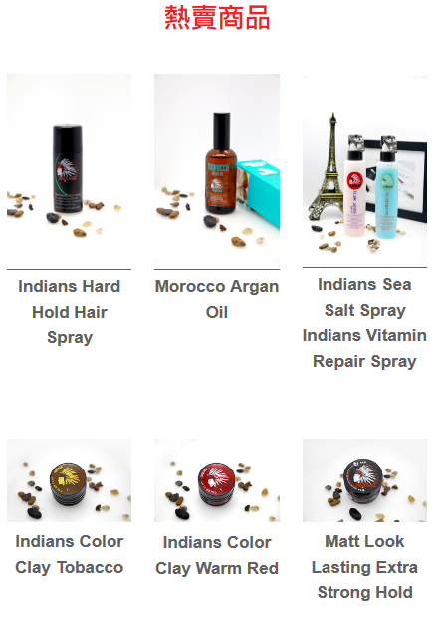
INDIANS
Hairstyling and Products Company
In the past
employ sales persons for promotion
hire agent to sell products
After using WebCenter
Use online advertising to attract customers, greatly promote the company
Reduce operation cost
Provide one-stop services
From product introduction, purchasing and customer service package
https://www.hairindians.com

Slide 15
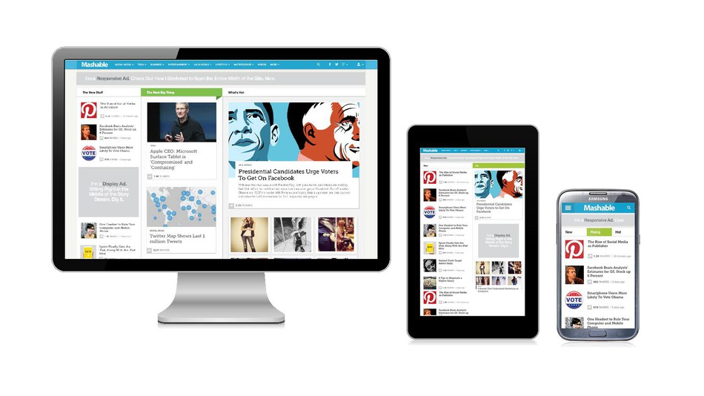
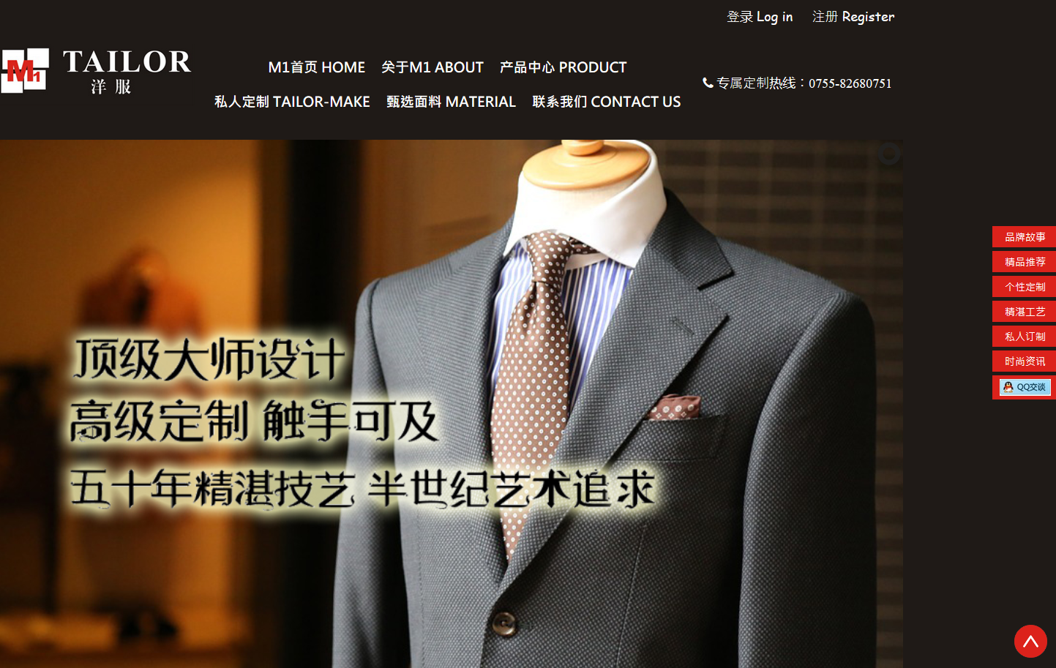
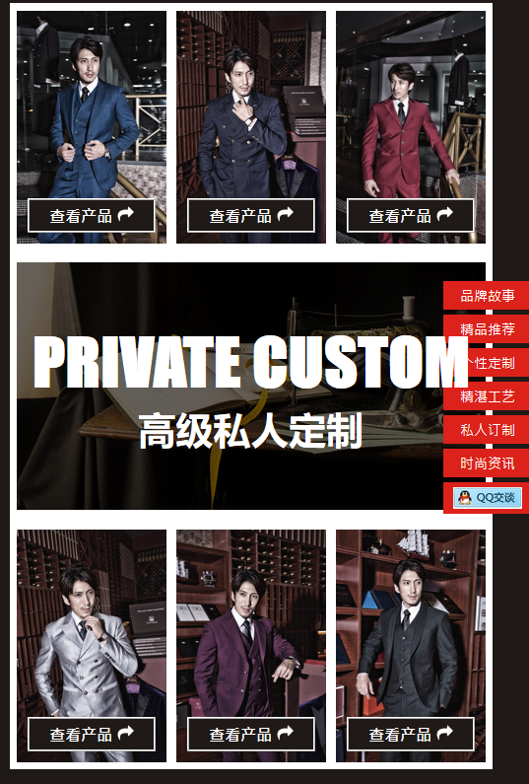
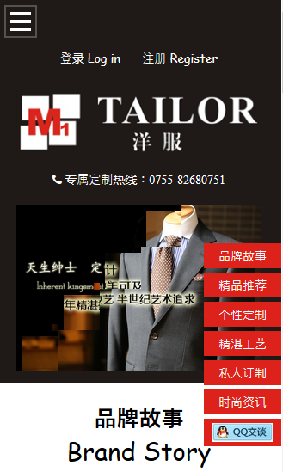
China website: The customer is an experienced tailor, but due to shop location (Shenzhen), the development of its business are limited in the area.
Aim at developing the business throughout China by using the new website
One week after the website has been set, a Shanghainese guest has discovered this website and come to Shenzhen for ordering tailor-made suit.
https://www.m1tailorhk.com/

Slide 16
TRAINING & SUPPORT
MAWC411.COM
WCT 101 & 201
OVERVIEW WEBINARS
CONTESTS

Slide 17
www.mawc411.com
Notes:
TRAINER’S NOTES:
www.mawc411.com – WebCenter Owner’s support site. This is the great place to share the WebCenter opportunity with potential business partners who could major in WebCenters, launch your business, find training learn more about our teams, and connect with our community
The downloads page is the most frequented page and houses many downloads including the ones we are about to showcase

Slide 18
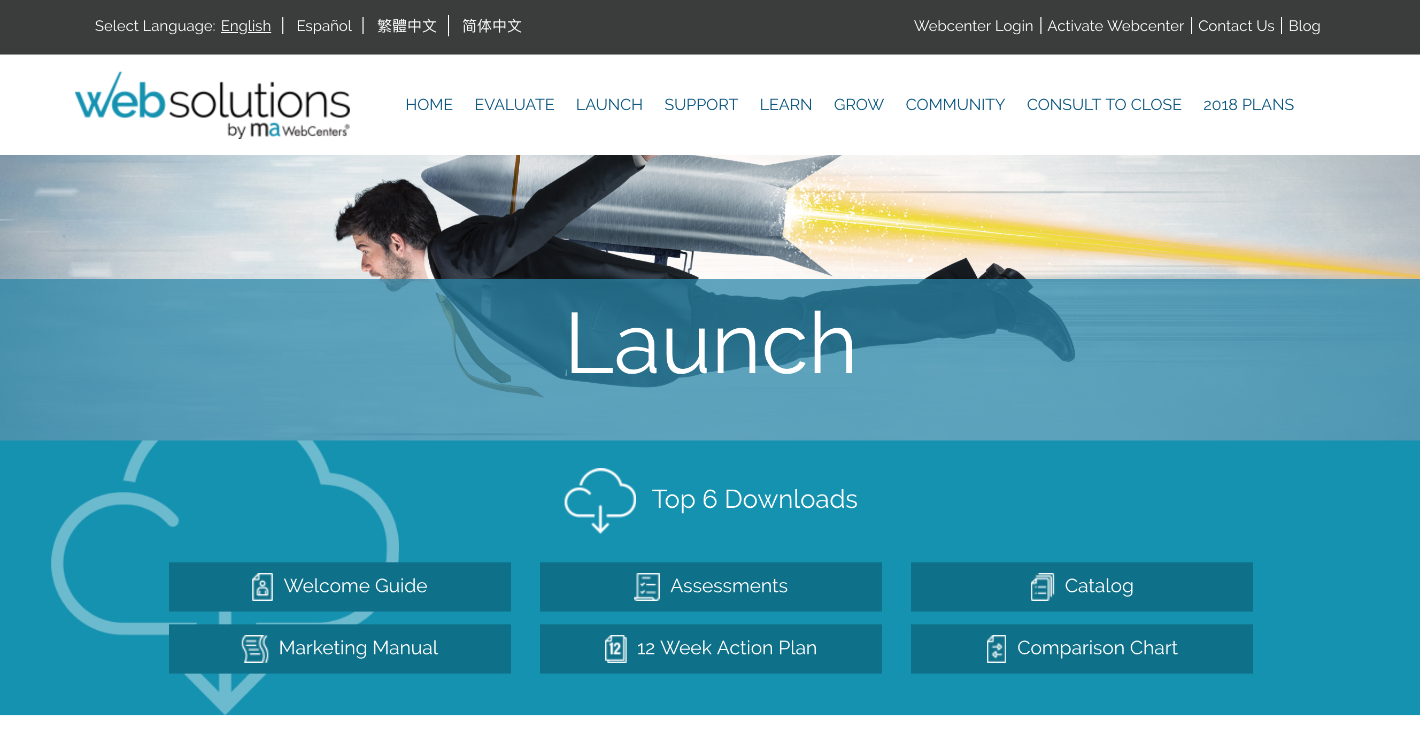

Slide 19
WCO & WCO PRO OVERVIEW
Register at: WWW.MAWC411.COM
WebCenter Overview
Launch once or twice a month (Market America)
Program including: The maWebCenters Product, Market Place, Retail Profits, BV, The System and The Support that exists for all WebCenter Owners.

Slide 20
WCT 101
WCT 101: Succeeding with WebCenters
WCT101 is designed to give you a simple and duplicatable system for building your UnFranchise as a WebCenter Owner.
The Product: Market, Shopping Annuity and Comparing and studying the competitive advantages of WebCenter products
System: Team & resources, WebCenter goal setting , 5C – Workshop for consultation and the management system in the back-end
Learning Business Building: Expanding your business through WebCenters

Slide 21
WCT 201
WCT 201: Advanced Selling & Networking
WCT201 is designed for the WebCenter Owner who completed the WCT101 to prepare for the next stage of his/her business.
The Strategy: Redefining goals, everyday procedures, organization
Marketing research: qualitative comparisons, Industry studies
Advanced Retailing: Find out the potentials, business commutation, explore strangers and sponsor customers, create your customer base
Advanced WebCenter tools:
Reports and advanced tools
Business Building: Recruiting potentials, monitor the trainees and WebCenter Onwers

