Slide 1
Perfect Pout Workshop

Slide 2
Motives® is a registered trademark of
Market America, Inc. in the United States and Market Hong Kong.

Slide 3
Exfoliate, Treat & Moisturize
Prep your pout for a lip look, while hydrating and nourishing. Taking the time to do these steps will result in longer wear and a more flawless application.

Slide 4
Step 1: Exfoliate
Purpose of a Lip Exfoliate (lipscrub.com)
Removing dead surface from your lips brings out new fresh layers, making lips soft, smooth, and kissable. With a smooth surface, lip cosmetics will adhere longer on your lips. This makes lipsticks, lip liner, and lip gloss much more effective and long lasting.
Lip exfoliation also helps lips retain moisture longer; helping to prevent cracked lips.

Slide 5
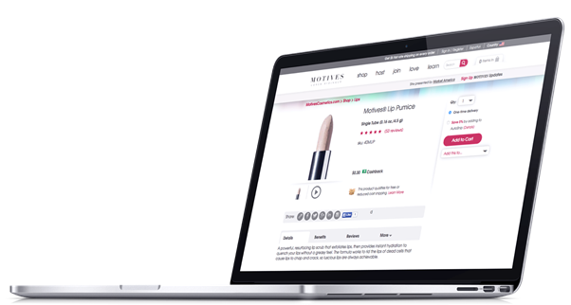
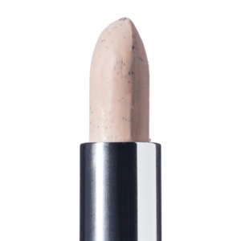
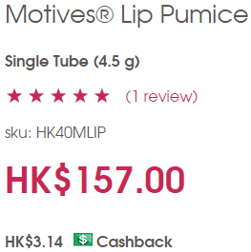
Motives® Lip Pumice

Slide 6
Benefits & Details
Benefits:
Helps achieve smooth, luscious lips
Allows for smoother application of your favorite Motives® lipstick or lip gloss
Acceptable for daily use
Details:
A powerful, resurfacing lip scrub that exfoliates lips, then provides instant hydration to quench your lips without a greasy feel. The formula works to rid the lips of dead cells that cause lips to chap and crack, so luscious lips are always achievable.

Slide 7
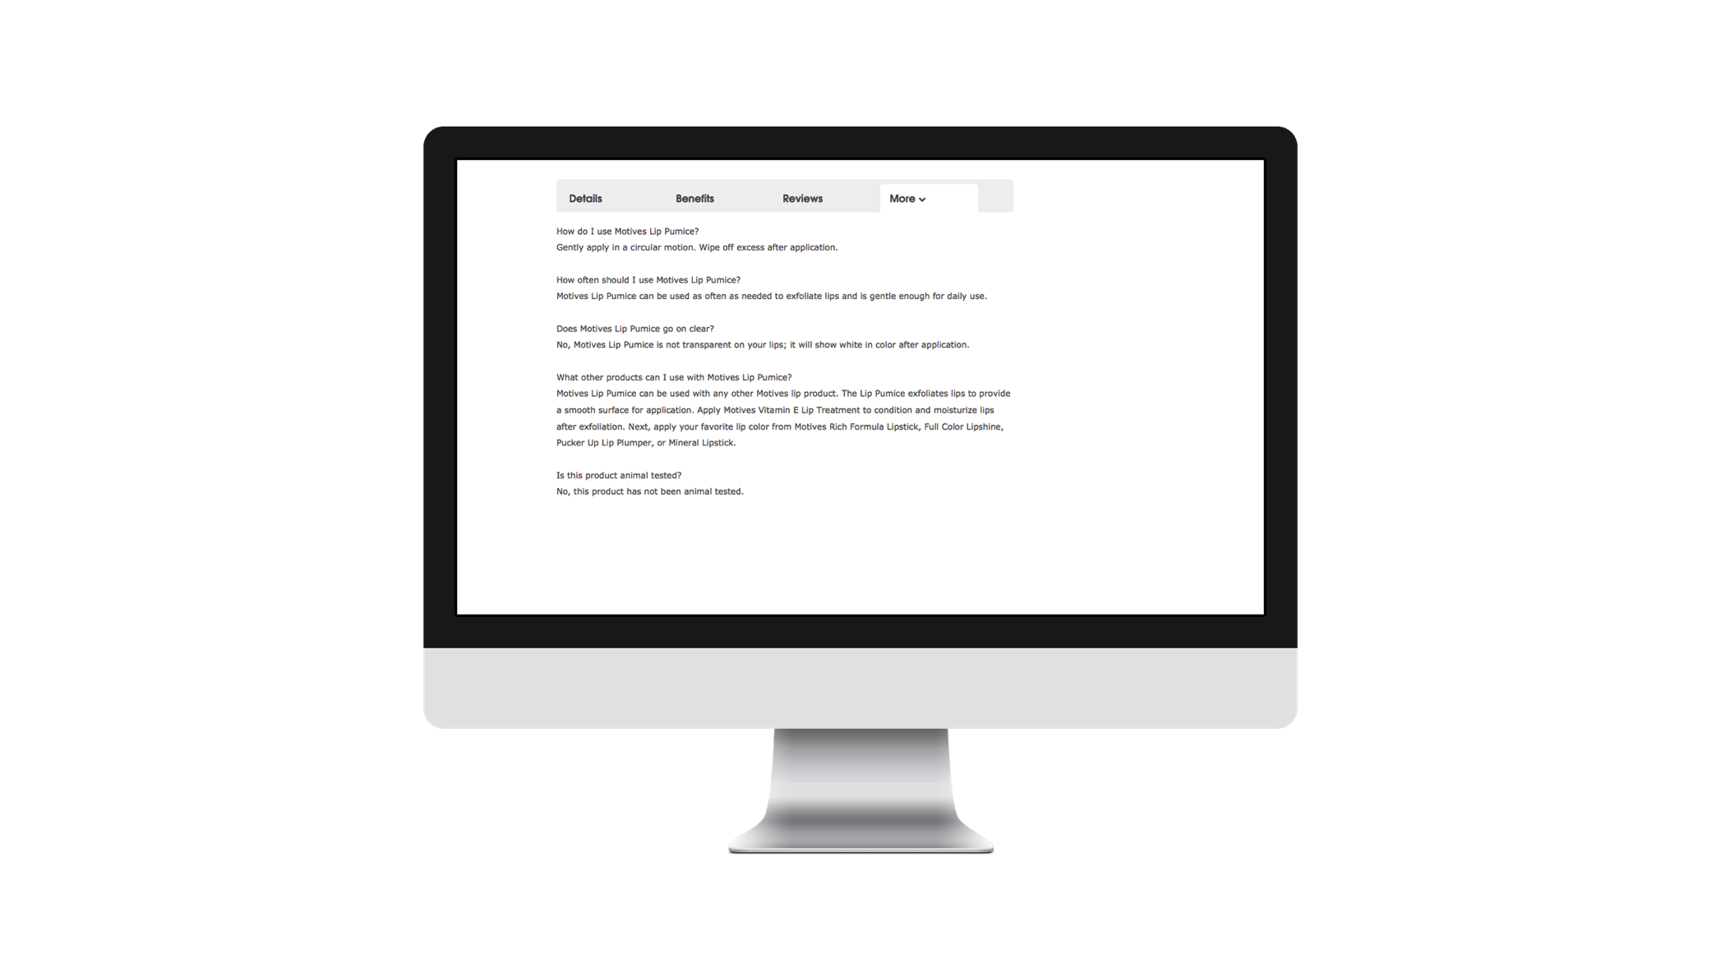
Frequently Asked Questions
Motives® Lip Pumice

Slide 8
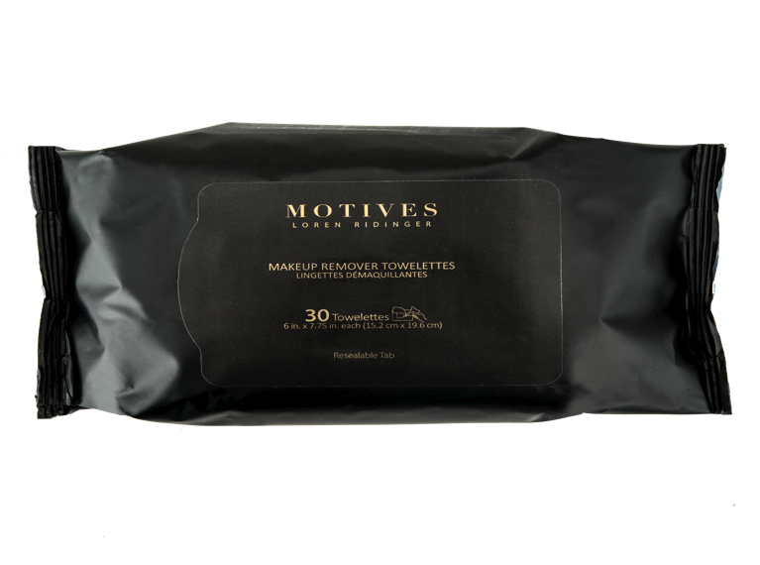
Action Item
Motives® Makeup Remover Towelettes
HK01MEMT
HK$72.00
HK$1.44 Cashback
Apply your Motives® Lip Pumice and
remove with Motives Makeup Remover Towelettes

Slide 9
Step 2: Treat
Purpose of a lip treatment
The purpose of a lip treatment is to heal and protect the lips. They contain a moisturizing ingredient that prevents water loss and also helps with the application of lipstick or lip gloss.

Slide 10
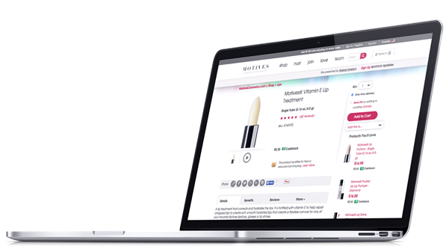
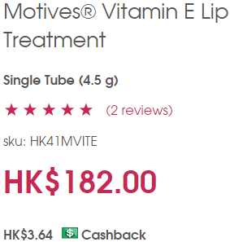
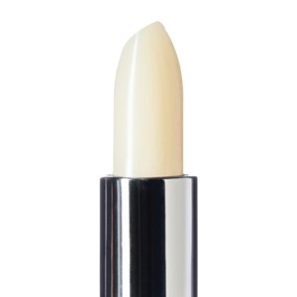
Motives® Vitamin E Lip Treatment

Slide 11
Benefits & Details
Benefits:
Supports healing and protects the lips and delicate skin under the eyes
Enriched with natural emollients
Perfect for use after Motives® Lip Pumice
Details:
A lip treatment that corrects and hydrates the lips. It is fortified with vitamin E to help repair chapped lips to create soft, smooth hydrated lips that create a flawless canvas for any of your favorite Motives® lipsticks, glosses or lip shines.

Slide 12
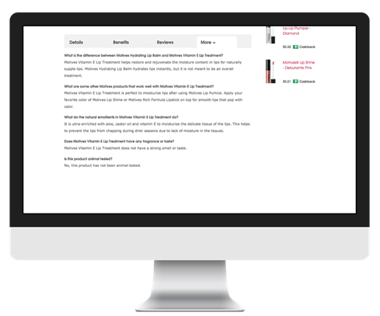
Frequently Asked Questions
Motives® Vitamin E Lip Treatment

Slide 13
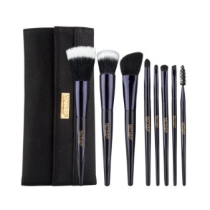
Action Item
Motives® 8-Piece Deluxe Brush Set - Includes Powder Brush, Flat-Top Foundation Brush, Contour Brush, Eye Shadow Brush, Crease Brush, Angled Liner Brush, Lip Brush and Spoolie
HK46MBR
HK$585.00
HK$11.70 Cashback
Apply your Motives® Vitamin E Lip Treatment with synthetic lip brush.

Slide 14
Step 3: Moisturize
Purpose of a lip treatment
Enrich your lips without bogging them down with thick gel.
Seeps into your lips and locks in more moisture
Prepare your lips for lip makeup application

Slide 15
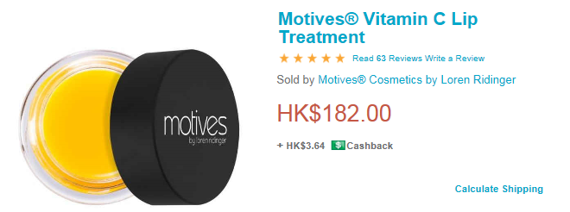
Motives® Vitamin C Lip Treatment

Slide 16
Benefits & Details
Benefits:
Helps lips resist chapping
Hydrates your lips
Gives you a smooth canvas for Motives® Lipstick
Details:
A high-shine treatment that enhances the natural color of the lips while offering essential nourishment. The smooth formula promotes suppleness and improves the definition of the lip area while preserving moisture. It can be worn alone, or under one of your favorite Motives® lip shines, lip glosses or lipsticks.

Slide 17
Motives® Vitamin C Lip Treatment
Frequently Asked Questions

Slide 18
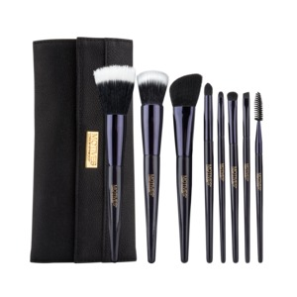
Action Item
Motives® 8-Piece Deluxe Brush Set - Includes Powder Brush, Flat-Top Foundation Brush, Contour Brush, Eye Shadow Brush, Crease Brush, Angled Liner Brush, Lip Brush and Spoolie
HK46MBR
HK$585.00
HK$11.70 Cashback
Apply your Motives® Vitamin C Lip Treatment with synthetic lip brush.

Slide 19
Popular Picks

Slide 20
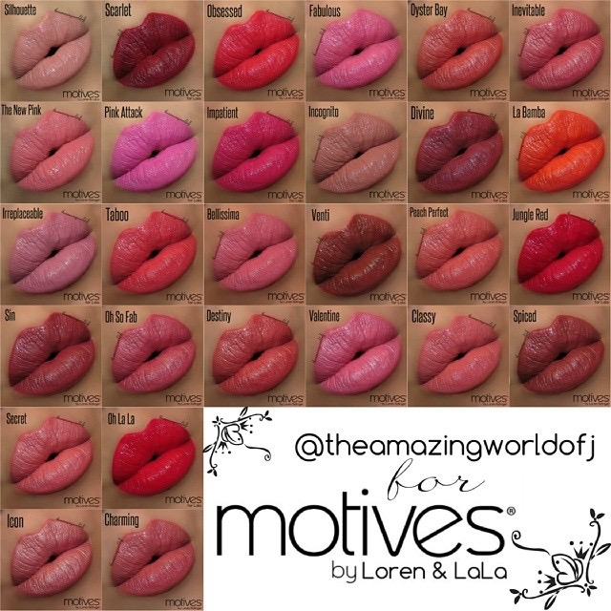
Moisture® Moisture Rich Lipsticks
Varies
HK$155.00
HK$3.10 Cashback
Provides creamy, long-lasting color in various finishes from matte to shimmer
Enriched with sunflower seed oil for instant moisture
Locks in moisture to condition for soft, supple lips
Paraben free

Slide 21
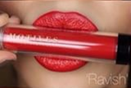
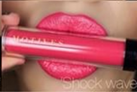
Motives® All Day Liquid Stick
Varies
HK$200.00
HK$4.00 Cashback
Full, long-lasting coverage for extended wear-ability
Creamy texture ensures perfect adherence to lips
Brilliant shine with high color impact
Paraben free

Slide 22
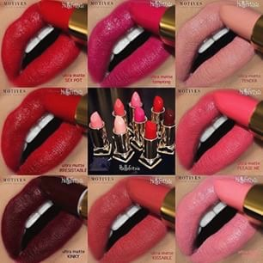
Motives® Mineral Lip Shine
Varies
HK$175.00
HK$3.50 Cashback
Mineral base provides intense hydration and conditioning
Provides ultra shine to lips throughout the day and night
Helps protect lips from dryness while providing a moisturized healthy lip line
Brush applicator provides increased color during application
Paraben free

Slide 23
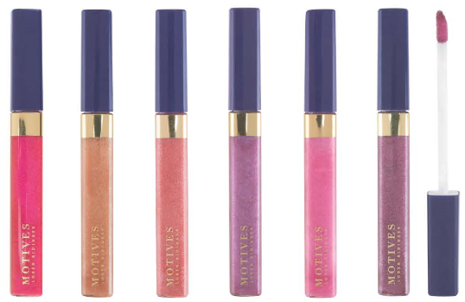
Motives® Lip Candies
Varies
HK$147.00
HK$2.94 Cashback
Brilliant shimmer with one application
Sheer wash of color that is buildable when layered
Flavored with refreshing spearmint

Slide 24
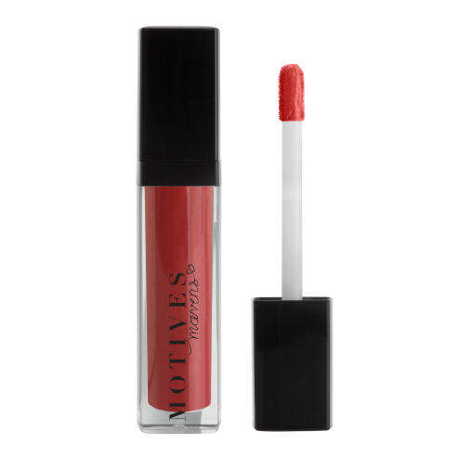
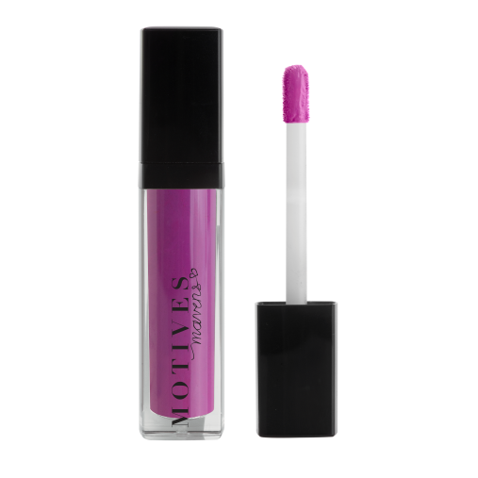
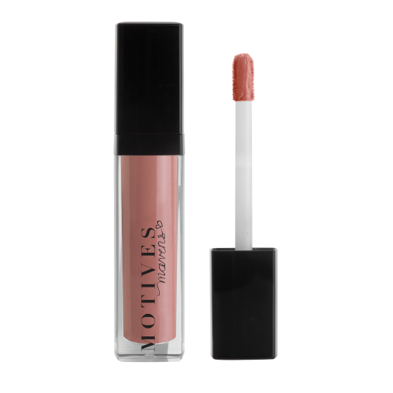
Motives® Maven Mattes
Varies
HK$175.00
Full, long-lasting coverage in a matte finish
Minimal transfer and feathering upon application
Creamy texture leaves lips feeling soft and smooth
Quick dry time
Paraben-free

Slide 25
LET'S PLAY!
Ombre Lip

Slide 26
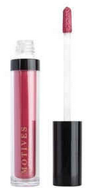
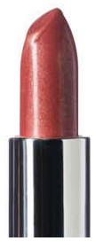
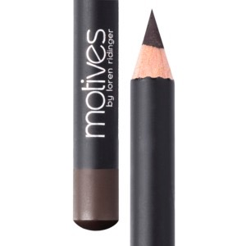
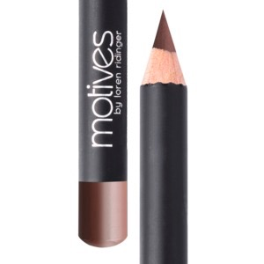
You Will Need
OR
Khol
Eyeliner
All Day
Liquid Stick
Lip
Crayon
Moisture Rich Lipstick
Coffee HK40MEP
Tantalize HK103DLS
Dusty Rose HK44MLP
Oyster Bay HK107MRL

Slide 27
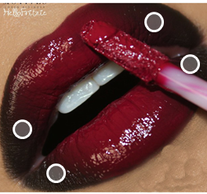
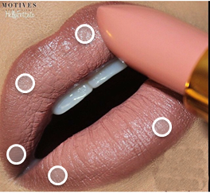
Action Item
Step 1:
Apply liner to designated “***”areas
Choose a Look & Practice!
Step 2:
Fill in with lipstick

Slide 28
LET'S PLAY!
Red Lip

Slide 29
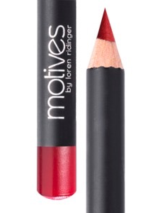
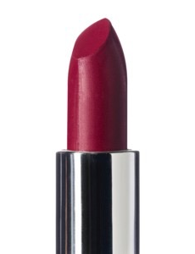
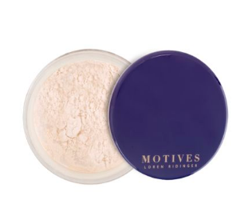
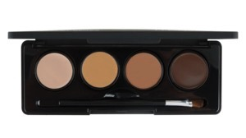
You Will Need
Luminous Translucent Loose Powder
Lip
Crayon
Rich
Formula Lipstick
Retro Red HK30MLP
Ruby HK203ML
Light HK344MLFP
Mavens Sculpt Series Ice - HK1SSI
Fire - HK2SSF

Slide 30
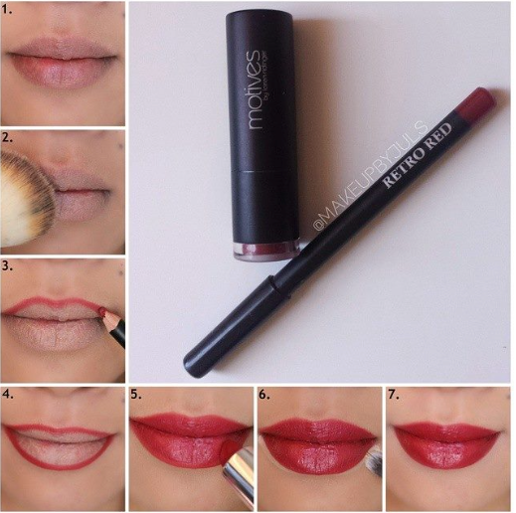
Action Item
Step 1-2:
Apply Luminous Translucent Loose Powder
Step 3-4:
Outline lips with Retro Red
Step 5:
Fill in lips with Ruby
Step 6:
Clean up lip outline with Mavens Sculpt Series
Step 7:
Finished!
Follow step by step pictorial

Slide 31
LET'S PLAY!
Pink Glitter Lip

Slide 32
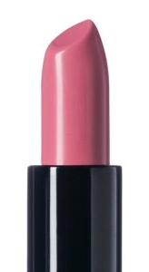
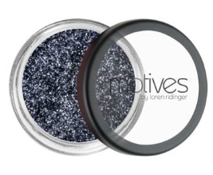
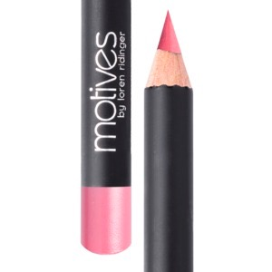
You Will Need
Mineral Lipstick
Petal Pink HK112ML
Glitter Pot
Aspire
HK100MEG
Lip Crayon
Pink Lady HK41MLP

Slide 33
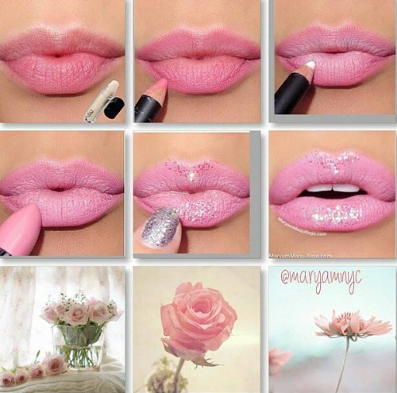
Action Item
Step 1:
Line the lips with Motives® Lip Crayon in Pink Lady and fill them in half way. Step 2:
Apply Motives® Kohl Liner in Angel to the center of the mouth to lighten, brighten and pop the lips.
Step 3:
Dab, do not glide, Motives® Lipstick in Petal Pink.
Press the lips together, then blot excess.
Step4:
Add a touch of Motives® Glitter Pot in Diamond to the center of the bottom lip and the top of the Cupid’s bow.
Follow step by step pictorial

Slide 34
Last Trick
Fuller Lip

Slide 35
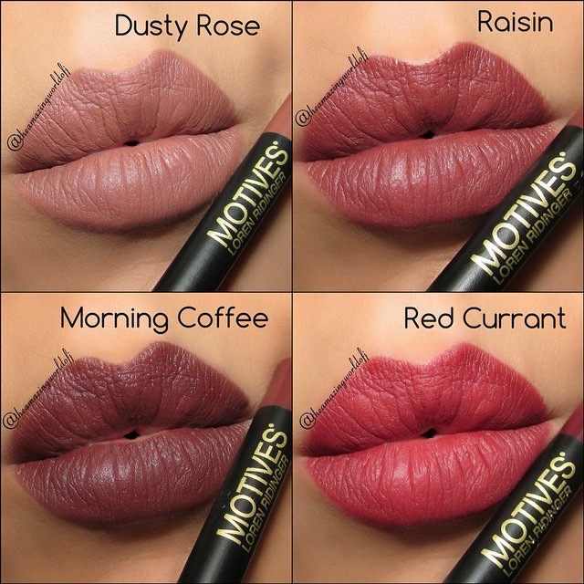
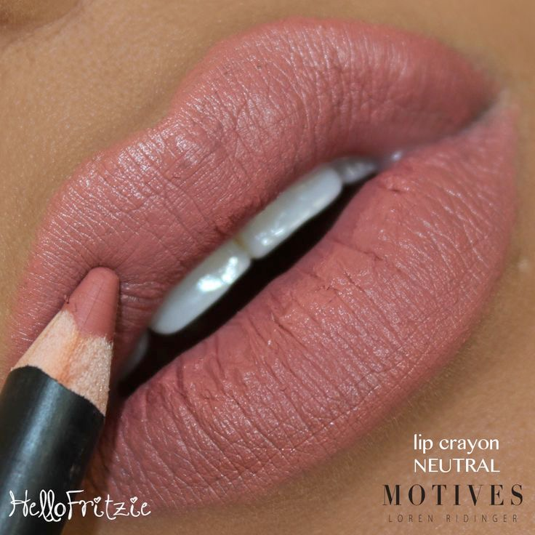
You Will Need
Complimentary
Motives® Lip Crayon
Complimentary
Motives® Lipstick
Of Your Choice
Of Your Choice
Dusty Rose (HK44MLP), Morning Coffee (HK42MLP), Red Currant (HK43MLP) Raisin (HK45MLP)
Neutral (HK31MLP)

Slide 36
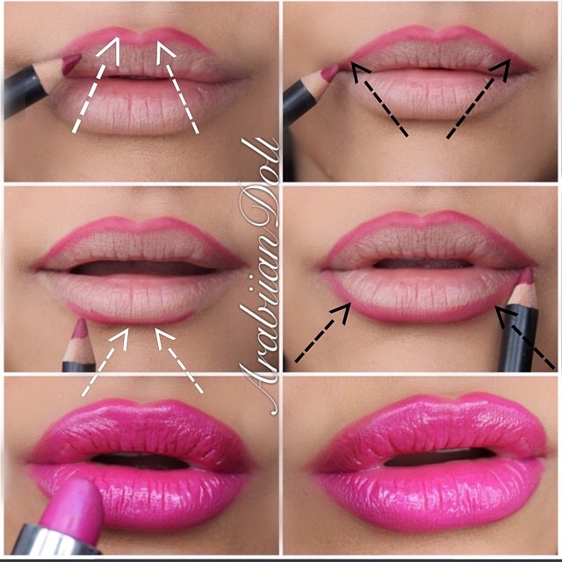
Action Item
Step 1-2:
Follow arrows outlining just above natural line of top lip
Step 3-4:
Outline follow arrows outlining just below natural line of bottom lip
Step 5:
Fill in with desired Motives® Lipstick
Step 6:
Finished!
Follow step by step pictorial

Slide 37
Social Media Marketing
Leveraging the time and talent of others is essential in branding yourself as an artist and an entrepreneur!
Here are some quick examples of what you have access to. This will not only help you to learn new techniques with product, but also makes promoting our brand both professional and efficient!

Slide 38
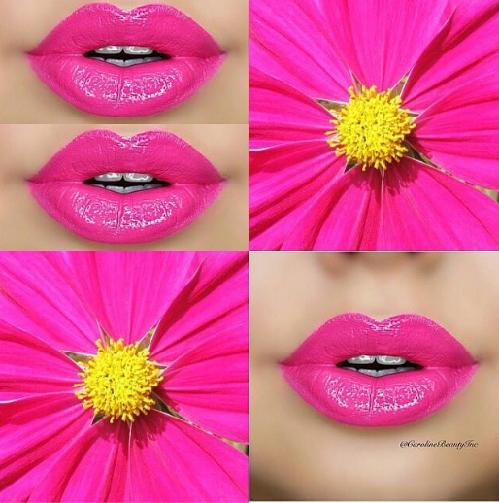
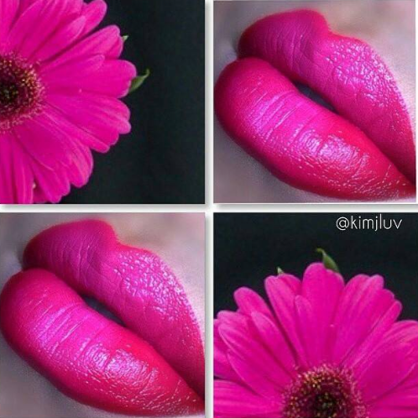
Vibrant HK101DLS
Hi-Voltage All
Day Liquid Stick

Slide 39
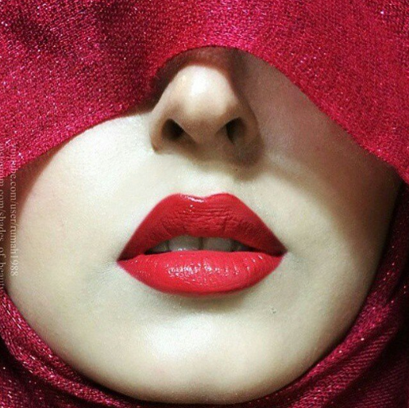
Naughty & Mysterious
Naughty Mineral Lipstick

Slide 40
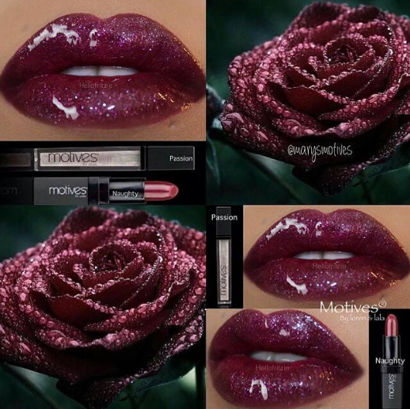
Sultry & Seductive
Passion & Naughty

Slide 41
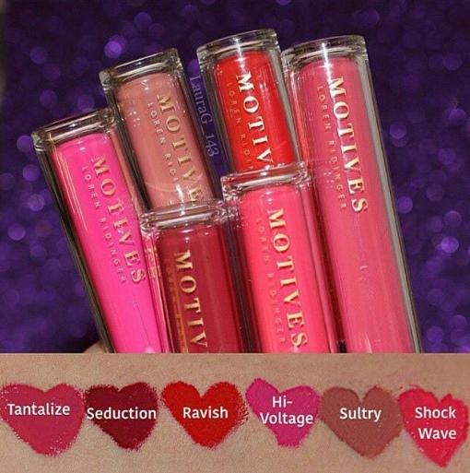
All Day Liquid Sticks
Tantalize (HK103DLS), Ravish (HK104DLS)
Hi-Voltage (HK101DLS), & Shock Wave (HK100DLS)

Slide 42
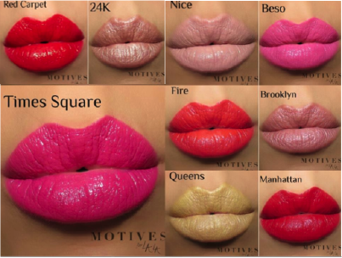
Get the Look with La La
Red Carpet, 24K (HK103MLML),
Nice (HK102MLML), Beso (HK106MLML), Time Square (HK105MLML), Fire (HK101MLML),
Brooklyn, Queens & Manhattan

